Slide 1
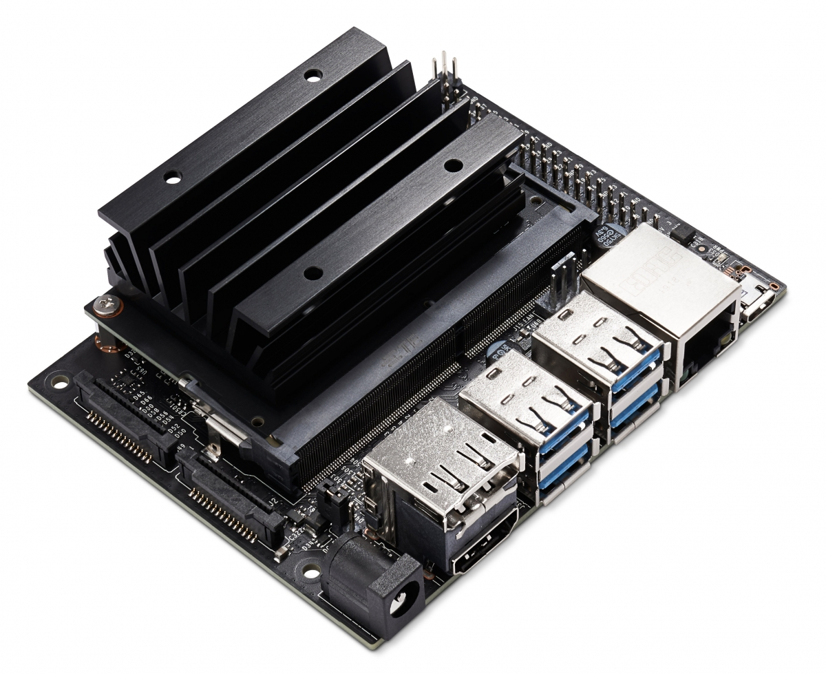
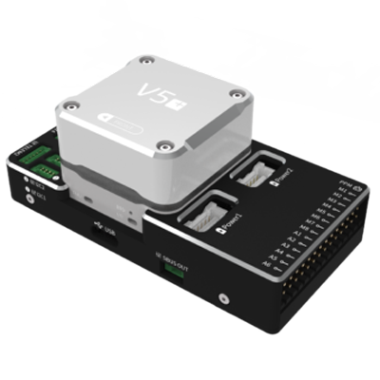
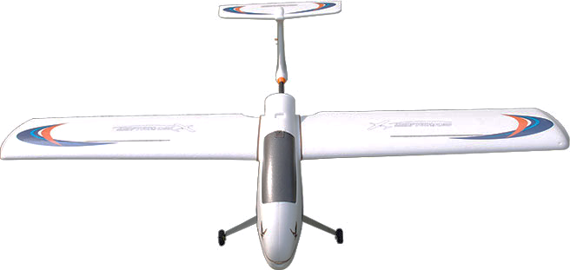
HOST COMPUTER
FIXED_WING_FORMATION_CONTROL
NODE1
MAVROS
NODE2
NVIDA Jetsion Nano
attitude setpoint
UAV states
ATTITUIDE INNER LOOP
SALVE COMPUTER
CUAV V5+
actuator
UAV states
UAV DYNAMAIC
PLATFORM
SKYWALKER 2015

