Slide 1
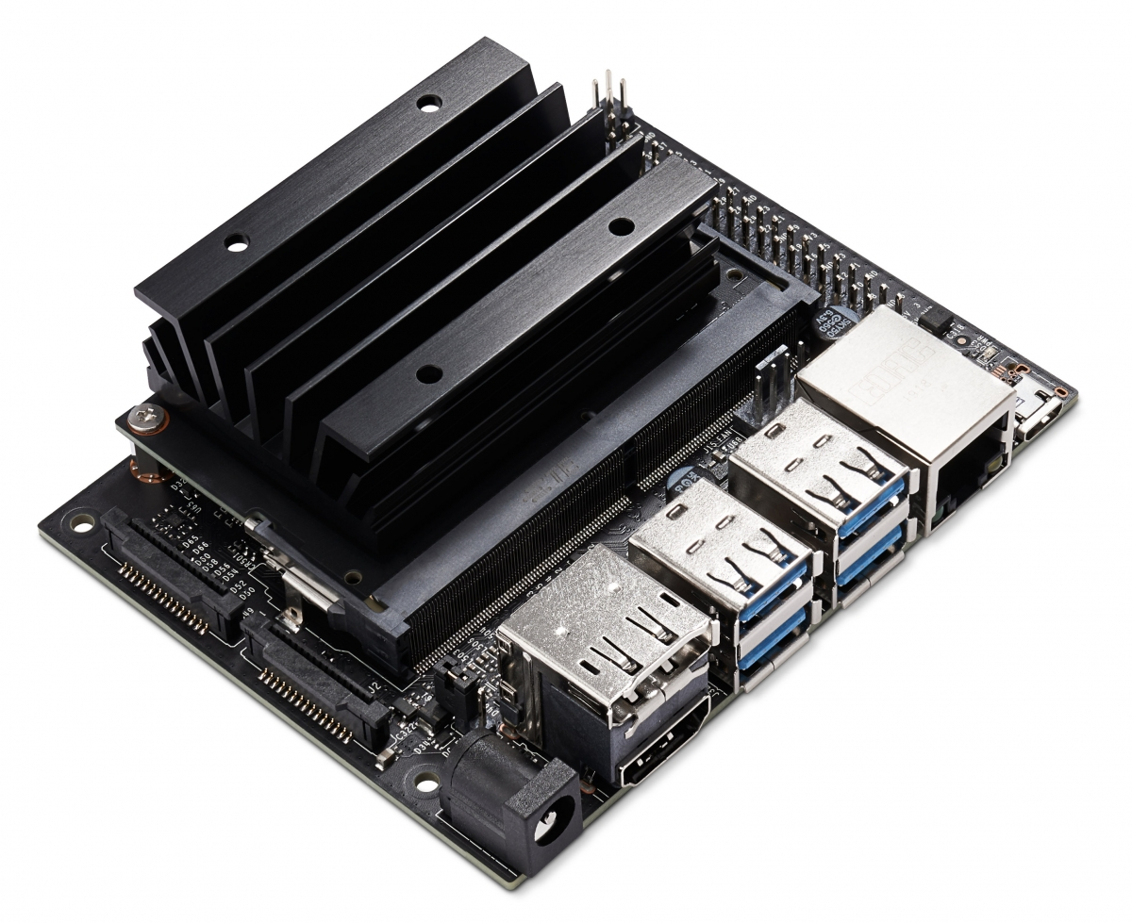
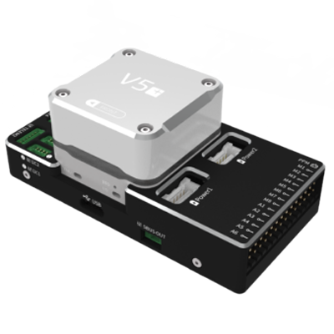
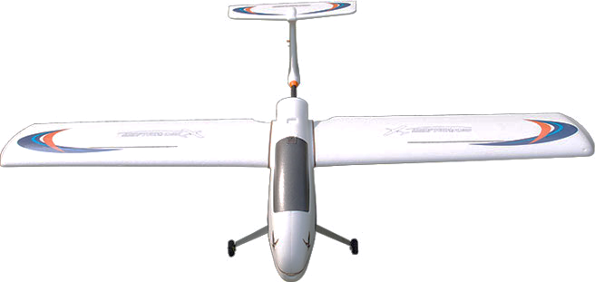
HOST COMPUTER
FIXED_WING_FORMATION_CONTROL
NODE1
MAVROS
NODE2
attitude setpoint
plane states
ATTITUIDE INNER LOOP
SALVE COMPUTER
actuator
plane states
UAV DYNAMAIC
PLATFORM

