Slide 1

Query-Efficient Black-Box Attacks
-----Hao Yun

Slide 2
Overview
Evolutionary Attack
- Efficient Decision-based Black-box Adversarial Attacks on Face Recognition
ZO-NGD(Zeroth-Order Natural Gradient Descent) Attack
- Towards Query-Efficient Black-box Adversary with Zeroth-Order Natural Gradient Descent

Slide 3
Overview
Introduction
Threat Model
Algorithm
Experimental Results & Comparison
Contributions

Slide 4
Evolutionary Attack

Slide 5
Introduction

Slide 6
Evolutionary Attack
Query-Efficient
Model local geometries of search directions
Reduce dimension of search space
Two sub-tasks of face recognition:
Face verification
Face Identification

Slide 7
Threat Model

Slide 8
Threat Model
Goal
Dodging attack (untargeted): recognized wrong or not recognized
Impersonation attack (targeted): recognized as a specific identity
Capability
Input: images
Output: hard-label outputs
Targeted Model: Face recognition models (SphereFace, CosFace, ArcFace)

Slide 9
Algorithm

Slide 10
Algorithm
Unconstrained optimization problem

Slide 11
Algorithm
(1+1)-CMA-ES (Covariance Matrix Adaption Evolution Strategy)
Stochastic Coordinate Selection
Dimensionality Reduction of search space

Slide 12
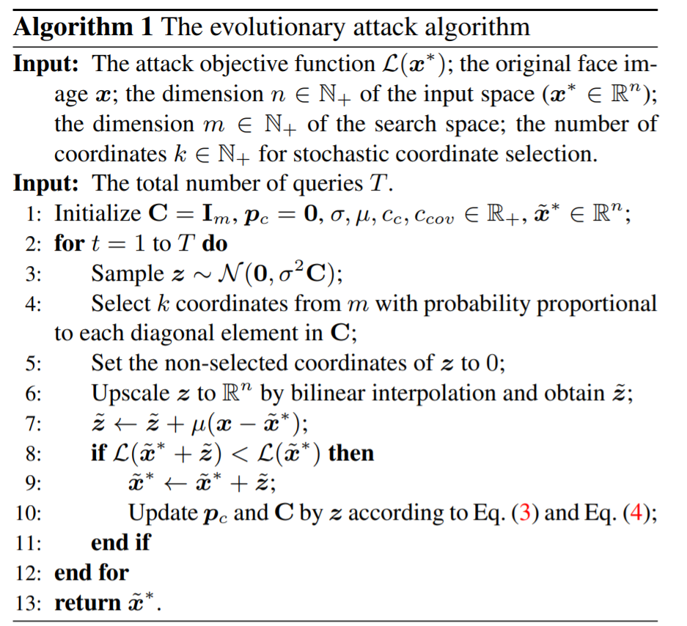
Algorithm
(1+1)-CMA-ES (Covariance Matrix Adaption Evolution Strategy)
Stochastic Coordinate Selection
Dimensionality Reduction

Slide 13
Result & Comparison

Slide 14

Experimental Results

Slide 15
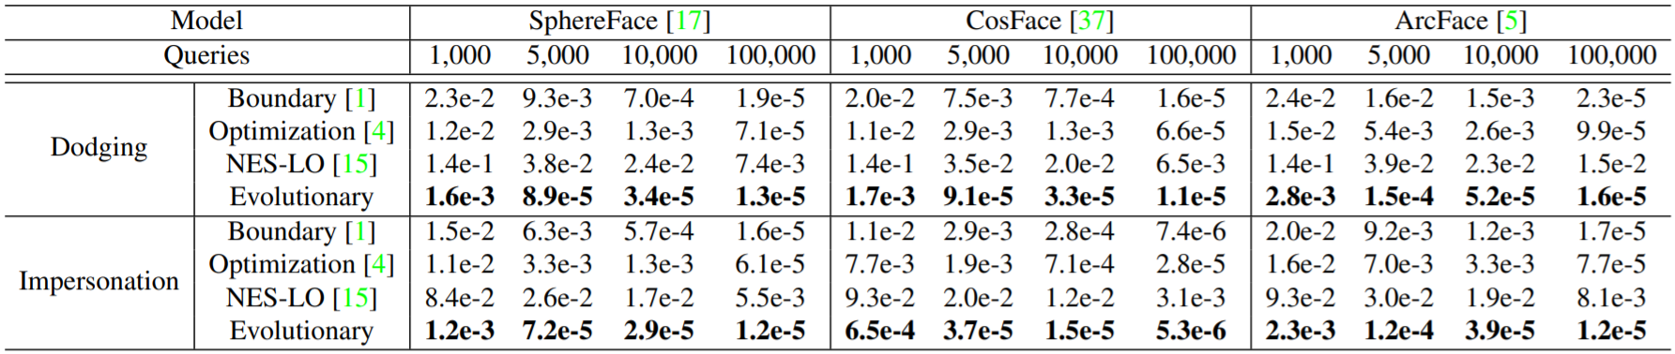
Results & Comparison
Experimental Results
Face Verification on LFW dataset

Slide 16
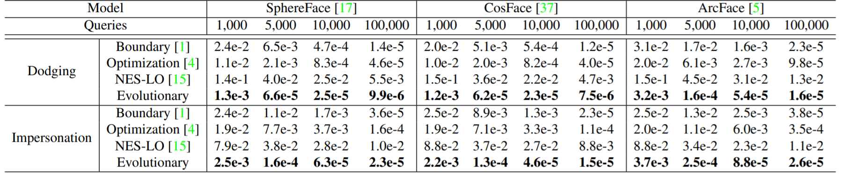
Results & Comparison
Experimental Results
Face Identification on LFW

Slide 17
Ablation Study

Slide 18
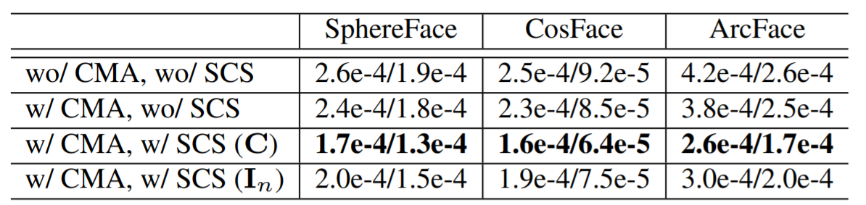
Results & Comparison
Ablation Study
Comparisons of evolutionary method with 4 settings for dodging/impersonation attack on face verification

Slide 19
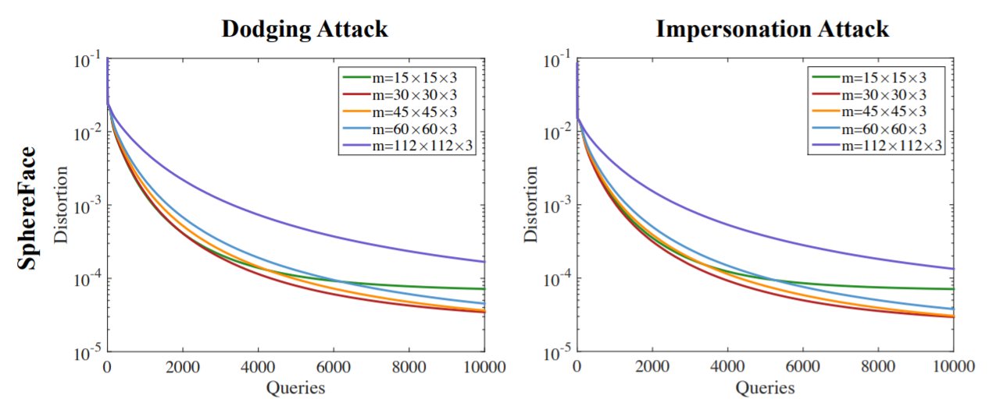
Results & Comparison
Ablation Study
Curves of MSEs for different dimensions of search space

Slide 20
Contributions

Slide 21
Contributions
Significantly Efficient
Model local geometries
Reduce dimension of search space
Practical Applicability
Demonstrate vulnerabilities of face models

Slide 22
ZO-NGD Attack

Slide 23
Introduction

Slide 24
ZO-NGD Attack
Query-Efficient
Zeroth-order optimization
Natural Gradient Descent (NGD)

Slide 25
Threat Model

Slide 26
Threat Model
Goal
Untargeted attack: misclassification of models
Capability
Input: images
Output: prediction probabilities
Targeted Model: DNN image classifier

Slide 27
Algorithm

Slide 28

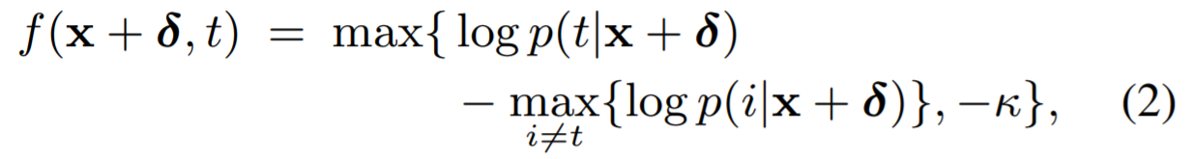
Algorithm
Optimization problem

Slide 29
Result & Comparison

Slide 30
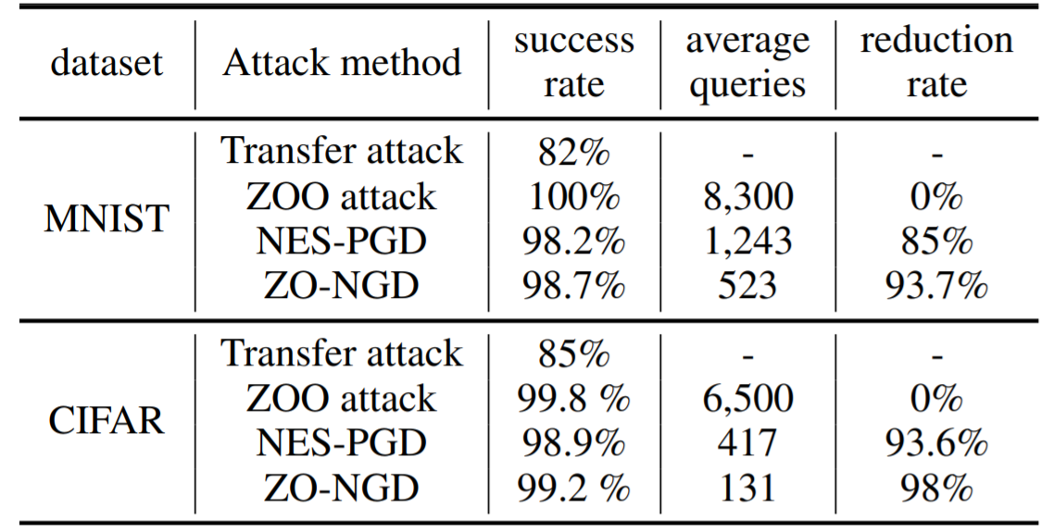
Results & Comparison
Performance evaluation on MNIST and CIFAR10

Slide 31
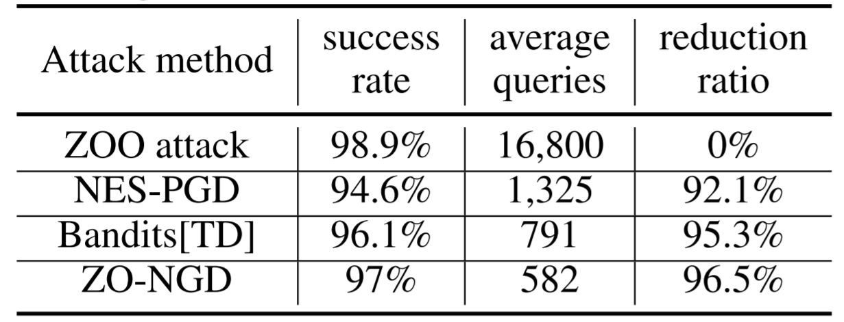
Results & Comparison
Performance evaluation on ImageNet

Slide 32
Contributions

Slide 33
Contributions
Design of adversary attacks with NGD
Query-Efficient
Scalability to high dimensional datasets

