Slide 1
CIRCUIT CONCLAVE HACKATHON 2026
DR. VISHWANATH KARAD MIT WORLD PEACE UNIVERSITY | DoEEE & prismlabs
DESIGN & IMPLEMENTATION OF A
4×4 REGISTER FILE
with Synchronous Read/Write and Asynchronous Clear
Team Members
Harshvardhan Rathod | PRN: —————
Alok Deep Verma | PRN: —————
Division: 23 | FY B.Tech E&CE
Faculty Mentor: Dr. Sarika Patil
Academic Year: 2025–26

Slide 2
INTRODUCTION
PROBLEM STATEMENT
TECHNICAL OBJECTIVE
Engineering education in digital electronics often stays theoretical — students study register files and memory hierarchies without building them at the hardware level.
This project addresses that gap by designing a 4×4 register file from discrete 74-series logic and a KiCad PCB, bridging classroom theory and hands-on engineering.
Design a 4×4 addressable register file using 74-series TTL ICs, supporting: • Synchronous clock-triggered write
• Tri-state bus-buffered read
• Asynchronous active-low clear
Controlled via E-Switch inputs and a NE555P 0.5 Hz clock, implemented as a KiCad PCB.
PBL Category: Digital Electronics / Memory Systems | DoEEE FY-Btech E&CE 2025-26

Slide 3
PROJECT OBJECTIVES
Design the Register Array
Astable Clock Generation
Build a 4-row × 4-bit register file using four SN74LS175N quad D flip-flops with common clock and active-low asynchronous clear.
Generate a 0.5 Hz square-wave clock with the NE555P in astable mode (R1=10 kΩ, R2=68 kΩ, C=20 µF) for step-by-step observation.
Implement Address Decoding
PCB Fabrication Ready
Use SN74LS139AN (2-to-4 decoder) to select one of four registers based on a 2-bit address (A0, A1).
Produce a verified KiCad PCB layout (RAM-project-001) with 31 components ready for fabrication.
Single RW Control
RW=0 (default) = Read mode; RW=1 (SWW1 pressed) = Write mode. One push-button controls the mode.

Slide 4
BACKGROUND THEORY
Register File Architecture
SN74LS139AN — 2-to-4 Decoder
Consists of register array, address decoder, write-enable logic, and read bus. Write cycle (RW=1): decoder activates register CLK; data latched on rising edge. Read cycle (RW=0): tri-state buffers drive shared bus.
Two independent decoders. Active-low G\ pin enabled by RW=0. Exactly one of four active-low outputs drives the selected register's clock-gate and buffer-enable lines.
SN74LS175N — Quad D Flip-Flop
SN74LS244N — Tri-State Buffer
Positive-edge-triggered with common CLK and active-low asynchronous CLR. Transfers D→Q on each rising clock edge. CLR\ LOW immediately resets all Q to 0.
Octal non-inverting buffer with two 4-channel groups. Active-low enable (G\) connects groups to decoder outputs. High-Z state prevents bus contention.

Slide 5
PROJECT METHODOLOGY
01
Literature Review
Studied Patterson & Hennessy (Computer Org. & Design) and Mano & Ciletti (Digital Design) for register file architecture and TTL IC datasheets.
02
Logisim Simulation
Built and verified the full register file in Logisim — all read/write/clear operations confirmed across 4 register rows.
03
Prototype Breadboard
Initial hardware prototype with ~30 ICs → optimised to 9 ICs by refining clock-gating and buffer logic.
04
KiCad PCB Design
Designed PCB layout RAM-project-001 in KiCad — routed 31 components across 2 copper layers with DRC clearance.
05
Functional Testing
Verified all system modes: write to each address, read back, clear. 100% test-case pass rate confirmed.

Slide 6
SYSTEM DESIGN — IC INVENTORY
KiCad Ref | Part No. | Description | Qty | Role
A7408 | SN74LS08N | Quad AND, DIP-14 | 1 | Write-enable clock gating
B074244, B174244 | SN74LS244N | Octal 3-State Buffer, DIP-20 | 2 | Read bus multiplexer
CNE555 | NE555P | 555 Timer, DIP-8 | 1 | 0.5 Hz astable clock
D74139 | SN74LS139AN | Dual 2-to-4 Decoder, DIP-16 | 1 | Address decoding
D074175–D374175 | SN74LS175N | Quad D Flip-Flop, DIP-16 | 4 | 4-bit registers (one/row)
N7402 | SN7402N | Quad NOR, DIP-14 | 1 | Row-select clock gating
O7432 | SN7432N | Quad OR, DIP-14 | 1 | Asynchronous clear logic
Total: 11 ICs | 8 Switches | 4 LEDs | 6 Resistors | 2 Capacitors = 31 Components | Single +5V Supply

Slide 7
CIRCUIT OPERATION & TRUTH TABLES
SYSTEM OPERATING MODES
Mode | RW | Clock | CLR\ | Result
Write | 1 (pressed) | ↑ auto 0.5 Hz | 1 | Data latched into Row n
Read | 0 (default) | — | 1 | Row n shown on OL0–OL3
Hold | 0 (default) | — | 1 | No change
Clear | X | — | 0 (SWC1) | Selected row → 0000
74LS139 ADDRESS DECODER (G\ = RW=0 → LOW)
G\ (RW) | A1 | A0 | Row Selected
H (RW=1) | X | X | None (write mode)
L (RW=0) | L | L | Row 0
L (RW=0) | L | H | Row 1
L (RW=0) | H | L | Row 2
L (RW=0) | H | H | Row 3
NE555P Astable Clock: f = 1.44 / [(R1 + 2×R2) × C] = 1.44 / [(10kΩ + 136kΩ) × 20µF] ≈ 0.5 Hz

Slide 8
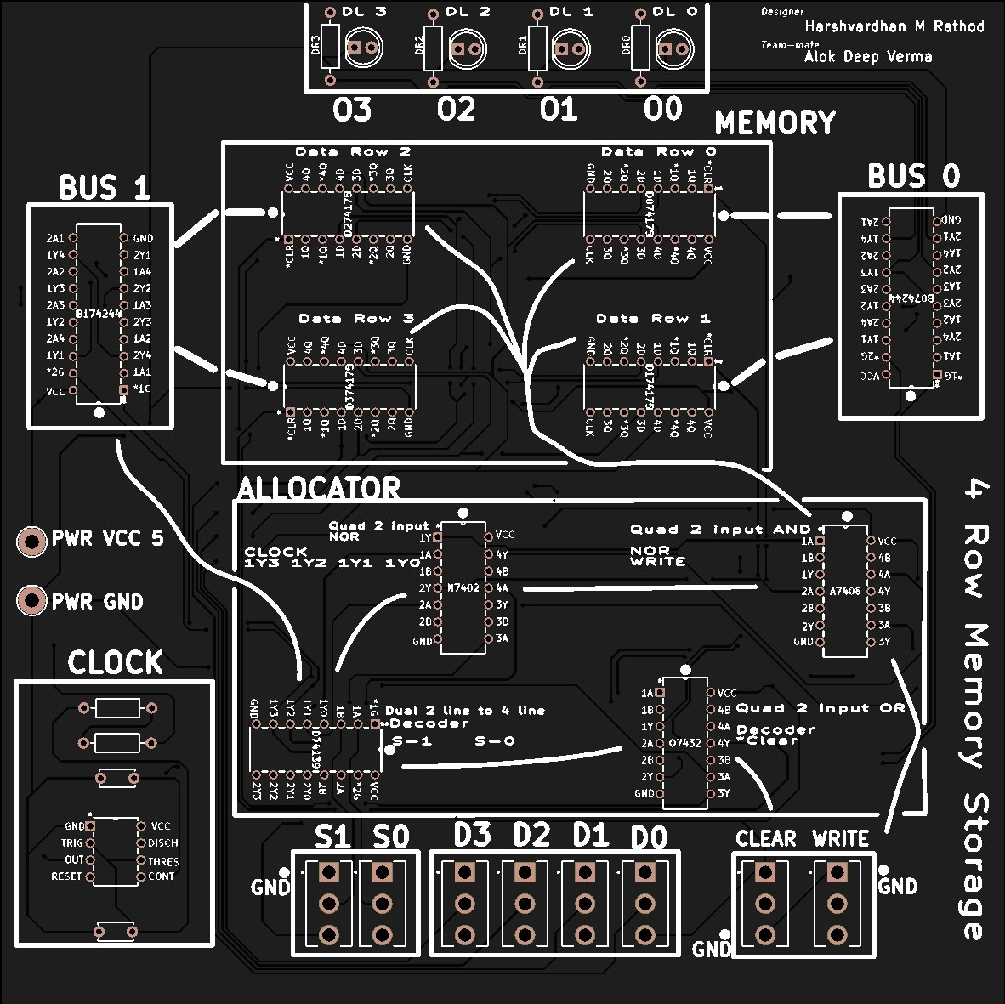
PCB IMPLEMENTATION — KiCad RAM-project-001
Board:
2-layer PCB, single +5V supply, all through-hole components
ICs:
7 unique 74-series TTL types, DIP packages — all from TI
Inputs:
6 data/address SPST switches + 2 momentary buttons (Clear, Write)
Clock:
NE555P astable circuit on-board (no external clock needed)
Output:
4× CQY99 LEDs with 220 Ω current-limiting resistors
Layers:
F.Cu, B.Cu, F/B Mask, F/B Paste, F/B Silkscreen, Edge Cuts
DRC:
Passed — PTH & NPTH drill files generated, board fabrication ready

Slide 9
BILL OF MATERIALS (BOM)
Component | Part / Value | Qty | Purpose
SN74LS08N | Quad AND Gate, DIP-14 | 1 | Write-enable clock gating
SN74LS244N | Octal 3-State Buffer, DIP-20 | 2 | Tri-state read bus
NE555P | 555 Timer, DIP-8 | 1 | 0.5 Hz astable clock
SN74LS139AN | Dual 2-to-4 Decoder, DIP-16 | 1 | Address decoding
SN74LS175N | Quad D Flip-Flop, DIP-16 | 4 | 4-bit registers
SN7402N | Quad NOR Gate, DIP-14 | 1 | Row-select clock gating
SN7432N | Quad OR Gate, DIP-14 | 1 | Asynchronous clear logic
SW_100SP1T1B4M2QE | E-Switch SPST / Momentary | 8 | Data (4), Address (2), Clear (1), Write (1)
CQY99 | LED 5mm, LED_D5.0mm | 4 | Output bus display
220 Ω ¼W | R_Axial DIN0207 | 4 | LED current limiting
10 kΩ ¼W | R_Axial DIN0207 | 1 | 555 timer R1 (charge)
68 kΩ ¼W | R_Axial DIN0207 | 1 | 555 timer R2 (timing)
0.1 µF 50V | C_Disc ceramic | 2 | VCC decoupling
Total: 31 Components | KiCad Ref: RAM-project-001 | Single +5V Supply

Slide 10
RESULTS & IMPACT
4
31
100%
0.5 Hz
Registers
(4-bit each)
Components
Placed
Test Cases
Passed
Clock
Generated
VERIFIED RESULTS
All 4 operating modes verified: Write, Read, Hold, Clear — with correct LED output for every address combination.
Clock-gating circuit (NOR–AND) correctly qualifies write pulses, preventing spurious latching during read.
Tri-state bus isolation confirmed — no bus contention detected when switching between register reads.
KiCad PCB passed DRC with zero errors. PTH + NPTH drill files generated; board ready for fabrication.
PBL Outcomes: Students demonstrated mastery of D flip-flop operation, bus multiplexing, and iterative PCB design workflow.

Slide 11
CONCLUSION & FUTURE SCOPE
CONCLUSION
FUTURE SCOPE
The 4×4 register file was successfully designed and implemented using standard 74-series TTL ICs, achieving all stated objectives:
• Synchronous write on rising 0.5 Hz clock edge
• Combinational tri-state read with no bus contention
• Asynchronous clear independent of clock
• KiCad PCB with 31 components, DRC-clean
The project operationalises five core Digital Electronics curriculum concepts in hardware — demonstrating that PBL bridges the gap between theory and engineering practice.
Expand to 8×8 register file with 3-bit addressing for larger data storage capacity.
Add a 7-segment display decoder for human-readable numeric output.
Implement dual-port access — simultaneous read from two separate addresses.
Replace 74-series ICs with FPGA implementation in VHDL/Verilog for speed comparison.
Integrate with a simple ALU for a minimal CPU datapath demonstration.

Slide 12
CIRCUIT CONCLAVE HACKATHON 2026 | MIT WORLD PEACE UNIVERSITY
DoEEE & prismlabs | Department of Electrical & Electronics Engineering
THANK YOU
Harshvardhan Rathod PRN: ————— | Alok Deep Verma PRN: —————
FY B.Tech E&CE | Division: 23 | Faculty Mentor: Dr. Sarika Patil | Academic Year: 2025–26
Project: Design and Implementation of a 4×4 Register File with Synchronous Read/Write and Asynchronous Clear

