Slide 1


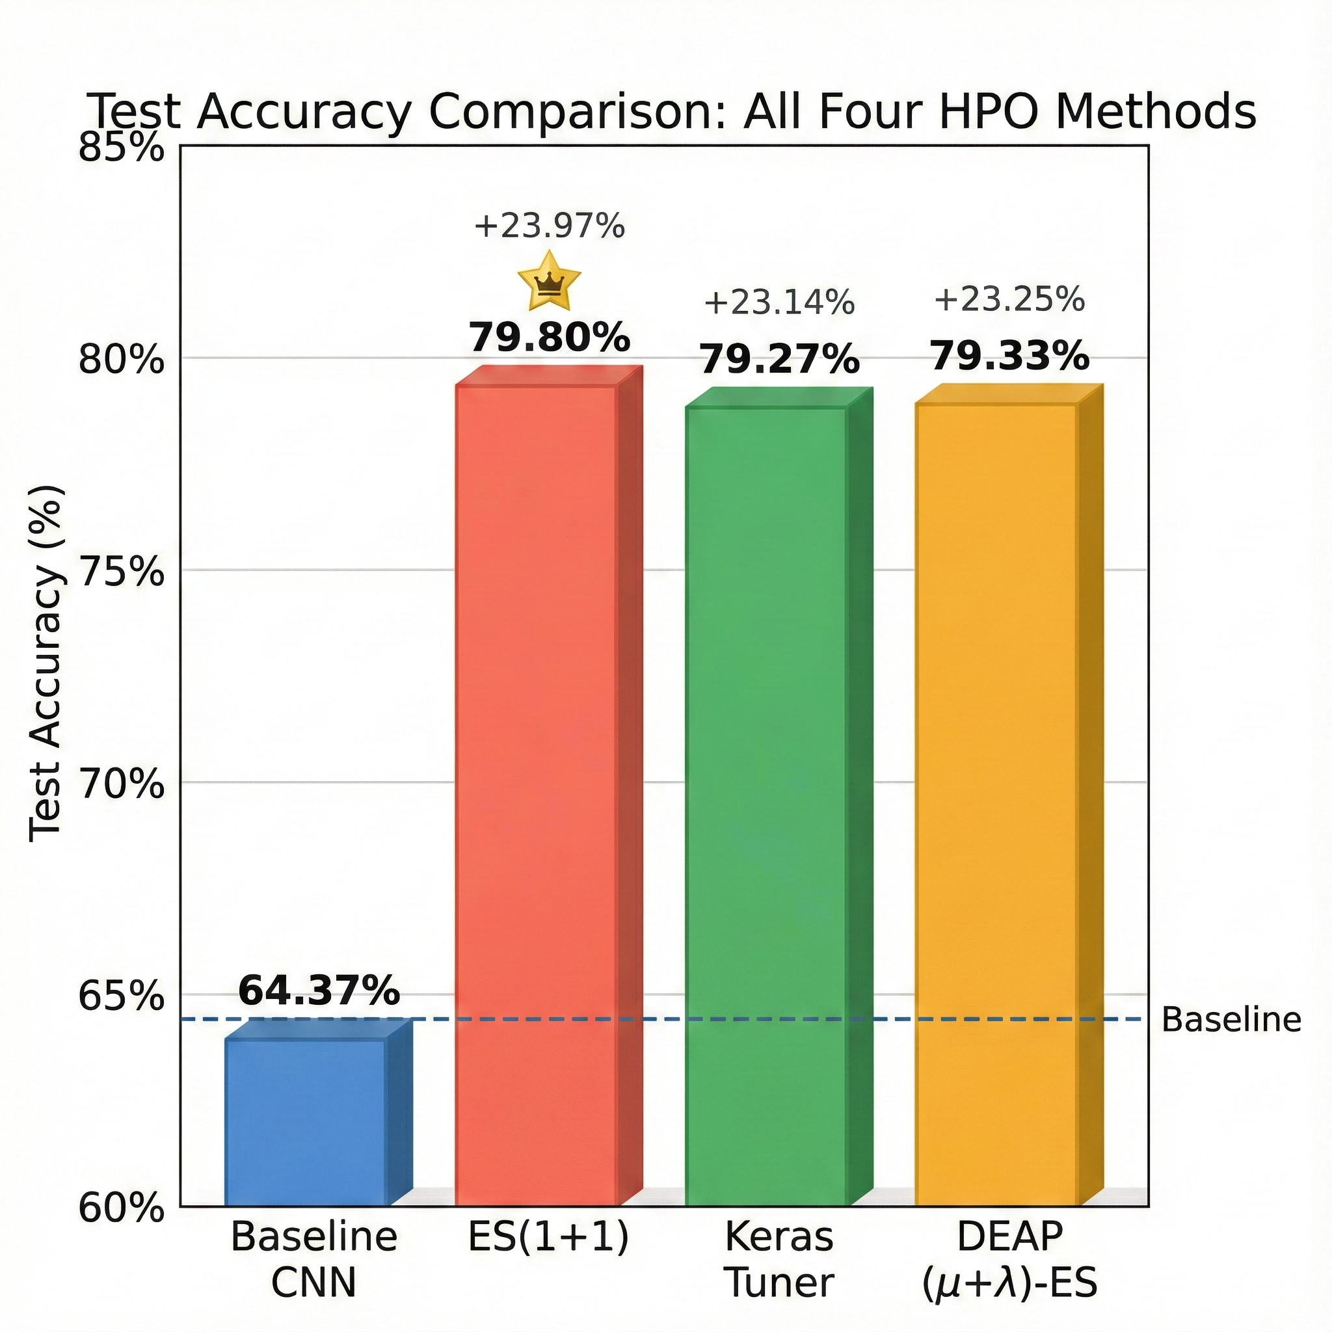
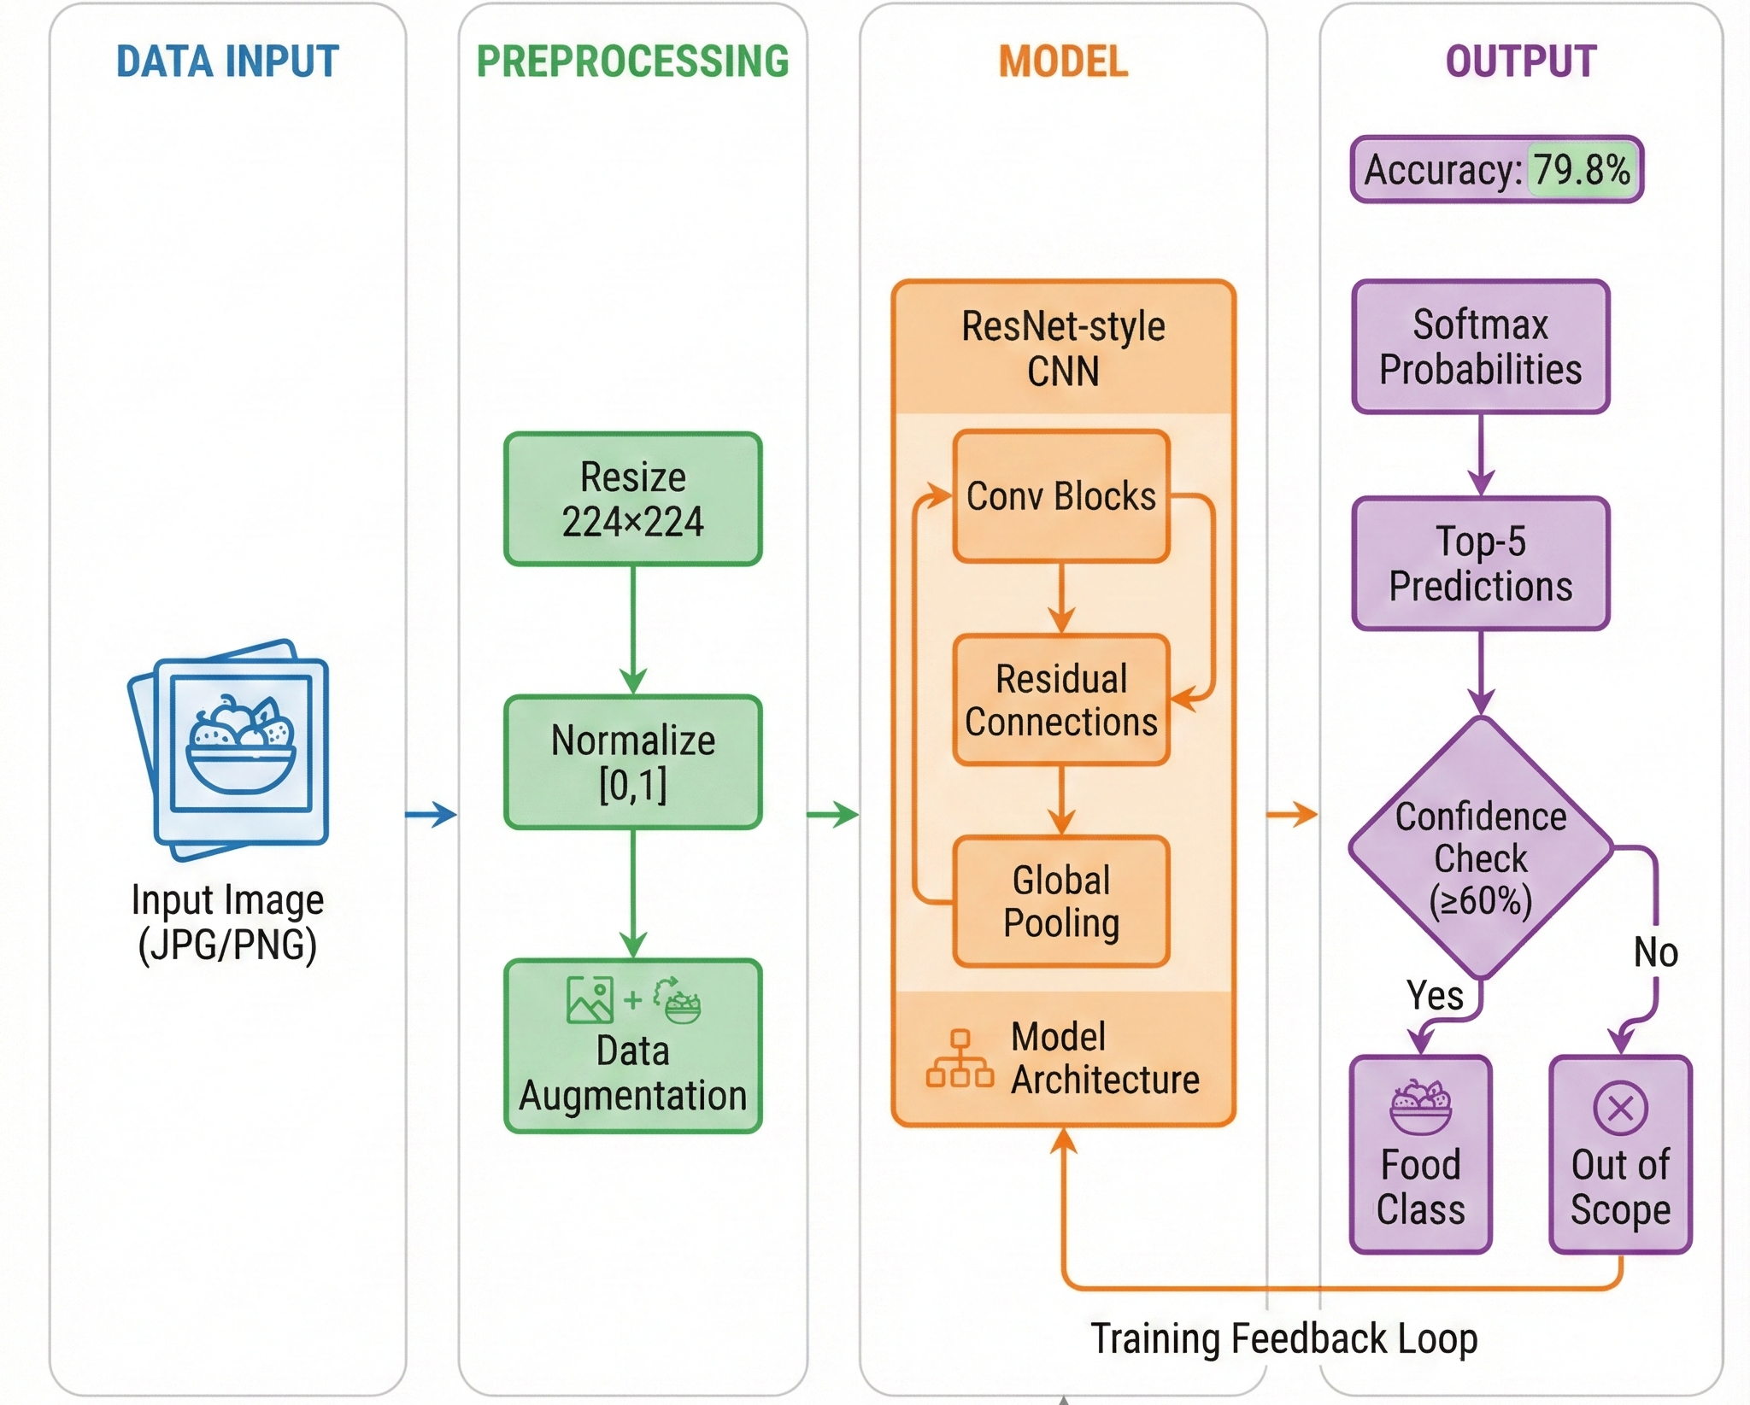
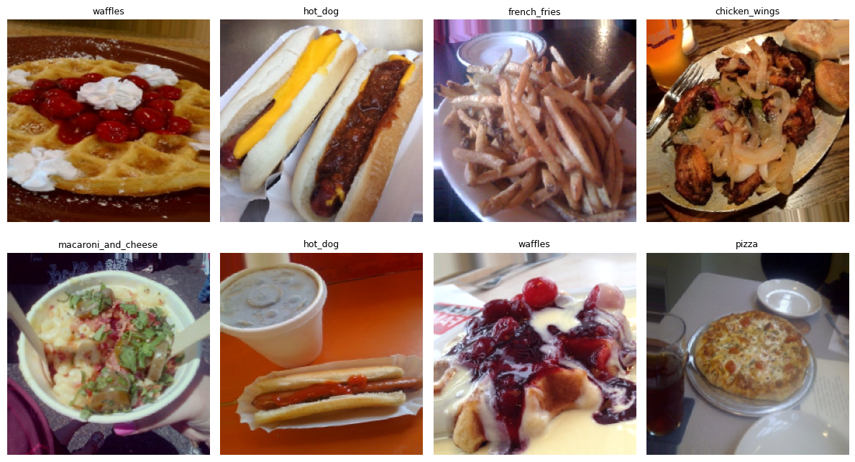
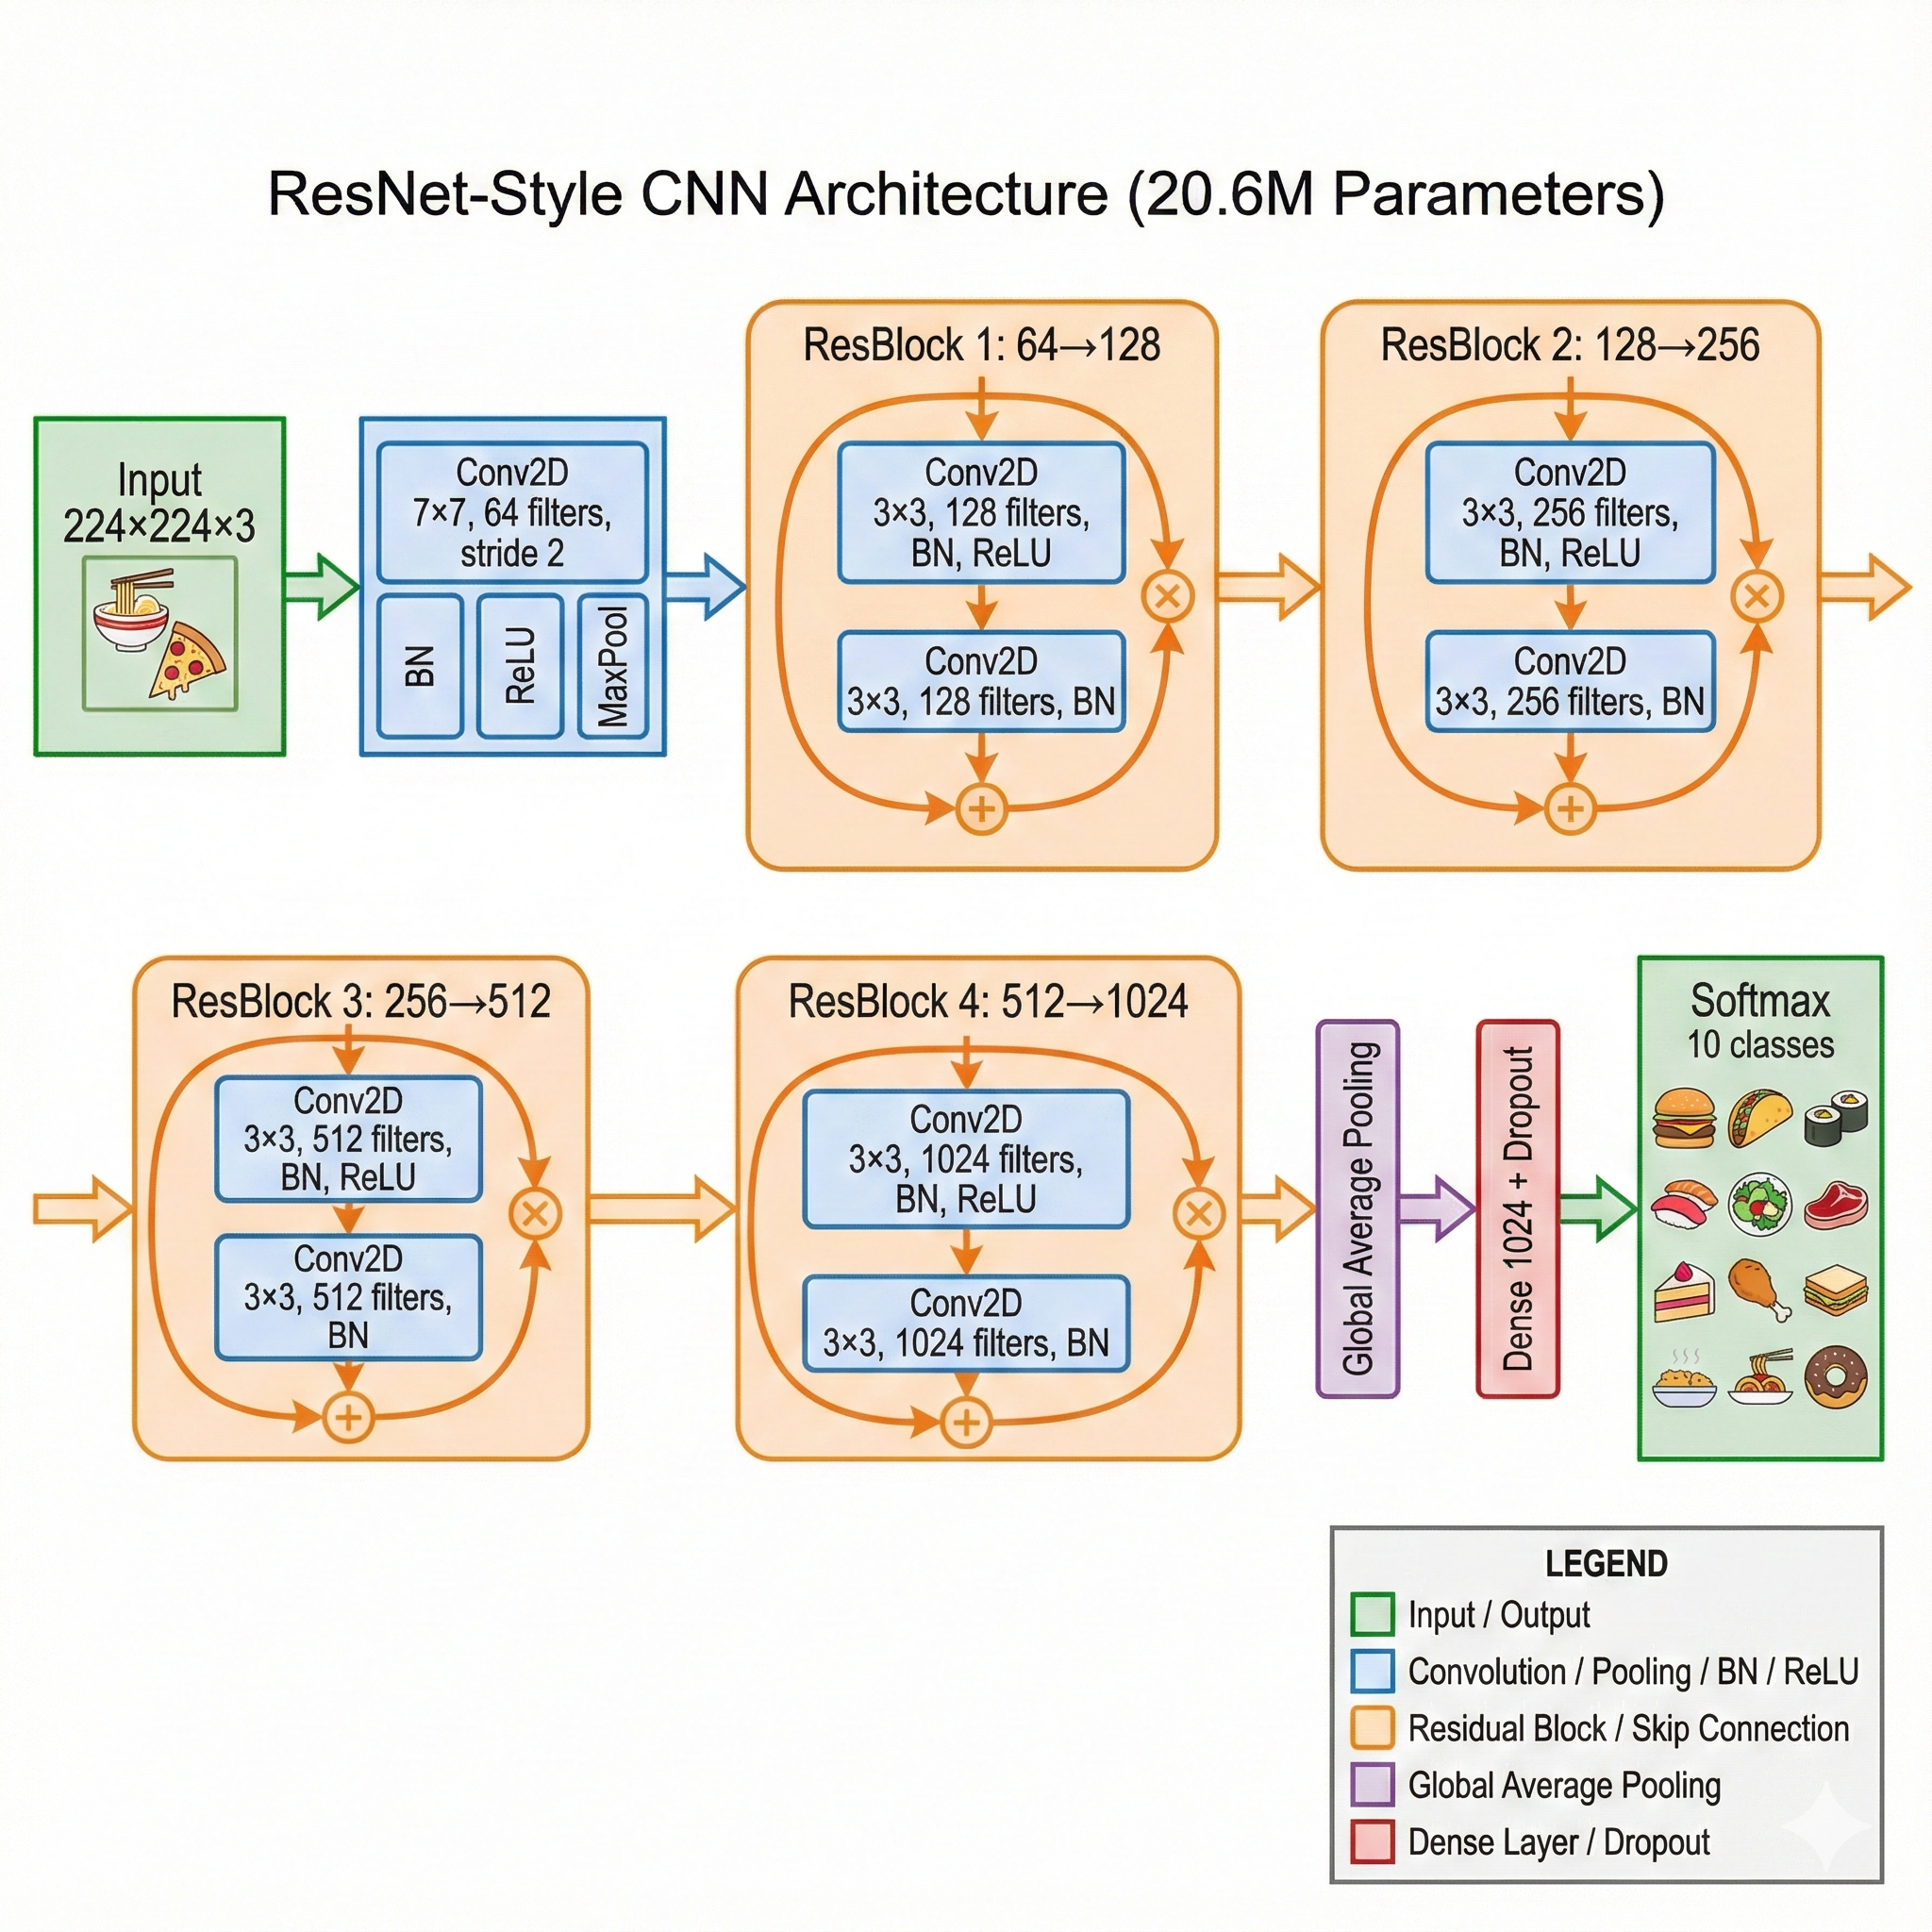
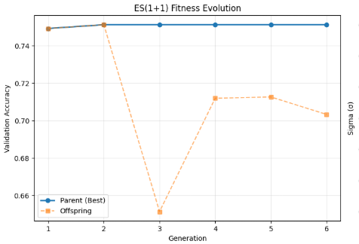
Deep Food Image Classifier with Convolutional Neural Networks and Evolutionary Hyperparameter Optimization
V Harsha Vardhan Yellela, MSCS Candidate; CJ Chung, PhD, Professor
College of Arts & Science, Lawrence Technological University
ABSTRACT
SYSTEM DESIGN & WORKFLOW
Qualitative Observations
ES(1+1) converged quickly and consistently improved validation accuracy.
CMA-ES/GA exhibited broader exploration, sometimes finding higher-variance solutions.
Random Search performance varied widely depending on sampled hyperparameters.
Confusion matrices showed improvement in class-specific recognition, especially for visually similar foods.
Inference on unseen internet images demonstrated robust predictions with confidence-based out-of-scope detection.
This project investigates automated hyperparameter optimization for a deep Convolutional Neural Network (CNN) food classifier trained on a small 10-class dataset. Because limited data restricts generalization and increases overfitting risk, three optimization strategies were implemented and compared: (1) Evolution Strategy ES(1+1) with the 1/5 Success Rule, (2) a second evolutionary method (CMA-ES / Genetic Algorithm), and (3) Random Search as a non-evolutionary baseline. Each method tunes learning rate, dropout, augmentation strength, and label smoothing. Experiments used a residual-style CNN trained with mixed-precision multi-GPU acceleration. Results demonstrate substantial improvements over the baseline model, with evolutionary methods showing stable convergence and improved test accuracy. This work highlights the value of evolutionary optimization for deep learning in small-dataset scenarios.
This workflow summarizes the end-to-end development pipeline for the food image classifier. The process begins with collecting and preprocessing the dataset, followed by model construction using a residual-style CNN architecture. Hyperparameter optimization is performed using ES(1+1), CMA-ES/Genetic Algorithm, and Random Search. Each algorithm iteratively evaluates candidate configurations using validation accuracy as the fitness metric. The best-performing models are then tested on unseen images, and inference results are used to assess generalization and robustness.
INTRODUCTION
Purpose of the system: classify 10 food categories
Motivation: small dataset → CNN requires hyperparameter tuning
Problem: baseline accuracy (≈64%) is too low for deployment
Solution: evaluate multiple optimization strategies to improve convergence and accuracy
Contributions: • Custom residual-style CNN • ES(1+1) with the 1/5 Success Rule • Second evolutionary method (CMA-ES or Genetic Algorithm) • Random Search baseline • Full comparative analysis across methods • Inference with confidence-based out-of-scope detection
Conclusion
RESEARCH GOALS
Data Input & Preprocessing
The dataset undergoes resizing, normalization, and augmentation (rotation, zoom, flip) to reduce overfitting and improve generalization.
Augmentation increases sample diversity, especially valuable for small datasets.
Model Architecture
A residual-style CNN is used for all experiments to maintain consistency.
Skip connections stabilize gradient flow and improve training convergence.
Optimization Algorithms
ES(1+1) adapts mutation size using the 1/5 Success Rule and converges rapidly.
CMA-ES / Genetic Algorithm explores correlated parameter interactions for deeper search.
Random Search serves as a simple but effective baseline.
Hyperband & DEAP extend the search across a broader hyperparameter space.
Evaluation & Inference
Final models are selected based on validation accuracy and tested on unseen images.
Confidence-based thresholding is applied to filter out low-certainty predictions.
The study demonstrates that evolutionary hyperparameter optimization significantly enhances model performance in small-dataset conditions. ES(1+1) proved to be efficient and stable, while CMA-ES/GA enabled more expressive search over correlated hyperparameters. Random Search established a lower-bound baseline for comparison. All optimization methods outperformed the baseline CNN, with evolutionary strategies producing the highest accuracies. These results highlight the value of evolutionary optimization as a practical tool for deep learning models constrained by limited data.
Improve accuracy of the baseline CNN
Compare ES(1+1), CMA-ES/GA, Random Search, Hyperband, and DEAP
Study hyperparameter sensitivity and convergence stability
Analyze behavior under small-dataset constraints
Identify the most effective optimization strategy for final deployment
Method | Val Acc (%) | Test Acc (%) | Δ vs Baseline | Macro F1 | Notes
Baseline CNN | 72.33 | 72.47 | — | 0.72 | Untuned
ES(1+1) | 75.13 | 79.80 | +7.33% | 0.80 | Best overall
CMA-ES | 77.07 | 77.13 | +4.66% | 0.77 | Good global search
Random Search | 77.00 | 77.93 | +5.46% | 0.78 | High variance
Keras Tuner (Hyperband) | 77.47 | 79.27 | +6.80% | 0.79 | Best structured HPO
DEAP (μ=5, λ=10) | 77.33 | 79.33 | +6.86% | 0.79 | Strong ES method
METHODS
EXPERIMENTAL RESULTS
Dataset
10 classes, 70/15/15 train–validation–test split
Real-world food photographs with variable lighting
Normalization + augmentation (flip, rotation, zoom, contrast)
CNN Architecture
Algorithms Used
ES(1+1) with 1/5 Success Rule
CMA-ES / Genetic Algorithm (second required evolutionary algorithm)
Random Search (non-evolutionary baseline)
Hyperband (Keras Tuner)
DEAP (μ+λ)-ES
Model Test Performance
The baseline CNN achieved ~64% accuracy, demonstrating the difficulty of training on a small dataset.
ES(1+1) improved performance significantly due to adaptive mutation rates and stable convergence under the 1/5 rule.
The second evolutionary algorithm (CMA-ES / GA) explored correlated parameter relationships and improved search efficiency.
Random Search provided a non-evolutionary baseline for comparison.
Hyperband and DEAP (μ+λ)-ES showed competitive performance with deeper exploration.
FUTURE WORK
Increase the size and diversity of the food image dataset to reduce overfitting.
Improve the CNN architecture or test lightweight variants to boost accuracy.
Add more robust hyperparameter search methods and compare optimization efficiency.
Evaluate the model on additional real-world images to test generalization.
Extend the classifier with more food classes or additional categories.
REFERENCES
Rechenberg, I. “Evolution Strategy Research.” 1973.
Schwefel, H.-P. “Numerical Optimization of Computer Models.” Wiley, 1981.
Hansen, N., et al. “The CMA-ES Algorithm.” Evolutionary Computation, 2006.
Bergstra, J., & Bengio, Y. “Random Search for Hyper-Parameter Optimization.” JMLR, 2012.
Li, L., et al. “Hyperband: A Novel Bandit-Based Approach to Hyperparameter Optimization.” ICLR, 2017.
He, K., et al. “Deep Residual Learning for Image Recognition.” CVPR, 2016.

