Slide 1
Pneumonia Detection using Python and Deep Learning
CRE Group 7: Harsha Vardhan Yellela, Honey Patel, Bryan Nguyen

Slide 2
Motivations and Methods
Motivation:
Pneumonia is a global health issue; early detection saves lives.
Manual X-ray analysis is resource-heavy and error-prone.
AI-based solutions provide fast, scalable, and accurate detection.
Methods:
Data:
Kaggle Chest X-Ray Dataset
Resizing images, normalization of pixel, and data augmentation.
Model:
VGG19 architecture fine-tuned for pneumonia detection.
Optimized using Adam optimizer and cross-entropy loss.
Metrics:
Precision, recall, f1-score and accuracy.
Evaluation:
Validation accuracy and confusion matrix

Slide 3
Dataset
Dataset Source:
The dataset used for this project is the Kaggle Chest X-Ray Dataset. It is a popular dataset containing X-ray images of normal lungs and lungs affected by pneumonia.
Dataset Structure:
Total Images: The dataset contains images divided into two primary classes: NORMAL and PNEUMONIA.
NORMAL: Number of images representing healthy lungs.
PNEUMONIA: Number of images representing infected lungs.
The dataset is further divided into training, validation, and testing sets to ensure robust model performance.
Class Imbalance:
A visualization of class distribution is provided to depict the imbalance between NORMAL and PNEUMONIA classes (e.g., using count plots).
Class imbalance poses a significant challenge, potentially affecting the model's learning, which was addressed through various techniques such as data augmentation.

Slide 4
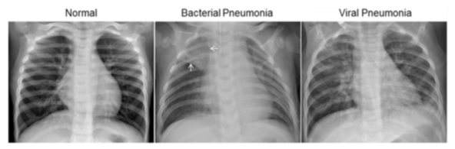
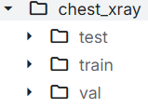
The dataset used is the Kaggle Chest X-Ray Dataset, containing X-ray images for NORMAL and PNEUMONIA categories. It is organized into three folders: train, test, and validation, with subfolders for Pneumonia/Normal. The dataset contains 5,863 X-ray images (JPEG) across two categories. Images are from pediatric patients (ages 1-5) at Guangzhou Women and Children’s Medical Center. Low-quality scans were removed, and diagnoses were graded by two expert physicians, with verification by a third expert. A visualization of class distribution shows imbalance between classes, which was addressed via data augmentation.

Slide 5
Model Architecture
Model:
Pre-trained VGG19 (Visual Geometry Group 19 Weight Layer) for feature extraction
16 convolution layers and 3 fully connected layers
Why transfer learning?
Custom layer added for binary classification
Flatten
Dense
Dropout (50%)

Slide 6
Training
Training Details:
Adam (Adaptive Moment Estimation)
Categorical Cross Entropy loss function
Batch size = 16
Epochs = 14
L2 Regularization to prevent overfitting
Notes:
Adam - efficient and robust
Categorical Cross Entropy - Compares the predicted probability distribution for each class with the true labels
L2 - prevents overfitting by penalizing large weights

Slide 7
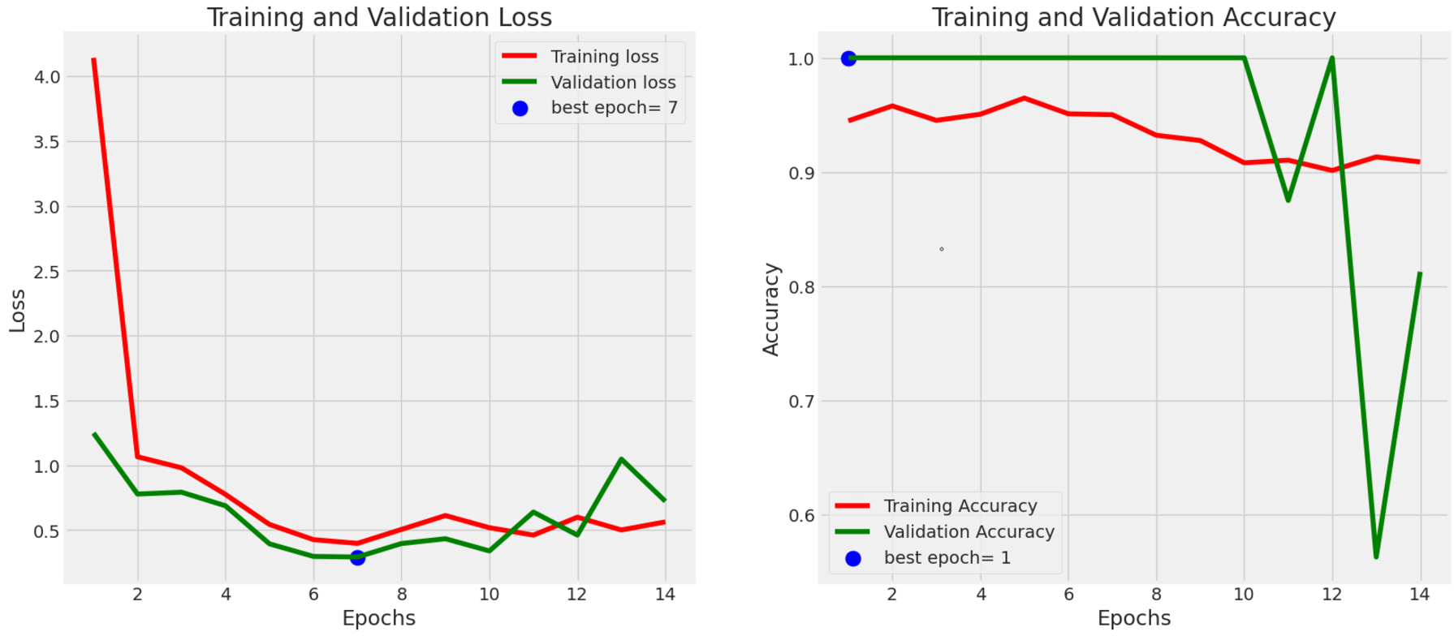
Results

Slide 8
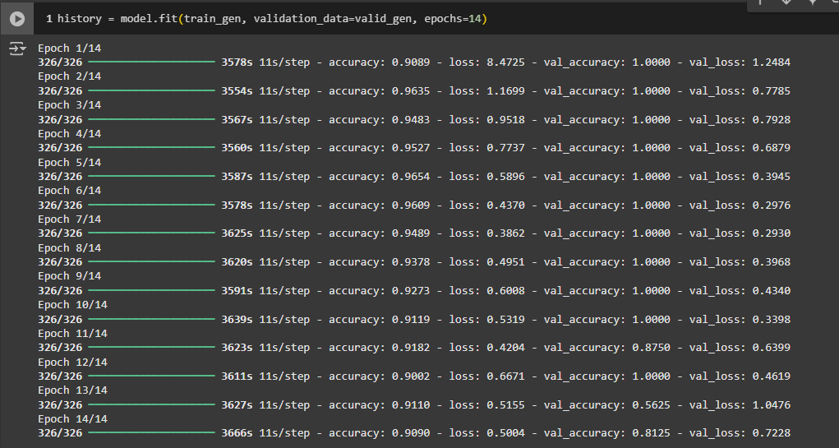

Slide 9
Results cont.
Training and Validation Loss:
Graph perform wells early
Fluctuations might indicate overfitting of the model
Training and Validation Accuracy:
Training accuracy fluctuates
Validation accuracy remains at 1, but fluctuates
Most likely due to learning noise rather than generalizing
Overfitting

Slide 10
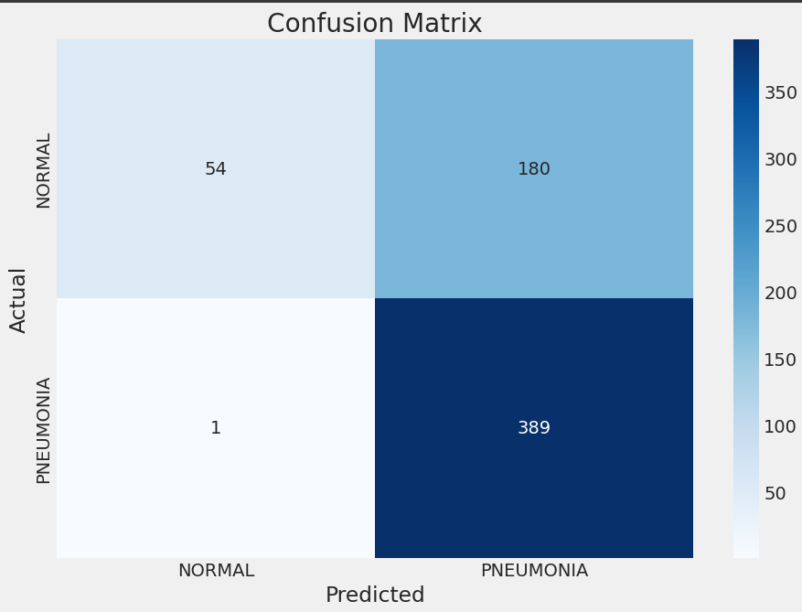
Confusion Matrix

Slide 11
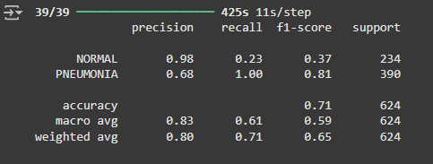
Results
Pros
High recall for pneumonia cases (0.997)
All actual pneumonia cases are (almost) identified
High precision for normal cases (0.98)
Of all cases predicted as normal, 98% are actually normal
Cons
High false positive rate (180)
Moderate accuracy

Slide 12
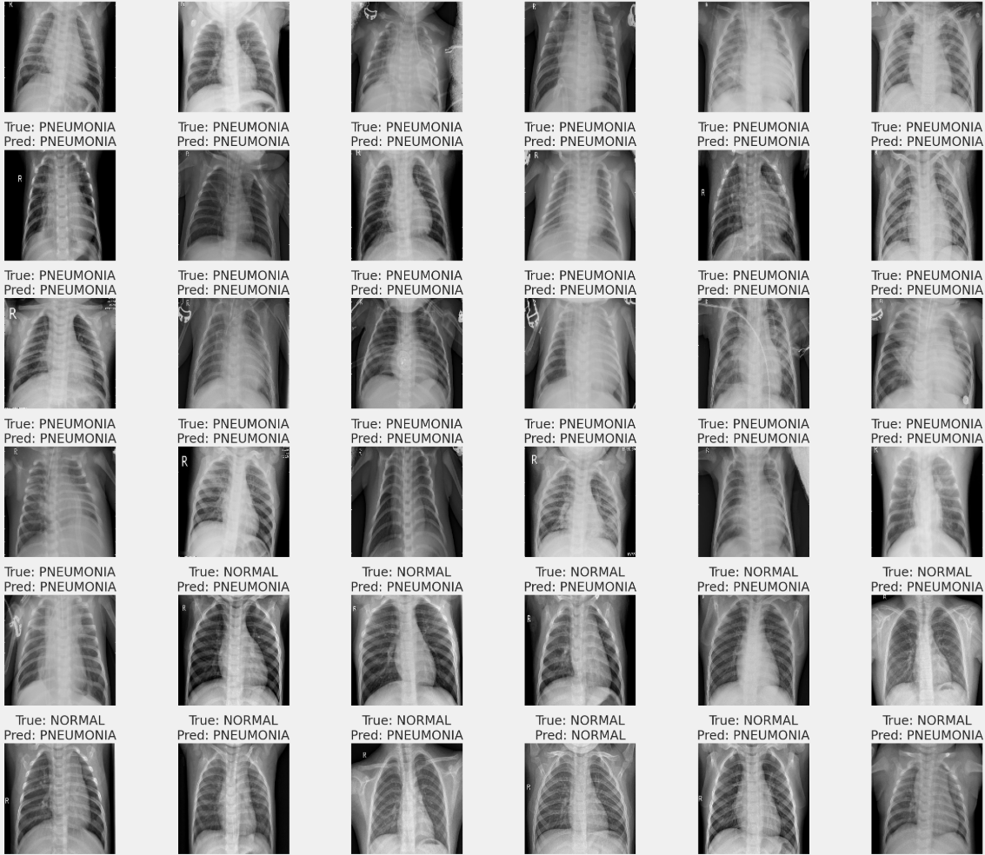

Slide 13
Future Work
Real-Time Detection:
Develop a real-time pneumonia detection system that can be used in emergency settings, potentially integrating with mobile devices or telemedicine platforms.
Optimize the model for faster inference times to facilitate immediate clinical decision-making.
Develop Clinical Decision Support Systems:
Integrate the model into a user-friendly software application that assists radiologists in diagnosing pneumonia.
Create a feedback loop where clinicians can provide input on model predictions to continuously improve the model.
Multi-Modal Approaches:
Combine chest X-ray analysis with other diagnostic tools (e.g., clinical data, lab results) to enhance diagnostic accuracy.
Explore the integration of natural language processing (NLP) to analyze patient history and symptoms alongside imaging data.

Slide 14
Conclusion
Leveraged transfer learning with VGG19 model for feature extraction and classification that is fast, scalable, and accurate
High recall and low false negatives
Demonstrated the potential for ML in healthcare
Opportunity to develop precise and clinically useful models

Slide 15
References
Kaggle Chest X-ray images
https://www.kaggle.com/datasets/paultimothymooney/chest-xray-pneumonia
Pneumonia Detection with Python
https://thecleverprogrammer.com/2020/11/22/pneumonia-detection-with-python/
Pneumonia Detection Using CNN based Feature Extraction
https://ieeexplore.ieee.org/document/8869364
Claude AI
ChatGPT

