Slide 1
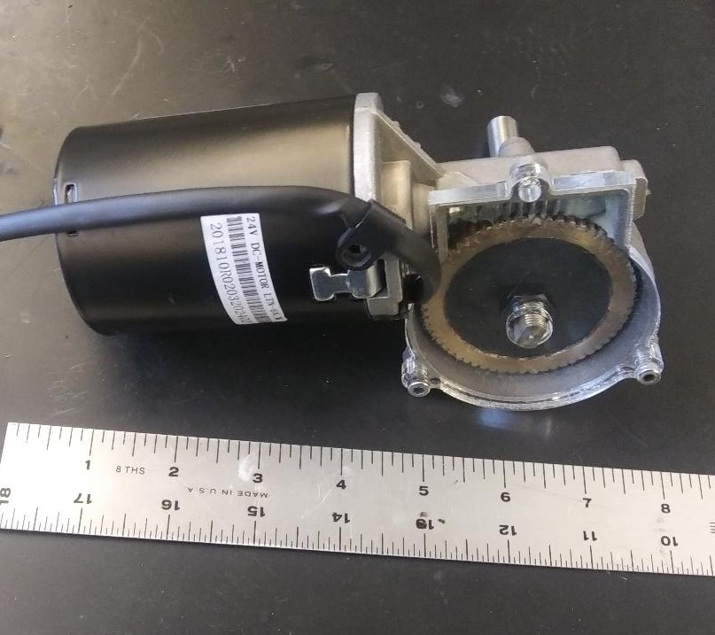
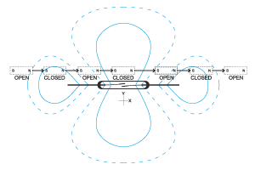
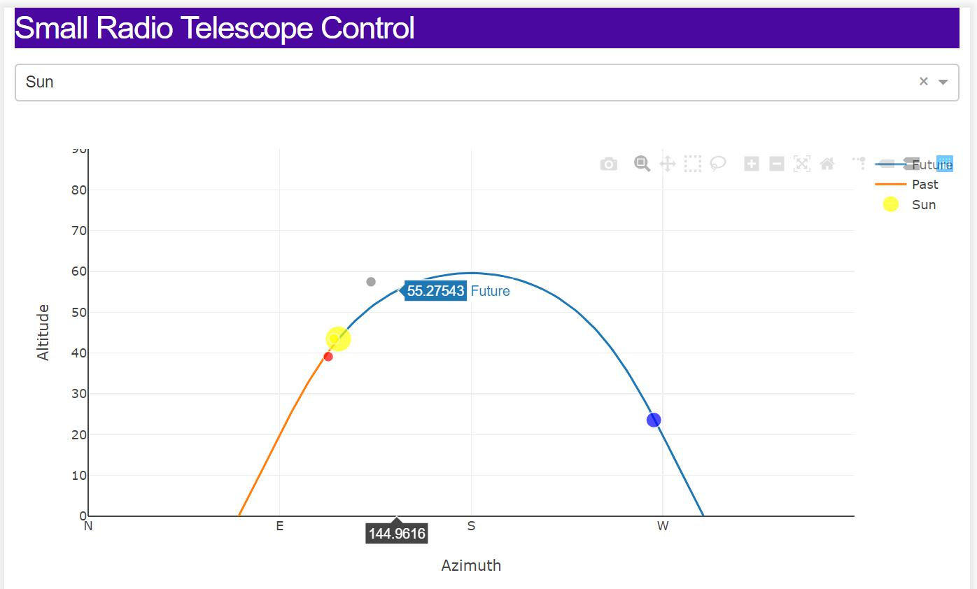
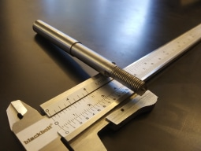
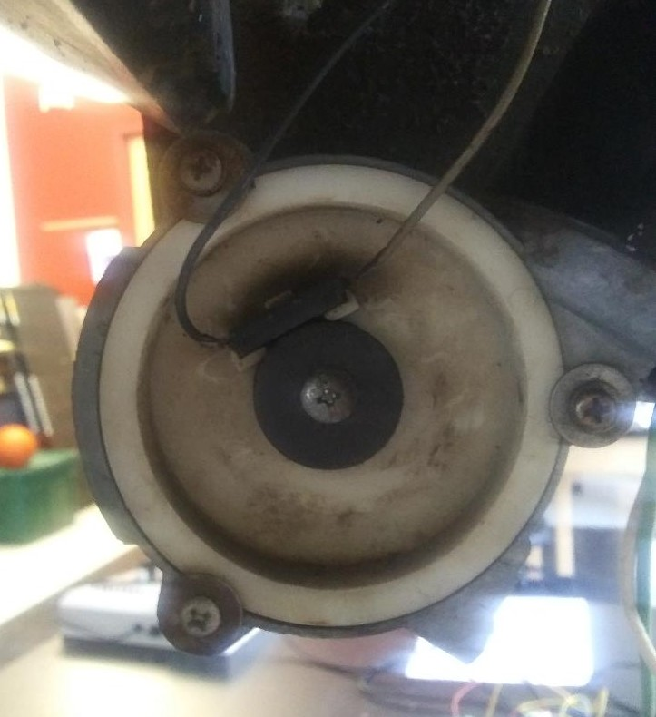
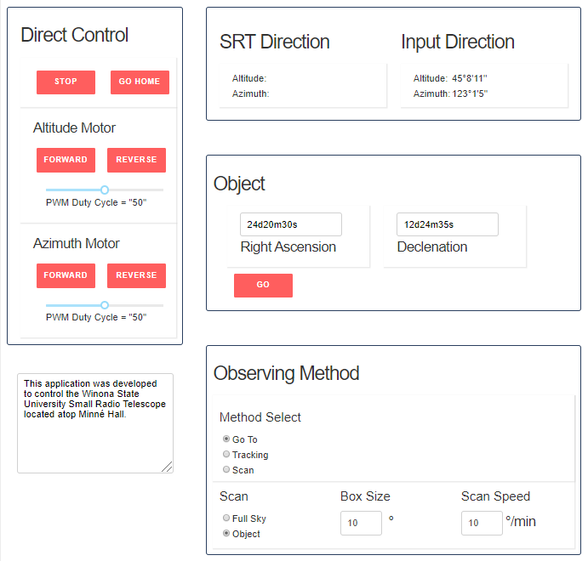
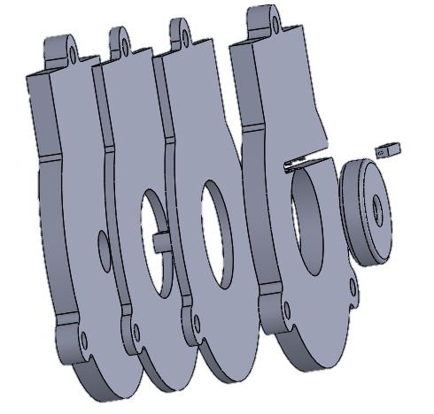
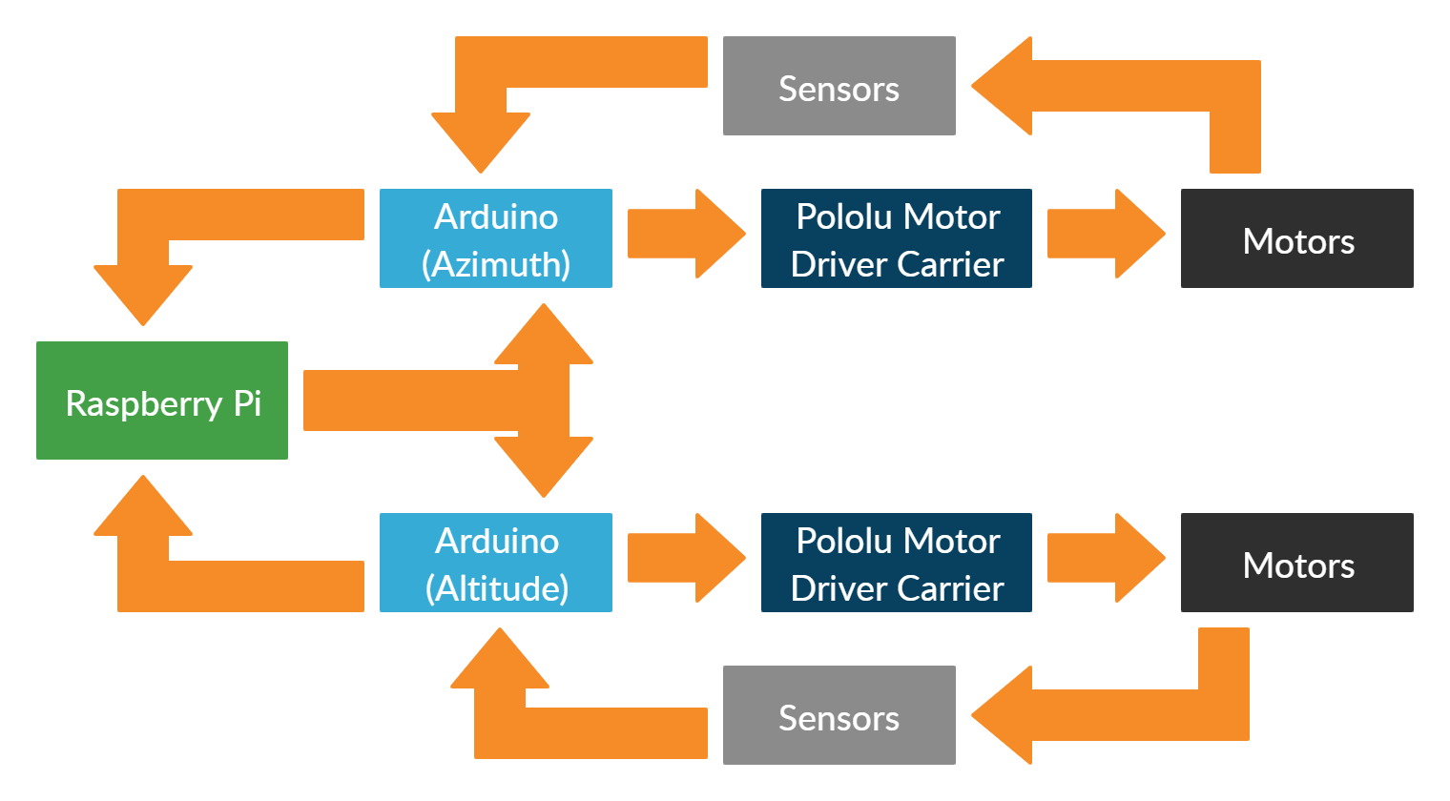
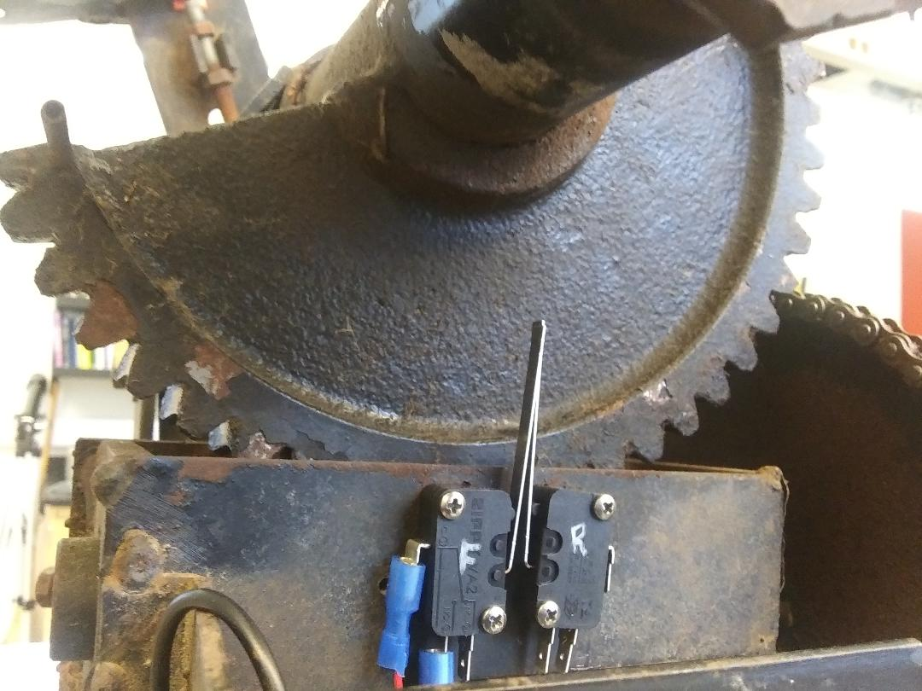
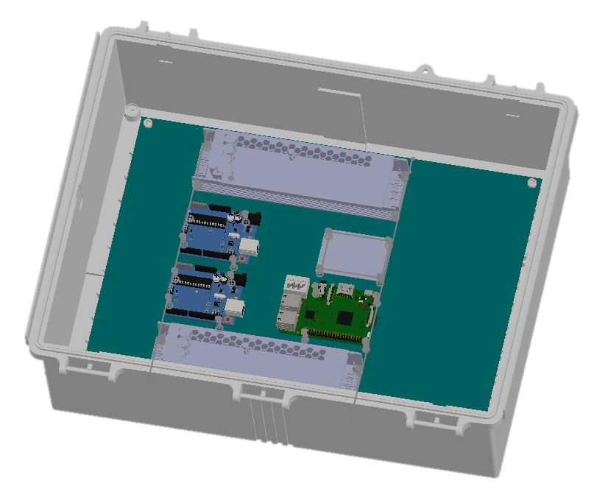
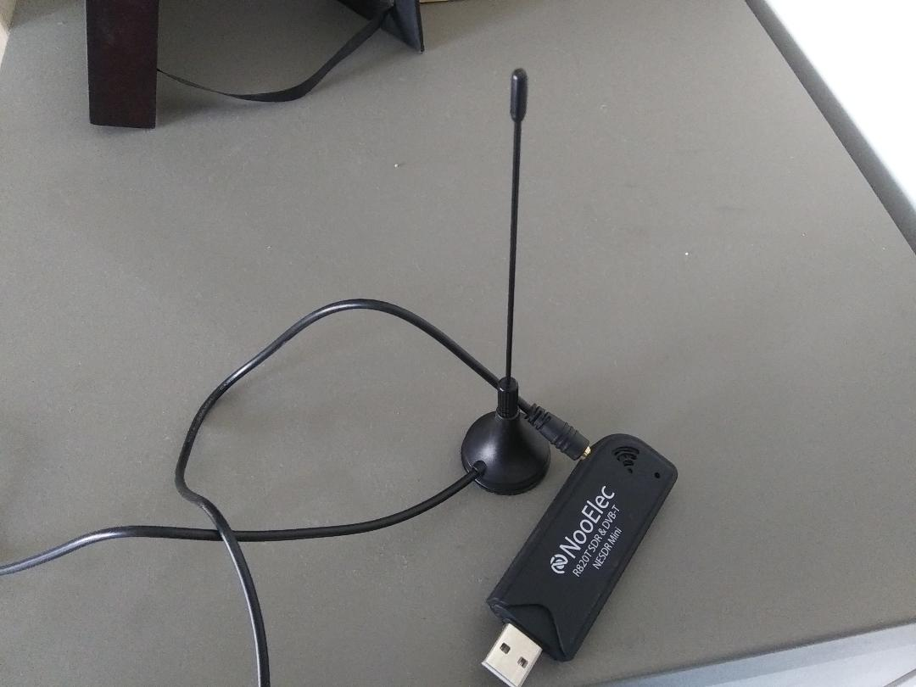


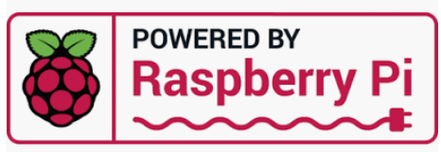


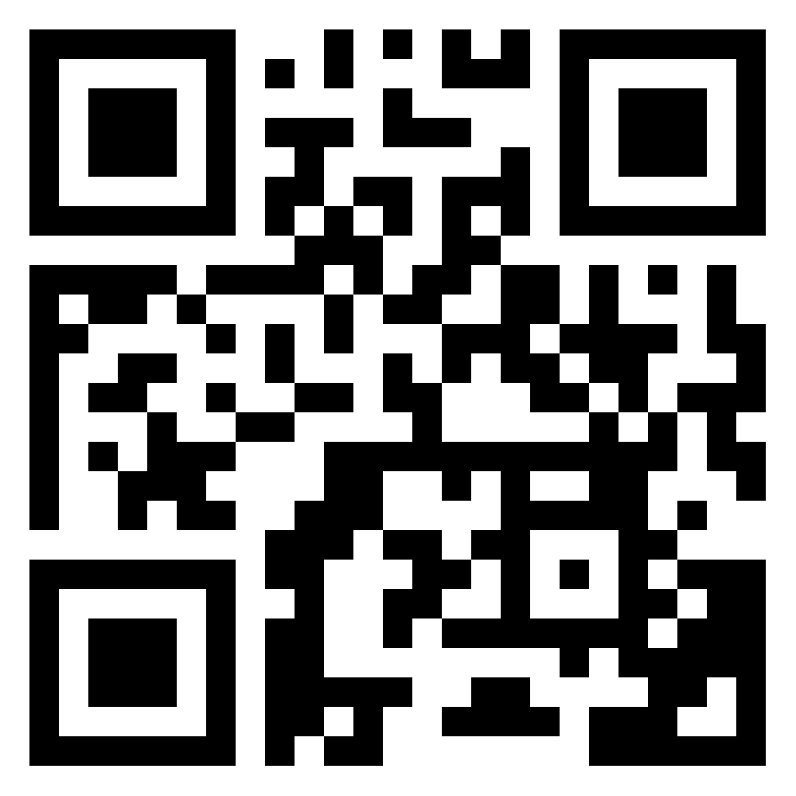
#175.09
235th Meeting of the
American Astronomical Society
Honolulu, Hawaii ● January 4 – 8, 2020
Clayton G. Hanson, Carl Ferkinhoff, Nathan Moore, Luke Zweifelhoffer
A Small Radio Telescope (SRT), originally developed by MIT’s Haystack Observatory, was donated to Winona State University by Mayo High School in Rochester, Minnesota. The assembly includes a 2.3 meter dish with mount and motors that allow pointing over the entire sky. The SRT, unfortunately, has been weathered over years of exposure to the elements, and was absent all the electronics necessary for pointing and collecting data. Here we report our efforts to repair, replace, and refurbish the SRT for future undergraduate research. Specifically, the replacement of pointing hardware, the development of a motor control system and graphical user interface (GUI), and future work to implement a software defined radio (SDR) for detection of astronomical signals.
Abstract
Figure 1: A fully assembled SRT with a similar design to our own.
Figure 2: The two motors used to point the dish required replacement.
Figure 6: A reed switch in a circuit on the digital input port detects the proximity of a magnet.
Hall Effect Sensor
Figure 3: New gear shafts needed to be cut for the motors on a lathe to meet the specifications of the system.
Figure 7: An Arduino microcontroller will track the dish’s direction by counting the pulses from the reed switch.
Motors
Figure 4:
New non-magnetic covers are first modeled in Solidworks, then laser printed on a Glowforge.
Figure 7:. Communication hierarchy
Figure 5: Two switches will limit the turning of the final conversion gear and assist in calibration.
Figure 8: A water proof plastic box will house the electrical components required for the SRT’s movements.
Further finalization and completion of the work presented here
Implementation of an SDR for data taking
Software to analyze information received by the SDR
Astronomical observations to be made with this telescope
Figure 9: Running on the Raspberry Pi; a DashDAQ GUI has been created to allow for a user friendly interface to control the SRT operations. Taking inputs of Right Ascension and Declination the user can choose between several observation functions and see the trajectory of their object mapped on the local sky.
Future Work
Figure 10: Example of and SDR that might be used on the SRT.
For more information visit https://osf.io/yktem/
Or email me at Clayton.Hanson@go.winona.edu

