Slide 1

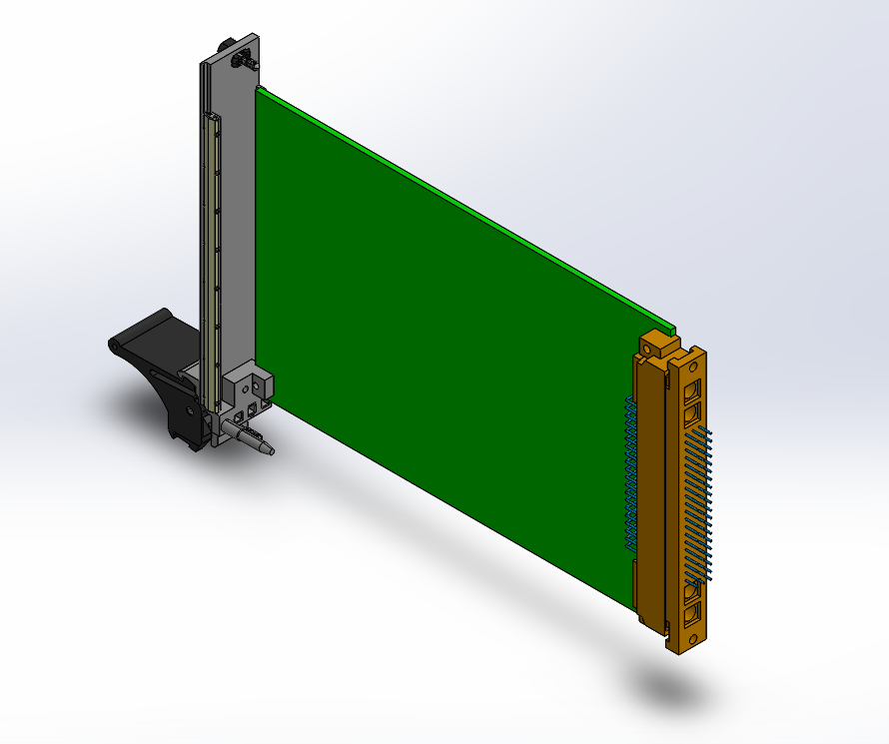
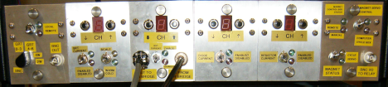
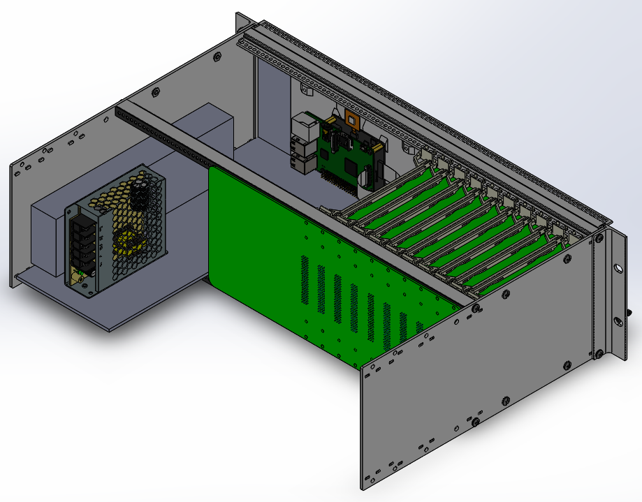
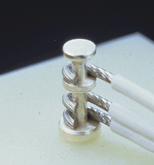
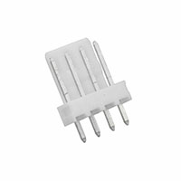

HARDWARE.astronomy: Housekeeping Box (H.aHkBox)
Here we present the HARDWARE.astronomy Housekeeping Box (H.aHkBox). The H.aHkBox is a low-cost open-source temperature monitoring and control system. It employs existing open-source devices (e.g Arduino, RaspberryPi) to reduce costs while also limiting the complexity of the development. The H.aHkBox features a chassis with a variety of capabilities, a control computer, and 10 expansion slots that can be populated by expansion cards. The first deployment of the H.aHkBox will be for the ZEUS-2 submillimeter grating spectrometer. As such the modular cards will include AC and DC excited 4-wire bridges, 2-wire bridge, and PID controller card. The system can output up to 200W, and achieve sub-millikelvin temperature sensing accuracy. Design, firmware, software and parts list will be published online allowing for other projects to adopt the system and create custom expansion cards as needed. Here we provide an overview of the project, initial layout of the chassis, electrical design, and specifications, as well as a proto-type expansion card.
Abstract
Prototyping Card
Background/Requirements
Backplane
Interface
Physical Design and Interface

