Slide 1
IBM SkillsBuild Bob Hackathon Showcase – Gujarat, 2026
“Exploring the Power of Agentic AI with IBM Granite and IBM Bob”

Slide 2
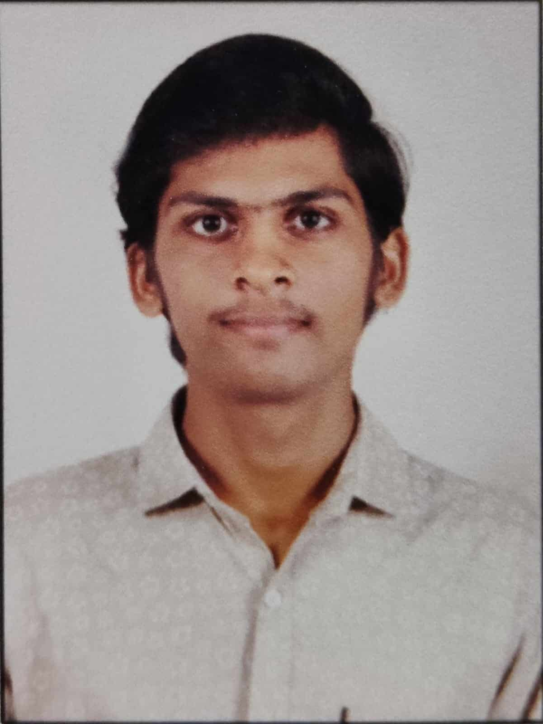
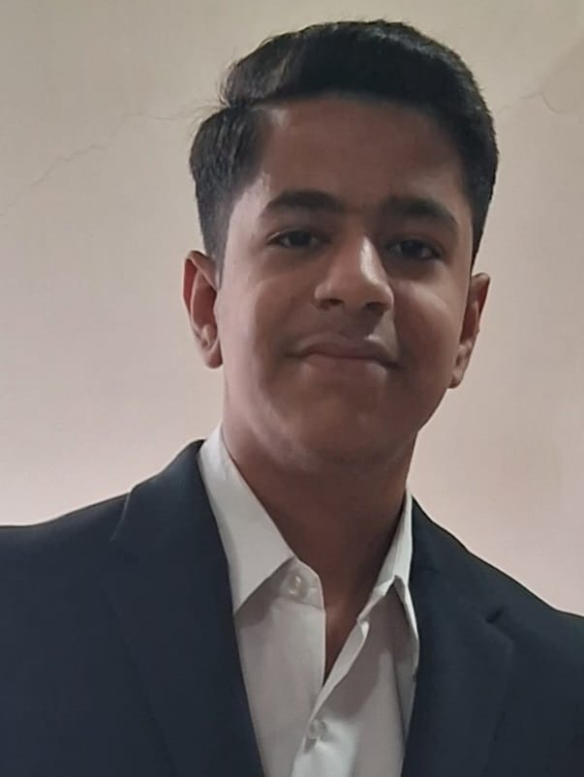
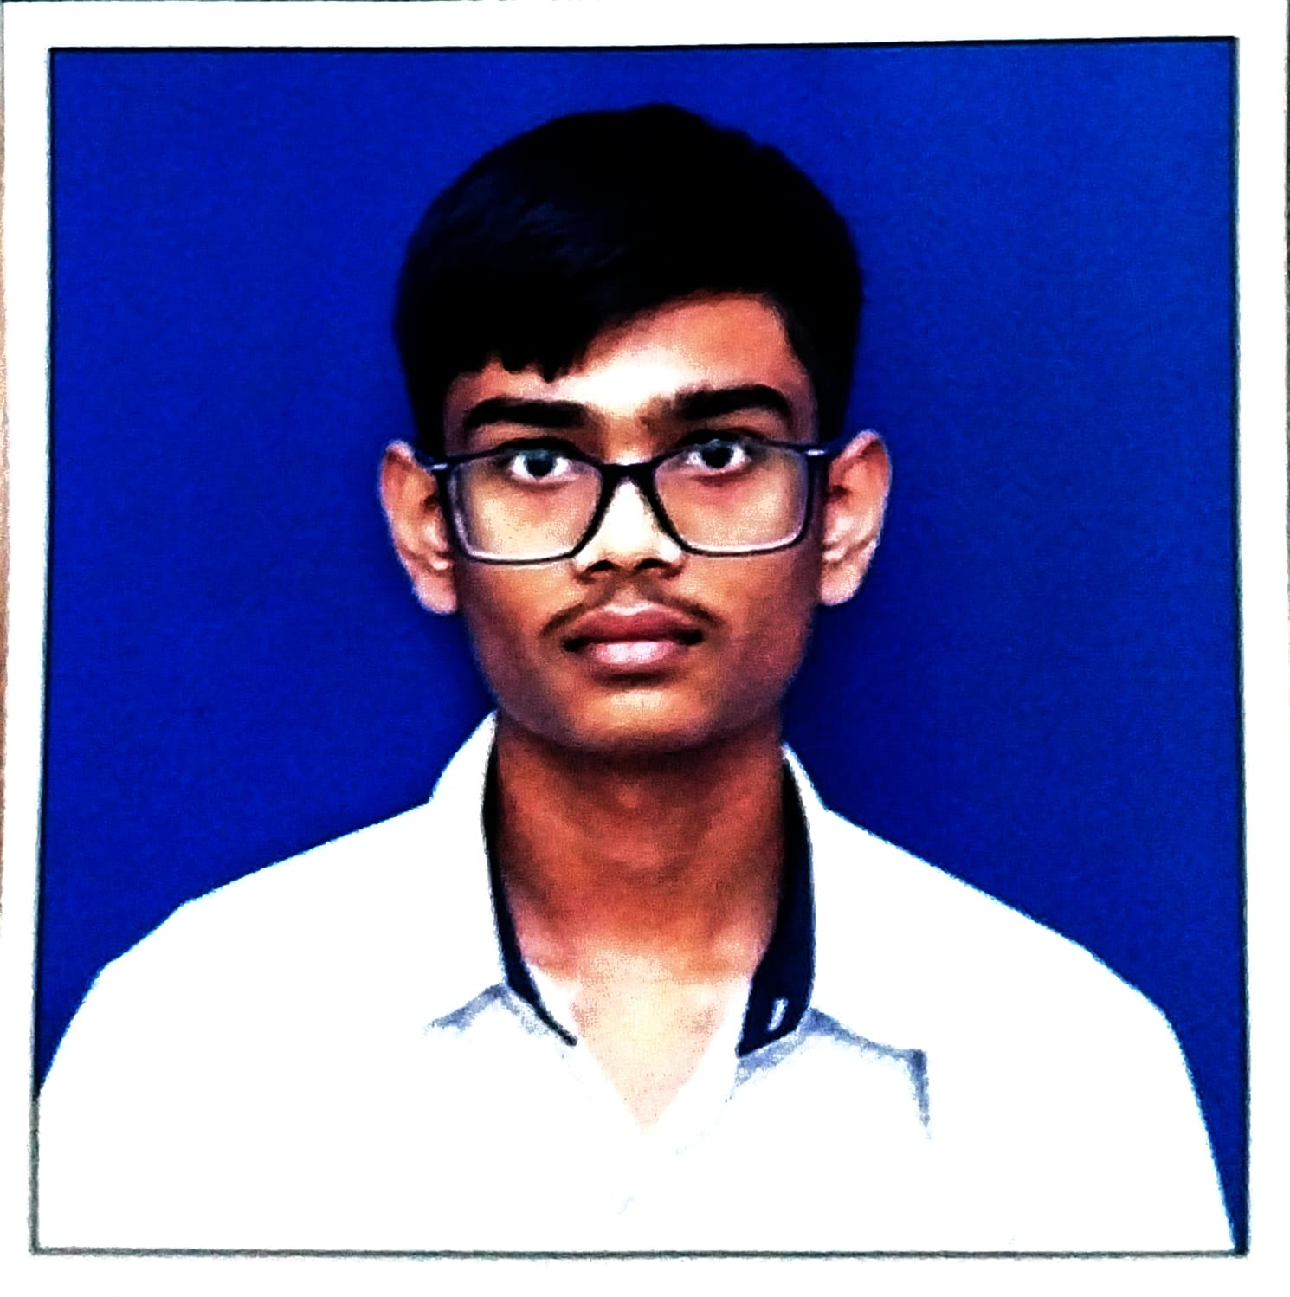
Project Title – VanRakshak AI: Agentic AI-Based Human–Wildlife Conflict Mitigation Platform for Gir
Domain of Project – Environmental Sustainability
Student Name | Recent Photo | Email ID | Mobile Number
Harshil Patil
harshilpatil2118@gmail.com
8780876858
Sumeet Khiani
khianisumeet8@gmail.com
8200694737
Prathmesh Mohite
prathmeshm4219@gmail.com
73593 09504

Slide 3
Problem Statement -
VanRakshak AI – Human–Wildlife Conflict Mitigation for Gir Forest
The Challenge
Human–wildlife conflict is often reactive due to delayed detection, fragmented reporting, and poor coordination. A unified platform is needed to turn wildlife data into early, informed, and human-supervised action.
The Objective
Build an Agentic AI Platform for Gir Forest that predicts conflict risk, generates alerts, coordinates responses, assists compensation, and identifies hotspots — while keeping forest officers in control.
5 Specialized AI Agents
Movement Prediction • Village Alerts • Response Coordination • Compensation Assistant • Hotspot Dashboard
Key Capabilities
Risk Prediction – Analyze sightings, proximity, time, environment, livestock density and history to generate High / Medium / Low risk with confidence.
Early Warnings – Generate concise English + Gujarati safety alerts.
Incident Coordination – Prioritize incidents and recommend response teams with mandatory officer approval.
Compensation Assistance – Prepare livestock-loss documentation and preliminary claims for human review.
Hotspot Detection – Identify recurring and emerging conflict zones through geospatial and historical analysis.
Core Workflow
Data → ML → Risk Score → 5 Agents → Orchestrator → Human Review → Action → Learn
Prototype: Uses labelled simulated / sample data. Predictions are probabilistic; consequential actions remain human-controlled.

Slide 4
Proposed Solution -
VanRakshak AI is an Agentic AI-powered command center that transforms fragmented wildlife data into predictive risk intelligence, coordinated response, and human-supervised action for Gir Forest communities.
How It Works
01 — Sense & Analyze
Collect simulated wildlife sightings, village data, historical incidents, livestock, and environmental factors.
02 — Predict & Score
ML models + explainable risk engine calculate conflict probability, risk level, and confidence.
03 — Act Through 5 AI Agents
Movement Agent → predicts movement & risk
Alert Agent → English / Gujarati warnings
Response Agent → prioritizes & recommends teams
Compensation Agent → prepares livestock claims
Hotspot Agent → detects recurring risk zones
04 — Orchestrate & Govern
A Central Orchestrator connects agents, maintains shared context, manages workflows, and sends consequential actions to a Forest Officer Approval Queue.
05 — Respond & Learn
Approved actions → alerts / response / compensation → incident outcomes become feedback for future risk analysis.
Core Differentiator
Predictive + Multi-Agent + Human-in-the-Loop + Explainable ML + Responsible AI
Impact
Earlier Warning → Faster Coordination → Better Community Support → Data-Driven Wildlife Conflict Mitigation
Prototype: Uses clearly labelled simulated / sample data; no autonomous wildlife intervention or unapproved response dispatch.

Slide 5
Technology Used -
IBM Bob
AI-Powered Development & Orchestration
Used for rapid application development, code generation, prototyping, and building the multi-agent architecture and workflows.
IBM Granite
Generative AI & Language Intelligence
Used for natural-language generation, summarization, Gujarati / local-language alerts, incident reports, compensation assistance, and hotspot summaries.
IBM Cloud
Deployment & Scalable Infrastructure
Provides the foundation for future secure deployment, scalable APIs, data services, and integration with real Forest Department infrastructure.
Python + Machine Learning
Prediction & Risk Intelligence
Used for feature engineering, wildlife-conflict risk scoring, movement analysis, classification, geospatial analysis, and hotspot detection.
Flask + Web Technologies
Application & API Layer
Used to build the responsive command-center dashboard, REST APIs, agent interfaces, alerts, incidents, officer approvals, compensation, and demo workflows.
Data & Responsible AI
Synthetic / Demo Data + Human-in-the-Loop
Uses clearly labelled sample data with confidence scores, audit logs, role-based access, privacy controls, and mandatory human approval for consequential actions.

Slide 6
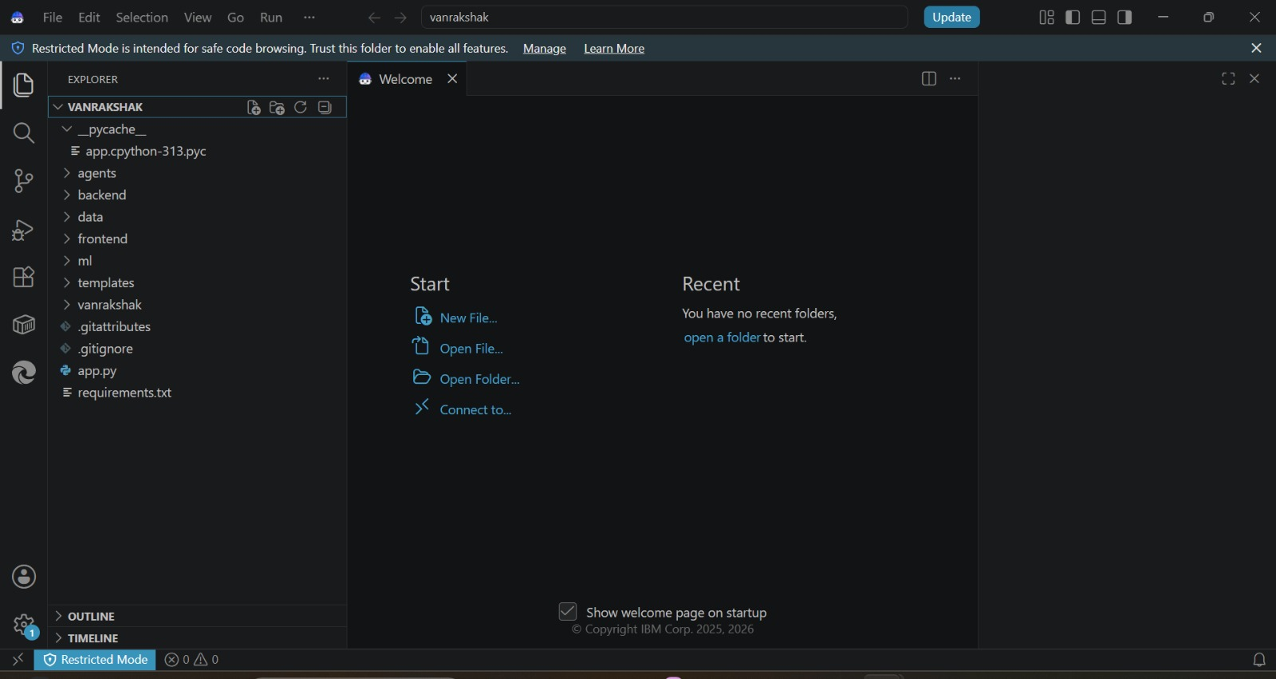
Required Files Created Using IBM Bob -
VS Code / IBM Bob workspace showing the VanRakshak project structure — agents, backend, ml, frontend, templates, and data modules.

Slide 7
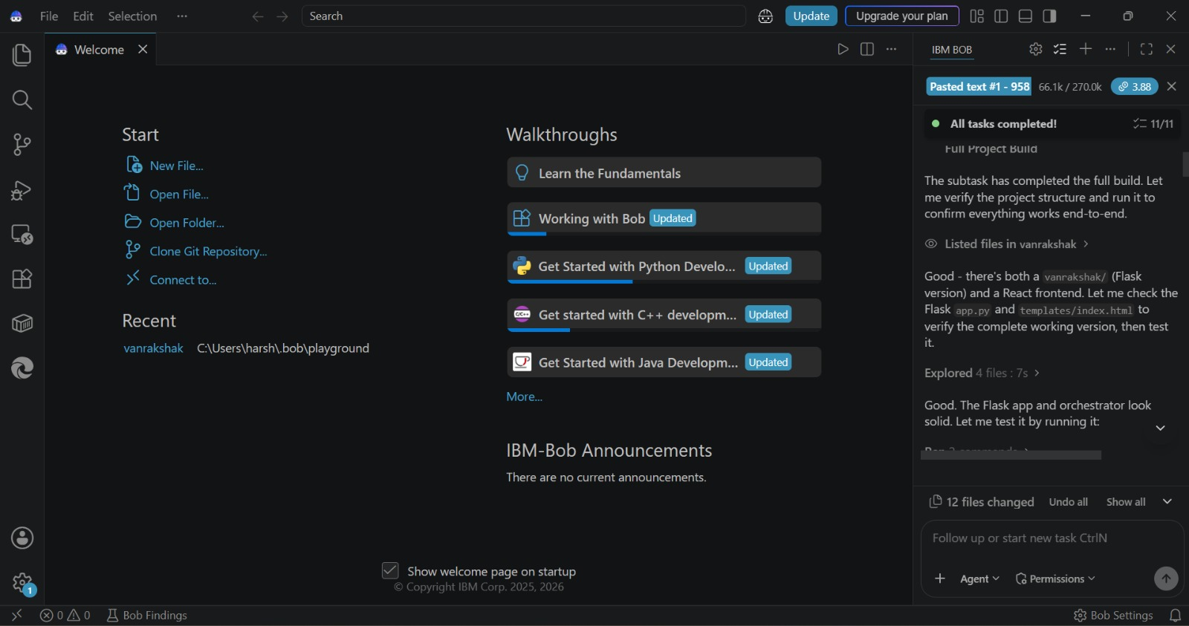
IBM Bob Screenshots -
IBM Bob agent panel — task completion summary (11/11 tasks) and file changes during the VanRakshak build.

Slide 8
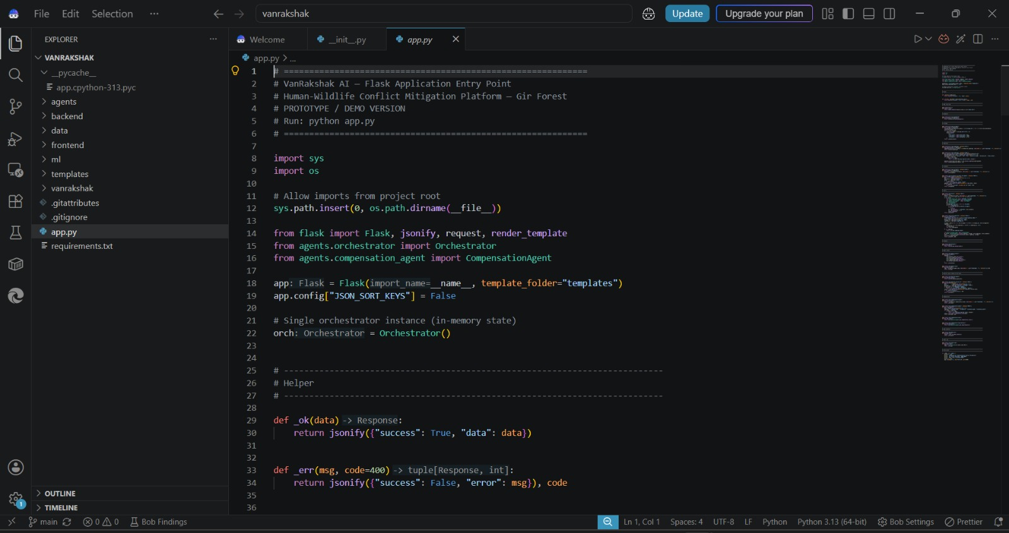
IBM Bob Screenshots -
Flask application entry point (app.py) generated with IBM Bob — orchestrator initialization and route setup.

Slide 9
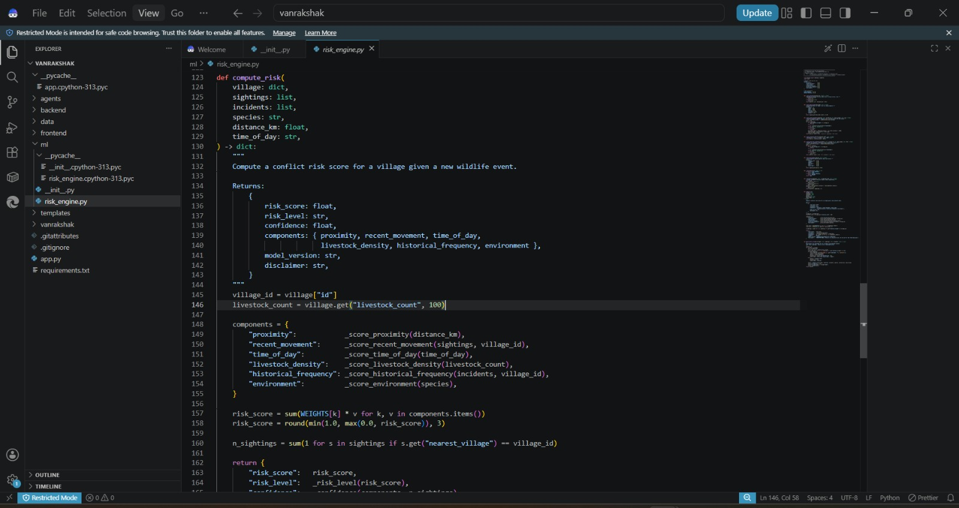
IBM Bob Screenshots -
Risk engine (risk_engine.py) — explainable weighted-component conflict risk scoring logic built with IBM Bob.

Slide 10
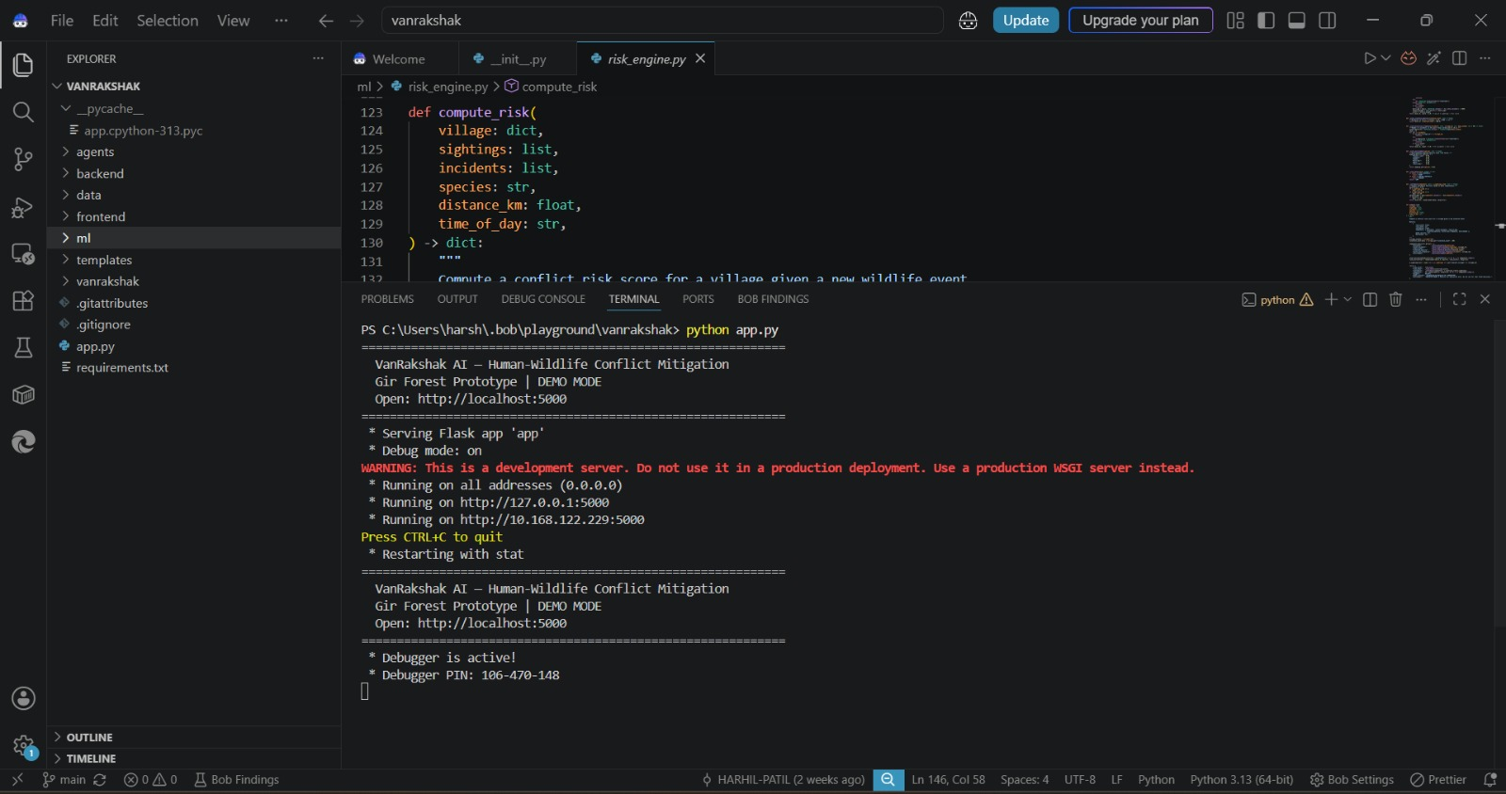
IBM Bob Screenshots -
Application execution evidence — Flask development server running the VanRakshak prototype on localhost:5000.

Slide 11
Role of Agentic AI in the Solution -
Agentic AI transforms VanRakshak AI from a passive monitoring system into a proactive, coordinated decision-support platform. Instead of a single chatbot, five specialized agents collaborate through a Central Orchestrator to move from prediction to action while keeping humans in control.
Human-in-the-Loop
Forest officers approve or override AI recommendations before any consequential action is taken.
Why Agentic AI?
Proactive • Context-Aware • Multi-Agent • Explainable • Human-Supervised • Goal-Driven
PERCEIVE
↓
REASON
↓
COLLABORATE
(5 Agents)
↓
ORCHESTRATE
↓
HUMAN
APPROVAL
↓
LEARN
Predict → Alert → Coordinate → Human Review → Respond → Learn

Slide 12
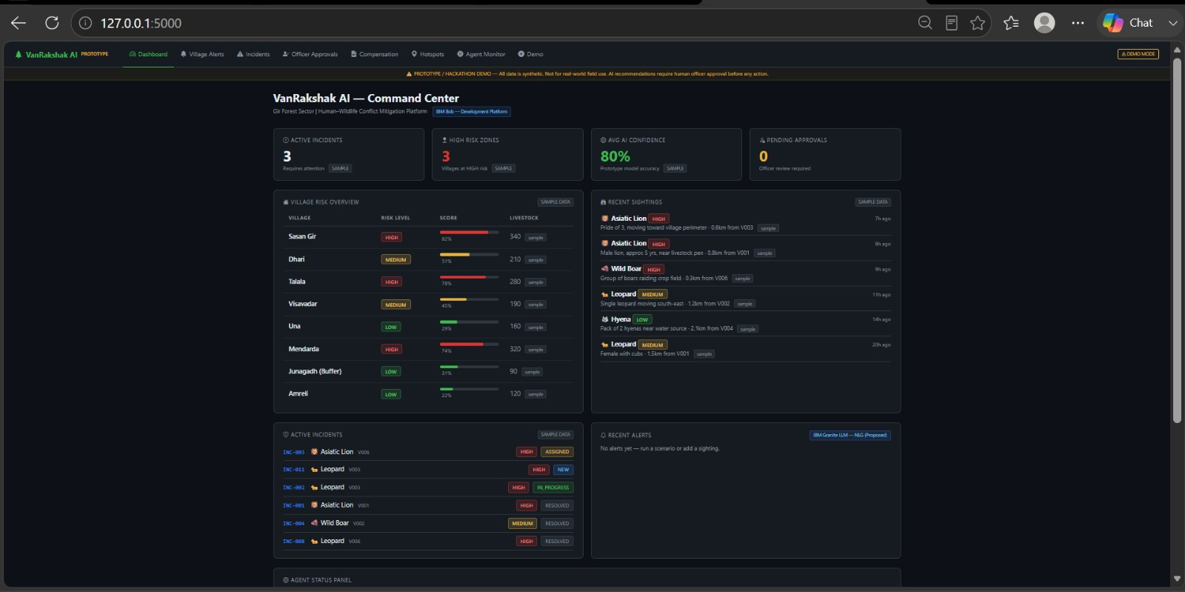
Project Output Screenshot -
Command Center — Dashboard
Village risk overview, active incidents, and recent sightings feeding the PREDICT stage of the workflow.

Slide 13
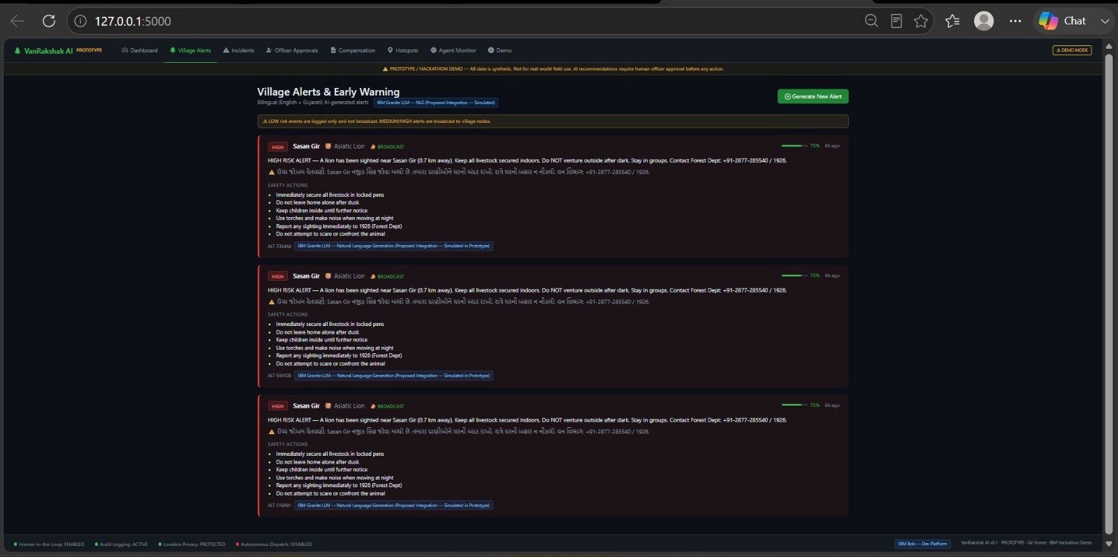
Project Output Screenshot -
Village Alerts

Slide 14
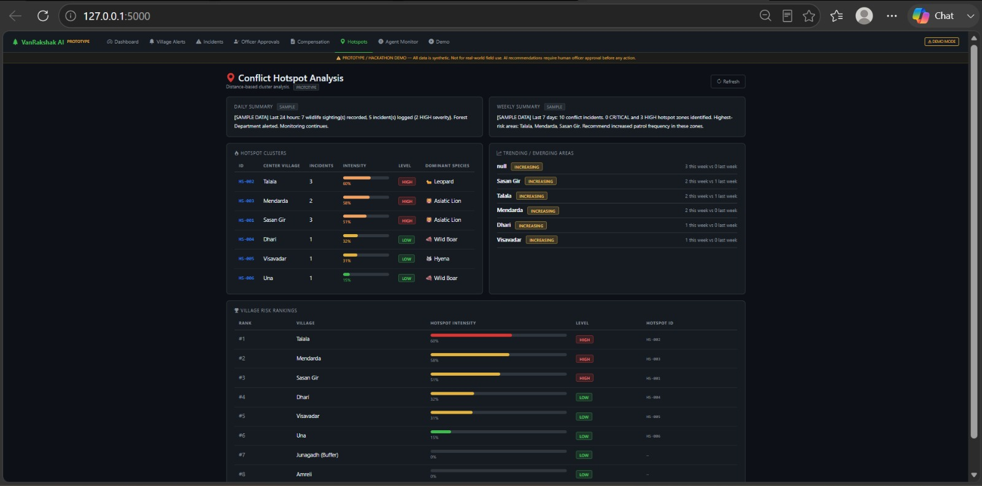
Project Output Screenshot -
Conflict Hotspot Analysis
Distance-based cluster analysis identifying recurring and emerging high-risk villages.

Slide 15
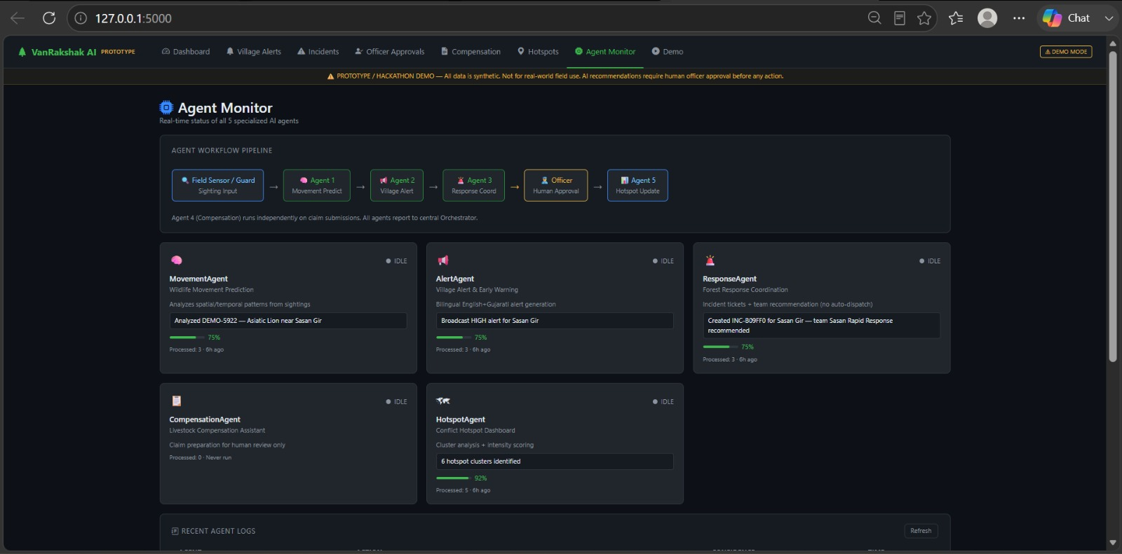
Project Output Screenshot -
Agent Monitor
Real-time status of all 5 specialized agents and the human officer-approval checkpoint in the pipeline.

Slide 16
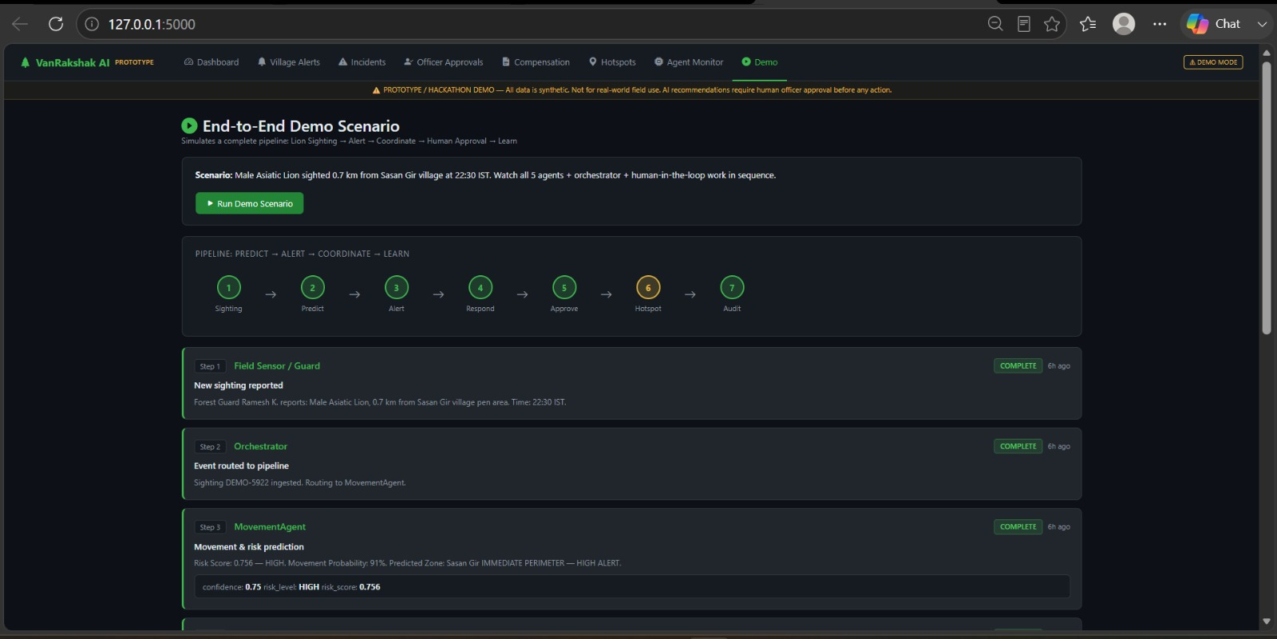
Project Output Screenshot -
End-to-End Demo Scenario
Full pipeline walkthrough: Sighting → Predict → Alert → Coordinate → Approve → Hotspot → Audit.

Slide 17
Novelty and Uniqueness -
What makes VanRakshak AI different?
1. Multi-Agent Intelligence
Five specialized agents collaborate through a Central Orchestrator instead of relying on a single chatbot.
2. Predictive Risk Intelligence
Combines ML-based movement analysis + explainable weighted risk scoring to identify potential conflict before it escalates.
3. Human-in-the-Loop AI
AI recommends; forest officers decide. Alerts, response recommendations, and compensation actions remain subject to human approval.
4. End-to-End Conflict Workflow
Sighting → Prediction → Alert → Incident → Response → Compensation → Learning.
5. Local & Actionable Alerts
Generates concise English + Gujarati safety warnings designed for real-world community action.
6. Closed-Loop Learning
Incident outcomes and new sightings become feedback for future risk analysis and hotspot detection.
Our USP
“From Reactive Wildlife Response to Predictive, Coordinated & Human-Supervised Conflict Mitigation.”
Explainable ML • Agent Collaboration • Human Governance • Privacy-Aware • Prototype-Ready

Slide 18
Future Scope -
From prototype to real-world forest intelligence
01 | Real-Time Wildlife Sensing
Integrate camera traps, GPS/radio collars, drones, IoT sensors and GIS data to continuously improve wildlife movement prediction and conflict-risk detection.
02 | Multilingual & Voice Alerts
Enable Gujarati voice + multilingual notifications through mobile / SMS / IVR channels, making warnings accessible to villagers and field teams.
03 | Smart Forest Command Center
Connect authorized Forest Department systems for real-time incident reporting, response-team coordination, hotspot monitoring and officer approvals.
04 | Continuous AI Learning
Use verified incident outcomes, new sightings and seasonal patterns to improve risk prediction, hotspot detection and false-alarm reduction.
Vision: Sense → Predict → Alert → Coordinate → Learn — built as a prototype today, designed to evolve into a secure, human-supervised AI platform for large-scale wildlife conflict mitigation.

Slide 19
GitHub Link -
Please create a public GitHub repository (enable the “Add README” option while creating the repository) and paste the working GitHub URL below.
GitHub URL – github.com/HARHIL-PATIL/vanrakshak

Slide 20
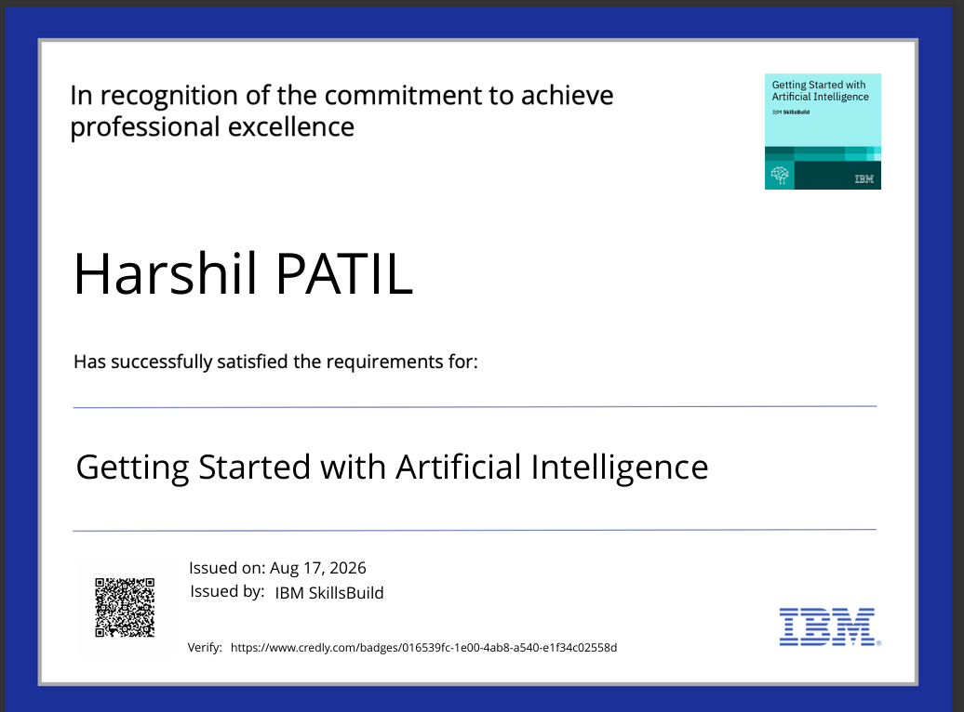
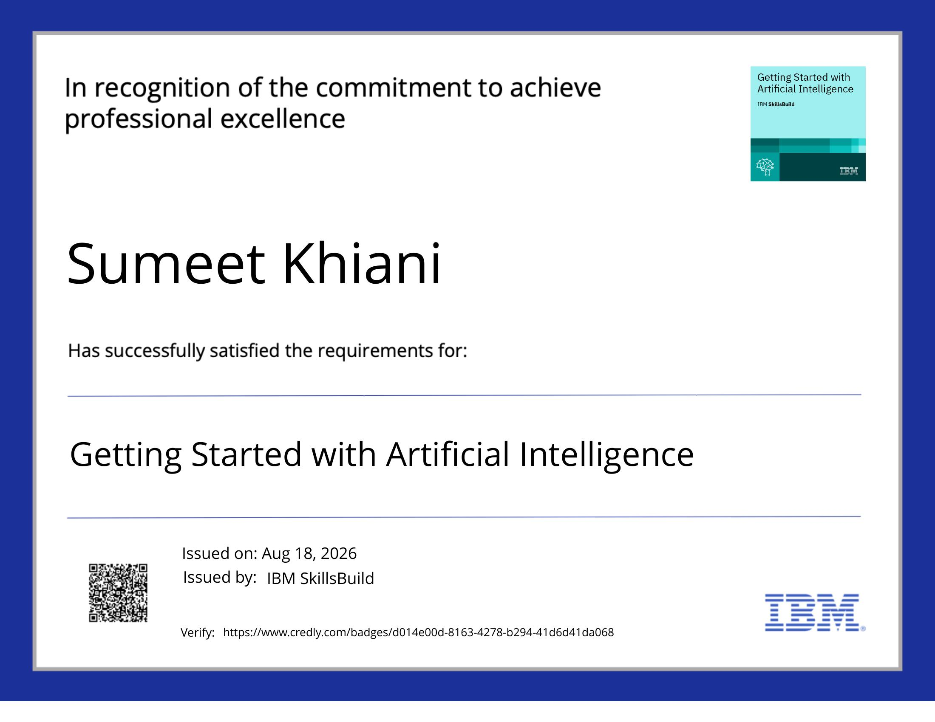
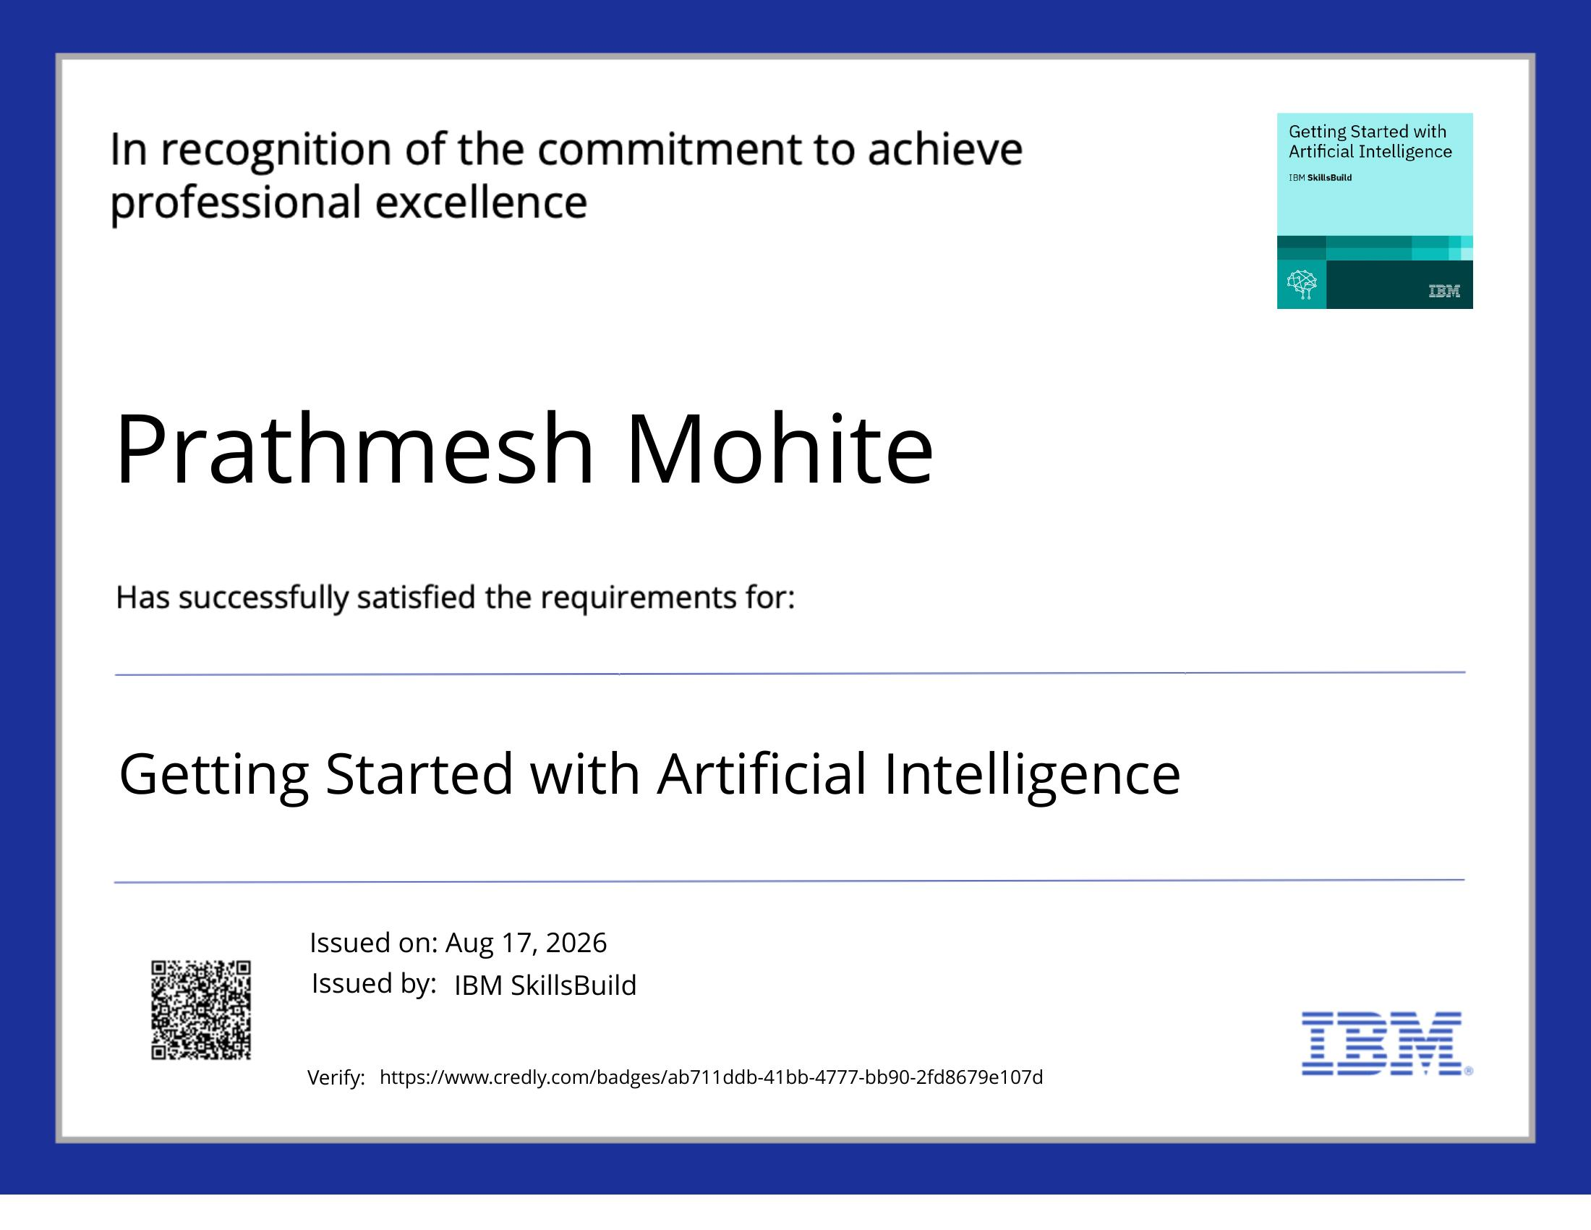
Certificates Earned -
Getting Started with Artificial Intelligence
Harshil Patil
Sumeet Khiani
Prathmesh Mohite

Slide 21
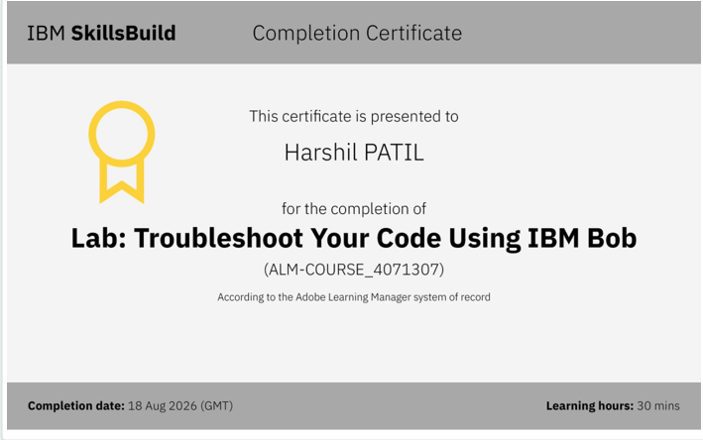
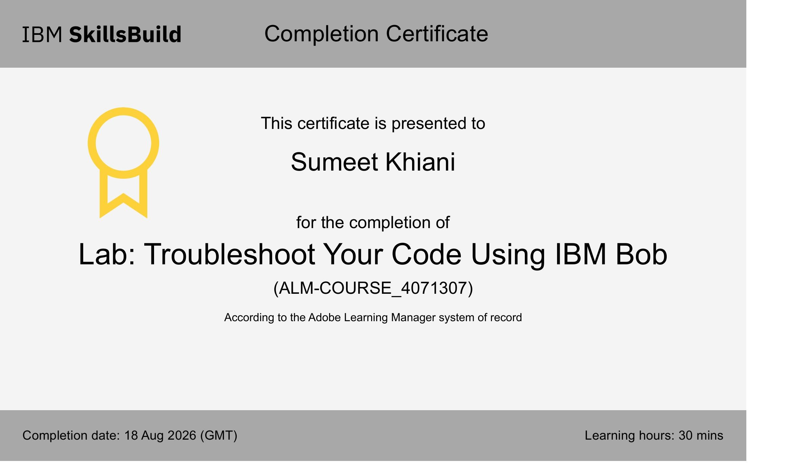
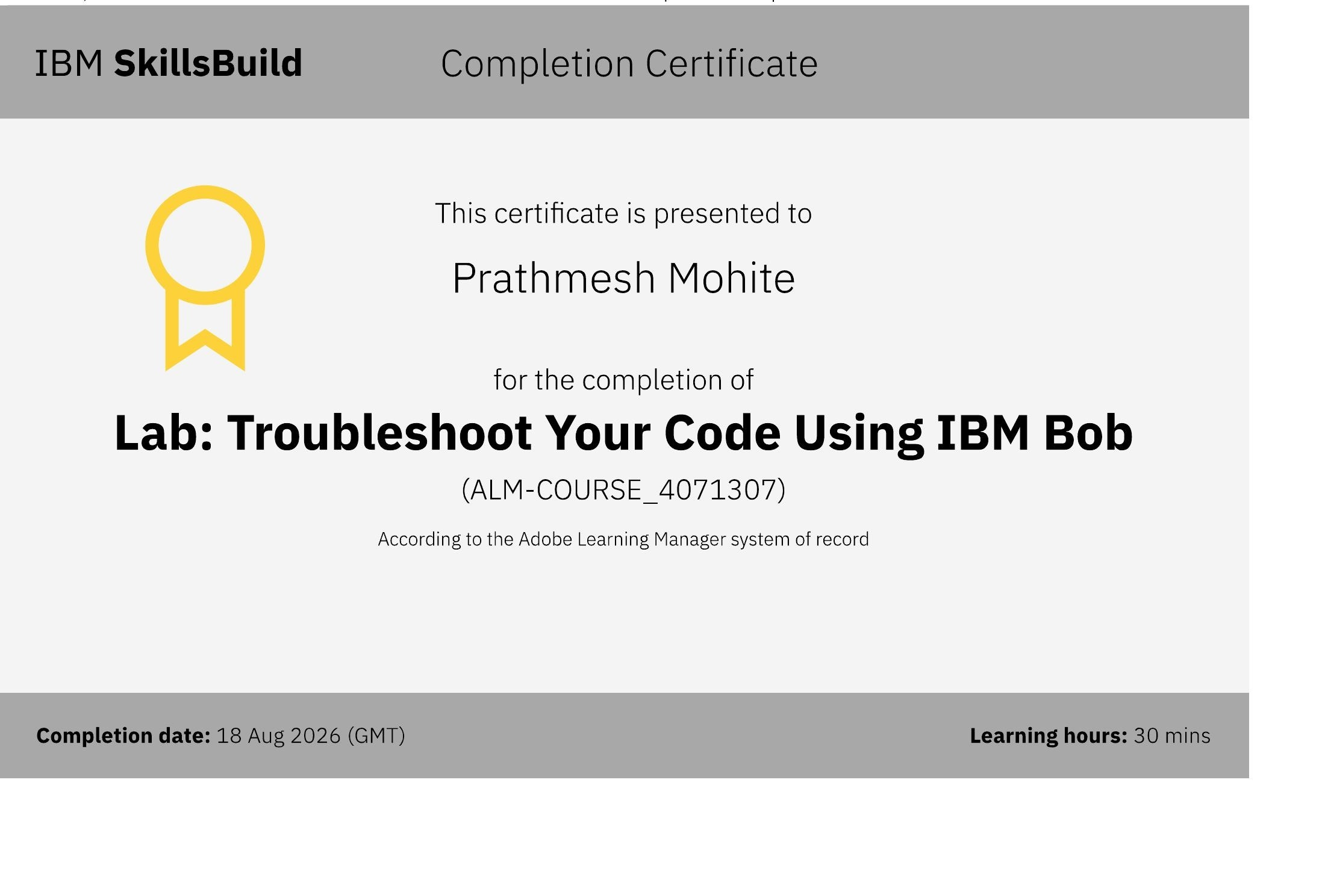
Certificates Earned -
Lab: Troubleshoot Your Code Using IBM Bob
Harshil Patil
Sumeet Khiani
Prathmesh Mohite

Slide 22
Thank You!
Thank you for your time and interest.
VanRakshak AI — Team Harshil Patil, Sumeet Khiani, Prathmesh Mohite

