Slide 1


HACK NEXUS 2026
  Problem Statement ID : PS-07
  Problem Statement Title- Offline Micro-Payment Infrastructure
  Theme - FinTech & Security
  Institution - National Forensic Sciences University
  Team Name - BobTheBuilder
  Project - ShadowPay
01

Slide 2

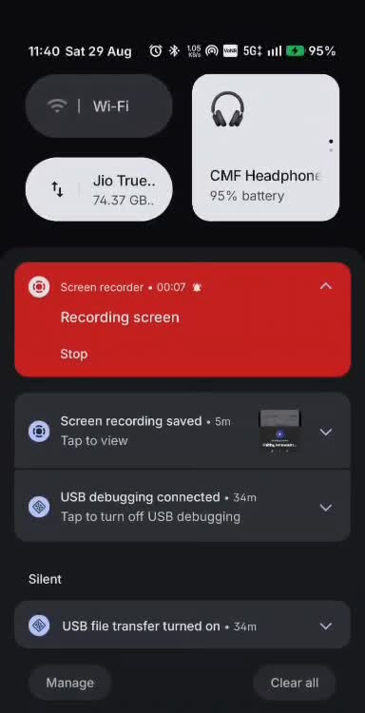
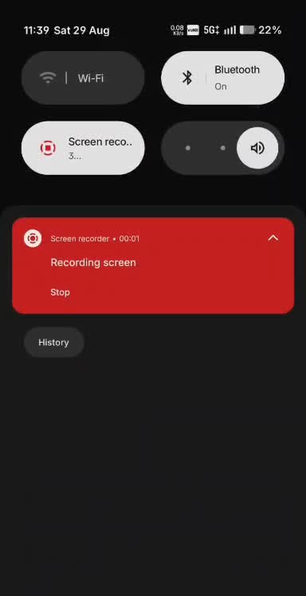
GODSEC
Zero-Trust Offline Payment Infrastructure For Secure Offline Transactions
# Critical Problem :
# Signal dead zones are everywhere:
  Metro tunnels, basements, bad weather, crowded stadiums, and parking lots have zero or unstable connectivity.
➡ No signal = No payment. The transaction dies before it starts.
# Backend servers fail unpredictably
  Bank gateways crash, payment processors go down for maintenance, and peak-hour traffic overloads the system.
➡ Even with full 5G, the payment fails because the server is dead.
# Offline transactions are completely blind
  No real-time balance check, no fraud scoring, no ability to revoke or cancel a suspicious payment.
➡ We are approving payments in the dark – with zero visibility into risk.
# Why This Matters? #
Digital India cannot afford "online-only" payments
The government's vision of a cashless economy collapses if payments fail the moment the internet flickers.
# Offline payments are not a luxury—they are a necessity for a truly digital nation.
2
Notes:
2

Slide 3

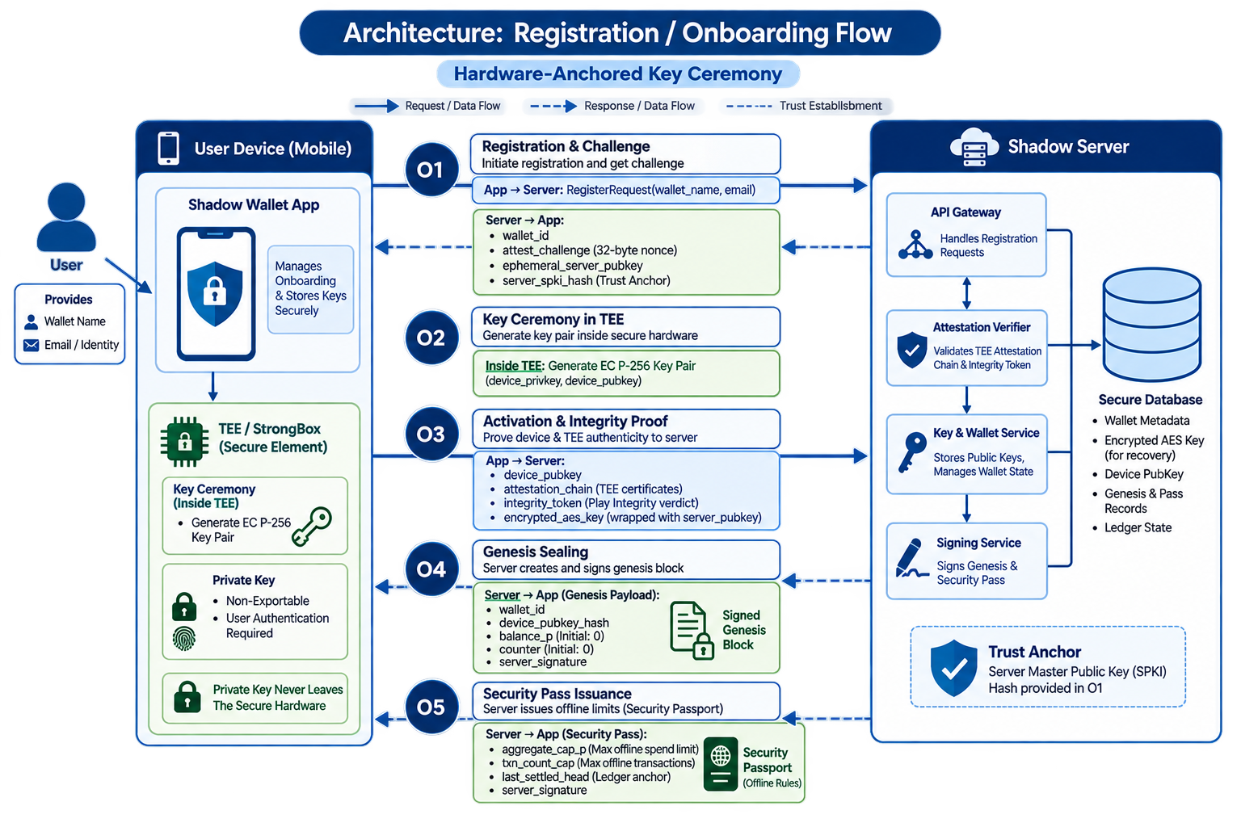
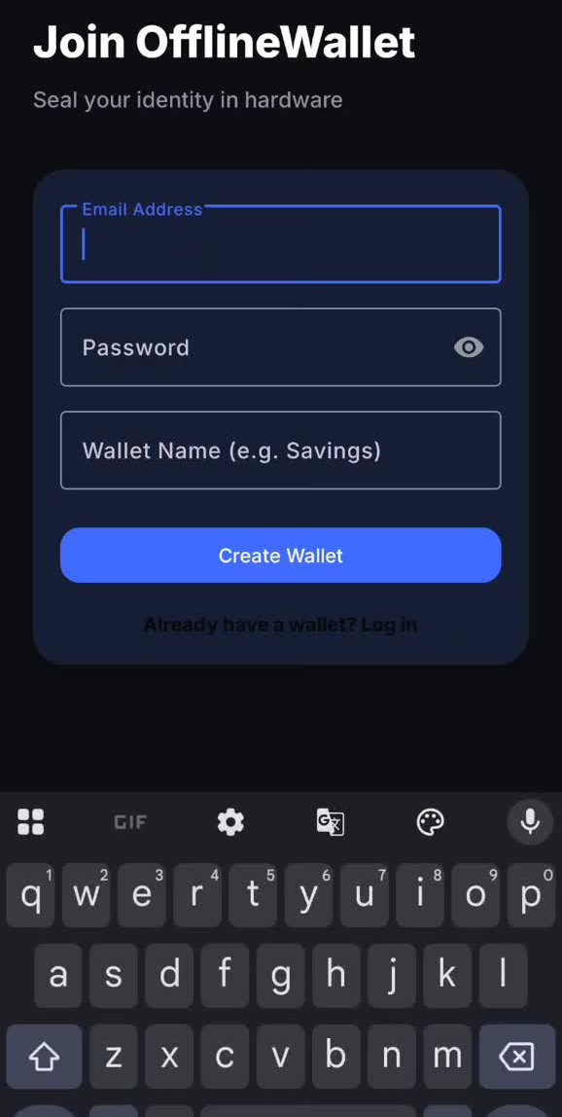
TECHNICAL APPROACH
GODSEC
3
Notes:
3

Slide 4
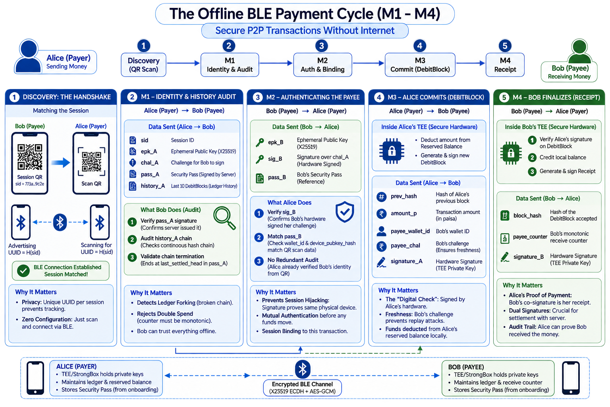
TECHNICAL APPROACH
GODSEC
Bob
Alice
3
Notes:
3

Slide 5
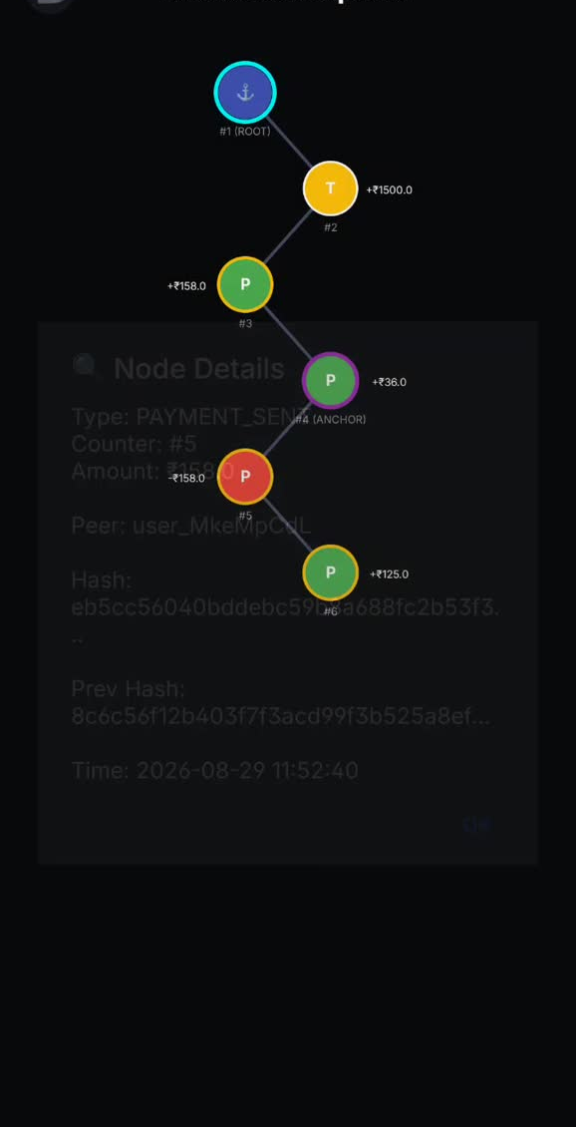
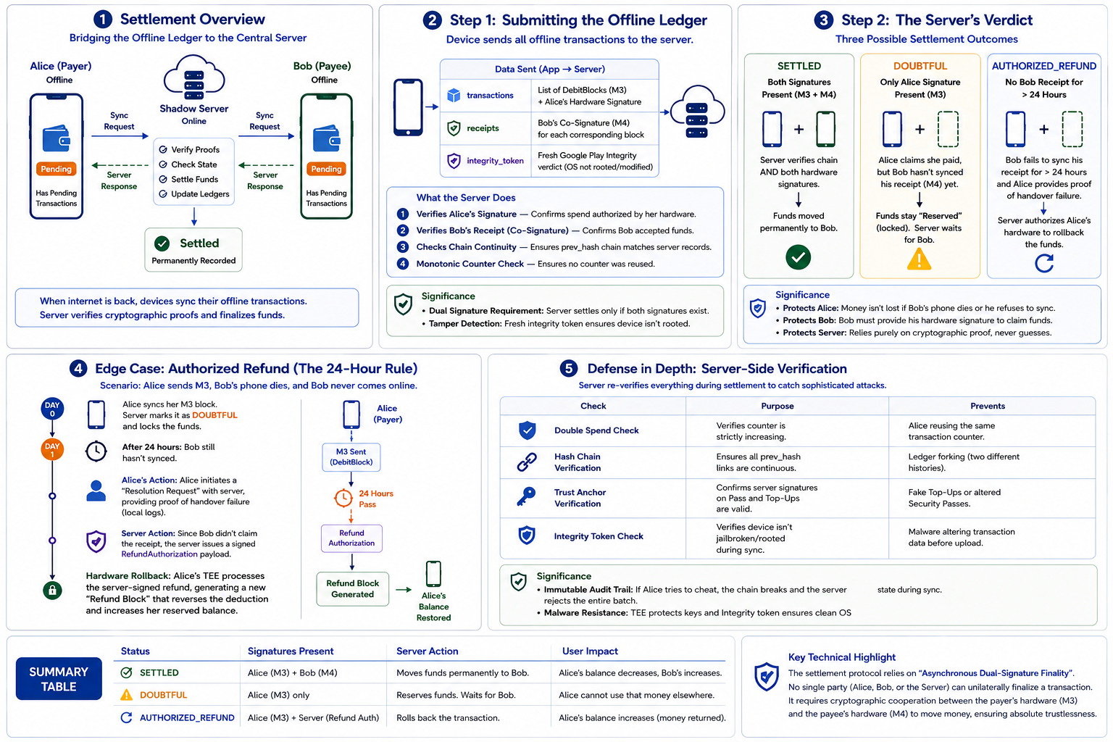
TECHNICAL APPROACH
GODSEC
3
Notes:
3

Slide 6


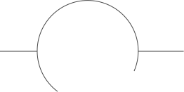





























FEASIBILITY AND VIABILITY
GODSEC
Immediate Problem Solving
# Technically
Feasible
# Feasibility #
Instantly enables digital payments when network and backend servers fail—solving the "no network = no payment" problem in seconds.
off-the-shelf hardware + proven crypto
# Security Feasible
1
Trust in Information
Hardware co-signing kills double-spend offline
2
Builds trust through hardware-anchored cryptography and on-device blockchain auditing—ensuring funds are always verifiable, even offline.
Viability
# Operationally Feasible
Potential for success by
addressing key challenges
effectively.
3
Leveraging Existing Behavior
Utilizes familiar actions like scanning QR codes, tapping phones (NFC), and Bluetooth connectivity—zero new user behavior required.
₹2,000 cap + stateless backend = low‑cost scale.
4
Disaster-Resilient Value
5
Provides life-saving transaction capability during natural disasters, network outages, and crowded events where digital payments typically fail.
Empowerment and Inclusion
# Potential Challenges#
Empowers unbanked and under-connected populations by enabling digital payments without requiring constant internet access or expensive infrastructure.
Strategies to overcome the challenge
# The “Middle-Node Tampering”
Immutable Hash-Chaining: Every transaction is a "block" linked to the previous one via its SHA-256 hash. If any field in any block is modified (even one byte), the hash changes, breaking the entire chain
What if a malicious node intercepts a transaction record and alters the amount, payee, or timestamp before it syncs to the server?
Dual-Sided Hardware Attestation: During the NFC/BLE handshake, both phones exchange "Security Passes" signed by the server—containing a "Hardware Tier".
# Trustless Handshake
How does Bob know Alice's phone hasn't been hacked to show a fake balance?
Server-Side Reconciliation Timeout: If the payee fails to upload the matching co-signed block to the server within 30 days, the server automatically invalidates the reservation. The funds are restored to the payer's main balance when they activate a new device—ensuring zero permanent loss of money.
# Device Loss or Theft
If a user's phone is lost, stolen, or broken during an offline handshake—reserved funds are trapped in the secure hardware, potentially lost forever.
4
Notes:
4

Slide 7
IMPACT AND BENEFITS
GODSEC
# Our Transformative Impact #
# Benefits:#
# Unlocking “Dead-Zone” Economices
# Zero-Failure Assurance (For user)
The Shift: High-friction environments (underground metros, remote rural areas, crowded stadiums) transform into active digital markets.
The Impact: Democratizes digital payments—ensuring users with the poorest network coverage have the same transaction reliability as those in high-speed 5G zones.
The Value: Eliminates "Payment Anxiety"—the fear of a transaction failing while standing in a long line.
The Result: 100% success rate at the point of sale, regardless of signal bars or server maintenance schedules.
# Focus on Eliminating Single Point of Failure
# Fraud Prevention
The Shift: The system moves from “always online, sometimes broken” to “sometimes offline, always working.”
The impact: Eliminates the server as a single point of failure - payment works anywhere, regardless of cloud connectivity .
The Value: Hardware-Anchored Counters and Play Integrity make it virtually impossible to fake or copy digital cash.
The Result: Exceeds the security of standard online wallets—private keys never leave the phone's physical Secure Element (StrongBox).
# Redefining the “Digital Tap”
# Instantaneous Checkout Speed
The Value: Removes the "waiting for SMS" or "waiting for bank confirmation" delay (typically 10–20 seconds).
The Result: Merchants process 3× more customers during peak hours—because the Shadow protocol confirms the payment locally in under 1.5 seconds.
The Shift: A phone tap currently only starts an online process. In our project, a "Tap" is a complete hardware handshake.
The Impact: Transforms the NFC antenna into a secure bridge that handles complex blockchain audits and fund transfers in milliseconds.
Notes:
5

Slide 8
RESEARCH AND REFERENCES
GODSEC
Comparison with Existing Systems
References
Parameter
Our System (Shadow Protocol)
UPI Lite X (NPCI)
RBI Offline Framework
ElasticPay (IIT Indore)
Crunchfish Digital Cash
•
RBI Circular: Offline Small-Value Digital Payments
Payment Type
P2P (Person-to-Person) + P2M
P2P + P2M (NFC phones/QR)
P2M (Cards/Wallets)
P2P
P2P + P2M
•
UPI Lite Offline Payment Limits – TaxGuru
Hardware Security
StrongBox/TEE – keys never leave hardware
None (software wallet)
None specified
TPM + TEE + SE
TEE-based wallets
•
RBI Offline Framework Amendment – TeamLease RegTech
Offline Verification
Atomic Co-Signing – both parties sign same block
Deferred settlement via PoS
Deferred settlement
Immediate settlement
Deferred (IOUs)
•
RBI Offline Digital Payments Framework Update – Casansaar
•
UPI Lite X: Offline Payment Limits & How It Works – PhonePe
Double-Spend Protection
Hardware monotonic counter – prevents rollback
Server reconciliation
Server reconciliation
Hardware-enforced
IOU-based reconciliation
•
ElasticPay: Offline Digital Payments System – Research Matters
Fraud Detection
Real-time local audit (walkBack) – before payment
Post-sync detection
Post-sync detection
Hardware-enforced
Post-sync detection
•
Crunchfish Digital Cash
Max Offline Limit
Configurable (default ₹2,000)
₹2,000 balance
₹500/txn, ₹2,000 total
Not specified
Not specified
Infrastructure Required
None – two phones only
NFC phones + certified terminals
Cards/Wallets/Pos
Secure hardware (TPM/TEE/SE)
Payment network integration
Channel
NFC (bootstrap) + BLE (data)
NFC only
Proximity mode
NFC + hardware
Multiple
6
Notes:
6

