Slide 1
VENDING MACHINE
A.HARIBABU_IT

Slide 2
OBJECTIVE
The reason behind making this project:
To reduce Shopkeeper’s work and to save time.
Eg. By using this project, they can able to do another work simultaneously.

Slide 3
Solution Description
The project involves selecting products from the list , adding them to cart, paying amount with QR code and get product from the machine.
Using this we can buy things by self without any vendor’s help.

Slide 4
Project Timeline
Overall Time taken is 5 days. Creating Frontend takes 3 days and for creating Backend takes 2 days.
Frontend Tools used are HTML, CSS and Backend Tool Used is JavaScript.
Some YouTube channels that I was referred are,
Error makes clever academy,
Tutor Joe’s.

Slide 5
Future Work
My future work for this project will be:
Displaying the selected product name & price on screen,
Including total amount on Payment page.

Slide 6
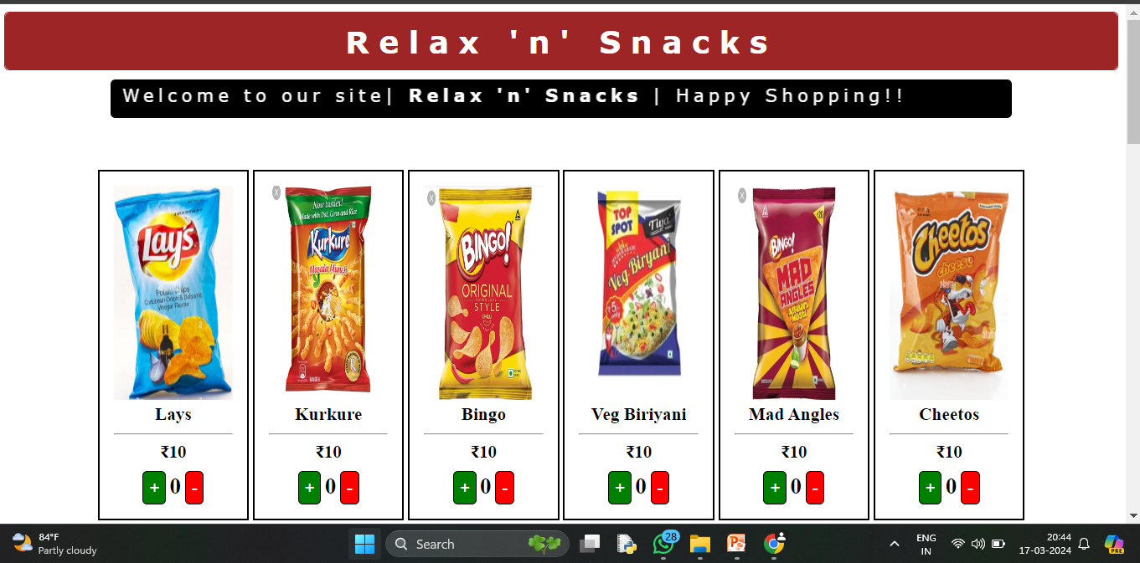
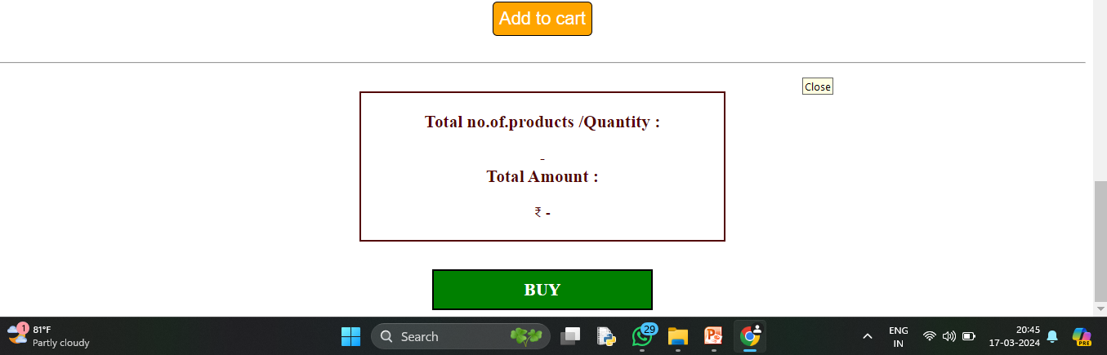
Results and Outcomes

