Slide 1

ACADEMIC YEAR 2026 - 2027
S5 PROJECT WORK I | SECOND REVIEW
INTELLIGENT MULTI-AGENT FRAMEWORK FOR
AUTOMATED SOFTWARE TESTING AND BUG ANALYSIS
(SentinelMesh)
BIT PROJECT ID
S5-CSE-2026-195
CATEGORY
INTERNAL - OWN PROJECT
BATCH MEMBERS
Hariesh P (7376241CS195) - Dept. of CSE
Midhum M (7376242AL152) - Dept. of AIML
PROJECT GUIDE
Ms. Ramya R (CS1906)
Assistant Professor
Dept. of Computer Science and Engineering

Slide 2
PROJECT WORK PLAN
Phase 1 - Problem Analysis & Literature Survey (Weeks 1-2)
Identified limitations in manual software testing and defect triage workflows.
Reviewed static analysis, mutation testing, and multi-agent coordination research.
Phase 2 - Architecture & Agent Design (Weeks 2-3)
Designed 9-agent coordination graph: Orchestrator, Static Analysis, Test Generation,
Test Execution, Bug Classification, Root Cause, Auto-Fix, Critic, Report agents.
Phase 3 - Implementation (Weeks 3-5)
Implemented AST-based analysis, test synthesis, sandbox execution, and reporting.
Integrated FastAPI backend, SQLite/SQLAlchemy, and React mission-control dashboard.
Phase 4 - Validation & Documentation (Weeks 6-7)
Validated: 37/37 tests passing, 85% platform code coverage.
Prepared full academic project report and Second Review presentation.

Slide 3
EFFECTIVE UTILIZATION OF MODERN TOOLS
Python 3.11+
Core agent logic, AST parsing, sandboxed test execution, and backend services.
FastAPI + Uvicorn
RESTful API gateway, WebSocket communication, and health-monitoring endpoints.
Python AST Module
Structural code parsing, cyclomatic-complexity scoring, security-smell detection.
SQLite + SQLAlchemy ORM
Persistent storage of analysis results, test records, patch history, agent state.
React 18 (Vite)
Mission-control dashboard: real-time telemetry, risk heat-map, report viewer.
pytest + coverage.py
37/37 automated tests passing; 85% platform code coverage measured.
Subprocess Sandbox
Isolated test execution with 20-second timeout and archive-size controls.
Git + GitHub
Version control - github.com/HARIESHPERIASAMY/S5_Mini_Project

Slide 4
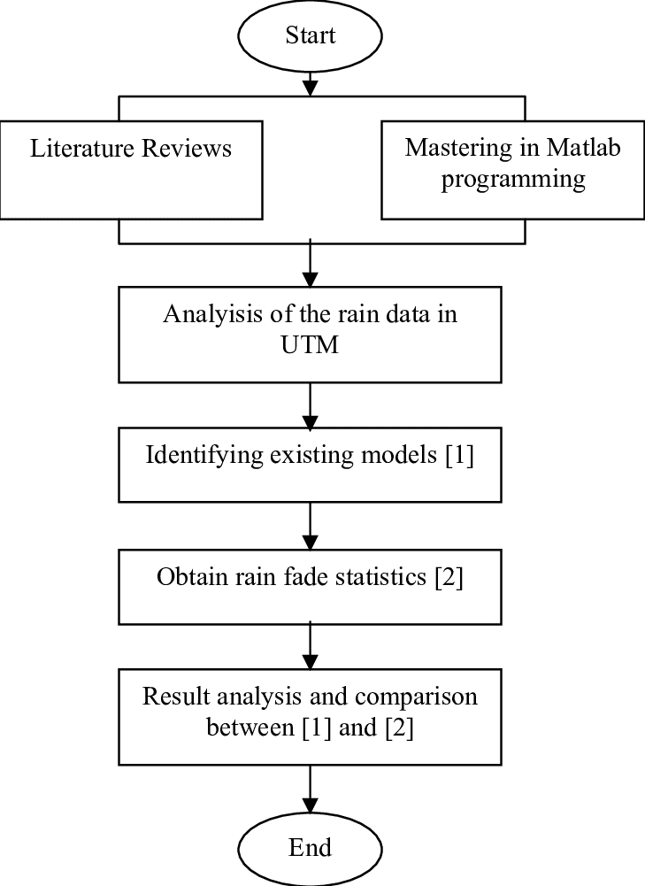
PROPOSED METHODOLOGY (FLOW CHART)

Slide 5
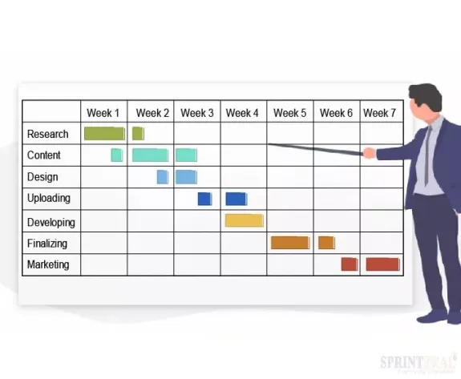
PROPOSED METHODOLOGY (GANTT CHART)

Slide 6
SYSTEM MODULES
1. Orchestrator Agent
Manages execution graph, agent retries, and lifecycle state transitions.
2. Static Analysis Agent
AST parsing, cyclomatic complexity, security-smell detection, risk scores per file.
3. Test Generation Agent
Prioritised unit, boundary, edge-case, and property-based pytest case generation.
4. Test Execution Agent
Runs tests in isolated subprocess sandbox; tracks coverage and flaky-test flags.
5. Bug Classification Agent
Labels defect type, severity level; detects duplicate findings.
6. Root Cause Agent
Maps stack traces to source locations; generates causal explanations.
7. Auto-Fix Agent
Proposes unified-diff patches; verifies by re-running tests in sandbox.
8. Critic / Reviewer Agent
Challenges findings via debate; computes consensus quality score.
9. Report Agent
Builds executive & technical reports; streams telemetry to React dashboard.

Slide 7
ADVANTAGES AND DISADVANTAGES
ADVANTAGES
Nine specialised agents divide testing tasks - no single point of failure.
AST-based static analysis provides deep source-level risk signals.
Subprocess sandbox limits execution time (20 s) and extraction size.
Patch proposals are re-tested in sandbox before being marked verified.
Structured JSON reports and risk heat-map improve review visibility.
Offline deterministic fallback - works without a cloud LLM provider.
37/37 tests passing; 85% platform code coverage validated.
LIMITATIONS
Static and test-generation rules are currently Python-focused.
Rule-based detectors may miss context-dependent or semantic defects.
LLM-assisted features depend on external API quotas (configurable).
Sandbox 20-second timeout may be insufficient for very large codebases.
Auto-generated tests do not guarantee complete path/branch coverage.
Multi-language support (Java, C++) is planned future work.

Slide 8
CONCLUSION
SentinelMesh demonstrates that multi-agent coordination can automate the full
software quality lifecycle - from static analysis to sandbox-verified auto-fix.
Nine dedicated agents collaborate via an event-driven bus without tight coupling,
enabling independent extensibility and testing of each component.
FastAPI backend, SQLite persistence, sandboxed execution, and a React dashboard
provide a production-grade foundation for local-first quality engineering.
Validated result: 37/37 automated tests passing; 85% platform code coverage.
Future directions: multi-language analysis (Java, C++, Go), cloud deployment,
LLM-augmented patch generation, and cross-repository trend analytics.
Outcome:
A fully traceable workflow from source-code submission to structured bug evidence,
root-cause explanation, sandbox-verified patches, and exportable executive report.

Slide 9
COST BENEFIT ANALYSIS
Background should be White in all slides
Font
  Cambria
  Font Size & Colors
    Headings – Blue – UPPER CASE – Bold ( Font Size 24)
    Subheadings Maroon / Violet / Green - Sentence Case- Bold ( Font Size 24)
    Black for Contents ( Font Size 20)

Slide 10
INDIVIDUAL CONTRIBUTIONS TO THE WORK
Member 1 : HARIESH P (7376241CS195) - Dept. of CSE
1. Designed overall system architecture and 9-agent coordination graph.
2. Implemented Orchestrator, Static Analysis, Bug Classification & Root Cause agents.
3. Developed FastAPI backend: API gateway, WebSocket endpoints, health checks.
4. Built SQLAlchemy ORM models, database schema, and migration scripts.
5. Wrote 37 automated unit and integration tests; achieved 85% code coverage.
6. Authored full academic project report and Second Review documentation.
7. Managed Git repository and maintained clean commit history on GitHub.

Slide 11
INDIVIDUAL CONTRIBUTIONS TO THE WORK
Member 2 : MIDHUM M (7376242AL152) - Dept. of AIML
1. Implemented Test Generation, Test Execution, and Auto-Fix agents.
2. Designed and integrated the subprocess sandbox with timeout & size controls.
3. Developed Critic / Reviewer Agent for consensus scoring and debate logic.
4. Built Report Agent and executive / technical report generation pipeline.
5. Developed React 18 (Vite) mission-control dashboard with real-time telemetry.
6. Integrated frontend with backend WebSocket streams and risk heat-map.
7. Assisted in validation testing, debugging, and Second Review preparation.

Slide 12
SYSTEM ARCHITECTURE OVERVIEW
SYSTEM ARCHITECTURE OVERVIEW
Client Layer
React 18 dashboard: repository upload, live agent log, risk heat-map, report download.
API Gateway
FastAPI + Uvicorn: REST endpoints, WebSocket streams, CORS, request validation.
Agent Orchestration Layer
Event-driven bus coordinates 9 agents with retry, timeout, lifecycle management.
Analysis & Execution Layer
Python AST engine, pytest runner, unified-diff patch applier, subprocess sandbox.
Persistence Layer
SQLite + SQLAlchemy ORM: analysis sessions, test records, patches, agent logs.

Slide 13
STATUS ON PARTIAL COMPLETION AND SUBMISSION OF PROJECT REPORT
List of Documents to be Submitted
SL. No. | List of Documents | Status
1 | Cover Page & Title Page | Completed
2 | Bonafide Certificate | Completed
3 | Declaration | Completed
4 | Acknowledgement | Completed
5 | Chapter I - Introduction | Completed
6 | Chapter II - Literature Survey | Completed

Slide 14
SUBMISSION OF PROJECT REPORT
List of Documents to be Submitted
SL. No. | List of Documents | Status
7 | Chapter III - Objectives & Methodology | Completed
8 | Chapter IV - Proposed Work Modules | Completed
9 | Chapter V - Results and Discussion | Completed
10 | Chapter VI - Conclusions & Future Work | Completed
11 | References (IEEE format, 28 entries) | Completed
12 | Appendices A - F | Completed

Slide 15
PUBLICATIONS (CONFERENCE / JOURNAL / PATENT)
SL. No. | Paper / Manuscript Title | Status
1 | Manuscript in preparation: SentinelMesh - Multi-Agent Automated Software Testing using AST Analysis and Sandboxed Execution | In progress
2 | No conference/journal/patent submitted as of Second Review date. | -

Slide 16
ORIGINALITY SCORE
SL. No. | Tool Name for Checking Originality Score | Status / Score / Link
1 | Turnitin / iThenticate | Pending - to be submitted before final viva
2 | Grammarly Plagiarism Checker (secondary) | Pending

Slide 17
REFERENCES
[1] HARIESHPERIASAMY, S5_Mini_Project - SentinelMesh, GitHub, 2026. https://github.com/HARIESHPERIASAMY/S5_Mini_Project
[2] Python Software Foundation, ast - Abstract Syntax Trees, Python 3.11 Docs. https://docs.python.org/3/library/ast.html
[3] T. Ramirez, FastAPI Documentation, Tiangolo, 2024. https://fastapi.tiangolo.com/
[4] Pytest Development Team, pytest Documentation, 2024. https://docs.pytest.org/
[5] SQLAlchemy Authors, SQLAlchemy Documentation, 2024. https://docs.sqlalchemy.org/
[6] React Authors, React 18 Documentation, Meta Open Source, 2024. https://react.dev/
[7] M. Wooldridge and N. Jennings, Intelligent Agents: Theory and Practice, Knowledge Engineering Review, vol.10, no.2, pp.115-152, 1995.
[8] A. Zeller, Why Programs Fail: A Guide to Systematic Debugging, 2nd ed., Morgan Kaufmann, 2009.
[9] P. Ammann and J. Offutt, Introduction to Software Testing, 2nd ed., Cambridge University Press, 2016.
[10] S. Yoo and M. Harman, Regression Testing Minimisation, Selection and Prioritisation: A Survey, STVR, vol.22, no.2, pp.67-120, 2012.
[11] G. Fraser and A. Arcuri, EvoSuite: Automatic Test Suite Generation for Object-Oriented Software, in Proc. FSE, 2011, pp.416-419.
[12] R. Feldt et al., Finding test data in existing code, in Proc. ICSME, 2013, pp.1-10.
[13] M. Harman and B. Jones, Search-based software engineering, Information & Software Technology, vol.43, no.14, pp.833-839, 2001.

