Slide 1


K.RAMAKRISHNAN COLLEGE OF TECHNOLOGY
(AUTONOMOUS), TRICHY.
AUCTION MANAGEMENT SYSTEM
PRESENTED
R HARIHAR
2303811710421051
SUPERVISOR
Mr. M. Saravanan, M.E.,
AP/CSE.

Slide 2
PRESENTATION OVERVIEW
Objective
Project Introduction
Problem Statement
Methodologies (Programming concepts relevant to problem statement)
Architecture of the proposed system
List of Modules
Merits
Results and Discussion
Queries

Slide 3
OBJECTIVE
Develop an intuitive Auction Management System using Swing.
Enable sellers to list items and manage auctions.
Allow bidders to place competitive bids in real-time.
Ensure transparency and fair bidding by logging activities and validating inputs.
Simplify the auction process for efficient and user-friendly participation.

Slide 4
PROJECT INTRODUCTION
Implements an Auction Management System using Swing GUI.
Allows sellers to list items, set starting prices, and manage sales.
Enables bidders to place and compete for bids in real-time.
Maintains real-time updates of highest bids and bidders.
Keeps an integrated auction log for transparency and efficiency.

Slide 5
PROBLEM STATEMENT
Bid Tracking: Automatic and accurate tracking of all bids.
Real-time Updates: Instant notifications for bidders about the highest offers.
User-friendly Interface: Java Swing-based GUI for seamless interaction.
Transparency:Both sellers and bidders can view auction details and histories, promoting trust.
Efficiency: Reduces manual effort, minimizes errors, and accelerates the auction process.

Slide 6
METHODOLOGIES
GUI Design: Built with Java Swing for user-friendly interaction.
Data Storage: Used HashMap to manage items and bids.
Event Handling: Implemented ActionListeners for user actions.
Validation: Ensured correct input for bids and prices.
Real-Time Updates: Dynamic updates for bids and auction status.
Activity Logging: Maintained an auction log for transparency.

Slide 7
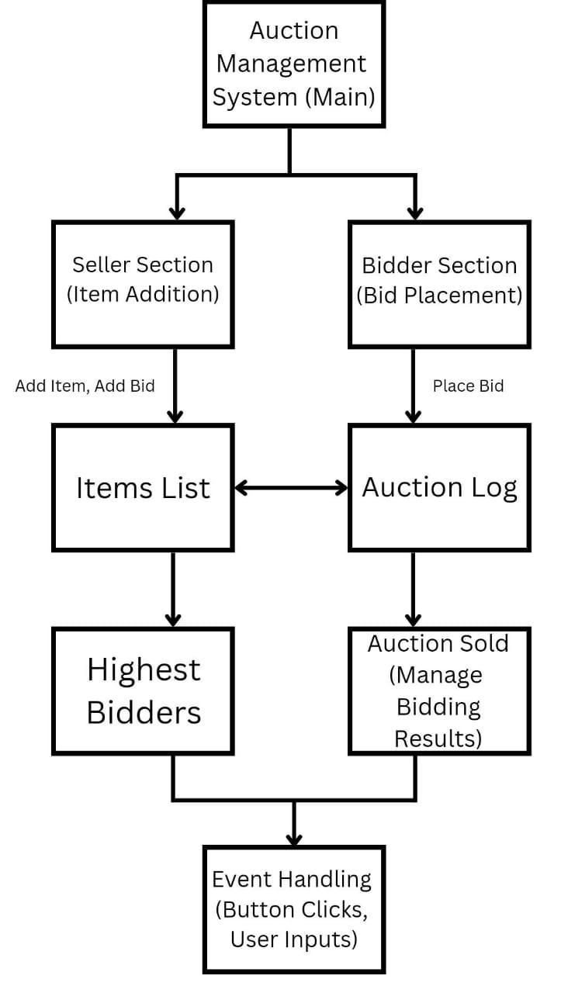
ARCHITECTURE OF THE PROPOSED SYSTEM

Slide 8
LIST OF MODULES
Seller Module: Lets sellers add and manage auction items, validate data, and finalize auctions by marking items as sold, updating the auction log. Bidder Module: Enables bidders to view items and place valid bids, ensuring they exceed the highest bid, with real-time auction log updates. Auction Log Module: Records all auction activities in real time, ensuring transparency with a read-only, chronological log of item additions, bids, and sales.

Slide 9
LIST OF MODULES
Data Management Module: Manages auction data using HashMaps for item prices and highest bidders, ensuring efficient updates and synchronization with other modules. GUI Module: Provides an interactive interface with Swing components, organized for easy navigation, and uses dialog boxes for feedback and error handling.

Slide 10
MERITS
User-Friendly Interface: Easy-to-use GUI for sellers and bidders. Real-Time Updates: Dynamic updates for bids and auction status. Error Handling: Validates inputs to ensure smooth operation. Transparency: Auction log ensures full transparency. Scalability: Easy to add more features in the future.

Slide 11
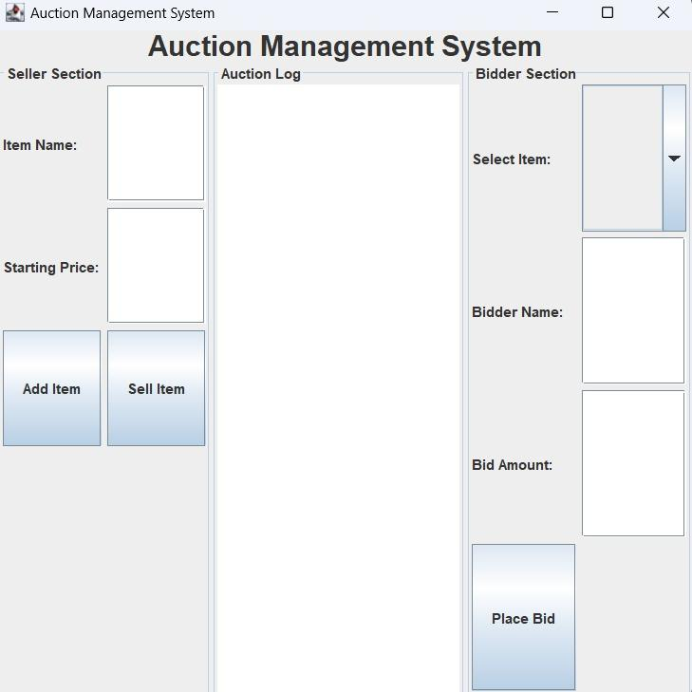
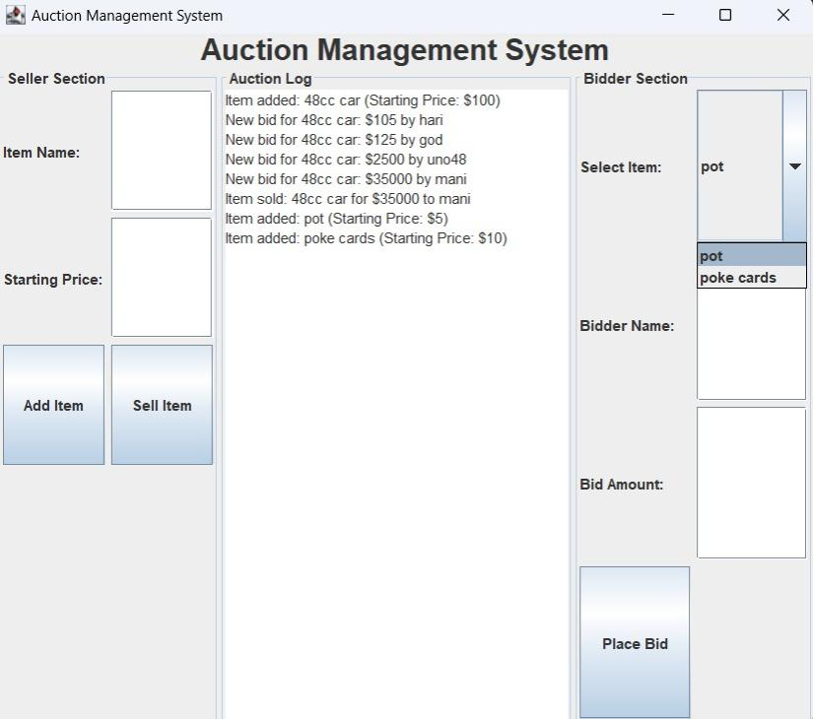
RESULTS AND DISCUSSION

Slide 12
QUERIES ?

