Slide 1
Create a chatbot in Python
Introduction:
•The challenge is to create a chatbot in Python.
•provides exceptional customer service, answering user queries on a website or application.
•The objective is to deliver high-quality support to users, ensuring a positive user experience and customer satisfaction.
•

Slide 2
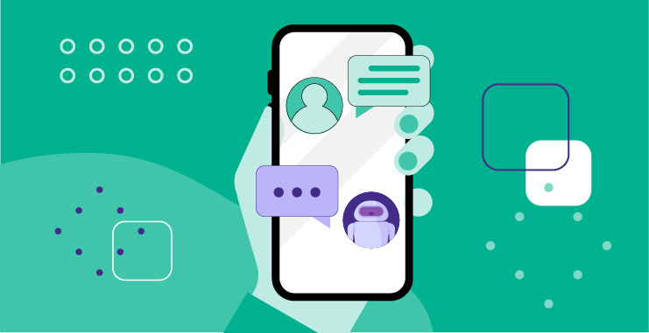





Functionality and User interface
scope:
Chatbots are hot software in the enterprise, but to maintain longevity and relevance, developers need to take a look at the barriers to entry, interface options and NLP issues.
Hello!
providing guidance:
use open menu to view scope for chatbot.
press note icon to view our guidance
Hello!welcome
to chatbot
NOTE!!..

Slide 3
Natural Language Processing(NLP):
Use the selected platform and the NLP techniques to implement the chatbot. ...
JSON: It is possible to utilize it to work with JSON data.
String: Provides access to several potentially valuable constants.
Random: For various distributions, this module implements pseudo-random number generators.
WordNetLemmatizer: It can lemmatize.
Tensorflow: A multidimensional array of elements is represented by this symbol.
Sequential: Sequential groups a linear stack of layers into a tf.keras.Model.

Slide 4
Responses:
In this chatbot will offer friendly user interface and give quick reply for any type basic questions.
It gives more accurate answers to all questions.
It also given suggestions for your requirements.
Its work ! Look like assistance.

Slide 5
Integration:
This chatbot will support both websites and applications
Testing and improvement:
It will check at all time and automatically updated model chatbot.

Slide 6
Outcome:
It provide best customer question clarifications .
It look like friendly user interface.
It also given suggestion and guidence.

