Slide 1


JOYBOT
WELCOME TO
JOYBOT

Slide 2


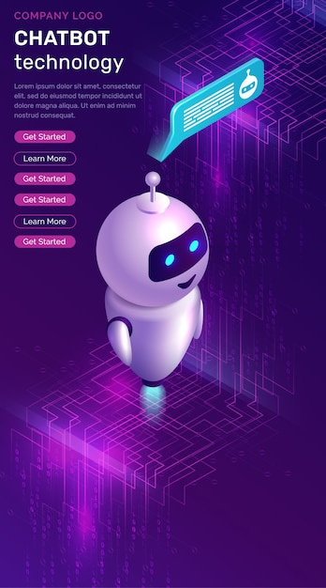
ABOUT JOYBOT
As more consumers have moved online – driven in large part by the pandemic – businesses have had to radically transform their customer experience. AI chatbots have really risen to prominence since March 2020, providing 24/7 support, and automatically resolving questions without any human intervention.

Slide 3
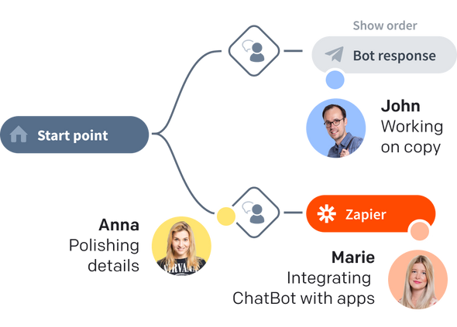
FUNCTIONALITY
If your organization has a fragmented view of the social channels and it delays your responses
If your organization has a global presence and requires multi-lingual support across multiple channels

Slide 4

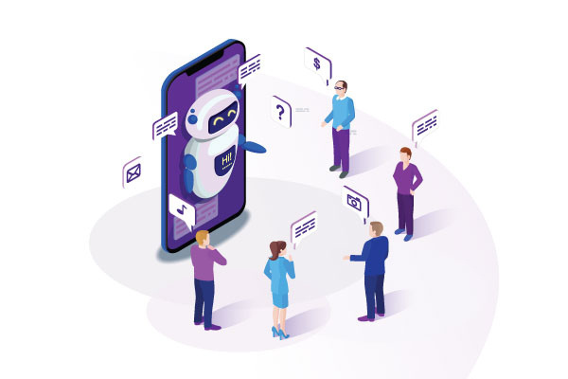
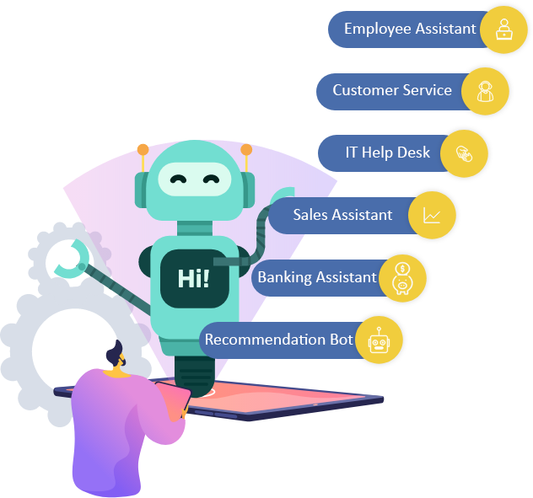
INTERFACE

Slide 5

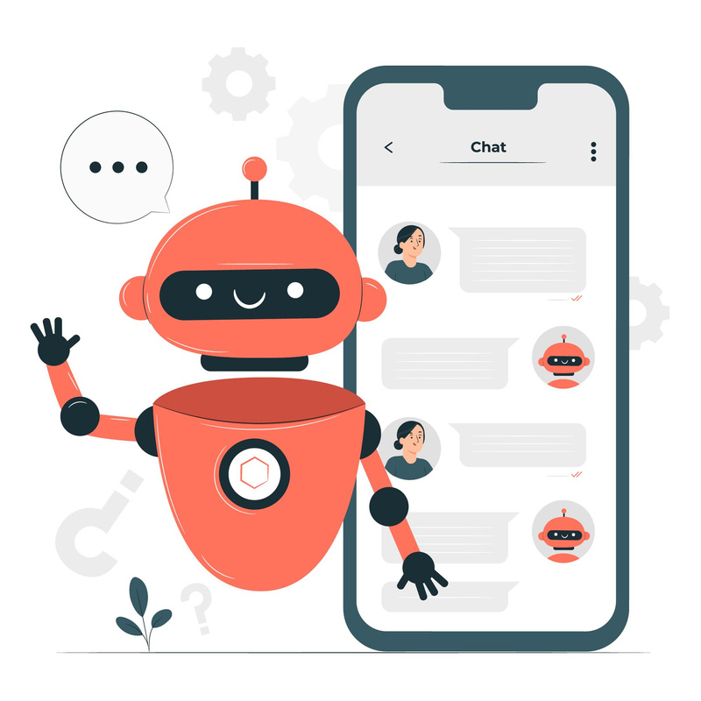
Enhance Customer
Interactions
AI customer service chatbot can remember customer queries and past interactions and use that information to provide a more personalized experience to the customers. For example, if a customer asks for a recommendation, the chatbot can use the conversation history to suggest products or services that are more aligned with the customer's preferences.

Slide 6
THANK'S
FOR
WATCHING

