Slide 1
Java operator
COMPARISON OPERATOR
Group 3
By
Hariharan
Dharani
Priya Dharanya
Sangeetha

Slide 2
WHAT IS A COMPARISON OPERATOR?
Comparison operations are used to compare two values
Comparison Operator
Equal to
Not Equal
Greater than
Less than
Greater than or equal to
Less than or equal to

Slide 3

Equal to
Description
Compare operands and return a Boolean value based upon whether the comparison is true or not. The operands may be numerical or string values.
Syntax
operand1 == operand2

Slide 4

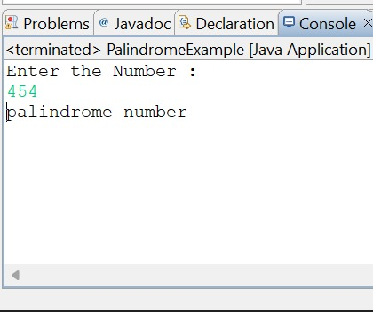
Example
class PalindromeExample {
public static void main(String args[]) {
int r,sum=0,temp;
Scanner scanner =new Scanner();
int n=scanner.nextInt();//It is the number variable to be checked for palindrome
temp=n;
while(n>0) {
r=n%10; //getting remainder
sum=(sum*10)+r;
n=n/10;
}
if(temp==sum)
System.out.println("palindrome number ");
else
System.out.println("not palindrome");
}
}

Slide 5
Not Equal
Description
Compares two operands to determine if the first operand is not equal to the second operand.
Syntax
result = operand1 != operand2

Slide 6
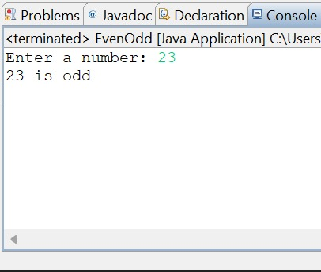
Example
import java . util. Scanner;
public class EvenOdd
{
public static void main(String[] args)
{
Scanner reader = new Scanner(System.in);
System.out.print("Enter a number: ");
int num = reader. nextInt ();
if(num % 2 != 0)
System.out.println (num + " is odd");
else
System.out.println (num + " is even");
}
}

Slide 7
Greater than
Description
Compare two operands to determine if the first operand is greater than the second operand
Syntax
result = operand1 > operand2

Slide 8

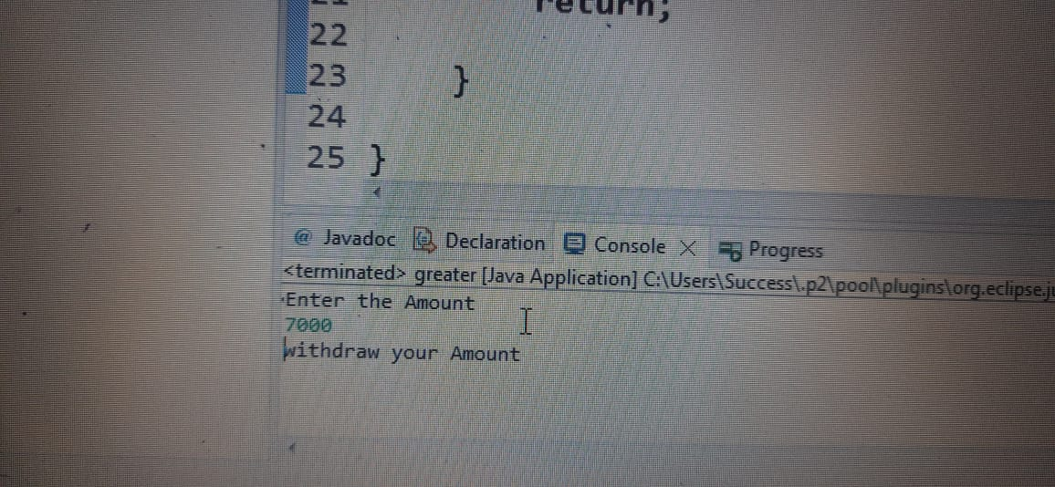
Example
import java.util.Scanner;
public class greater {
public static void main(String[]args) {
Scanner scanner=new Scanner(System.in);
System.out.print("Enter the Amount");
int Amount=scanner.nextInt();
if(20000>Amount) {
System.out.println("withdraw your Amount");
}
else {
System.out.println("Sorry Account Balance lessthan");
}
return;
}
}

Slide 9
Less than
Description
Compare two operands to determine if the first operand is less than the second operand
Syntax
result = operand1 < operand2

Slide 10
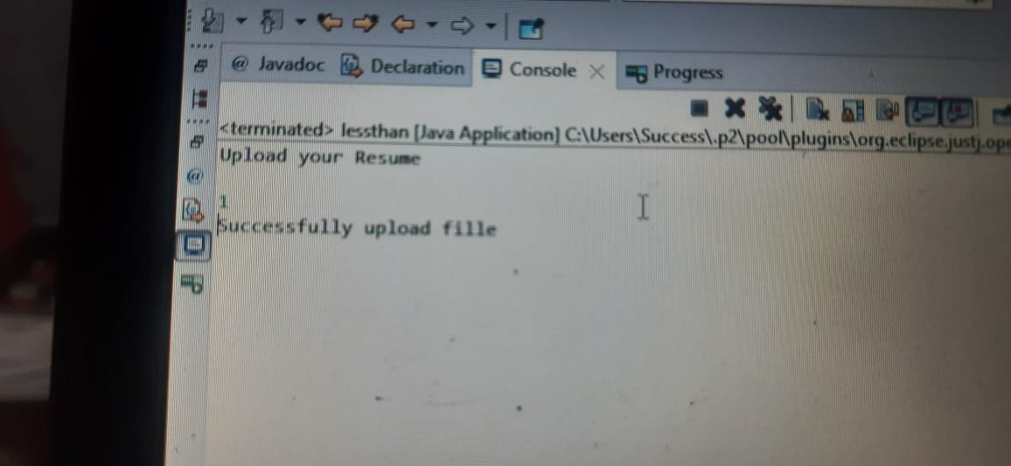

Example:
import java.util.Scanner;
public class lessthan {
public static void main(String[]args) {
System.out.println("Upload your Resume");
Scanner scanner=new Scanner(System.in);
int Size=scanner.nextInt();
if(Size<2) {
System.out.println("Successfully upload fille");
}
else {
System.out.println("Please upload from lessthan 2MB so Check your Resume");
}
}

Slide 11
Greater than or Equal to
Description
Compare two operands to determine if the first operand is greater than or equal to the second operand
Syntax
result = operand1 >= operand2

Slide 12
Less than or Equal to
Description
Compare two operands to determine if the first operand is less than or equal to the second operand
Syntax
result = operand1 <= operand2

Slide 13
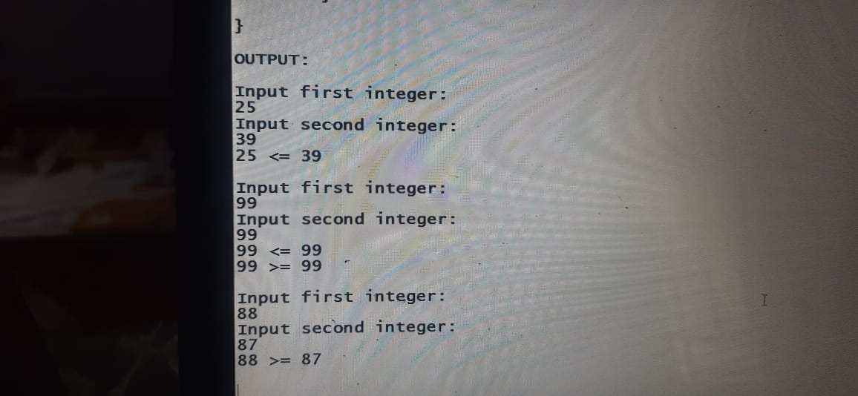

Example:
import java.util.Scanner;
public class Comparison {
public static void main(String[] args) {
Scanner input=new Scanner(System.in);
int number1;
int number2;
System.out.println("Input first integer:");
number1=input.nextInt();
System.out.println("Input second integer:");
number2=input.nextInt();
if(number1 <= number2)
System.out.printf("%d <= %d\n",number1, number2);
if(number1 >= number2)
System.out.printf("%d >= %d\n", number1, number2);
}
}

Slide 14


