Slide 1


Money Laundering Classification

Slide 2

Introduction
Money laundering can be defined as the process of transforming the profits of illegal activities into ostensibly legitimate assets. This process typically involves three stages:
Placement: Introducing the illicit funds into the financial system.
Layering: Engaging in a series of complex financial transactions to obscure the origins of the money.
Integration: Re-entering the money into the economy, making it appear to come from a legitimate source.

Slide 3

Why Money Laundering is a Problem
Enables Criminal Activity: By making illicit funds appear legitimate, money laundering supports and facilitates ongoing criminal enterprises.
Distorts Economies: It can lead to unfair competition, distorting market prices and damaging the integrity of financial markets.
Threatens National Security: Money laundering can finance terrorism, corruption, and other activities that threaten national and international security.
Regulatory and Legal Risks: Financial institutions that fail to detect and prevent money laundering can face severe legal and regulatory penalties.

Slide 4
Combating Money Laundering(AML efforts)
To combat money laundering, governments and financial institutions implement Anti-Money Laundering (AML) regulations and practices, which include:
Know Your Customer (KYC) Procedures: Verifying the identity of clients and assessing their risk levels.
Transaction Monitoring: Using automated systems to detect suspicious activities and patterns.
Reporting Requirements: Mandating the reporting of large or suspicious transactions to regulatory authorities.
Employee Training: Ensuring that employees are trained to recognize and respond to potential money laundering activities.
Effective AML practices are essential for maintaining the integrity of the financial system and preventing the illicit use of financial institutions.

Slide 5
Dataset Observation
Step:
Description : Represents a unit of time in hours.
Range : 1 to 744 (30 days).
Type:
Description : The type of transaction.
Values:
CASH-IN : Money added to an account.
CASH-OUT : Money withdrawn from an account.
DEBIT : A direct debit transaction.
PAYMENT : A payment transaction.
TRANSFER : Money transferred from one account to another.
Amount:
Description: Monetary value of the transaction in local currency.
Range: Varies based on the transaction.
NameOrig:
Description : Identifier for the customer who initiated the transaction.
OldbalanceOrg:
Description : Initial balance of the originator before the transaction.
.

Slide 6
NewbalanceOrig:
Description : New balance of the originator after the transaction.
NameDest:
Description : Identifier for the customer who received the transaction.
OldbalanceDest:
Description : Initial balance of the recipient before the transaction.
NewbalanceDest:
Description : New balance of the recipient after the transaction.
IsFraud:
Description : Indicates whether the transaction is fraudulent.
Values:
1: Fraudulent transaction.
0: Legitimate transaction.
IsFlaggedFraud:
Description : Indicates whether the transaction was flagged as an attempt to transfer more than 200,000 in a single transaction.
Values:
1: Transaction flagged.
0 : Transaction not flagged.

Slide 7
Steps to Build the Model
Data Preprocessing: Clean and preprocess the data, handling missing values, and encoding categorical variables.
Feature Engineering: Create new features that may help improve model performance.
Model Selection: Choose appropriate machine learning algorithms for classification.
Model Training: Train the models on the training dataset.
Model Evaluation: Evaluate the models using appropriate metrics (e.g., accuracy, precision, recall, F1-score, ROC-AUC).
Model Tuning: Tune the hyperparameters to improve model performance.

Slide 8

Data Collection and Exploration
Load the dataset.
Dataset Overview Columns: 11Rows: 63,626,620 (sample: 50,000 - 100,000)
Understanding the dataset and identifying patterns, anomalies, and relationships between variables. Here, we will perform various data exploration tasks such as data visualization, statistical analysis, and correlation analysis.

Slide 9
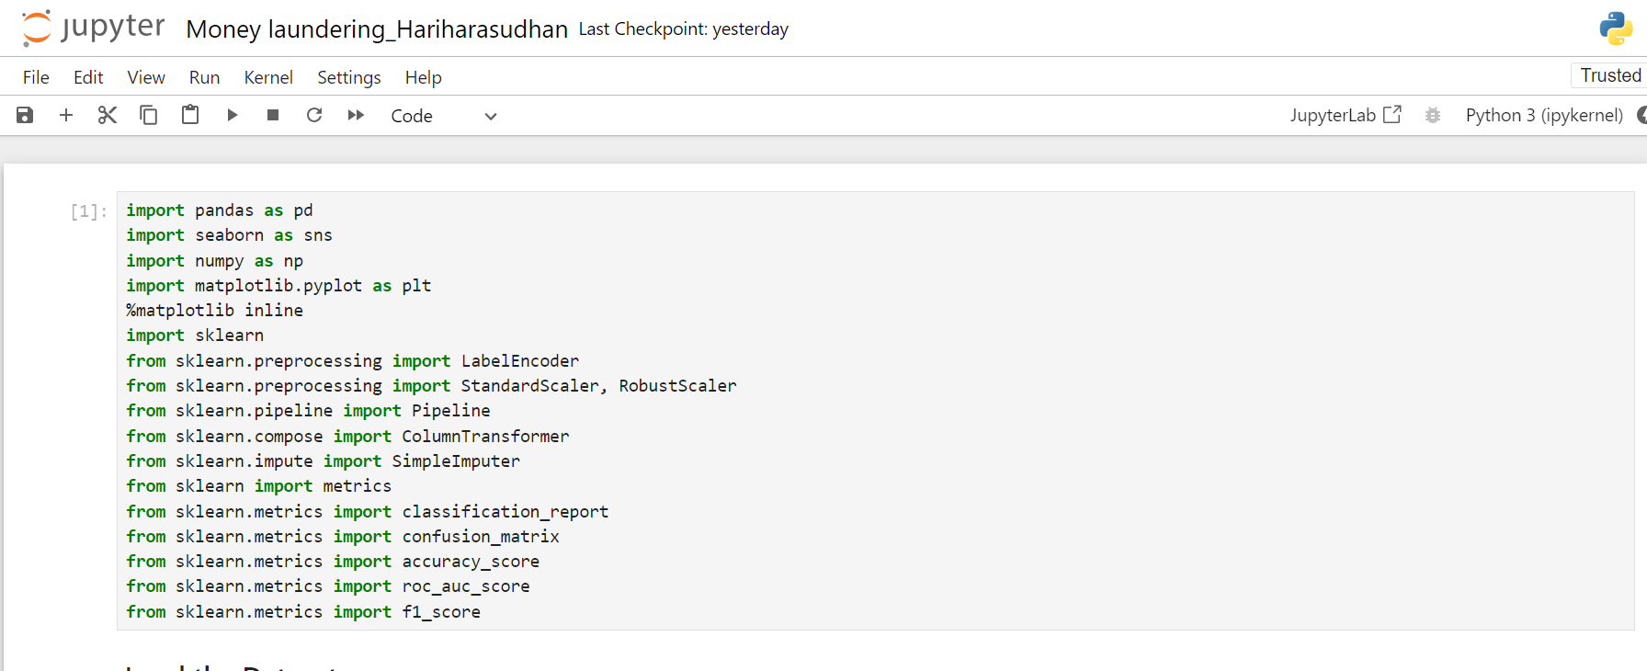
Import Libraries

Slide 10
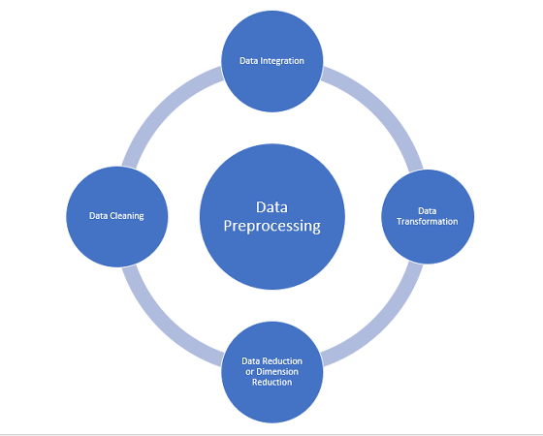
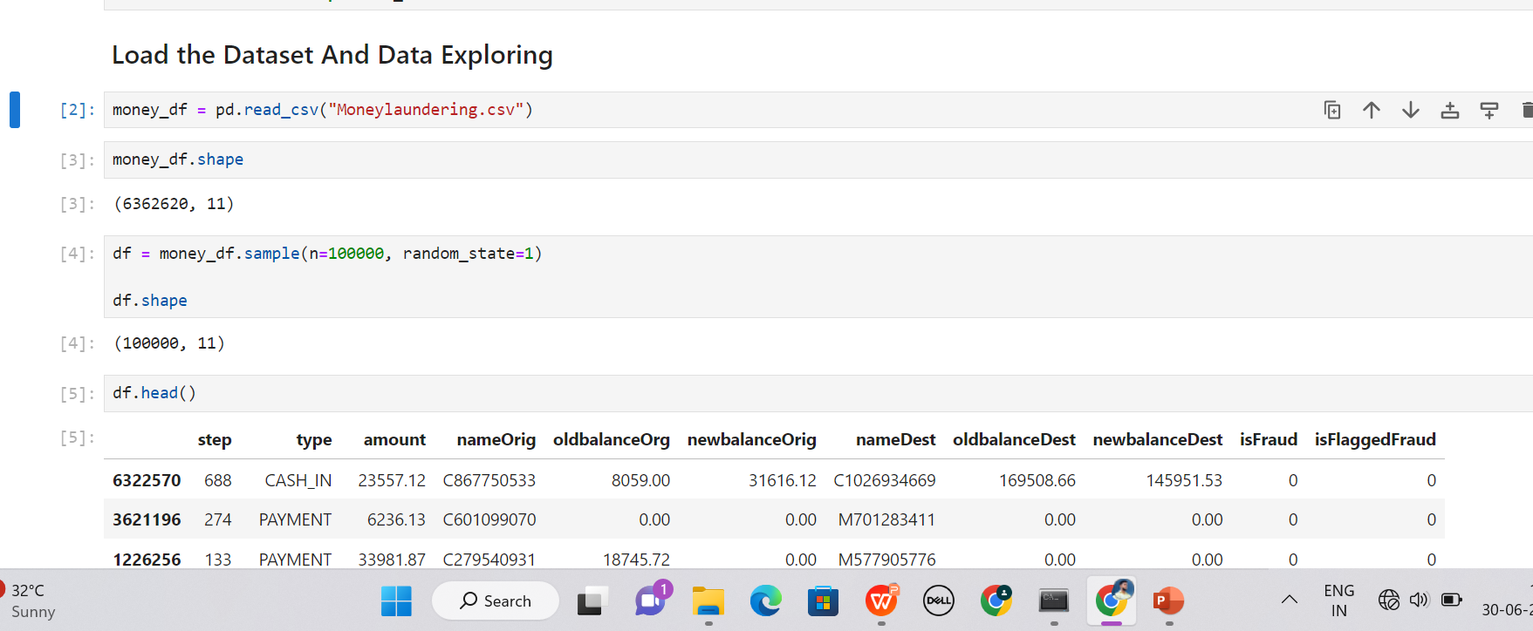
Data Exploration and gathering

Slide 11
2. Data Preparation and Data Preprocessing
Handle missing values (none in this case).
Convert categorical variables into numerical (e.g., transaction type).
Create new features that might be indicative of fraudulent behavior (e.g., balance differences, transaction ratios)

Slide 12
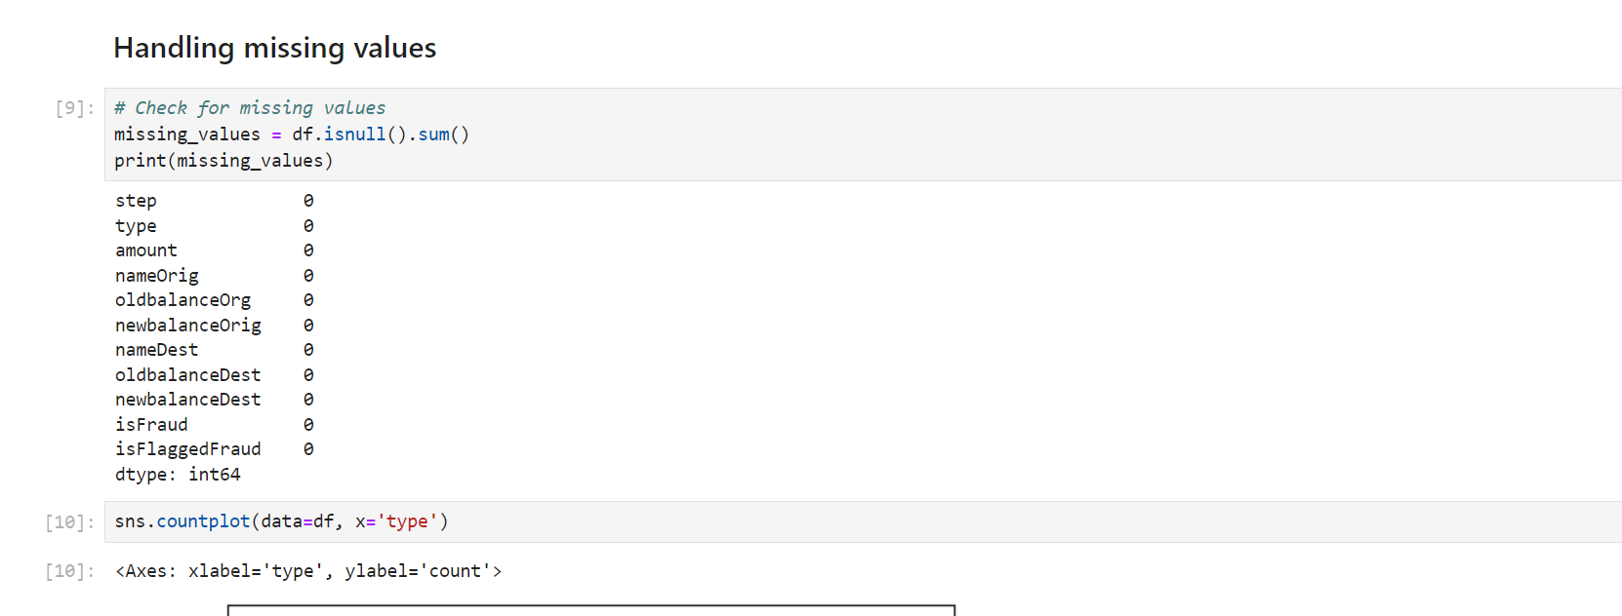
Data Preprocessing and Cleaning

Slide 13
3. Feature Engineering
Address Data Imbalance:
Use techniques like SMOTE (Synthetic Minority Over-sampling Technique) to balance the dataset during training.
One-hot encoding is used to convert categorical variables into a binary matrix format, where each category is represented by a binary value (0 or 1) in its own column. This technique is often employed because many machine learning algorithms work better with numerical data rather than categorical data.

Slide 14
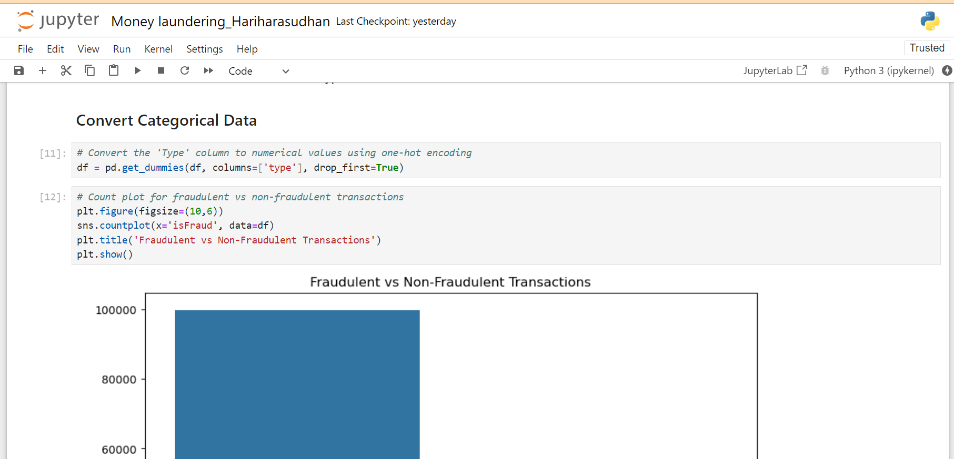
Convert the 'Type' column to numerical values using one-hot encoding

Slide 15
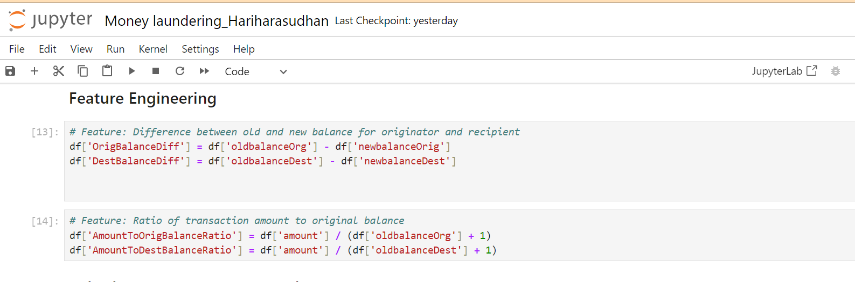
Feature Engineering

Slide 16
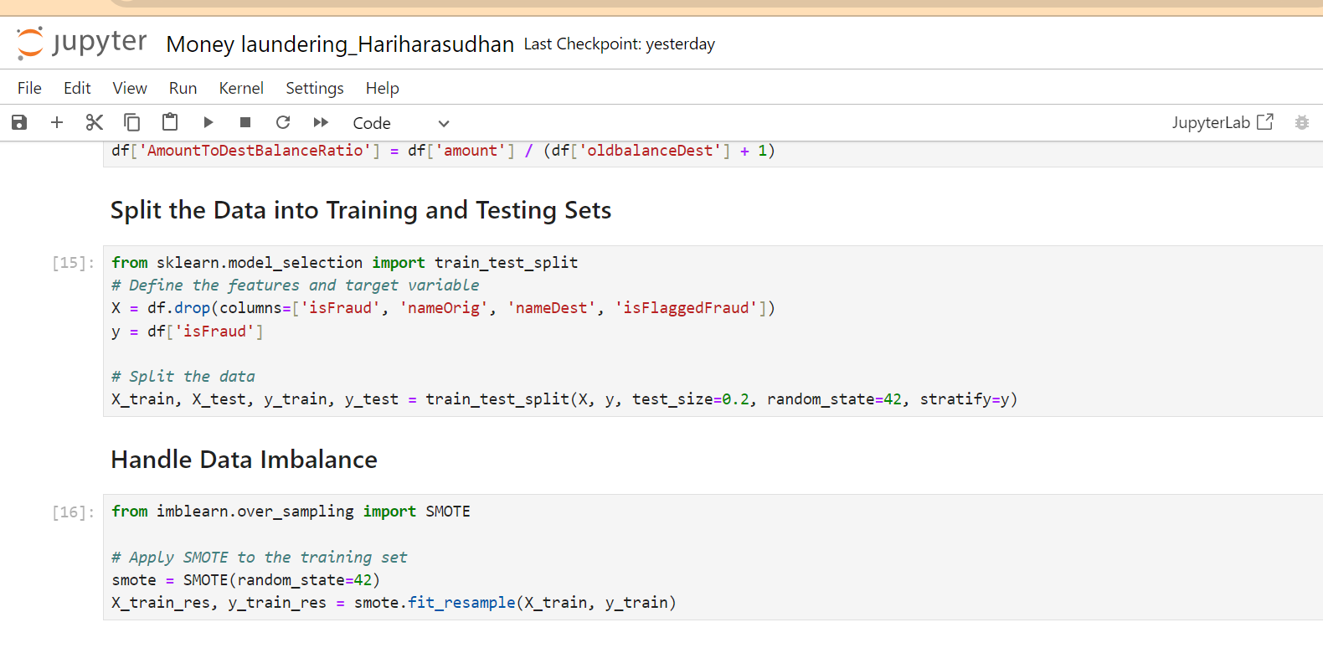
Handling Imbalance using SMOTE and Split the Data into test and train

Slide 17

Model Selection and Training
Select machine learning algorithms such as Random Forest.
Train the models on the training dataset.
Split the dataset into training and testing sets.
Train multiple models to evaluate their performance (e.g., Logistic Regression, Random Forest, Gradient Boosting).
Use cross-validation to ensure robustness.

Slide 18
Model Evaluation
To effectively evaluate the performance of the models, we use multiple metrics such as accuracy, precision, recall, F1-score, confusion matrix, and ROC AUC score.
Use confusion matrices to visualize performance and identify areas for improvement.
Classification Report : Provides precision, recall, F1-score, and support for each class.
ROC AUC Score : Measures the area under the ROC curve, giving an aggregate measure of performance across all classification thresholds.
Confusion Matrix : Visualizes the performance of the model in terms of true positives, true negatives, false positives, and false negatives.
ROC Curve : Plots the true positive rate against the false positive rate at various threshold settings, providing insight into the trade-offs between sensitivity and specificity.

Slide 19
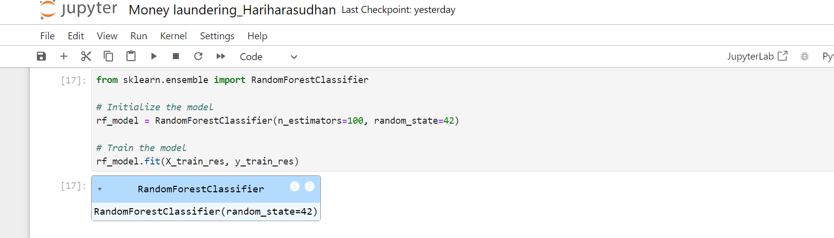
Model Selection and Training
Random forest

Slide 20
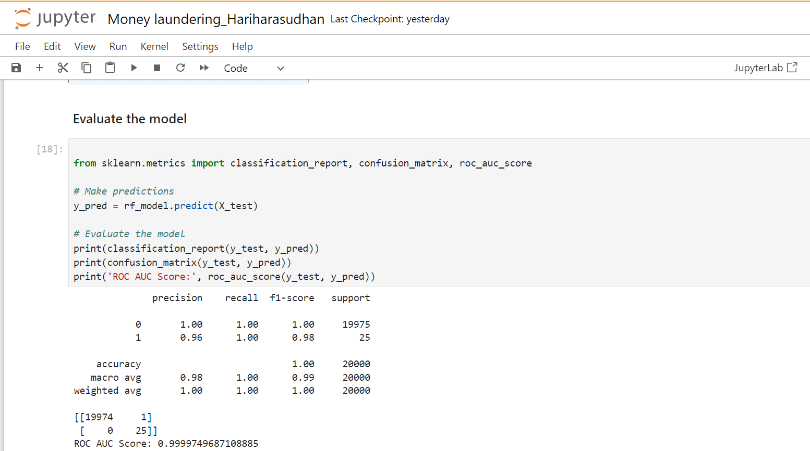
Evaluate the Model

Slide 21
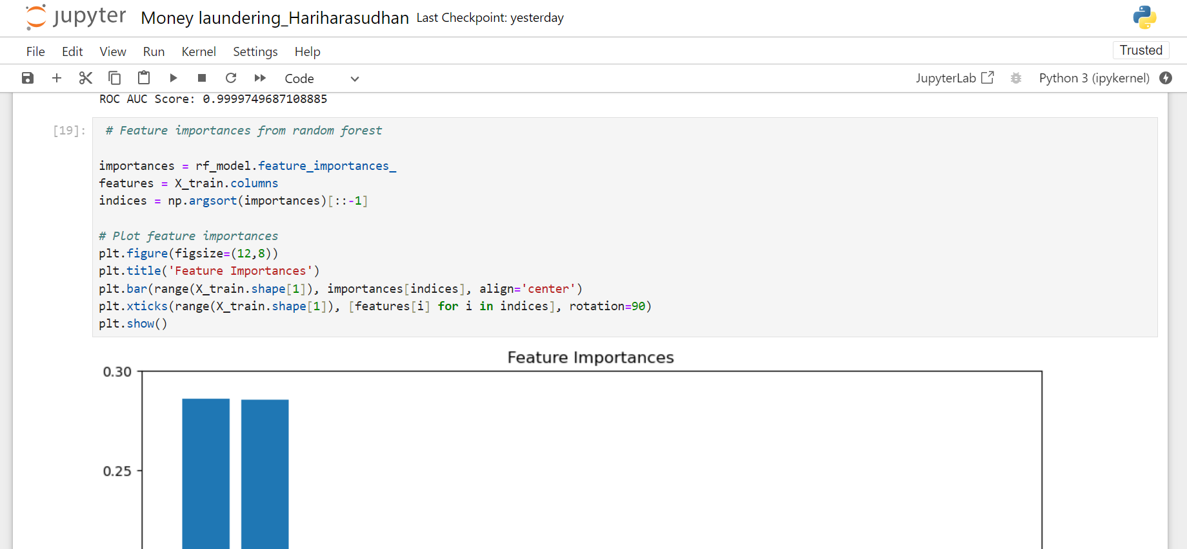
Feature Importance from Random forest

Slide 22
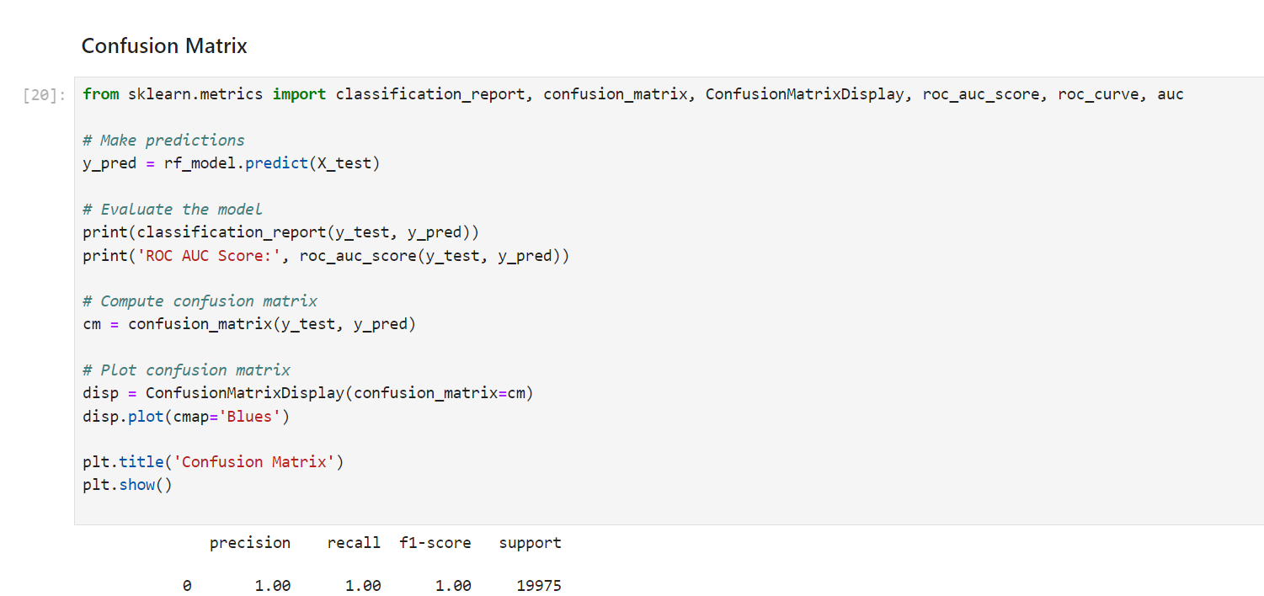
Using Confusion Matrix

Slide 23
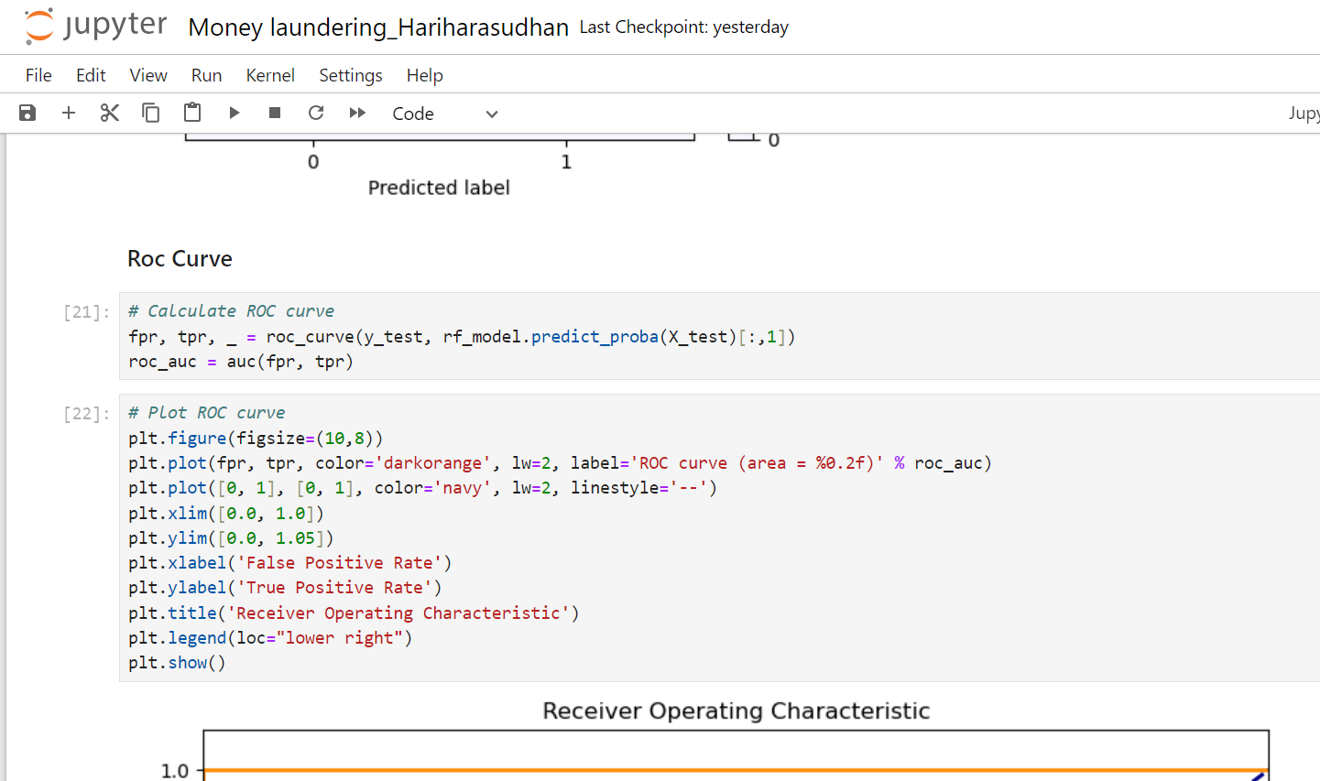
Calculate Roc Curve

Slide 24
Summary
The steps to develop a robust model for detecting potential money laundering transactions:
Data Preprocessing: Clean and transform the data.
Handle Data Imbalance: Use techniques like SMOTE.
Model Training: Train a model (Random Forest in this case).
Model Evaluation: Evaluate the model using appropriate metrics.
In summary, addressing money laundering requires a multifaceted approach combining advanced technologies, regulatory adherence, and institutional vigilance. Through ongoing efforts and collaboration, financial institutions can protect the financial system's integrity and contribute to a safer global economy.

Slide 25
Conclusion
you can preprocess the data, balance it using SMOTE, train multiple models, and evaluate their performance using confusion matrices and ROC curves. This approach helps in building a robust model that can accurately identify potential money laundering transactions, enhancing the institution's AML efforts.
Money laundering is a critical challenge that undermines the integrity of the global financial system, enabling various criminal activities. Financial institutions play a key role in combating this issue by implementing robust Anti-Money Laundering (AML) programs, which include Know Your Customer (KYC) protocols and continuous monitoring of transactions. The advent of machine learning and artificial intelligence has enhanced the detection capabilities, allowing institutions to identify suspicious transactions more accurately and efficiently.

Slide 26


