Slide 1


“ Predictive Maintenance and Condition-Based Monitoring (CBM) for Maritime Drive Systems Using Machine Learning Techniques ”

Slide 2


Introduction
Predictive maintenance and CBM are methods used to keep maritime drive systems running smoothly by predicting when parts will fail and monitoring their condition to perform timely maintenance. This helps prevent unexpected breakdowns and reduces maintenance costs.
(In Our Project)
This dataset contains measurements from a ship's gas turbine propulsion system, recording various operational metrics such as torque, revolutions per minute (RPM), temperatures, pressures, and fuel flow. Each row represents data collected at different times or under different operating conditions. These measurements are vital for monitoring the system's performance and health.

Slide 3

(Research and Observation)
Predictive Maintenance:
Early Detection: Identifies potential issues early.
Cost Efficiency: Reduces maintenance costs.
Increased Reliability: Enhances equipment lifespan.
Condition-Based Monitoring (CBM):
Real-Time Monitoring: Continuously assesses machinery health.
Optimized Maintenance: Maintenance based on actual condition.
Improved Safety: Reduces risk of equipment failure.
Ship's Gas Turbine Propulsion System Dataset
Metrics Captured: Torque, revolutions, temperatures, pressures, fuel flow, state coefficients.
Purpose: Monitor and analyze performance, efficiency, and maintenance needs.

Slide 4

Methods & possible implementation
Predictive Maintenance: Predict when parts might need maintenance to prevent unexpected breakdowns.
Performance Optimization: Improve the efficiency and performance of the propulsion system.
Anomaly Detection: The dataset supports the identification of unusual patterns or deviations, allowing for early detection of potential issues and prompt interventions.Spot patterns indicating issues or improvements.
By analyzing these metrics, we can ensure the propulsion system runs smoothly, efficiently, and safely.

Slide 5
Dataset Observation
Maritime Propulsion Systems
Propellers:
Starboard and Port Propeller Torque (Ts, Tp): Measures the torque on each propeller. Imbalances or abnormal readings can indicate damage or wear.
Gas Turbine (GT):
GT Shaft Torque (GTT): Measures the rotational force. Abnormal torque values can indicate mechanical issues.
GT Rate of Revolutions (GTn): Monitors the RPM. Deviations from normal ranges can signal problems.
GT Compressor Inlet/Outlet Air Temperature (T1, T2): Temperature variations can indicate efficiency loss or mechanical wear.
GT Compressor Inlet/Outlet Air Pressure (P1, P2): Pressure changes can signify blockages or leaks.
GT Turbine Decay State Coefficient: Indicates the overall health and efficiency of the turbine.
High-Pressure Turbine:
HP Turbine Exit Temperature (T48): High exit temperatures can suggest efficiency loss or impending failure.
HP Turbine Exit Pressure (P48): Pressure readings help in assessing the operational state of the turbine.
Fuel Flow (mf): Monitors the rate of fuel consumption. Irregular flow rates can indicate fuel system issues.

Slide 6

Steps to Build our Model
Data Cleaning and Preprocessing
Duplicate Removal: You identify and remove duplicate rows, which helps in ensuring the integrity of the data.
Missing Values: You handle missing values by dropping rows with NaN values, filling NaNs with the mean of columns, and interpolating where appropriate.
Column Name Cleanup: You clean up column names to remove extra spaces and special characters, which helps in consistent data handling.
Data Type Conversion: You convert object columns to numeric types, ensuring that all data is in the correct format for analysis.
Exploratory Data Analysis (EDA)
Visualizations: You create visualizations to understand the distribution of fuel flow by lever position and to visualize the correlation network among features. This helps in identifying patterns and relationships within the data.
Correlation Analysis: By creating a correlation network graph, you analyze the relationships between different features, which aids in feature selection and understanding dependencies.

Slide 7
Feature Engineering
Interaction Terms: You generate interaction terms by multiplying different features. This can capture more complex relationships between features, which might improve the predictive performance of your model.
Model building and Evaluation
Regression Analysis
Linear Regression: You fit a linear regression model to the data, assess the performance using RMSE and R-squared metrics, and print out the model summary.
Model Improvement: By incorporating interaction terms, you aim to improve the model's performance and capture more complex relationships.
Used XGBRegressor to compute feature importances.Plotted feature importances to identify which features have the most influence on the target variable.
Anomaly Detection: Added IsolationForest from scikit-learn to detect anomalies in the dataset.Plotted the distribution of a specific feature (Ship speed (v)) to visualize the detected anomalies.
Metrics: You use RMSE and R-squared to evaluate the performance of the regression model. This helps in assessing how well the model is fitting the data and predicting the target variable.

Slide 8
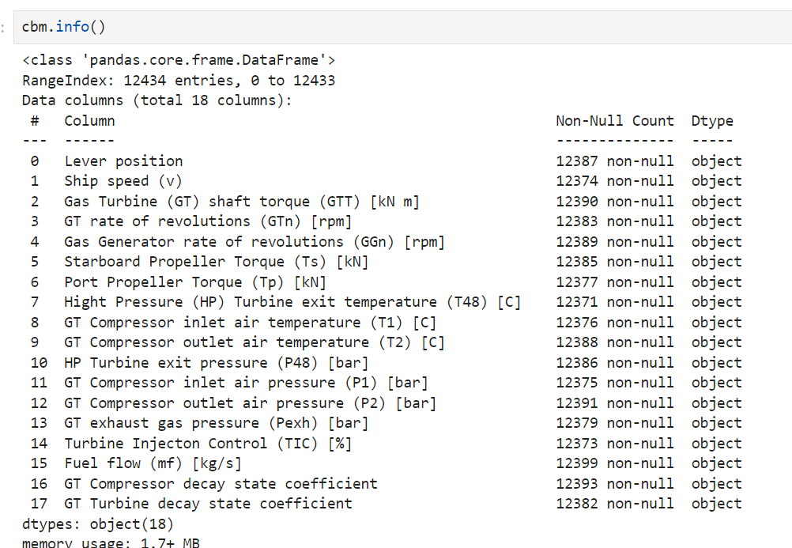
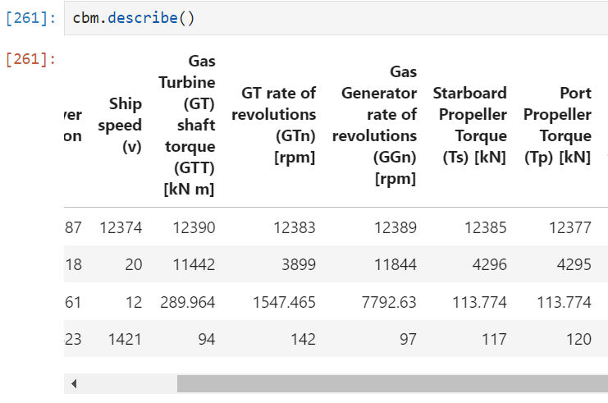
Data Exploration and gathering

Slide 9
2. Data Preprocessing (observation)
Original Dataset: 12,434 rows and 18 columns
After Dropping Missing Values: 11,993 rows and 18 columns Analysis.
Extent of Missing Data:
Rows removed: ( 12,434 - 11,993 = 441 ) rows
Percentage of rows removed: \( \frac{441}{12,434} \times 100 \approx 3.5\% )
Decision Based on Missing Data 3.5% Missing Data:
This percentage is relatively small, so dropping rows with missing values is a reasonable approach. It ensures that only complete cases are used in your analysis or modeling while only losing a small portion of the dataset.
Column Name Cleanup: You clean up column names to remove extra spaces and special characters, which helps in consistent data handling.
Data Type Conversion: You convert object columns to numeric types, ensuring that all data is in the correct format for analysis.
That’s why we can simple dropping method not using Imputation method.

Slide 10
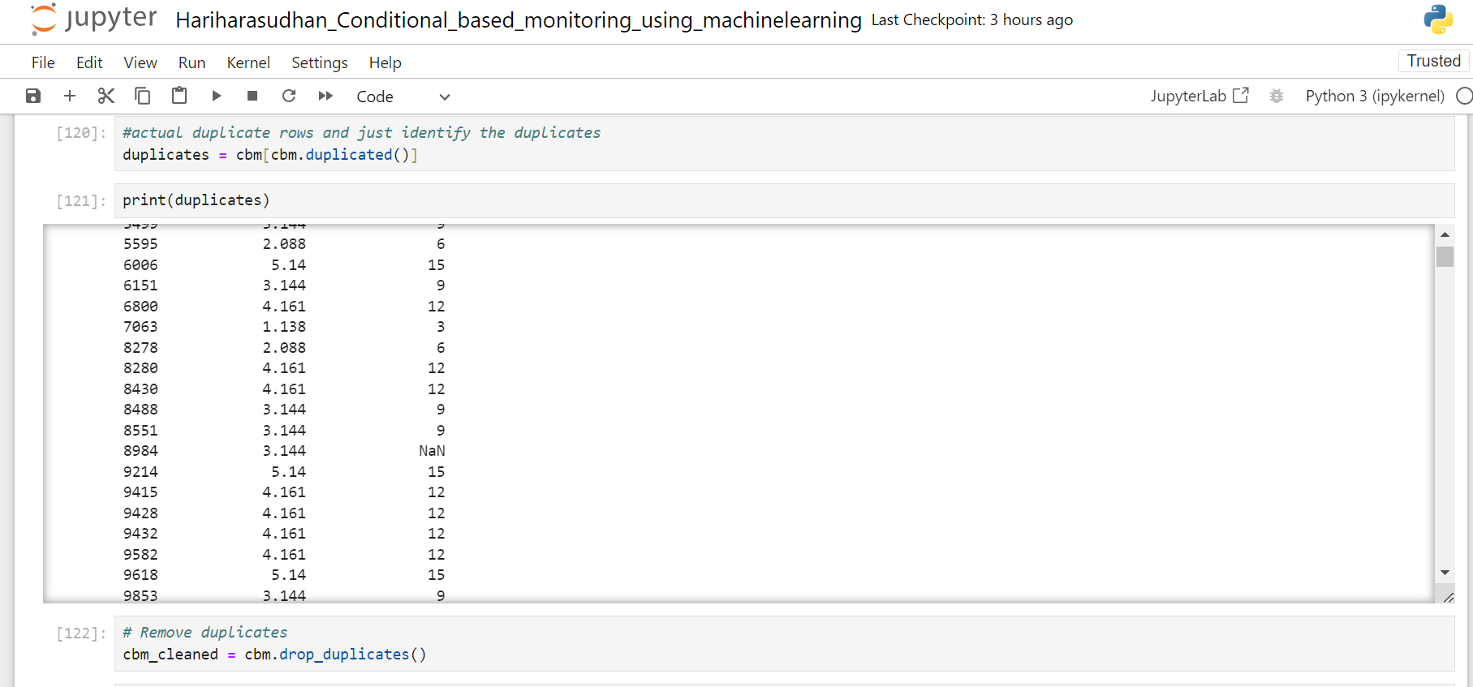
Data Preprocessing and Cleaning
Summary for our dataset, with only 3.5% of the rows removed due to missing values, dropping missing values is a suitable and practical approach. If the percentage were significantly higher, imputation might be more appropriate to preserve data.

Slide 11
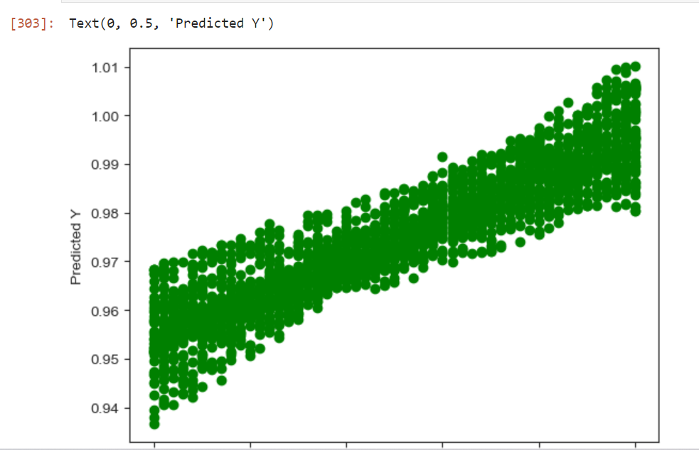
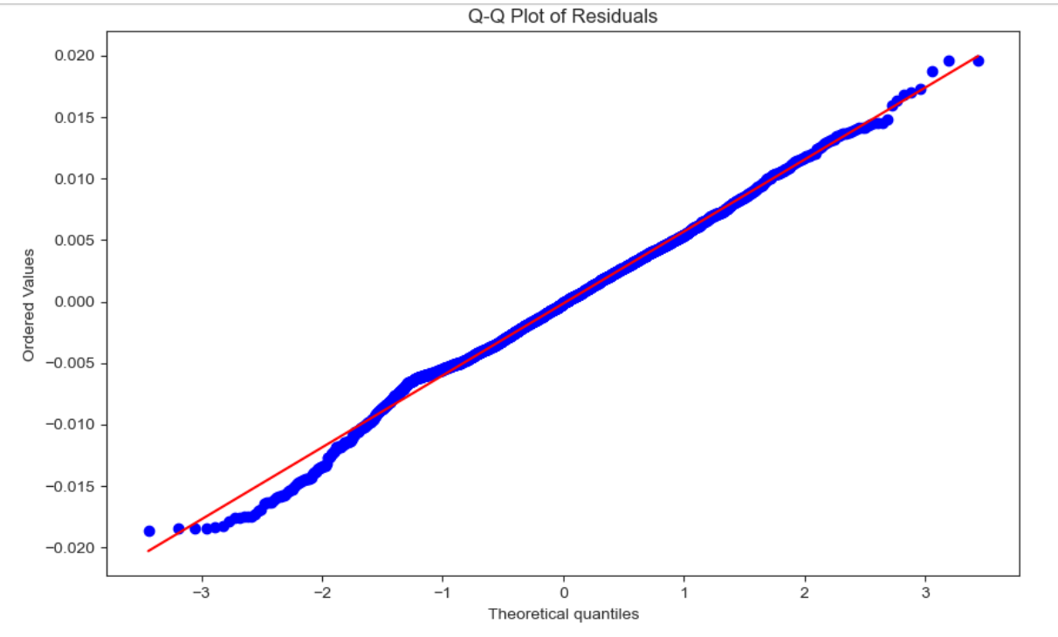
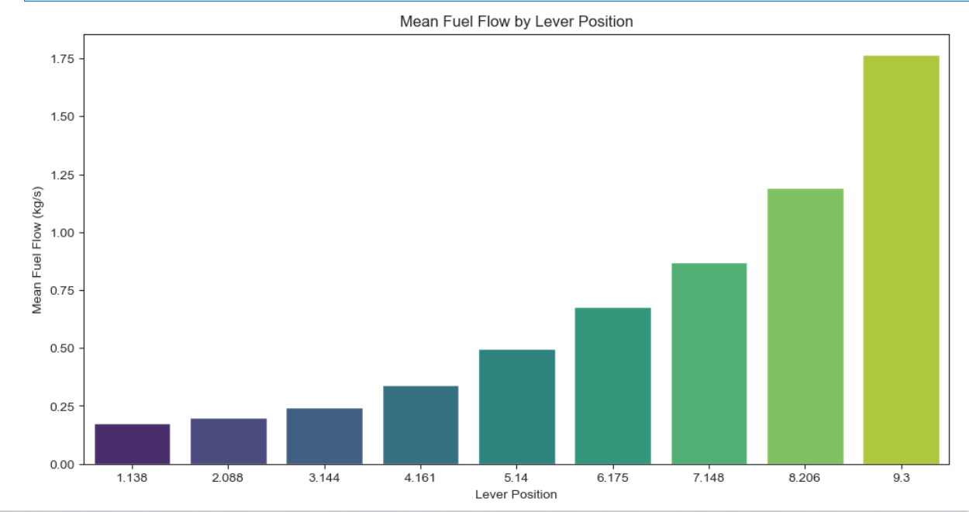
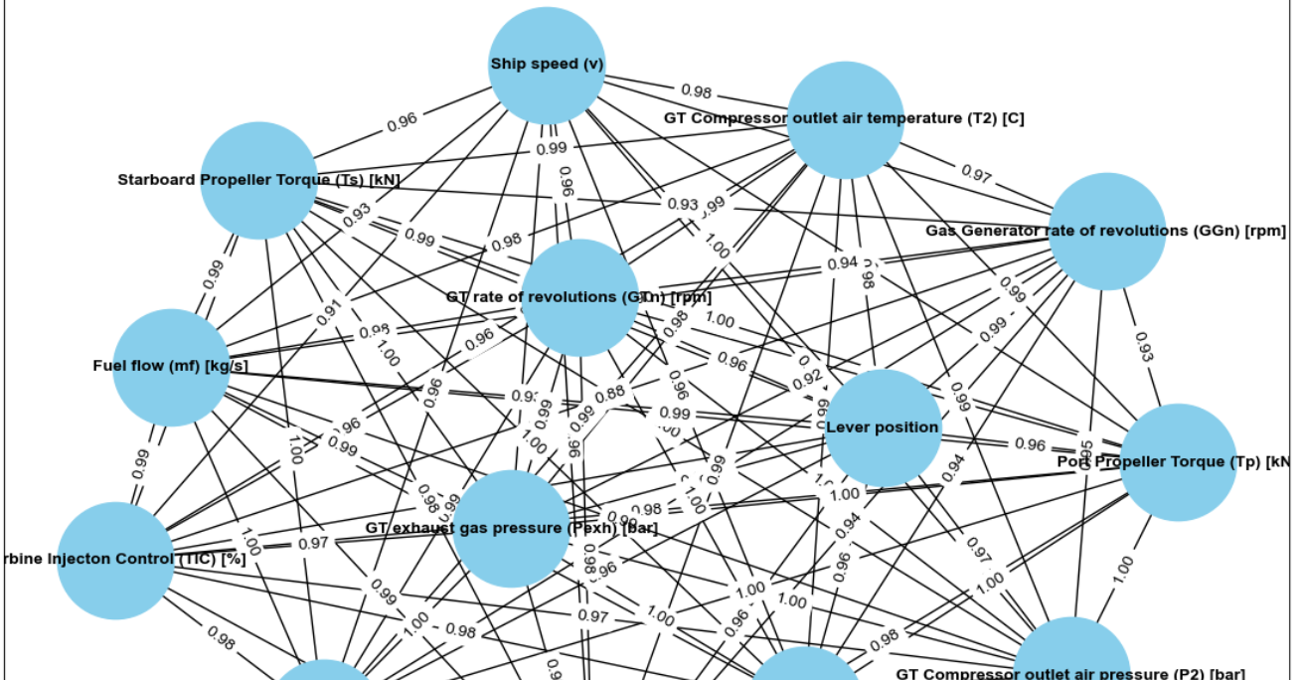
Data Visualization & Correlation analysis
Creating a scatterplot of the y_test values vs the predicted y_test values
Calculate residuals
Group by 'Lever position' and calculate the mean fuel flow
network graph from the correlation matrix

Slide 12
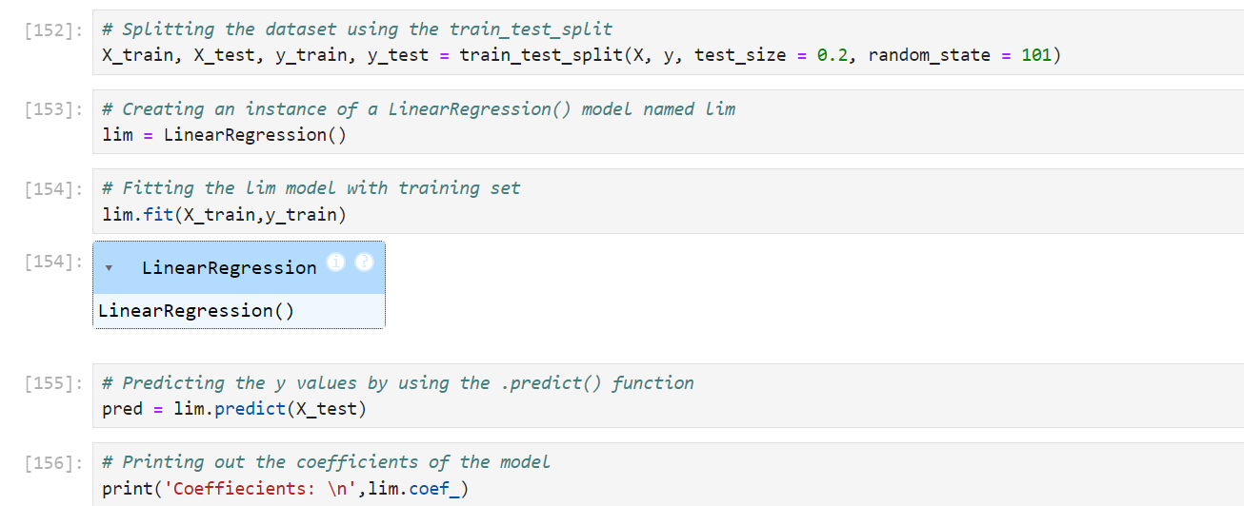
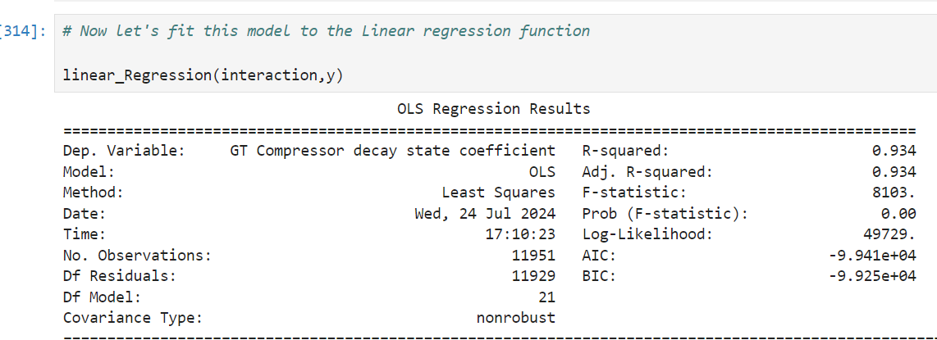
Model Selection and Training
Using Linear regression for Condition based monitoring maintenance
R-squared: The model explains 93.4% of the variance in the GT Compressor decay state coefficient, indicating a very good fit.
F-statistic: The high F-statistic and the low p-value suggest that the model is statistically significant and that the predictors are collectively useful for predicting the dependent variable.

Slide 13
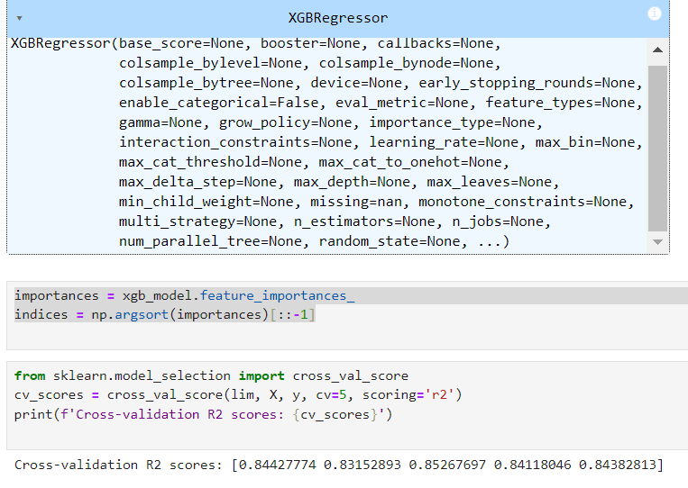
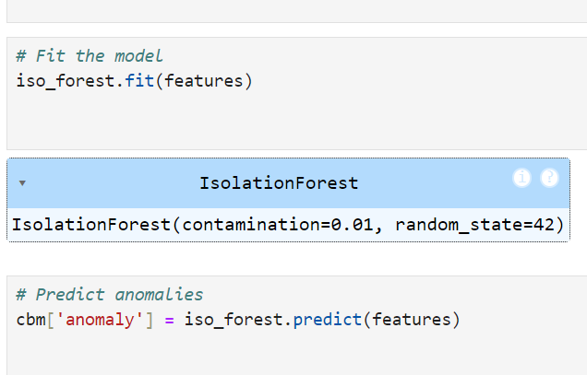
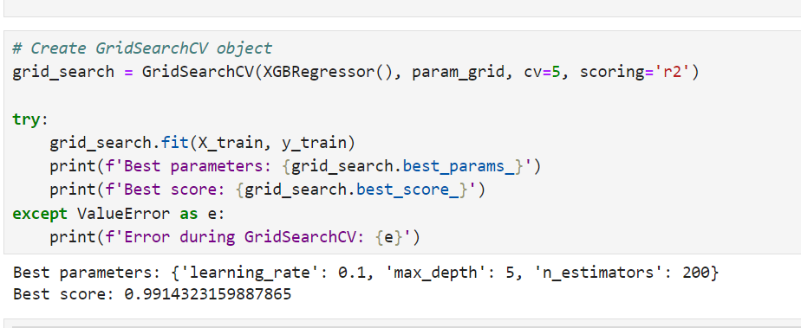
XGBoost Model
Anamoly detection and isolation forest
Using Grid search (Model Evaluation

Slide 14

Overall Summary and Conclusion
In our analysis of the ship's gas turbine propulsion system, Delved into the relationship between 14 operational features and two key performance metrics: the GT Turbine decay state coefficient and the GT Compressor decay state coefficient. Our approach involved:
Feature Analysis: Identified that the GT Turbine decay state coefficient exhibited a perfect correlation with all 14 features, indicating that these features are well-aligned with this metric. Conversely, the GT Compressor decay state coefficient demonstrated a linear relationship with only 12 of these features, suggesting that two features were not relevant for its prediction.
Model Development: You constructed a predictive model to estimate the GT Compressor decay state coefficient. Initially, the model achieved an R-squared value of 84.3%, reflecting a strong fit to the data. To enhance the model’s predictive power, you incorporated interaction terms based on a correlation heatmap. This adjustment led to a substantial improvement, with the R-squared value increasing to 93.4%, thereby establishing the model as highly effective for predicting the GT Compressor decay state coefficient.

Slide 15

Anomaly Detection: Implement algorithms specifically designed for anomaly detection, such as Isolation Forest.
The grid search for hyperparameter tuning of your XGBoost model yielded optimal parameters that significantly enhanced model performance. The best parameters were identified as a learning rate of 0.1, a maximum depth of 5, and 200 boosting rounds. With these parameters, the model achieved an exceptional score of 0.9914, indicating a very high level of performance and accuracy. This high score suggests that the model effectively captures the underlying patterns in the data and makes highly accurate predictions.
Our refined model, with its improved R-squared value, underscores the importance of considering feature interactions in predictive analytics. This enhancement demonstrates a deeper understanding of how combined feature effects influence performance metrics, providing valuable insights for optimizing the gas turbine propulsion system.

Slide 16



