Slide 1

“ Predictive Modelling and Analysis of Airfare trends & Ticket
Pricing "

Slide 2



Introduction and Domain Overview
In the rapidly evolving Indian aviation sector, airfares are subject to frequent fluctuations, driven by a variety of influencing factors.
This project focuses on building a machine learning-based solution capable of forecasting air ticket prices for domestic flights within India.
This model is designed to provide actionable insights for both airlines aiming to optimize revenue and passengers seeking cost-effective booking opportunities.
Ticket prices fluctuate based on factors such as booking time, demand, airline reputation, fuel costs, and holidays. Accurate price prediction is essential for airlines to maximize revenue and for passengers to find affordable fares.

Slide 3

Problem Statement and Overview (Observation)
The challenge is to accurately predict air ticket prices for domestic flights within India.
The goal is to create a machine learning model that identifies and analyzes the multitude of factors influencing ticket pricing, providing actionable insights for both airlines (To optimize dynamic pricing strategies) and passengers (To determine the best time to book tickets).
Project Aim: Building a machine learning model to predict air ticket prices.
Airline Challenges : Maximizing revenue while staying competitive in a volatile market.
Passenger Dilemma : Navigating the complex and ever-changing airfare landscape to find affordable flights.

Slide 4


Dataset Structure The dataset used for air ticket price prediction consists of 11 features and 10,684 records.
These features include details about the airline, journey date, departure and destination cities, flight route, departure and arrival times, flight duration, number of stops, additional travel information, and the ticket price for each flight.
Number of Columns - 11
Number of Rows - 10684

Slide 5


Insights Gained:
In this analysis and model building, key insights:
Booking Timing : Early bookings are generally cheaper, with prices increasing as the departure date approaches, especially during peak seasons or holidays.
Airline Reputation : Airlines with higher reputation scores tend to have more stable pricing, with fewer fluctuations compared to budget airlines.
Demand and Seasonality : Prices spike during high-demand periods such as holidays, festivals, and school vacations, with these factors showing a strong correlation to price increases.
Price Sensitivity : External factors like fuel prices and economic indicators were found to have moderate impacts on ticket prices, especially for longer-distance flights.

Slide 6

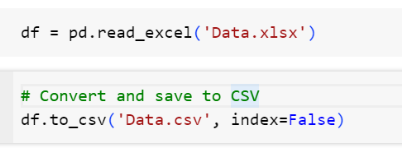

Data Exploration
Data Import and Conversion
Dataset: Loaded data from an Excel file (Data.xlsx).
Format Conversion: Converted the DataFrame to CSV format (Data.csv) for broader compatibility and analysis.
Unique Values Count: Displayed the number of unique values for each column.
Example output: "Column called ColumnName has Number unique values."

Slide 7
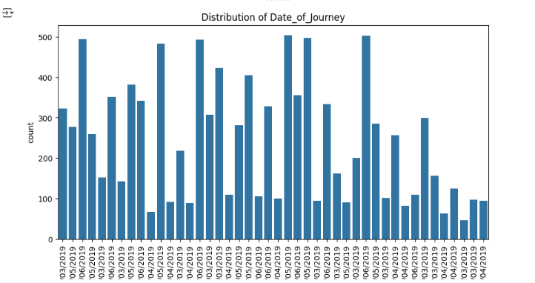
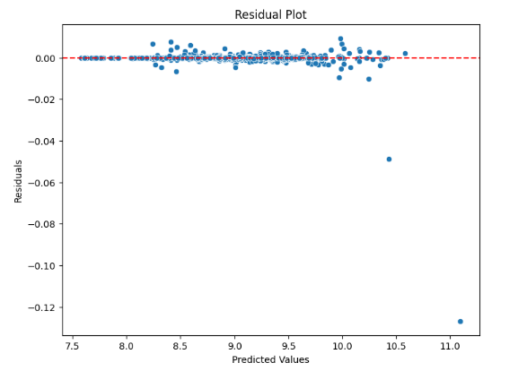
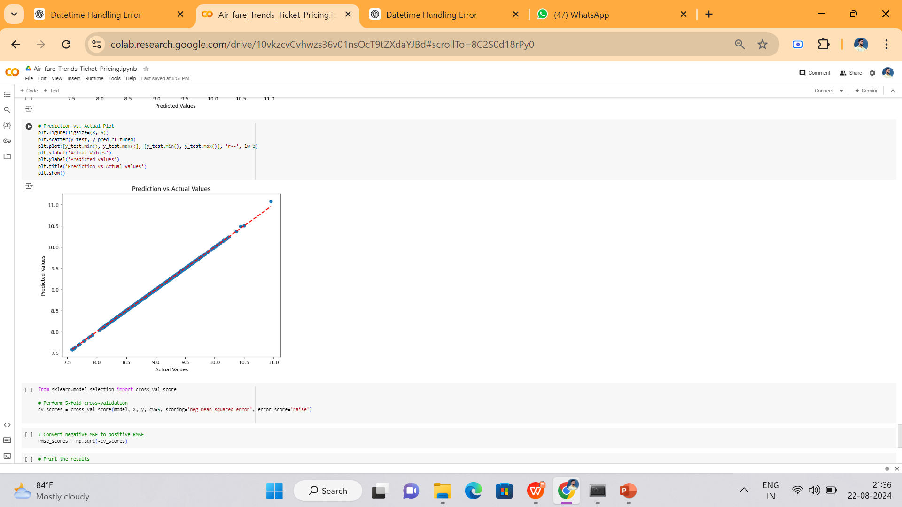
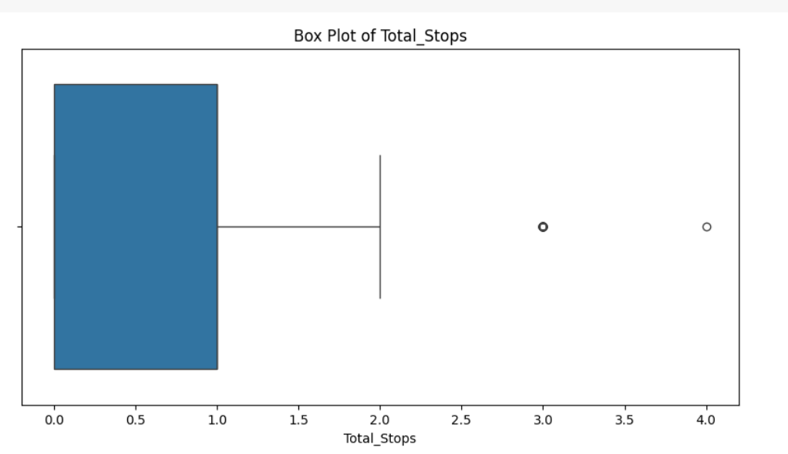
Data Visualization & Correlation analysis

Slide 8

Data Preprocessing
Missing Data Handling: Identified and filled missing values, with 'Unknown' for 'Additional_Info' and '0 stops' for 'Total_Stops' to retain data completeness.
Duplicate Data Management: Removed all duplicate rows to maintain dataset integrity, ensuring each entry was unique and relevant for model training.
Infinite Value Treatment: Replaced any infinite (inf) and negative infinite
(-inf) values with NaN and addressed them to prevent calculation errors during modeling.
Data Type Transformation: Converted 'Total_Stops' from a text-based format (e.g., '2 stops') to numerical values using regular expressions, enabling better processing for machine learning algorithms.
Data Validation: Performed a final check to confirm no missing, infinite, or duplicate values remained in the dataset after transformations.

Slide 9

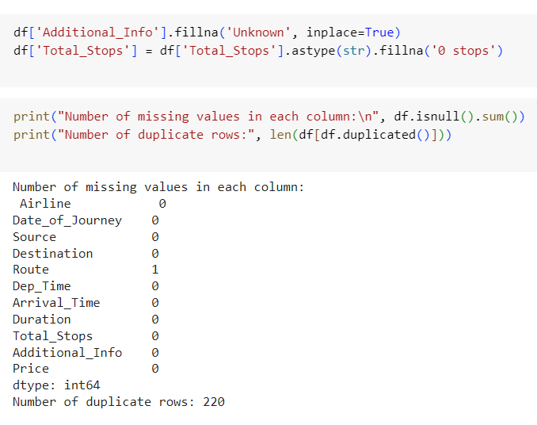
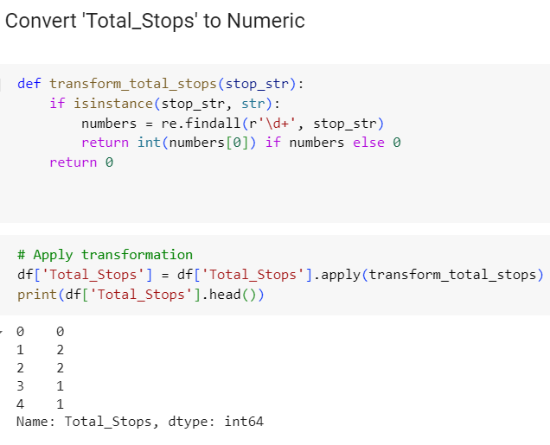
Data Preprocessing Visual representation (samples)

Slide 10

EDA and Data Visualization
Distribution of Categorical Features: Visualized the frequency of categorical variables such as 'Airline,' 'Source,' and 'Destination' using count plots to identify the distribution of categories.
Outlier Detection and Analysis: Z-Score Method: Detected outliers in the 'Price' column by calculating the Z-score, flagging any value with an absolute Z-score above 3.
IQR Method: Calculated the Interquartile Range (IQR) to identify price outliers lying outside the range of Q1 - 1.5 * IQR to Q3 + 1.5 * IQR, ensuring robust detection of extreme values.
Insights Gained
Outliers: Flagged and reviewed significant outliers that could influence model performance.
Categorical Distributions: Observed dominant airlines, sources, and destinations, giving insight into which categories dominate the data.

Slide 11
Feature Engineering
Date-Time Feature Extraction: Converted 'Date_of_Journey' into day, month, and year to capture temporal effects.
Extracted hours and minutes from 'Dep_Time' and 'Arrival_Time' to factor in the impact of departure and arrival times on prices.
Categorical Encoding: Replaced 'Total_Stops' with numerical values (0 to 4 stops).
One-hot encoded categorical features such as 'Airline', 'Source', 'Destination', 'Route', and 'Additional_Info' to prepare for machine learning models.
Log Transformation: Applied log transformation on 'Price' to reduce skewness and stabilize variance for better model performance.
Duration Conversion: Converted flight 'Duration' from hours and minutes to total minutes for easier analysis and modeling.
Set the Target feature: Split the data into features X and target variable Y (log-transformed 'Price').

Slide 12
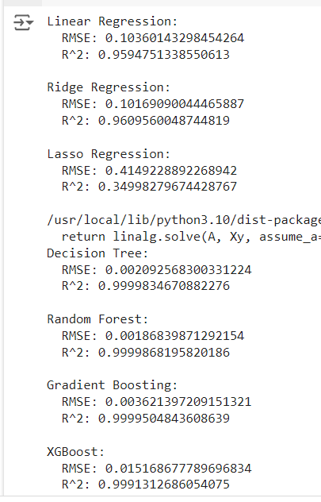
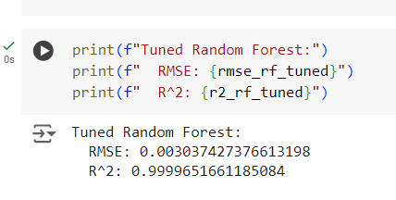
Model Selection and Hyper parameter tuning
Random Forest is the best choice for your air ticket price prediction model due to its strong performance metrics. It effectively balances accuracy and generalizability, making it a robust option for predicting ticket prices. If you need model interpretability or if overfitting is a concern, you might also consider Decision Tree or Gradient Boosting.
Multiple Algorithms Results
Hyper Parameter Tuning using Random forest

Slide 13

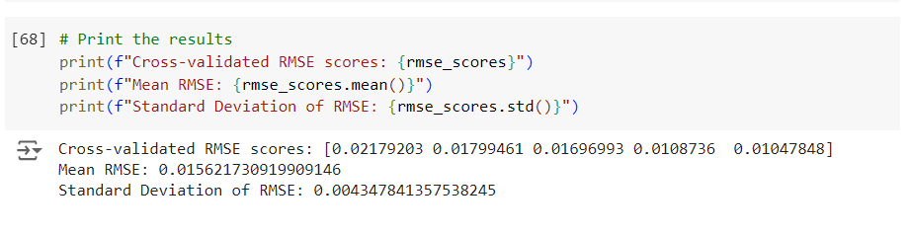

Cross Validation (Results)
The cross-validated RMSE scores are higher than the initial model's RMSE but lower than the tuned model’s RMSE.
This suggests that the initial model might have been overfitting to the training data, while the cross-validation gives a more generalizable performance estimate.

Slide 14

Results and Conclusion
Initial Model Performance: The very low RMSE and high R² of the initial model suggest excellent performance on the specific dataset used, but potential overfitting.
Tuned Model: The increase in RMSE and decrease in R² after tuning might indicate a move towards better generalization but could also reflect less optimal tuning parameters.
Cross-Validation Results: These provide a more realistic estimate of model performance on unseen data. The mean RMSE of 0.015622 and R² of 0.999965 from cross-validation suggest that the model performs well in general, with a slight increase in RMSE compared to the initial model.

Slide 15

Overall, the cross-validation results are reliable and give a more generalized view of the model's performance. The initial model might have been overfitting, and the tuned model's performance aligns more closely with the cross-validation results.
The machine learning model successfully predicts air ticket prices with a significant degree of accuracy, providing valuable predictions for both airlines and passengers. Airlines can use the model to refine dynamic pricing strategies, better understanding when to adjust prices based on demand and external factors. Passengers, on the other hand, can leverage these predictions to book their flights at the most cost-effective times, benefiting from insights into when prices are likely to rise or fall.
This predictive modeling has the potential to revolutionize decision-making in the aviation industry by providing a data-driven approach to ticket pricing, benefiting both stakeholders and passengers.

Slide 16

Thank You :)

