Slide 1
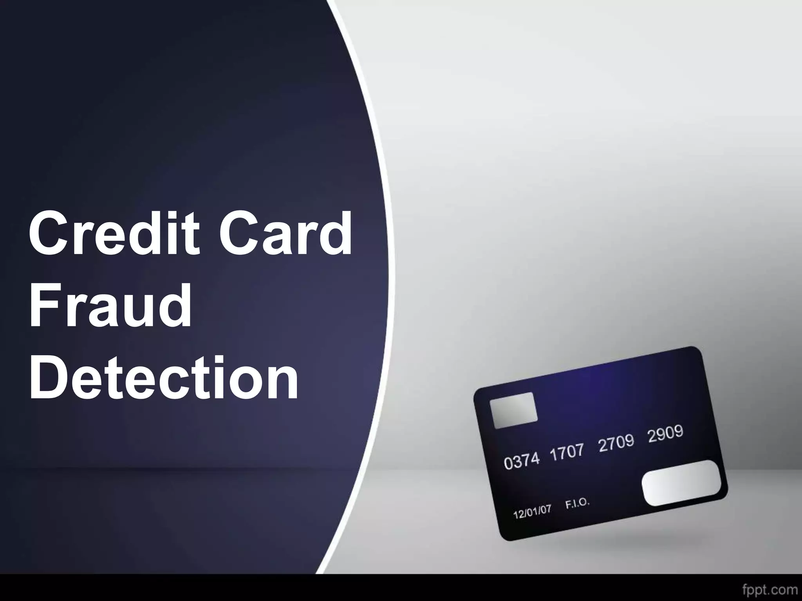

Slide 2
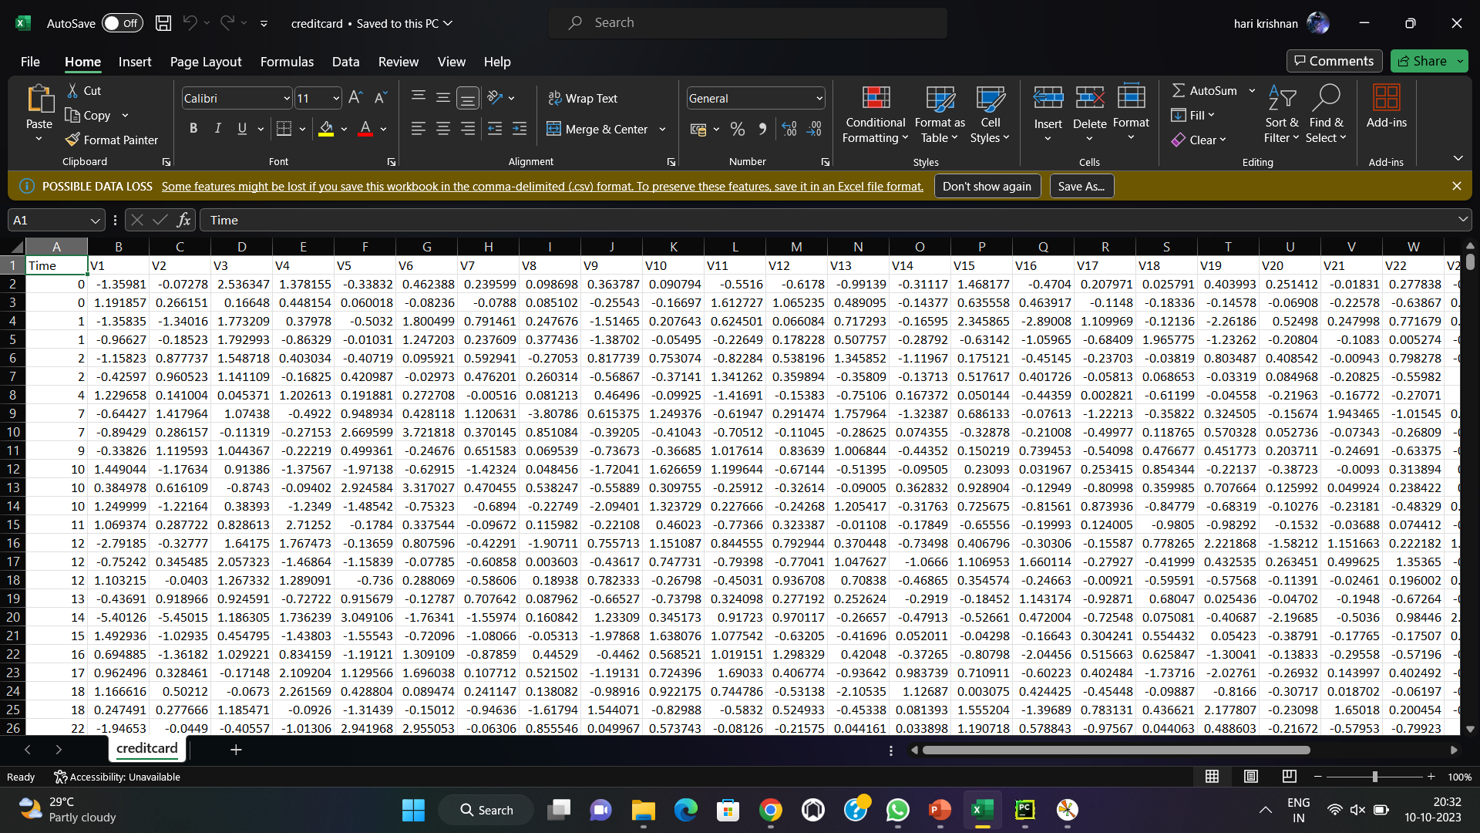
Definition: Credit card fraud detection plays a crucial role in protecting consumers and financial institutions from financial losses and maintaining trust in the payment system. Advanced technologies and continuous monitoring help stay ahead of evolving fraud tactics employed by criminals. Data wrangling techniques: Data wrangling is an iterative process, and the specific techniques you use will depend on the nature of your data and your analysis objectives. It often involves a combination of these techniques to prepare the data for further exploration, analysis, and modeling

Slide 3
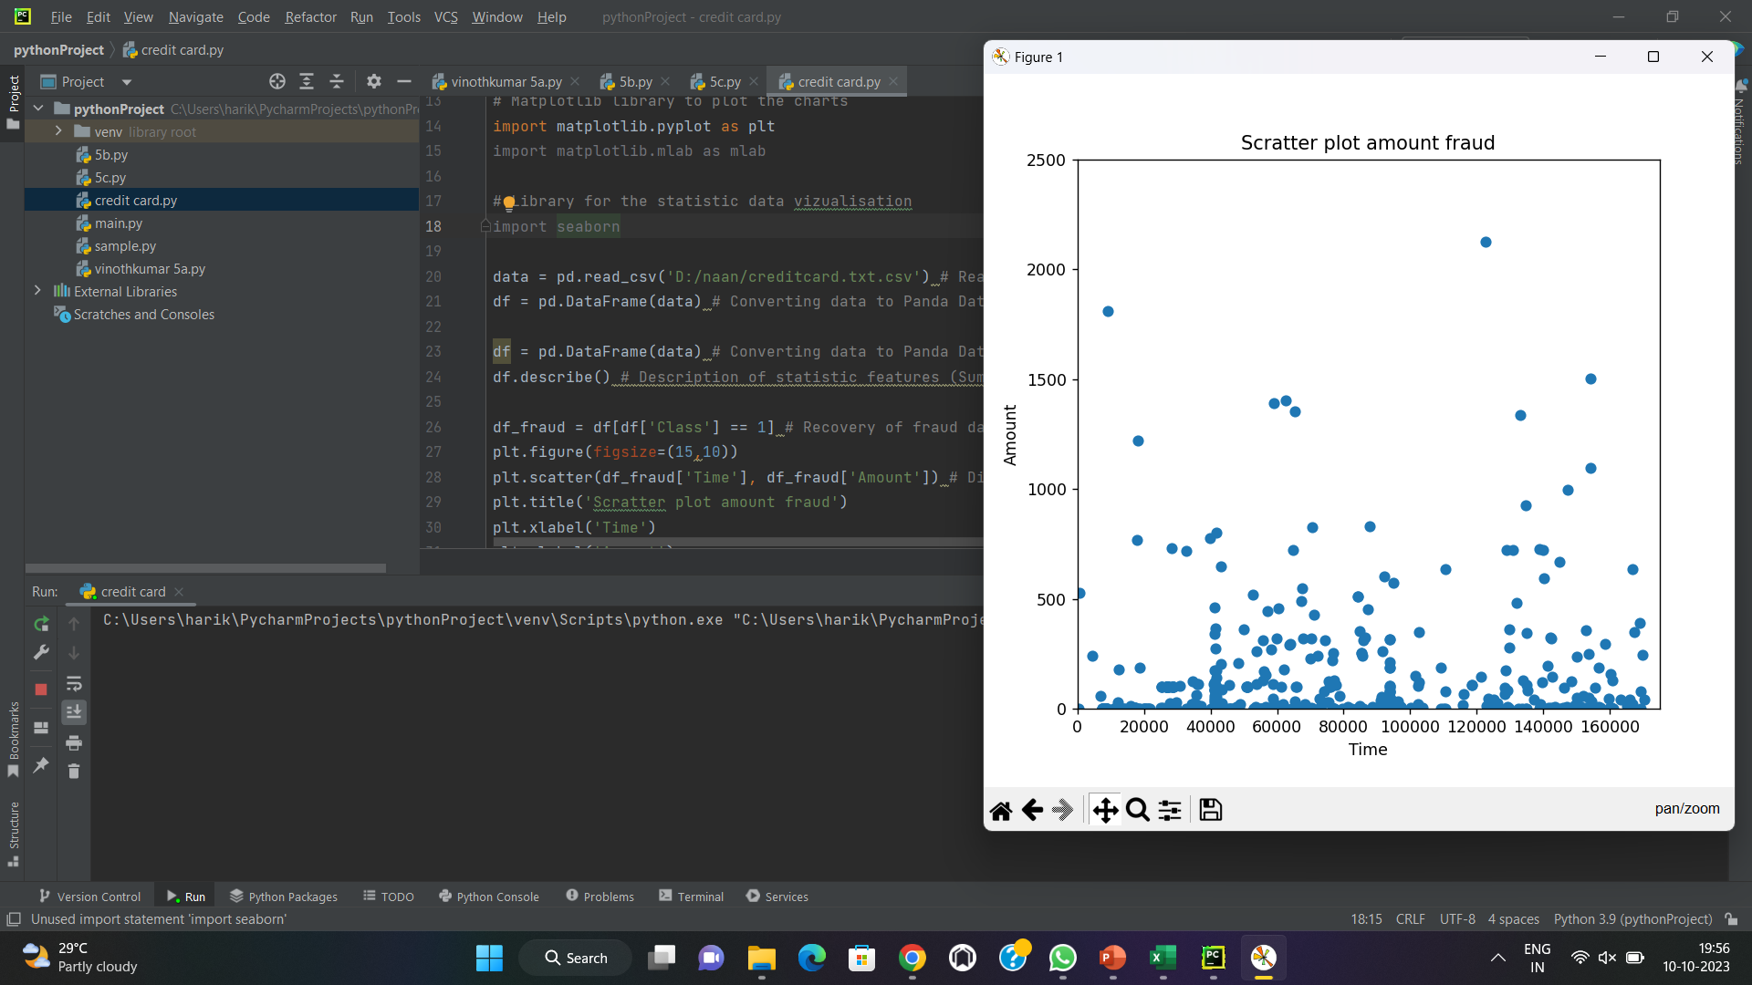
Data analysis: Credit card fraud analysis is an ongoing process that requires vigilance and adaptability to combat evolving fraud techniques. Additionally, compliance with data privacy regulations and ethical considerations is essential when handling sensitive financial data.

Slide 4
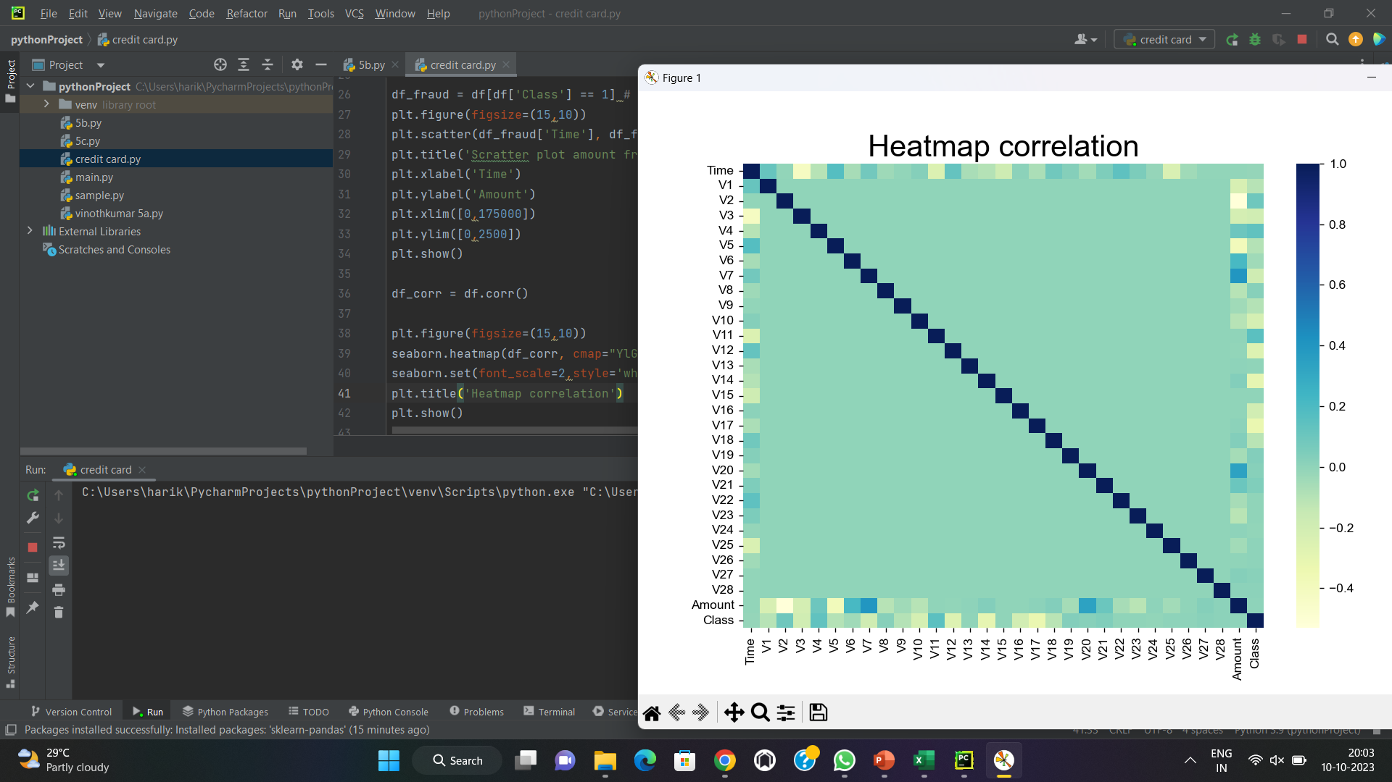
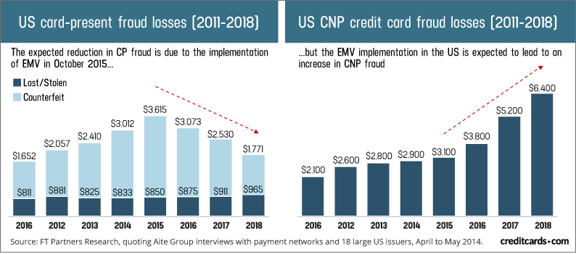
Heatmap: A heatmap is a graphical representation of data in a two-dimensional matrix, where individual values are represented as colors. It is a powerful tool for visualizing and exploring relationships within complex datasets. Heatmaps are commonly used in data analysis, data visualization, and various fields like biology, finance, and machine learning to reveal patterns and trends in the data.
Credit card fraud prediction:
the United States during the mentioned years(2011-2018), I recommend consulting reputable sources such as government agencies, financial institutions, or organizations specializing in fraud prevention and financial data analysis. These sources may publish reports and statistics related to credit card fraud trends and losses.

