Slide 1

B. Tech ECE BECE204L COURSE PROJECT Final Review
Atmosphere & Air Monitoring System
Team Members:
23BEC0358 – HARI KRUTHIK SK
23BEC0037 – SANKESH SU
23BEC0169 – RUDRESH KP
23BEC0208 – SENAPATHY C
SLOT: D2 + TD2
FACULTY: Dr. GOPINATH P

Slide 2
CONTENTS
Literature Survey
Identifying the Gap
Problem Statement
Project Objective
Design Approach and Algorithm
System Architecture
  Project Circuit
  Project Illustration
  Project Codes
  Blynk UI
Analytical and Theoretical Description
Hardware and Software tools used
Result Analysis
Conclusion and Future work
Social and Environmental Impact
Work Plan
Cost Analysis
References

Slide 3


LITERATURE SURVEY
IoT in Environmental
Monitoring
IoT-based monitoring systems are widely used for real-time data collection in environmental applications, providing valuable insights into air quality, pollution levels, and weather conditions.
BMP280 Sensor for
Atmospheric Data
BMP280 sensors are reliable for measuring temperature and atmospheric pressure, widely adopted in weather monitoring and environmental research due to high accuracy and low power consumption.
MQ2 Sensor for Gas
Detection
The MQ2 sensor is commonly used for detecting gas concentrations like LPG, smoke, and methane, making it ideal for air quality systems. Previous studies validate its effectiveness in monitoring indoor and outdoor pollution.
Blynk IoT Platform for
Data Visualization
Blynk has proven effective for real-time monitoring in IoT projects, allowing easy access to data from remote locations. It is commonly used in similar air quality monitoring projects for displaying metrics on mobile devices.
Data Logging
Continuous data logging, as implemented with SD cards, supports analysis over time, enabling trend identification and response planning for air quality management.

Slide 4
IDENTIFYING THE GAP
Limited Real-Time Monitoring
with Data Storage
Many atmosphere & air monitoring systems provide real-time data but lack continuous data logging for historical analysis. Our system addresses this by storing readings every 5 seconds on an SD card.
Few Cost-Effective, Portable
Solutions
Existing systems can be costly and complex, making them less accessible. Our solution is affordable, portable, and easy to implement using ESP32, MQ2, and BMP280 sensors.
Absence of Comprehensive Gas
Monitoring in Small Devices
Most compact devices focus on limited air quality metrics. By integrating multiple metrics (temperature, pressure, LPG, gas, and smoke levels), our system provides a fuller picture of atmosphere & air quality in a single, small device.
Need for User-Friendly IoT
Integration
While many air quality monitors exist, few offer seamless IoT integration for remote monitoring. Our system uses Blynk, enabling users to monitor air quality on mobile devices conveniently.

Slide 5
PROBLEM STATEMENT
Air pollution and poor indoor air quality pose significant health risks, yet accessible, affordable, and comprehensive monitoring solutions are limited. Current systems often lack real-time data accessibility, reliable storage for historical data analysis, or user-friendly remote monitoring. This project aims to develop an Atmosphere & Air monitoring system that provides real-time insights into temperature, pressure, LPG levels, gas concentration, and smoke levels, with continuous data logging and remote monitoring through a mobile app.

Slide 6


PROJECT OBJECTIVE
To design and implement an Atmosphere & air quality monitoring system that:
Measures Key Metrics
  Monitors temperature, pressure, LPG level, gas concentration, and smoke level using BMP280 and MQ2 sensors.
Provides Real-Time Data Access
  Utilizes Blynk for displaying live data on a mobile app for remote monitoring.
Enables Data Logging for Analysis
  Records all sensor readings on an SD card every 5 seconds, allowing for historical data analysis and trend tracking.
Offers a Cost-Effective and Portable Solution
  Uses affordable components to create a compact and accessible device suitable for various settings.

Slide 7


DESIGN APPROACH AND ALGORITHM
Design Approach
ESP32: Main controller, handles data from sensors, sends data to Blynk, logs data on SD card.
BMP280 Sensor: Measures temperature and pressure.
MQ2 Sensor: Measures LPG, gas concentration, and smoke.
SD Card Module: Stores data every 5 seconds for record-keeping and analysis.
Algorithm
Step 1: Initialize sensors and SD card.
Step 2: Read data from BMP208 and MQ2 sensors.
Step 3: Display data on Blynk app in real time.
Step 4: Save data to SD card every 5 seconds.
Step 5: Repeat.

Slide 8
SYSTEM ARCHITECTURE

Slide 9
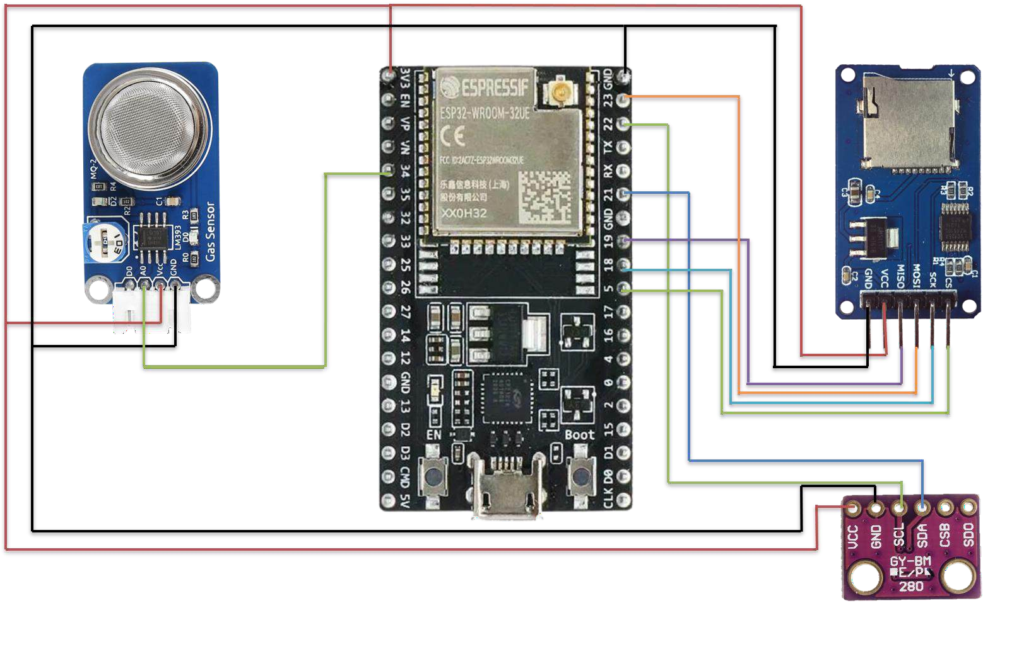
Project Circuit

Slide 10
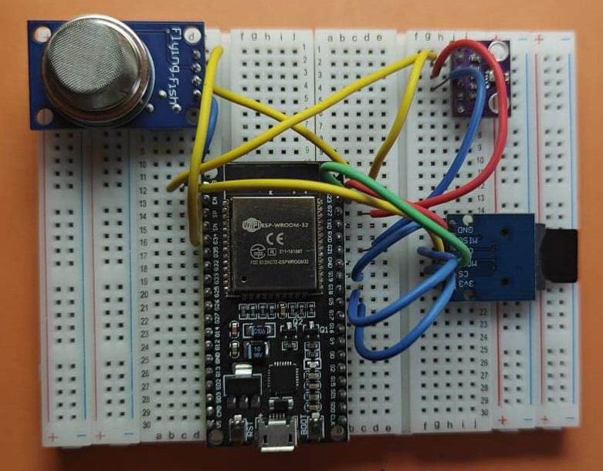
Project Illustration

Slide 11
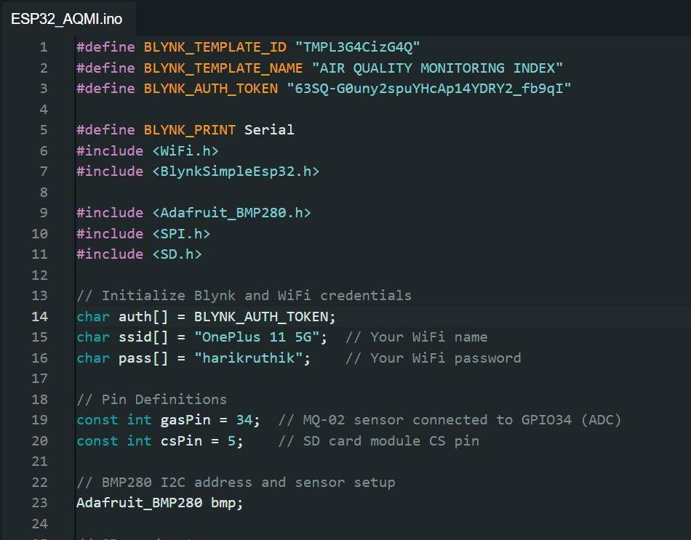
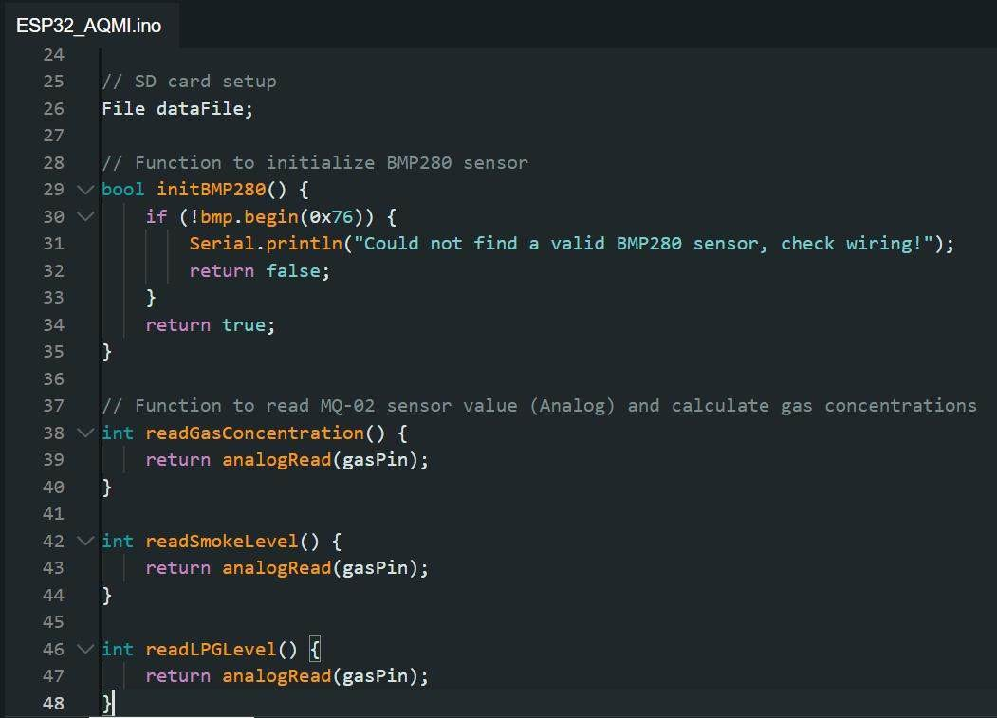
Project Codes

Slide 12
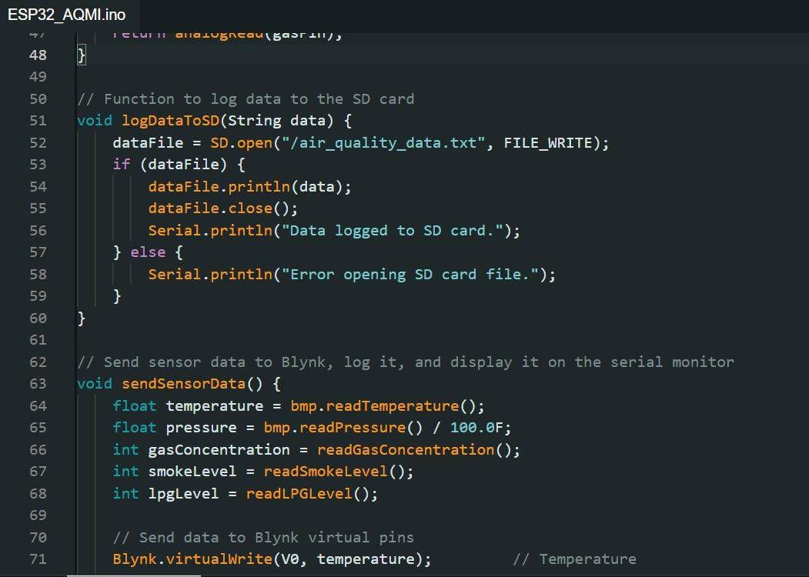
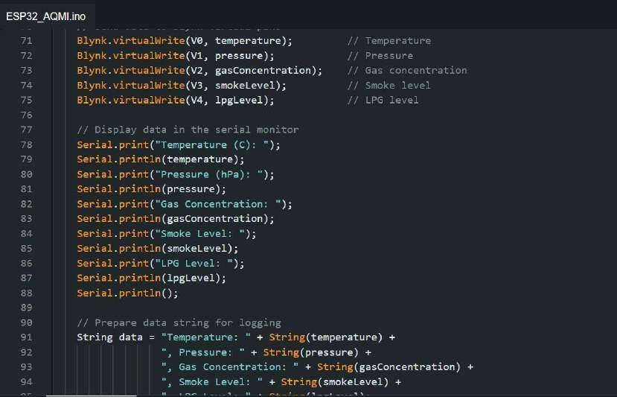
Project Codes

Slide 13
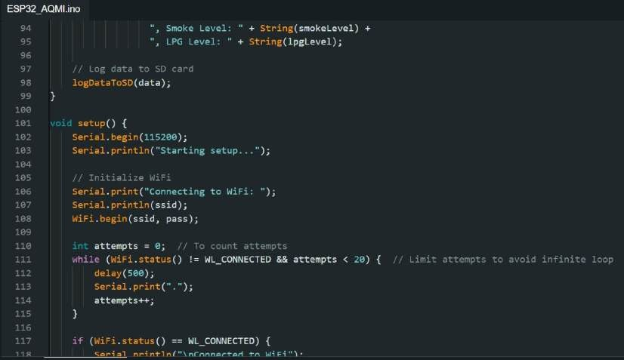
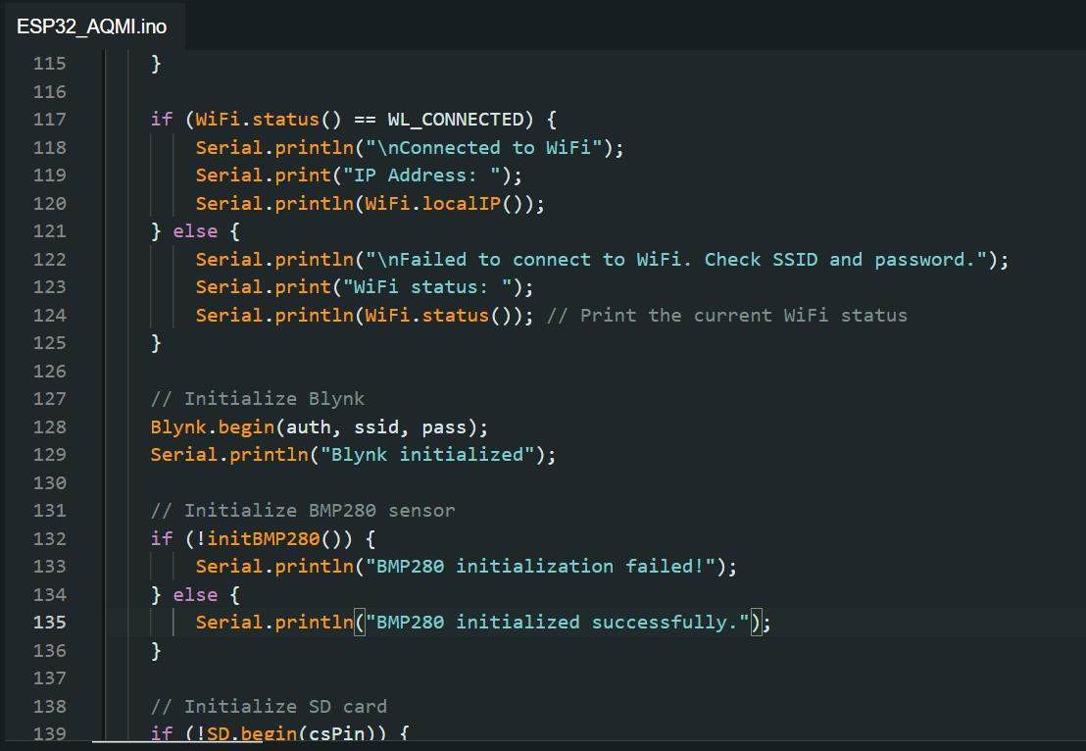
Project Codes

Slide 14
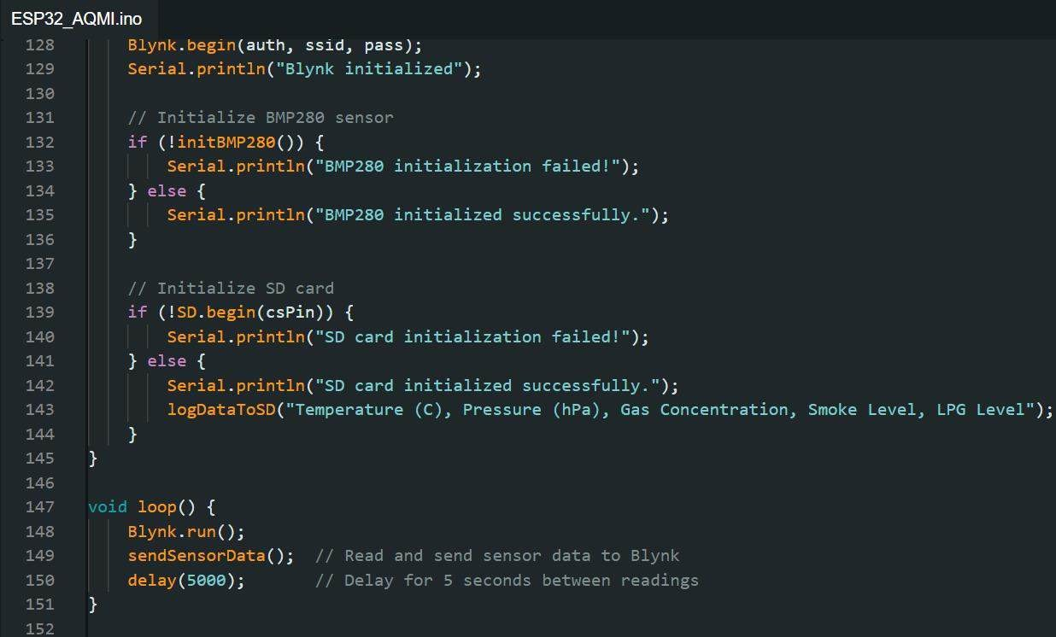
Project Codes

Slide 15
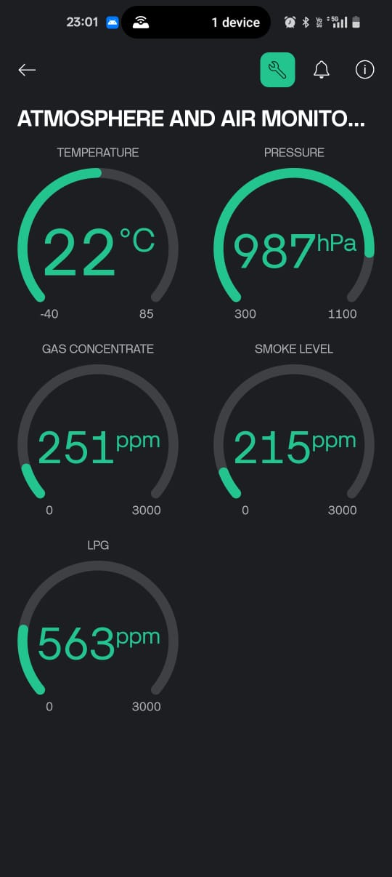
BLYNK UI

Slide 16
ANALYTICAL AND THEORETICAL DESCRIPTION
Sensor Data Interpretation
BMP280 Sensor: Uses barometric pressure and temperature sensors based on piezo- resistive technology. Outputs digital values that correspond to environmental temperature and atmospheric pressure levels.
MQ2 Sensor: The MQ2 sensor operates based on a change in resistance when exposed to gases like LPG and smoke. The sensor outputs a voltage proportional to the concentration of these gases, allowing for an estimation of air pollution levels.
Data Processing and Calibration
Temperature and Pressure Calculation: The BMP208's output values are converted to Celsius and Pascal units based on factory calibration.
Gas Concentration Estimation: The MQ2 sensor provides an analog value, which is converted to gas concentration (ppm) using a specific sensitivity curve and calibration factor.
Data Logging Mechanism
Sampling Frequency: Data is sampled every 5 seconds and stored on the SD card. This enables time-stamped historical analysis.
Data Transmission to Blynk: The ESP32 sends processed sensor data to Blynk via Wi- Fi, allowing real-time monitoring.
Theoretical Basis for System Design
Atmosphere & Air Monitoring System: Theoretical studies show that IoT systems enhance real-time environmental monitoring. Blynk is leveraged to streamline data visualization, following principles of remote sensing and IoT-based environmental analysis.

Slide 17
HARDWARE/SOFTWARE TOOLS USED
ESP32 – Microcontroller for processing sensor data and
connecting to Blynk via Wi-Fi.
BMP280 Sensor – Measures temperature and atmospheric pressure.
MQ2 Sensor – Detects LPG, gas concentration, and smoke levels.
SD Card Module – Stores data every 5 seconds for record-keeping.
Small Breadboard – Keeps all the components intact and helps connect the components
Power Bank – Provides temporary power supply via
ESP32’s micro-USB socket for demonstrations.
Software Tools
Arduino IDE – Used for coding and uploading firmware to ESP32.
Blynk App – IoT platform to monitor real-time data on
mobile devices.

Slide 18



RESULT ANALYSIS
Real-Time Monitoring
  Successful live monitoring of temperature, pressure, LPG level, gas concentration, and smoke level on the Blynk app, demonstrating effective IoT integration.
Data Logging
  Data recorded on the SD card every 5 seconds, providing a continuous log for historical analysis.
System Responsiveness
  System showed prompt response to changes in air quality, with accurate readings displayed in real-time on the mobile app.
Testing and Validation
  A video of the project test has been recorded, demonstrating system functionality and response.
Ctrl + Click here to redirect to the Video
(or copy paste link):
https://drive.google.com/file/d/18byQ9v7wR8aLm_dq0yQSkwy9s2eVX4WH/view?usp=drivesdk

Slide 19
CONCLUSION AND FUTURE WORK
Conclusion
Successfully developed an IoT-based air quality monitoring system capable of tracking temperature, pressure, LPG, gas concentration, and smoke levels in real-time with data logging for analysis.
Limitations and Constraints
Limited sensor range due to cost efficiency may affect accuracy in
larger or open spaces.
Requires continuous Wi-Fi connection for real-time monitoring on Blynk.
Future Improvements
Additional Sensors – Add sensors for more pollutants, such as CO2 and particulate matter.
Data Analysis and Alerts – Implement data analysis features and real-time alert notifications for critical air quality levels.

Slide 20

Social and Environmental Impact
Health and Safety Awareness
Promotes public awareness of indoor air quality, helping users identify harmful levels of pollutants that can affect respiratory health, especially for vulnerable populations.
Environmental Monitoring
Supports efforts to monitor and reduce air pollution by providing accessible, real-time data on key environmental metrics.
Use Case During Diwali
Contribution to Sustainable Living
Enables individuals and communities to take informed actions to improve air quality, contributing to a healthier and more sustainable environment.
Cost-Effective Solution
During Diwali, increased fireworks lead to a spike in air pollution levels.
This system allows households to monitor air quality in real-time, helping them make decisions about ventilation, mask usage, or limiting outdoor exposure, especially for children, the elderly, and individuals with respiratory issues.
Provides an affordable way to track air quality, making it accessible to households, schools, and small businesses focused on creating safer environments.

Slide 21
WORK PLAN
PHASE | TIME PERIOD | TASKS | CONTRIBUTION
Phase 1 | Before CAT1 Exams | Planning and discussing the project ideas. | Collaborative brainstorming and idea generation by all team members.
Phase 2 | After CATI and before CATII Exams | Finalized the project topic, researched sensors, coding requirements, and purchased components. | Each member researched specific areas (sensors, coding, hardware) and pooled findings.
Phase 3 | After CATII | Assembled all components, resolved bugs, and completed the project to perfection. | Worked together on assembly, debugging, and finalization for a successful implementation.

Slide 22

23BEC0169 – RUDRESH KP
Project Planning: Contributed to brainstorming and discussing project ideas and
objectives during Phase 1.
IoT Integration: Took charge of integrating the IoT platform (Blynk) and ensuring real-time data transmission to the mobile app.
23BEC0037 – SANKESH SU
Component Purchase: Responsible for sourcing and purchasing necessary components for the project.
Research on Sensors: Took the lead in researching suitable sensors (BMP280 and MQ2) for the air quality monitoring system.
23BEC0358 – HARI KRUTHIK SK
INDIVIDUAL CONTRIBUTION
System Design: Contributed to system architecture and design, ensuring proper integration of ESP32, sensors, and SD card module.
Coding: Developed the code to interface with the BMP280 and MQ2 sensors, as
well as for data logging and communication with Blynk.
Testing: Performed initial system tests and identified issues related to sensor calibration and data accuracy.
23BEC0208 – SENAPATHY C
        Debugging and Bug Fixing: Worked on resolving bugs related to the hardware and software integration during Phase 3.
        Final Presentation: Assisted in preparing the final project report and presentation, ensuring clarity and coherence..

Slide 23
COST ANALYSIS
Component | Description | Cost (INR)
ESP32 | Microcontroller for processing and Wi-Fi connectivity. | 300
BMP280 Sensor | Sensor for measuring temperature and atmospheric pressure. | 50
MQ2 Sensor | Sensor for detecting LPG, gas concentration, and smoke. | 100
SD Card Module | For storing data logs every 5 seconds. | 100
Power Bank | Temporary power supply for testing. | 500
Wires and Connectors | For connecting components and assembly. | 50
Miscellaneous | Small additional items (PCB, casing, etc.). | 100
 | Total Estimated Cost: ₹1,200 (approx.)

Slide 24
REFERENCES
C. F. Johnson, S. K. Bandyopadhyay, and P. S. Chakrabarti, “Real-time monitoring of air quality using wireless sensor networks,” in Proc. Int. Conf. Communication and Signal Processing, Apr. 2016.
A. R. Ranjan, A. G. Kulkarni, and M. K. Pandey, “Design and implementation of air quality monitoring system based on IoT,” in IEEE Int. Conf. Smart Technologies and Management for Computing, Communication, Controls, Energy and Materials, Oct. 2019.
L. D. Castro and R. S. Schenkel, “Wireless air quality monitoring system using IoT technologies,” in Proc. IEEE Int. Symp. Consumer Electronics (ISCE), Jun. 2018, pp. 1-6.
G. M. M. Faris and E. S. El-Alfy, “Smart air quality monitoring using internet of things (IoT),” in 2020 Int. Conf. Electrical Engineering and Computer Science (ICEECS), Aug. 2020, pp. 1-6.
S. Fefilatyev, “Algorithms for Visual Maritime Surveillance with Rapidly Moving Camera,” Ph.D. dissertation, Univ. South Florida, 2012.

Slide 25
Digi-Key Corporation. [Online]. Available: http://www.digikey.com
A. Wu, “IoT Air Quality Sensors: A Comprehensive Guide,” All About Circuits, 2021. [Online]. Available: https://www.allaboutcircuits.com
R. K. Gupta, S. Dey, and T. Banerjee, “IoT-enabled air quality monitoring system for smart cities,” in Proc. IEEE Sensors Conf., Sep. 2021, pp. 1045-1052.
H. K. Sharma, M. R. Islam, and A. Choudhury, “A low-cost IoT-based air pollution monitoring system using ESP32,” in Proc. 2022 IEEE Conf. Emerging Technologies (ICET), Dec. 2022, pp. 158-163.
M. A. Khan and F. Zhang, “Design and implementation of an air quality index prediction system using IoT and machine learning,” in Proc. IEEE Int. Conf. Artificial Intelligence and IoT (AIIoT), Oct. 2023.

