Slide 1

Precision-Scalable NPU (4×4)
A Multi-Precision Neural Processing Unit using INT2 / INT4 / INT8
Team Presentation | Edge AI Hardware Design
TEAM :
Sanjay Krishna A [ 23BEC0113 ]
Hari Kruthik SK [ 23BEC0358 ]
Sriram KP [ 23BEC0206 ]
Kamalesh [ 23BEC0298 ]

Slide 2
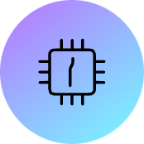



Problem Statement
Fixed Precision Limitation
Hardware Duplication
Existing NPUs operate at fixed precision (typically INT8 or higher), limiting flexibility for diverse neural network workloads
Supporting multiple precisions requires separate hardware blocks, increasing cost, area, and power consumption significantly
Edge AI Flexibility Gap
No Unified Solution
Edge systems need runtime trade-offs between performance and power efficiency across different precision levels
Lack of integrated hardware supporting runtime precision scaling for matrix operations in neural networks

Slide 3

Our Solution & Innovation
Architecture Overview
4×4 NPU built with precision-scalable MAC units
Unified hardware for INT2, INT4, INT8 operations
Weight-stationary systolic-style design
16 parallel MAC tiles for matrix computation
Key Innovations
Single datapath supports multiple precisions without duplication
Runtime precision switching via mode signal
4× throughput boost at INT2, 2× at INT4
FPGA-friendly, scalable, low-cost implementation

Slide 4
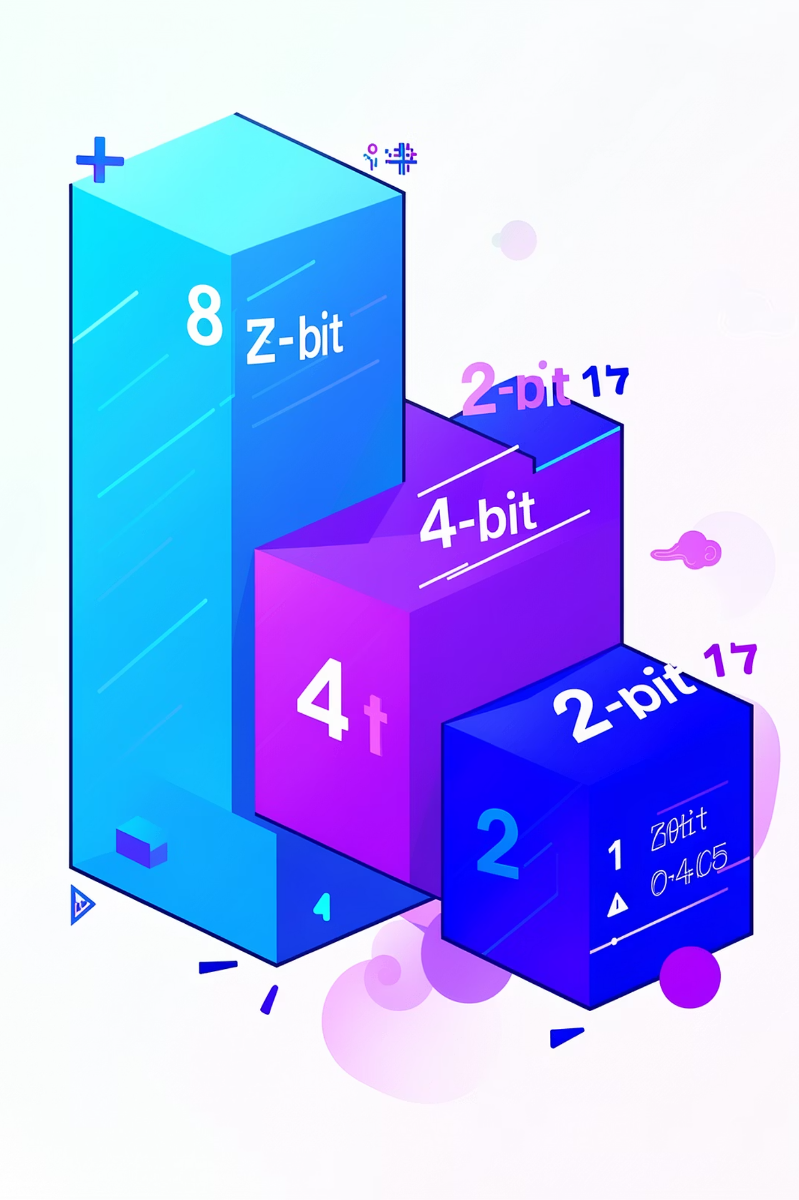


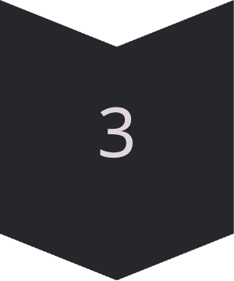
Precision Scaling Concept
Single hardware block adapts to different precision requirements dynamically
INT8 Mode
Full 8-bit precision for accuracy-critical operations
INT4 Mode
2× throughput by packing two 4-bit values per 8-bit lane
INT2 Mode
4× throughput using four 2-bit values per 8-bit lane

Slide 5
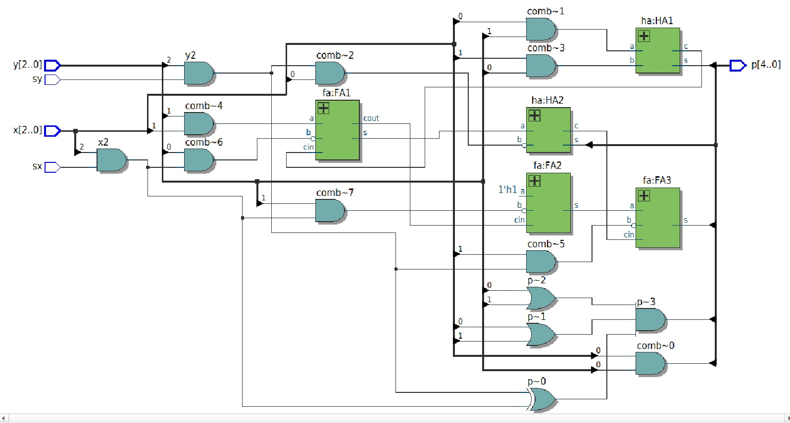
SBB — Simple Bit Brick
Atomic 2×2-bit signed Baugh-Wooley multiplier · gate-level implementation
RTL Schematic
What is SBB?
The atomic compute cell — the smallest multiplier unit.
Inputs: x[2:0], y[2:0], sx (sign-x), sy (sign-y)
Output: p[4:0] — 5-bit signed product
Method: Baugh-Wooley signed multiplication using AND gates, Half Adders (HA) and Full Adders (FA). No standard multiplier primitive used.
Key Optimisation
Standard 2×2 signed multiply has 6 partial products.
This implementation
removes p[5], saving one Full Adder and one AND gate — area and power reduction at the atomic level.
Role in Hierarchy
Every multiplication at every precision level ultimately decomposes into SBB computations.
SBB ⊂ BBU (4×SBB) ⊂ RFU (4×BBU)
PSMAC NPU — Precision-Scalable Multiply-Accumulate Unit
4 / 13

Slide 6
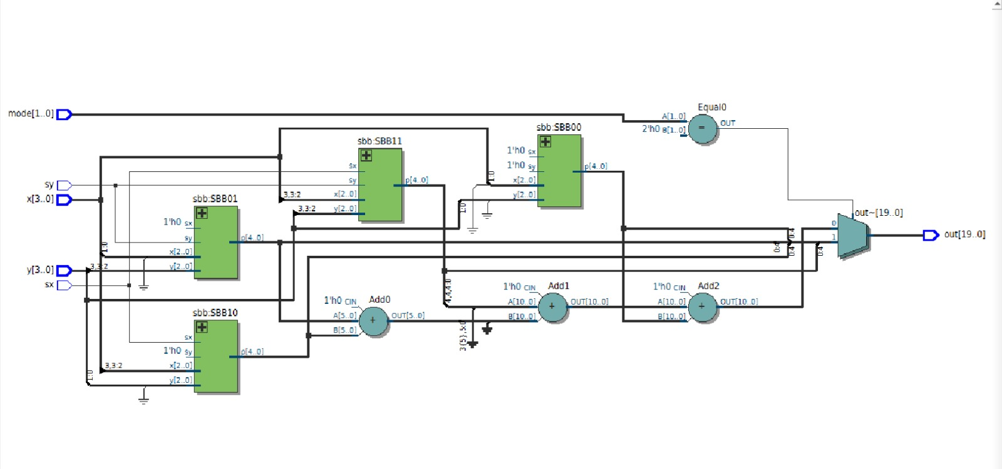
BBU — Bit Brick Unit
4×SBB + adders — computes all partial products of a 4×4-bit Karatsuba multiply
RTL Schematic
What is BBU?
Groups 4 SBB cells to compute all partial products of a 4×4-bit multiply:
SBB00: xL×yL, SBB01: xL×yH
SBB10: xH×yL, SBB11: xH×yH
Ports: x[3:0], y[3:0], sx, sy, mode[1:0] → out[19:0]
Mode-Dependent Output
INT2 mode (00): Four independent 5-bit products packed: {p11u, p10u, p01u, p00u}
INT4/INT8 mode: Karatsuba fusion:
p11_shifted + mid_shifted + p00_ext → fused[10:0]
Adders in RTL
Add0: p01 + p10 → mid[5:0] (cross terms)
Add1: p11_shifted + mid_shifted → partial
Add2: partial + p00_ext → fused[10:0]
Final mux selects INT2-pack vs fused based on mode.
PSMAC NPU — Precision-Scalable Multiply-Accumulate Unit
5 / 13

Slide 7
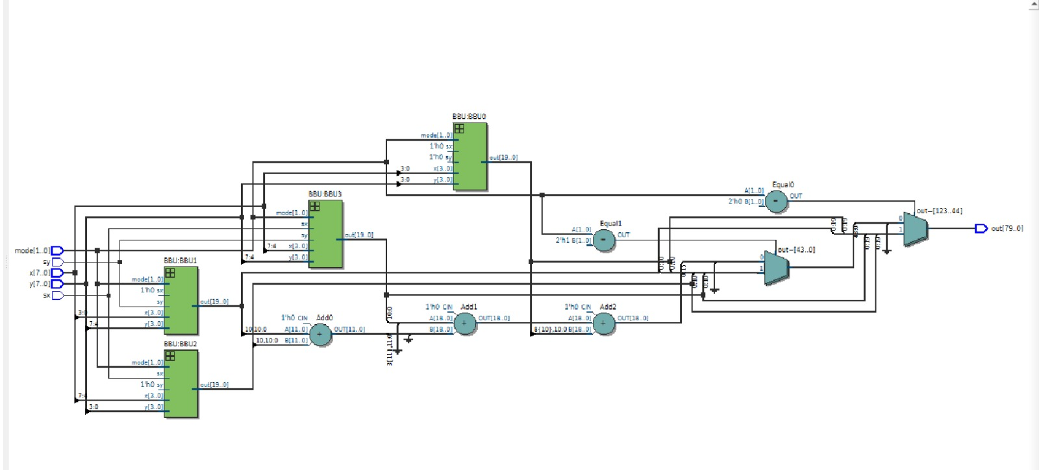
RFU — Recursive Fusion Unit
4×BBU — full 8×8-bit precision-scalable multiplier core
RTL Schematic
What is RFU?
The top-level multiply core. Contains 4 BBU instances, splitting 8-bit inputs into nibbles:
BBU0: xL×yL, BBU1: xL×yH
BBU2: xH×yL, BBU3: xH×yH
Output: out[79:0] — packed based on mode
80-bit Output Layout by Mode
INT8 (2'b10):
bits [15:0] = single 16-bit Karatsuba result
bits [79:16] = zeros
INT4 (2'b01):
four 11-bit slots: p0[10:0], p1[21:11], p2[32:22], p3[43:33]
INT2 (2'b00):
p3[19:0], p2[19:0], p1[19:0], p0[19:0] — 16 sub-products
Fully Combinational
No clocked elements in RFU. All computation is purely combinational — output valid within the same clock cycle that inputs are presented. This enables the 2-stage pipeline in psmac_top.
PSMAC NPU — Precision-Scalable Multiply-Accumulate Unit
6 / 13

Slide 8
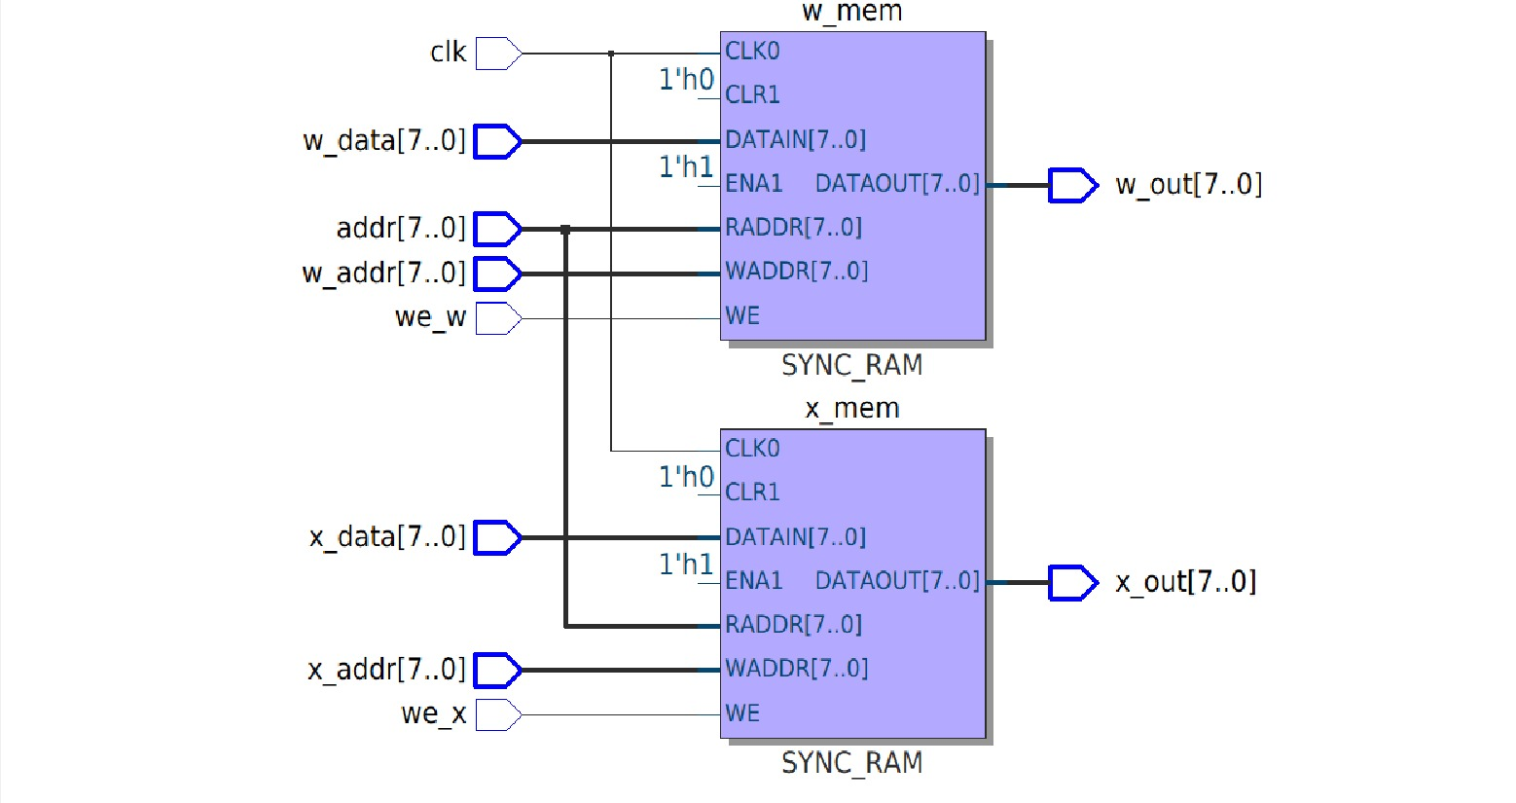
weight_mem — Memory array
Dual 256×8-bit SRAM with asynchronous read
RTL Schematic
What is weight_mem?
Stores both input activations (x_mem) and weights (w_mem).
Each is a 256-deep × 8-bit wide SRAM block.
The FSM drives a single
addr[7:0] port — both memories read the same address simultaneously.
Async Read — Critical Design Choice
assign x_out = x_mem[addr]
assign w_out = w_mem[addr]
Data is valid the same cycle that FSM drives addr. This eliminates one pipeline stage — the RFU can begin computing immediately without waiting one extra clock for memory output.
Write Interface
Writes are synchronous (posedge clk).
w-path: we_w, w_addr[7:0], w_data[7:0]
x-path: we_x, x_addr[7:0], x_data[7:0]
Testbench loads all values before asserting psmac_en.
PSMAC NPU — Precision-Scalable Multiply-Accumulate Unit
7 / 13

Slide 9
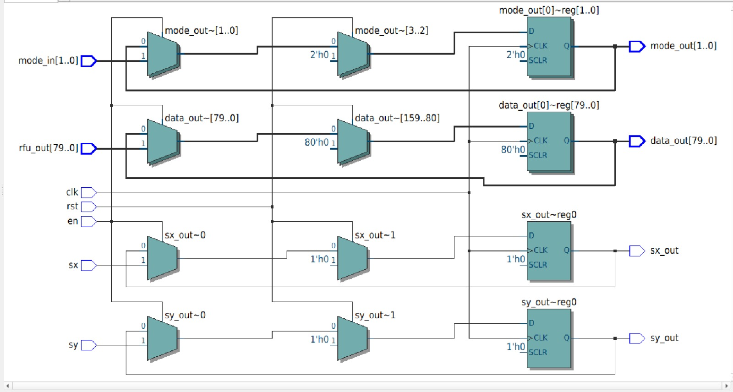
pipe_reg — Pipeline Register
80-bit D-FF bank — breaks combinational path for timing closure
RTL Schematic
What is pipe_reg?
An 80-bit wide clocked D-FF register bank that latches the RFU output on posedge clk when pipe_en = 1.
It also pipelines: mode[1:0], sx, sy — so the accumulator always knows the mode of the data currently in the register.
Why It Exists — Timing
The chain: weight_mem (async) → RFU (combinational) creates a very long combinational path.
Without pipe_reg: the 80-bit RFU output directly drives the accumulator — critical path too long for high Fmax.
With pipe_reg: path is broken into two stages. Each stage can run at higher frequency.
Synchronous Reset
On rst=1:
data_out ← 0, mode_out ← 0, sx_out ← 0, sy_out ← 0
On en=1 (pipe_en from FSM):
All four outputs latch their respective inputs.
PSMAC NPU — Precision-Scalable Multiply-Accumulate Unit
8 / 13

Slide 10
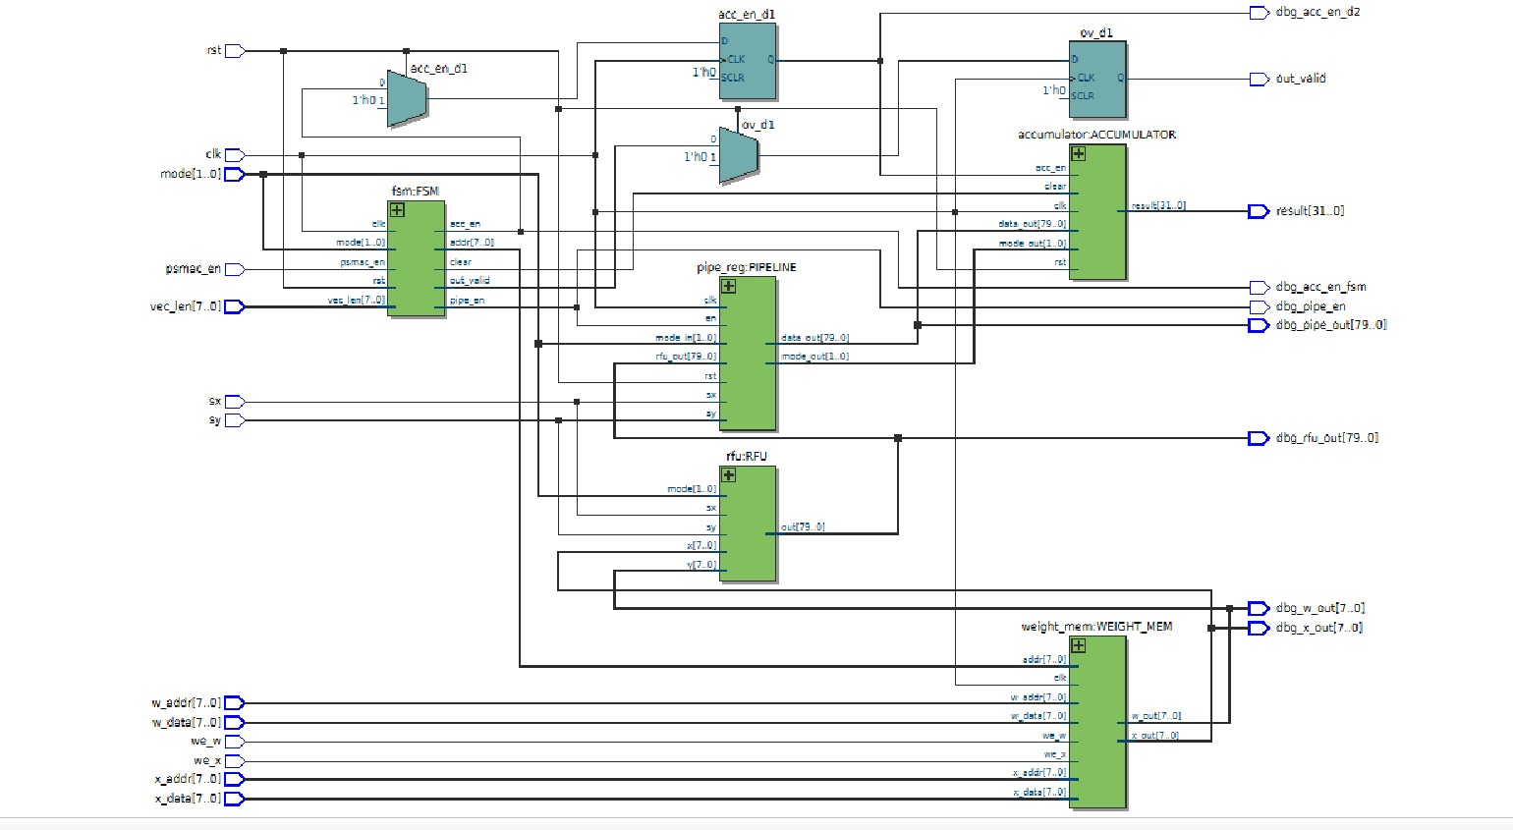
psmac_top — Full Integration
Top-level module: all blocks connected with 2-stage pipeline and acc_en_d1 alignment fix
RTL Schematic — psmac_top
2-Stage Pipeline
acc_en_d1 Fix
ov_d1 Register
Debug Ports
addr → weight_mem (comb) → RFU (comb) → pipe_reg (clocked) → accumulator (clocked)
D-FF delays acc_en by 1 cycle. Prevents accumulator from adding stale pipe_reg data.
out_valid delayed 1 cycle to ensure result is fully stable before asserting to testbench.
dbg_x_out, dbg_w_out, dbg_rfu_out, dbg_pipe_out, dbg_acc_en_d2, dbg_pipe_en exposed for waveform inspection.
PSMAC NPU — Precision-Scalable Multiply-Accumulate Unit
11 / 13

Slide 11
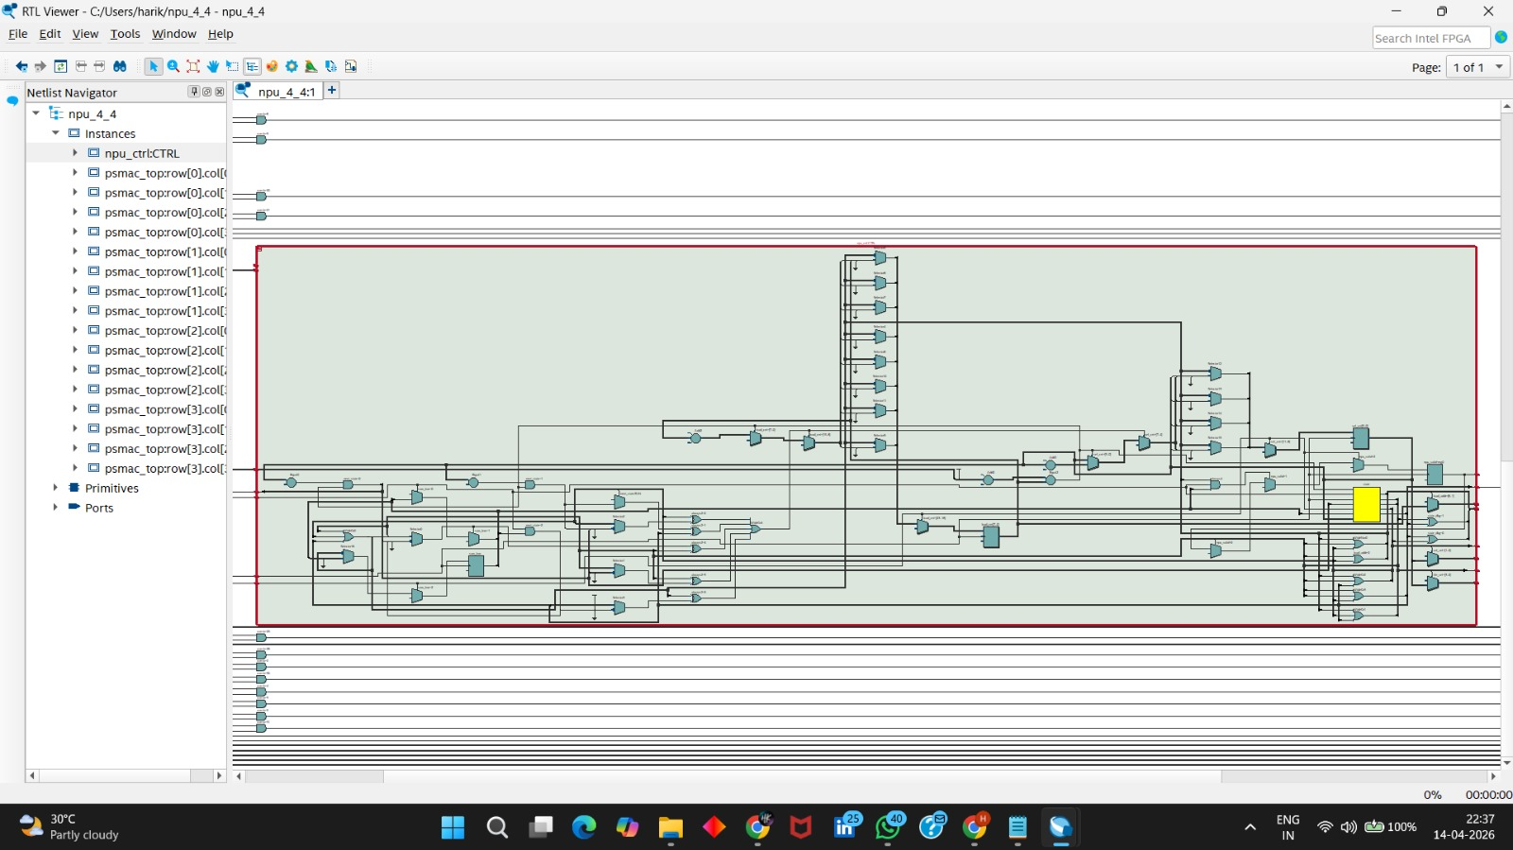

Slide 12
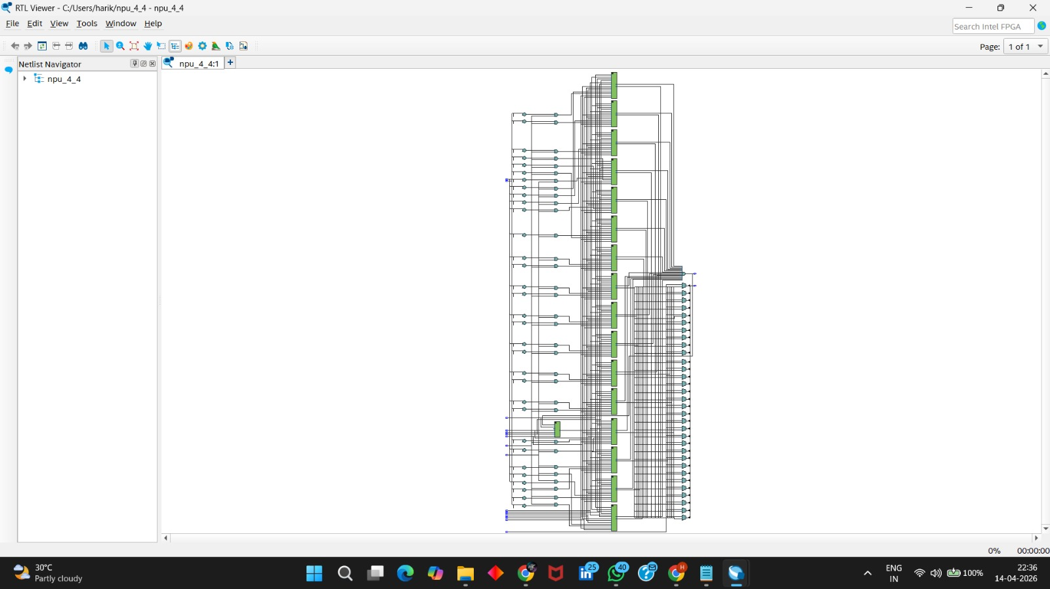

Slide 13
NPU Controller (npu_ctrl)
IDLE
1
Initial state, awaiting command
2
LOAD_W
Load weights into tile memories
LOAD_X
3
Broadcast inputs per column
4
RUN
Trigger parallel computation
COLLECT
5
Gather results via MUX
Control Signals
Key Features
we_w, we_x (write enables)
psmac_en (enable MACs)
tile_sel, col_sel
result_sel, npu_valid
Automates full inference cycle, optimizes data movement, controls 16 MAC units in parallel with shared control signals.

Slide 14

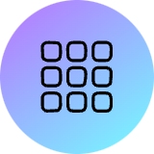
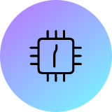

Full NPU Architecture (4×4 Array)
16 PSMAC Tiles
Weight-Stationary
4×4 grid computes Y = W × X
Local storage, input streaming
High Throughput
16-64 MACs/cycle depending on precision
Matrix Multiplication Mapping
Each tile computes one output element Y[r][c] through parallel computation with shared control signals.

Slide 15
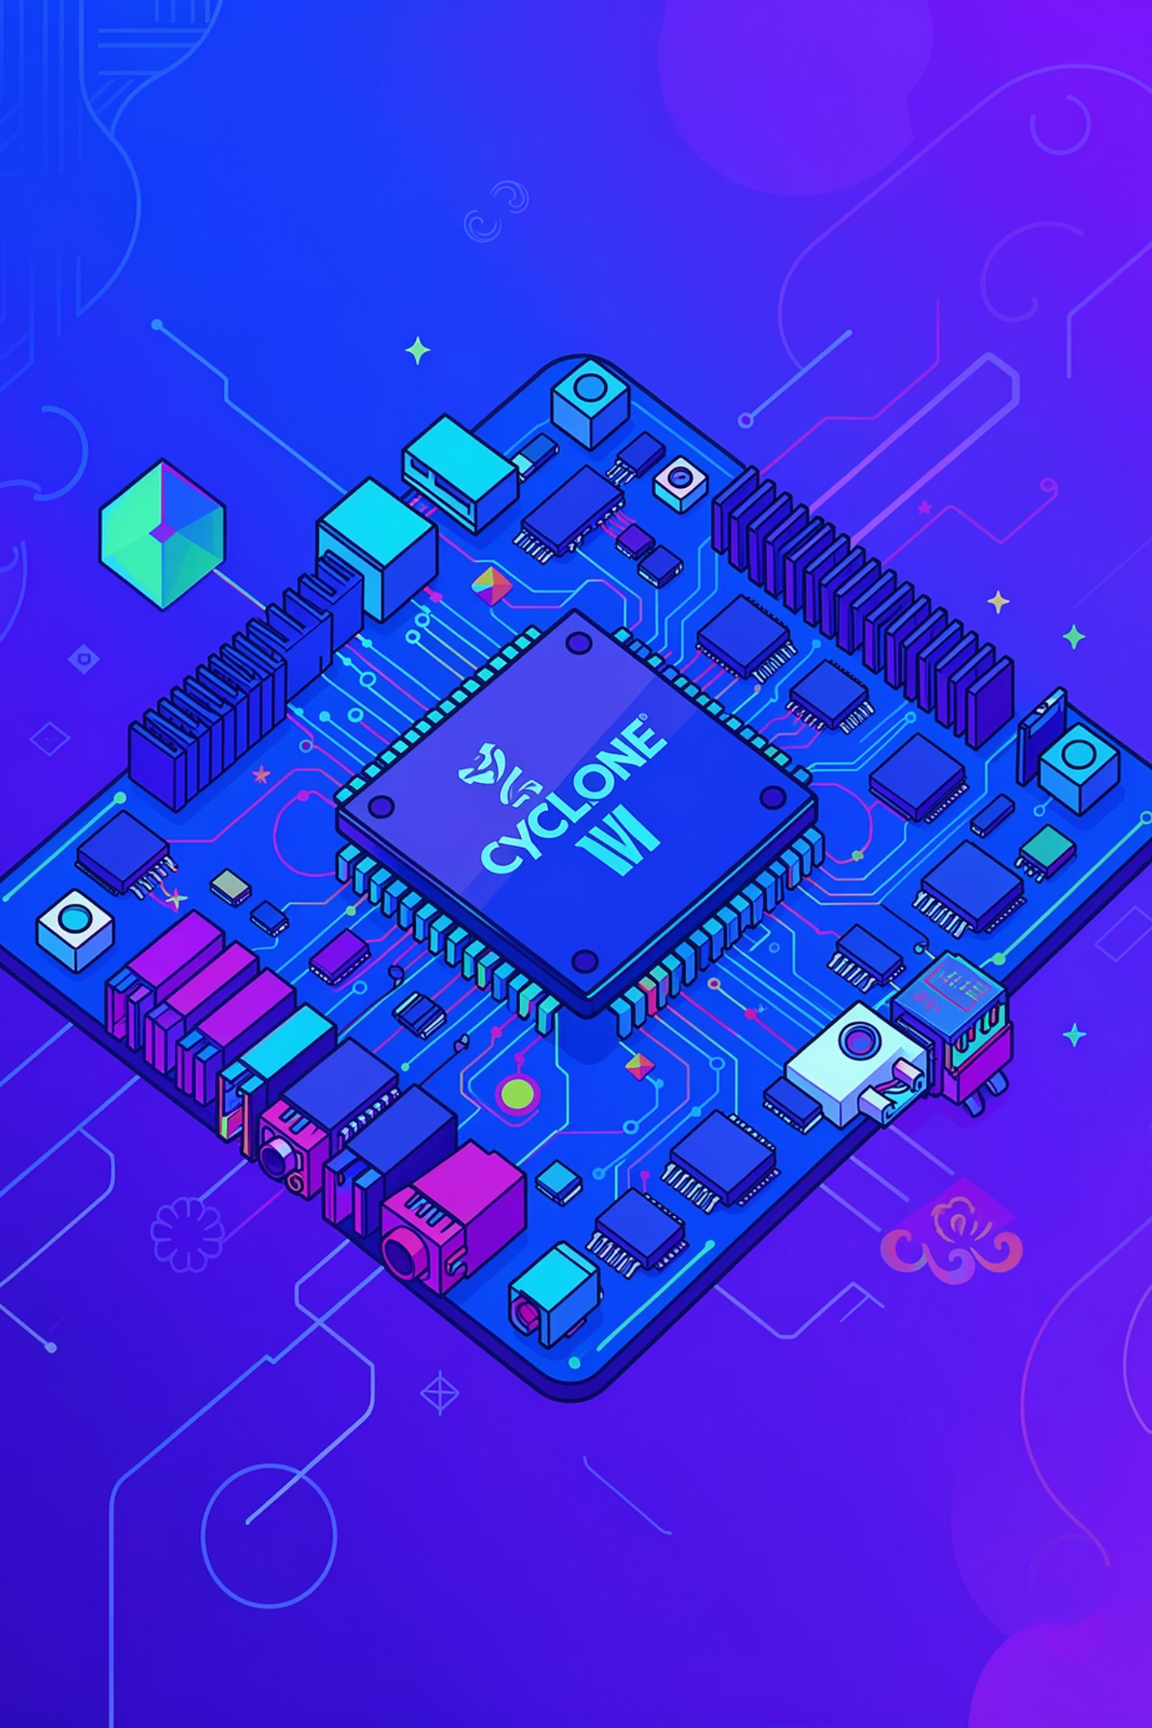
Implementation Results
4×4
40 MHz
NPU Size
Operating Freq
16 MAC tiles in systolic array
Maximum clock speed achieved
100%
Resource Utilization
Efficient logic usage on Cyclone IV
Key Achievements
4× Throughput Gain
Unified Architecture
INT2 mode delivers quadruple processing rate vs INT8 baseline
Single design supports all precision levels without hardware duplication
FPGA-Optimized
Low-cost Cyclone IV implementation suitable for edge deployment

Slide 16


Conclusion & Future Work
Key Contributions
Future Enhancements
First 4×4 NPU with runtime precision scaling
Single datapath for INT2/INT4/INT8 operations
4× throughput improvement at lower precision
FPGA-friendly systolic architecture
Weight-stationary dataflow for efficiency
Integration with larger AI accelerator platforms
Support for floating-point precision modes
Advanced quantization-aware training methods
Power gating for dynamic voltage scaling
Multi-layer neural network automation
Impact: This design bridges the gap between fixed-precision ASICs and flexible FPGA implementations, enabling adaptive precision for edge AI applications

