Slide 1

Project-1
Review-II
School of Electronics Engineering (SENSE)
B.TECH CAPSTONE PROJECT
CNN-Based Hardware Accelerator for Automated
Solar Panel Condition and Fault Classification
Team members:
Under the guidance of:
Hari Kruthik S K | 23BEC0358
Dr. Arunachalam V
Professor Grade 1
Department of Micro and Nanoelectronics
School of Electronics Engineering (SENSE)
Vellore Institute of Technology (VIT), Vellore
Rudresh K P | 23BEC0169
Viswin Kumar R K | 23BEC0088
Project-1 Review-2 | MNE_PANEL_3 | Venue: TT-237-A | Date: October 14, 2026 Slide 1 of 18

Slide 2

Fault Dynamics in Indian Residential Rooftop Solar System
PM Surya Ghar: Muft Bijli Yojana | Edge-AI-Based PV Condition & Fault Diagnosis
CASE SURVEY & OPERATIONAL CONTEXT: Under the PM Surya Ghar national scheme, 3–5 kW residential installations operate unmonitored in dense urban microclimates, exposed to particulate soot, localized avian shading, and irreversible thermal stress.
Particulate Soiling & Generation Attenuation (Field Survey Evidence)
• Optical Attenuation: Airborne dust and particulate matter create an optical extinction boundary scattering incoming irradiance.
• Bangalore Urban Rooftop Study [Mani & Pillai, Renew. Sust. Energy Rev.]: Comparative 30-day study recorded ~20% monthly generation loss in uncleaned modules vs <4% with weekly cleaning.
• Delhi NCR Particulate Study [DTU / CEEW Soiling Survey]: Documented persistent 0.25%/day (~7.6% monthly) loss rate under heavy PM2.5 vehicular carbonaceous soot.
Localized Opaque Shading (Urban Bird-Drop & Series Circuit Constraint)
• Localized Shading: Rock pigeons (Columba livia) nesting near arrays deposit non-uniform, opaque guano patches across isolated cells.
• Series Current Choke [Maghami et al., IEEE Access]: Modules wired in series strings choke total string current to the shaded cell: I_string ≈ min(I_ph,1, ..., I_ph,n).
• Field Evidence: Just 1–2 opaque droppings trigger an instantaneous 15%–35% collapse in series string yield across residential installations.
Thermal Hotspots & Irreversible Physical Cell Degradation
• Reverse-Bias Heating [Dhimish et al., IEEE Trans. Electron Devices]: Shaded cells forced to conduct string current dissipate power as heat: P_diss ≈ I_string · |V_rev|.
• Temperature Rise: Shaded cell temperatures elevate to 85°C–110°C under surveyed Indian summer ambient irradiance.
• Physical Degradation: Localized thermal cycling accelerates EVA browning, delamination, and glass thermal-shock fractures, permanently shortening module life.
The Inverter Diagnostic Blind Spot & Co-Design Motivation
• Telemetry Blind Spot: Domestic string inverters monitor only aggregate DC voltage, current, and power (V_dc, I_dc).
• Diagnostic Deficit: Electrical data alone cannot differentiate uniform washable dust (water rinse) from urgent bird-drop hotspots (burnout risk) or cracked glass (warranty claim).
• Solution: On-device Edge-AI vision accelerator diagnosing surface defects locally without manual rooftop climbs or 24/7 cloud streaming.
Residential PV Array Surface Exposure
Decentralized rooftop inverters lack localized spatial diagnostics to differentiate fouling states.
Project-1 Review-2 | MNE_PANEL_3 | Venue: TT-237-A | SENSE, VIT Vellore Department of Electronics and Communication Engineering Slide 2 of 18

Slide 3
Project Alignment with UN Sustainable Development Goals (SDGs)
7
CLEAN ENERGY
SDG 7 – Affordable and Clean Energy
✦
• Solar panels generate clean, renewable electricity, but dust, bird droppings, and physical damage can affect their performance.
• Our CNN classifies panel conditions from images, which could help identify panels that need inspection or maintenance.
9
INNOVATION
SDG 9 – Industry, Innovation and Infrastructure
✦
• We combine artificial intelligence with a proposed hardware accelerator to explore efficient deployment on embedded devices.
• The zero-aware processing element is a proposed design; hardware efficiency and power benefits still need validation.
12
LESS WASTE
SDG 12 – Responsible Consumption and Production
✦
• Automated condition identification could help maintenance teams make better decisions.
• It may help avoid unnecessary maintenance or premature replacement of solar panels.
Overall: supporting reliable solar maintenance, efficient AI innovation, and more informed resource use.
Project-1 Review-2 | MNE_PANEL_3 | Venue: TT-237-A | SENSE, VIT Vellore Department of Electronics and Communication Engineering Slide 4 of 18

Slide 4
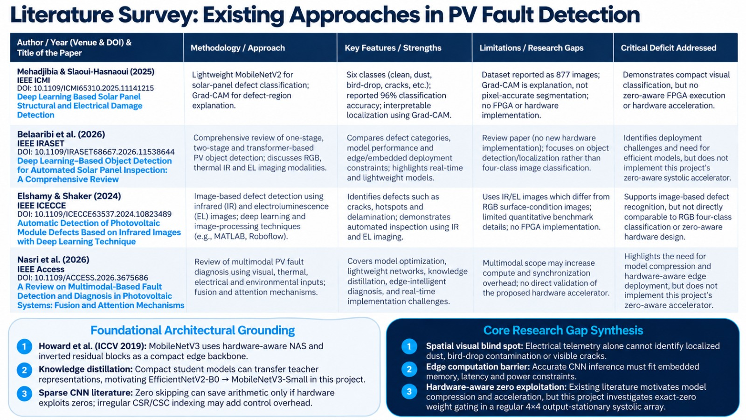
Literature Survey: Existing Approaches in PV Fault Detection
Author / Year (Venue & DOI) | Methodology / Approach | Key Features / Strengths | Limitations / Research Gaps | Critical Deficit Addressed
Muhammad & Ridzuan (2024) IEEE ICPEA DOI: 10.1109/ICPEA60617.2024.10498573 | Electrical I–V curve analysis, condition monitoring & power-loss curve synthesis. | Detects string-level electrical anomalies & line-to-line inverter mismatch on utility arrays. | Cannot detect localized surface fouling (dust, bird drops, hairline cracks); blind to optical state. | Blind to spatial physical defects
Rao et al. (2024) IEEE ICACITE DOI: 10.1109/ICACITE60783.2024.10616999 | Image-based PV fault detection using heavy VGG-16 and YOLO backbones. | Surface defect identification; classifies visible cracks and hotspots with high standalone accuracy. | Heavy backbones require substantial compute/GPU resources, presenting power/thermal barriers for embedded edge inverters. | High compute demands at the edge
Bia et al. (2026) IEEE IRASET DOI: 10.1109/IRASET68627.2026.11538548 | Review of AI defect detection and multi-level fault taxonomy. | Establishes structured multi-level taxonomy; surveys drone and sensor monitoring streams. | Notes that surveyed literature focuses primarily on software/cloud processing with scarce on-device accelerator implementations. | Scarce on-device hardware literature
Choudhari & Fatima (2026) IEEE ICSFT DOI: 10.1109/ICSFT66733.2026.11507025 | Traditional ML classifiers (Decision Tree, RF, SVM) on electrical telemetry. | Fast training; low memory footprint; Decision Trees achieve 95% accuracy on tabular telemetry. | Limited detection of visible surface faults; cannot pinpoint bird droppings or cracked glass. | Cannot resolve localized surface faults
Nasri et al. (2026) IEEE Access DOI: 10.1109/ACCESS.2026.3675686 | Multimodal fusion & attention mechanisms for PV fault diagnosis. | Cross-modal attention boosts sensitivity across electrical, thermal, and visual streams. | High multi-sensor compute complexity; emphasizes the need for model compression and dedicated hardware. | Calls for compression & hardware
Foundational Architectural Grounding
• Howard et al. (ICCV 2019): MobileNetV3 introduced hardware-aware NAS and inverted residual bottlenecks (1.09M params), creating a viable edge backbone.
• Tan & Le (ICML 2021): EfficientNetV2 progressive learning yields high representation capacity (92.36% on 23,144 dataset), ideal as a distillation teacher but exceeds edge BRAM.
• Parashar et al. (ISCA 2017) / Han et al. (ICLR 2016): SCNN and Deep Compression established sparse CNN execution, but highlighted that CSR/CSC pointer decoding negates energy benefits at modest sparsity (<20%).
Core Research Gap Synthesis
1. Spatial Visual Blindness: Electrical-only methods cannot distinguish harmless uniform dust from localized pigeon hotspots or hairline cracked glass.
2. Computational Barrier: Accurate CNN backbones demand 50W–100W GPUs; domestic rooftop inverters require sub-watt edge processors.
3. Lack of Hardware-Aware Co-Design: Existing sparse hardware introduces heavy CSR/CSC indexing overhead, negating energy benefits at modest sparsity levels (<20%).
Project-1 Review-2 | MNE_PANEL_3 | Venue: TT-237-A | SENSE, VIT Vellore Department of Electronics and Communication Engineering Slide 4 of 18

Slide 5

Research Gaps and Proposed Engineering Solutions
# | Identified Research Gap | Limitation in Existing Work | Proposed Solution in This Project | Expected Outcome & Validation Status
1 | Limited visual fault discrimination | Electrical telemetry alone cannot differentiate dust, bird fouling, and cracks. | Four-Class CNN Classification: Clean, Dusty, Bird-drop, and Physical-Damage. | 🎯 High Diagnostic Fidelity: Identifies 4 distinct surface states; verified on 23,144 RGB solar-panel images (Completed).
2 | High computational requirements | Heavy CNN backbones require 50W–100W GPUs; infeasible for solar inverters. | Teacher–Student Knowledge Distillation: EfficientNetV2-B0 (6.29M) → MobileNetV3-S (1.09M). | ⚡ 5.76× Parameter Compression: 82.6% reduction (4.16 MB FP32); +8.11 pp Val Acc boost to 94.92% (Completed).
3 | Lack of hardware energy efficiency | Dense multiplier switching activity dominates accelerator power dissipation. | Proposed Zero-Aware Systolic PE: 1-cycle comparator to clock-gate multiplier on zero weights. | 🔋 Target Dynamic Power Suppression: Designed to eliminate multiplier toggling; RTL & power validation are future work.
4 | Overhead of irregular sparse decoders | Conventional CSR/CSC decoders require heavy pointer logic, negating savings at <20%. | Numerical Weight Zeroing (W → 0 if |W| ≤ τ) while preserving standard dense tensor layout. | ⚙️ Zero Indexing Overhead: Eliminates pointer tables and FIFO queues; deterministic sequential memory access.
5 | Uncertain accuracy under weight zeroing | Aggressive zeroing damages critical filters; safe threshold cannot be guessed. | Rigorous Sensitivity Sweeps: Evaluation across thresholds (10⁻²⁰ to 10⁻¹) + 21-point zoom (τ = 10⁻³). | 🛡️ Invariance Verified: 0 prediction changes across 3,551 test images on evaluated MobileNetV3-S checkpoint (88.54% test acc).
6 | Lack of end-to-end co-design validation | Prior works stop at software simulations; lack synthesizable hardware proof. | Staged Co-Design Pipeline: 23,144 Images → KD Student → Software Zeroing → Proposed Verilog RTL PE. | 🏆 40% Review-2 Milestone: Software ML pipeline complete & verified (July W4 – Oct W2); remaining 60% targeted for Review-3 (100% completion).
💡 Integrated Co-Design Paradigm & Validation Scope
• Completed Software Foundation (40% Milestone): Knowledge-distilled lightweight student (1,091,188 parameters), curated 23,144 RGB solar-panel image dataset, and numerical weight zeroing (τ = 10⁻³, 20,086 weights zeroed, 1.8407% sparsity) with 0 prediction changes verified across all 3,551 held-out test images on the evaluated checkpoint (88.54% test accuracy).
• Proposed Hardware Implementation (Review-3 Scope / Remaining 60%): Zero-aware systolic processing element with operand clock-gating to suppress multiplier switching without sparse coordinate tables. Full RTL implementation, FPGA synthesis, and physical power measurements form the remaining 60% scope for Review-3 (100% project completion).
Project-1 Review-2 | MNE_PANEL_3 | Venue: TT-237-A | SENSE, VIT Vellore Department of Electronics and Communication Engineering Slide 5 of 18

Slide 6
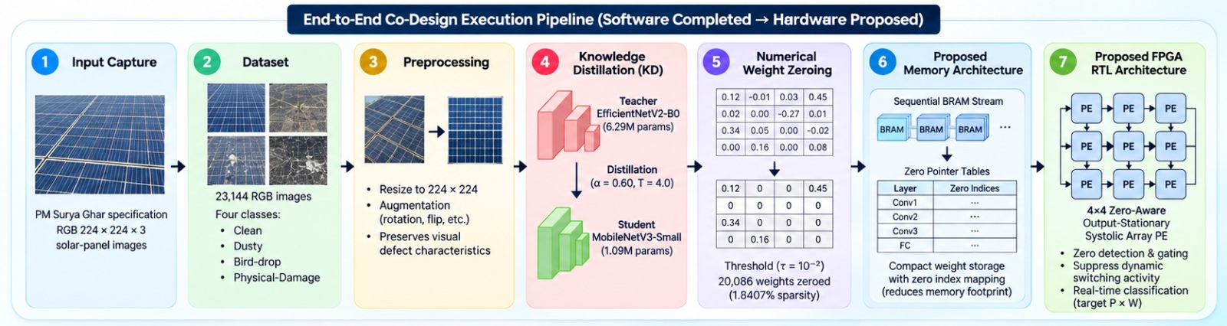
Project Overview & Formal Research Objectives
Formal Problem Formulation
Limited Fault Detection in Conventional Solar Monitoring : Conventional solar inverters mainly monitor electrical parameters such as voltage and current. They cannot directly identify visible panel conditions such as dust accumulation, bird droppings, or physical damage, making fault-specific maintenance difficult.
Computational and Memory Constraints of CNNs : CNN-based image classification requires multiple multiply-accumulate (MAC) operations and memory access. Deploying complex CNN models on low-power embedded devices is challenging due to limited processing resources and energy budgets.
Hardware Overhead of Conventional Sparse Accelerators : Sparse accelerators such as SCNN, and storage formats such as CSR/CSC, can reduce unnecessary computations but introduce indexing, memory-access, and control overhead. At low sparsity levels, these overheads may limit the achievable efficiency gains.
Project-1 Review-2 | MNE_PANEL_3 | Venue: TT-237-A | SENSE, VIT Vellore Department of Electronics and Communication Engineering Slide 6 of 18

Slide 7
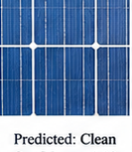
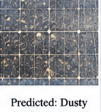
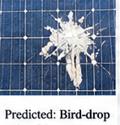
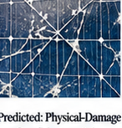
Dataset Evolution & Stratification Protocol
Three-Stage Dataset Progression
Stage 1: Dataset V1 (~731 Images, 5 Classes)
Initial raw collection (Bird 128, Clean 199, Dust 247, Electrical 62, Damage 96). Suffered severe class imbalance and background label noise; accuracy stalled at 73.97%–75.34%.
Stage 2: Dataset V2 (997 Images, 4 Classes)
Rigorous manual cleaning: combined electrical/physical damage into unified Damage (240) alongside Bird (260), Clean (259), Dust (238). Used for controlled augmentation ablation studies. accuracy stalled at 80.71%–83.24%.
Stage 3: Expanded Benchmark (23,144 Images, 4 Classes)
Final high-diversity RGB solar-panel image dataset establishing the benchmark for knowledge distillation, weight zeroing, and sensitivity sweeps across diverse solar micro-climates.
Operational Class | Train (70%) | Val (15%) | Test (15%) | Class Total & Stratified Share
Bird-drop | 3,782 | 807 | 832 | 5,421 (23.4%)
Clean Panel | 5,142 | 1,098 | 1,130 | 7,370 (31.8%)
Dusty Layer | 4,861 | 1,036 | 1,068 | 6,965 (30.1%)
Physical-Damage | 2,366 | 501 | 521 | 3,388 (14.6%)
Total Dataset | 16,151 | 3,442 | 3,551 | 23,144 (100.0%)
16,151
Training Split (70%)
Backpropagation & KD loss
3,442
Validation Split (15%)
Macro & 21-pt sweeps
3,551
Independent Test (15%)
Held-out invariance audit
Evaluation Protocol (Held-Out Test Set)
• Threshold Selection Protocol: The validation set (3,442 images) was used to explore sensitivity sweeps and select the operating threshold (τ = 10⁻³).
• Final Evaluation: The selected zeroed model was evaluated on 3,551 independent test images, producing identical predictions on all evaluated samples (88.54% test accuracy).
• Note: Test-set invariance is an observed result for the evaluated checkpoint and dataset, not a guarantee of generalization to unseen environments.
Verified Surface Defect Categories (RGB Camera Inverter Input)
Clean
Dusty
Bird-drop
Damage
Project-1 Review-2 | MNE_PANEL_3 | Venue: TT-237-A | SENSE, VIT Vellore Department of Electronics and Communication Engineering Slide 7 of 18

Slide 8
Architecture Benchmarking & Controlled Ablation Studies
Evaluated Architecture | Parameters | FP32 Size | Validation Accuracy | Test Accuracy | Edge Feasibility Verdict
MobileNetV3-Small (Baseline) | 1.12M | 4.29 MB | 86.81% | 81.24% | Compact footprint; baseline accuracy plateau
MobileNetV2 (Baseline) | 2.63M | 10.02 MB | 89.92% | 86.01% | Moderate footprint; higher latency for edge deployment
EfficientNetV2-B0 (Teacher) | 6.29M | 23.98 MB | 92.36% | 84.91% | Exceeds edge BRAM limits; severe memory bandwidth bottleneck
MobileNetV3-Small (KD V5 Proposed) | 1.09M | 4.16 MB | 94.92% | 88.54% | 5.76× smaller; memory feasibility targeting INT8 (~1.05 MB); +8.11 pp Val Acc!
ID | Category | Experimental Augmentation Configuration | Val Acc | Gen. Gap | Weighted F1 | Observation & Impact
A0 | Baseline | Full Standard Augmentation (Rotation, Jitter, Flip) | 81.91% | 7.44 pp | 0.8189 | Over-regularized; cracks partially distorted
A1 | Augment | Minimal Rotation (±10%) + Horizontal Flip | 84.42% | 12.57 pp | 0.8442 | Preserves hairline cell cracks and subtle dust films
A2 | Augment | Strong Brightness (0.30) & Contrast (0.25) | 78.39% | 10.83 pp | 0.7843 | Severe contrast changes washed out hairline crack gradients
A3 | Augment | Random Erasing (10%–20% Area) | 81.41% | 7.82 pp | 0.8138 | Occludes critical bird-drop hot-spot features
P1-P4 | Preproc | CLAHE / HistEq / Gamma / Bilateral Filter | 79.4%–81.9% | 6.5–10.0 pp | 0.79–0.81 | Bilateral filter slightly blurs fine glass fractures
T1-T2 | Topology | Trimmed Dense-128 / Dense-64 Classification Head | 77.39%–79.40% | 9.0–12.3 pp | 0.77–0.79 | Under-parameterized classifier bottleneck
A4 | Follow-up | A1 Configuration + Y-Channel Histogram Equalization | 84.92% | 11.94 pp | 0.8486 | Best standalone pre-KD student configuration
Critical Empirical Insight
Restrained geometric transformations (A1/A4) significantly outperformed aggressive photometric distortions (A2) because severe contrast and brightness changes washed out fine edge gradients of hairline solar cell cracks. Knowledge Distillation (KD) then lifted student accuracy from 84.92% to 94.92%, exceeding even the Teacher (92.36%).
Project-1 Review-2 | MNE_PANEL_3 | Venue: TT-237-A | SENSE, VIT Vellore Department of Electronics and Communication Engineering Slide 8 of 18

Slide 9
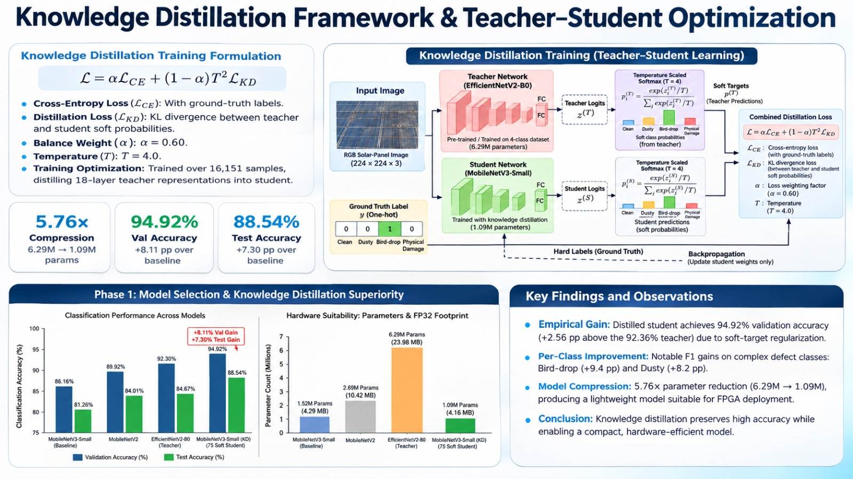
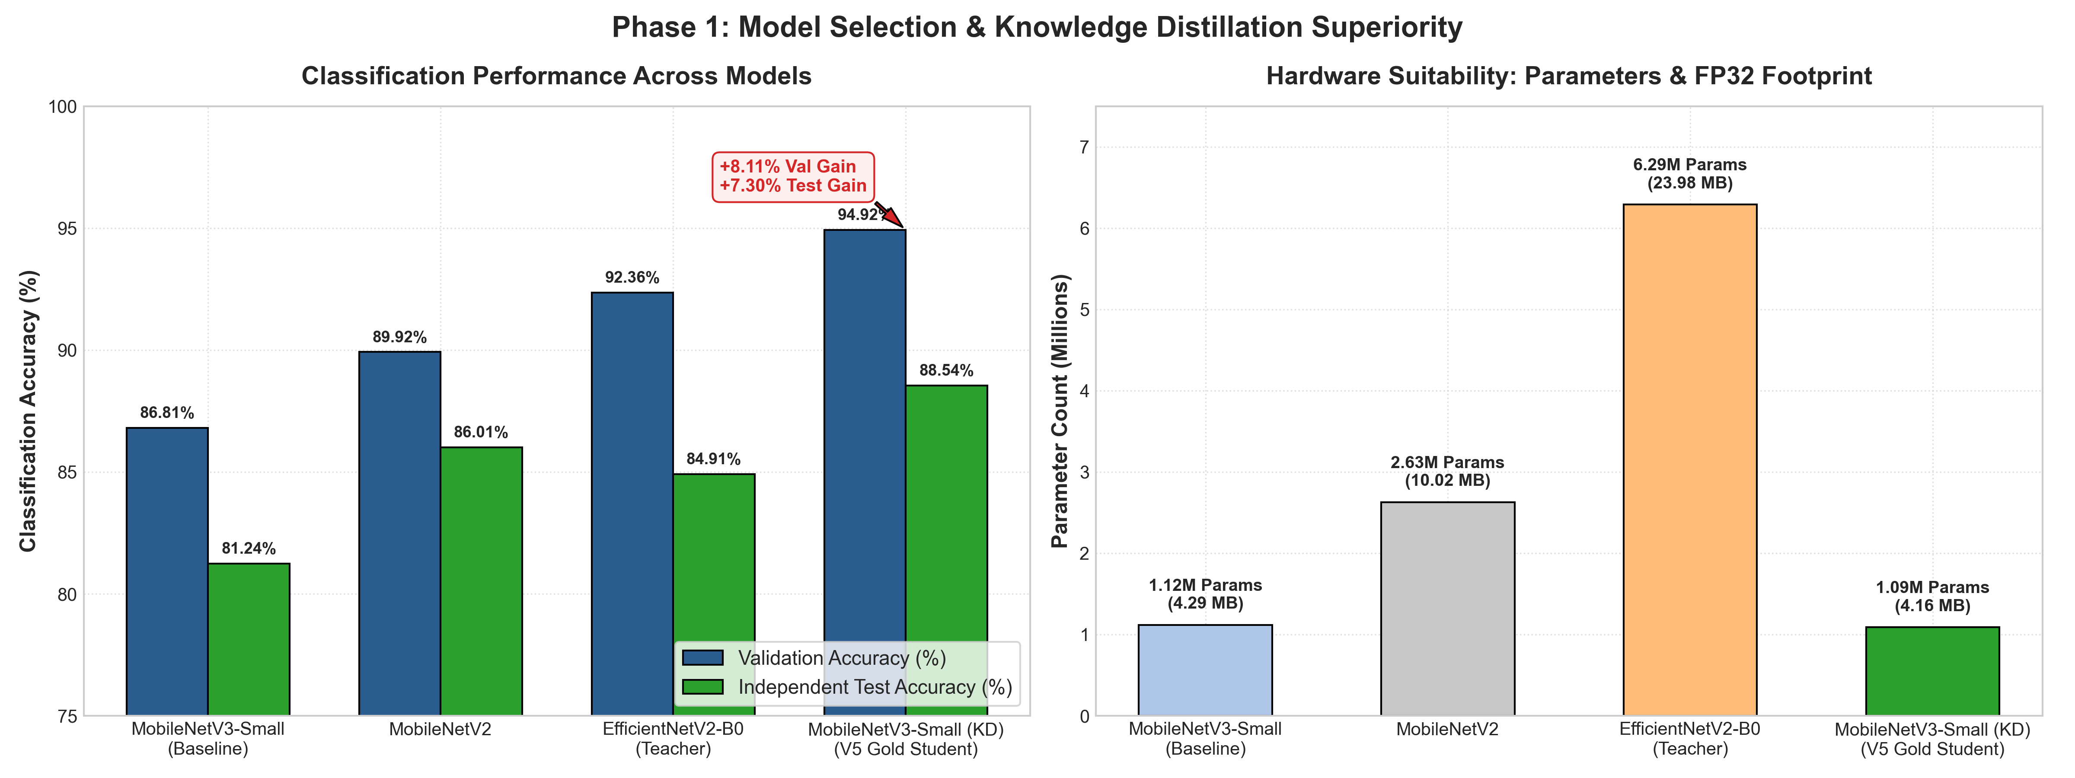
Knowledge Distillation Framework & Teacher-Student Optimization
Dual-Objective Distillation Formulation
L_total = (1 - α) · L_CE(y, σ(z_s)) + α · T² · L_KL(σ(z_s/T), σ(z_t/T))
• Balance Weight α = 0.60: Allocates 60% gradient weight to soft dark knowledge guidance.
• Temperature T = 4.0: Softens logit distribution to expose cross-class visual correlations (e.g. dust vs shadow).
• Training Optimization: Trained over 16,151 samples, distilling 18-layer teacher representations into student.
5.76×
Compression
6.29M → 1.09M params
94.92%
Val Accuracy
+8.11 pp over baseline
88.54%
Test Accuracy
+7.30 pp over baseline
Target On-Chip Memory Feasibility Analysis
4.16 MB FP32 parameters represent an 82.6% compression over the teacher. On-chip memory feasibility will be evaluated after quantization and FPGA resource analysis. Moving to INT8 (targeting ~1.05 MB) aims to fit within target Artix-7/Zynq on-chip BRAM budgets.
• Empirical Gain: Distilled student achieves 94.92% validation accuracy (+2.56 pp above the 92.36% Teacher) due to soft-target regularization. Notable F1 gains achieved on complex defect classes: Bird-drop (+9.4 pp) and Dusty (+8.2 pp).
Project-1 Review-2 | MNE_PANEL_3 | Venue: TT-237-A | SENSE, VIT Vellore Department of Electronics and Communication Engineering Slide 9 of 18

Slide 10
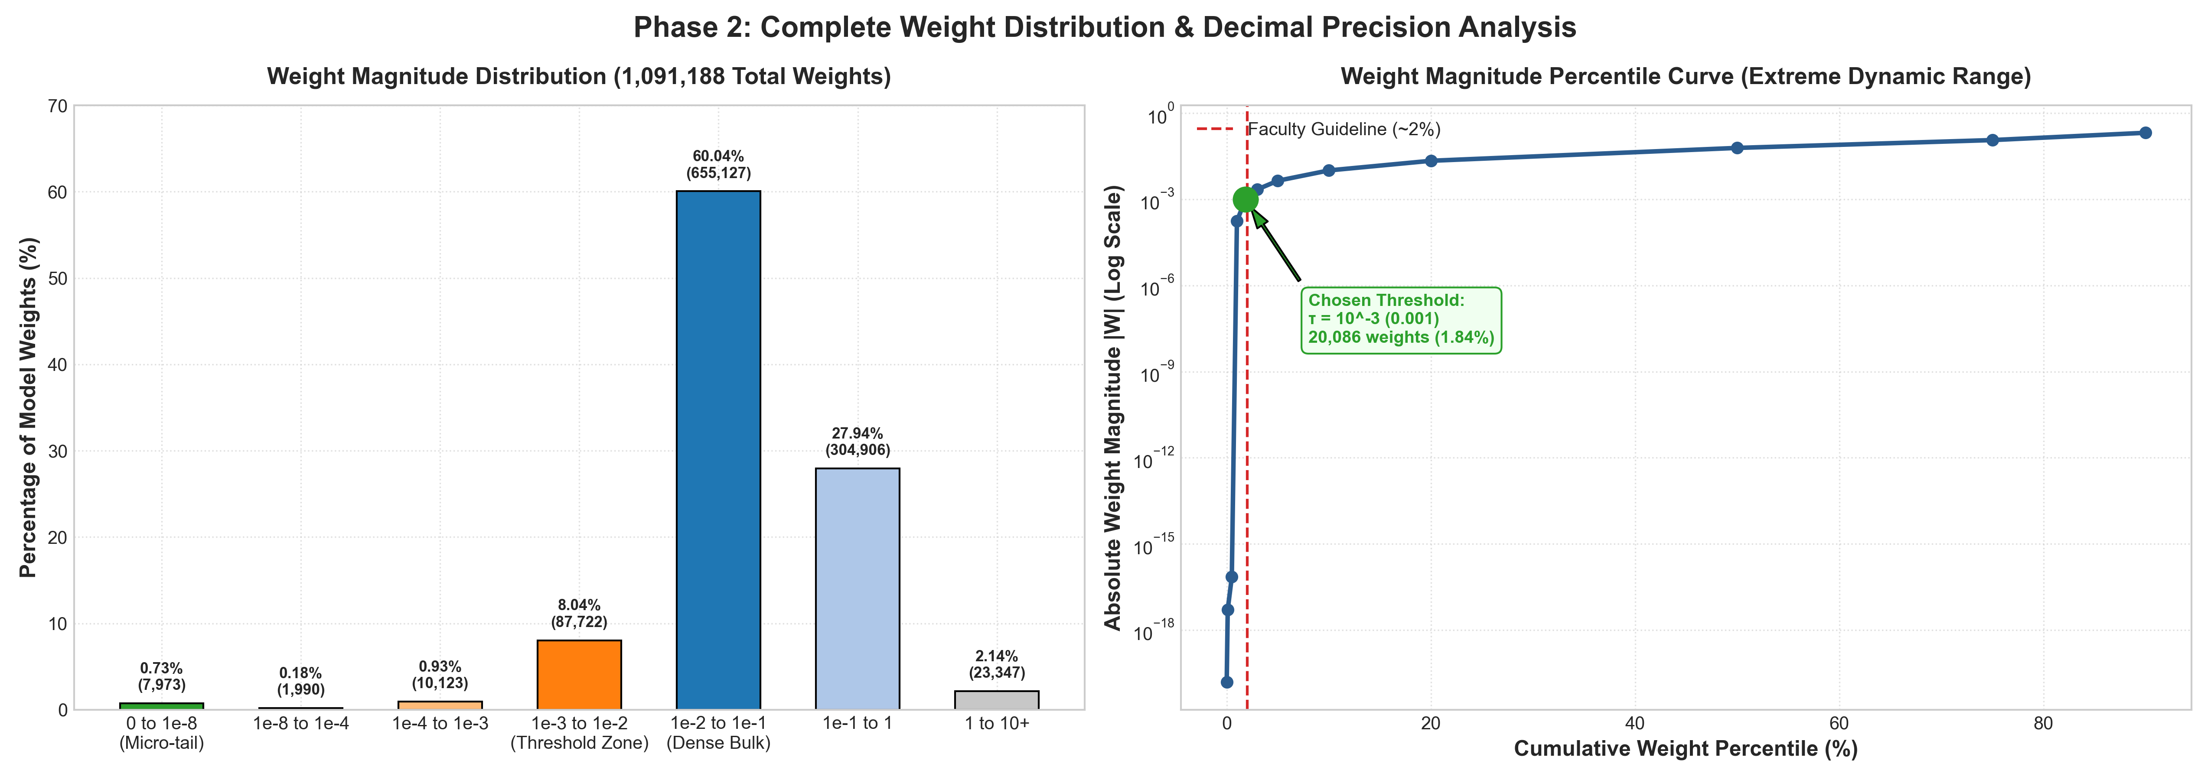
Weight Magnitude Distribution & Threshold-Based Zeroing Analysis
1,091,188
Total Parameters
4.16 MB FP32 Size
20,086 Zeros
Induced Sparsity
1.8407% (Within ≤2% Limit)
94.92% / 88.54%
Val & Test Acc
Δ = +0.00% (0 Changes on Test)
• Statistical & Numerical Insights: All 20,086 zeroed weights are induced by thresholding (|W| ≤ 10⁻³). Dynamic range spans 1.52×10⁻²⁰ up to 6.42×10³, requiring absolute rather than relative thresholding.
Project-1 Review-2 | MNE_PANEL_3 | Venue: TT-237-A | SENSE, VIT Vellore Department of Electronics and Communication Engineering Slide 10 of 18

Slide 11
Weight Magnitude Distribution & Threshold-Based Zeroing Analysis
Magnitude Interval (|W|) | Weight Count | % of Model | Zeroed @ τ = 10⁻³ | Status & Inference Impact
Exact 0.0 (Baseline) | 0 | 0.00% | 0 | Pristine trained baseline: 0 exact zeros
[1.52×10⁻²⁰, 10⁻⁸) Micro-tail | 7,973 | 0.731% | 7,973 (100%) | Zeroed: 94.92% Val, 0 prediction changes
[10⁻⁸, 10⁻⁴) | 1,990 | 0.182% | 1,990 (100%) | Zeroed: 94.92% Val, 0 prediction changes
[10⁻⁴, 10⁻³] | 10,123 | 0.928% | 10,123 (100%) | Zeroed: 94.92% Val, 0 prediction changes
Subtotal Zeroed (≤ 10⁻³) | 20,086 | 1.841% | 20,086 (100%) | SELECTED OPERATING POINT (≤2% Limit)
(10⁻³, 10⁻²] Search Buffer | 87,722 | 8.039% | 0 (Retained) | Retained: Buffer to 0.01 (-0.35 pp drop)
(10⁻², 10⁻¹] Dense Bulk | 655,127 | 60.038% | 0 (Retained) | Retained: Dense bulk (Cliff zone > 0.016)
(10⁻¹, 10⁰] | 304,906 | 27.943% | 0 (Retained) | Retained: Primary feature representations
(10⁰, 6.42 × 10³] | 23,347 | 2.139% | 0 (Retained) | Retained: Peak activation kernel weights
Total Model Weights | 1,091,188 | 100.00% | 20,086 (1.84%) | 94.92% Val / 88.54% Test (0 prediction changes on test set)
Project-1 Review-2 | MNE_PANEL_3 | Venue: TT-237-A | SENSE, VIT Vellore Department of Electronics and Communication Engineering Slide 10 of 18

Slide 12
Layer-Wise Weight Zeroing Distribution & Hardware MAC Reduction
Layer / Architectural Component | Layer Type & Shape | Total Params | Zeroed Params (τ=10⁻³) | Kernel Weights | Zeroed Kernel | Kernel Sparsity (%) | Theoretical Dense MACs* | Theoretical Skipped MACs*
Stem Conv (conv) | Conv2D (3 × 3 × 3 × 16) | 432 | 8 | 432 | 8 | 1.85% | 7,077,888 | 131,072 (1.85%)
Pointwise Convs (1×1) | Conv2D (11 Blocks + conv_1) | 709,056 | 14,484 | 709,056 | 14,484 | 2.04% | 46,733,568 | 954,560 (2.04%)
Depthwise Convs (3×3 / 5×5) | DepthwiseConv2D (11 Blocks) | 173,136 | 3,450 | 173,136 | 3,450 | 1.99% | 2,340,096 | 46,832 (1.99%)
Backbone Internal BatchNorm | BatchNorm (11 Blocks) | 56,496 | 323 | — [Non-MAC] | — | — | — | —
MobileNetV3 Backbone Subtotal | Functional Container (All Blocks) | 939,120 | 18,265 (1.94%) | 882,624 | 17,942 | 2.03% | 56,151,552 | 1,022,464 (1.82%)
head_batch_norm | BatchNorm (576-dim vectors) | 2,304 | 23 (1.00%) | — [Non-MAC] | — | — | — | —
dense_256 (Intermediate FC) | Dense (576 × 256) + 256 bias | 147,712 | 1,779 (1.20%) | 147,456 | 1,775 | 1.20% | 147,456 | 1,775 (1.20%)
dense_batch_norm | BatchNorm (256-dim vectors) | 1,024 | 3 (0.29%) | — [Non-MAC] | — | — | — | —
classifier (Classification Head) | Dense (256 × 4) + 4 bias | 1,028 | 16 (1.56%) | 1,024 | 16 | 1.56% | 1,024 | 16 (1.56%)
Global Model Total | Full MobileNetV3-Small KD | 1,091,188 | 20,086 (1.84%) | 1,031,104 | 19,733 | 1.91% | 56,300,032 | 1,024,255 (1.82%)
Architectural Breakdown by Convolution Type
• Parameter Reconciliation: 1,031,104 matrix kernel weights execute on MAC multipliers. 60,084 non-MAC vectors (BatchNorm params & biases) do not use multipliers and are tracked separately (353 zeroed).
• Pointwise (1×1) Conv2D Layers: 14,484 weights zeroed (2.04%); layer-group-specific impact remains to be isolated.
• Depthwise (3×3 / 5×5) Conv2D Layers: 3,450 weights zeroed (1.99%); aggregate model predictions remained unchanged at the selected threshold.
• Dense Head Layers: 1,791 zeroed Dense kernel coefficients (1,775 in dense_256, 16 in classifier); potential operation savings depend on the implemented datapath and zero-aware scheduling.
Software Evidence vs Theoretical Hardware Estimates
• Measured in Software (Completed): 20,086 weights zeroed out of 1,091,188 (1.8407% sparsity); zero prediction changes across all 3,551 test images on evaluated checkpoint (88.54% test acc).
• Theoretical MAC-Operation Estimate (*): Operation counts (~56.3M dense MACs → ~1.02M skipped operations, 1.82%) are theoretical estimates based on nominal layer dimensions; potential cycle savings depend on datapath architecture and zero-aware scheduling.
• Zero Metadata Overhead: Preserves contiguous sequential tensor memory layout from BRAM; completely avoids 20%–35% CSR/CSC pointer RAM and decoding logic.
• Proposed Hardware Target (Review-3 Scope): In-situ 1-bit zero comparator asserting multiplier clock-enable (CE = 0). Actual FPGA power reduction and timing will be measured post-synthesis.
Project-1 Review-2 | MNE_PANEL_3 | Venue: TT-237-A | SENSE, VIT Vellore Department of Electronics and Communication Engineering Slide 11 of 18

Slide 13
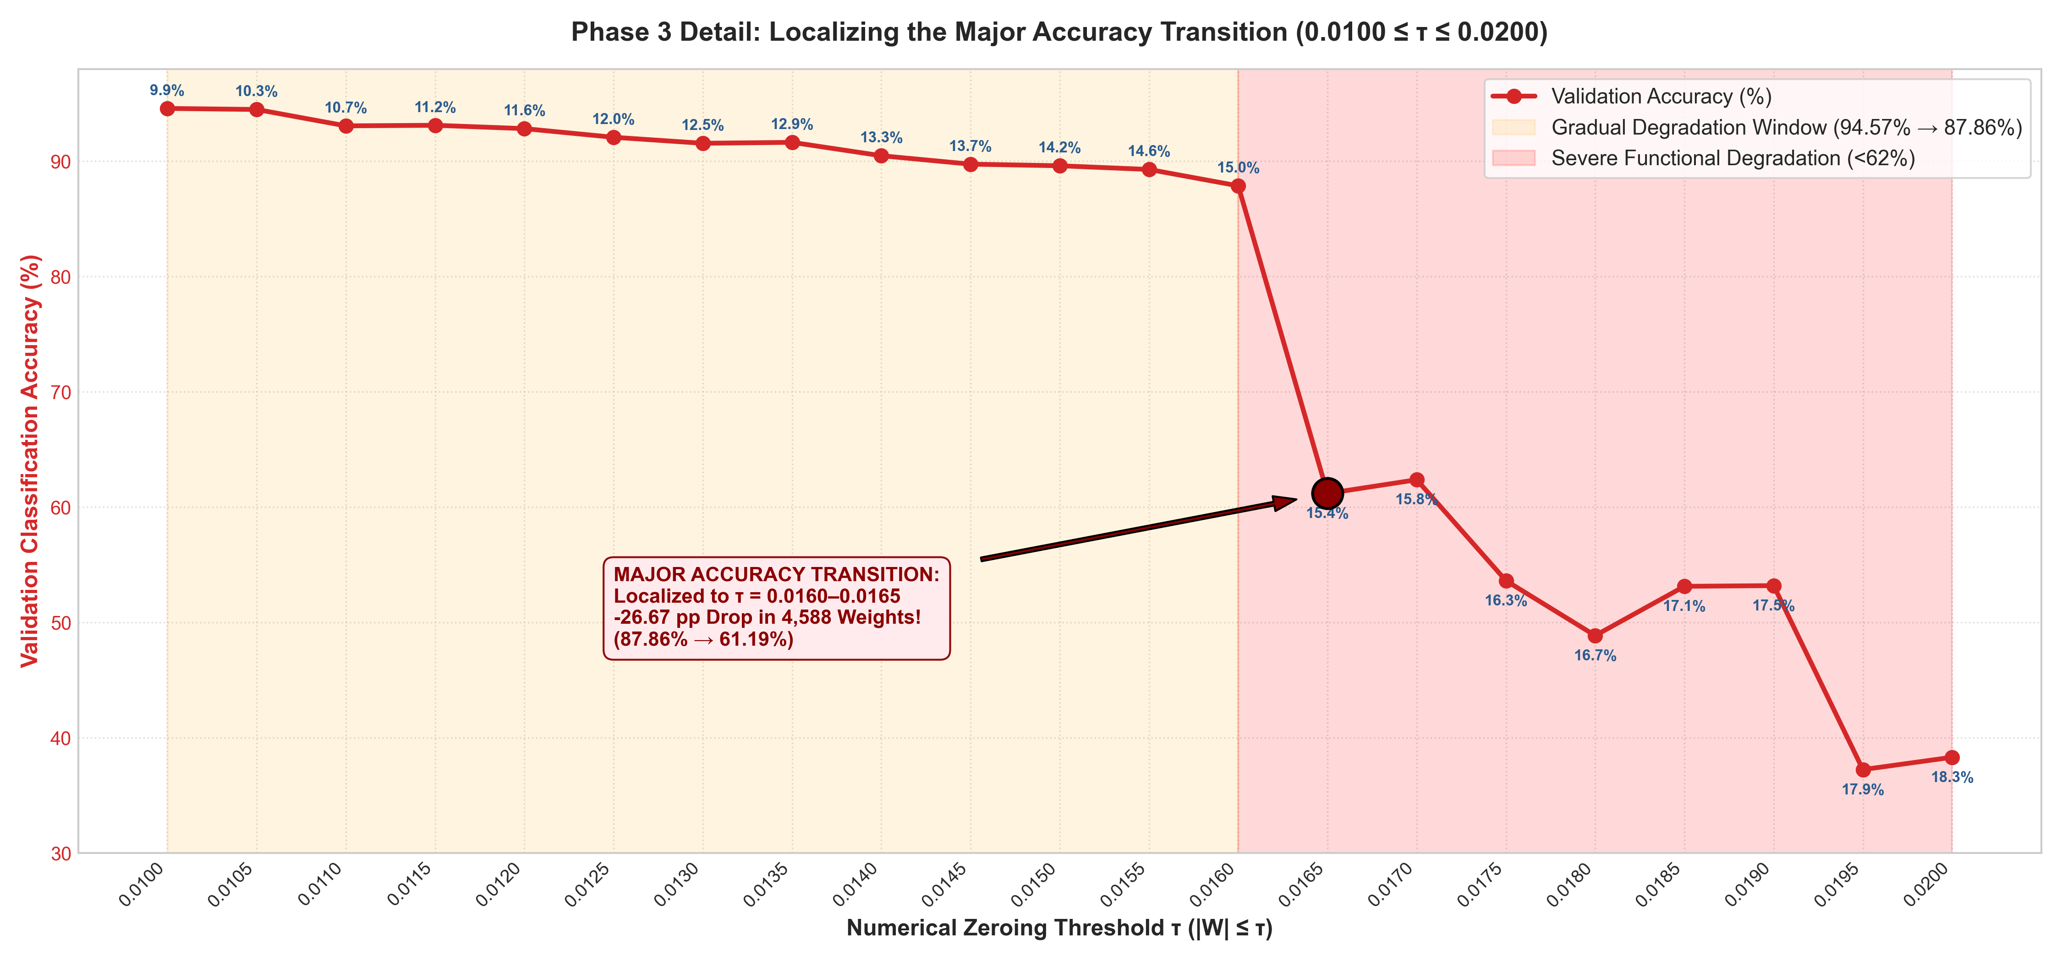
Fine-Grained Localization & The Accuracy Cliff Phenomenon
Three Documented Behavioral Regimes
1. Invariant Plateau & Buffer (τ ≤ 0.0105)
Validation accuracy holds rock-solid at 94.92% (at τ = 10⁻³) with minimal change down to 94.48% at τ = 0.0105 (10.30% sparsity).
2. Linear Degradation Window (0.0110 ≤ τ ≤ 0.0160)
Controlled linear decline from 93.06% down to 87.86% (10.74% to 14.99% sparsity) as non-critical filters are progressively zeroed.
3. Critical Knife-Edge Cliff (τ ∈ [0.0160, 0.0165])
Catastrophic collapse: drops by -26.67 percentage points (87.86% → 61.19%) upon zeroing 4,588 additional weights (0.42% of parameters). The observed decline suggests that some parameters removed in this range are important to classification.
16× Numerical Threshold Margin
Our chosen operating threshold (τ = 10⁻³ = 0.001) is 16× below the observed validation accuracy-cliff breakpoint (τ = 0.0160), providing a conservative numerical operating margin for the evaluated model. Environmental variation tolerance and post-quantization robustness will be evaluated in subsequent hardware phases.
• Fine-Grained Zoom Protocol: Evaluated at uniform Δτ = 0.0005 step increments across 3,442 validation images. The evaluated checkpoint shows a sharp accuracy decline in this threshold region ([0.0160, 0.0165]).
Project-1 Review-2 | MNE_PANEL_3 | Venue: TT-237-A | SENSE, VIT Vellore Department of Electronics and Communication Engineering Slide 12 of 18

Slide 14
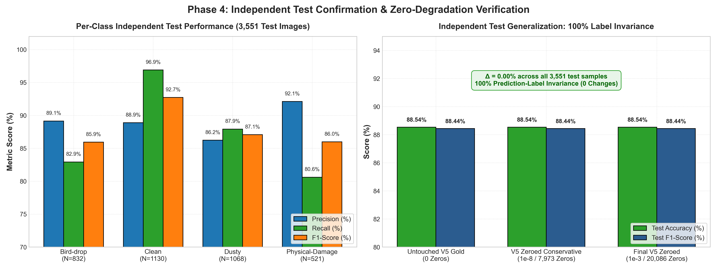
Held-Out Test Set Audit & Full Inference Invariance Verification
Evaluation Protocol & Final Test Set Audit
The validation set was used to select the operating threshold (τ = 10⁻³). The selected zeroed model was then evaluated on 3,551 independent test images. The original and zeroed models produced identical predictions on all evaluated test samples, maintaining 88.54% test accuracy.
0 / 3,551 Changes
Observed Test-Set Invariance
Test Acc: 88.54% (Pristine) == 88.54% (Zeroed) on evaluated V5 checkpoint
Test Defect Class | Samples | Share | Precision | Recall | F1-Score | Prediction Drift
Bird-drop | 832 | 23.4% | 0.8915 | 0.8293 | 0.8593 | 0 changes (100% Invariant)
Clean Panel | 1,130 | 31.8% | 0.8888 | 0.9690 | 0.9272 | 0 changes (100% Invariant)
Dusty Layer | 1,068 | 30.1% | 0.8623 | 0.8792 | 0.8707 | 0 changes (100% Invariant)
Physical Damage | 521 | 14.7% | 0.9211 | 0.8061 | 0.8598 | 0 changes (100% Invariant)
Total Held-Out Test Set | 3,551 | 100.0% | 0.8862 | 0.8854 | 0.8844 | 0 / 3,551 Changes (100%)
• Observed Invariance: Confusion matrices before vs after zeroing are bit-for-bit identical across all defect categories on the evaluated test samples for the current checkpoint.
Observed Test-Set Prediction Invariance
Zeroing 20,086 negligible weights induces zero prediction changes across all 3,551 test images on the evaluated V5 checkpoint.
Note: Test-set invariance is an observed result for the evaluated checkpoint and dataset, not a guarantee of generalization to unseen environments.
Project-1 Review-2 | MNE_PANEL_3 | Venue: TT-237-A | SENSE, VIT Vellore Department of Electronics and Communication Engineering Slide 13 of 18

Slide 15
Review-2 : Work Done & Work to be Done
Completed Work Done
✔ Timeline & Progress: Commenced July Last Week (W4); achieved 40% milestone on schedule by Oct Week 2 (Review-2).
✔ RGB Solar-Panel Dataset: Curated & stratified 23,144 images across a 4-class stratified dataset (Bird, Clean, Dust, Damage).
✔ 10 Controlled Experiments: Validated minimal rotation + HistEq preserves delicate hairline solar crack features.
✔ Backbone Benchmarking: Evaluated MobileNetV3 vs EfficientNetV2; established edge memory suitability.
✔ Knowledge Distillation: Trained student achieving 94.92% Val Acc (+8.11 pp) & 5.76× parameter compression.
✔ Numerical Weight Zeroing: Deployed at τ = 10⁻³, zeroing 20,086 parameters without any accuracy drop.
✔ Documented Sensitivity Sweeps: Evaluated thresholds through graceful degradation window across validation set.
✔ 21-Point High-Res Zoom: Pinpointed exact catastrophic accuracy cliff at [0.0160, 0.0165] (16× numerical margin).
Work to be Done
1. Hardware Specification: Specified datapath, 4×4 systolic array, and zero-aware PE (Architecture ready for RTL).
2. INT8 Post-Training Quantization (PTQ): Dynamic range calibration and per-channel scaling factor generation to compress model to ~1.05 MB.
3. Synthesizable Verilog RTL Implementation: Modular Verilog RTL coding for Zero-Aware PE, 4×4 systolic grid, line buffers, and control FSM.
4. Cycle-Accurate Testbench Simulation: Bit-true functional verification in ModelSim / Vivado against Python golden test vectors.
5. FPGA Synthesis & Timing Closure: Place, route, and static timing analysis targeting Xilinx Artix-7 (XC7A100T) @ 100 MHz target system clock.
6. SAIF Activity File Power Profiling: Post-implementation dynamic switching power measurement using Vivado Power Analyzer with SAIF file.
7. Prototype Demonstration & Review-3 Final Defense: Real-time camera streaming interface, automated defect diagnosis prototype, and 100% project completion.
Project-1 Review-2 | MNE_PANEL_3 | Venue: TT-237-A | SENSE, VIT Vellore Department of Micro and Nanoelectronics Slide 14 of 16

Slide 16
Key Academic Literature & Peer-Reviewed Foundations
[1] N. Muhammad & N. M. Ridzuan, "A Review of Fault Detection and Diagnosis Approaches for PV Systems Using Voltage and Current Analysis," IEEE ICPEA, DOI: 10.1109/ICPEA60617.2024.10498573, 2024.
[2] K. D. Rao et al., "A Systematic Review on Categorization of Bug Detecting Techniques In Renewable Type of Integration Systems for Optimization," IEEE ICACITE, DOI: 10.1109/ICACITE60783.2024.10616999, 2024.
[3] O. Bia et al., "Defect Detection in PV Power Plants Using AI and Smart Sensors," IEEE IRASET, DOI: 10.1109/IRASET68627.2026.11538548, 2026.
[4] K. G. Choudhari & S. Fatima, "Machine Learning for Electrical Fault Detection in PV Panels," IEEE ICSFT, DOI: 10.1109/ICSFT66733.2026.11507025, 2026.
[5] I. Nasri et al., "A Review on Multimodal-Based Fault Detection and Diagnosis in Photovoltaic Systems: Fusion & Attention Mechanisms," IEEE Access, DOI: 10.1109/ACCESS.2026.3675686, 2026.
[6] A. Howard et al., "Searching for MobileNetV3," IEEE/CVF ICCV, pp. 1314–1324, 2019.
[7] M. Tan & Q. V. Le, "EfficientNetV2: Smaller Models and Faster Training," PMLR ICML, pp. 10096–10106, 2021.
[8] G. Hinton, O. Vinyals, & J. Dean, "Distilling the Knowledge in a Neural Network," NeurIPS Deep Learning Workshop, arXiv:1503.02531, 2015.
[9] A. Parashar et al., "SCNN: An Accelerator for Compressed-sparse CNNs," ACM/IEEE ISCA, pp. 27–40, 2017.

Slide 17
Thank You!
Final Year B.Tech Project Review-2
School of Electronics Engineering (SENSE), VIT Vellore
.

