Slide 1

Java Exceptions - Try...Catch
Universitas Nusa Putra

Slide 2
Java Exceptions
When executing Java code, different errors can occur: coding errors made by the programmer, errors due to wrong input, or other unforeseeable things.
When an error occurs, Java will normally stop and generate an error message. The technical term for this is: Java will throw an exception (throw an error).

Slide 3
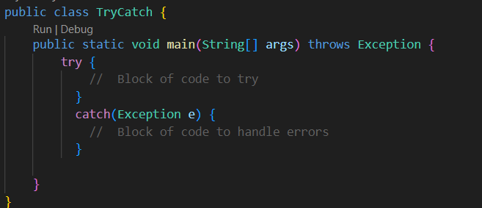
Java Try and Catch
The try statement allows you to define a block of code to be tested for errors while it is being executed.
The catch statement allows you to define a block of code to be executed, if an error occurs in the try block.
The try and catch keywords come in pairs:

Slide 4
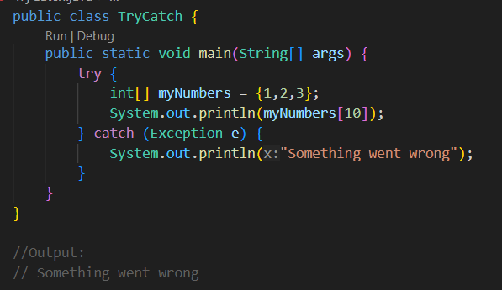
Example of Try and Catch
If an error occurs, we can use try...catch to catch the error and execute some code to handle it:

Slide 5
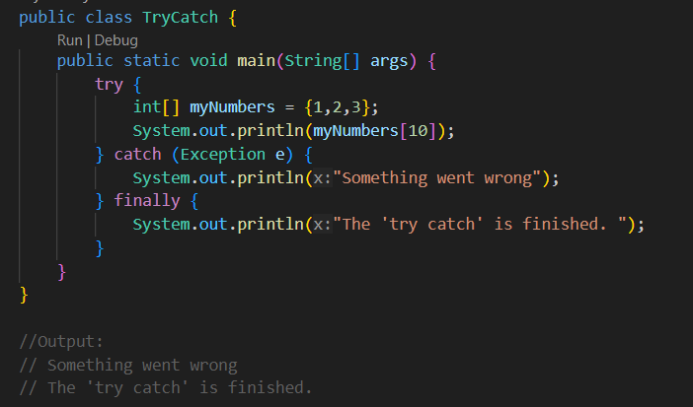
Finally
The finally statement lets you execute code, after try...catch, regardless of the result:

Slide 6
The Throw Keyword
The throw statement allows you to create a custom error.
The throw statement is used together with an exception type. There are many exception types available in Java: ArithmeticException, FileNotFoundException, ArrayIndexOutOfBoundsException, SecurityException, etc.

Slide 7
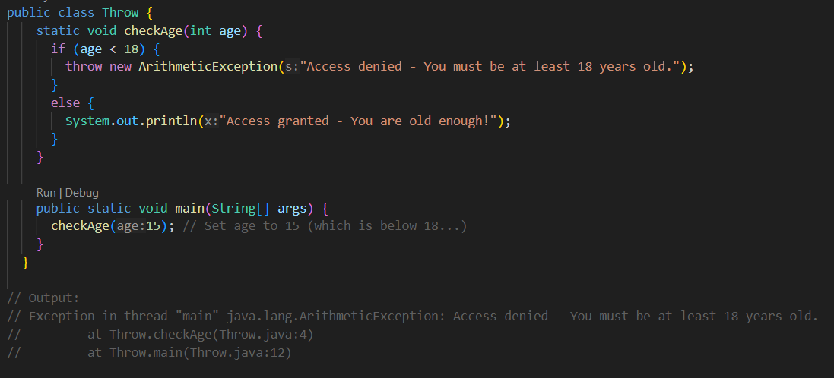
Throw Example
Throw an exception if age is below 18 (print "Access denied"). If age is 18 or older, print "Access granted":

Slide 8
Thank You

