Slide 1

SMART INDIA HACKATHON 2026
TITLE PAGE
Problem Statement ID – 26261
Problem Statement Title - AI-Powered Application Validation, Document Authentication and Regulatory Compliance Verification
Theme - Smart Automation
PS Category- Software
Team ID- 198045
Team Name – MARK 44

Slide 2
ShowYourWork
The AI Document Checker That Never Accuses, Only Shows Evidence
Flag. Verify. Decide.
MARK 44
Problem in the statement | Our answer
Missing, expired, inconsistent documents | Graph and date checks catch them early
Repeated manual checking | Officers see only exceptions
Suspected alterations | Evidence-linked “indicator” flags
Issuer confirmation | Verification Ladder with fallbacks
Infrastructure gaps | Flag “needs evidence” or “needs inspection”
Trust and traceability | Evidence Cards, audit trail, officer sign-off
How it works
Extract: OCR + layout parsing turns each document into Evidence Nodes (value, page, bounding box, confidence score)
Cross-check: nodes are linked in an Evidence Graph across documents and AICTE records
Validate: a JSON rule engine, mapped to Handbook clauses, decides compliance
Verify: a Verification Ladder runs issuer API → digital signature → QR → portal → manual review, and logs source, time and result
Report: an Evidence Card shows the highlighted proof, the clause and the next step
What makes it unique
Graph-based checks: catches contradictions between documents, not just errors inside one file
Rules decide, LLM only explains: results are repeatable and auditable
Forensic signals: file and perceptual hashing, PDF edit traces, signature validation, date-logic checks
Versioned and tamper-proof audit: every decision replays under its original rule version, with a hash-chained log
Maker-checker lock: no adverse action without officer sign-of

Slide 3
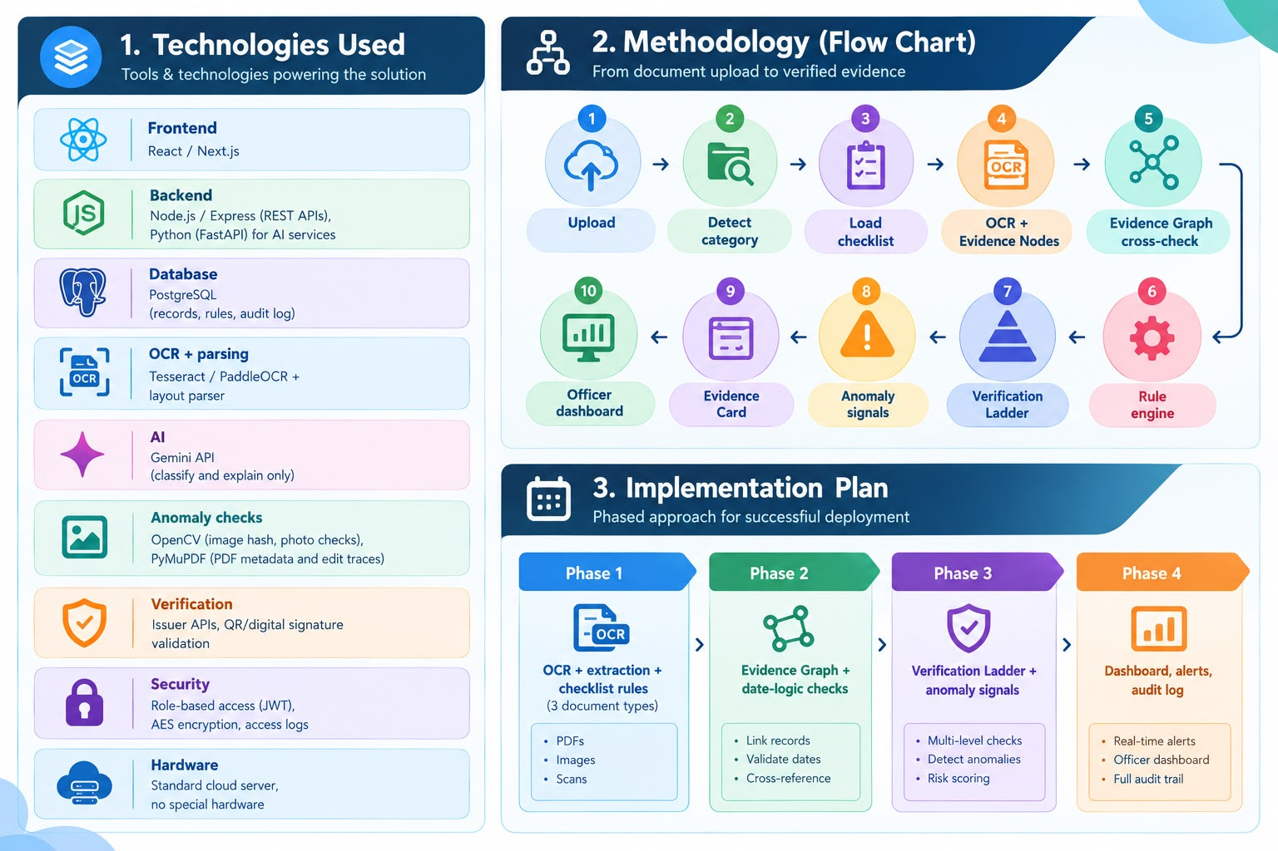
TECHNICAL APPROACH
MARK 44

Slide 4
FEASIBILITY AND VIABILITY
MARK 44
Feasibility
Technically ready: OCR, hashing, PDF analysis and QR/signature checks already exist as open tools
Low cost: runs on a standard cloud server, no special hardware
Low risk to start: begins with 3 common document types and adds more later
Easy to plug in: works beside the AICTE portal through REST APIs, no rebuild needed
Legally safe: uses only authorized sources and role-based access
Challenge | Strategy
Issuer has no API | Fall back to QR or signature check, then manual review
Poor or blurry scans | Confidence score per field; low scores go to a human
False flags | Flags are “indicators” only; officer confirms
Data privacy | Role-based access, encryption, logs, retention limits
Rules change often | Editable rule configs with version history
Access to AICTE data | Demo on synthetic data; integration through authorized APIs only
Rollout : Prototype → Pilot on one application category → Scale to all categories

Slide 5
IMPACT AND BENEFITS
MARK 44
Impact on the Target Audience
Who | Impact
AICTE officers | No repeat checking; only exceptions reach them
Institutions | Instant “what’s missing” report; fix gaps before submission
Students and parents | Approvals rest on verified documents, so they can trust an institution’s status
Benefits
Social: fair, evidence-based decisions. Good institutions are not wrongly flagged, and fake documents are caught
Economic: less officer time per application, fewer returned applications and re-submissions, lower inspection cost since only flagged cases need visits
Environmental: less paper and fewer physical document checks and travel
Governance: every decision has an audit trail, so processing is transparent and consistent
How We Measure It
Extraction accuracy
Source verification success rate
Time per verification
Alert speed
Drop in manual effort

Slide 6
RESEARCH AND REFERENCES
MARK 44
1. AICTE and Regulatory Sources
AICTE Approval Process Handbook (current edition): source for the checklists and rules. Download from https://www.aicte-india.org
AICTE Extension of Approval (EoA) guidelines: https://www.aicte-india.org
DigiLocker (issuer-verified documents): https://www.digilocker.gov.in
IT Act, 2000 (digital signatures) and DPDP Act, 2023 (data protection): https://www.meity.gov.in
2. Research Work
LayoutLM: Pre-training of Text and Layout for Document Image Understanding (Xu et al., 2020): https://arxiv.org/abs/1912.13318. This is the basis for layout-aware extraction.
Perceptual hashing for duplicate and near-duplicate image detection: https://phash.org
3. Tools and Documentation
Tesseract OCR: https://github.com/tesseract-ocr/tesseract
PaddleOCR: https://github.com/PaddlePaddle/PaddleOCR
OpenCV: https://opencv.org
PyMuPDF (PDF metadata and edit traces): https://pymupdf.readthedocs.io
Gemini API: https://ai.google.dev/gemini-api/docs
FastAPI: https://fastapi.tiangolo.com
PostgreSQL: https://www.postgresql.org

