Slide 1
Capstone Project - The Battle of the Neighborhoods Applied Data Science Capstone by IBM/Coursera M.HARINI

Slide 2
Table of contents
* Introduction
* Data
* Methodology
* Analysis
* Results and Discussion
* Conclusion

Slide 3
* Introduction:
This report analyses to find the best location and features for starting a Chinese Restaurant in Chennai,a city in Southern State of India. we will try finding neighborhood which is not crowded with many restaurants and also analyse features that are missing in other restaurants like analysing the number of restaurants with online delivery and neighborhoods with less delivery rating rate and less average rating rate.

Slide 4
Problem:
This report analyses on finding a correct location to start a Chinese Restaurant in the city and also suggests what are other features to be added to improve its profit by comparing with neighborhood restaurants using the Zomato Dataset.

Slide 5
* Data:
we will be using Foursquare location data to map the clustering of the restaurants in a neighborhood and also to get the top venues in each neighborhood like what is the top visited venues in each locality.
we will also be using the Zomato Restaurant data to get the details of the restaurants in each neighborhood their average rating, price, latitude,longitude,location and etc. we will refine the dataset so that it contains only relevant information.

Slide 6
Methodology Section:
In this report we have compared the top restaurants in the city based on the locality and had found the locality with the least and highest number of restaurants and also those with the highest and least rating.we had also found the proportion of restaurants that has online delivery. and those with that the least and highest average rating.

Slide 7
Analysis These are the plots for comparing number of restaurants in each locality. one hot encoding was done to catogorize the top venues in each locality. All the locality were then divided into 5 cluster and each was categorised with features such as top common venues,aggerate rating,rating text.

Slide 8
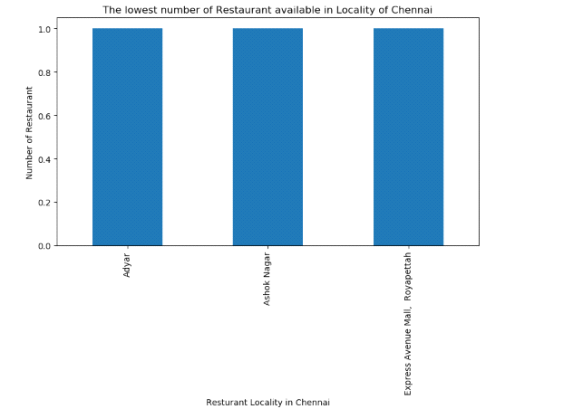

Slide 9
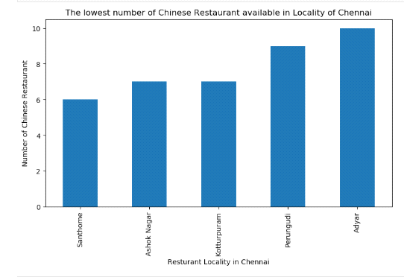

Slide 10
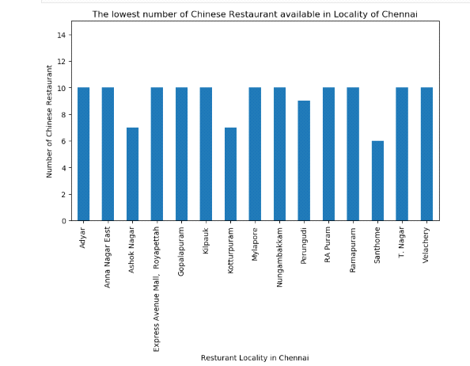

Slide 11
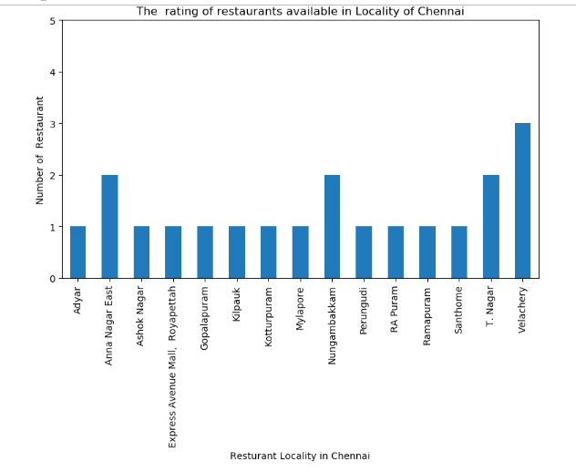

Slide 12
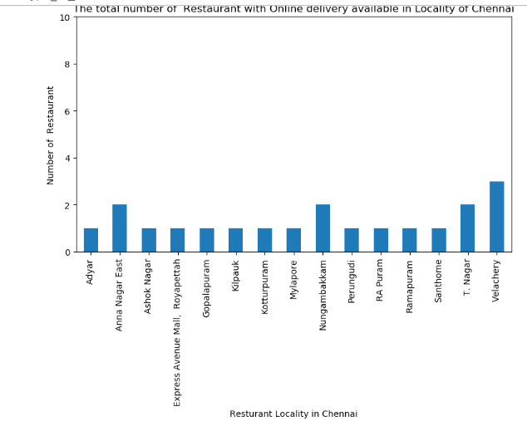

Slide 13
Result and Discussion:
The lowest number of Chinese Restaurant is in
* Santhome
* Ashok nagar
* Kotturpuram
* Perungudi
* Adyar

Slide 14
The online delivery of restaurants and the rating of other restaurants in Santhome is very less and below the average.The availablity of Chinese Restaurants is also less. But other type of restaurants like southern style,Middle Eastern, fast food food are very common. So,however competition would be high.
The online delivery of restaurants and the rating of other restaurants in Ashok nagar is also very less and below the average.The availablity of Chinese Restaurants is also less.But other type of restaurants like fast food,Multi cuisine are very common. So,however competition would be high.

Slide 15
The online delivery of restaurants and the rating of other restaurants in Adyar is also very less and below the average.The availablity of Chinese Restaurants is in 8th common venue.So,however competition would be high.
The online delivery of restaurants and the rating of other restaurants in Kotturpuram is also very less and below the average.The availablity of Chinese Restaurants is less.there is also very less number of other type of restaurants.So,however competition would be less.

Slide 16
The online delivery of restaurants and the rating of other restaurants in Perungudi is very less and below the average.The availablity of Chinese Restaurants is also less. But other type of restaurants like southern style,Middle Eastern, fast food food are very common. So,however competition would be high.

Slide 17
Conclusion:
If the restaurant is located in Adyar,Ashok Nagar ,Perungudi and Santhome,the owner need to take a chance. But if it is located in Kotturpuram the risk is less.since,the competition is less and also rating of surrounding restaurant is also less.

