Slide 1
WOMEN ENTREPRENEURSHIP & DEVELOPMENT
The Entrepreneurial Journey of
Midhula Devabhaktuni
From Idea → Product → Brand → Manufacturing
Presented by
• PATHURI SRUTHI CHOWDARY — 24BQ1A05Z4
• PUVVALA PREMA SWARUPA RANI — 24BQ1A050X
• SATTENAPALLI VATHSALYA — 25BQ5A0547
• PEDAKOTLA HARSHA VARDHAN — 24BQ1A05Z7
• PULIVARTHI ANTHONI — 24BQ1A050T
• REDDI SANTOSH — 25BQ5A0545
Mivi • Indian Consumer Electronics
1

Slide 2
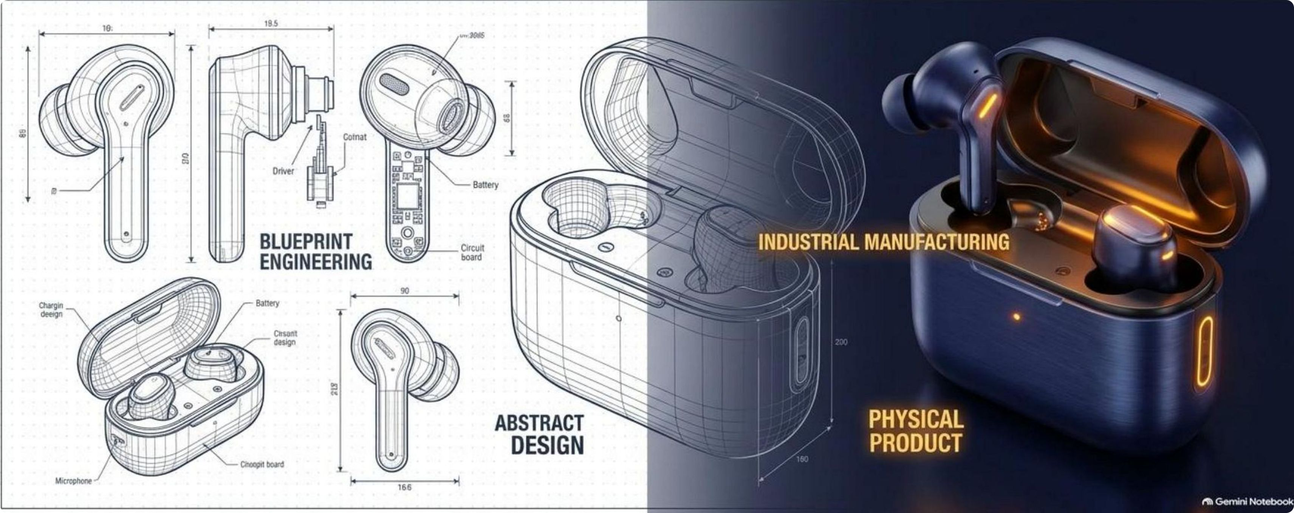
Who Is Midhula Devabhaktuni?
The education and professional foundation behind her entrepreneurial shift.
Education
Professional experience
B.Tech in Computer Science from JNTU (2008).
Later completed an MS in Computer Science and an MBA in the US.
Worked as a software engineer before moving from a corporate career into entrepreneurship.
Entrepreneurial shift
After returning to India, she explored consumer-electronics opportunities and built Mivi with Viswanadh Kandula. Mivi was established in 2015; products began selling in 2016.
Her journey combines technical knowledge, business education, customer understanding and execution.
Source: User-provided Mivi/Midhula presentation and supporting podcast material.
2
2

Slide 3
From Corporate Career to Entrepreneurship
A deliberate move from software engineering toward a customer-focused business.
2008
US
Career
India
2015
Engineering
Higher study
Software engineering
Opportunity search
Mivi
B.Tech in Computer Science, JNTU
MS in Computer Science + MBA
Professional experience before entrepreneurship
Returned to India and explored consumer electronics
Built the company with Viswanadh Kandula
The transition
She moved from applying technology inside established companies to applying business, technology and customer insight to build a new Indian consumer brand.
3
3

Slide 4
Identifying the Market Gap
In 2015, the opportunity was between affordability, quality and local relevance.
Cheap / grey-market products
Global brands
Mivi's white space
• Lower prices
• Concerns around quality and certification
• Limited warranty and reliability
• White-label products
• High quality and certification
• Strong brand recognition
• Higher prices
• Often designed around non-Indian use cases
Quality + value + products designed around Indian consumers and conditions.
The focus was not simply on being cheaper; it was on making the value proposition clear.
VS
Entrepreneurial lesson: start with a genuine customer problem rather than copying an existing business.
4
4

Slide 5
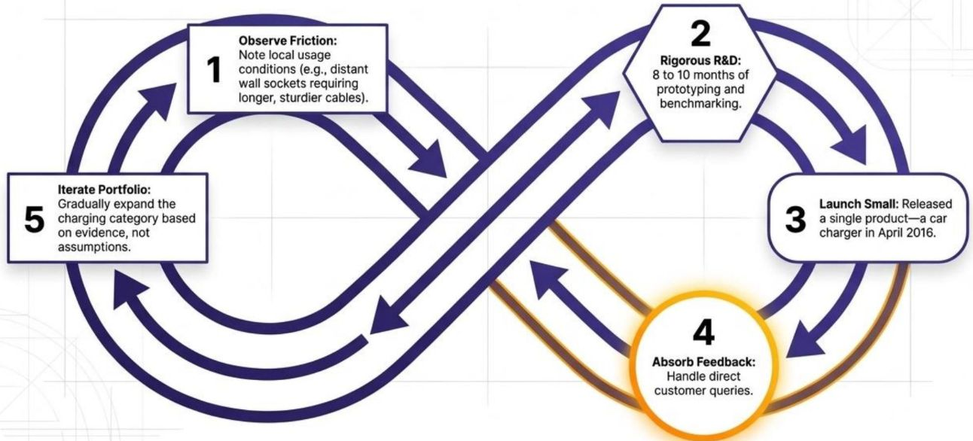
Starting Small: Bootstrapping Mivi
The early business was built through constrained testing instead of immediate large-scale expansion.
2BHK
₹3.5 Cr
0
8–10 mo
Initial operating setup in Jubilee Hills
Personal savings used to bootstrap
External funding initially
Prototyping and benchmarking
The early strategy: observe the market → research deeply → build carefully → learn before scaling.
5
5

Slide 6
From Prototype to the First Product
Mivi used a small first launch to validate demand before expanding the portfolio.
1. Observe
Study local usage conditions and customer friction.
2. Research & prototype
Spend 8–10 months benchmarking and refining the product.
3. Launch small
A single car charger became the first product, launched in April 2016.
The principle: evidence before expansion.
6
6

Slide 7
Customer Feedback Became Part of the R&D Process
Early customer conversations helped shape reliability, warranties and the brand experience.
Direct customer contact
During the first six months, Midhula personally spent around 5–6 hours a day handling customer calls and emails.
Feedback → improvement
Customer problems became inputs for product changes, warranty decisions and service improvements.
Brand building
Marketing and positioning focused on quality, value and a clear reason for Indian customers to choose Mivi.
7
7

Slide 8
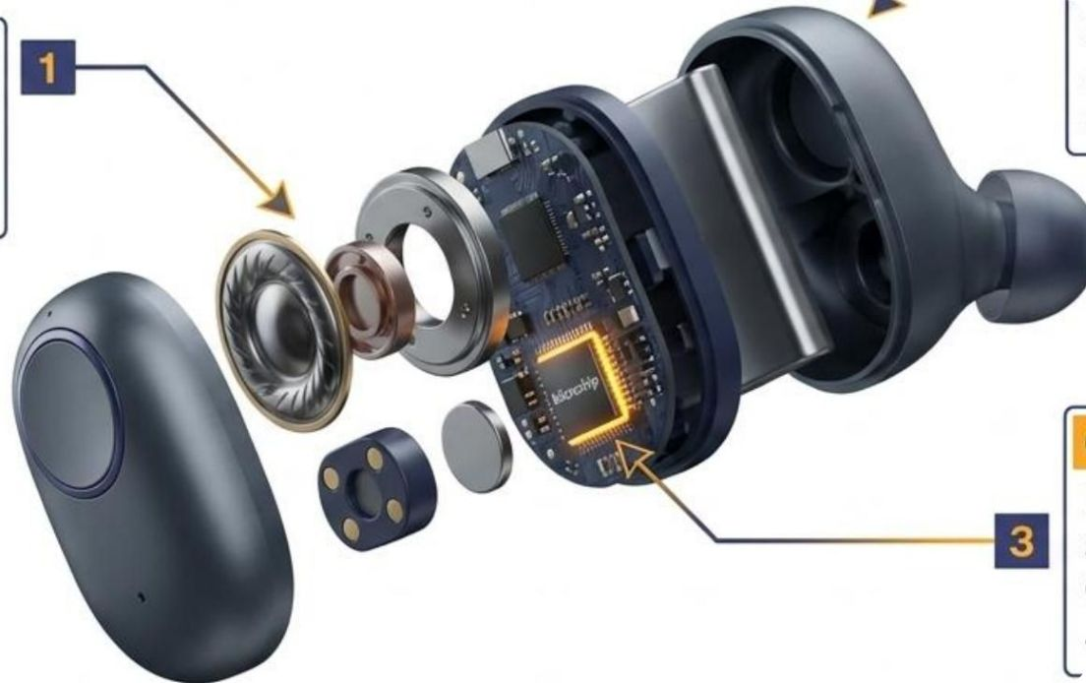
Product Innovation: Understanding Indian Use Cases
By 2017, Mivi expanded into audio products and focused on local preferences and conditions.
Audio expansion
Earphones, headphones, Bluetooth devices and speakers became part of the portfolio.
Acoustic tuning
Products were developed around Indian consumer preferences, including sound and comfort.
Environmental durability
Attention to dust, sweat and local environmental conditions supported everyday use.
Certification
The source presentation notes Hi-Res Audio certification from the Japan Audio Society.
8
8

Slide 9
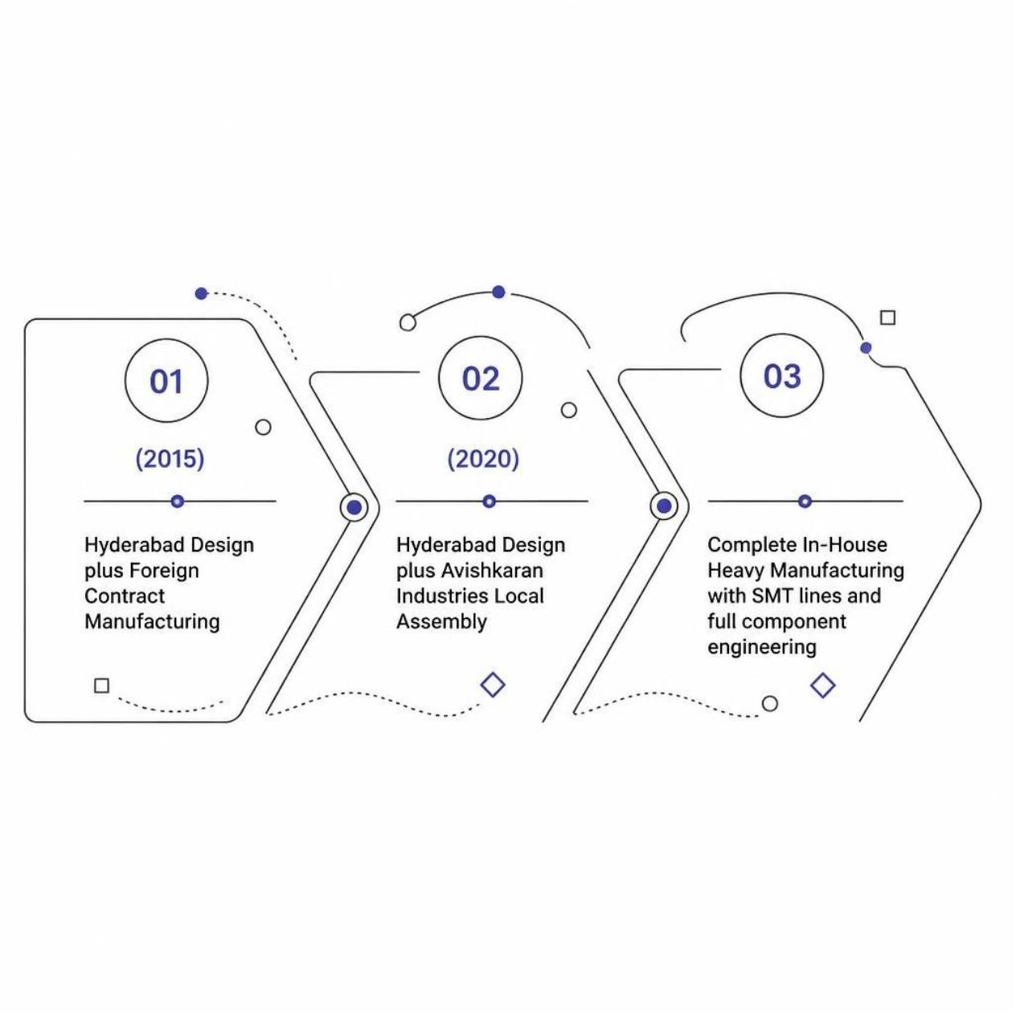
From Selling Products to Building Manufacturing Capability
Mivi's journey moved from external manufacturing toward increasing local production capability.
2015
Hyderabad design + foreign contract manufacturing.
2020
Hyderabad design + local assembly; move toward internal production.
2022
The source presentation describes 9 production lines and 700+ employees.
2024
₹200 crore second facility, 2,000 jobs and 100,000 units/day capacity as stated in the source case study.
Source: User-provided presentation; figures are presented as stated in that source.
9
9

Slide 10
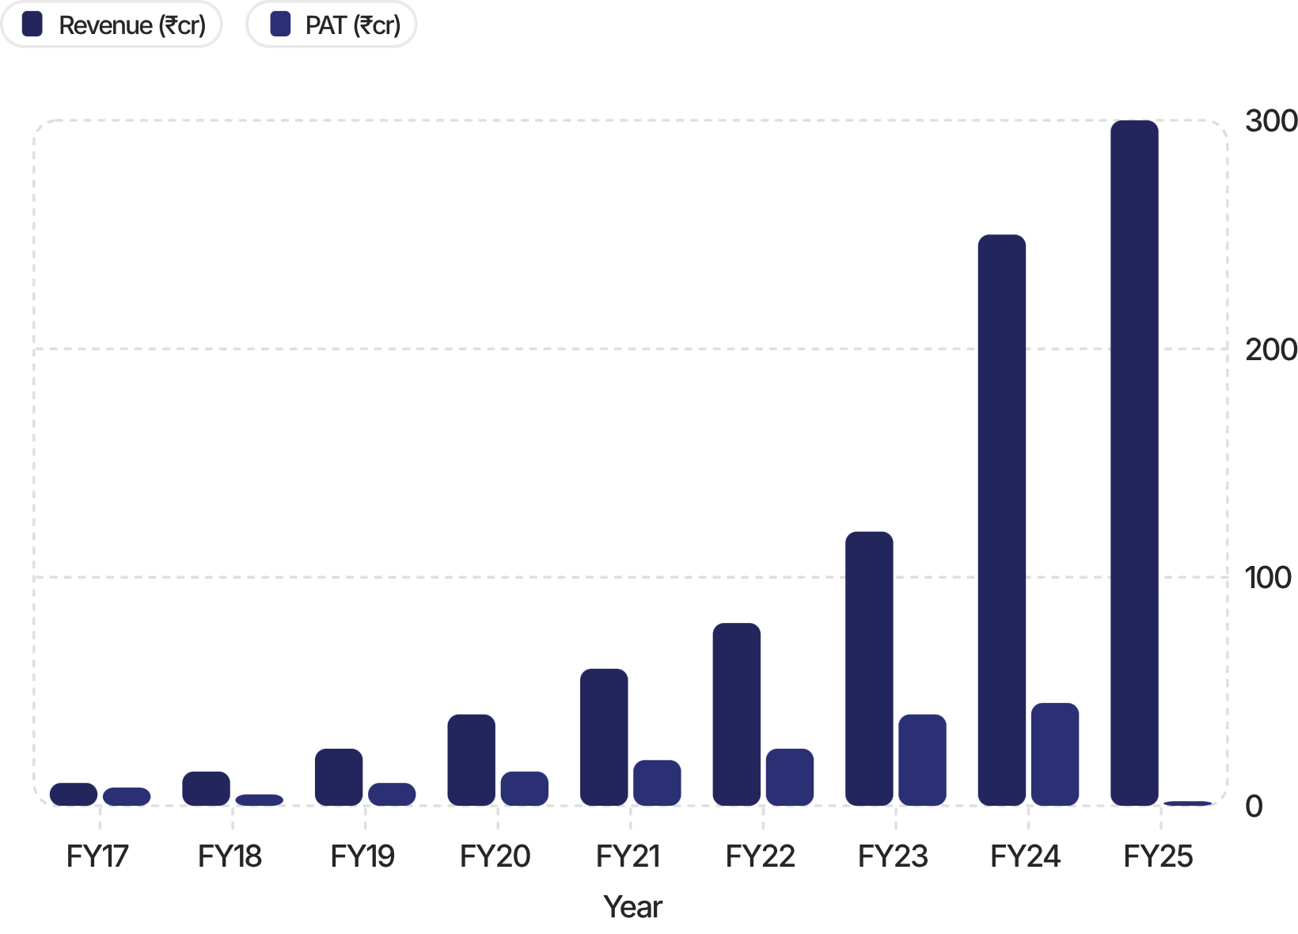
Growth, Scale and the Financial Reality
Scaling a hardware company requires capital, infrastructure and careful attention to profitability.
~₹10 Cr
>₹300 Cr
FY17 revenue in the source case study
FY25 revenue in the source case study
₹2.4 Cr
2022
FY25 provisional PAT stated in the source
Debt round mentioned in the source
What this shows
Revenue growth and physical expansion can increase financial complexity; growth and profitability are different measures.
Source: User-provided presentation; financial figures are presented as stated in that source.
10
10

Slide 11
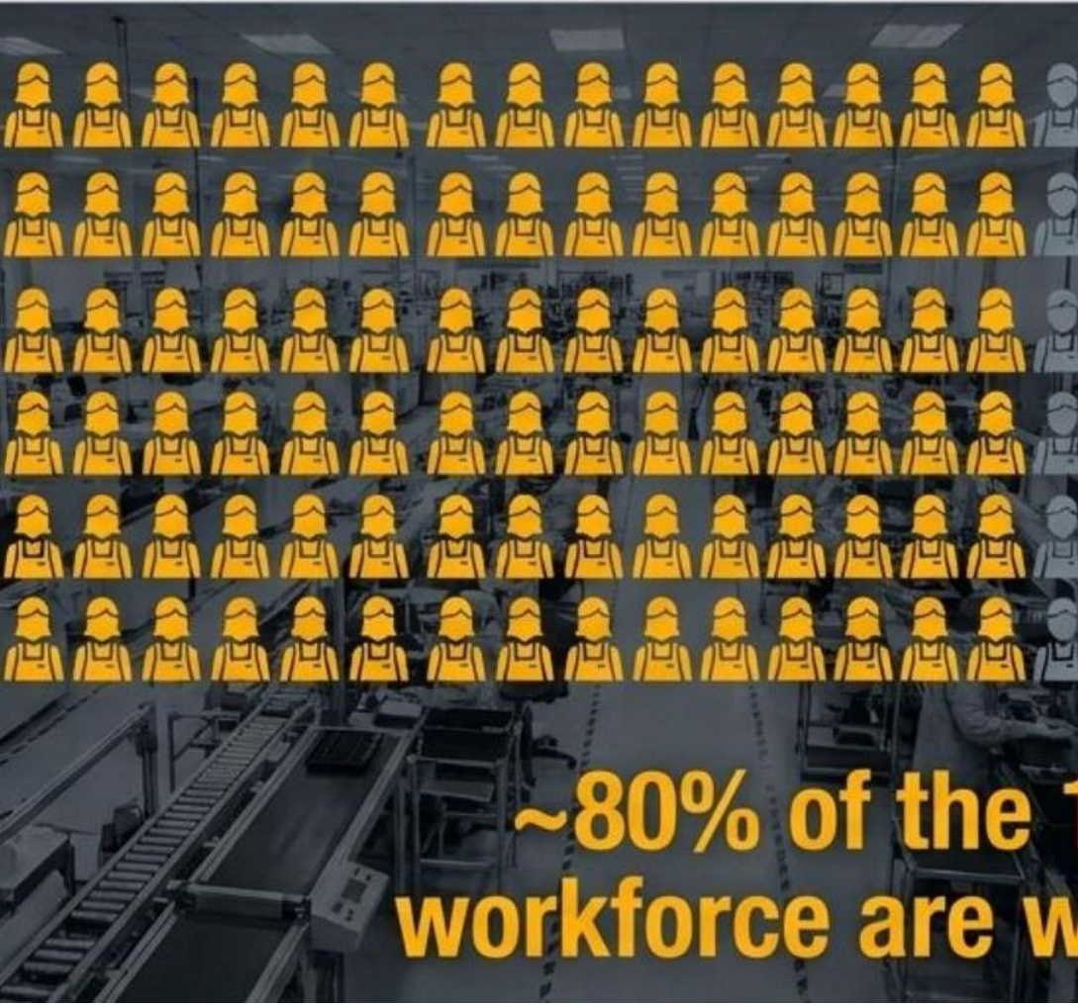
Women Entrepreneurship and Employment
Midhula's leadership journey also connects entrepreneurship with opportunities for women in manufacturing.
Leadership in technology
Midhula moved from a software-engineering career into leadership in a technology and consumer-electronics company.
Building together
She built Mivi with Viswanadh Kandula, combining complementary responsibilities and shared decision-making.
Women at Mivi
The source case study highlights a predominantly women workforce and in-house training as part of workforce development.
Entrepreneurship → Employment → Skills → Leadership
Source: User-provided presentation and case-study material.
11
11

Slide 12
Challenges Midhula and Mivi Had to Navigate
The journey involved product, market, operational and financial challenges.
Market competition
Quality at scale
Manufacturing shift
Building a consumer-electronics brand in a competitive market and earning customer trust.
Maintaining product quality and customer experience while expanding the portfolio.
Moving from outsourced production toward domestic and internal manufacturing capability.
Capital requirements
Technology change
Operational complexity
Hardware manufacturing requires investment in facilities, people, equipment and working capital.
Rapid changes in electronics and shifting customer preferences require continuous product learning.
Growth brings more processes, teams, suppliers and financial decisions to manage.
The entrepreneurial challenge is not only starting — it is building systems that can support the next stage of growth.
12
12

Slide 13
What We Can Learn From Midhula's Journey
The story connects customer understanding, persistence, product quality and long-term execution.
01
Identify
02
Research
03
Position
Start with a real customer problem.
Understand the market before investing heavily.
Be clear about why customers should choose your brand.
04
Build
05
Persist
06
Create impact
Make quality and value part of the product itself.
Entrepreneurship requires patience and long-term execution.
A business can create employment, skills and opportunities for women.
Overall journey: Idea → Market Gap → First Product → Feedback → Brand → Product Expansion → Manufacturing → Employment
Sources: User-provided Mivi/Midhula presentations; Raw Talks With VK Podcast-46 references contained in the source material.
13
13

Slide 14
Thank You
The entrepreneurial journey of Midhula Devabhaktuni
Women Entrepreneurship & Development

