Slide 1
WOMEN ENTREPRENEURSHIP & DEVELOPMENT
The Mivi Journey
From idea to product, brand and Made-in-India manufacturing
A case study of Midhula Devabhaktuni and Mivi
Presented by
PATHURI SRUTHI CHOWDARY - 24BQ1A05Z4
PUVVALA PREMA SWARUPA RANI - 24BQ1A050X
SATTENAPALLI VATHSALYA - 25BQ5A0547
PEDAKOTLA HARSHA VARDHAN - 24BQ1A05Z7
PULIVARTHI ANTHONI - 24BQ1A050T
REDDI SANTOSH - 25BQ5A0545

Slide 2
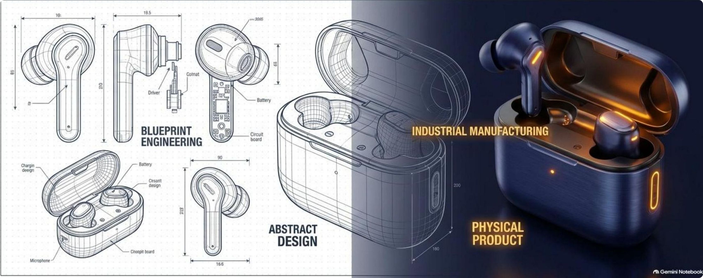
Who is Midhula Devabhaktuni?
Co-Founder & CMO of Mivi — a consumer electronics brand built around quality, value and Indian customer needs.

Slide 3


Education, Career & Entrepreneurial Shift
Midhula built a foundation in technology, business and corporate execution before returning to India to build Mivi.
Engineering Foundation
Higher Education
Corporate Experience
B.Tech in Computer Science, JNTU (2008)
Worked as a software engineer in the US, including Xerox and Raymond James, before moving into entrepreneurship.
MS in Computer Science and later an MBA in the US (Florida State University)

Slide 4
Finding the Opportunity in the Indian Market
The founders identified a gap between low-cost imports and expensive global brands: Indian customers wanted quality, value and dependable service.
Mivi's Opportunity
Low-Cost Imports
Global Brands
Build a homegrown brand combining product quality, value, customer service and products suited to Indian consumers.
Quality products were available, but prices were often high and products were not always designed around Indian usage.
Cheap white-label products could offer low prices but often lacked certification, warranty and consistent quality.

Slide 5
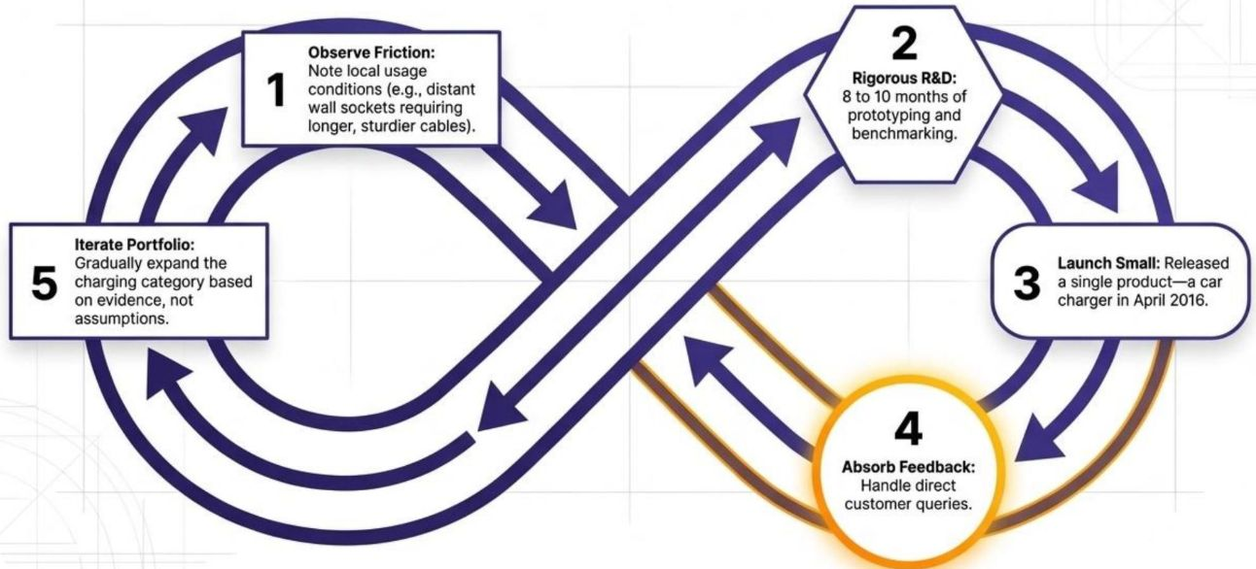
From Corporate Career to a Small-Scale Start
Midhula and Viswanadh left their professional careers and tested the business idea before attempting large-scale expansion.
The Starting Point
Bootstrapped Approach
Small Before Scale
Mivi was established in 2015; the first products began selling in 2016.
The first stage was funded from personal savings, allowing the founders to focus on product and customer learning.
The business began from a home-office environment and grew through experimentation rather than an immediate large factory.

Slide 6
Validate, Learn and Iterate
Midhula's journey emphasizes understanding customer problems before investing heavily in products and scale.
Observe
Launch
Iterate
Understand local usage and customer pain points
Start with a focused product and collect real feedback
Use evidence to improve the portfolio
1
2
3
4
5
Research
Listen
Prototype, test and improve before scaling
Customer questions and reviews become product inputs
Customer Support as R&D
In the early online-only phase, Midhula personally handled customer calls and emails, using direct feedback to improve products, warranties and trust.

Slide 7

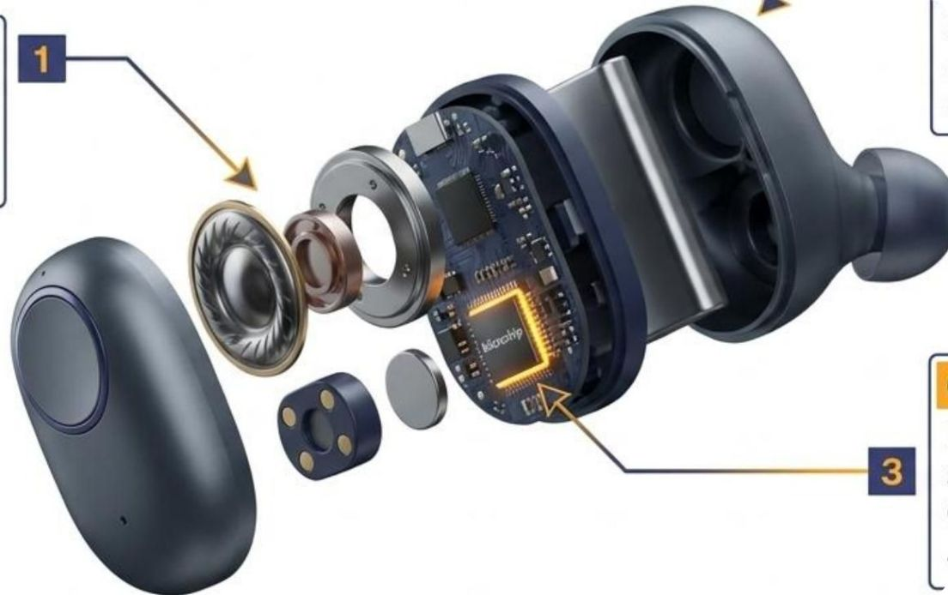
Building Products for Indian Consumers
Mivi moved into audio and wearable products, where technology, design, comfort, sound quality and customer expectations meet.
1
2
3
Category Choice
Local Understanding
Quality & Validation
Headphones, earphones, Bluetooth devices and speakers create frequent customer interaction.
Product decisions were shaped by Indian preferences and usage conditions.
Mivi pursued product quality and certification as part of building customer trust.

Slide 8
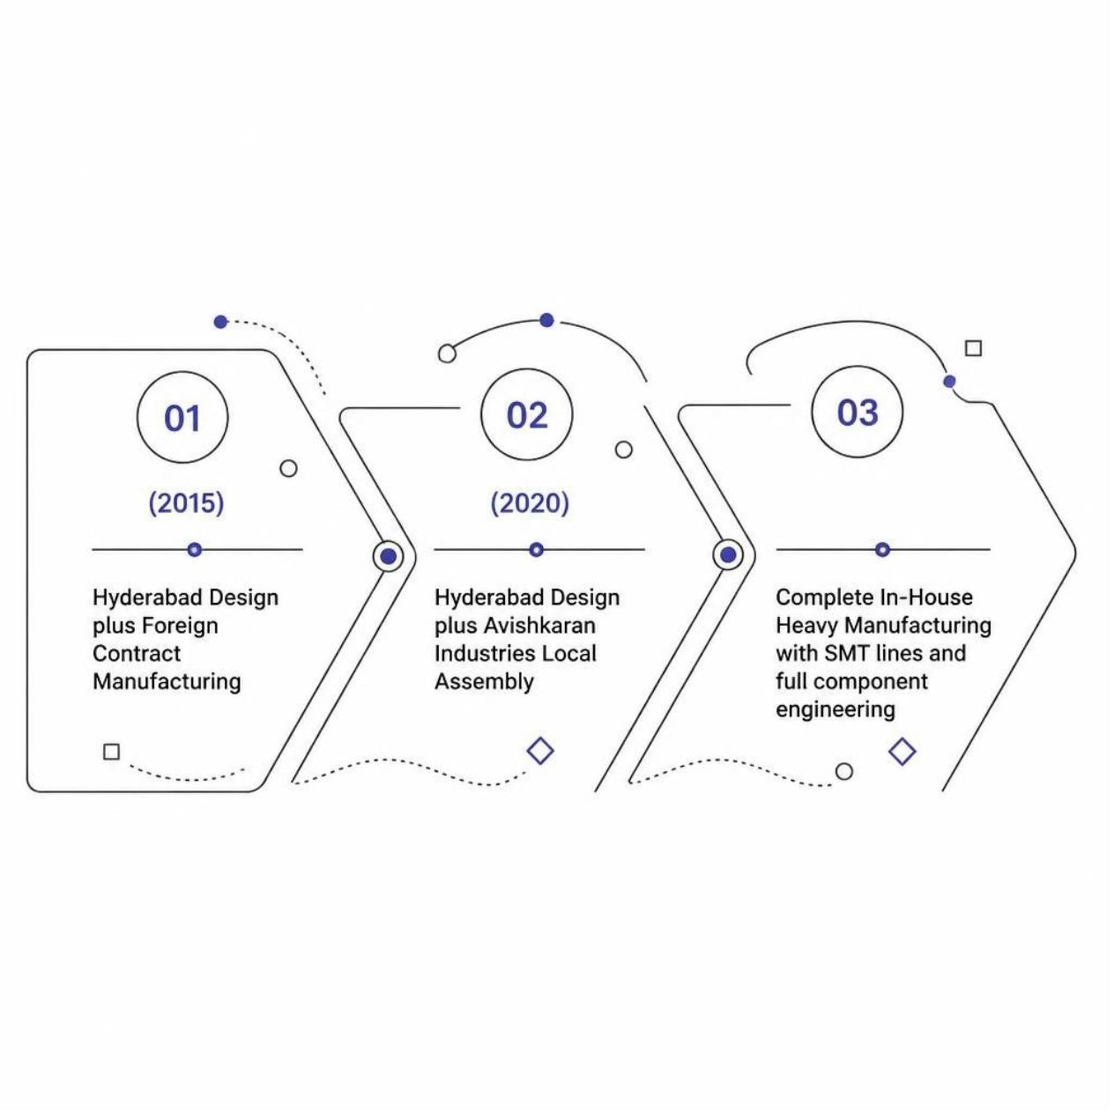
From Selling Products to Making in India
Mivi's journey moved beyond importing products toward building domestic manufacturing capability, people and processes.
Scaling the Physical Footprint
2020
2022
2020 — 1 production line and 50+ employees
2022 — 9 production lines and 700+ employees
2024
2024 — ₹200 crore second facility, 2,000 jobs and 100,000 units/day

Slide 9
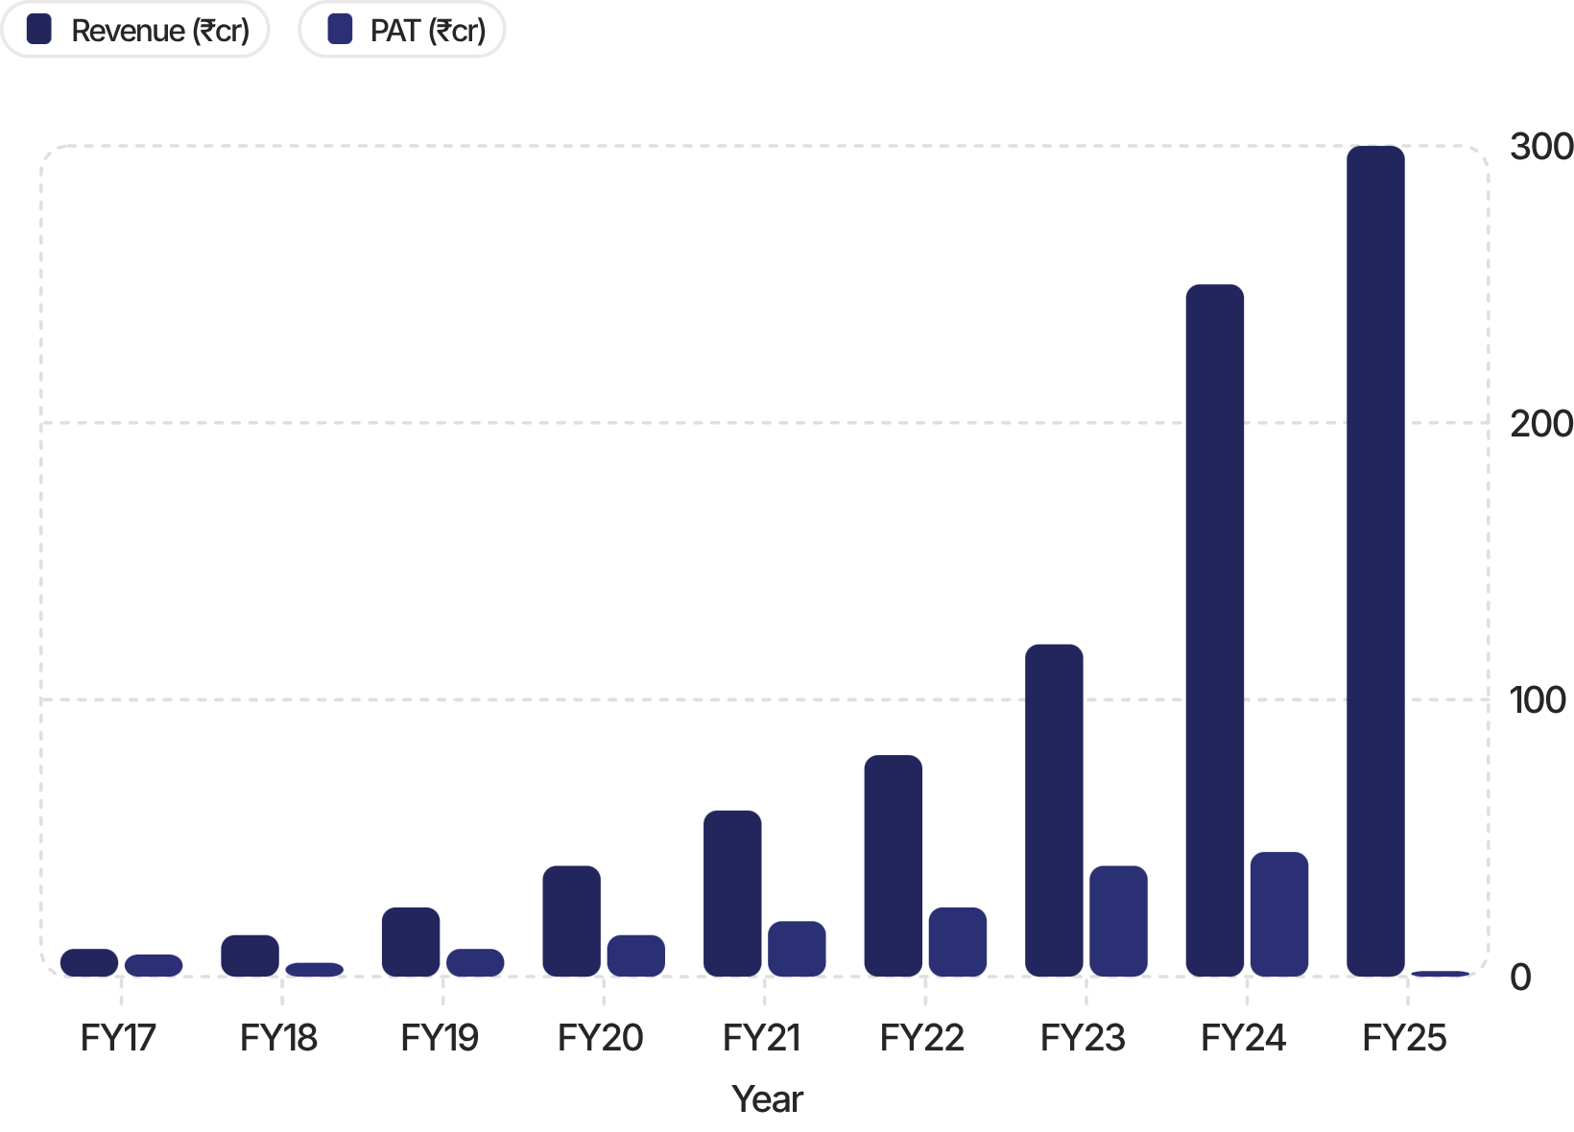

Finance, Growth & Long-Term Thinking
Growth has to be balanced with cash flow, pricing, margins, investment and the economics of hardware.
The podcast discusses how financial decisions become increasingly important as a company scales. Pricing should reflect customer value and business economics rather than simply copying competitors.
The long-term focus is sustainable growth — not spending money simply to look bigger.

Slide 10
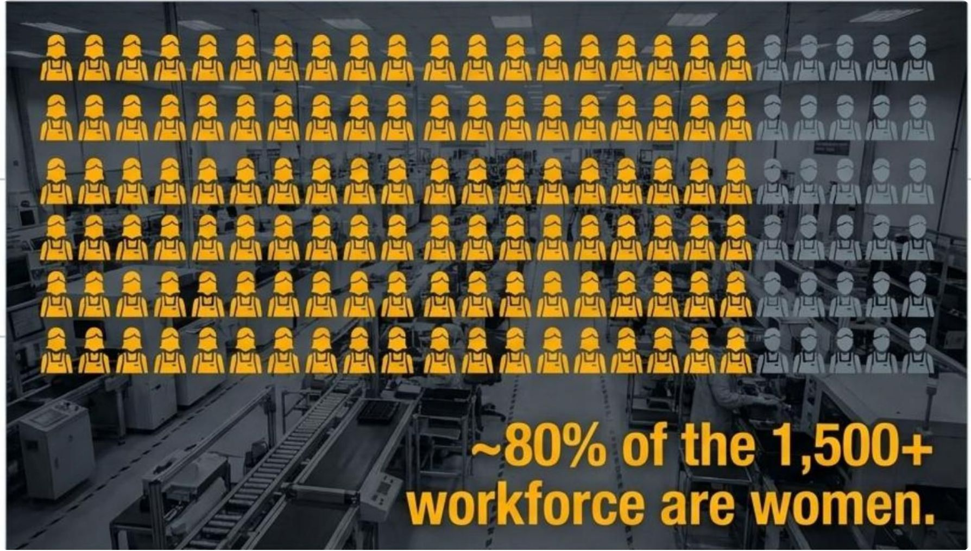
Partnership, Leadership & Women Entrepreneurship
Midhula and Viswanadh built Mivi together, combining complementary skills while sharing responsibility for the business.
Entrepreneurial Partnership
Women in Technology
Employment & Opportunity
Running a company as partners requires communication, shared responsibility and clarity between personal and professional roles.
Midhula's leadership demonstrates that women can build and lead technology and hardware businesses.
Mivi's workforce also highlights opportunities for women in manufacturing, skills development and leadership.

Slide 11
Marketing, Positioning & Customer Trust
Mivi's growth involved more than promotion: the brand had to communicate a clear reason for customers to choose it.
Marketing
Customer Trust
Feedback Loop
Use channels such as marketplaces, social media and influencers while connecting spending to measurable outcomes.
For electronics, reliability, reviews, service and after-sales support strongly influence perceived value.
Satisfied customers can become a source of repeat business and brand growth.
1
2
3
4
5
Positioning
Brand Building
Answer the customer question: why choose this brand? Mivi focused on quality, value and Indian consumers.
A strong brand grows from consistent product experience and customer satisfaction—not visibility alone.
A Practical Lesson
Marketing brings attention; positioning gives customers a reason to choose; product experience and service help build trust.

Slide 12
Key Lessons from Midhula's Journey
The journey connects customer understanding, product quality, disciplined growth and long-term execution.
1 IDENTIFY
2 RESEARCH
Start with a real customer problem.
Understand the market before investing heavily.
3 POSITION
4 BUILD
Be clear about why customers should choose you.
Make quality and value part of the core product.
5 PERSIST
6 CREATE IMPACT
Entrepreneurship requires patience and continuous execution.
A business can create jobs, skills and opportunities for women.

Slide 13
Women at Mivi: Skills, Work & Impact
Entrepreneurship can create opportunities beyond the founders — through employment, skills and leadership.
WORKFORCE
Women can participate in precision-oriented manufacturing roles supported by training and structured processes.
TRAINING
In-house learning helps employees develop the skills required for electronics manufacturing operations.
LEADERSHIP & GROWTH
Creating pathways for women in technology and manufacturing can extend the social and economic impact of a growing business.
Key idea: business growth and inclusion can reinforce each other when people are trained, supported and given room to grow.

Slide 14
Thank You

