Slide 1
MCA
CONSTRUCTION SERVICE & MATERIAL
MANAGEMENT SYSTEM
A Unified Web Marketplace for Workers, Contractors & Building Materials
HARIPRASAD T B
Enrolment No.: 232MCAN0168 | Reg. No.: 23MCA5168
Guide: Dr. S. Meera — Associate Professor & Head (I/c)
Department of Computer Science (AI)
Centre for Distance and Online Education, Bharathiar University | 2023–2025

Slide 2
Agenda
01
Introduction & Problem Statement
02
Objectives
03
Existing vs Proposed System
04
System Architecture
05
User Roles & Modules
06
Database Design (ER)
07
Technology Stack
08
Application Walkthrough
09
Testing & Results
10
Conclusion & Future Work
Construction Service & Material Management System | MCA Major Project
2

Slide 3
Introduction
The Context
• Construction is one of India's largest employment sectors
• Hiring relies on word-of-mouth and local referrals
• Material purchase needs visits to multiple suppliers
• No unified digital platform for services + materials
• Providers lack online presence and booking tools
Proposed System
A full-stack web marketplace that unifies
worker hiring • contractor booking • material purchase
Built with Next.js 16, React 19, MongoDB,
and JWT-secured role-based access
Construction Service & Material Management System | MCA Major Project
3

Slide 4
Problem Statement
1
2
3
4
5
No Verification
Hard to find verified, rated workers and contractors
Opaque Pricing
Labour and material rates unclear until work begins
No Records
Bookings, orders and payments are untracked
No Digital Tools
Providers cannot manage requests or earnings online
No Oversight
No central admin control over users and listings
Construction Service & Material Management System | MCA Major Project
4

Slide 5
Objectives
1
Develop a unified construction marketplace web application
2
Implement secure JWT authentication & role-based access (5 roles)
3
Enable worker hiring and contractor booking with filters & ratings
4
Provide material e-commerce with cart and checkout
5
Support bookings, orders, reviews and unified activity history
6
Deliver Admin, Provider and Vendor management dashboards
Construction Service & Material Management System | MCA Major Project
5

Slide 6
Existing System vs Proposed System
EXISTING — Manual & Fragmented
• Word-of-mouth referrals, phone negotiations
• Visits to multiple shops for material prices
• No ratings, verification or comparison
• Paper-based or zero record keeping
• Partial apps: services OR materials, never both
PROPOSED — Unified Web System
• Single platform: workers + contractors + materials
• Transparent pricing, photos, ratings & reviews
• Cart, checkout, bookings and order tracking
• Role-based dashboards for every participant
• Secure JWT sessions, MongoDB persistence
Construction Service & Material Management System | MCA Major Project
6

Slide 7
System Architecture
Three-tier architecture
Browser
(All Roles)
PRESENTATION LAYER
Next.js Pages • React 19 Components • Tailwind CSS • Zustand Cart
HTTP / REST + JWT Cookie
APPLICATION LAYER
Next.js API Routes (REST) • Middleware • JWT Auth • Role Permissions
Mongoose Queries
DATA LAYER
MongoDB • Mongoose ODM • users · providers · products · bookings · orders · reviews
Construction Service & Material Management System | MCA Major Project
7

Slide 8
User Roles
Five roles with dedicated dashboards
CUSTOMER
Browse • Book • Order Review • Track activity
WORKER
Listing • Bookings Earnings dashboard
Unified
Platform
Unified
Platform
CONTRACTOR
Projects • Bookings Earnings dashboard
VENDOR
Products • Orders Sales statistics
ADMIN
Users • Listings • Bookings • Orders — full control
Construction Service & Material Management System | MCA Major Project
8

Slide 9
Application Modules
Authentication
Register, login, JWT cookie sessions, middleware protection
Services
Workers & contractors with filters, detail pages, booking
Materials
Product catalog, categories, sorting, image sliders
Cart & Checkout
Per-user cart for products + services, order creation
My Activity
Unified history of orders and bookings
Reviews & Ratings
Star ratings and comments for providers
Admin Panel
Users, providers, vendors, materials, bookings, orders
Provider Panel
Booking management and earnings analytics
Vendor Dashboard
Product listings and sales overview
Construction Service & Material Management System | MCA Major Project
9

Slide 10
Database Design — ER Diagram
MongoDB `buildconnect` — six collections
PROVIDER
type: worker/contractor
pricing, portfolio
rating, isApproved
REVIEW
rating (1–5)
comment
userId, providerId
1 : N has
USER
name, email, mobile
password (bcrypt)
role, isBlocked
1 : N owns
PRODUCT
name, category, price
unit, stock, image
vendorId
1 : N places
in items[]
BOOKING
serviceType, startDate
totalAmount
status workflow
ORDER
items[], total
deliveryAddress
status workflow
Construction Service & Material Management System | MCA Major Project
10

Slide 11
Database Collections
Collection | Purpose | Key Fields
users | Accounts & credentials (5 roles) | name, email, password, role, isBlocked
providers | Worker / contractor listings | type, title, location, pricing, rating, portfolio
products | Material catalog | name, category, price, unit, stock, vendorId
bookings | Service bookings | userId, providerId, startDate, totalAmount, status
orders | Material purchases | userId, items[], total, deliveryAddress, status
reviews | Provider feedback | userId, providerId, rating (1–5), comment
Construction Service & Material Management System | MCA Major Project
11

Slide 12
Technology Stack
Next.js 16
Full-stack framework — pages + REST API routes
React 19
Component-based responsive user interface
Tailwind CSS 4
Utility-first styling, dark construction theme
MongoDB + Mongoose 8
Document database with schema validation
JWT + bcrypt
HTTP-only cookie sessions, hashed passwords
Zustand
Per-user shopping cart state
Recharts
Earnings & dashboard analytics
TypeScript 5
Static typing across the entire codebase
Construction Service & Material Management System | MCA Major Project
12

Slide 13
Key Workflows
Material Order Flow
Browse
Materials
Add to Cart
(Zustand)
Checkout
POST
/api/orders
MongoDB
orders
My Activity
Tracking
Service Booking Flow
Browse
Workers
View Details
& Pricing
Book
Service
POST
/api/bookings
Provider
Confirms
Earnings
Dashboard
Authentication Flow
Register /
Login
bcrypt
Verify
JWT Signed
(7 days)
HTTP-only
Cookie
Middleware
Guard
Role-based
Dashboard
Construction Service & Material Management System | MCA Major Project
13

Slide 14
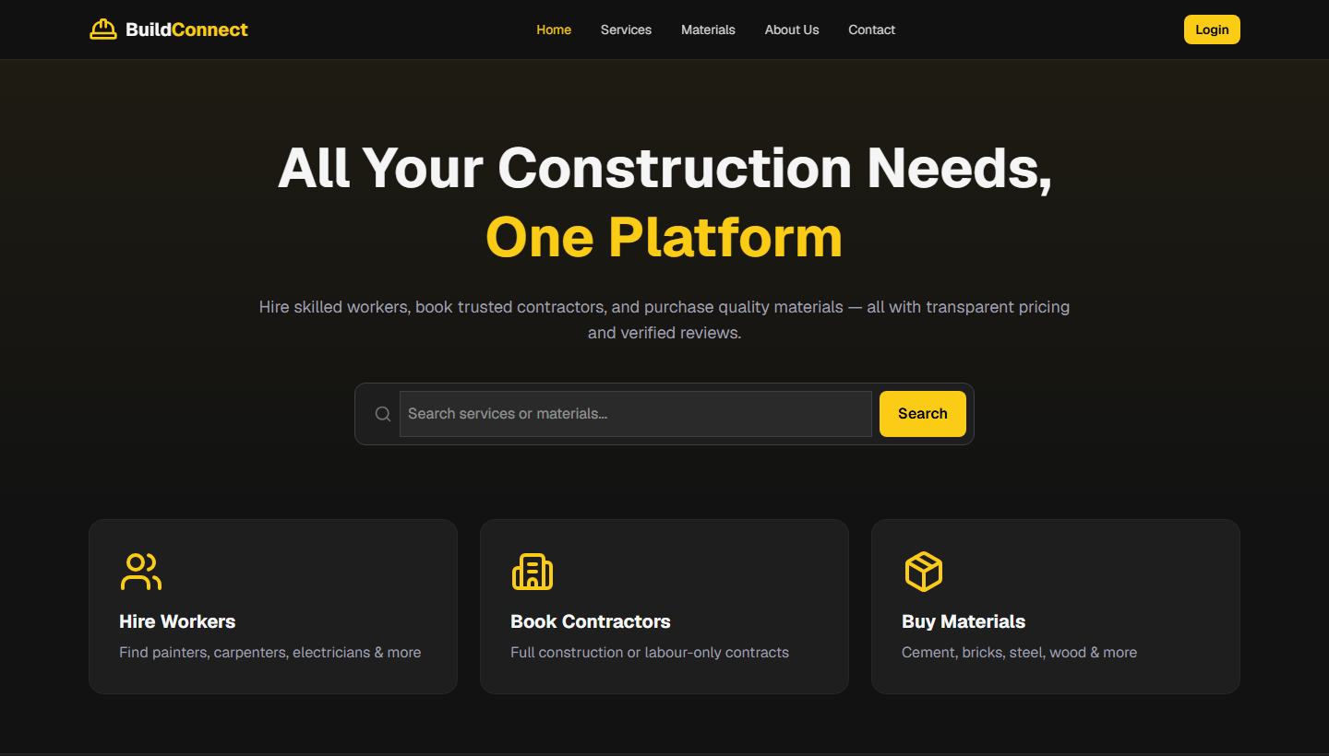
Walkthrough — Home Page
Landing page with search and service categories
Construction Service & Material Management System | MCA Major Project
14

Slide 15
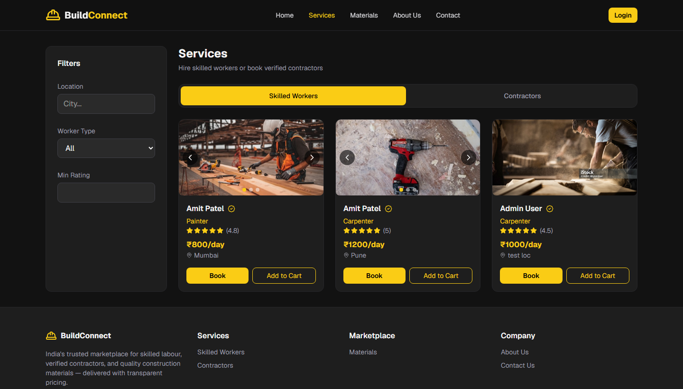
Walkthrough — Services
Skilled workers with filters, ratings and booking
Construction Service & Material Management System | MCA Major Project
15

Slide 16
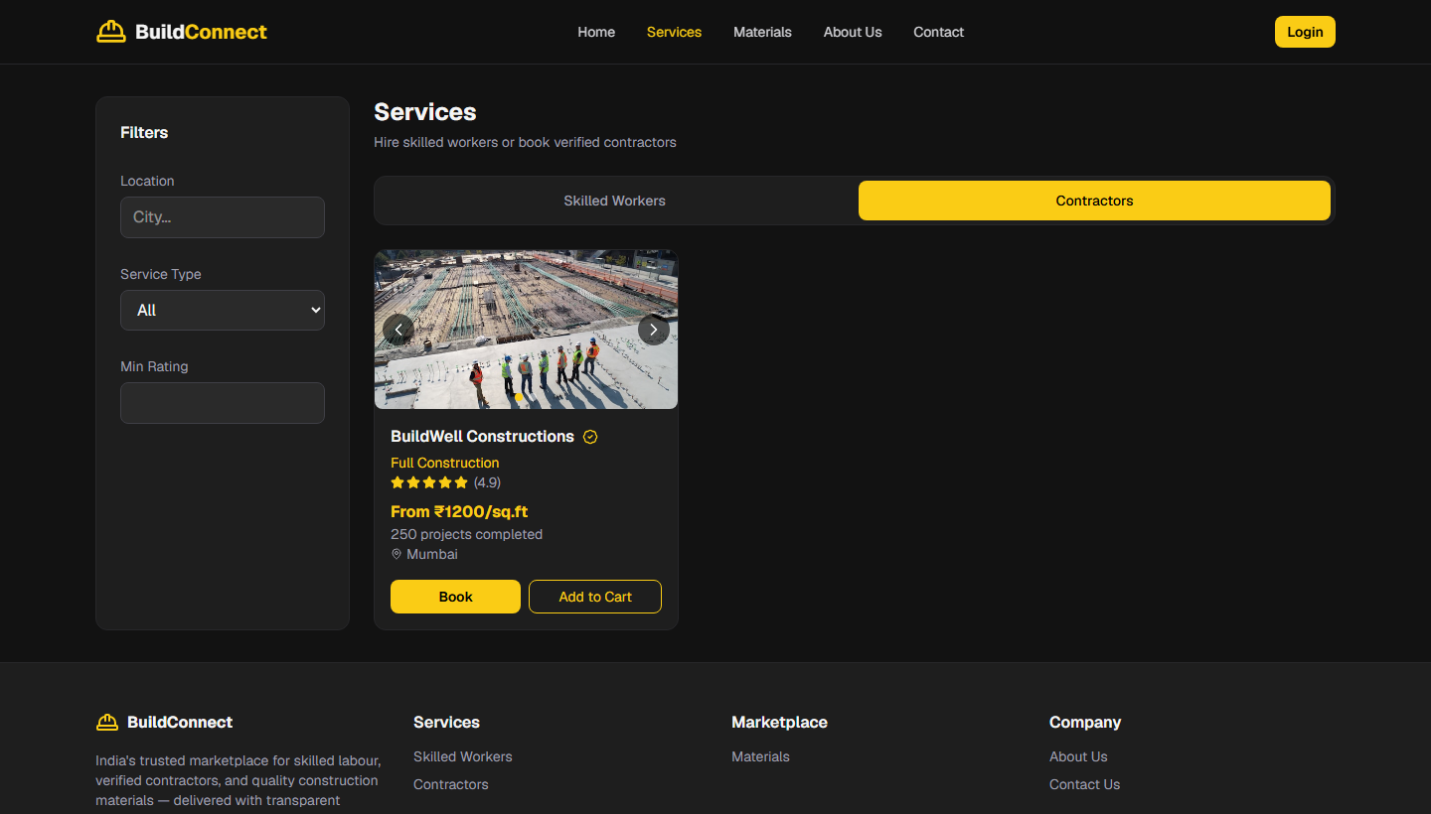
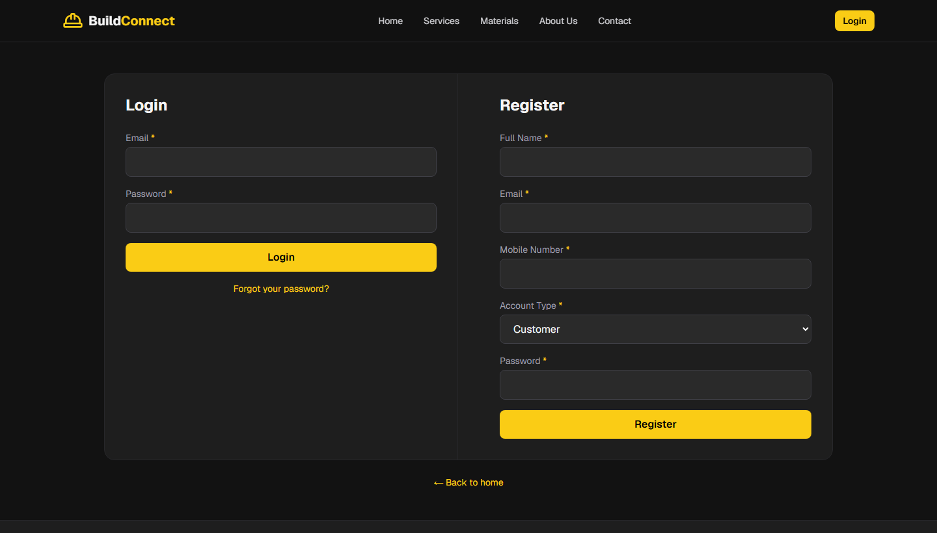
Walkthrough — Contractors & Login
Contractor listings
Login / Registration
Construction Service & Material Management System | MCA Major Project
16

Slide 17
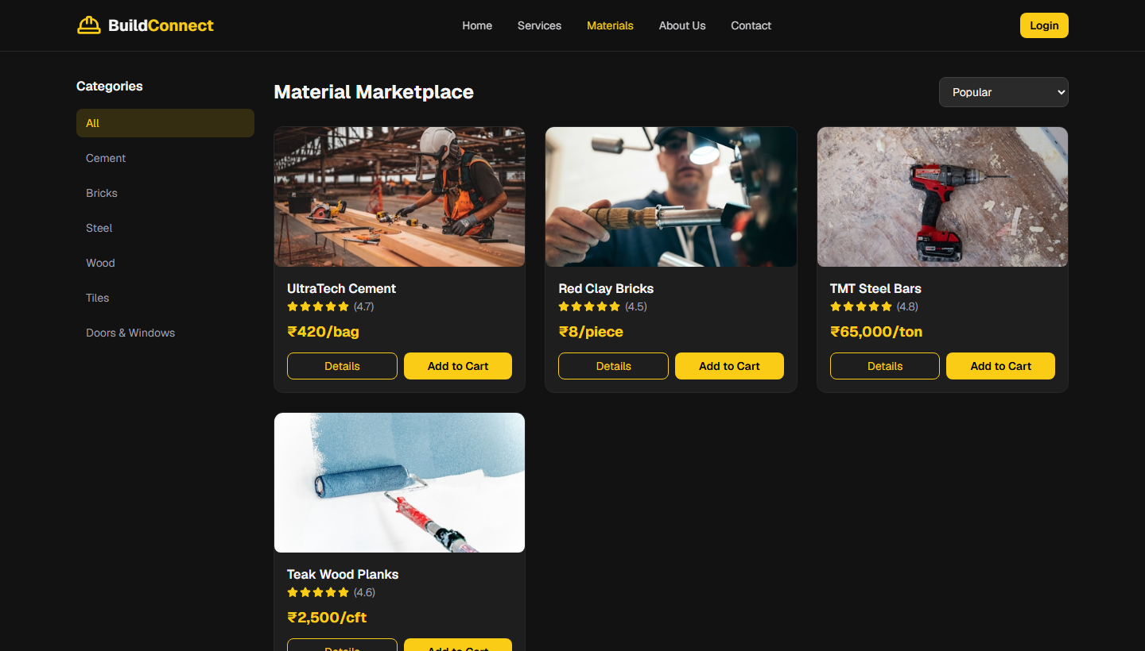
Walkthrough — Materials Marketplace
Product catalog with categories, pricing and cart
Construction Service & Material Management System | MCA Major Project
17

Slide 18
Testing & Results
Test Case | Scenario | Result
TC01 | Login with valid / invalid credentials | Pass
TC04 | Add to cart — logged-in user | Pass
TC05 | Cart access as guest → redirect login | Pass
TC06 | Worker booking creation | Pass
TC07 | Material order checkout & total | Pass
TC09 | Provider booking status & earnings | Pass
TC10 | Admin blocks user → login denied | Pass
TC12 | Production build (npm run build) | Pass
Levels Covered
• Unit testing
• Integration testing
• User acceptance
• Output testing
• Validation testing
• Security checks
Construction Service & Material Management System | MCA Major Project
18

Slide 19
Conclusion
Achievements
• Unified marketplace: services + materials, one platform
• Five-role system with secure JWT access control
• Cart, bookings, orders, reviews fully working
• Admin / Provider / Vendor dashboards delivered
• All 12 test cases passed; clean production build
Future Enhancements
• Razorpay / UPI payment gateway
• Email & SMS notifications
• Mobile app (React Native)
• GPS worker tracking
• AI-based recommendations
• Cloud deployment with CI/CD
Construction Service & Material Management System | MCA Major Project
19

Slide 20
Thank You
Questions & Discussion
HARIPRASAD T B
232MCAN0168 | 23MCA5168
Guide: Dr. S. Meera — Dept. of Computer Science (AI)
Bharathiar University CDOE | 2023–2025

