Slide 1

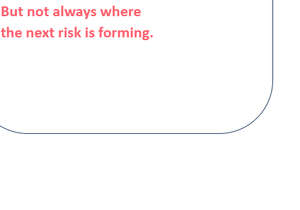
AI •ROAD SAFETY •PREVENTION
AI-Powered Proactive
Road Safety Intelligence
THE CORE GAP
Accident data tells us
where crashes happened.
Risk Prevention System
Current road safety systems mostly study accidents after they happen. This
reactive approach misses warning signs and emerging hazards that could
be identified earlier.
THE SHIFT
From reacting to crashes → predicting risk before impact

Slide 2
02
Proposed Solution
A continuous AI-based view of road risk — combining five safety dimensions.
01
02
03
TRAFFIC BEHAVIOUR
PEDESTRIAN SAFETY
ROAD INFRASTRUCTURE
Speeding • sudden braking
unsafe lane changes • flow
Crossing conflicts • near-misses
vehicle–pedestrian proximity
Potholes • damaged surfaces
missing signs • road defects
04
05
VISIBILITY & WEATHER
ROAD GEOMETRY & LOCATION
Low light • rain • fog
reduced visibility conditions
Sharp curves • junctions
black spots • school zones
OBSERVE THE RISK.
PREDICT THE DANGER.
PREVENT THE ACCIDENT.

Slide 3
03
Technology Stack
From data sources to the user interface.
1. Data Sources
CCTV / Video Clips • OpenWeather API • OpenStreetMap (Overpass API)
↓
2. Vision Pipeline
OpenCV • YOLOv8 • ByteTrack
↓
3. Feature Engineering
Vehicle counts • Speed • Pedestrian counts • Close calls • Weather and road context
↓
4. Risk Prediction
XGBoost • SHAP Explainability
↓
5. Backend & Storage
FastAPI • SQLite • PostgreSQL + PostGIS (optional)
↓
6. User Interface
React.js • MapLibre GL / Leaflet • Plotly / Recharts

Slide 4
04
Work Architecture
How raw road observations become actionable prevention measures.
1
CAPTURE
Collect video, road-condition images, weather and map context.
2
DETECT & TRACK
Identify vehicles, pedestrians, road defects and relevant objects.
3
ANALYSE CONTEXT
Measure speed patterns, proximity, visibility, road geometry and conflict indicators.
4
PREDICT & PRIORITISE
Combine indicators into a location-based risk score and classify risk level.
5
ALERT & ACT
Show hotspots on a dashboard; notify the responsible team to inspect or intervene.
Human review remains part of the loop: alerts guide inspections and decisions; they do not replace road-safety authorities.

Slide 5
05
What Makes It Novel?
The innovation is the integration of multiple early-warning signals into one proactive risk view.
MULTI-DIMENSIONAL
PROACTIVE, NOT REACTIVE
Connects five risk dimensions instead of analysing crashes or one hazard in
isolation.
Looks for developing risk patterns and near-miss indicators before an accident
occurs.
LOCATION-AWARE
ACTION-ORIENTED
Combines AI observations with GIS and road geometry to pinpoint where risk
is emerging.
Prioritises risk hotspots so teams can inspect, repair, improve visibility or
manage traffic.
ONE RISK PICTURE
→
EARLIER, TARGETED PREVENTION

Slide 6
06
Impact & Benefits
Turning road intelligence into safer streets and better-informed interventions.
EARLIER WARNING
SAFER ROAD USERS
SMARTER MAINTENANCE
Identify emerging hazards before they
contribute to a crash.
Highlight pedestrian conflict zones and risky
traffic behaviour.
Prioritise potholes, damaged surfaces, signs and
visibility issues.
BETTER PLANNING
DATA-DRIVEN DECISIONS
SCALABLE FRAMEWORK
Use risk maps to guide infrastructure upgrades
and enforcement.
Track risk patterns over time and evaluate
interventions.
Adapt the system to new roads, camera feeds
and local datasets.
THE OUTCOME
A shift from accident response to continuous risk prevention.

