Slide 1
Evaluation of CNN On FOOD CLASSIFICATION
Guide,
Mr. R. Raja Subramanian
Team Members,
Kota Rama Sai Vamsi
Hariram S
Gokul Pandian M

Slide 2
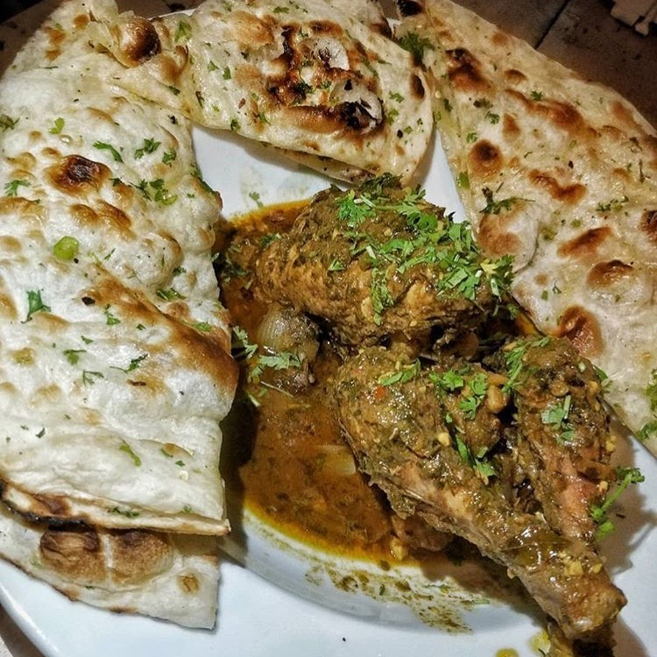
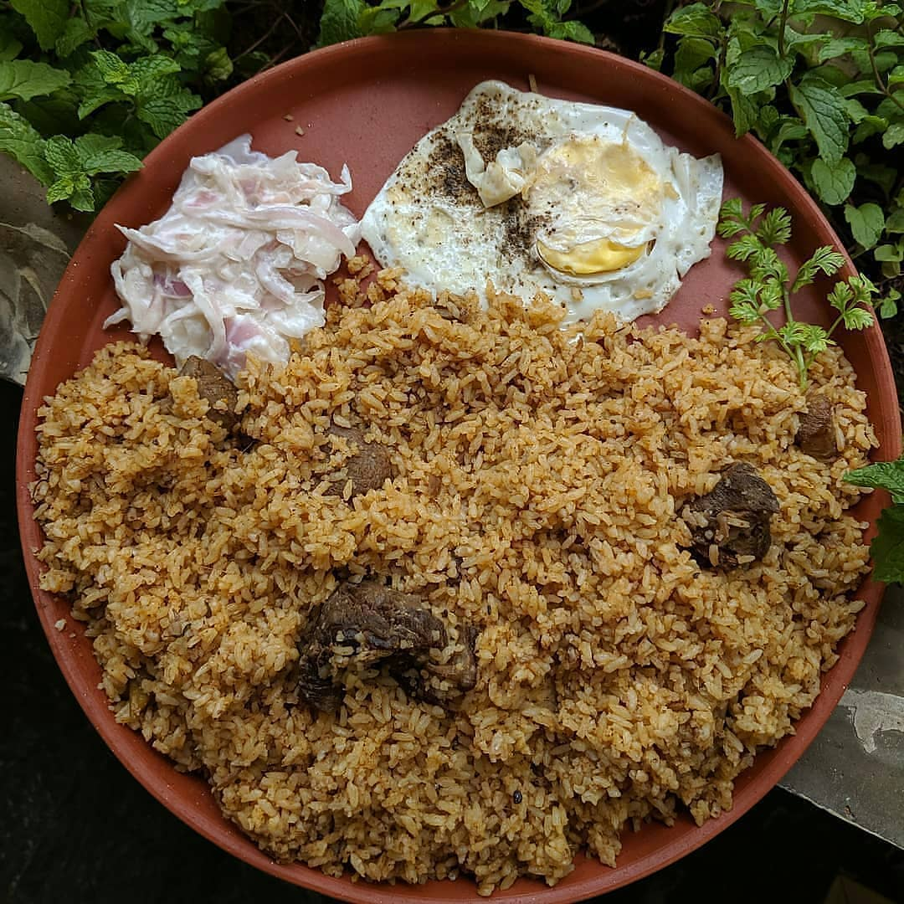
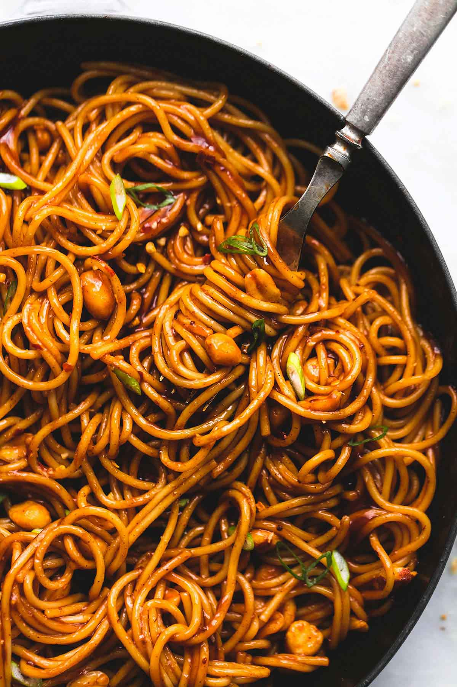
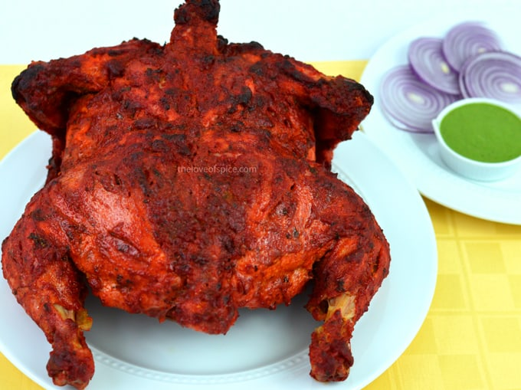
Developing and understanding Customized Deep Learning Models for Food CLASSIFICATION

Slide 3
Food20 Image Dataset
Overview
Number of images: 2,000
Food categories: 20
Challenges: Variations in lighting, background, and food presentation
‎
Notes:
The Food20 image dataset is a challenging dataset for food detection, with variations in lighting, background, and food presentation. It contains 20,000 images of 20 different food categories, including pizza, sushi, and burgers.

Slide 4
Objective:
Food detection using deep learning has emerged as a promising solution for various applications in the food industry, health, and nutrition.
CNN models can be a promising choice for food detection tasks, especially in resource-constrained environments.

Slide 5
Convolutional Neural Networks
Role of Deep Learning Models in Food Detection
CNNs: Specialized neural networks for image processing
Architecture: Various architectures can be used for food detection, including VGG19, MobileNetV2, and InceptionResNetV2
‎
Notes:
Convolutional Neural Networks (CNNs) are specialized neural networks for image processing, and are commonly used in deep learning models for food detection. Various CNN architectures can be used for this task, including VGG, ResNet, and Inception.

Slide 6
Preprocessing and Augmentation
Importance of Deep Learning Models in Food Detection
‎
Preprocessing: Techniques for cleaning and preparing data
Convolutional:Techniques for compressing the data.
Augmentation: Techniques for generating additional training data
Notes:
Data preprocessing and augmentation are important techniques for improving the performance of deep learning models for food detection. Preprocessing techniques include cleaning and preparing data, while augmentation techniques involve generating additional training data to improve model robustness.

Slide 7
Training and Validation
Process for Deep Learning Models for Food Detection
‎
Training: Process of optimizing model parameters using training data
Validation: Process of evaluating model performance using validation data
Notes:
Training and validation are critical steps in the development of deep learning models for food detection. During training, the model parameters are optimized using training data, while during validation, the model performance is evaluated using validation data.

Slide 8
Hyperparameter Tuning
Importance in Deep Learning Models for Food Detection
‎
Hyperparameters: Parameters that control model behavior
Tuning: Process of selecting optimal hyperparameters
Notes:
Hyperparameter tuning is an important step in the development of deep learning models for food detection. Hyperparameters are parameters that control model behavior, and tuning involves selecting the optimal values for these parameters to improve model performance.

Slide 9
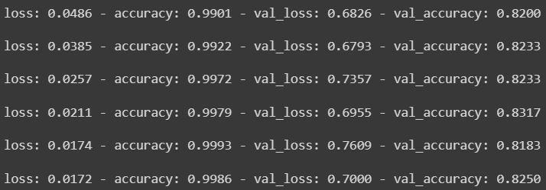
Evaluation Metrics
Measures of Performance for Deep Learning Models for Food Detection
Precision: Proportion of true positives among all positive predictions
Recall: Proportion of true positives among all actual positives
F1-score: Harmonic mean of precision and recall
‎
Notes:
Evaluation metrics are important measures of performance for deep learning models for food detection. Precision measures the proportion of true positives among all positive predictions, recall measures the proportion of true positives among all actual positives, and F1-score is the harmonic mean of precision and recall.

Slide 10
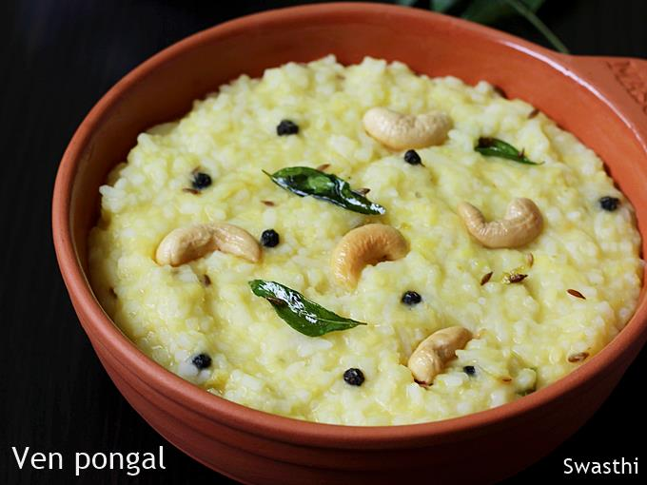
Fine-tuning
Process for Customizing Pre-trained Models for Food Detection
Fine-tuning: Process of retraining pre-trained models on new data
Layers: Selection of layers to be retrained
Regularization: Techniques for preventing overfitting
‎
Notes:
Fine-tuning is a critical step in the customization of pre-trained models for food detection. During fine-tuning, the pre-trained model is retrained on new data, with the selection of layers to be retrained and the use of regularization techniques to prevent overfitting.

Slide 11
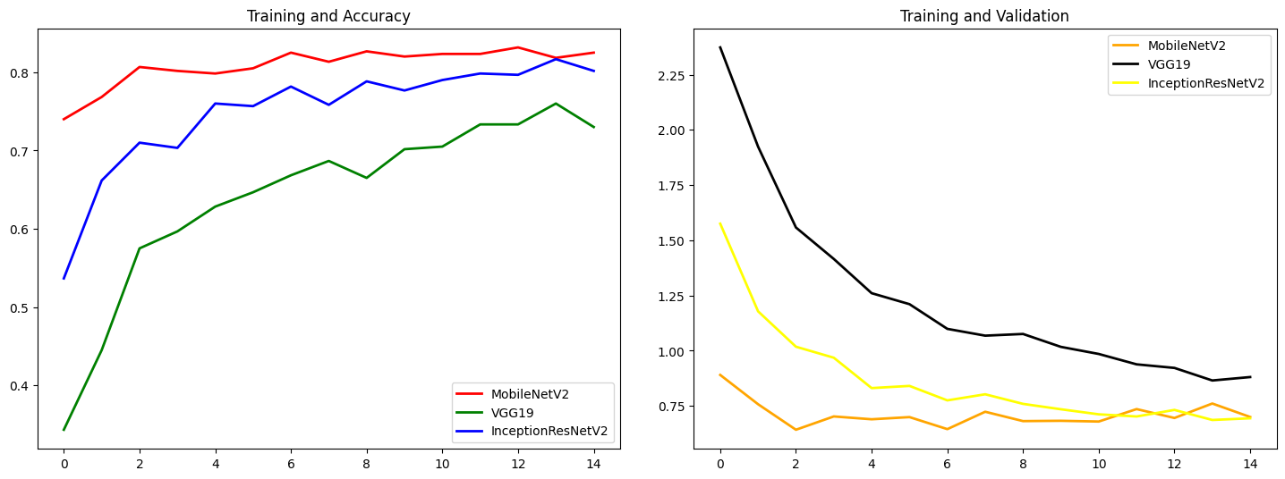
Results
Performance of Customized Deep Learning Models on Food20 Image Dataset
Evaluation Metrics: Precision, Recall, F1-score
Comparison: State-of-the-art models
‎
Notes:
Our customized deep learning models achieved state-of-the-art performance on the Food20 image dataset, with high precision, recall, and F1-score. These results demonstrate the effectiveness of our approach for developing customized deep learning models for food detection.

Slide 12
Applications
Potential Applications of Customized Deep Learning Models for Food Detection
Food Recognition: Mobile apps, dietary assessment, and food waste reduction
Other Applications: Agriculture, food safety, and quality control
Notes:
Customized deep learning models for food detection have a wide range of potential applications, including food recognition in mobile apps, dietary assessment, and food waste reduction. They can also be used in other domains, such as agriculture, food safety, and quality control.

Slide 13
Conclusion
Key Insights and Recommendations for Future Research
Customized deep learning models: Effective for food detection
Potential applications: Mobile apps, dietary assessment, and food waste reduction
Future research: Optimization of model architectures and evaluation metrics
Notes:
In conclusion, customized deep learning models are effective for food detection, and can be used in a wide range of applications, including mobile apps, dietary assessment, and food waste reduction. Data preprocessing and augmentation, hyperparameter tuning, and fine-tuning are all critical steps in the development of these models, and future research should focus on the optimization of model architectures and evaluation metrics.

Slide 14
THANK YOU

