Slide 1


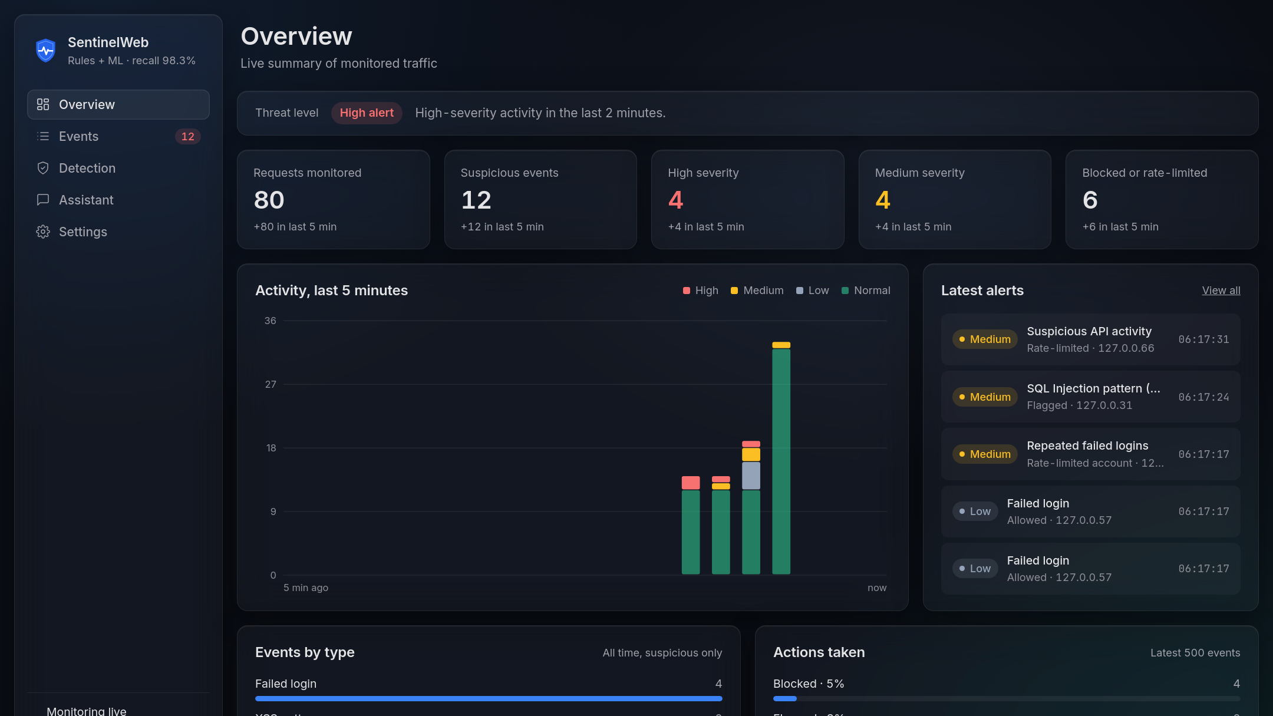
SentinelWeb
Real-time web attack monitoring with rules and machine learning, explained in plain language.
SentinelWeb protects and explains
SentinelWeb Lab sends safe test traffic
[Presenter name] · [Date]
Notes:
0:00 to 0:20. SentinelWeb is an educational prototype with two products. SentinelWeb itself sits in front of a demo web app, catches attacks and explains every alert on a live dashboard. SentinelWeb Lab is a separate app that sends safe test traffic, so anyone can see the detection working. In the next four minutes: the problem, how it works, how well it detects, and a look at both products.

Slide 2




Four attacks a small web app sees every day
THE PROBLEM
SQL injection
Cross-site scripting
Brute-force logins
Request floods
Database commands typed into an input box to rewrite a query.
Script-like text a browser could run if a page showed it unsafely.
Many password guesses against one account in a short time.
One client sending far more requests than a person ever would.
Small teams rarely read raw logs. They need alerts they can trust, understand and test.
Notes:
0:20 to 0:45. These are the four threats we watch for. Red ones are input attacks, which are blocked; amber ones are behaviour-based, which are rate-limited. The real problem is not detection alone: small teams need alerts they can trust and understand, and a way to test them safely.

Slide 3
Send, check, explain
HOW IT WORKS
SentinelWeb Lab
scenarios → requests
RequestMonitor
4 checks per request
Detectors
rules + ML model
Event log
SQLite
Dashboard
UI + assistant
Demo app
answers if allowed
Gemini / Groq
optional AI
Blocked requests never reach the demo app
1
Send
2
Check
3
Explain
The Lab (or any browser) calls the demo app under /demo/*.
Every request passes 4 checks: locked? → rate → input scan → failed logins.
Each event is logged with its evidence and a plain reason, shown live.
Notes:
0:45 to 1:20. Left to right: the Lab sends test traffic to the demo app. Every request hits SentinelWeb's middleware first, which runs four checks in order: is the client already locked, is it sending too fast, does any input look like an attack, and is someone guessing passwords. It logs an event, and the dashboard reads the same log. Inputs can be query strings, nested JSON, form or text bodies, even the URL path.

Slide 4
The model catches what the rules miss
RULES + MACHINE LEARNING
Rules
Recall on 2,256 held-out attacks
5 SQL injection + 4 XSS patterns. High severity, blocked.
31.1%
98.3%
ML model
TF-IDF character n-grams + logistic regression on 30,529 rows.
rules only
rules + ML
Model only
Missed attacks: 1,554 → 39
Score ≥ 0.70 is flagged for review, never auto-blocked.
Test split of 6,106 rows (Kaggle SQLiV3). The dataset repeats similar payloads, so real traffic will score lower.
Notes:
1:20 to 1:55. Hand-written rules are precise but narrow: alone they caught under a third of the test attacks. Adding a small text classifier lifted recall to 98.3 percent and cut missed attacks from 1,554 to 39. The design rule: only rule matches are blocked; when only the model fires, the request is flagged for a human, because a statistical guess can be wrong. Honest caveat: the dataset repeats payloads, so real traffic will score lower.

Slide 5
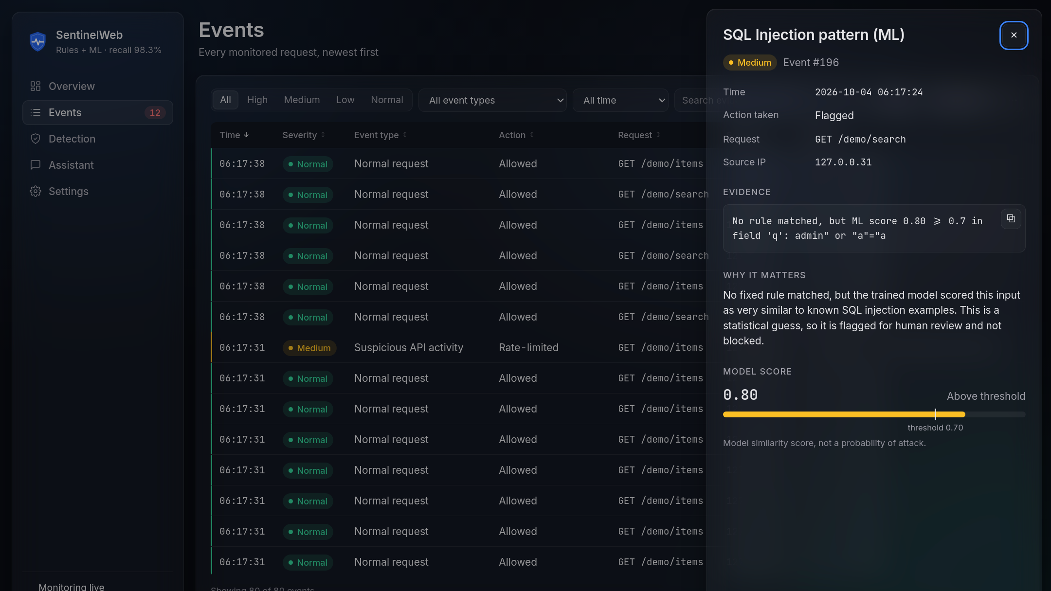
Every alert explains itself
SENTINELWEB DASHBOARD
Overview threat level, live counters, 5-minute activity, latest alerts
Event details evidence, why it matters, ML score vs the 0.70 threshold
Notes:
1:55 to 2:30. The dashboard updates every three seconds. One threat level at the top, counters with what changed in the last five minutes, and the latest alerts. Click any event and the drawer shows the exact evidence, a plain-language reason, and for model detections the score against the threshold. The Events page filters, sorts and exports to CSV, and the Detection page shows the live model metrics and every rule.

Slide 6
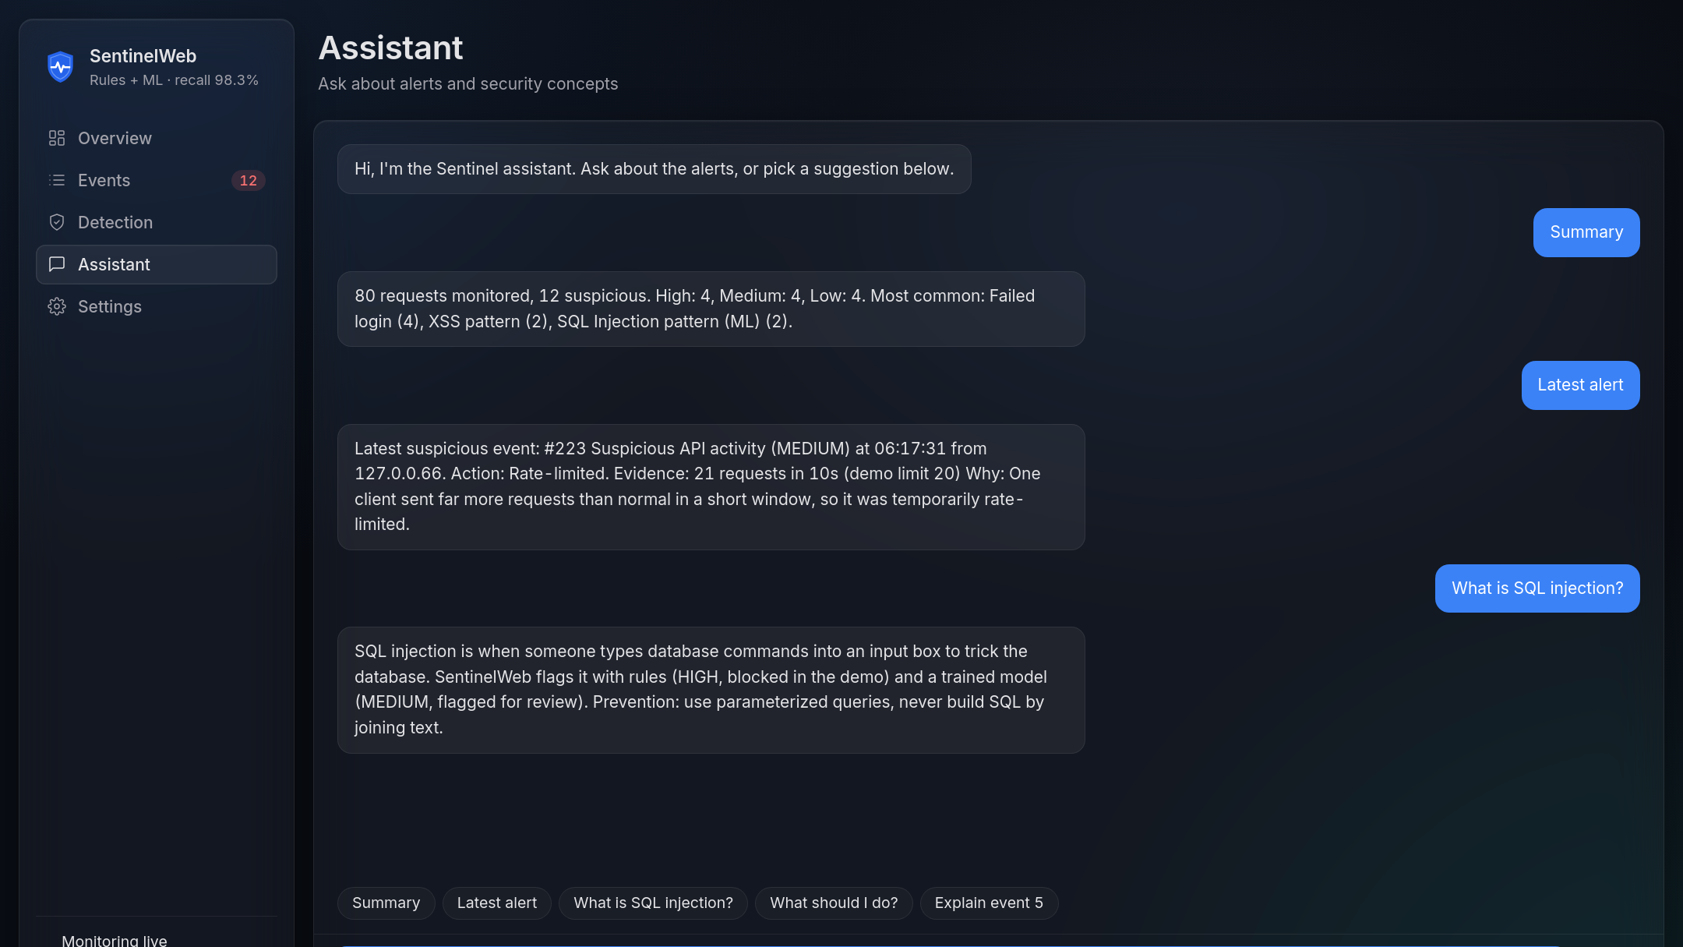
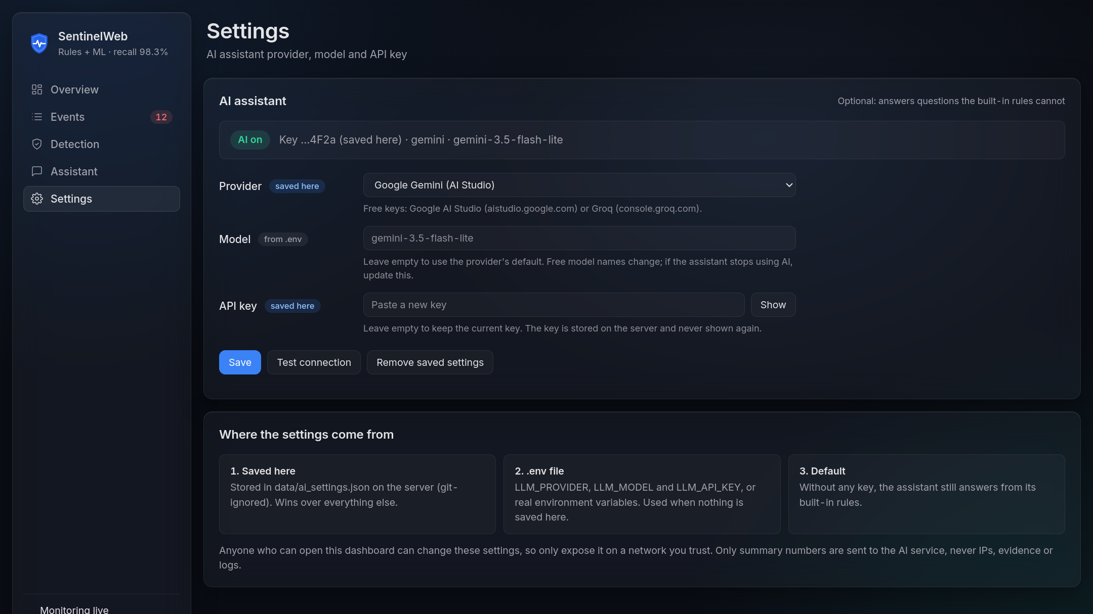
Plain-language answers, optional AI
ASSISTANT
Rules first summaries, latest alert, FAQs, with no internet needed
AI optional Gemini or Groq key on the Settings page or in .env; never shown again, only summary numbers sent
Notes:
2:30 to 2:55. The assistant answers from built-in rules first, so it works offline. If you add a free Gemini or Groq key, either on this Settings page or in the .env file, it falls back to AI for other questions. A key saved here wins over .env, it is never shown again, and only summary counts are ever sent to the AI service.

Slide 7
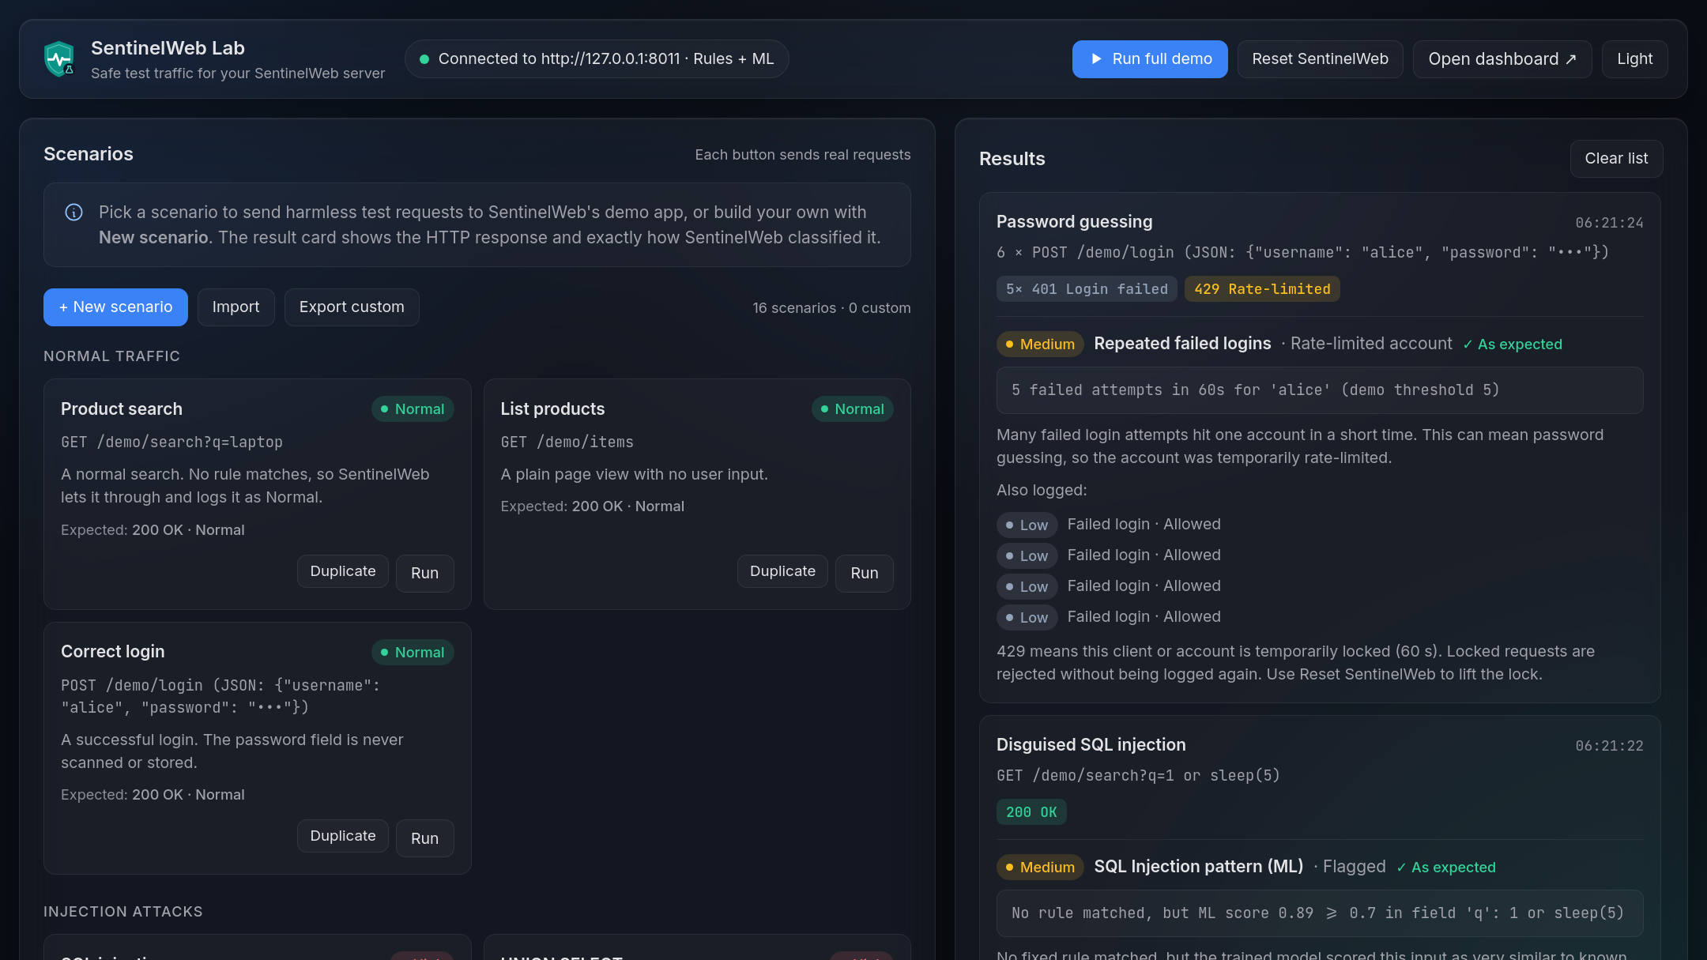
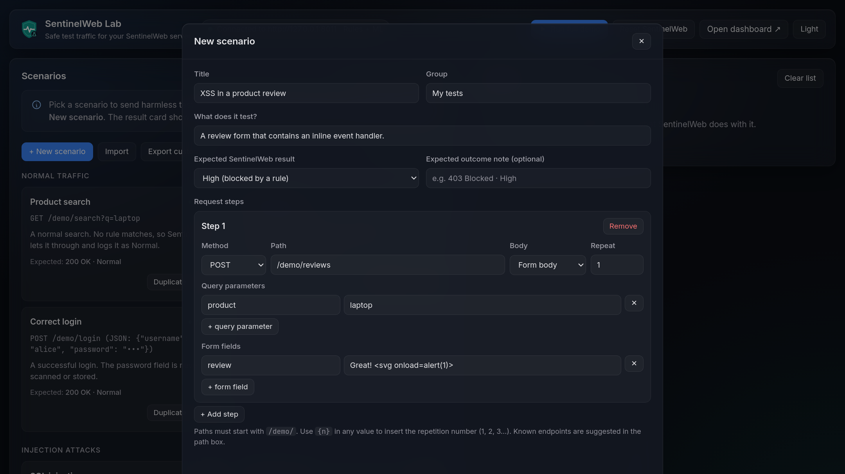
Test it live, and add your own scenarios
SENTINELWEB LAB
16 ready scenarios normal traffic, injections, logins, floods; each result shows the verdict and ✓ As expected
Your own scenarios any /demo path, method and body; save, duplicate, import or export as JSON
Notes:
2:55 to 3:30. SentinelWeb Lab replaces a terminal script with a page anyone can follow. Each card sends one scenario and the result shows the HTTP response and exactly how SentinelWeb classified it, with a check mark when it matches the expectation. New scenario opens an editor: any demo path, method, query, JSON, form or text body, and a repeat count. Scenarios are plain JSON, so teams can share them as files. For safety, the Lab can only reach the demo app of the server it was started with.

Slide 8

Built so the monitor is never the weak spot
SAFE BY DESIGN · RUN IT
Attack strings are shown as text, never run as HTML
$ cd docker
$ docker compose up --build
dashboard → localhost:8000
lab → localhost:8001
Parameterized SQL everywhere
Passwords, tokens and keys are never scanned, stored or shown
Without Docker: uvicorn main:app + python client/app.py
Model-only detections are flagged, not blocked
Questions?
Next: an XSS model, tuning rules that flag benign SQL-like text, and testing on real traffic.
Dataset: SQLiV3.csv, Kaggle · [dataset author] · [license]
Notes:
3:30 to 4:00. A security tool that stores attack strings is itself a target, so everything is shown as plain text, all SQL is parameterized, secrets are never stored or shown, and a statistical guess never blocks anyone. With Docker, two commands from the project folder run both products. Next steps: an XSS model, tuning noisy rules, and testing on real traffic. Thank you; questions?

