Slide 1
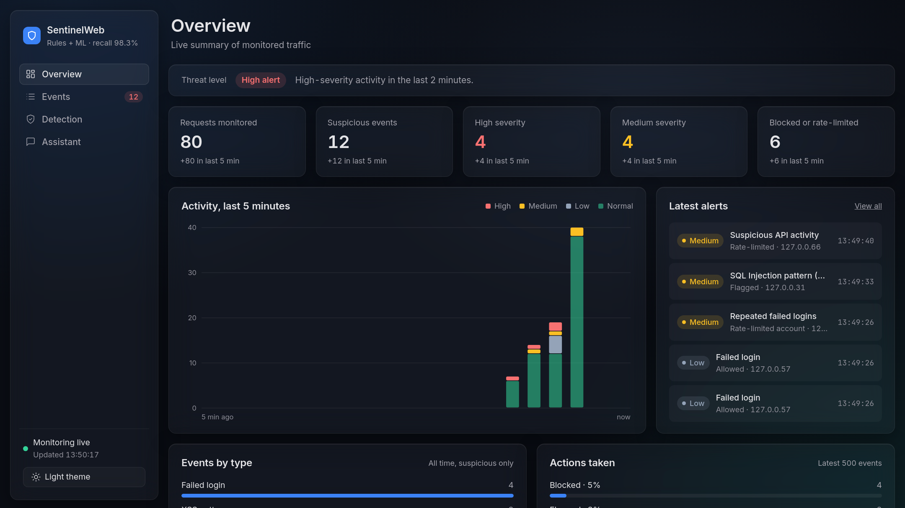
SentinelWeb
WEB ATTACK MONITORING PROTOTYPE
Rules plus a trained model catch SQL injection, XSS, brute-force logins and request floods, and explain every alert in plain language.
FastAPI · scikit-learn · SQLite | [Presenter name] · [Date]
Notes:
SentinelWeb is an educational prototype: it sits in front of a small demo web app, watches every request, flags suspicious ones with fixed rules and a machine-learning model, and shows everything on a live dashboard. Today: the problem, how it works, how well the model performs, the product itself, and what is still missing.

Slide 2




Four attacks a small web app sees every day
THE PROBLEM
SQL injection
Cross-site scripting
Brute-force logins
Request floods
Database commands typed into an input box to rewrite a query.
Script-like text a browser could run if a page showed it unsafely.
Many password guesses against one account in a short time.
One client sending far more requests than a person ever would.
Small teams rarely have time to read raw logs. They need alerts they can trust and understand.
Notes:
These are the four threat types SentinelWeb watches for. Red marks the input attacks, which are blocked in the demo; amber marks behaviour-based threats, which are rate-limited. The key point: small teams don't read raw logs, so alerts must be both accurate and explained.

Slide 3



SentinelWeb watches, decides and explains
THE IDEA
01
02
03
Watch
Decide
Explain
A FastAPI middleware sees every request to the demo app under /demo/*.
Rules, an ML model and time-window counters assign a severity, then block, flag or rate-limit.
Each event is logged with its evidence and a plain-language reason, shown live on a dashboard.
Notes:
The whole product in three verbs. Watch: only requests to /demo are monitored, so the dashboard itself is never scanned. Decide: three kinds of detectors produce a severity of High, Medium, Low or Normal, and an action. Explain: every event carries its evidence and a sentence a non-expert can read.

Slide 4
One process, four parts
ARCHITECTURE
Client
Browser or simulate.py
Sentinel middleware
FastAPI, main.py
Detection
Rules · ML model · sliding windows
Event log
SQLite, parameterized queries
if allowed
Demo app
/demo/search, /demo/login
Dashboard
Overview, events, chatbot
Dashboard API
/api/events, /api/stats
Notes:
Read it left to right. Every request to /demo hits the middleware first. The middleware asks the detection module for a verdict, writes an event to SQLite, and only then, if the request was not blocked, passes it on to the demo app (the green arrow). The dashboard polls the API every three seconds and draws everything from the same event table.

Slide 5
Every request passes four checks, in order
REQUEST PIPELINE
1
2
3
4
Already locked?
Request rate
Input scan
Login tracking
A rate-limited IP or account gets HTTP 429 straight away.
More than 20 requests in 10 s from one IP locks it for 60 s.
Query and JSON fields go through the rules and the ML model.
5 failed logins in 60 s locks that account for 60 s.
Fields named password, token and session are never scanned or stored.
Notes:
The order matters. Locked clients are rejected first and not logged again, so an attacker can't flood the log. The rate check comes before the more expensive input scan. Login failures need the app's response, so they are counted last. All thresholds are demo values set at the top of main.py.

Slide 6
Confidence decides the action
DETECTION LAYERS
Threat | Detected by | Severity | Action
SQL injection | 5 fixed rules | High | Blocked (demo)
SQL injection, model only | ML score ≥ 0.70 | Medium | Flagged for review
Cross-site scripting | 4 fixed rules | High | Blocked (demo)
Repeated failed logins | 5 in 60 s, per account | Medium | Account rate-limited
Request flood | Over 20 in 10 s, per IP | Medium | IP rate-limited
Single failed login | Counter | Low | Allowed, counted
Notes:
The design rule: only high-confidence matches are blocked. A fixed rule matching SQL or script syntax is High and blocked in the demo. When only the model fires, the input is Medium and flagged for a human, never blocked automatically, because a statistical guess can be wrong. XSS is rules-only because the training dataset contains SQL injection examples only.

Slide 7
A small, fast text classifier for SQL injection
THE ML MODEL
Data: SQLiV3.csv (Kaggle)
Pipeline
30,529
Character 2–5-grams
clean rows, from 30,919 after dropping shifted and contradictory rows
TF-IDF, up to 200k features
24,423
train rows
6,106
held-out test rows
Logistic regression, balanced
Score ≥ 0.70 → flag
Notes:
Character n-grams work well for injection because the signal is in punctuation and keyword fragments like quote-space-or, not whole words. Training takes about five seconds. The same normalize function cleans both training text and live requests. If the model file is missing, SentinelWeb falls back to rules only.

Slide 8
RECALL ON 2,256 HELD-OUT ATTACKS
31.1%
98.3%
Rules only
Rules + ML model
Adding the model cut missed attacks from 1,554 to 39.
Notes:
This is the headline result. Hand-written rules are precise but narrow: they caught under a third of the test attacks. With the model alongside them, SentinelWeb caught 98.3 percent and missed only 39 of 2,256 attack strings in the held-out split.

Slide 9
Rules vs model vs both
EVALUATION
False alarms
Rules only
60
ML only
1
Rules + ML
61
Missed attacks
Rules only
1,554
ML only
39
Rules + ML
39
Caveat: the dataset repeats similar payloads, so these scores are optimistic. Real traffic will score lower.
Notes:
Why is combined precision lower than ML alone? Almost all of the 61 false alarms come from the rules: benign SQL-looking sentences such as SELECT ... UNION SELECT match the UNION SELECT rule. That's a deliberate trade-off for a demo, because rule hits are explainable. In a real deployment those rules would need tuning.

Slide 10
0.70 keeps recall high with one false alarm
THRESHOLD CHOICE
Threshold 0.50
Threshold 0.70
Used
Threshold 0.90
98.8%
98.3%
93.7%
recall · 1 false alarm
recall · 1 false alarm
recall · 0 false alarms
The model score is a similarity score, not the probability that an attack is happening.
Notes:
Three thresholds on the 6,106-row test split. 0.5 and 0.7 both produce a single false alarm, but 0.7 gives more margin against noisier real traffic. 0.9 removes that last false alarm but misses five percent more attacks. Because model-only hits are flagged, not blocked, a false alarm costs a reviewer a few seconds; a miss costs much more.

Slide 11
One calm screen for live traffic
THE DASHBOARD
Notes:
The overview page. At the top, a single threat level: High alert, because a high-severity event happened in the last two minutes. Then five counters, each showing how many arrived in the last five minutes. The activity chart stacks events by severity in 15-second buckets, and the latest alerts list opens any event in one click.

Slide 12
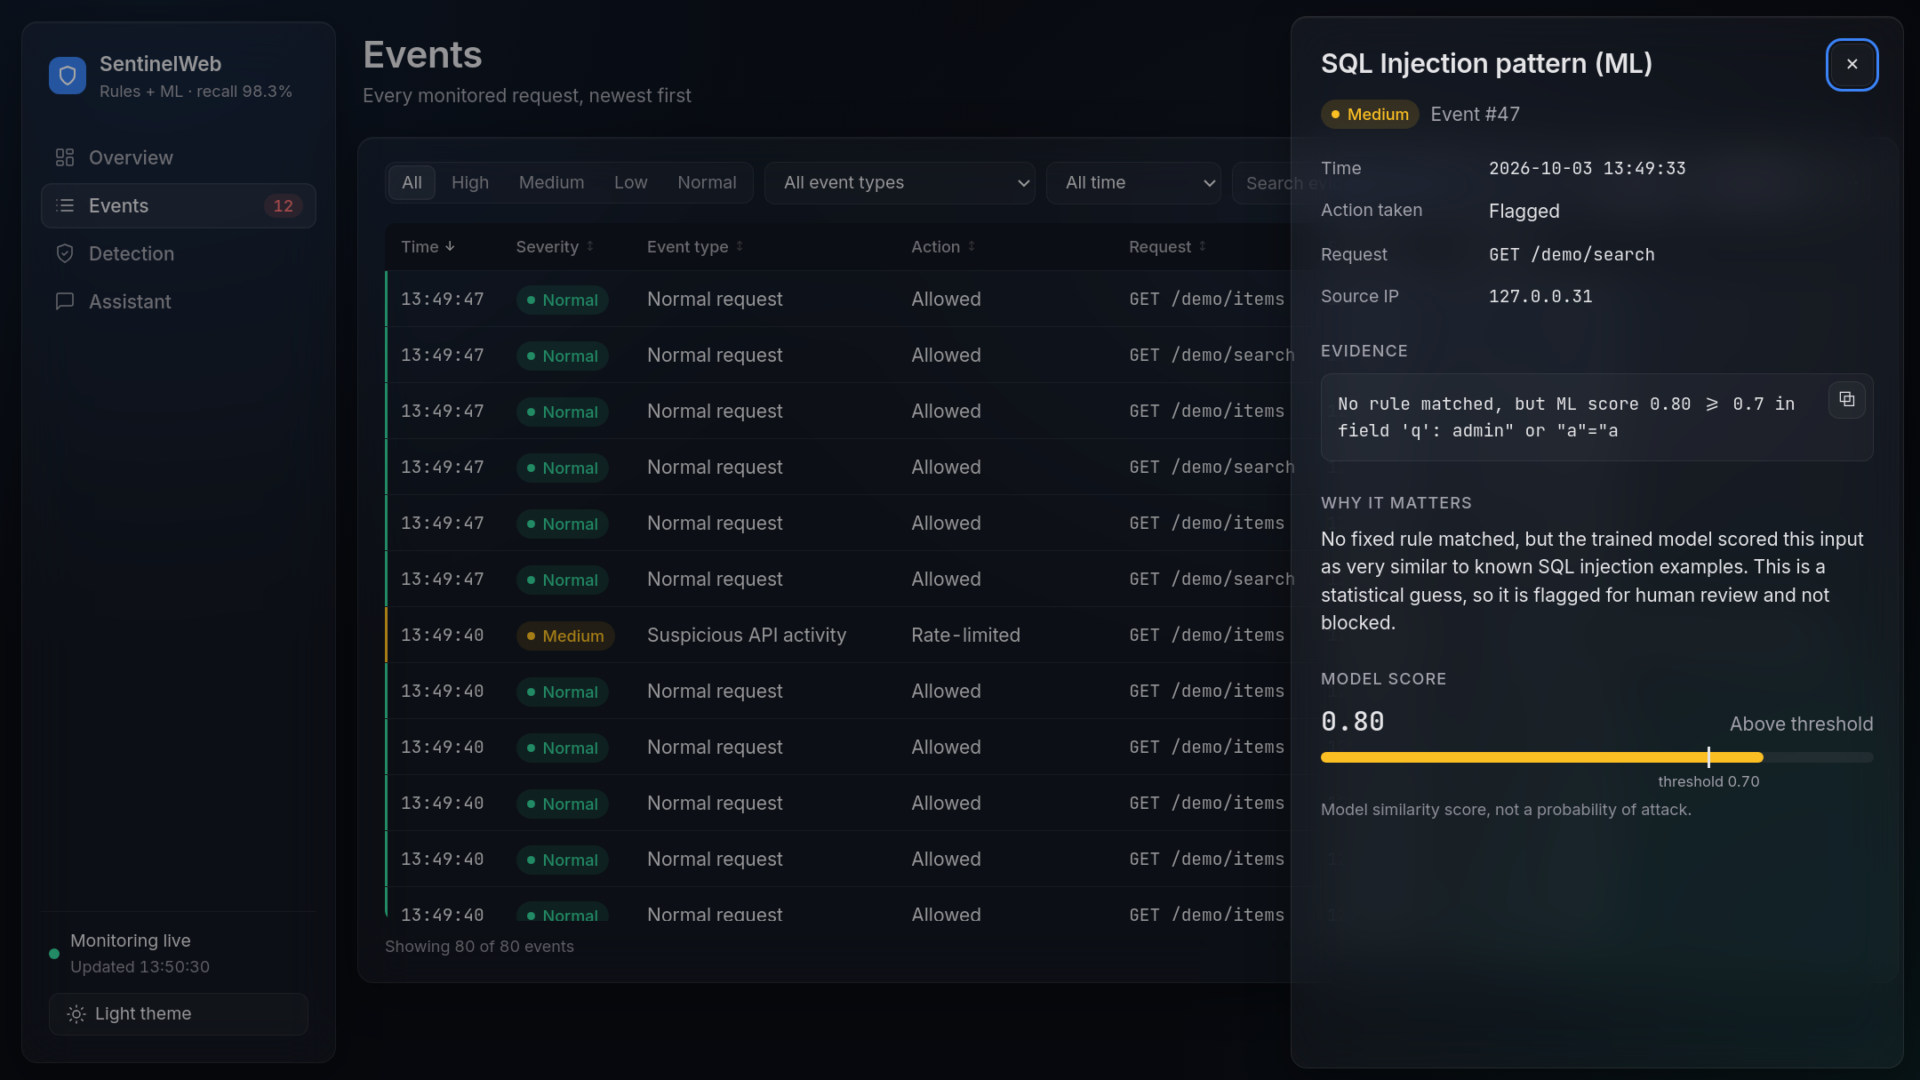


Every alert explains itself
INVESTIGATE
Evidence
The exact rule or score, the field and the input, with a copy button
Why it matters
A plain-language reason anyone on the team can read
Model score
0.80 against the 0.70 threshold: flagged for review, not blocked
Notes:
Clicking any row on the Events page opens this drawer. This example is an input no fixed rule caught, admin" or "a"="a, but the model scored it 0.80. Because it's a model-only hit, it's Medium and flagged rather than blocked. The caption under the bar is deliberate: the score measures similarity to known attacks, not the probability of an attack. The Events page also filters by severity, type, time and text, and exports to CSV.

Slide 13
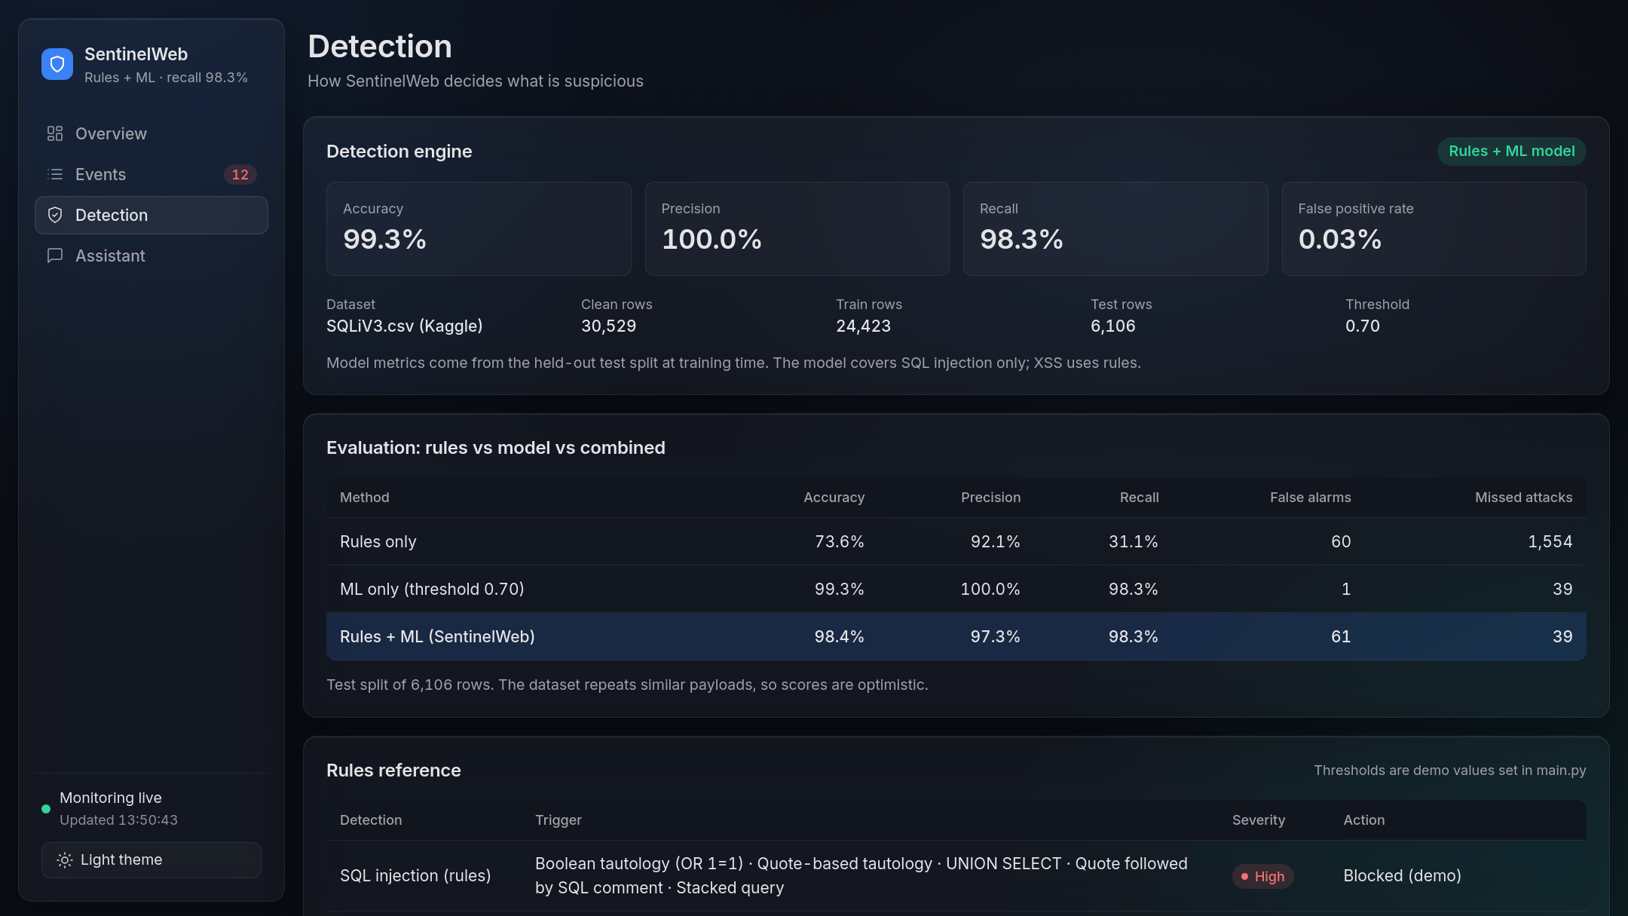



The rules and the model, inside the product
TRANSPARENCY
The Detection page shows what the engine runs, how well it scored, and every rule behind an alert.
Live model metrics
Rules vs model vs combined
Every rule, severity and action
Notes:
Users trust alerts more when they can see why the system decides what it does. This page answers that inside the product: engine status and test metrics come live from the model file, the evaluation table matches the results in this deck, and the rules reference lists every trigger with its severity and action.

Slide 14
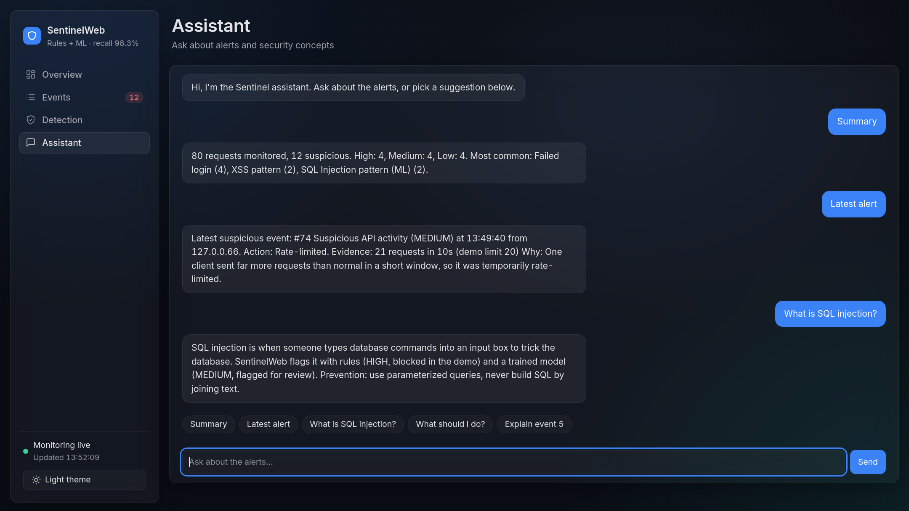
Answers in plain language
ASK SENTINEL
Rules first
Summaries, the latest alert, event lookups and security FAQs come straight from the event log.
AI optional
A free AI model answers only when no rule matches, and it sees summary numbers only.
Notes:
The assistant is rule-first: it reads the event log and a small FAQ, so it works with no internet and no API key. With a free Gemini or Groq key it falls back to an AI model for questions the rules can't answer, but only summary counts are sent, never IPs, evidence or logs. Replies are rendered as plain text, like everything else on the dashboard.

Slide 15
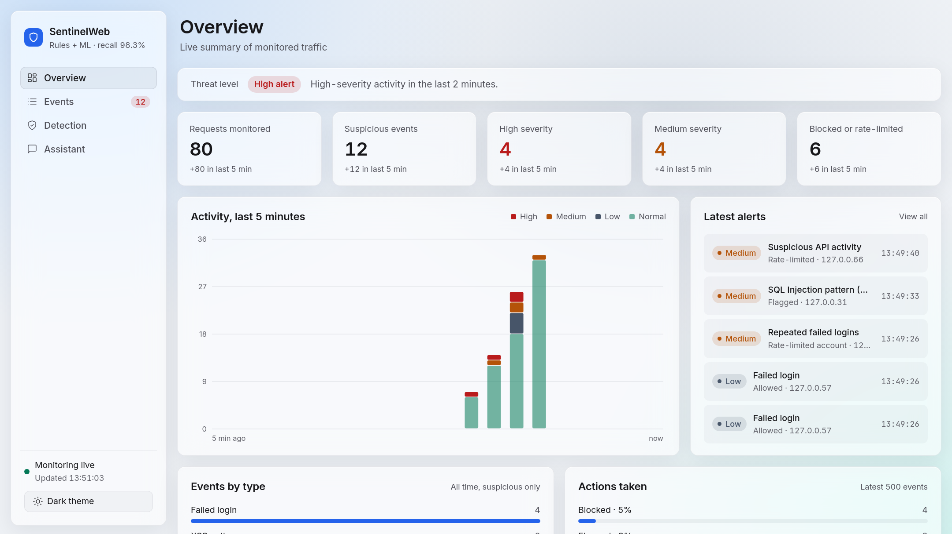
Built for the night shift and the day shift
DESIGN
Dark theme · default
Light theme · remembered per browser
Frosted-glass panels, one accent colour, severity colours always paired with a text label. Keyboard accessible and responsive down to phone width.
Notes:
Restrained frosted-glass panels over a quiet backdrop, one accent colour, and severity colours used only for severity and always with a text label. The layout works down to phone width, is keyboard accessible, announces new alerts to screen readers and respects reduced-motion settings. It's a single HTML file with no build step, served directly by FastAPI.

Slide 16



The monitor must not become the weak spot
SAFE BY DESIGN
Logged text is shown with textContent, so attack strings never run
Every SQL query uses ? placeholders
Passwords, tokens and sessions are never scanned or stored
Model-only hits are flagged for a human, never auto-blocked
The AI fallback sees summary numbers only, never IPs or logs
CSV export neutralises formula-like cells from attack strings
Notes:
A security tool that stores attack strings and shows them on a web page is itself a target. These six choices close the obvious holes: no HTML injection in the dashboard, no SQL injection in the log, no secrets in storage, no automatic blocking on a guess, no sensitive data sent to a third-party AI, and no spreadsheet formula injection from exported logs.

Slide 17



What it still misses, and what comes next
LIMITS AND NEXT STEPS
Still missed in testing
Next steps
begin dbms_lock.sleep ( 5 )
Train an XSS model; XSS is rules-only today
hi or a = a
Tune rules that flag benign SQL-like text
Keep rate-limit counters across restarts
PRINT @@variable
Test on real, non-repeating traffic
Short or unusual payloads with little SQL syntax to learn from.
Notes:
Honest limits. The model misses very short or unusual payloads where there is little SQL syntax to learn from. Rate-limit counters live in memory, so a restart resets them. And because the dataset repeats similar payloads, the next real test should use fresh traffic captured from the demo app.

Slide 18
Run the demo locally
TRY IT
$ pip install -r requirements.txt
$ python3 train_model.py
$ uvicorn main:app --host 0.0.0.0 --port 8000
$ python3 simulate.py
Open the server's address on port 8000 and watch the alerts arrive. Use it only on your own demo app.
Questions?
Dataset: SQLiV3.csv, Kaggle · [dataset author] · [license]
Notes:
simulate.py sends harmless test traffic: a normal search, a SQL injection string, an XSS string, two inputs only the model catches, six wrong logins and a burst of 25 requests. Within a few seconds the dashboard shows each one. Fill in the dataset author and license before presenting.

