Slide 1
Topic: Automating Blood Cell Counting Using Image Processing Techniques
TEAM NO: 2
Group Details: AKIELLAN S - CB.EN.U4CCE22011
IVANA FREDERIC - CB.EN.U4CCE22024
HARISH R - CB.EN.U4CCE22062

Slide 2
Introduction
Blood cell counting is a crucial diagnostic process used to detect various health conditions. The traditional manual methods for counting blood cells are time-consuming and prone to human error. Automating this process using image processing techniques can improve accuracy, efficiency, and consistency in the results.
This case study explores various image processing methods such as Edge Base Segmentation, morphological operations, texture-based classification, and Circular Hough Transformation (CHT) to automate blood cell counting, focusing on Red Blood Cells (RBCs), White Blood Cells (WBCs), Platelets.

Slide 3
Motivation
Efficiency: Manual blood cell counting is labor-intensive and time-consuming. Automation reduces time and effort.
Accuracy: Human error in manual counting can lead to inaccurate results. Automated techniques provide higher accuracy and reliability.
Scalability: Automation allows for quickly processing large volumes of blood samples, which is essential for large-scale diagnostic labs.
Consistency: Automated systems provide consistent results, reducing the variability introduced by different technicians.

Slide 4
Problem Statement
Input: Digital images of blood smear slides.
Output: Accurate count of RBCs, WBCs, and platelets.
Techniques to be Used:
RBC Counting: Circular Hough Transformation (CHT)
,Morphological Operator, Vegetation Method, and Texture Object-Based Classification
WBC & Platelet Counting: Morphological Operator and Texture Object-Based Classification.
Aim: To determine the most effective method for each cell type, focusing on accuracy and computational efficiency.

Slide 5
Dataset Description
Total Images: 120 images
Training: 96 images
Test: 24 images
Categories:
Red Blood Cells (RBC)
White Blood Cells (WBC)
Platelets
Details: The dataset includes images of blood smears, categorized by cell type for training and validation. Each category contains a specific number of labeled images to facilitate accurate model training.

Slide 6
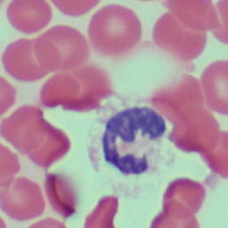
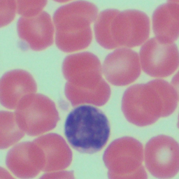
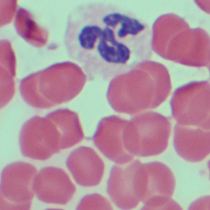
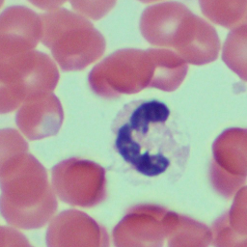
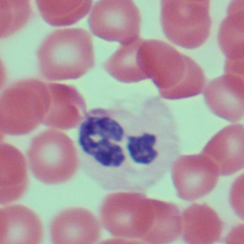
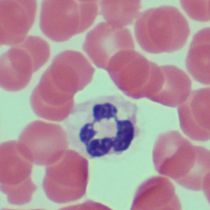
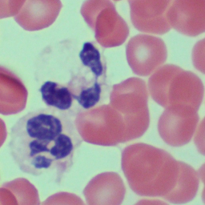
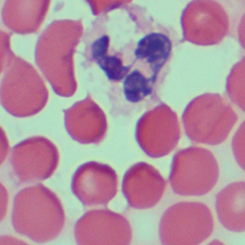
Sample Images

Slide 7
Challenges
Image Quality: Variability in image quality can affect the accuracy of cell detection.
Overlapping Cells: Overlapping cells pose a challenge in distinguishing individual cells, especially in dense regions.
Classification Accuracy: Differentiating between similar cells, such as WBCs and platelets, requires robust classification techniques.
Computational Complexity: Some techniques, while accurate, may be computationally intensive, impacting the speed of processing.

Slide 8
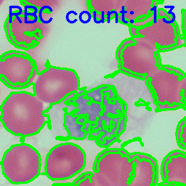
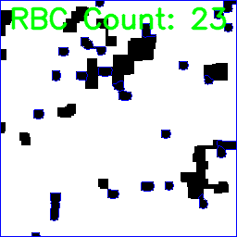
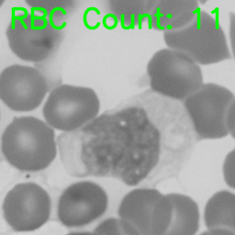
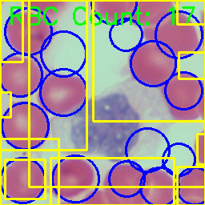
OUTPUT(RBC):

Slide 9
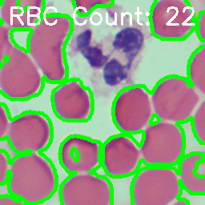
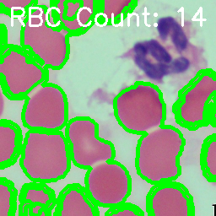
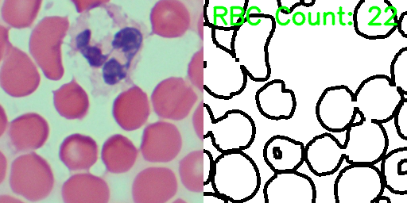
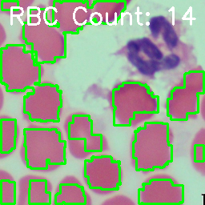
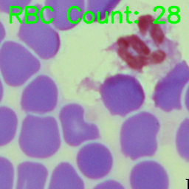
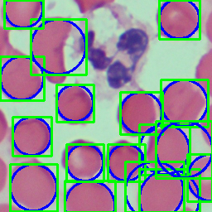
OUTPUT(RBC):

Slide 10
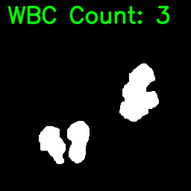
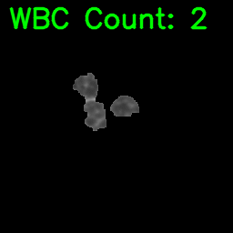
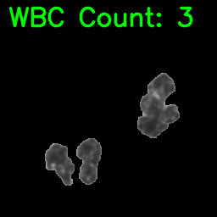
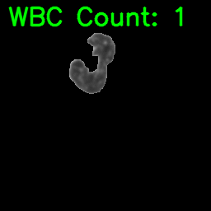
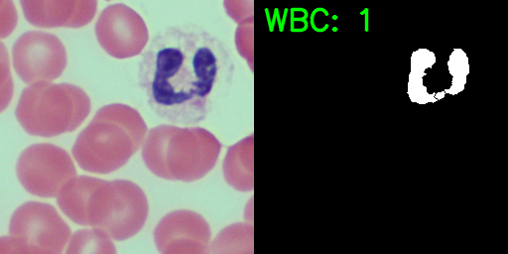
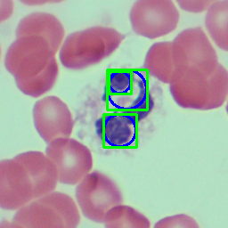
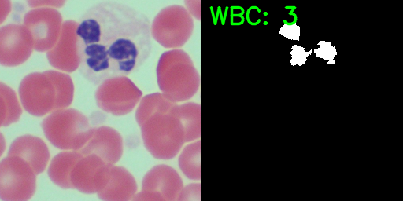
OUTPUT(WBC):

Slide 11
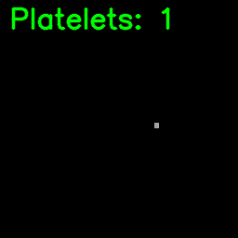
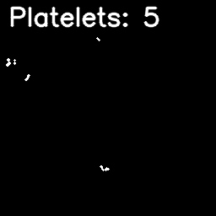
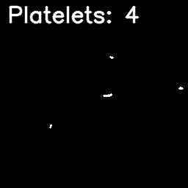
OUTPUT(PLATELETS)

Slide 12
INFERENCE
The developed digital image processing algorithms are tested different blood samples of different subjects. The images obtained from an electron microscope are used to count the blood cells by using different image processing algorithms.
The manual microscopic method gives the better result to detect and count blood cells but it takes a lengthy procedure, hence less time taking electronics microscopic blood counting along with digital image processing algorithms are implemented to automate and reduce the error during this process.

Slide 13
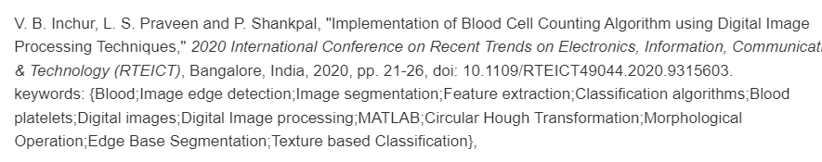
References
https://ieeexplore.ieee.org/document/9315603
https://www.kaggle.com/datasets/draaslan/blood-cell-detection-dataset

