Slide 1
Predicting the Customer Retention Potential Level
Gampala Harish
Data Scientist
Emp Id : 4752

Slide 2
Overview:
Problem Description
About Data
Visualizations
Approaches
Error metric
Challenges I have faced
Clustering
Conclusion

Slide 3
Problem Description:
The objective is to predict customer retention potential levels as high/medium/low.
By analyzing historical customer data, retailers can predict which customers are likely to churn.
The focus is particularly on the medium-level customers since they are the ones most likely to switch to a competitor unless some actions are taken to prevent customer churn from happening.
The retail company can create marketing strategies that will help to retain customers and proactively engage with them.
The goal is to increase customer loyalty, which in turn increases profits.

Slide 4
About Data:
Train data :
CustomerID and Retention Potential.
Customer Data :
CustomerID , City , Date Of Registration, Preferred Delivery Day, Online Communication, Automatic Refill and Doorstep Delivery.
Transaction Data :
CustomerID, Date Of Order, Timestamp and Order Quantity.
Email Data :
CustomerID, Date Of email, Email Type, Timestamp, Mail Opened and Mail Clicked.

Slide 5
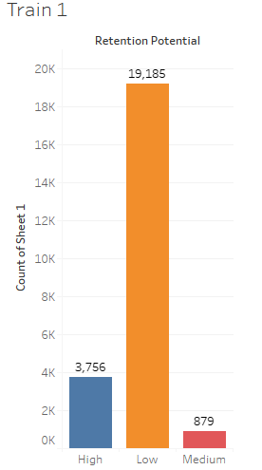

Visualizations of Train data
Insights from the visualizations :
Majority of the retention potential falls under the Low category with a value of 19185.
The Retention Potential value of Medium and High are 879 and 3756 , but this are lower than the Low category .
So we should focus on retaining this customers from the Low and Medium categories.

Slide 6
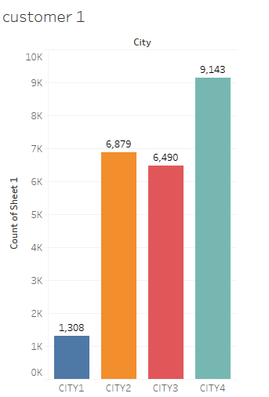
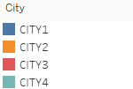
Visualizations of Customer Data
Insights from the visuals :
City 4 has the highest count of customers, So that the can invest some funds .
City 2 and City 3 have a similar number of customers, so we can explore the business.
City 1 has the lowest count of customers, there is less business
So we should concentrate more on cities having the better business.

Slide 7
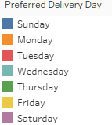
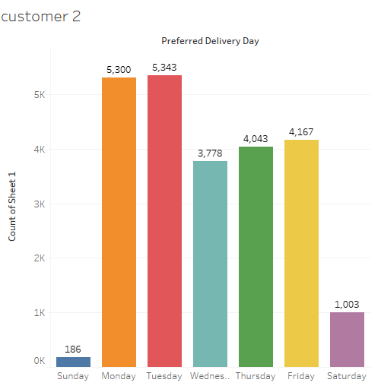
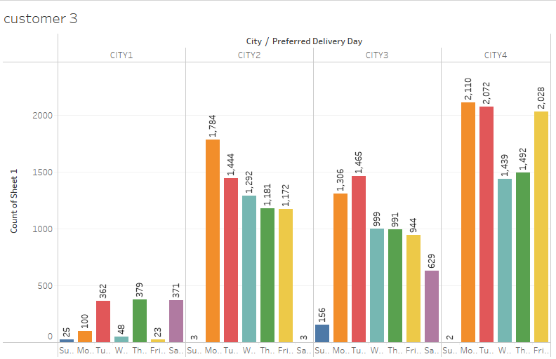
Visualizations of Preferred Delivery Day
Insights from above visuals :
Since the bar plot indicates that most of customers prefer delivery on weekdays, So we should increase and adjust the delivery options.
In city 2 and city 4 having very few deliveries on weekends compare to other cities. In city 4 has more deliveries.

Slide 8

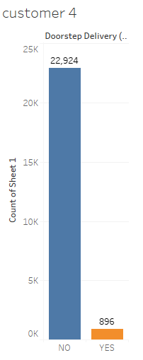
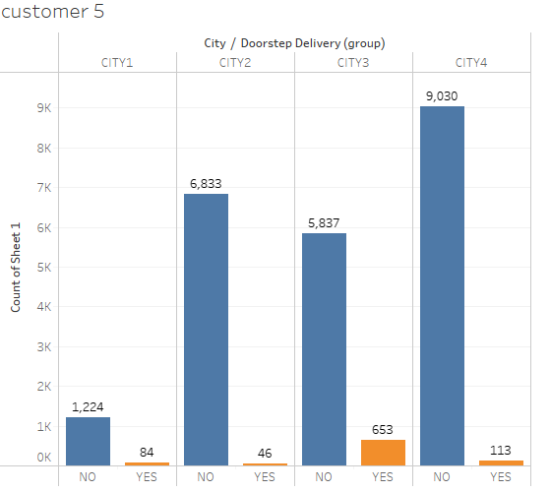
Visualizations of Doorstep Delivery
Insights from the visuals :
Majority of the customers are not preferring the door step delivery ,we should resolve the issues if any.
For customers , the company should provide some services like tracking delivery, scheduling delivery at a convenient time and providing updates .

Slide 9

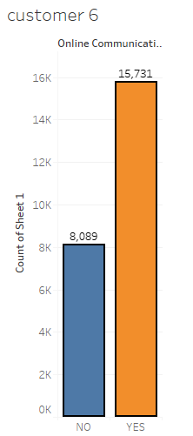
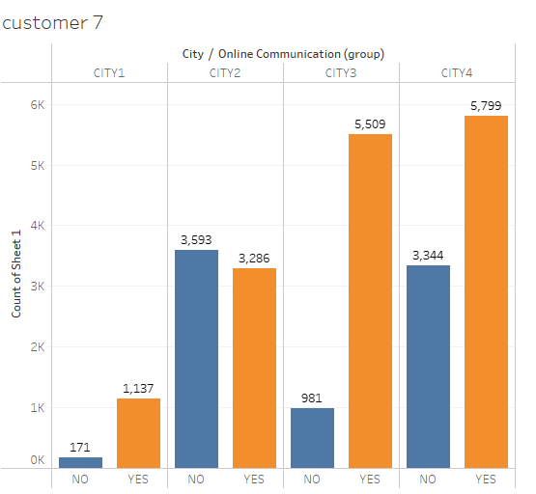
Visualizations of Online Communication
Insights from the visuals :
While it is good to see that the majority of customers prefer online communication.
Who do not prefer online communication(most of them are from City 2&4), the company should explore alternative communication channels to better understand their needs.

Slide 10
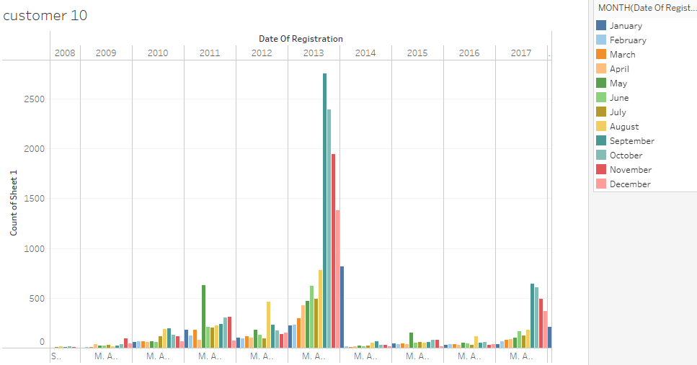
Visualizations for Registrations
Insights from the visuals :
Gradual increase in registrations until 2013 could indicate a growth phase for the company and a sudden down fall .
To overcome the downfall situation, We have to improve the marketing strategies and technological advancements according to present conditions.

Slide 11
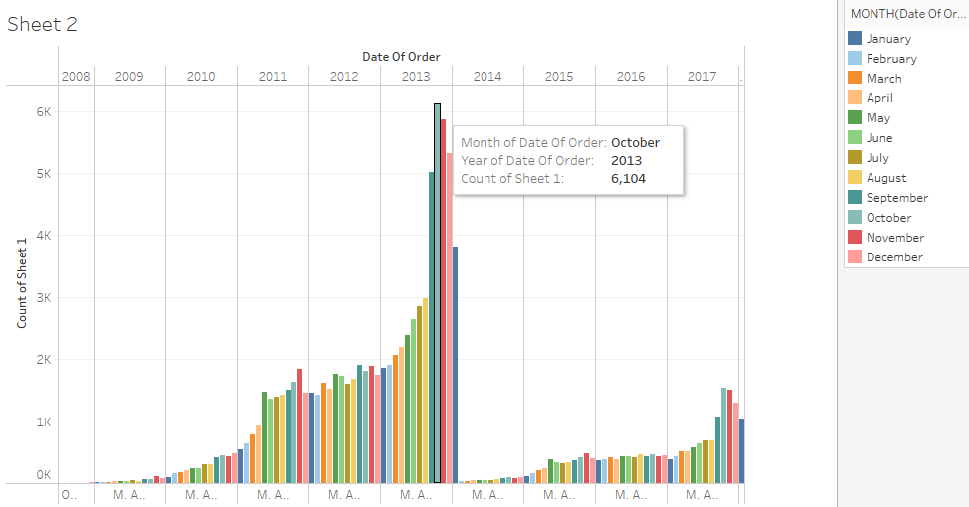
Visualizations of Transaction Data
Insights from the visuals:
The number of orders is directly depends on the number of customer registrations.
September had the highest number of registrations, followed by an increase in orders in October.
It is unclear why some registered customers have not placing any orders.

Slide 12

Operations in Transactions data
By analyzing Date of Order column, we can determine the customer's first and last orders.
we can calculate the number of business days spent by the customer with the company.
Additionally, we can also determine the order gap in days and average order gap for specific CustomerID.(for decreasing the records)
By analyzing order quantity ,we can calculate the total number of orders made by a customer as well as the order frequency.

Slide 13
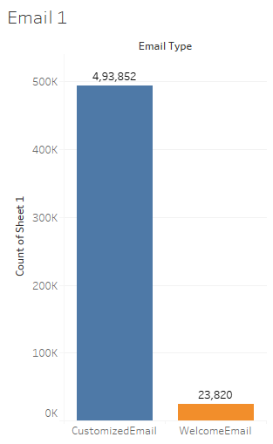
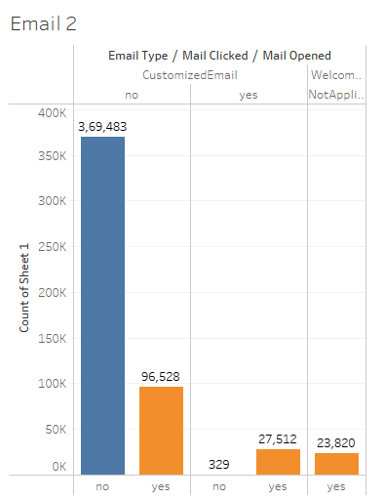
Visualizations of Email Data
Insights from the visuals :
A large number of customers have not opened/clicked on the emails.
Some customers have opened but not clicked because email content may not be convincing, leading to low click-through rates.
To overcome this the company needs to improve the email marketing strategies

Slide 14

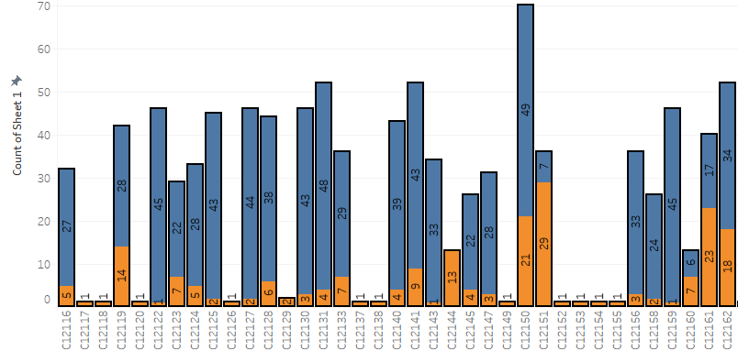
Visualizations of Email Opened
Insights from visuals :
The customer may be overwhelmed with the number of emails received from a company.
To overcome this, the company should consider reducing the frequency of emails sent to the customer.
The company should offer the option for the customer to select their email preferences. It improve the customer engagement.

Slide 15
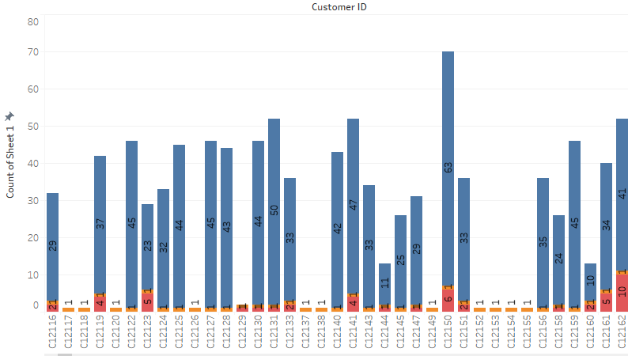

Visualizations of Email Clicked
Insights from visuals :
Every customer has one email i.e., welcome email which is shown in plot by not applicable for clicking .
We should decrease the number of emails sending to a customer, so that the customer can open and click the mail if it’s relevant.

Slide 16

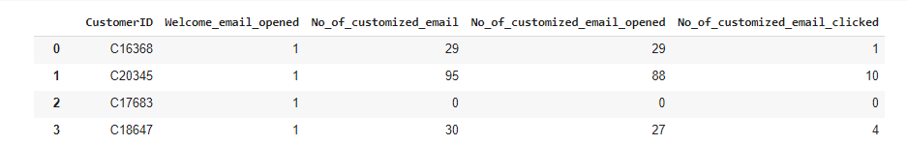
Operations on Email Data
By analyzing the Email Type , I have categorized it into two columns as Customized email and welcome email.
From the Customized email ,I determined into No.of Customized emails , No.of Customized emails opened and No.of Customized emails clicked.

Slide 17
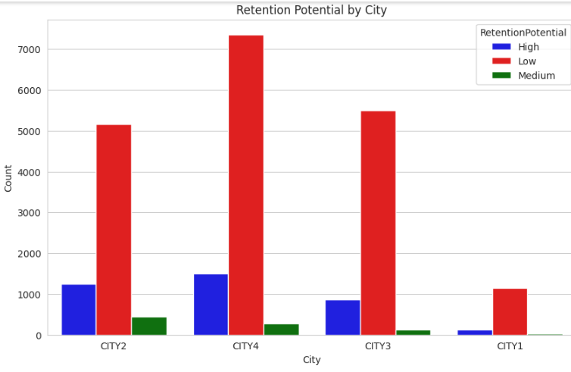
Visualizations of Merged Data
Insights from the visuals :
Here Retention Potential of customers are too low in city2, city3, and city4.
Specially for city1 having less customers

Slide 18
Approach 1 :
After examining the Customer data and Train data, I noticed that both data sets contained 23,820 records.
I performed several operations and utilized the groupby function on Transaction and Email datasets, which resulted in 23,820 records.
I merged all the datasets by using an inner join. Final shape is (23820,16)
Pre-processing :
Checked the data types of the columns
Converted categorical variables to numerical variables
Changed the data type of a column from datetime64ns to datetime64
Checked for outliers, skewness, and correlation

Slide 19
Model building
Machine Learning algorithms that I have build are :
Random Forest Classification (RFC)
KNearestNeighbors Classification (KNC)
Gradient Boosting Classification (GBC)
Ada Boosting Classification (ABC)
Observation :
After applying the above classification models, I achieved high accuracy and recall metrics for few models.
However, I realized that the dataset was imbalanced, which could negatively affect the performance of the model.
To address this issue, I utilized two techniques:

Slide 20
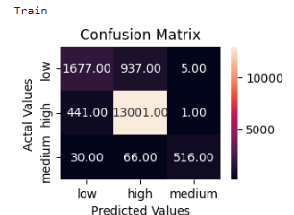
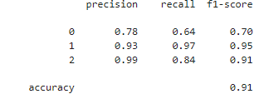
Hyperparameter tuning :
I was able to optimize its performance on the imbalanced dataset.
I have applied this for RFC and KNC than I choose the best model with good accuracy and recall i.e., RFC
Train

Slide 21
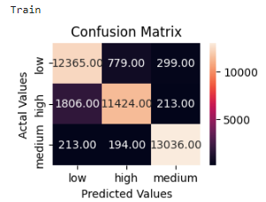
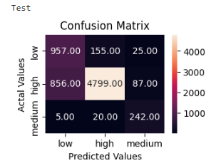
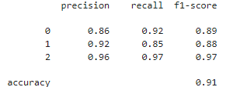
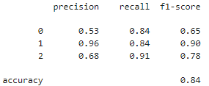
SMOTE (Synthetic Minority Over-sampling Technique):
It generates samples of the minority class to balance the class
I have applied this for RFC , GBC, ABC and KNC than I choose the best model with good accuracy and recall i.e., GBC

Slide 22
Approach 2:
I have read all the data sets and than I checked for the null values
I analyzed and that they have different shapes .
Then I checked for duplicates and I analyzed few datasets consisting duplicates in it .
I merged all the datasets by using the joins by using the column 'CustomerID
From the total data I have taken the samples of data by dropping the duplicates in the 'CustomerID' column
By this I have got 20538 records .

Slide 23
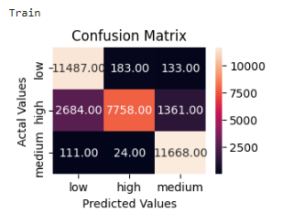
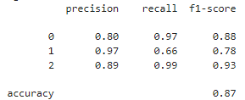
Model building :
The preprocessing steps and Machine Learning algorithms that I have used are similar as the approach1.
To address the imbalance issue, I utilized two techniques:
Hyperparameter tuning and SMOTE :
I have applied these techniques on the models ,then I choose the best model with good accuracy and recall i.e., KNN with smote .

Slide 24
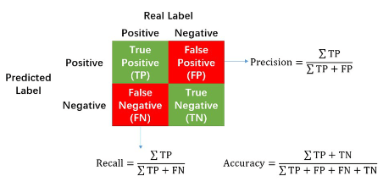
Error Metrics
In addition to the confusion matrix, error metrics are also used to evaluate classification models.
Recall is the error metric used for the given dataset.
Recall : It measures the proportion of true positive predictions out of all actual positive cases.

Slide 25
My results after building the model
From approach 1:
After analyzing the performance results of all the models from the approach 1, I can confidently conclude that the Gradient Boosting Classifier model has performed well.
The model achieved a training accuracy of 91 and a recall score of 97, So I can predict the target variables accurately.
From approach 2 :
I can confidently conclude that KNN Classifier model has performed well.
The model achieved a training accuracy of 87 and a recall score of 99 .

Slide 26
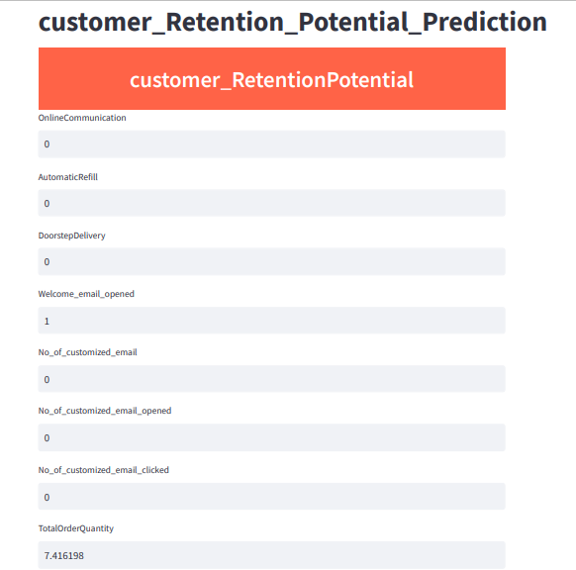
Deployment with Streamlit

Slide 27
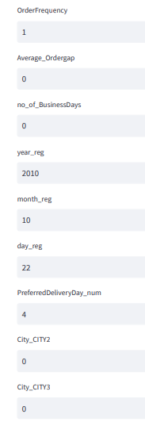
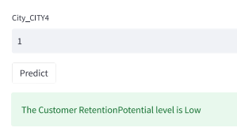
Using the Streamlit API, I have predicted the customer retention potential level as Low for the first CustomerID : C17838
Local URL: http://localhost:8501
Network URL: http://192.168.1.6:8501

Slide 28
Challenges I have faced :
The primary obstacle that I encountered while working with the Train data was the issue of imbalanced data
By analysing the Transaction and Email data , I encountered with the issue i.e.,
The datasets contain multiple instances of the same CustomerID for multiple transactions.
I am faced a challenge in merging the datasets with the train dataset.
In the email dataset, there are instances where customers did not open the email, but they still clicked on the link provided in the email.
The grid search process for the Random Forest and K-Nearest Neighbors models is taking a significant amount of time to complete.

Slide 29
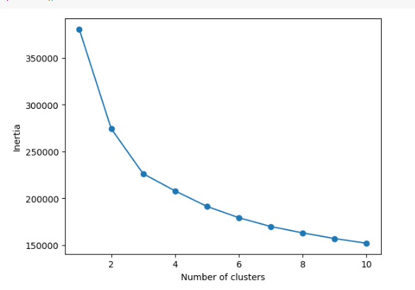
Clustering
Customer segmentation
After dropping the target column and performing standard scaling on df.
K-means model with random clusters was constructed
An elbow plot was generated and got 5 clusters.
Clusters were assigned to each customer based on the resulting predictions.

Slide 30
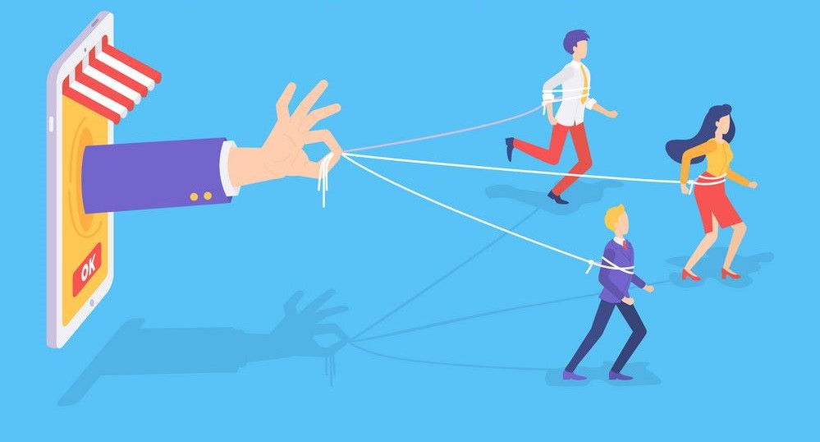
Conclusions :
By providing the customer data to streamlit , I can successfully predict the customer retention potential level for the given dataset.
Additionally, appropriate marketing strategies to enhance customer retention, increase sales, and ultimately improve profitability.

Slide 31


