Slide 1

AGB1211 – DESIGN THINKING
Department of Artificial Intelligence and Data Science
Academic Year: 2024 – 2025 (Odd Semester)
Year : II
Semester : III
Section : A
Date : 5/12/24
PRESENTED BY
1.GAYATHRI.R
2.GIRITHA.P
3. HARISWASTHRA.S
4.INDHUJA.A
AGB1211 – DESIGN THINKING

Slide 2

Title of the Project
SAFETY AND SERVICES IN
INSTITUTES
Ensuring Safety, Enhancing Services – Your Trust, Our Priority!!!!
AGB1211 – DESIGN THINKING

Slide 3
Problem Identification
Fragmented Safety Reporting: Multiple channels for reporting safety issues cause delays and confusion.
Limited Access to Emergency Resources: Difficulty accessing emergency contacts and helplines quickly during crises.
Delayed Notifications: Lack of timely alerts for urgent safety concerns or updates.
Inefficient Communication: Slow communication between students, staff, and campus security.
Lack of System Integration: Safety features like alerts and location tracking are not unified, slowing response times.
AGB1211 – DESIGN THINKING

Slide 4
Objective
The objective of the "Safety and Services in Institutes" app is to provide a centralized platform that enhances campus safety and accessibility to essential services. It aims to enable users to report safety concerns, maintenance issues, and request services such as counseling, medical assistance, or facility repairs in a quick and efficient manner. The app also ensures easy access to emergency contacts and institutional support resources, fostering a secure, supportive, and well-maintained campus environment through streamlined communication and timely assistance.
AGB1211 – DESIGN THINKING

Slide 5
BrainStorming
CAMPUS SECURITY
TECHNICAL SUPPORT
RISK ASSESSMENT
SAFETY TRAINING
EMERGENCY RESPONSE
SERVICE QUALITY
HAZARD PREVENTION
STUDENT SERVICES
FIRE SAFETY
HEALTH AND SAFETY
TECHNICAL SUPPORT
HAZARD IDENTIFICATION
CAREER SERVICES
SAFETY PROTOCOLS
EMERGENCY ALERTS
FEEDBACK SYSTEM
ACCESS CONTROL
ENVIRONMENT SAFETY
EMERGENCY PREPAREDNESS
TUTORING SERVICES
AGB1211 – DESIGN THINKING

Slide 6
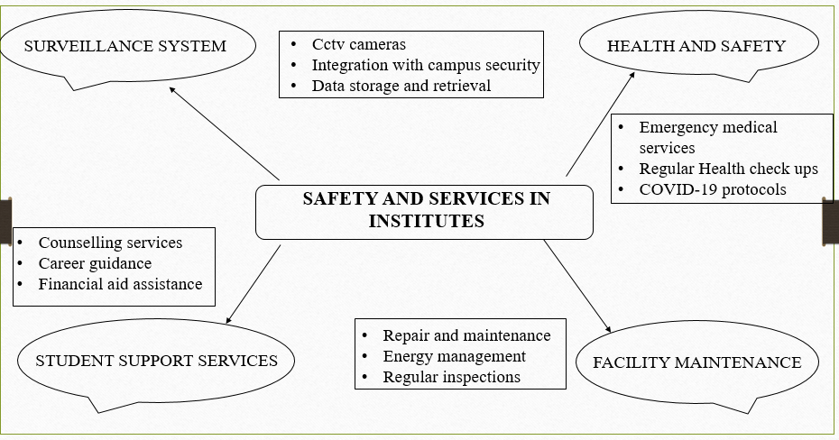
Mind Map
AGB1211 – DESIGN THINKING

Slide 7
Primary Research
Primary research involves collecting firsthand data from stakeholders to analyze safety measures and services in institutes. The process includes:
Objectives: Understand safety concerns, service quality, and areas for improvement.
Stakeholders: Engage students, staff, parents, and administration for diverse perspectives.
Methods:
  Surveys: Quantify satisfaction and concerns with safety and services.
  Interviews: Gain detailed insights from administrative heads and security staff.
  Observation: Assess safety equipment, emergency readiness, and service facilities.
  Focus Groups: Discuss challenges and potential improvements.
Tools: Use Google Forms, printed questionnaires, and recording devices for data collection.
Analysis: Utilize software like Excel or SPSS for quantitative insights and thematic analysis for qualitative feedback.
Outcome: Identify gaps, understand stakeholder needs, and propose actionable solutions for enhanced safety and services.
AGB1211 – DESIGN THINKING

Slide 8
Secondary Research
Safety Concerns:
Focus on campus security, emergency response systems, and physical safety measures like fire drills and infrastructure checks.
Explore mental health support services and medical facilities available in institutes.
Review cybersecurity measures to protect data and privacy.
Services in Institutes:
Assess academic services such as libraries, labs, and e-learning platforms.
Evaluate student support systems like career counseling, mentorship, and accessibility infrastructure.
Investigate infrastructure services including hostels, transport, and canteens.
Technological Integration:
Study the use of surveillance systems, IoT devices, and AI tools for enhancing safety.
Examine digital solutions for improving service delivery and feedback mechanisms.
Global Benchmarks:
Compare safety and service standards across institutions worldwide.
Highlight best practices and successful case studies for implementation.
Challenges:
Identify common issues such as financial constraints, policy gaps, and technological barriers.
AGB1211 – DESIGN THINKING

Slide 9
Proposed Work
Inefficient Reporting: Lack of a centralized system for reporting safety concerns and service requests, leading to delays and risks.
Fragmented Safety Measures: Disconnected safety systems like fire alarms and CCTV, causing inadequate real-time monitoring.
Limited Service Access: Difficulty accessing and requesting services such as healthcare, cafeteria, and transport due to separate systems.
Lack of Emergency Preparedness: Insufficient emergency response systems and awareness, leading to slow reactions during crises.
Inconsistent Monitoring & Feedback: No real-time monitoring or centralized feedback system, causing gaps in safety and service effectiveness.
AGB1211 – DESIGN THINKING

Slide 10
List of Modules
USER AUTHENTICATION MODULE
PROFILE MANAGEMENT MODULE
SAFETY SERVICES MODULE
UI/UX MODULE
AGB1211 – DESIGN THINKING

Slide 11
Module 1 Description
USER AUTHENTICATION MODULE:
Features:
Login functionality for students and staff (as shown in the first and second images).
Registration for new users. - Password recovery (e.g., "Forgot Password").
Remember Me functionality.
Technologies:
Firebase Authentication or custom authentication service.
Secure password storage (e.g., hashing).
Advantages:
  Hashing and salting prevent storage of plain-text passwords.
  Resistant to common attacks like brute force and rainbow table attacks.
  Does not rely on external services or databases for demonstration purposes.
  Can be expanded to include features like "Forgot Password" or integration with a database or authentication service.
AGB1211 – DESIGN THINKING

Slide 12
Module 2 Description
.
PROFILE MANAGEMENT MODULE:
Features:
Input and update personal details such as name, guardian details, phone number, course, and college (third image).
Email verification.
Validation of entered data.
Technologies:
Form handling libraries (e.g., React Hook Form for React Native).
Backend database to store user profiles (e.g., Firebase Realtime Database or PostgreSQL).
Advantages:
Users can easily input, view, and update their personal details in one place.
Allows users to update specific fields without affecting others.
Confirms the authenticity of the email address before storing it in the system.
AGB1211 – DESIGN THINKING

Slide 13
Module 3 Description
SAFETY SERVICES MODULE
Features:
Emergency contact storage (Guardian Phone Number).
Quick access to safety resources or institute helplines.
Notifications for alerts (e.g., emergencies, announcements).
Technologies:
Push notification services (e.g., Firebase Cloud Messaging).
Integration with APIs for safety-related features (e.g., location-based emergency alerts).
Advantages:
Provides instant access to emergency contacts and safety resources, ensuring quick responses during critical situations.
Real-time notifications and location-based alerts keep users informed about emergencies and important announcements.
AGB1211 – DESIGN THINKING

Slide 14
Module 4 Description
UI/UX MODULE:
Features:
- Simple and user-friendly design for login, registration, and profile management.
- Navigation between screens (Login, Registration, Profile, Dashboard).
Technologies:
- Frontend: Flutter, React Native, or native Android (Java/Kotlin) and iOS (Swift).
-Backend (Optional for Frontend Demo):
  Firebase for user authentication and profile storage.
Advantages:
Runs on both Android and iOS with a single codebase.
Clear navigation and minimalistic UI enhance usability
Separate files for each screen ensure maintainability and scalability.
Flutter’s navigation makes switching between screens seamless.
AGB1211 – DESIGN THINKING

Slide 15
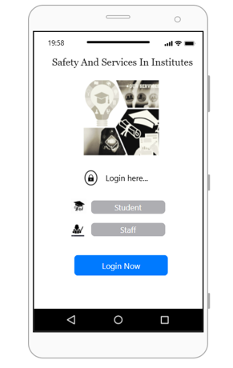
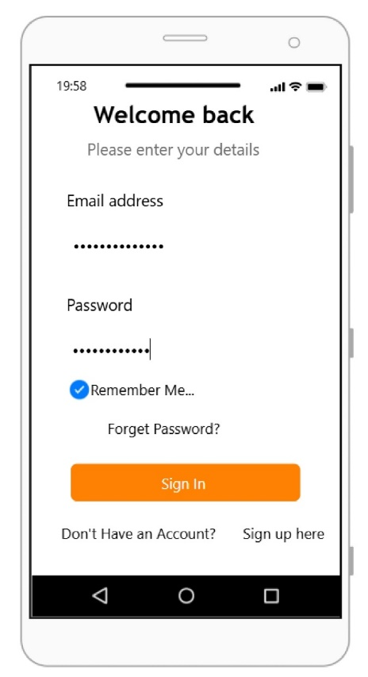
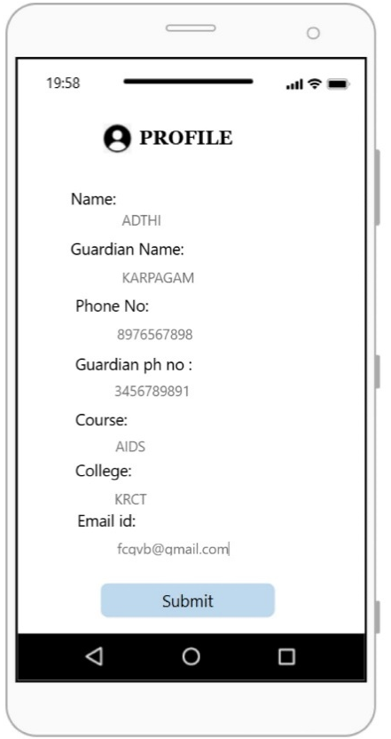
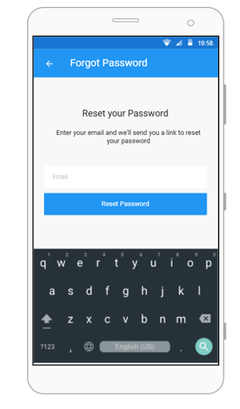
Results
AGB1211 – DESIGN THINKING

Slide 16
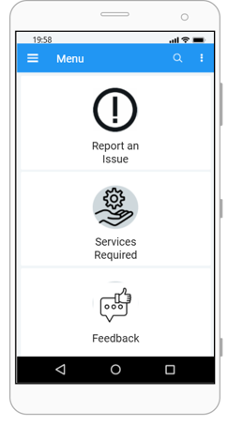
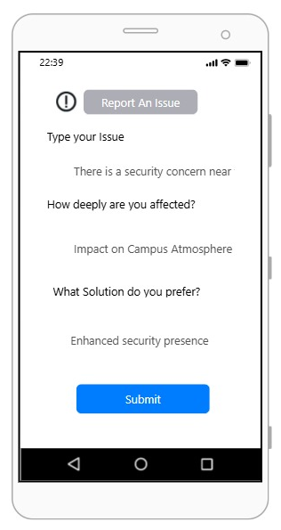
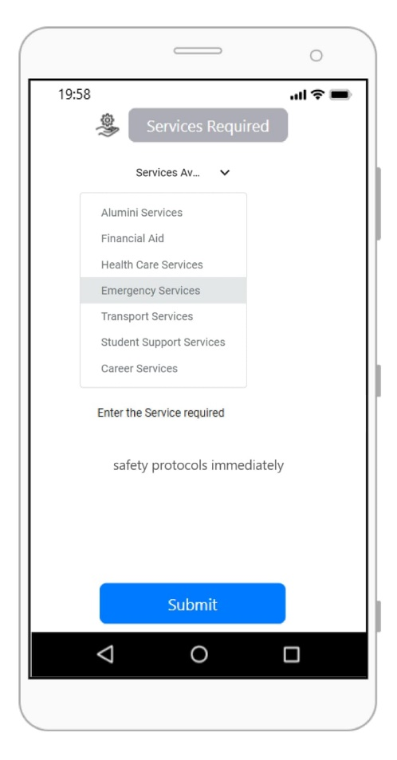
Results
AGB1211 – DESIGN THINKING

Slide 17
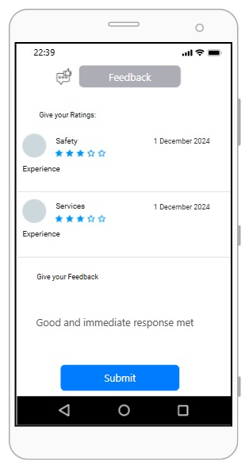
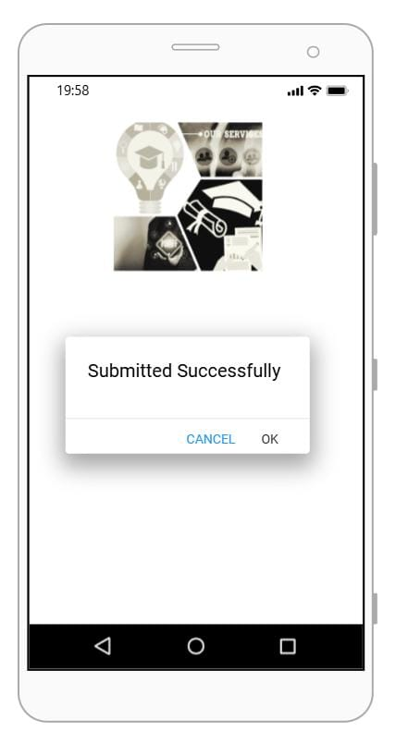
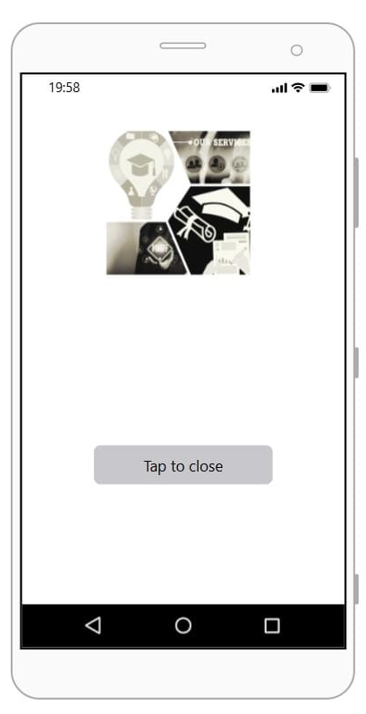
Results
AGB1211 – DESIGN THINKING

Slide 18
Conclusion
The "Safety and Services in Institutes" app offers a comprehensive solution for enhancing campus safety and accessibility to essential services. By streamlining issue reporting, service requests, and emergency responses, the app ensures a secure, responsive, and well-supported environment for students, staff, and faculty. With its intuitive design and efficient functionality, the app fosters a proactive approach to safety, promoting a safer and more connected campus experience for all users.
AGB1211 – DESIGN THINKING

Slide 19
Thank You
ANY QUERIES???
AGB1211 – DESIGN THINKING

