Slide 1
Name: A.HARITHA
NM id: au730321104014
Reg. No: 730321104014
Year: III
Department: BE/COMPUTER SCIENCE AND ENGINEERING
College Name: BUILDERS ENGINEERING COLLEGE
3/21/2024
Annual Review
1

Slide 2
PROJECT TITLE
SIGN-LANGUAGE-DETECTION
3/21/2024
Annual Review
2

Slide 3

1. Project Planning and Research
2. Data Collection and Preparation
3. Data Preprocessing
4. Feature Extraction
5. Selection and Training
6. Evaluation and Performance Metrics
7. Deployment and Integration
8. Documentation and Reporting
9. Future Work and Maintenance
10. Presentation and Dissemination
AGENDA
3/21/2024
Annual Review
3

Slide 4

PROBLEM STATEMENT
"In today's world, effective communication is essential for inclusion and accessibility. However, for individuals who are deaf or hard of hearing, traditional communication barriers persist.
Such a system would empower individuals with hearing impairments to communicate effectively in various settings.
Addressing these challenges requires interdisciplinary collaboration, leveraging cutting-edge machine learning, computer vision, and signal processing techniques.
Ultimately, the goal is to create inclusive technologies that enhance accessibility and promote equal participation for all members of society."
3/21/2024
Annual Review
4

Slide 5

PROJECT OVERVIEW
Sign language detection aims to interpret and understand sign language gestures using technology.
It involves leveraging computer vision and machine learning techniques.
The goal is to create systems that can accurately recognize and interpret sign language gestures in real-time.
Sign language detection enhances accessibility for individuals who are deaf or hard of hearing.
Challenges include the complexity and variability of sign language gestures.
Solutions often involve training machine learning models on diverse datasets of sign language gestures.
3/21/2024
Annual Review
5

Slide 6

WHO ARE THE END USERS?
Deaf or Hard of Hearing Individuals
Interpreters and Translators
Educators and Students
Healthcare Professionals
Family Members and Friends
3/21/2024
Annual Review
6

Slide 7

SOLUTION AND ITS VALUE PROPOSITION
Solution:
A real-time sign language detection system leveraging advanced machine learning and computer vision techniques.
Value Proposition
Efficient real-time sign language detection system enabling seamless communication for the deaf or hard of hearing, fostering inclusivity and independence.:
3/21/2024
Annual Review
7

Slide 8

THE WOW IN SOLUTION
Precision in Gesture Interpretation
Real-Time Communication Enablement
Breakthrough in Accessibility
Empowering Independence
3/21/2024
Annual Review
8

Slide 9
MODELLING
Relationships:
Hand Gestures and Language Elements
Feature Extraction and Gesture Representation
Training Data and Machine Learning Models
Input and Output Mapping
Temporal Context and Sequential Patterns
Error Analysis and Feedback Loop
User Interaction and System Response
Contextual Information and Environmental Factors
3/21/2024
Annual Review
9

Slide 10
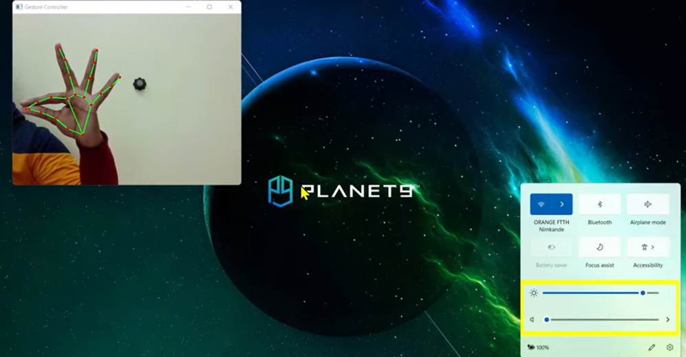
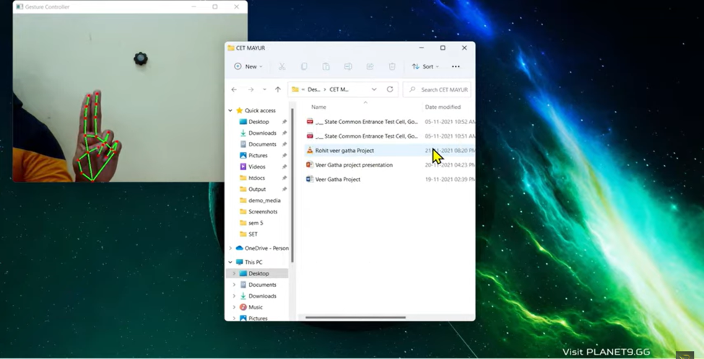
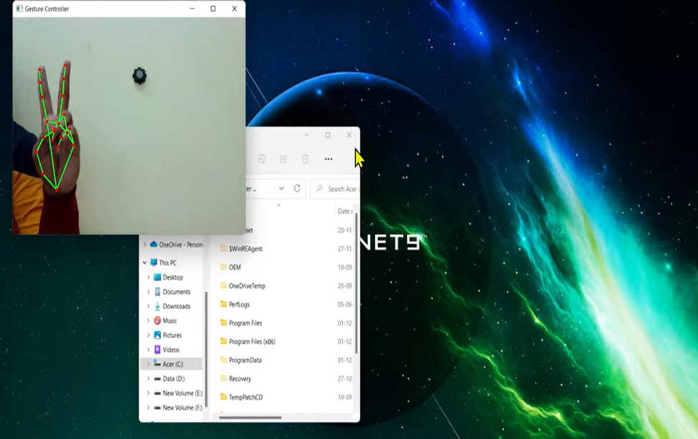
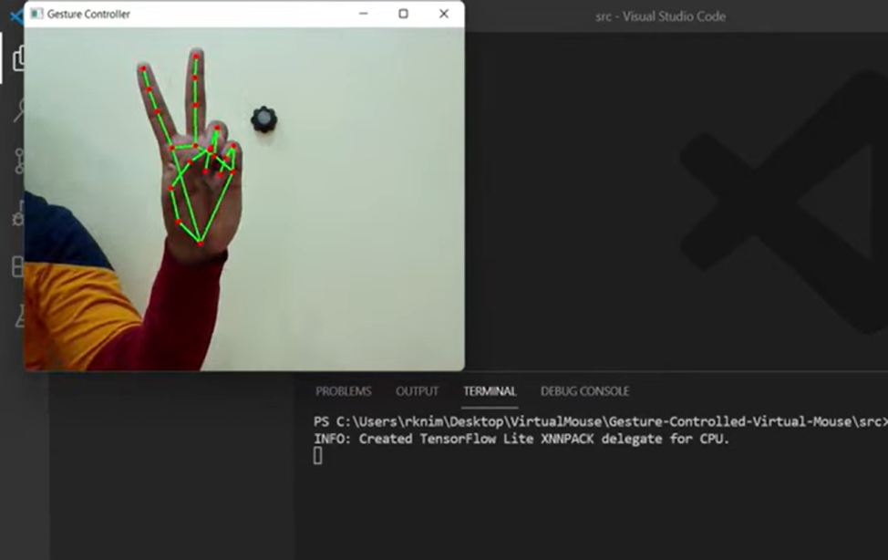
RESULTS
https://colab.research.google.com/drive/1jzrh-ftlXzI-8ips_sNFHjwz-42C64XF#scrollTo=w66R4goW4Bl1&line=346&uniqifier=1
3/21/2024
Annual Review

