Slide 1
HARKBird Installation instruction and manual

Slide 2
Installation on Ubuntu
Required packages for HARKBird:
HARK
HARK-Python
sox
Execute “sudo apt-get install sox”
Follow the installation instruction on HARK website for HARK and HARK-Python
Required python packages:
PySide
pandas
pysoundfile
These packages can be installed by executing “sudo pip install ‘package name’”
HARKBird installation and startup
Extract harkbird.zip in any directory
Execute install.sh without superuser privilege (not use “sudo”)
You can execute it by “./install.sh”, “sh install.sh”, and so on
A shortcut named “HARKBird” will appear on the desktop, and HARKBird can be run by double clicking it

Slide 3
Installation on Windows
Required packages for HARKBird:
HARK for Windows
If the installation process fails during installation of HARK-Python, execute ‘python “C:\Program Files (x86)\HARK\ HARK-Python\setup.py”’
sox
After installation, add “C:\Program Files (x86)\sox-14-4-2” to the environment variable “Path”
Required python packages:
PySide
pysoundfile
These packages can be installed by executing “pip install ‘package name’” on a command prompt
HARKBird installation and startup
Extract harkbird.zip in any directory
Execute install.bat
A shortcut named “HARKBird” will appear on the desktop, and HARKBird can be run by double clicking it

Slide 4
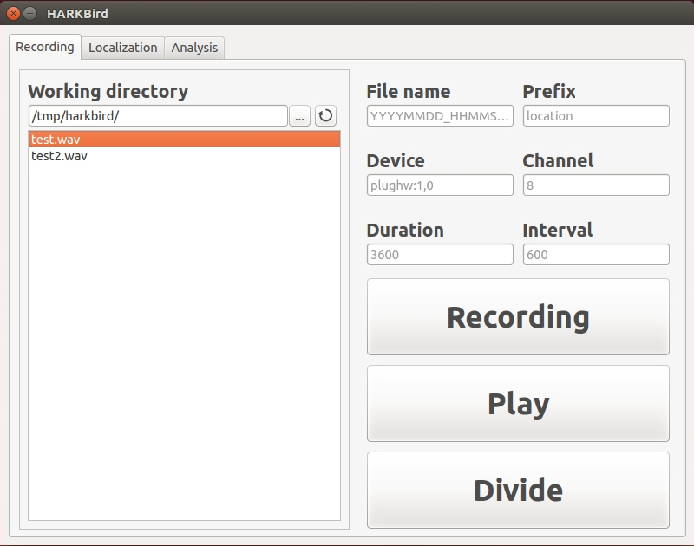
Recording
Refreshing the directory information
File name of the recording (default: “Prefix-YYYYMMDD_HHMMSS.wav”)
Directory in which recorded files are saved
Prefix of the filename (default: none)
# of channels of a microphone array
Only for Ubuntu
The device names of microphones can be specified
If multiple microphones are connected, enumerate their device names, separating them with “;”
The duration of each recording session (default: 600sec)
Recording duration (default: 3600sec)
Starts recording
Plays the wav file specified by left box
List of wav files in the working directory
Divides the specified wav file into several short recording files

Slide 5
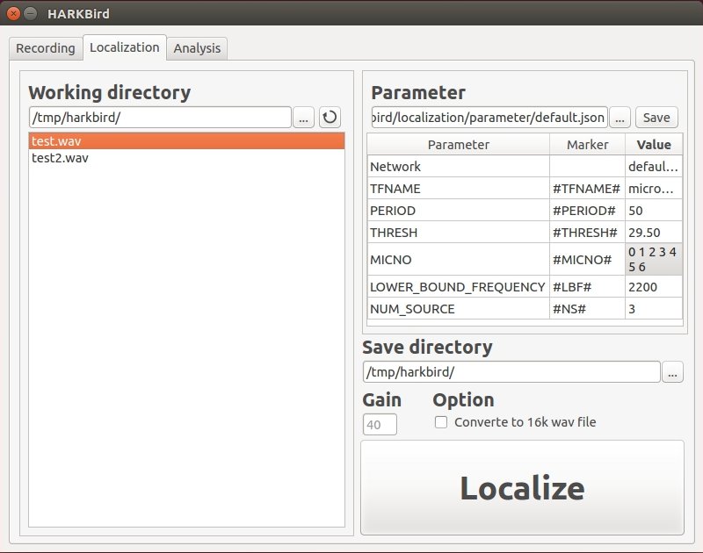
Localization
Directory in which recorded files are saved
Refreshing the directory information
Loads a JSON file of localization setting
Saves the current setting to a JSON file
Marker in the network file of HARK will be replaced by the corresponding Value
Markers and Values can be edited by double-clicking each cell
List of wav files in the working directory
Network files and transfer functions should be in the corresponding folders in localization folder
The localization results will be saved in the specified directory
Once localization was done successfully, the folder “localized_<filename>” will be created, and there are some files:
separated sounds (sep_*.wav)
MUSIC spectrum (spectrum.txt)
localization results (separated.csv)
If checked, the recording file will be converted 16kHz before localization
Starts localize the specified wav file with the setting above
Multiple files can be analyzed at one time
Increase or decrease the gain of the recording file before localization

Slide 6
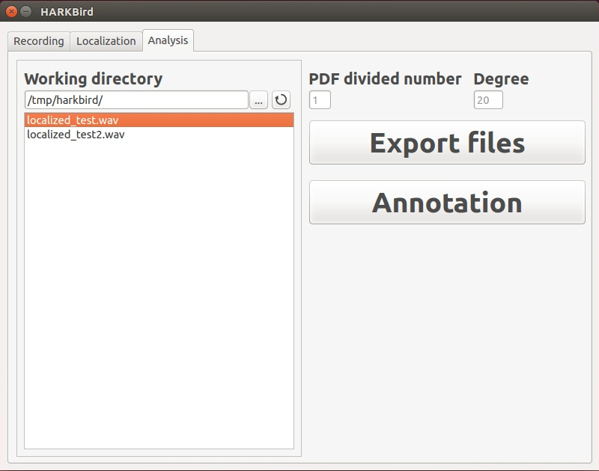
Analysis
Refreshing the directory information
Directory in which results of localization are saved
The number of pages of the exported PDF
The localized sources were regarded as ones of conspecifics if the DOA difference is within this degree
Exports the analyzation results using localized results
Multiple files can be specified at one time
localized and classified results (sourceinfo[.csv|.json])
List of localized sources (sourcelist.csv)
Visualized result (visualized.pdf)
Launches annotation tool for the specified analyzed file
List of “localized_” folders in the working directory

Slide 7
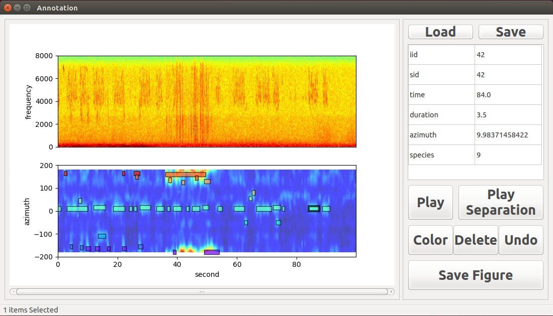
Annotation
Loads localized and classified results or annotated files with JSON format
Saves the current annotation as a JSON or CSV file
Displays the information on the selected sound source
Each value can be modified by directly editing the values
Plays the original recording during the corresponding duration of the selected sound source
Plays the corresponding separated sound of the selected sound source
Changes the color map of species
Deletes the selected sound source
Undo the previous operation
Saves the annotation result shown in the current window as PDF or PNG file
The number of sub-figures can also be specified
Each rectangle represents the information of a localized sound source
Each information can be modified by dragging, moving, or changing
in the length of the rectangle
A mouse wheel: the scale of the graph
Left click: source selection
Left double-click: creating a new sound source information
Right drag: selection of multiple sources (enabled and disabled by Q/A)

