Slide 1
SWUDS
Site-Specific Water-Use Data System
Todd Augenstein
Office of Water Information
Notes:
[presentation to the Connecticut Water Planning Council, Oct. 17, 2014 via WebEx]

Slide 2
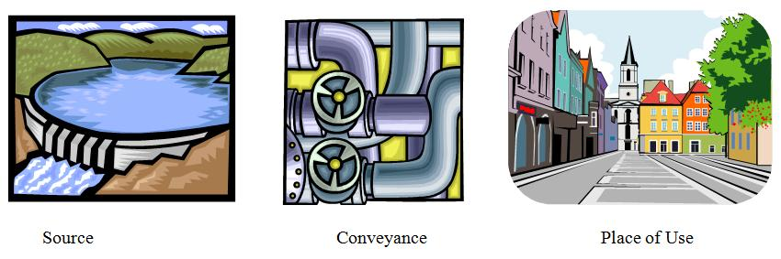
SWUDS – A Conveyance-based System
Notes:
NWIS,
SWUDS is the Site-specific Water Use Data System, a subsystem of NWIS
Acronym heavy, sorry: Just want to give the basics.
Site file is the unifying element, and we’ll come back to it.
GWSI - groundwater site inventory system—well construction, water levels, well logs, aquifer test results
QWDATA – water quality data
ADAPS – Automated Data Processing System, continuous (by minutes or even seconds, up to daily, generally)
SWUDS
AWUDS is another NWIS water-use database, not connected to sitefile

Slide 3
What can SWUDS store?
Sites
Owners, contacts
Permits
Water Quantities
Ancillary Data

Slide 4
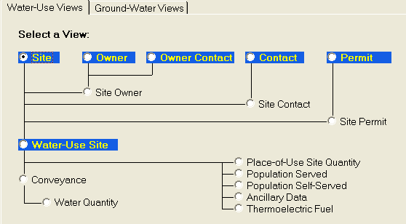
SWUDS Views
Data are in logical groups = Views
Some hierarchy is required
Notes:
Reiterate that some views must be processed before others.
SWUDS will give you errors if things are out of order, say if you process a Conveyance record before the sites for it are in the site file.

Slide 5
SWUDS Templates
Templates contain data for one View
Excel files
Column headings give data element names

Slide 6
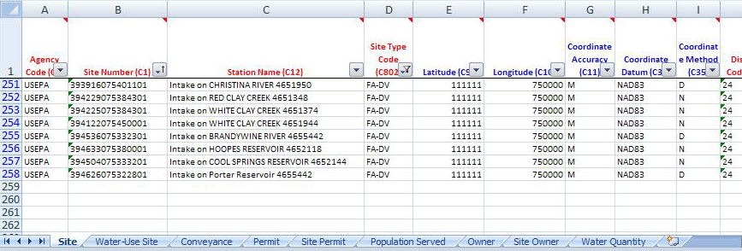
SWUDS Template
Notes:
SWUDS Template, with data from NAWQA SWUDS
These must be processed one tab/worksheet at a time, sometimes in a specified order as shown on the previous slide. Ex: cannot do anything before you have the sites. Cannot enter any water-use data until the WUSite record has been entered. Only one type of data at a time, though.
Others can be entered as you wish: Owner and Permit any time, SiteOwner and SitePermit anytime after Site, Owner, and Permit have been entered.
WaterQuantity will be a blank template, data must be entered from sources used for the 2010 compilation, or from other sources.

Slide 7
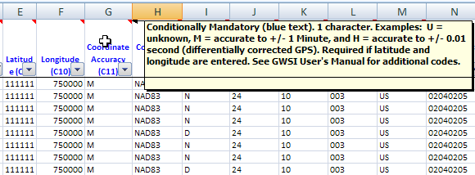
SWUDS Template
Notes:
The template in Excel
Column headings can be read by SWUDS to know what data is in each: “auto maps” the data during batch input.
Color coding of headings: Red are mandatory, Blue are conditionally mandatory—for example, if you enter lat-long, you must enter accuracy, datum, and method. Lat-longs themselves are conditionally mandatory based on the site type. Black text in the heading means the entry is optional.
Are comments/tool tips behind each column header with some additional information. Hover over the heading cell with your mouse to make these appear.

Slide 8
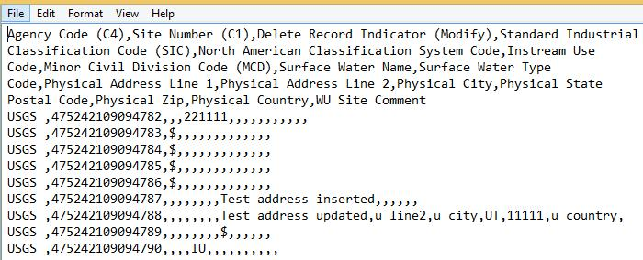
SWUDS Delimited Text Input

Slide 9
Site File
Site File
GWSI
QWDATA
ADAPS
SWUDS
Unifying element of NWIS
Agency Code and Site number
Geographic information
Site Type
Site-level security
Notes:
Everything in NWIS is connected to a site, sites can be used in multiple subsystems of NWIS. For example, can store water levels and water quality analyses for one well, or well construction in the GW subsystem for a well used in SWUDS.
A major advantage: we want to know if different kinds of data are in fact for one site.
Site type helps define what is being measured—is the data a characteristic of a river? Stream site. If the measurement is of the amount of water being withdrawn from a river, it’s a measurement from an intake, called a Diversion in NWIS.
Also wanted to mention that some security is implemented at the Site level—I’ll come back to this at the end of my presentation.

Slide 10
SWUDS
Site File
GWSI
QWDATA
ADAPS
SWUDS
Stores withdrawal, use, and return data
Tracking database, not just point data
Water treatment plant
Customers
Well
Wastewater Treatment Plant
Outfall
Notes:
Stores withdrawal, use, and return data in same database as streamflow, water levels, and water quality
Can track water movement from withdrawal to use to return locations
Point locations (sites) are connected by one-way “conveyances” that show how water is being moved. ”—think of it as a virtual pipe, though it might really be a canal or some other way to move water from one point to another.
Water sales: can be major (wholesale) customers, to show water sources for public supply systems which only purchase water, or can indicate retail sales to customer groups, like all the commercial users for a given public supplier.
Can identify interbasin transfers

Slide 11
Sites- Sources
Spring
Well
Collector or Ranney-type Well
Interconnected Wells
Multiple Wells
Groundwater Drain
Aggregate Groundwater Use
Diversion
Animal Waste Lagoon
Aggregate Surface-Water Use

Slide 12
Sites- Facilities that receive water
Aggregate Water-Use Establishment
Field, Pasture, Orchard, or Nursery
Golf Course
Hydroelectric Plant
Thermoelectric Plant
Water-Use Establishment
Water-Distribution System
Water-Supply Treatment Plant

Slide 13
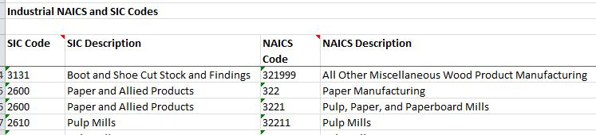
Sites- Water-Use Establishment Sub Types

Slide 14
Sites- Water leaves and moves to
Animal Waste Lagoon
Septic System
Storm Sewer
Combined Sewer
Wastewater Sewer
Water-Supply Treatment
Outfall
Wastewater Disposal
Waste Injection Well

Slide 15
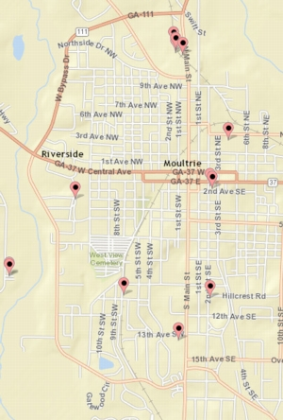
Aggregate Sites
Aggregate Groundwater
Aggregate user
Aggregate
Surface Water
Notes:
Sites:
Also have sites to accommodate data that may not be at each source—permit systems that require combined reports for all wells or intakes under the single permit.
These sites do not have to have a single latitude and longitude in the site file, but can have geographic attributes like state, county, and HUC at whatever level encompasses the sites in the aggregate.

Slide 16
Water Quantities
Withdrawals, returns, transfers (deliveries) between facilities
Identified as groundwater, surface water, raw water, finished water, wastewater, etc
Also identified as fresh, saline
Water treatment plant
Customers
Well
Wastewater Treatment Plant
Outfall
Notes:
Monthly and annual values
Stores a method (metered, various estimation methods), source agency, and comments for each year’s record.
Can store multiple records if the measurement method and/or source of data are different, say reported under a permit program and an estimate based on production data
Multiple records require that one be flagged as the ‘preferred record’, will be the default for retrievals

Slide 17
Example - Public Supply withdrawal
From site and To site
Year
Data Source Code
Water Quantity Code=WD (withdrawal)
Water Type Code = GW (groundwater)
Method Code and Accuracy Code
Data Aging Code=W, Working
National Water Use Code =
WS (Public Supply).

Slide 18
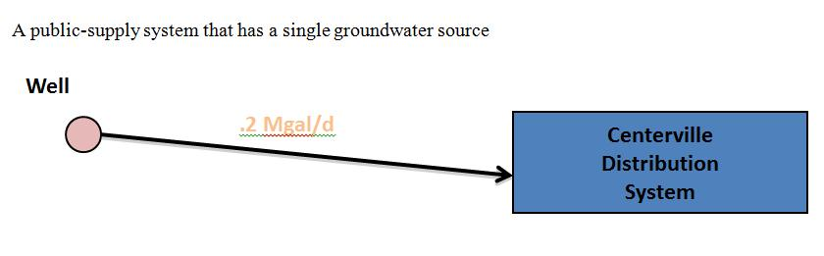
Example-Public Supply withdrawal
Notes:
A public-supply system that has a single groundwater source

Slide 19
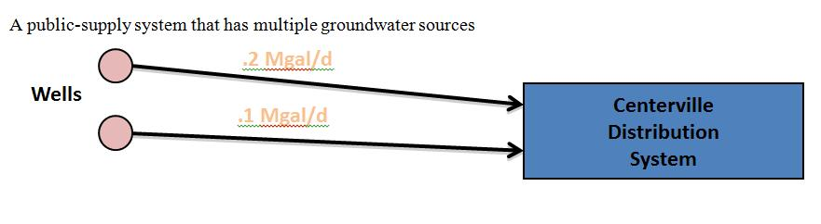
Example-Public Supply withdrawal
Notes:
A public-supply system that has multiple groundwater sources

Slide 20
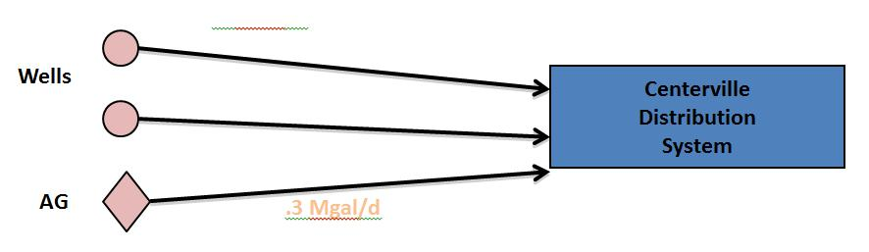
Example-Public Supply withdrawal
Notes:
An aggregate groundwater site is needed if you do not have separate withdrawal amounts for individual sources, although the individual wells should be input as well. The wells and aggregate GW site can each be connected to the distribution system site:

Slide 21
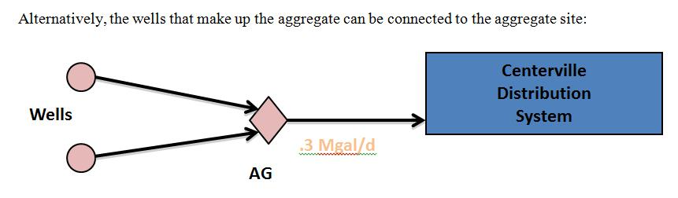
Example-Public Supply withdrawal
Notes:
Alternatively, the wells that make up the aggregate can be connected to the aggregate site:

Slide 22
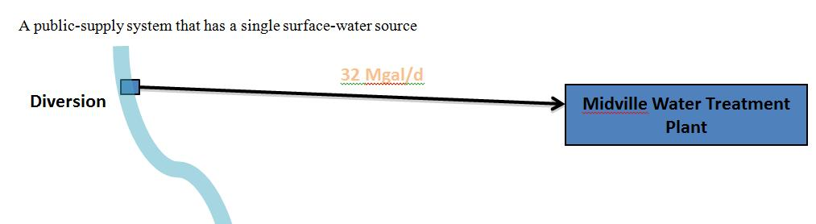
Example-Public Supply withdrawal
Notes:
A public-supply system that has a single surface-water source

Slide 23
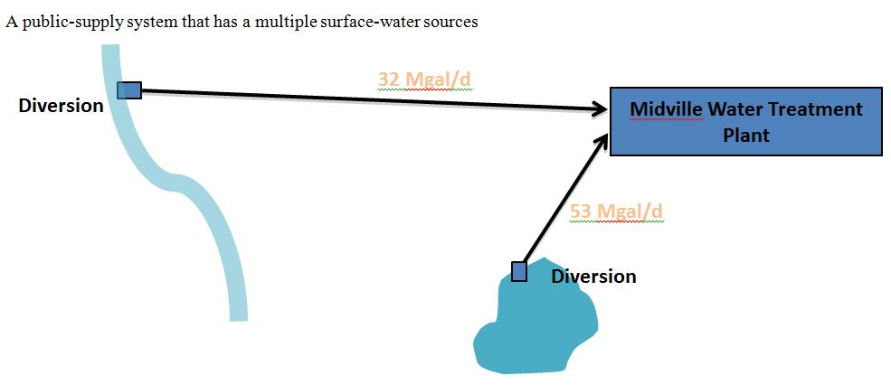
Example-Public Supply withdrawal
Notes:
A public-supply system that has a multiple surface-water sources

Slide 24
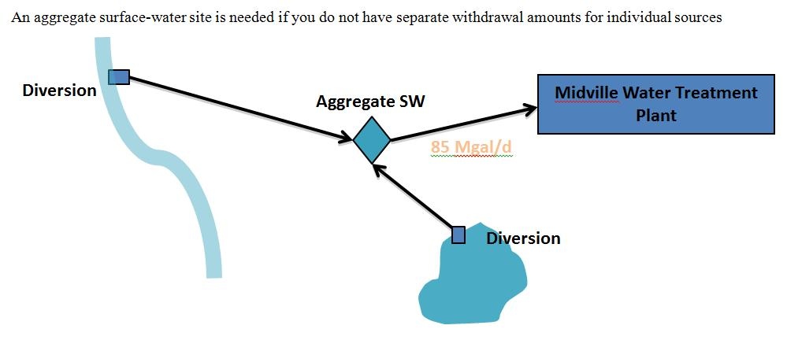
Example-Public Supply withdrawal
Notes:
An aggregate surface-water site is needed if you do not have separate withdrawal amounts for individual sources

Slide 25
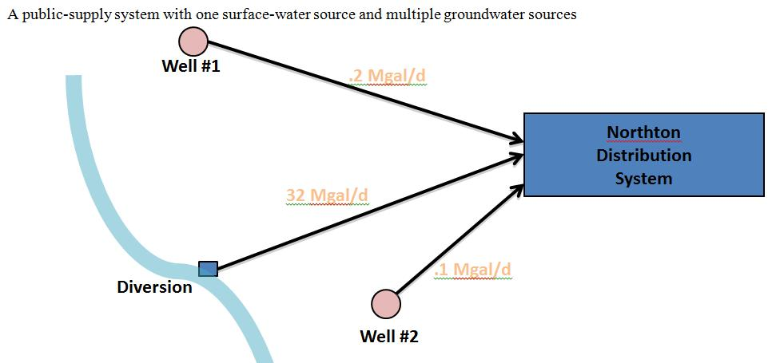
Example-Public Supply withdrawal

Slide 26
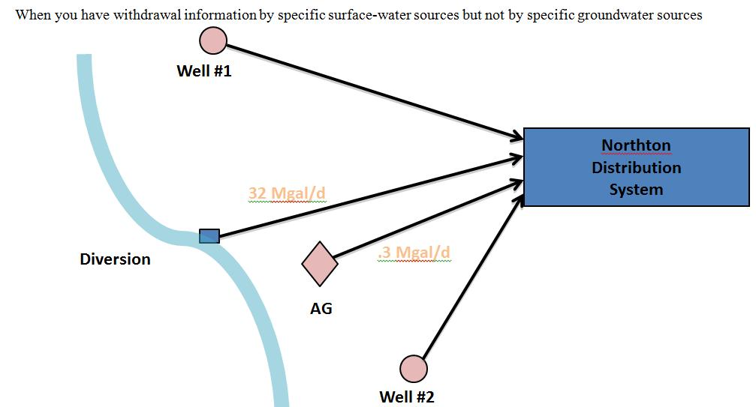
Example-Public Supply withdrawal
Notes:
When you have withdrawal information by specific surface-water sources but not by specific groundwater sources

Slide 27
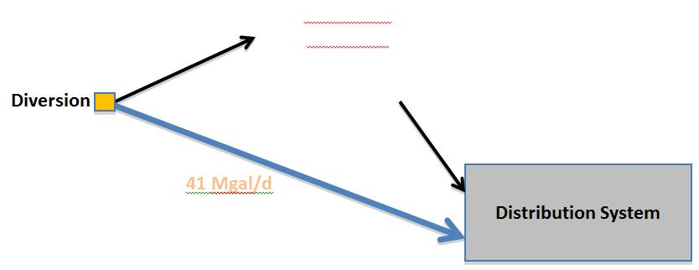
Example-Offstream Reservoir
Notes:
Offstream Reservoir: Water is pumped from a stream when streamflow allows to a treatment plant and/or an offstream reservoir, When streamflow falls too low to allow withdrawals from the stream, water is withdrawn from the reservoir.
This scenario will be modeled simply as a conveyance from the diversion to the distribution system—the blue conveyance—in the NAWQA SWUDS files. However, these will be flagged so you will know there’s something more complicated going on and can decide if you need to deal with them differently. If withdrawal amounts are available for both the stream diversion and the offstream reservoir, the more complicated model may be desirable.

Slide 28
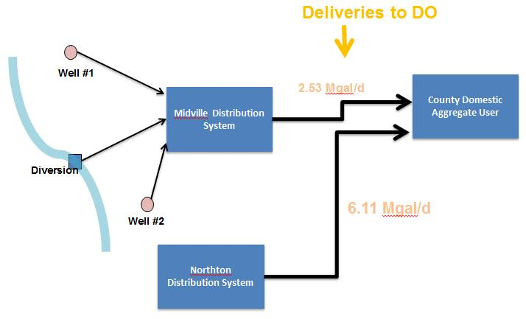
Public-supply deliveries to Domestic users
Notes:
Deliveries to domestic users are modeled in SWUDS by creating conveyance between a place-of-use site representing the public supply system (a Distribution System or Water Treatment Plant site) and an Aggregate Water User place-of-use site representing all Domestic users in a county.
The NAWQA SWUDS data model
The NAWQA SWUDS files have been created with the following data model:
Sources are entered individually, that is, no aggregate GW or SW sites are created. (No water withdrawal data are available from NAWQA SWUDS to determine whether such aggregate sites are needed.)
All sources are linked to one Water Distribution System site for the public supplier.
One County Domestic Aggregate User was created for each county, and each Water Distribution System is linked to the County Aggregate User site for the system.

Slide 29
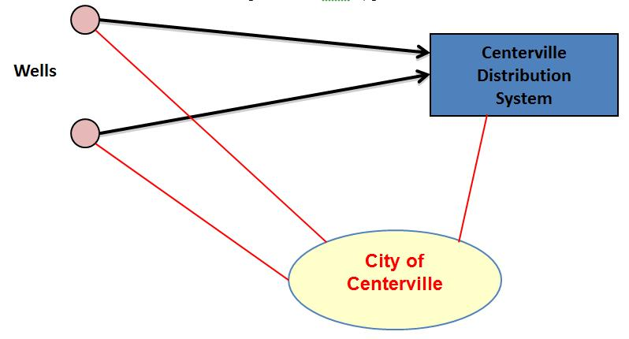
Owner or permit data entered once
Notes:
An owner can be associated with multiple sources and(or) places of use

Slide 30
Owner
Name
Address
Contact name, address, phone
Owner type (individual, government, corporation, tribal government, water supplier, other)
For each site: begin/end dates of ownership

Slide 31
Permit
MW0125498-2
Distribution System
Permit type
Permitting agency
Permit average and max rate
Begin/end dates
One permit, multiple sites
One site, multiple permits
Wells
02-035-0001
Notes:
Permit is an identifier assigned under a regulatory or reporting program, such as drinking water programs (EPA and state), drilling permits, wastewater discharge permits, and EIA facility IDs. Input the permit and its associated data once, relate that entry to all the sites (of all types) that it applies to.
Note the well that has 2 permit records associated with it—one for the drinking water system, one might be a drilling permit, etc.

Slide 32
Permit Types
ALLC Allocation Permit
APPL Land Application
CERC EPA CERCLA Number
DOEN DOE Number (thermoelectric and hydroelectric plants)
DRLL Drilling Permit
EPWS EPA Drinking Water Permit
INJC Injection
MINE Mining
NPDS EPA NPDES
RCHG Artificial Rec
RGHT Water Right
STWL State Well Number
WWRU Wastewater Reuse
UNSP Unspecified

Slide 33
Place-of-use Quantities
Consumptive use, instream use, recycled water
Water treatment plant
Industry
Well
Notes:
Monthly and annual values

Slide 34
Ancillary Data
Population Served (public suppliers)
stored on Place-of-Use sites (Water Distribution Systems, Water Treatment Plants)
Production data
Identified by type and SIC/NAICS code
Type – acres, employees, power, production
Notes:
Two other types of data we are allowing for in the data model: Population served and Deliveries
Pop Served is a count of the people supplied by the public supply system, and in the national water use compilation we ask for it separated by GW and SW pop served.
In SWUDS the data is stored on Place of Use sites
Ancillary data
Both of these can be stored as monthly and/or annual values.

Slide 35
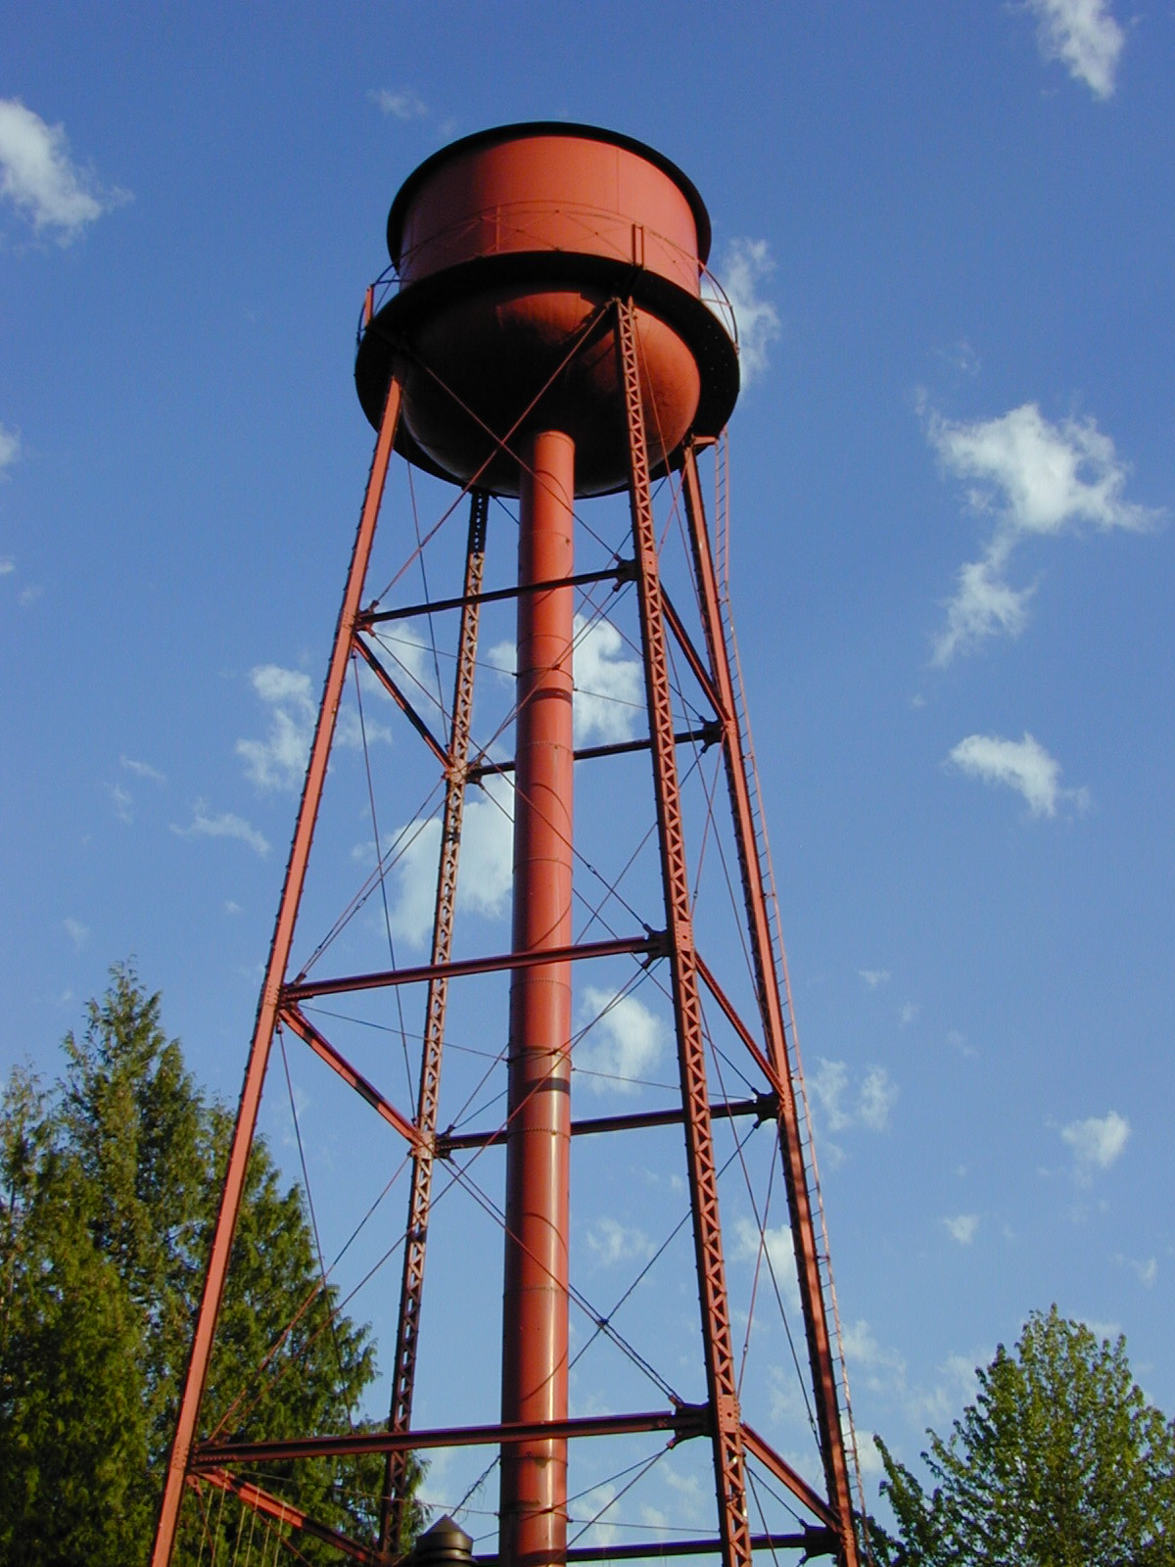
Questions?

Slide 36
Security
Internal database, requires access to the USGS network and authorization to use NWIS
Read-only or Write access for SWUDS
SWUDS is limited to control at the Sitefile level
Public
Local use only
Proprietary
Only Site data currently goes to NWISWeb.
Notes:
Sitefile control means everything about a site is under one rating.

Slide 37
Homeland Security Requirements
Public-supply sources cannot be identified as such
NWISWeb does not show water-use codes, site names for sources cannot indicate they are a public supply source.
Precise locations of treatment plants and powerplants cannot be given

Slide 38
Future of NWIS
Moving to single database from distributed servers
Expected timeframe of 3-5 years

