Slide 1
Water-Use Open Forum
Please put your phone on mute until the end of the presentation.

Slide 2
USGS Water-Use Databases Water-Use Open Forum
Nancy Barber National Water Use Leadership Team
South Atlantic Water Science Center –Norcross, Georgia
February 23, 2016

Slide 3
Outline
USGS Water Databases – NWIS and NWISWeb
Water-Use Data Concepts
Aggregate Water-Use Data System
Site-Specific Water-Use Data System
Notes:
Very abbreviated introduction to SWUDS

Slide 4
National Water Information System
Site File
GWSI
QWDATA
ADAPS
SWUDS
AWUDS
Notes:
NWIS, the umbrella term for the USGS Water databases.
Acronym heavy, sorry: Just want to give the basics.
Site file is the unifying element, and we’ll come back to it.
Components developed for the 4 traditional types of water data USGS works with: groundwater, surface water, water quality, water use. A relatively new component for biological data also exists.
GWSI - groundwater site inventory system—well construction, water levels, well logs, aquifer test results
QWDATA – water quality data
ADAPS – Automated Data Processing System, continuous (by minutes or even seconds, up to daily, generally) Includes the real-time streamflow, but also groundwater and water quality data. Potentially water use!
SWUDS is the Site-specific Water Use Data System, a subsystem of NWIS
Biological data is in a system called BioData, fairly recently brought under the umbrella.
AWUDS is another NWIS water-use database, not connected to sitefile

Slide 5
NWIS Basics
Oracle database
User interfaces for various components in Fortran, Visual Basic 6, .NET, Java, Perl, running in Unix, Windows desktop apps, and some web applications
Distributed system of 45 servers in Water Science Center offices, plus national servers
Notes:
NWIS today is an accumulation of 30 years of code development, and some of the earliest code is still in use.
Distributed servers are the internal databases that support USGS internal data entry and processing

Slide 6
NWIS in Transition
In process of modernizing this system
First step: continuous data component moving to a customized version of Aquarius by Aquatic Informatics
Next steps: initial planning underway, will replace all other components plus
Notes:
All of that is in the process of changing.
Aquarius should be the working database for continuous data beginning sometime this year, replacing ADAPS
Must replace the other components with a more modern system, with one major driver being the retirements of the Fortran programmers who have been keeping it running. Also must move from distributed servers to fewer centralized system.
So, while we expect to have the same functionality in the future, all of the underlying systems will be changing over the next few years.

Slide 7
National Water Information System
Site File
GWSI
QWDATA
ADAPS
SWUDS
AWUDS
Aquarius
Notes:
NWIS,
Now, these are the internal, working databases for USGS—where USGS personnel enter, process, QA, and use the data for our studies.
The system that makes NWIS data available to the public is called NWISWeb.

Slide 8
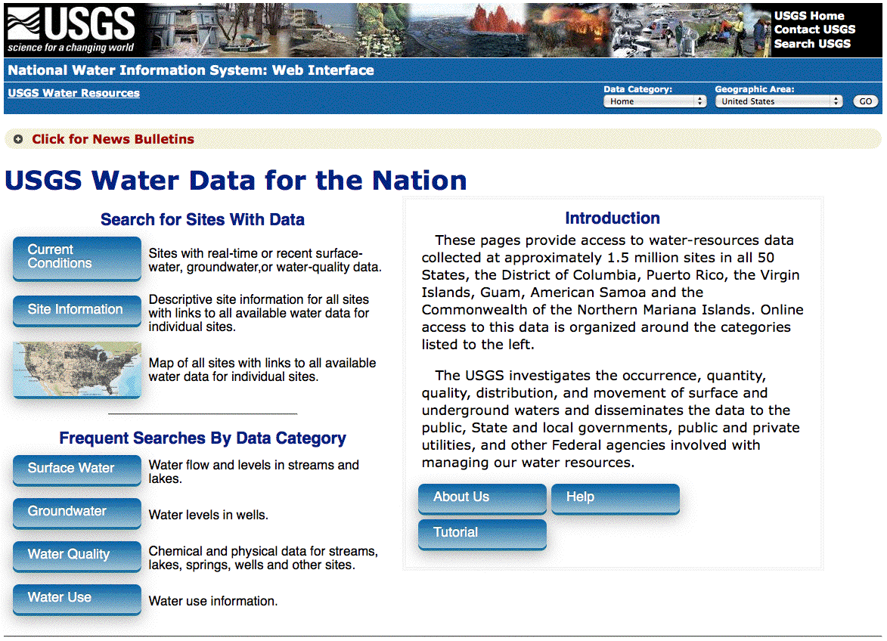
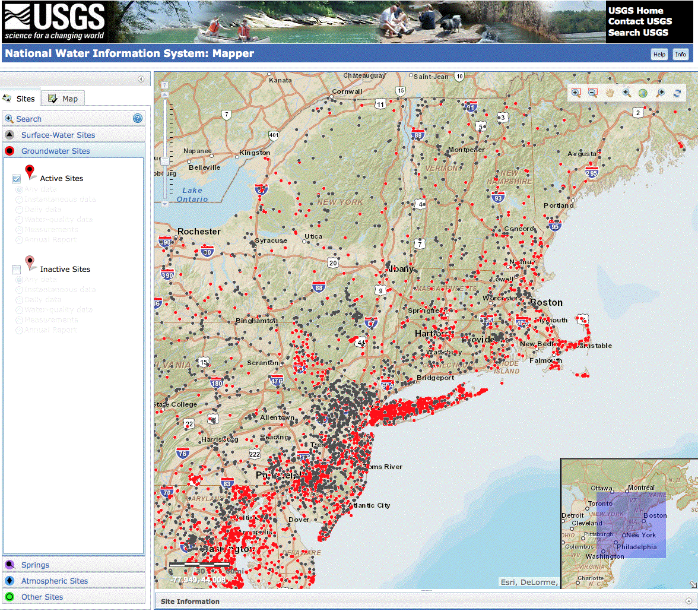
Water Data for the Nation
http://waterdata.usgs.gov/
Notes:
Public-facing database for USGS Water
Real-time and periodic measurements; streamflow, groundwater data, water quality data. Water use has been recently added, as county aggregate data for various water-use categories.
Mapper—showing SW and GW site locations, may have water quality information at some of these as well.
A small part of the full Water database system, the National Water Information System or NWIS. We call this NWISWeb—the web interface to NWIS.

Slide 9
NWISWeb Does NOT Contain:
Data that fails QA checks (realtime data may be there but flagged)
Well construction data, etc.
Proprietary data
Most water-use data
…more to come on this!

Slide 10
Water-Use Data Types
Aggregated Data
Site-Specific Data
Notes:
Molly talked about this last time, but as a review: I’m going to talk about two types of water-use data
Site-specific data
Aggregated data
Focus of national program has been aggregated data. The best source for aggregated data, however, is site-specific data, and that generally means data from State water agencies that manage water resources. This makes water use different from the other areas that USGS works in, as we are not the primary data collectors.

Slide 11
Aggregated Data
Total quantity withdrawn for an area
Grouped water sources
Surface water, fresh and saline
Groundwater, fresh and saline
Categories of use
Ancillary data (population, acres irrigated, power)
Notes:
Aggregated data looks at groups of users, not at specific locations and facilities.
Total quantity withdrawn for an area
Larger locations (entire county)
Grouped water sources (surface water)
Categories of use (industrial)
A typical aggregated data element is industrial withdrawals from ground water for Smith County

Slide 12
Site-Specific Data
Specific water source
Which stream
Which aquifer
Location of withdrawal
Water quantity
Category of use
Wells
BigWidgets, Inc. factory
Diversion
Notes:
Focus: water quantity
location
water source--aquifer, location on river
Site-specific data is needed to support much of the rest of USGS water resources activities, like ground-water models

Slide 13
Outline
USGS Water Databases – NWIS and NWISWeb
Water-Use Data Concepts
Aggregate Water-Use Data System
Site-Specific Water-Use Data System
Notes:
Very abbreviated introduction to SWUDS

Slide 14
National Water Information System
Site File
GWSI
QWDATA
ADAPS
SWUDS
AWUDS
Notes:
The database we use to store it is AWUDS
Aggregate Water-Use Data System
Under the NWIS umbrella, but not connected to the Site file because the data stored is for areas.

Slide 15
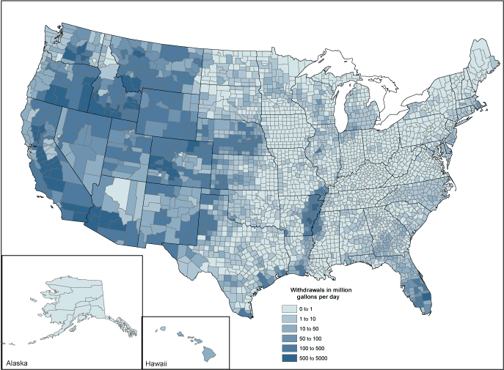
Aggregation Areas
County
HUC
Aquifer
Notes:
The locations are called aggregation areas: in various national compilations, we have done aggregated data by county, 8-digit hydrologic unit, and national aquifer.
All work in AWUDS is by State, as water-use data is so dependent on State laws and data sources. In other words, for a HUC or aquifer which crosses a State boundary, AWUDS will have entries for the pieces in each State. The State datafiles are developed by a person in one of the USGS Water offices, often in that State.

Slide 16
Data Elements
Water amounts
Withdrawals, returns, deliveries
Consumptive use, conveyance loss
Ancillary data
Total population
Population served by Public Supply
Power production
Irrigated acres
Notes:
For each aggregation area, the information we request can be translated into data elements, or the actual numbers that could be reported as aggregated water-use data--Molly
For an area, and a category, we could collect:
Water amounts
Withdrawals, returns, deliveries
Consumptive use, conveyance loss
Ancillary data
Total population
Population served by Public Supply
Power production
Irrigated acres
Terminology also used in AWUDS.

Slide 17







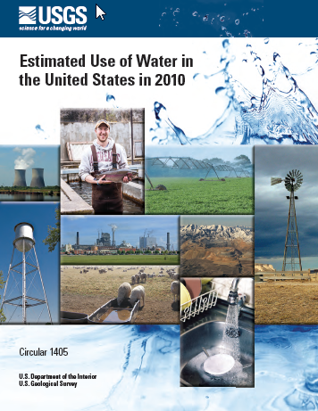





Estimated Use of Water in the United States
Notes:
AWUDS is the database that supports the USGS signature water use products, the Circulars titled EUOWITUS, produced every 5 years since 1950.
From 1950 to 1980, the underlying data was State totals and HUC2 or HUC4 equivalents
Beginning in 1985, county estimates were collected, though the printed reports show State totals. County data is made available concurrently with the report publication. Watershed data moved to HUC8 also in 1985.
National Aquifer estimates have been made once, for 2000. We are exploring a possible repeat of this for 2015.

Slide 18
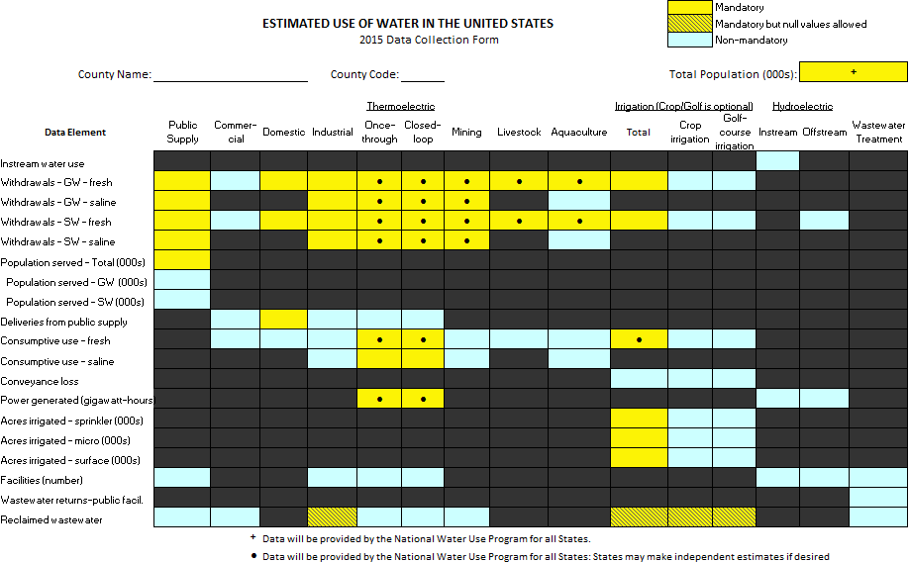
2015 – County
Notes:
Molly showed this last time, but it’s a good visual for the amount of data we collect and store in AWUDS.
Data elements
Categories
Yellow boxes are mandatory, blue are non-mandatory, dots are data elements where we provide estimates on the national level if the State compiler choses to use them.

Slide 19
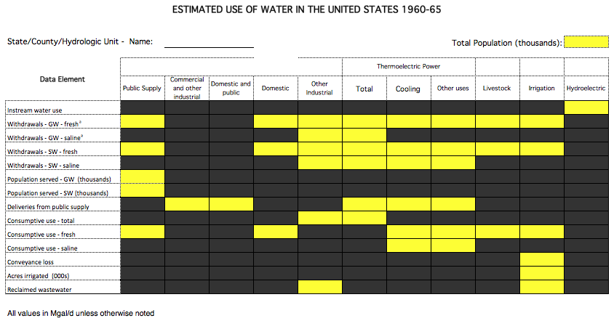
1960 and 1965
Notes:
If we had AWUD in 1960, this would have been the coding form, and it would have been completed only at the State level and for HUC2

Slide 20
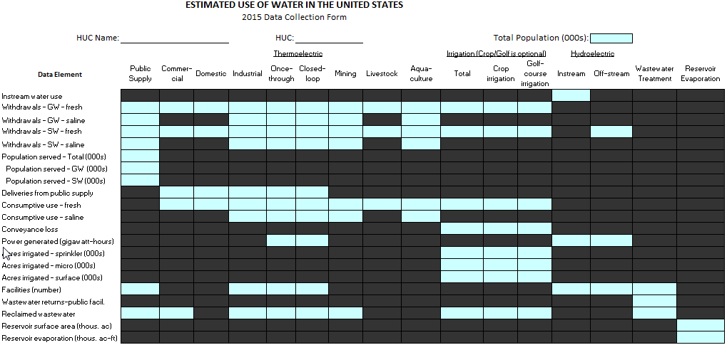
2015 – HUC

Slide 21
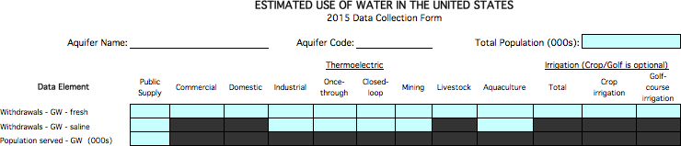
2015 – Aquifer

Slide 22
AWUDS Features
Multiple Datasets – published and revised
Data aging
QA Tools – Some on data entry, reports to flag inconsistencies, large changes
Basic Tables by Category report becomes Circular tables
Notes:
Multiple datasets allow us to archive the data used for a report, then to revise it if corrections or improved estimates come along. After reviseions are approved, the new dataset is flagged as “best available” for that State, year, and area type.
Data aging is fairly gross level—all counties/HUCs/aquifers in the dataset age together, categoris can be aged separately

Slide 23
AWUDS to NWISWeb
County-level data
1985-2010, compilation years
“Best Available” data
Updated quarterly, frozen during active compilation periods
Notes:
Published datasets available on the USGS National Water Use home page

Slide 24
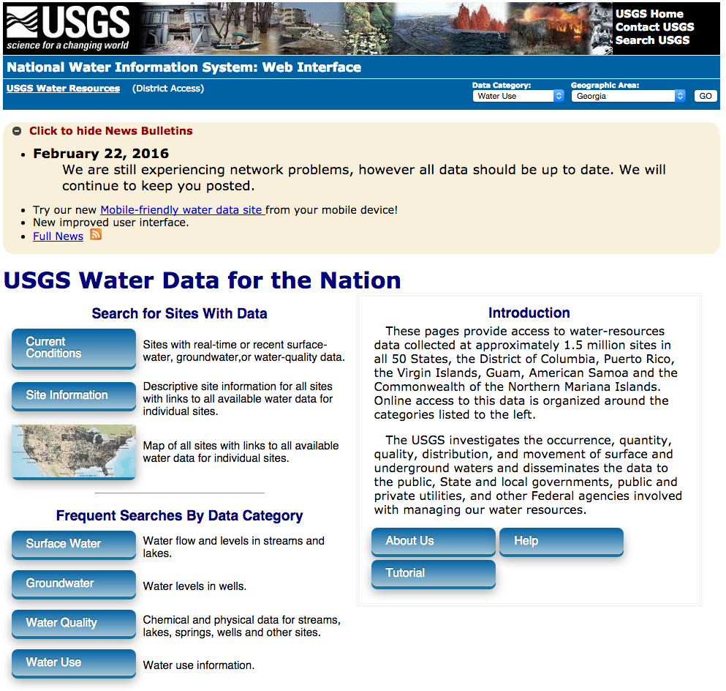
Water Use on NWISWeb

Slide 25
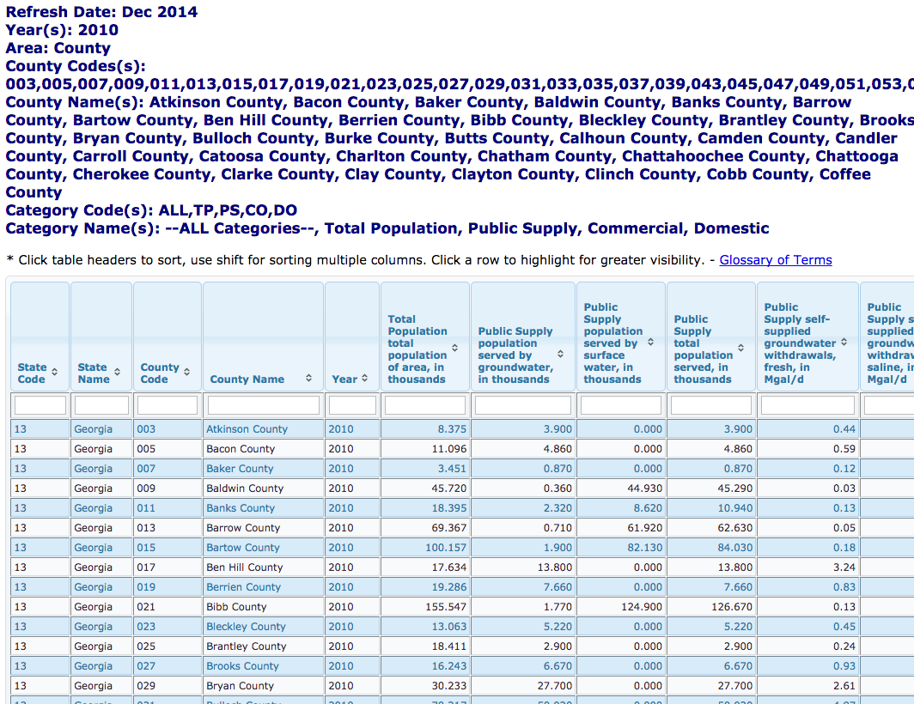

Slide 26
Water Use on NWISWeb: Future
Add HUC8 data
Add National Aquifer data
(maybe) Add historical State-level data
Notes:
HUC8 data: have historical datasets, and ongoing Focus Area Studies are developing HUC8 datasets for their basins. Would like to have these incorporated into NWISWeb so they are available to the public in the same interface as the county data.
Aquifer will be yet another effort.
Everything depends on having the resources to develop these, and putting it in the priority list.

Slide 27
Outline
USGS Water Databases – NWIS and NWISWeb
Water-Use Data Concepts
Aggregate Water-Use Data System
Site-Specific Water-Use Data System
Notes:
Very abbreviated introduction to SWUDS

Slide 28
Site-Specific Data
Specific water source
Which stream
Which aquifer
Location of withdrawal
Water quantity
Category of use
Wells
BigWidgets, Inc. factory
Diversion
Notes:
Focus: water quantity
location
water source--aquifer, location on river
Site-specific data is needed to support much of the rest of USGS water resources activities, like ground-water models

Slide 29
Site File
Unifying element of NWIS
Geographic information
Site Type
Site File
GWSI
QWDATA
ADAPS
SWUDS
Notes:
Back up a minute as I move into site-specific data and talk about the NWIS Site file.
Everything in the 4 core components of NWIS is connected to a site, sites can be used in multiple subsystems of NWIS. For example, can store water levels and water quality analyses for one well, or well construction in the GW subsystem for a well used in SWUDS.
A major advantage: we want to know if different kinds of data are in fact for one site.
Site type helps define what is being measured—is the data a characteristic of a river? Stream site. If the measurement is of the amount of water being withdrawn from a river, it’s a measurement from an intake, called a Diversion in NWIS.
In the early days of NWIS, Sites were always thought of as a point. More recently “sites” have become areal features too, like a water treatment plant, a powerplant, or a orchard. We still keep our county, HUC, and aquifer aggregated data in AWUDS in a different data structure, but really the range between site specific data at a single well to data for a county is a continuum of ‘sites’.

Slide 30
SWUDS
Site File
GWSI
QWDATA
ADAPS
SWUDS
Stores withdrawal, use, and return data
Tracking database, not just point data
Water treatment plant
Customers
Well
Wastewater Treatment Plant
Outfall
Notes:
Stores withdrawal, use, and return data in same database as streamflow, water levels, and water quality
Can track water movement from withdrawal to use to return locations
Point locations (sites) are connected by one-way “conveyances” that show how water is being moved. ”—think of it as a virtual pipe, though it might really be a canal or some other way to move water from one point to another.
Water sales: can be major (wholesale) customers, to show water sources for public supply systems which only purchase water, or can indicate retail sales to customer groups, like all the commercial users for a given public supplier.
Can identify interbasin transfers

Slide 31
Tracking database
Connect sources to use locations to discharges
Detail can reflect available information or needs
Define a data model to answer your questions
Interbasin transfers
Allows “one-sided conveyances”

Slide 32
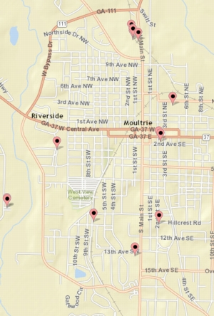
Aggregate Sites
Aggregate Groundwater
Aggregate
Surface Water
Aggregate user
Notes:
Sites:
Also have sites to accommodate data that may not be at each source—permit systems that require combined reports for all wells or intakes under the single permit.
These sites do not have to have a single latitude and longitude in the site file, but can have geographic attributes like state, county, and HUC at whatever level encompasses the sites in the aggregate.

Slide 33
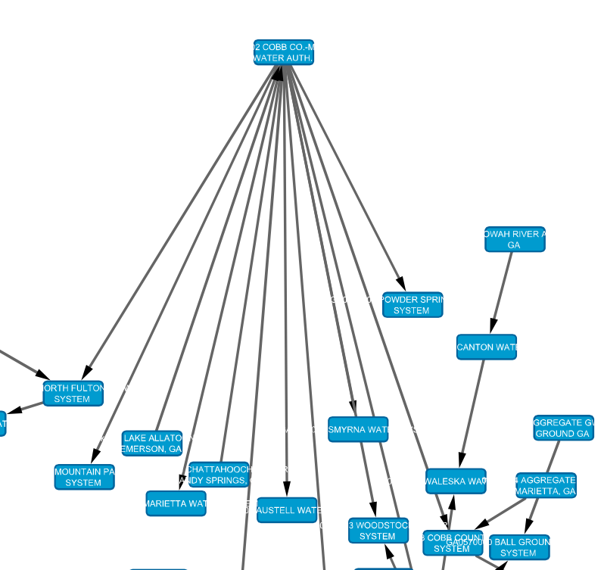
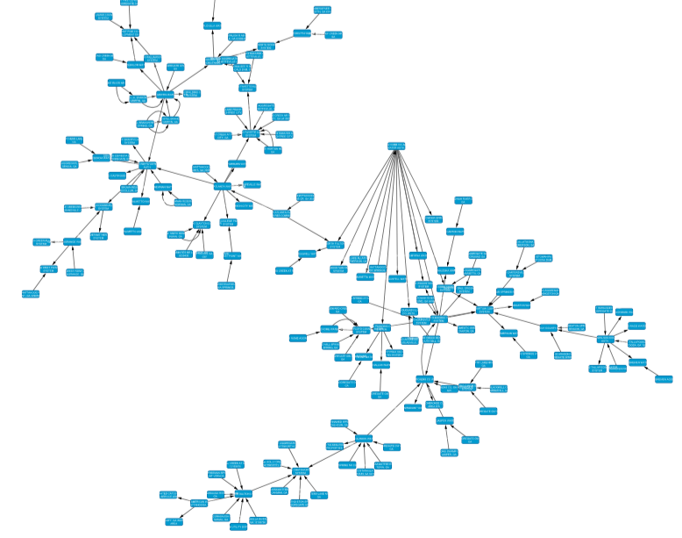
Notes:
With this tracking database, we can develop the network of water use and see where water moves and who affects others ‘down network’.
This is a visualization of a network drawn using tool called Cytoscape using data from the SWUDS database for Georgia. Suburban Atlanta water systems, shows water systems and intakes.
NOTE: external tool, SWUDS can’t do this. Also Cytoscape is not geographically ‘aware’, so I arranged these boxes by hand after Cytoscape drew them with the various arrows for me. Maybe someday we will be able to draw these more directly in SWUDS.
Zoom on the core system—Cobb-Marietta Water system northwest of Atlanta.

Slide 34
What can SWUDS store?
Sites
Owners, contacts
Permits
Water Quantities
Ancillary Data

Slide 35
Owner and Permit
Enter owner or permit data once, associate the record to multiple sites as needed
City of Smithton 123 City Hall Smithton, ST 12345
Well
Distribution System
Outfall
Wastewater Treatment Plant
Notes:
Owner and Permit, which add additional data about a site.
Similar functionality in the database. Base (Parent) record
Updates are done to parent record and then will show up on retrievals for all the sites.

Slide 36
Permit
MW0125498-2
Permit type
Permitting agency
Permit average and max rate
Begin/end dates
One permit, multiple sites
One site, multiple permits
Distribution System
Wells
02-035-0001
Notes:
Permit is an identifier assigned under a regulatory or reporting program, such as drinking water programs (EPA and state), drilling permits, wastewater discharge permits, and EIA facility IDs. Input the permit and its associated data once, relate that entry to all the sites (of all types) that it applies to.
Note the well that has 2 permit records associated with it—one for the drinking water system, one might be a drilling permit, etc.

Slide 37
Water Quantities
Withdrawals, returns, transfers (deliveries) between facilities
Identified as groundwater, surface water, raw water, finished water, wastewater, etc
Also identified as fresh, saline
Water treatment plant
Customers
Well
Wastewater Treatment Plant
Outfall
Notes:
Monthly and annual values
Stores a method (metered, various estimation methods), source agency, and comments for each year’s record.
Can store multiple records if the measurement method and/or source of data are different, say reported under a permit program and an estimate based on production data
Multiple records require that one be flagged as the ‘preferred record’, will be the default for retrievals

Slide 38
Place-of-use Quantities
Consumptive use, instream use, recycled water
Water treatment plant
Industry
Well
Notes:
Monthly and annual values

Slide 39
Ancillary Data
Population Served (public suppliers)
stored on Place-of-Use sites (Water Distribution Systems, Water Treatment Plants)
Production data
Identified by type and SIC/NAICS code
Type – acres, employees, power, production
Notes:
Two other types of data we are allowing for in the data model: Population served and Deliveries
Pop Served is a count of the people supplied by the public supply system, and in the national water use compilation we ask for it separated by GW and SW pop served.
In SWUDS the data is stored on Place of Use sites
Ancillary data
Both of these can be stored as monthly and/or annual values.

Slide 40
SWUDS System Information
Oracle database
Most of user interface is Visual Basic 6
Input and output uses Excel
Batch load only, as most data is from other agencies

Slide 41
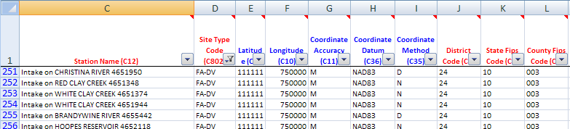
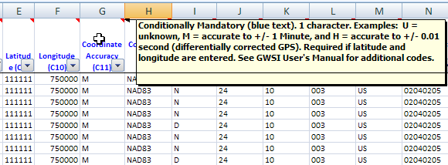
SWUDS Template
Notes:
The template in Excel
Column headings can be read by SWUDS to know what data is in each: “auto maps” the data during batch input.
Color coding of headings: Red are mandatory, Blue are conditionally mandatory—for example, if you enter lat-long, you must enter accuracy, datum, and method. Lat-longs themselves are conditionally mandatory based on the site type. Black text in the heading means the entry is optional.
Are comments/tool tips behind each column header with some additional information. Hover over the heading cell with your mouse to make these appear.

Slide 42
Water-Use Sites on NWISWeb
Site data only
Local decision as to display
Name must meet security guidelines
Notes:
Advantage of seeing map of stream gages and water-use withdrawals and discharges—switch to live NWISWeb.

Slide 43
Homeland Security Requirements
Public-supply sources cannot be identified as such
NWISWeb does not show water-use codes, site names for sources cannot indicate they are a public supply source.
Precise locations of treatment plants and powerplants cannot be given

Slide 44
Use of SWUDS in USGS
“Secondary” data not entered in NWIS in most offices historically
USGS National Water Census: push to add water-use component of water cycle

Slide 45
Public Supply SWUDS effort
Agreement with EPA to use SDWIS site data
Locations are proprietary
Funded USGS local offices to build public supply sources and systems in SWUDS
Local data sources can be used
Goal: national site-specific water-use data
Notes:
Begin to store site-specific information at least for larger water users, and those where information is available fairly consistently across the country, integrated with the other data USGS uses for our studies.
Because of security and other data sensitivity, probably will present this not as points and specific withdrawals, but in small aggregates, perhaps a HUC12 watershed.

Slide 46
Questions?

