Slide 1
WUDR Update
2nd February 2021
Notes:
Update on github

Slide 2
Outline
Review of Census and DEQ data
Data availability in both datasets
Correlation between datasets
Irregularities between datasets
Notes:
GitHub
Irregularities for data in different counties

Slide 3
USDA Census Data
ACCOMACK | Irrigated Acreage | No of operations
AREA OPERATED: (1.0 TO 9.9 ACRES) | 29 | 9
AREA OPERATED: (10.0 TO 49.9 ACRES) | 25 | 7
AREA OPERATED: (50.0 TO 69.9 ACRES) | 82 | 4
AREA OPERATED: (70.0 TO 99.9 ACRES) | (D) | 1
AREA OPERATED: (100 TO 139 ACRES) | NA | NA
AREA OPERATED: (140 TO 179 ACRES) | NA | NA
AREA OPERATED: (180 TO 219 ACRES) | NA | NA
AREA OPERATED: (220 TO 259 ACRES) | (D) | 1
AREA OPERATED: (260 TO 499 ACRES) | 668 | 5
AREA OPERATED: (500 TO 999 ACRES) | (D) | 1
AREA OPERATED: (1,000 TO 1,999 ACRES) | (D) | 1
AREA OPERATED: (2,000 OR MORE ACRES) | 4,129 | 7
Census data on irrigated acreage and number of farms
Total in county
Breakdown by farm size
2017, 2012, 2007, 2002, 1997
Notes:
Accomack county 1st coloumn is the different size of farms
(1.0 TO 9.9 ACRES) there are 9 such farms reporting to USDA irrigating 29 acres
D means removed for privacy

Slide 4
USDA Census Data
Final dataset:
Irrigated Operations (Sum of No. of operations)
Irrigated Acreage (reported at county level)
Data for 94 counties for operations and 84 for Irrigated Acreage
COUNTY_NAME | Irrigated Operations | Irrigated Acreage | Size Bins | Operation Bins
ACCOMACK | 36 | 5078 | 5 | 9
ALBEMARLE | 67 | 783 | 6 | 12
AMELIA | 14 | 204 | 1 | 6
AMHERST | 12 | 175 | 1 | 7
Notes:
for a county greater size bins represents more variety of farms reporting data to USDA
For our study an appropriate scenario would be to have a bigger size bins for reported data.

Slide 5
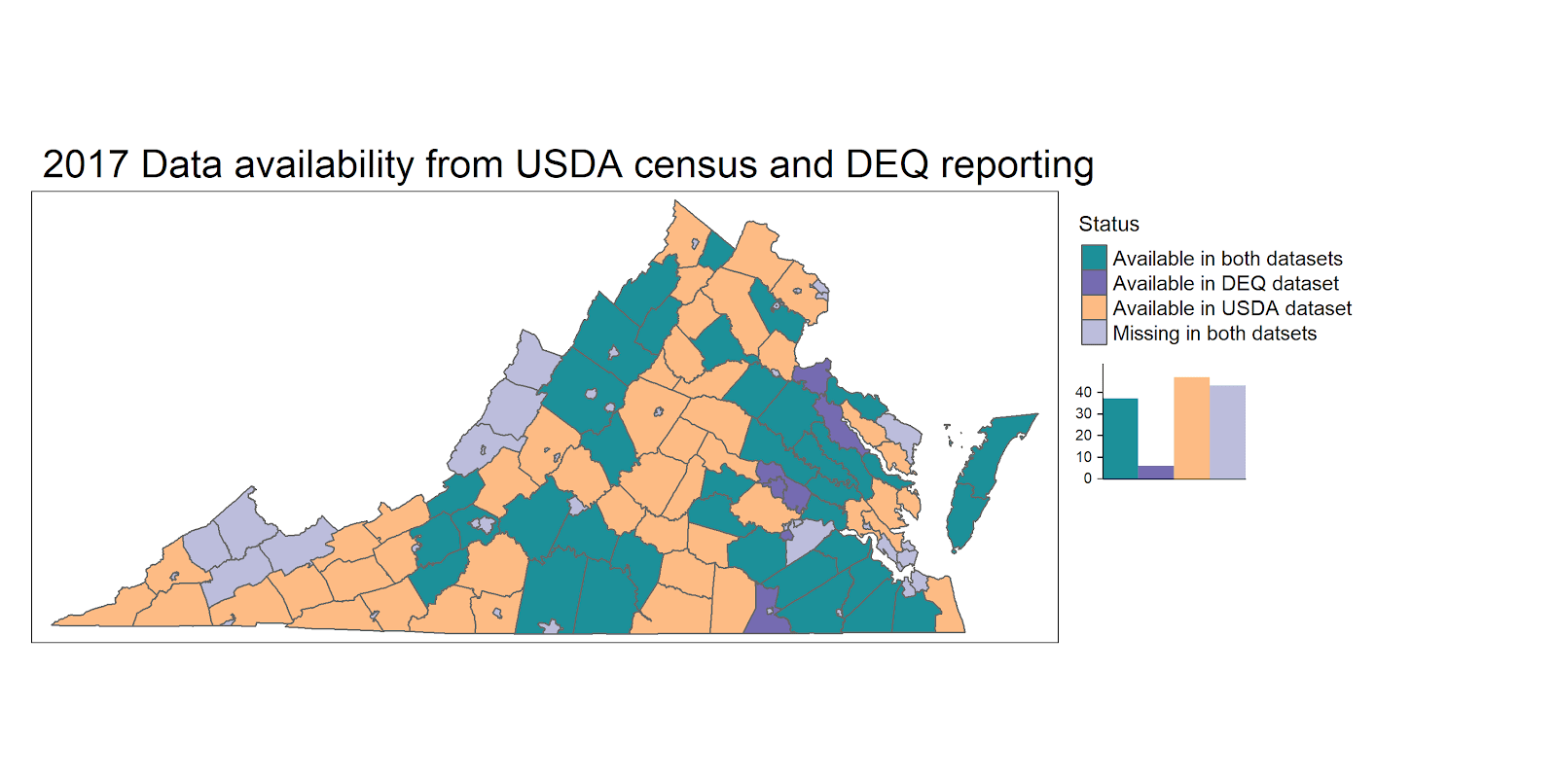
 | Acreage | Withdrawals | No of counties
Available in both datasets | 46,273 | 6,640 | 37
Available in DEQ dataset |  | 682 | 6
Available in USDA dataset | 13,852 |  | 47
Notes:
Missing in both datasets 43
Available in DEQ but not in USDA : King George(2), Essex (4), Henrico(2), Greensville (2), Richmond City(1) , Petersburg City(1)
There are legit facilities; Richmond city have a nursery
Discrepancy between the datasets and also justifies our goal that DEQ might not have full picture of withdrawals in the state.
WE got DEQ withdrawal data as well and then selected the counties with data in both datasets. There are 37 such counties.

Slide 6
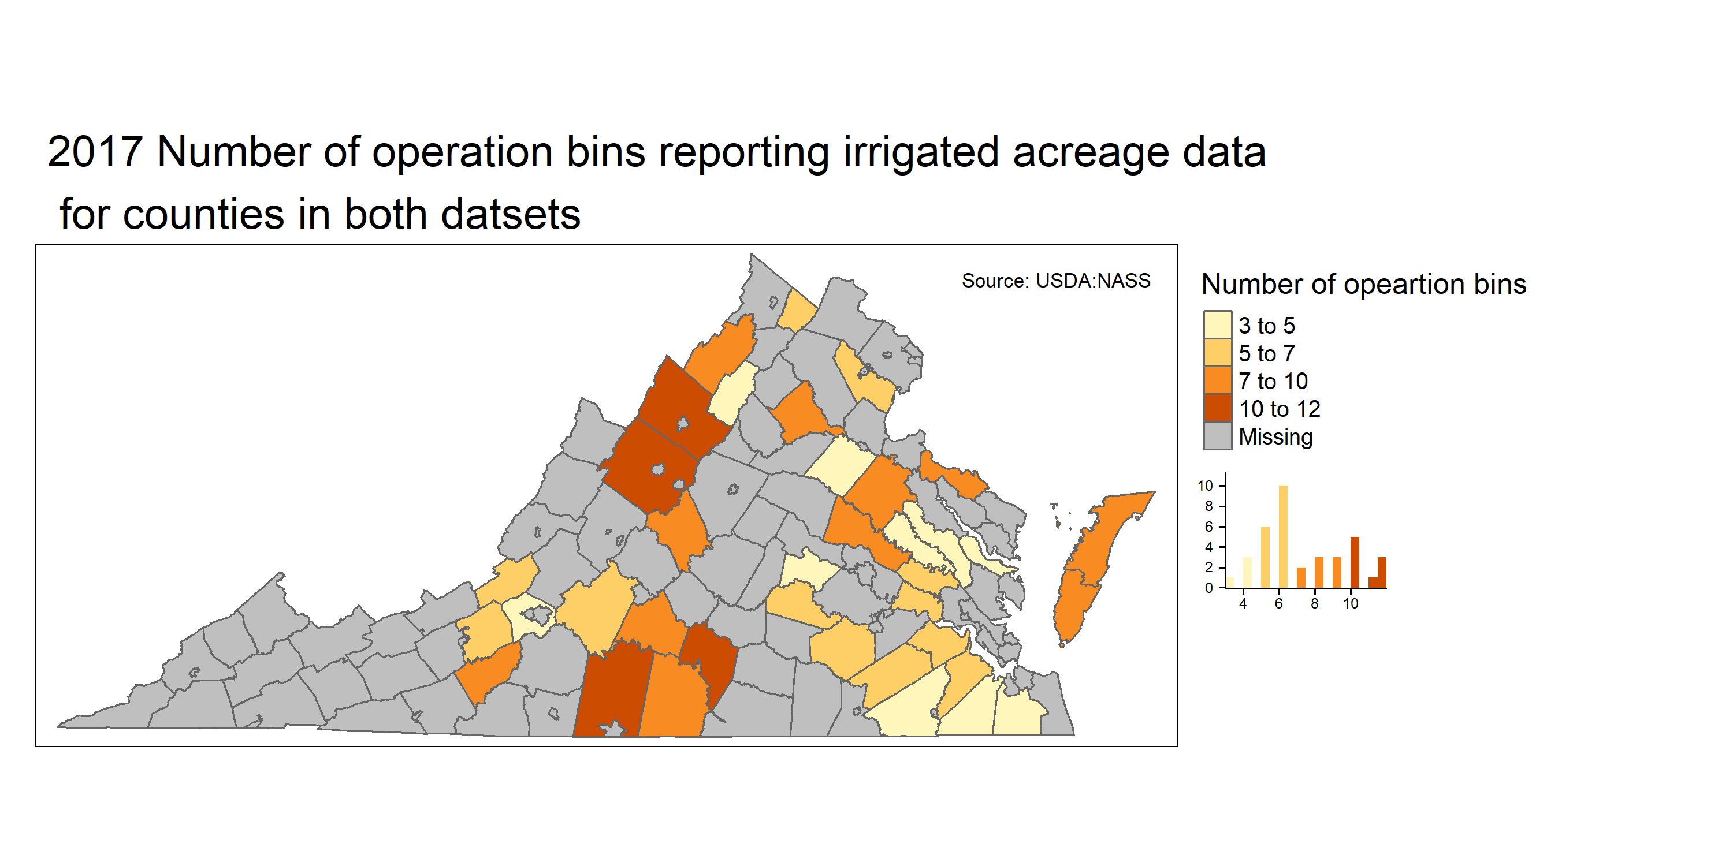
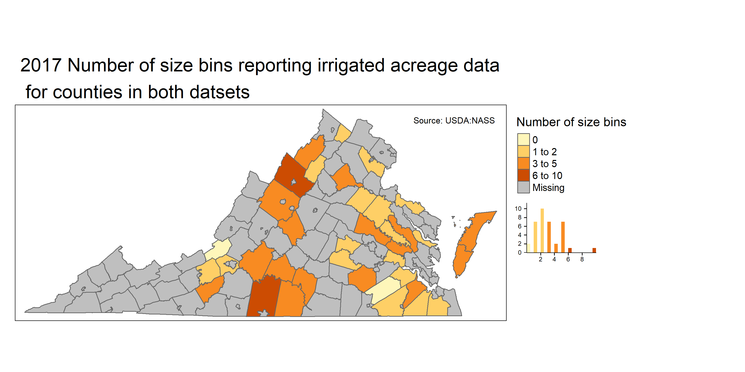
Binned data summary for counties in both datasets
Notes:
Operation bins vary 1:12
Size bins 1: 10
No of farms of different sizes reporting operations
No of farms of different sizes reporting irrigated acreage
With data form more size and operation
Bins are the different farm sizes
Size bins: Rockingham county 10, Pittsylvania6, Accomack- Augusta 5,
Rockingham county 12, Pittsylvania12, Charlotte5, Augusta

Slide 7
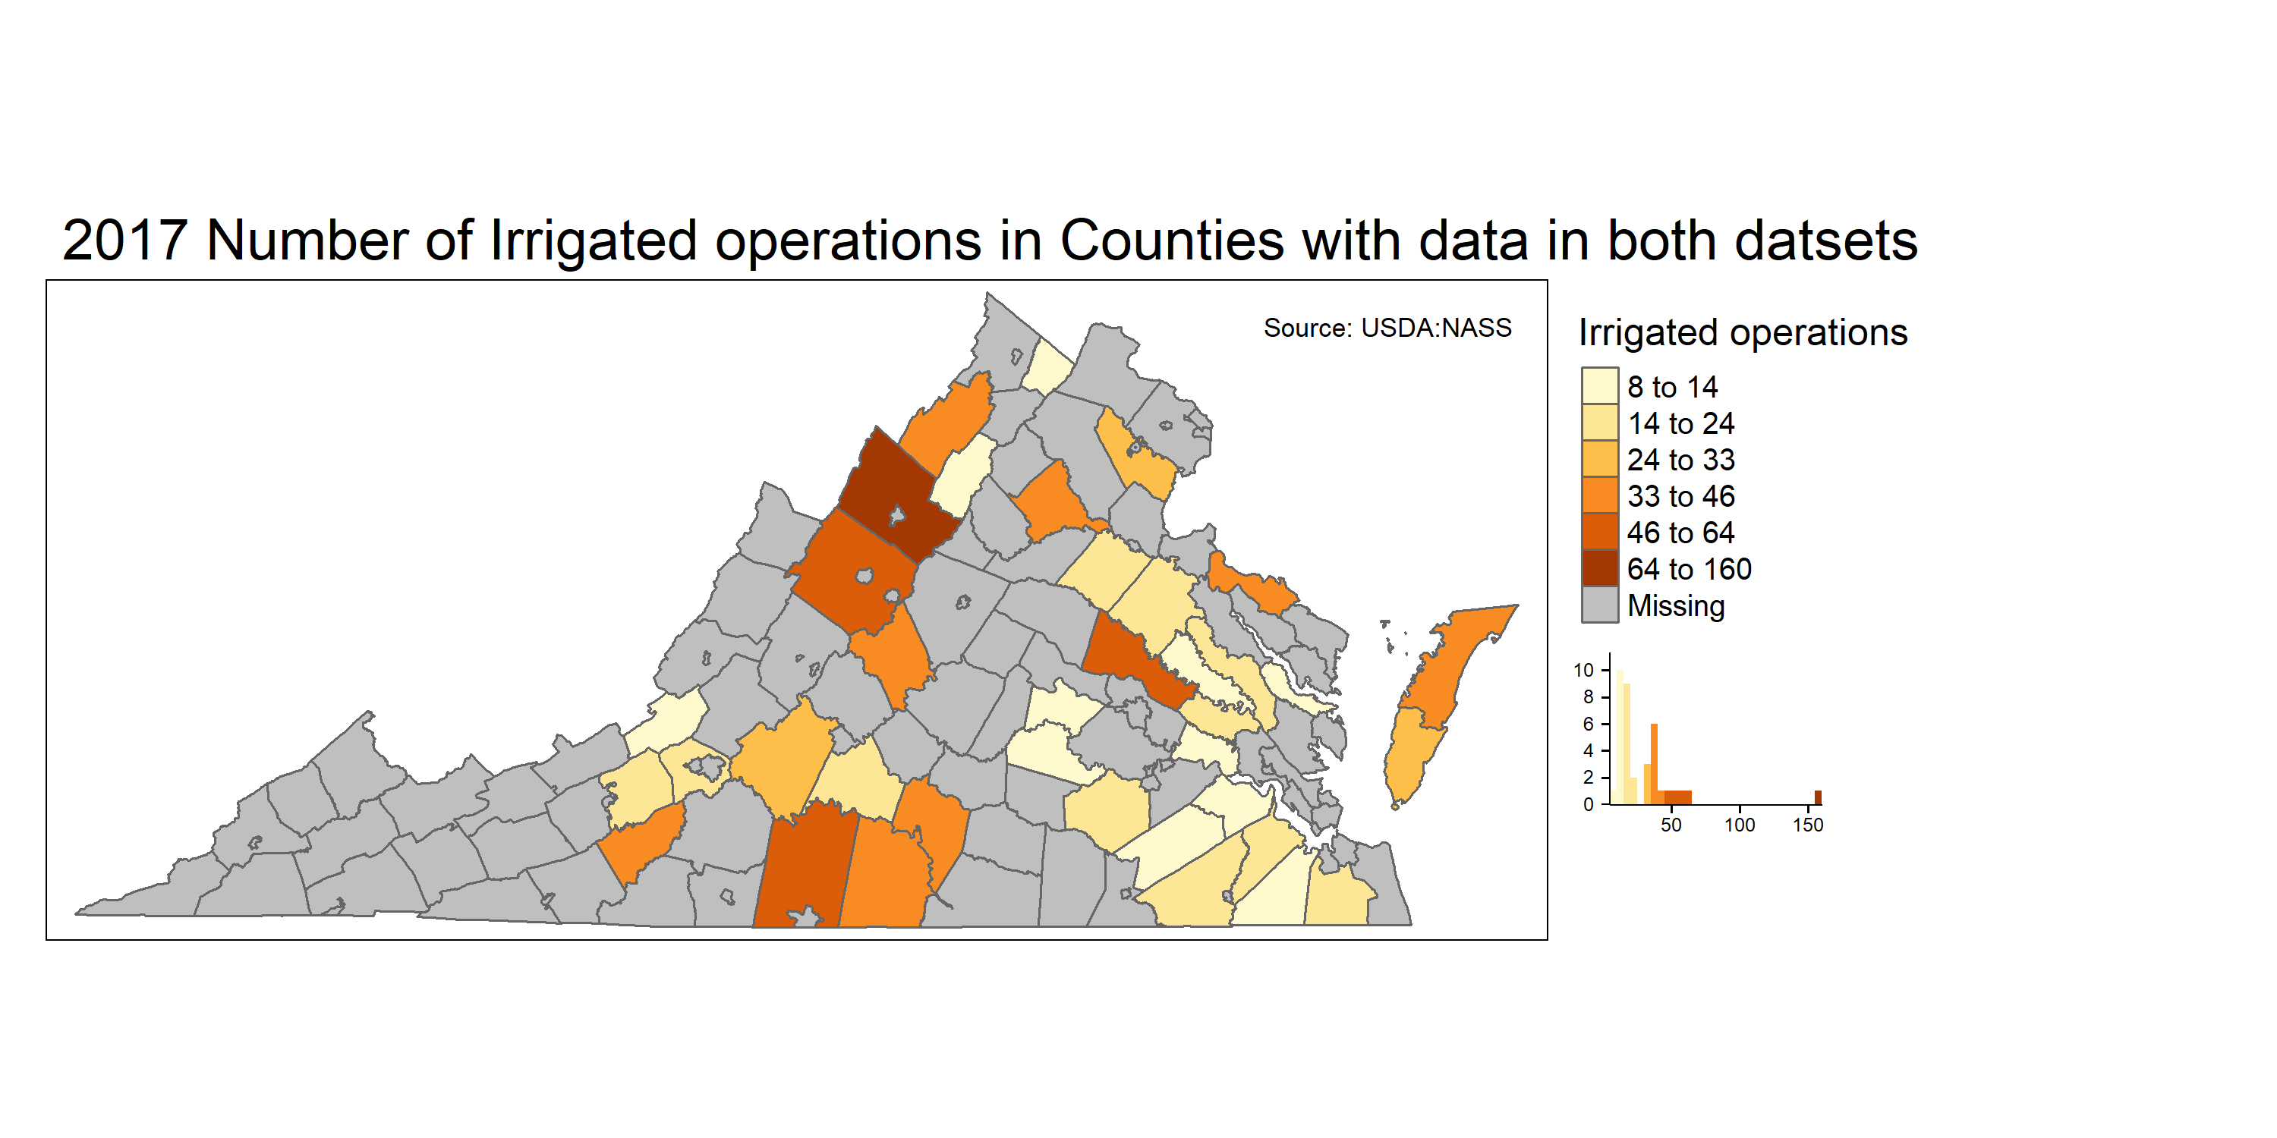
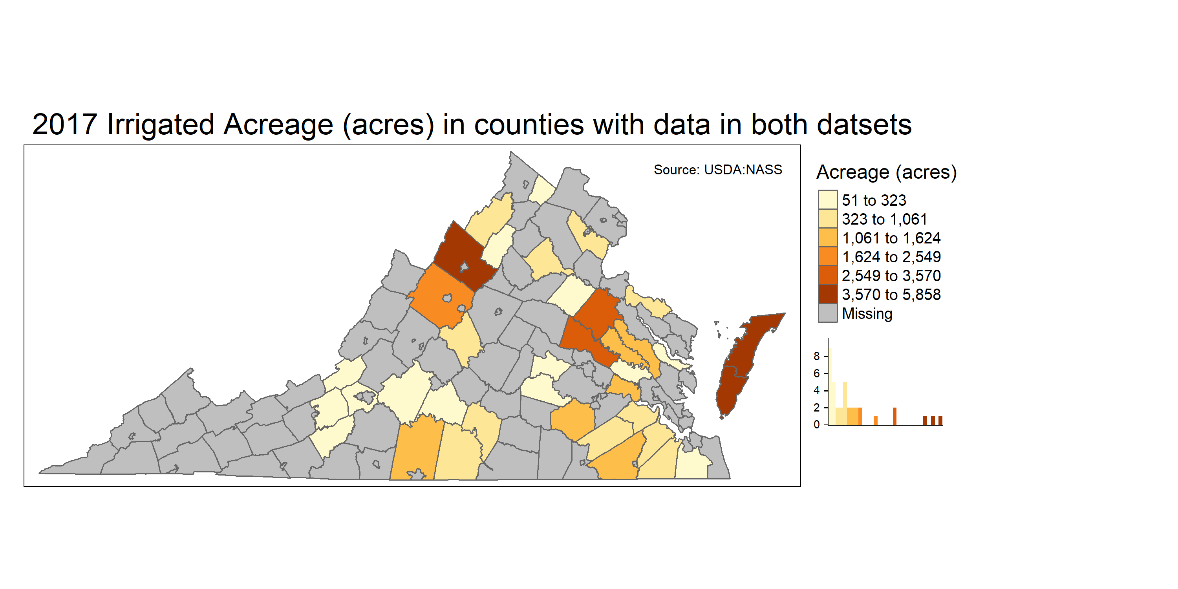
Irrigated data summary for counties in both datasets
Notes:
Available in both datasets 37 counties have irrigated acreage ranging from 10 to 5858 acres
31 have irrigated acreage less than 2000 exact (1684)
6 counties: ACCOMACK(3rd) , AUGUSTA, CAROLINE , HANOVER , NORTHAMPTON (max), ROCKINGHAM(2nd) above 2000 (In more detail about specific) counties in next slides)
Smaller Acreage reporting to Census which might not be reporting to DEQ

Slide 8
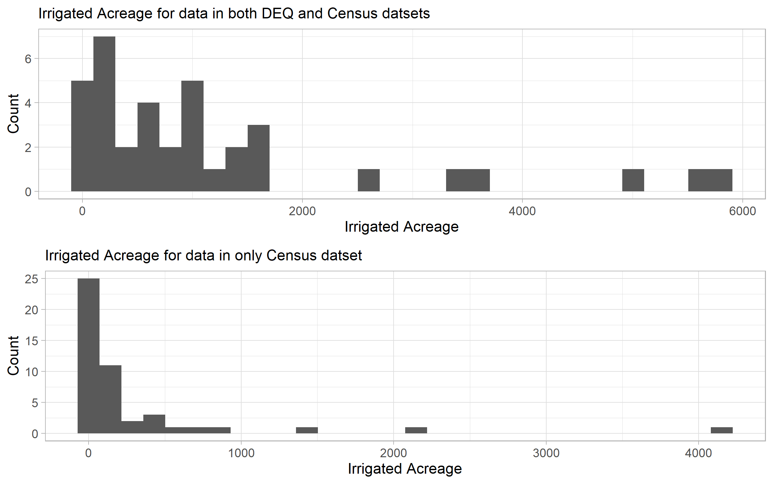
Notes:
Main Point: To see the distribution of counties with the irrigated acreage
Above plot: Available in both datasets 37 counties have irrigated acreage ranging from 10 to 5858 acres
31 have irrigated acreage less than 2000 exact (1684)
6 counties: ACCOMACK(3rd) , AUGUSTA, CAROLINE , HANOVER , NORTHAMPTON (max), ROCKINGHAM(2nd) above 2000 (In more detail about specific) counties in next slides)
Below plot: To see the counties not in DEQ
Available in USDA dataset 47 have irrigated acreage ranging from 10 to 4162 areas
3 counties above 1000 acres: LUNENBURG(1402), RUNSWICK(2114), MECKLENBURG (4162)
sum(13852)

Slide 9
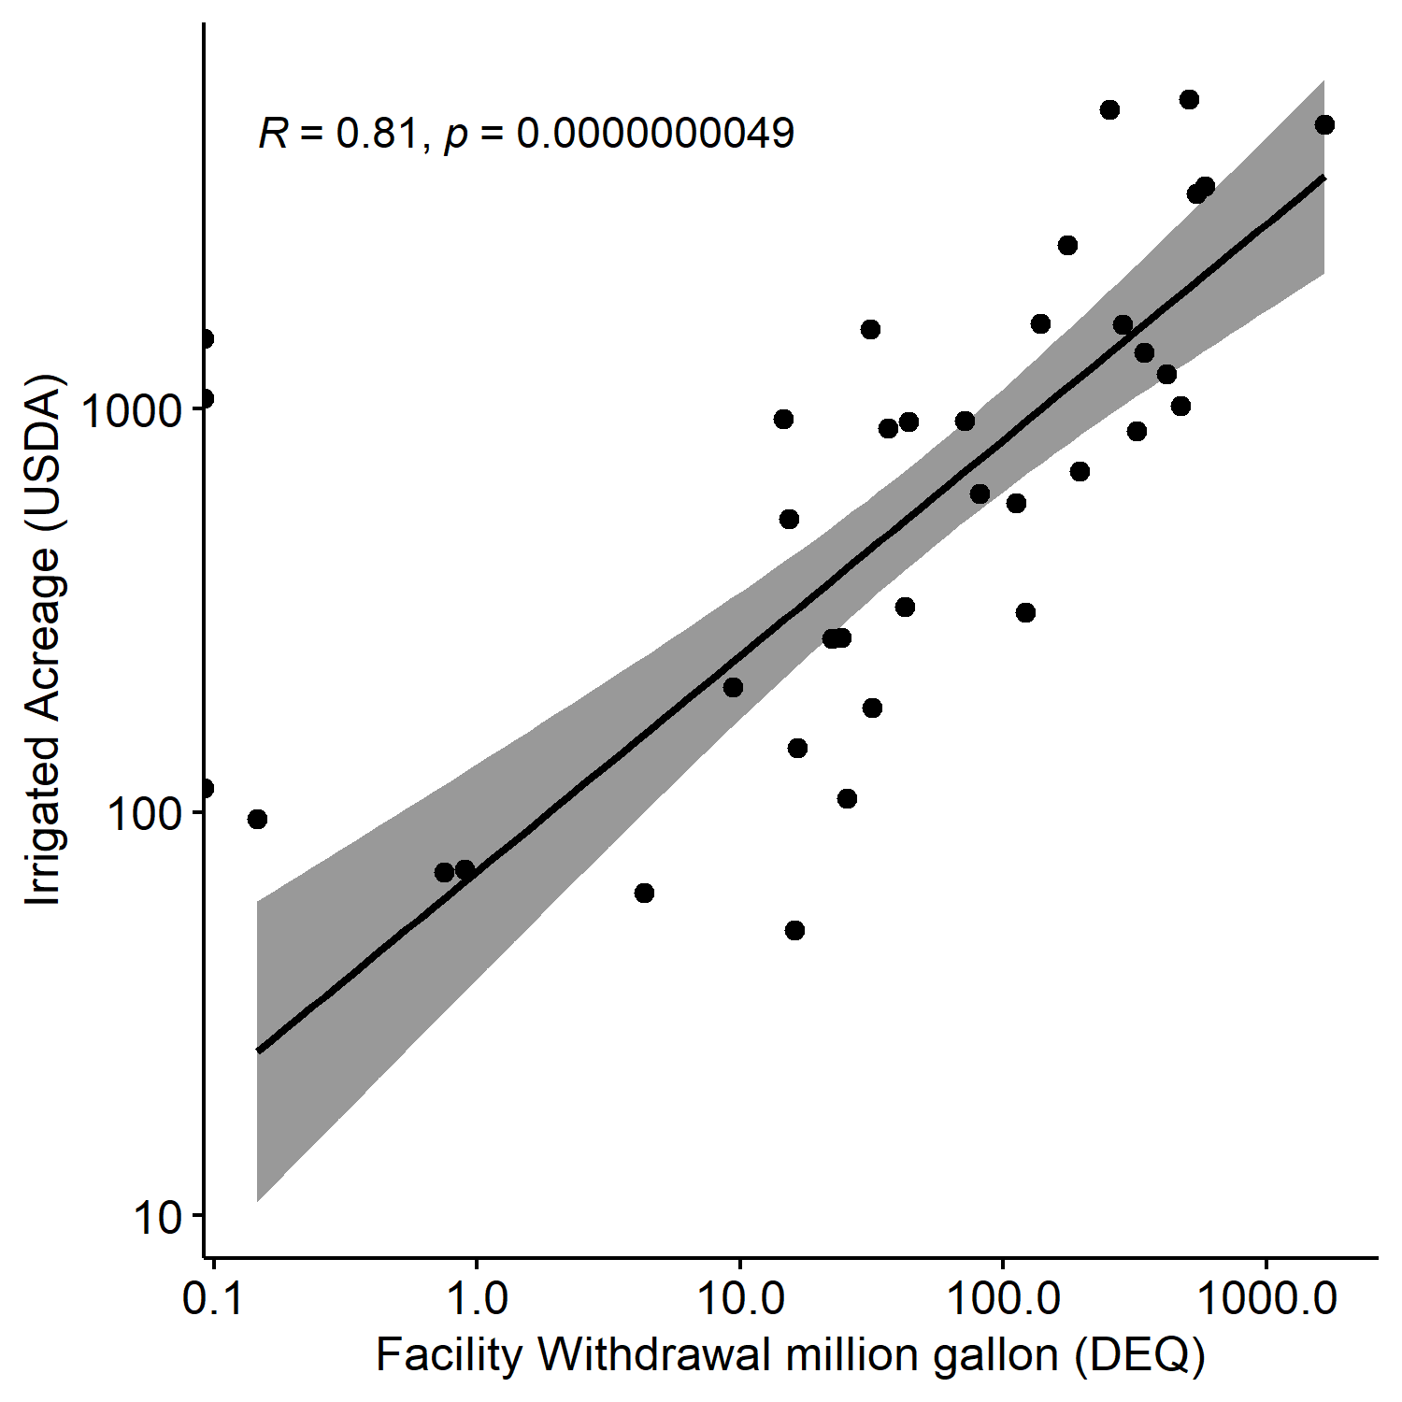
Scatterplot of DEQ irrigation withdrawal vs USDA irrigated acreage
Notes:
Summary of withdrawals ta county scale.
3 counties with facilities reporting zero withdrawals.
Correlation Sign and magnitude: Positive and strong
3 Counties: Hailfax, Pittsylvania(2) and Craig with facilties reporting 0 withdrawals.

Slide 10
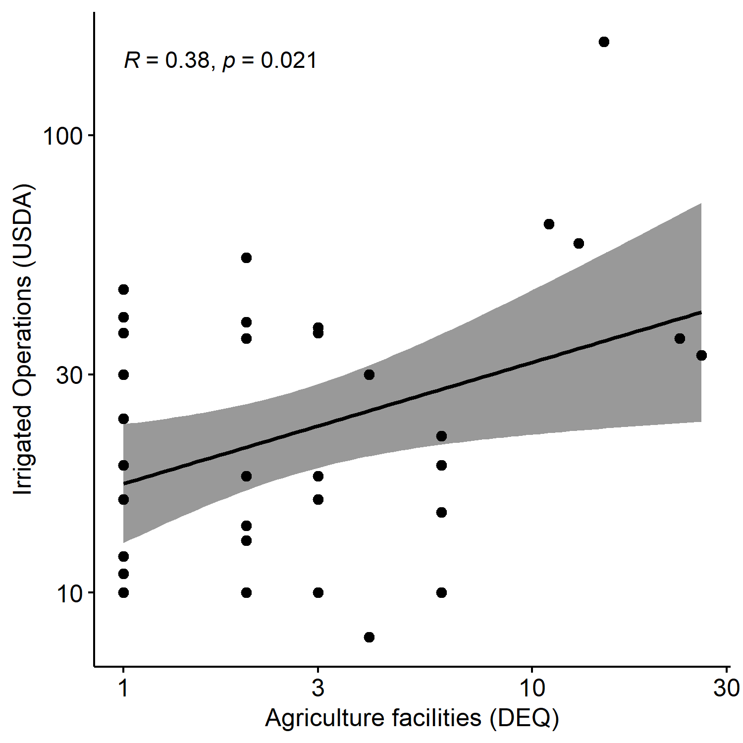
Scatterplot of DEQ irrigation facilities vs USDA operations with irrigation
Notes:
Positive but weak.
Positive is good to see. Weak correlation is understood due to the facilities reporting more in census. VDEQ data is not the complete picture of irrigation in the state.

Slide 11
Top counties in terms of DEQ irrigation withdrawals, responsible for 80% of total irrigation withdrawals in the state
 | Counties | Facilities | Withdrawal mg | Percentage of total | Withdrawal per facility | Status
1 | Accomack County | 23 | 1674 | 25 | 73 | High in both datasets
2 | Hanover County | 13 | 584 | 9 | 45 | High in both datasets
3 | Caroline County | 6 | 544 | 8 | 91 | High in both datasets
4 | Northampton County | 26 | 510 | 8 | 20 | High in both datasets
5 | Nelson County | 2 | 474 | 7 | 237 | High in both datasets
6 | King and Queen County | 3 | 419 | 6 | 140 | High in both datasets
7 | Charles City County | 6 | 344 | 5 | 57 | High in both datasets
8 | Westmoreland County | 3 | 322 | 5 | 107 | High in DEQ data not in USDA
9 | King William County | 3 | 285 | 4 | 95 | High in both datasets
10 | Rockingham County | 15 | 254 | 4 | 17 | High in both datasets
Notes:
10 counties =81 percent
These 10 counties make up for 80% of the withdrawals in DEQ dataset. For this table we selected which counties make up for 80% of withdrawals and acreage in both datasets. The common counties making this contribution are marked as “high in both datasets”. Here except Westmoreland County: We all 9 counties are also in the list of counties for census 80% acreage
Westmoreland Ocunty: INGLESIDE PLANTATION and LIBERTY FARM, Read Oak Nurseries, Foundation Seed farm

Slide 12
Top counties in terms of USDA acreage responsible for 80% of total irrigated acreage in the state
 | County Name | Irrigated Acreage | Irrigated Operations | Rank Acreage | Rank Operations | Percent Acreage of total | Irrigated Acreage per operation | Status
1 | Northampton County | 5858 | 33 | 1 | 13 | 13 | 178 | High in both datasets
2 | Rockingham County | 5526 | 160 | 2 | 1 | 12 | 35 | High in both datasets
3 | Accomack County | 5078 | 36 | 3 | 11 | 11 | 141 | High in both datasets
4 | Hanover County | 3570 | 58 | 4 | 3 | 8 | 62 | High in both datasets
5 | Caroline County | 3411 | 19 | 5 | 18 | 7 | 180 | High in both datasets
6 | Augusta County | 2549 | 64 | 6 | 2 | 6 | 40 | High in USDA data not in DEQ
7 | Southampton | 1624 | 15 | 7 | 26 | 4 | 108 | High in USDA data not in DEQ
8 | Charles City County | 1376 | 10 | 11 | 32 | 3 | 138 | High in both datasets
9 | Dinwiddie County | 1578 | 22 | 9 | 17 | 3 | 72 | High in USDA data not in DEQ
10 | King and Queen County | 1221 | 16 | 12 | 23 | 3 | 76 | High in both datasets
11 | King William County | 1618 | 10 | 8 | 34 | 3 | 162 | High in both datasets
12 | Pittsylvania County | 1492 | 54 | 10 | 4 | 3 | 28 | High in USDA data not in DEQ
13 | Halifax County | 1061 | 40 | 13 | 6 | 2 | 27 | High in USDA data not in DEQ
14 | Isle of Wight County | 933 | 18 | 16 | 20 | 2 | 52 | High in USDA data not in DEQ
15 | Nelson County | 1016 | 39 | 14 | 7 | 2 | 26 | High in both datasets
Notes:
Similarly, 15 counties result in 80% of the irrigated acreage. 6 counties in this list are not in DEQ list.
For counties with unreported data irrigated acreage per operation should have been small as we would expect the small withdrawals not being reported to DEQ by large number of intakes. This seems the case except for south Hampton county

Slide 13
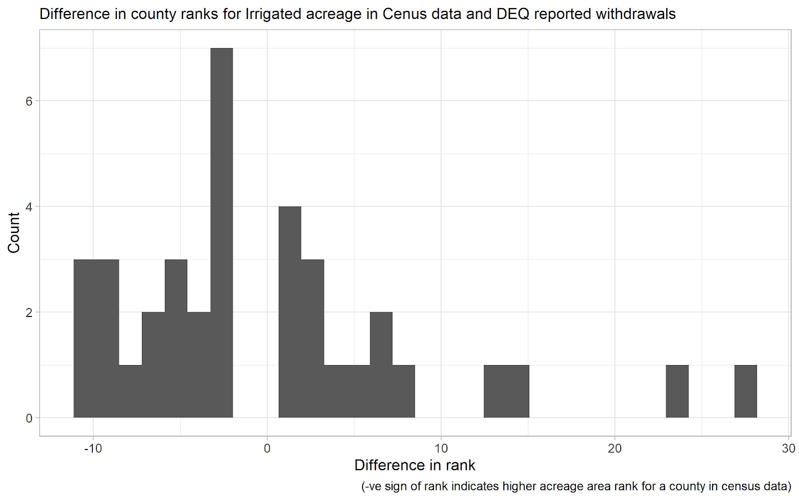
Relatively high irrigation amount in USDA data relative to VDEQ
Notes:
This plot gives the overall distribution of difference in ranks for Withdrawals and acreage.
Subtracted the rank of VDEQ from Census. Close to zero counties are the ones with similar rank in both datasets.
Higher rank for a county in census data than in deq data will give –ve sign
Pittsylvania County has rank of 37 in DEQ 10 in Census dataset.

Slide 14
Rank for withdrawals in DEQ dataset and irrigated acreage in Census data
 | DEQ Withdrawals Rank | Census Acreage Rank | Difference in Rank
Westmoreland County | 8 | 19 | -11
Campbell County | 14 | 25 | -11
Bedford County | 27 | 37 | -10
Sussex County | 11 | 20 | -9
Page County | 23 | 32 | -9
Rockingham County | 10 | 2 | 8
Dinwiddie County | 22 | 9 | 13
Prince William County | 29 | 15 | 14
Halifax County | 36 | 13 | 23
Pittsylvania County | 37 | 10 | 27
Notes:
From Slide 11: This table is more detail for the counties on tails of the graphs. The counties with higher difference in ranks. Blue color counties are the one s with large unreported data.

Slide 15
Next steps:
Census data for remaining years
IWMS data
Begin area-proportional coefficient estimation
Progress report to USGS due at the end of March
Notes:
Irrigation farm and management survey

Slide 16
In Agriculture data
Rockingham County | 2 facilities Poultry and Dairy farm
Dinwiddie County
Prince William County
Halifax County
Pittsylvania County

