Slide 1
WUDR Update
19th April

Slide 2
Outline
Area under-reported
Review of Census and DEQ data for all census years
Substituting and rescaling D values

Slide 4
Census Data
ACCOMACK | Irrigated Acreage | No of operations
AREA OPERATED: (1.0 TO 9.9 ACRES) | 29 | 9
AREA OPERATED: (10.0 TO 49.9 ACRES) | 25 | 7
AREA OPERATED: (50.0 TO 69.9 ACRES) | 82 | 4
AREA OPERATED: (70.0 TO 99.9 ACRES) | (D) | 1
AREA OPERATED: (100 TO 139 ACRES) | NA | NA
AREA OPERATED: (140 TO 179 ACRES) | NA | NA
AREA OPERATED: (180 TO 219 ACRES) | NA | NA
AREA OPERATED: (220 TO 259 ACRES) | (D) | 1
AREA OPERATED: (260 TO 499 ACRES) | 668 | 5
AREA OPERATED: (500 TO 999 ACRES) | (D) | 1
AREA OPERATED: (1,000 TO 1,999 ACRES) | (D) | 1
AREA OPERATED: (2,000 OR MORE ACRES) | 4,129 | 7
Census data on irrigated acreage and number of farms
Breakdown by farm size
Total in county

Slide 5
Census Data
County Summary
Irrigated Operations (Sum of No. of operations)
Irrigated Acreage (reported at county level)
COUNTY_NAME | Irrigated Operations | Irrigated Acreage | Size Bins | Operation Bins
ACCOMACK | 36 | 5078 | 5 | 9
ALBEMARLE | 67 | 783 | 6 | 12
AMELIA | 14 | 204 | 1 | 6
AMHERST | 12 | 175 | 1 | 7

Slide 6
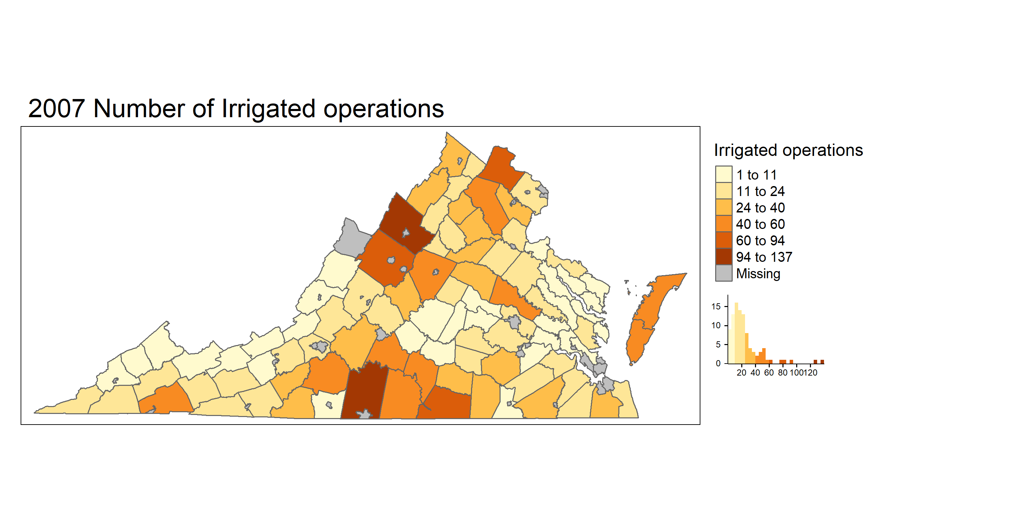
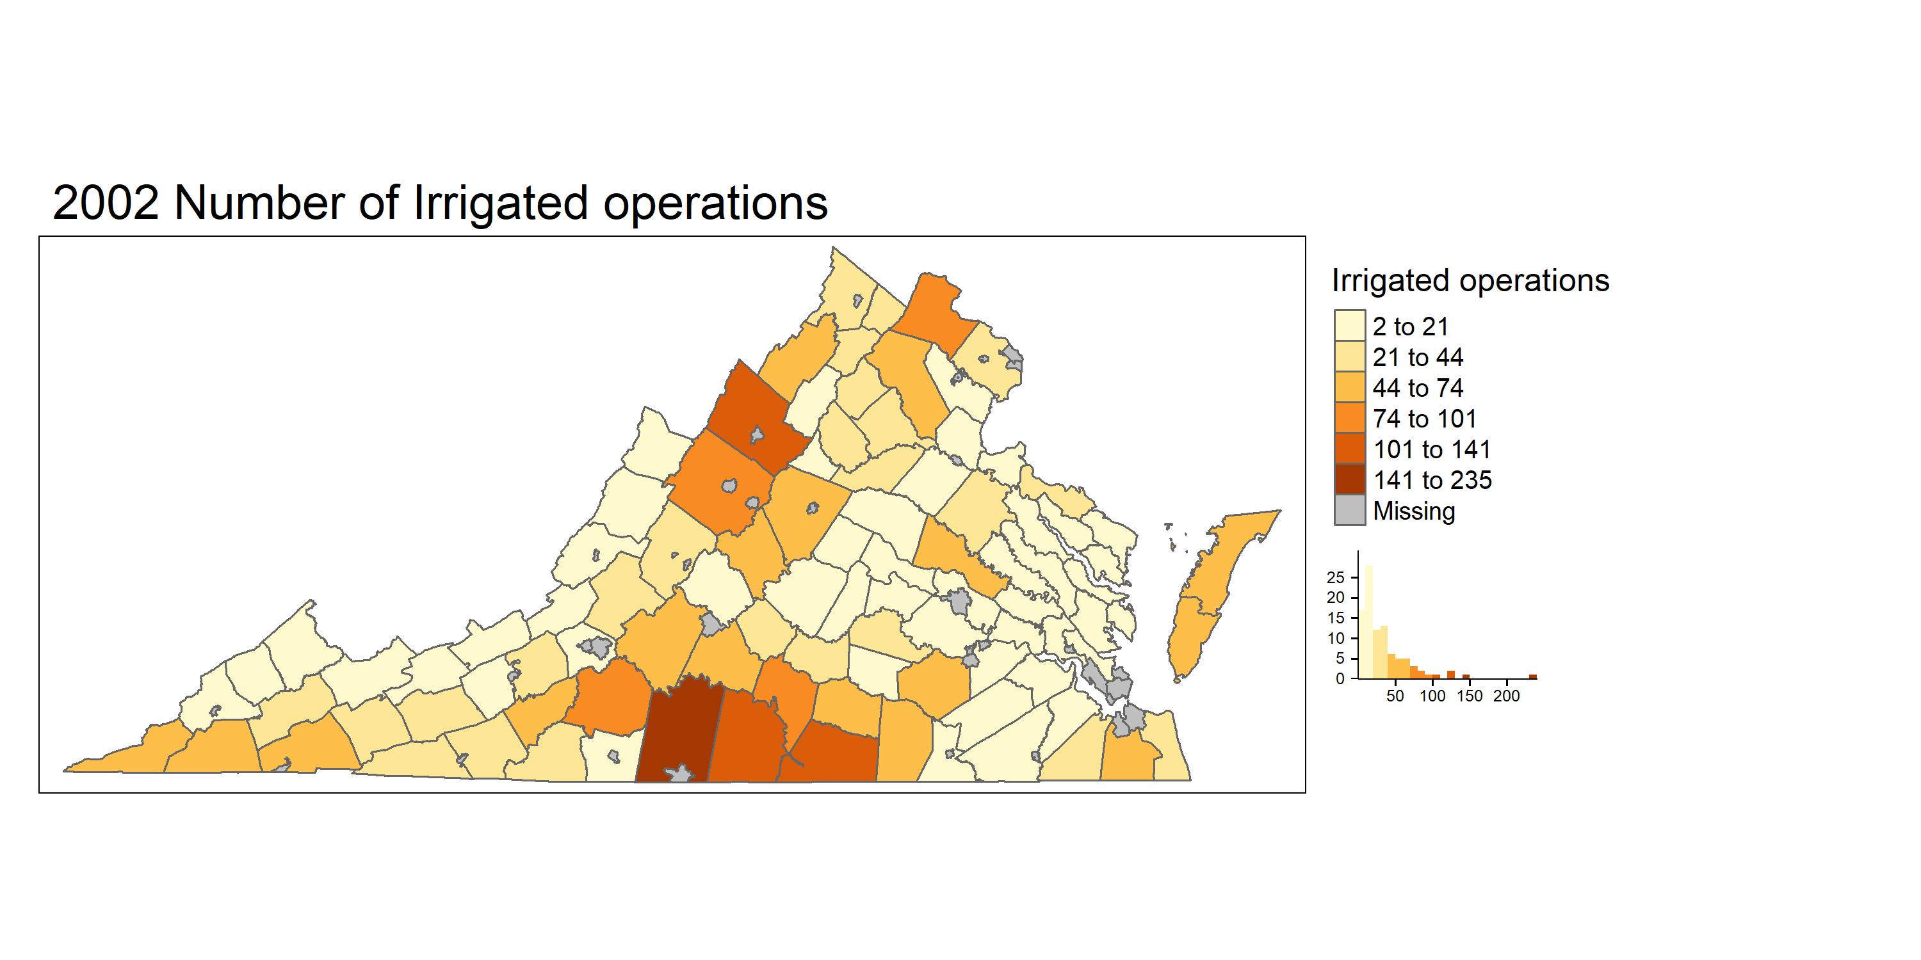
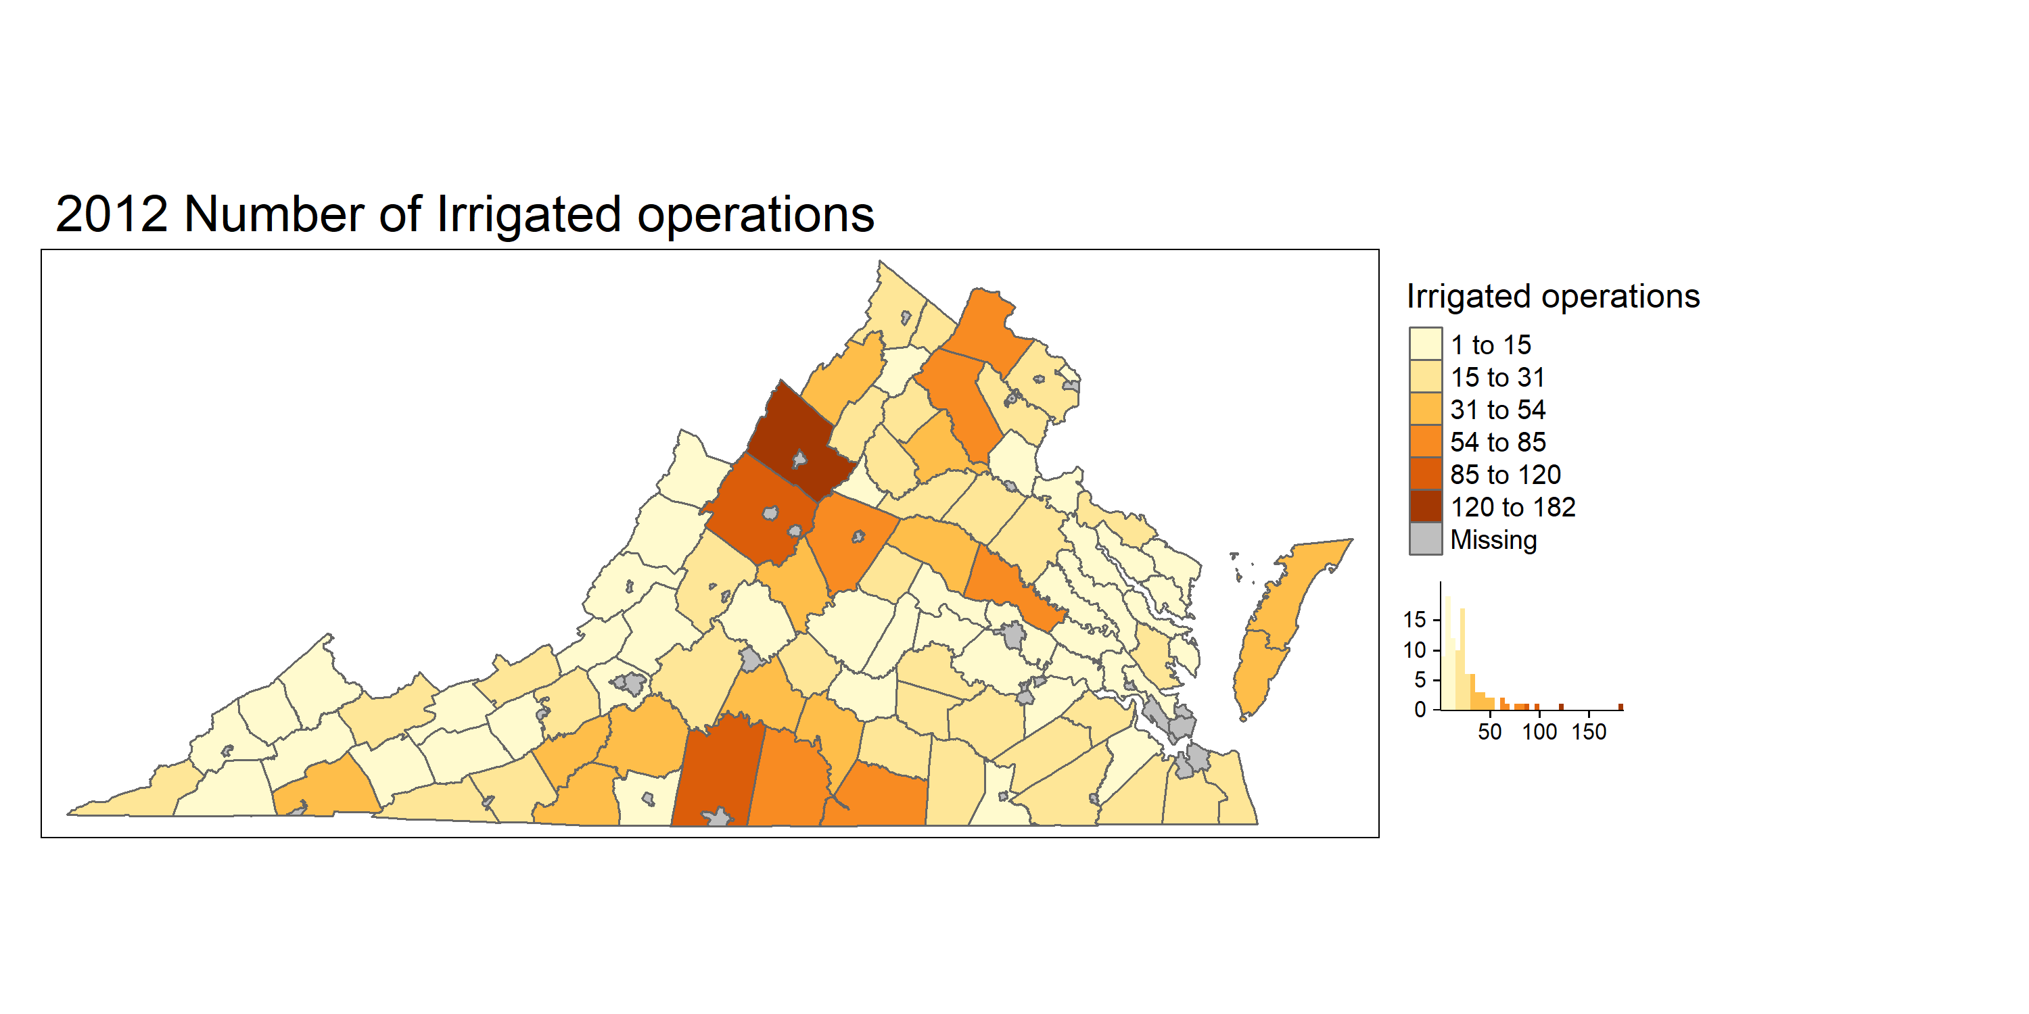
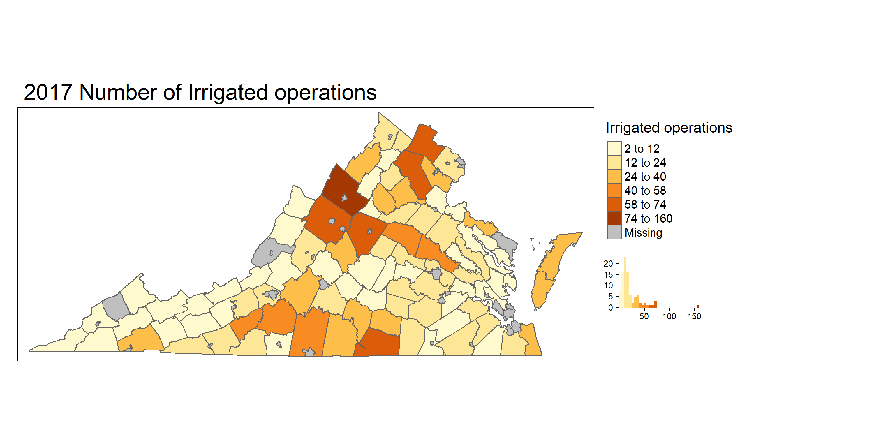
Irrigated Operations for different years
90 Counties : 3285 operations
87 Counties : 2296 operations
90 Counties : 2408 operations
85 Counties : 2003 operations
Notes:
Irrigated operations were higher in 2002 . May be due to previous drought years ?
2002 PITTSYLVANIA 235 , ROCKINGHAM 141, HALIFAX 126, MECKLENBURG 123, AUGUSTA 101
2007 : ROCKINGHAM 137 , PITTSYLVANIA 127, AUGUSTA 94, MECKLENBURG 81, LOUDOUN 76
2012: ROCKINGHAM 182 PITTSYLVANIA 120 AUGUSTA 95 HALIFAX 85 HANOVER 81
2017: ROCKINGHAM 160 MECKLENBURG 74 LOUDOUN 74 FAUQUIER 71 ALBEMARLE 67
PITTSYLVANIA had most reduction in number of operations

Slide 7
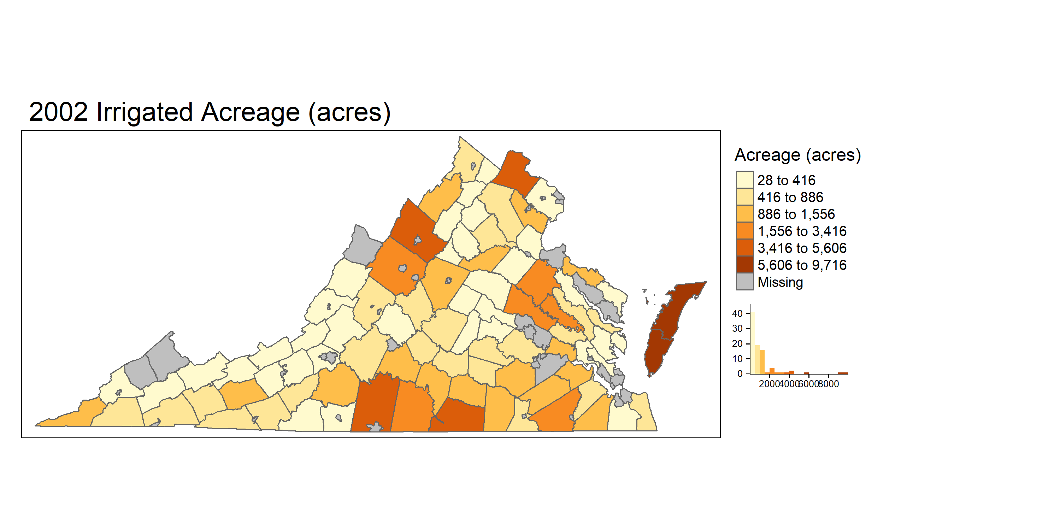
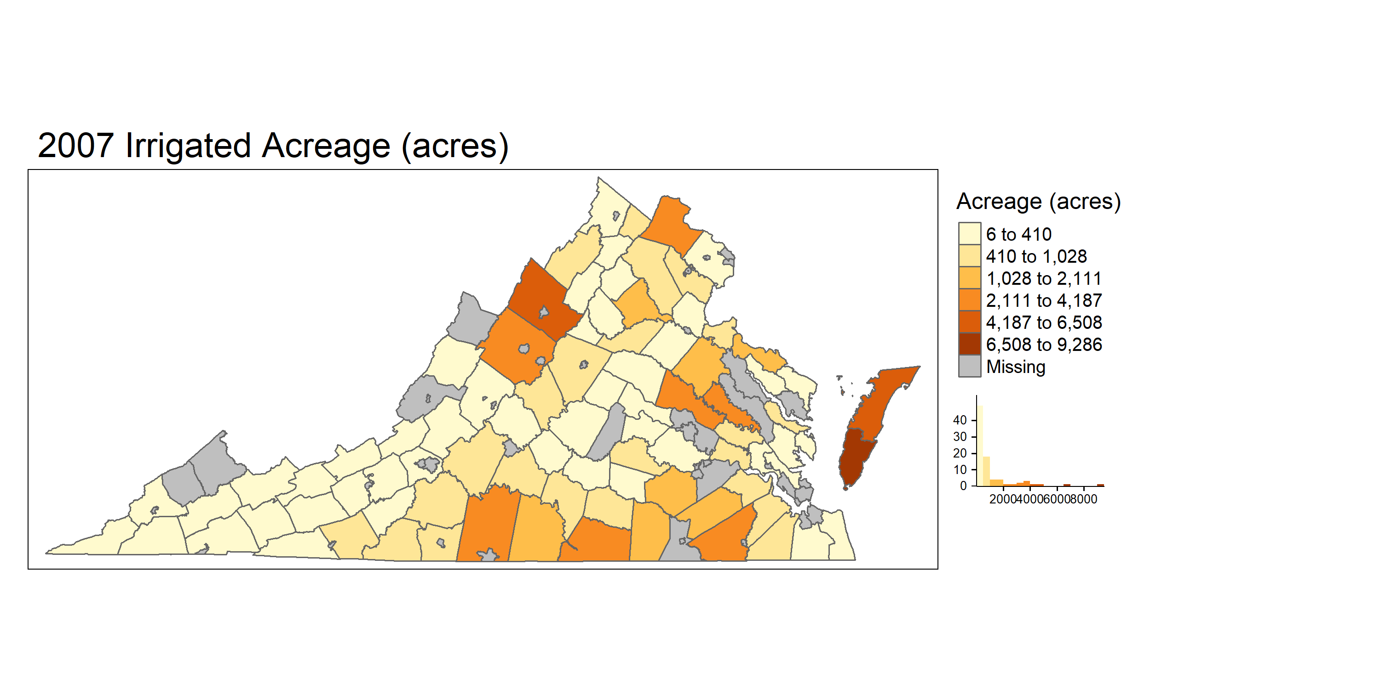
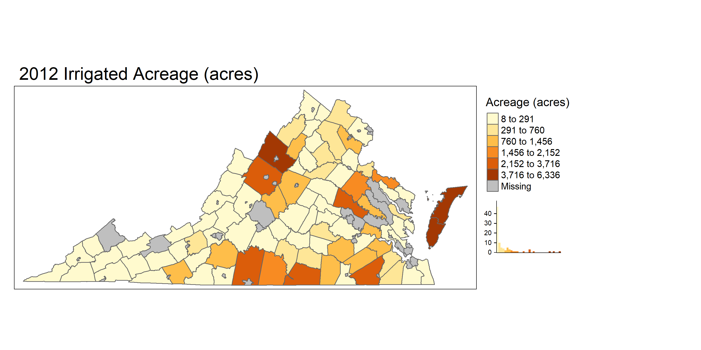
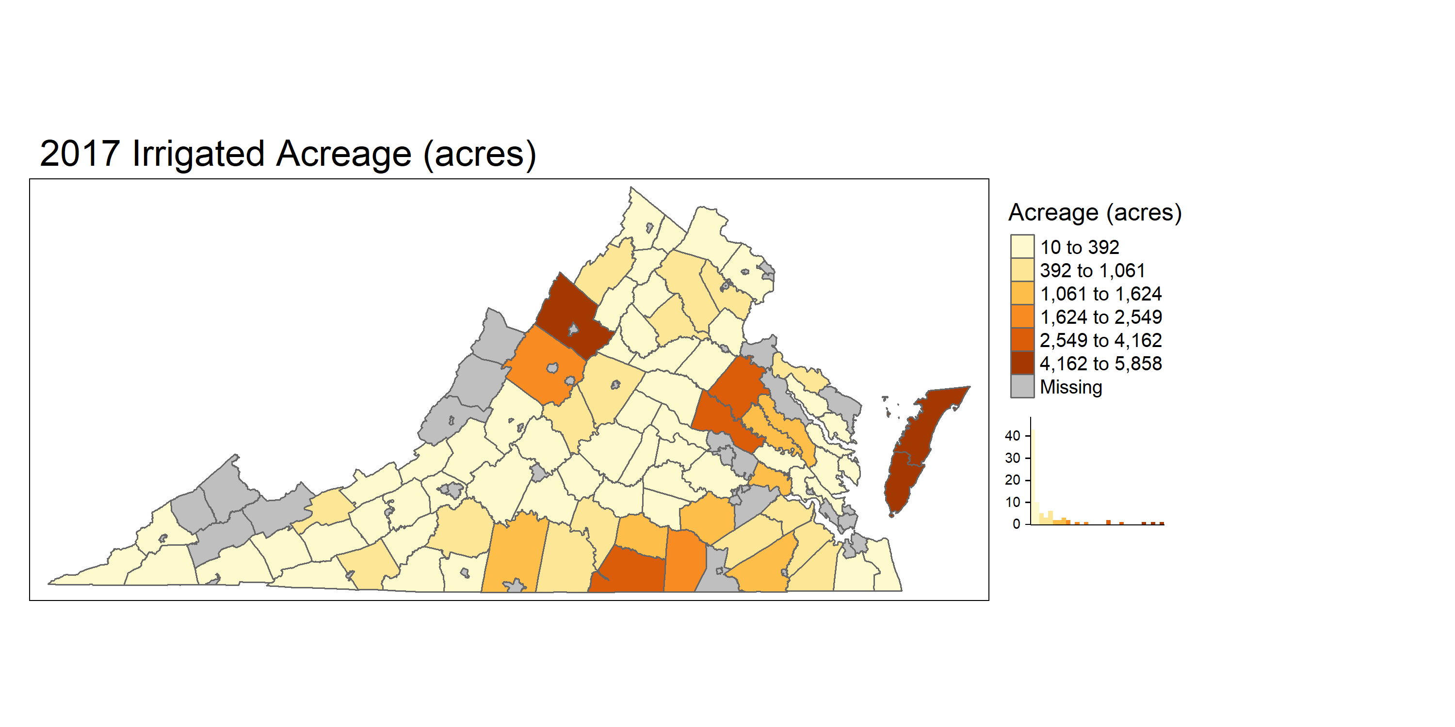
Irrigated Acreage for different years
90 Counties: 97309 acreage
87 Counties : 78925 acreage
90 Counties : 64577 acreage
85 Counties : 60125 acreage
Notes:
Similar to operations Irrigated acreage ad same trend
2002: ACCOMACK 9716 NORTHAMPTON 9338 PITTSYLVANIA 5606 ROCKINGHAM 4355 MECKLENBURG 4158 LOUDOUN 3666
2007: NORTHAMPTON 9286 ACCOMACK 6508 ROCKINGHAM 4808 PITTSYLVANIA 4187 AUGUSTA 3813
2012: NORTHAMPTON 6336 ROCKINGHAM 5645 ACCOMACK 5370 PITTSYLVANIA 3716 HANOVER 3338
2017: NORTHAMPTON 5858 ROCKINGHAM 5526 ACCOMACK 5078 MECKLENBURG 4162 HANOVER 3570 (Most reduction Acomack, northampton Pitts and loudon 1492 and 392 in 2017)

Slide 8
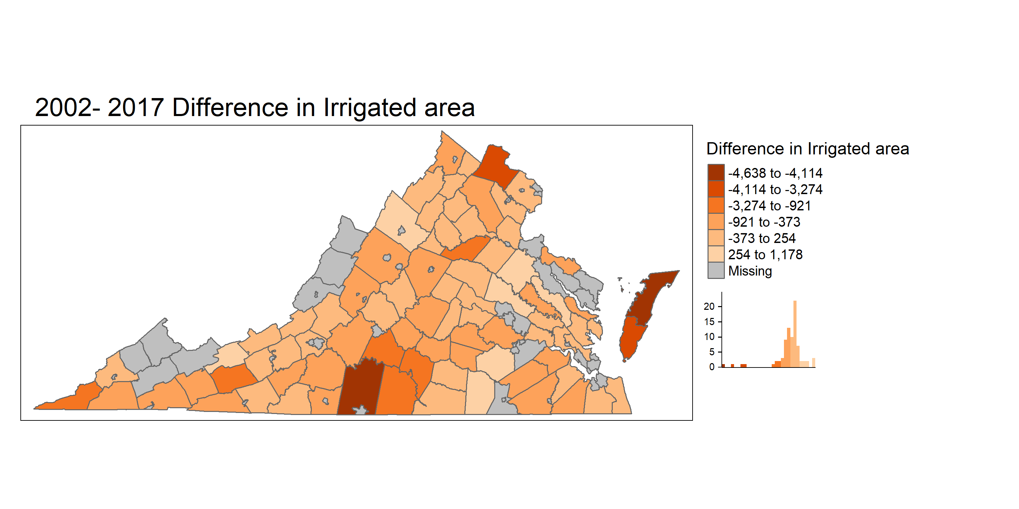
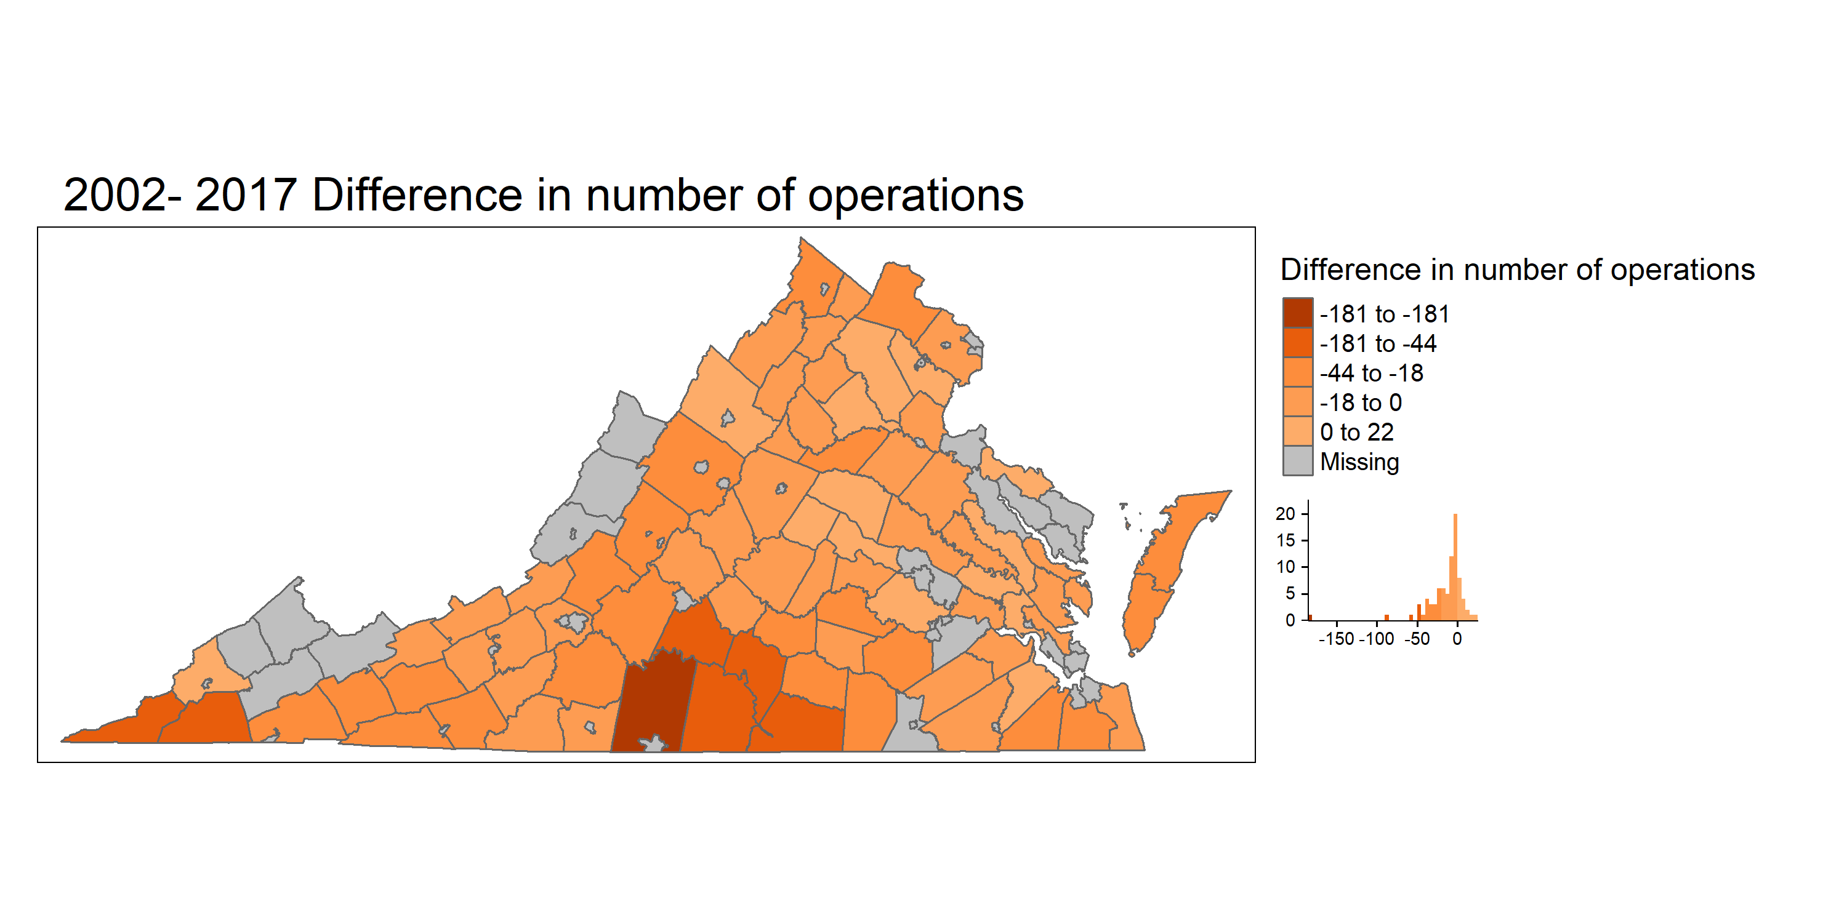
Difference between 2002 and 2017
Notes:
Acreage decrease: ACCOMACK -4638 PITTSYLVANIA -4114 NORTHAMPTON -3480 LOUDOUN -3274 HALIFAX -1556
Acreage Increase : HANOVER 1178 ROCKINGHAM 1171 CAROLINE 1139 BLAND 666 BRUNSWICK 640
Operation increase: LOUISA 22 ROCKINGHAM 19 PRINCE WILLIAM 11 ISLE OF WIGHT 10 FAUQUIER 8
Operation decrease: PITTSYLVANIA -181 HALIFAX -86 SCOTT -60 LEE -50 MECKLENBURG -49

Slide 9
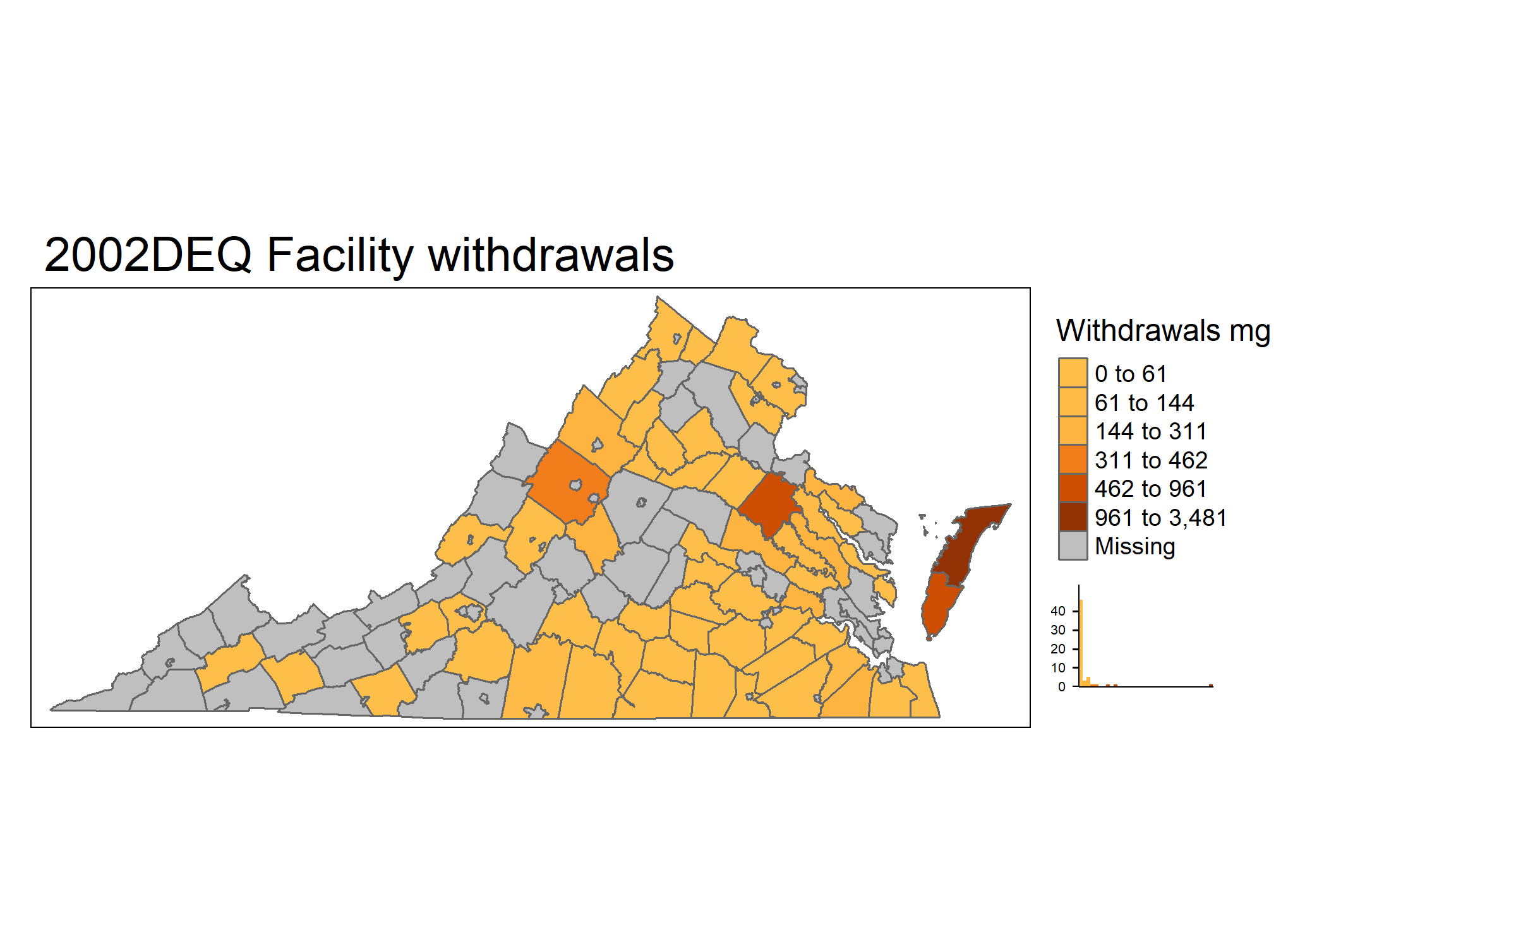
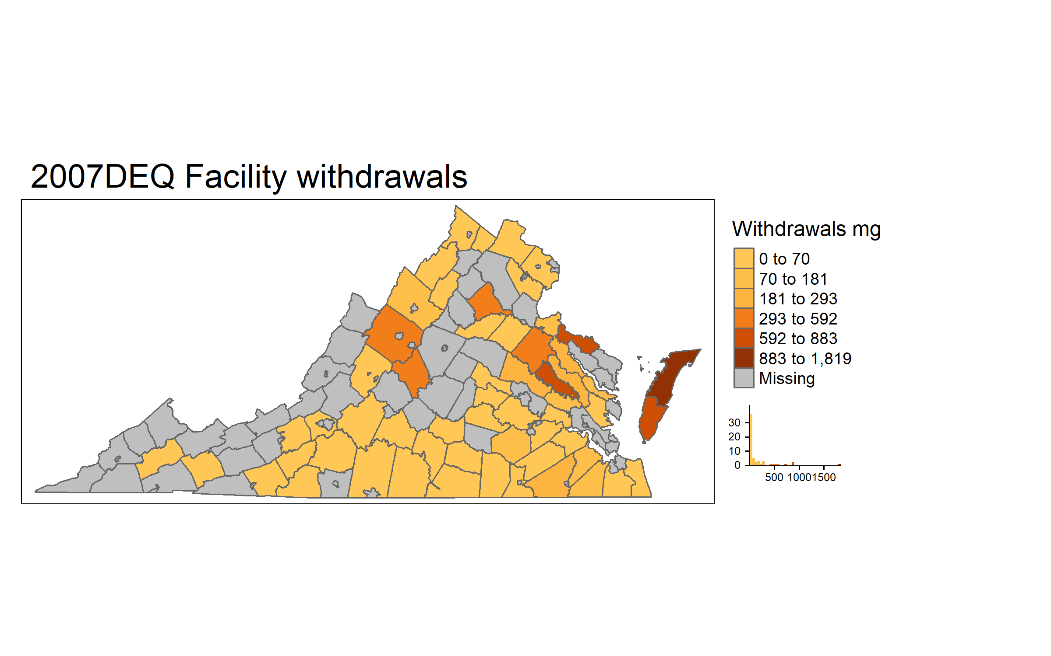
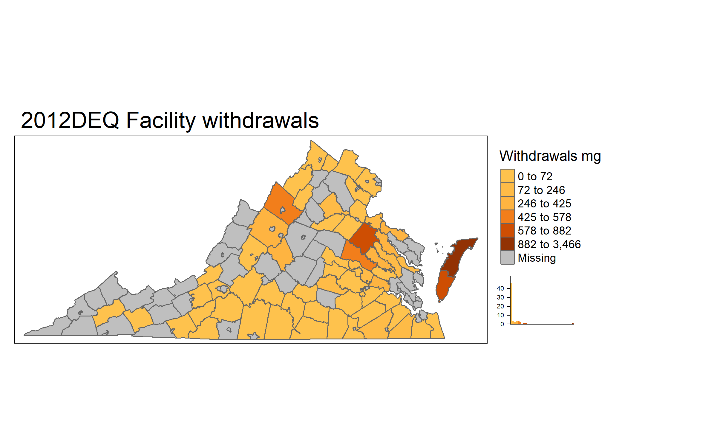
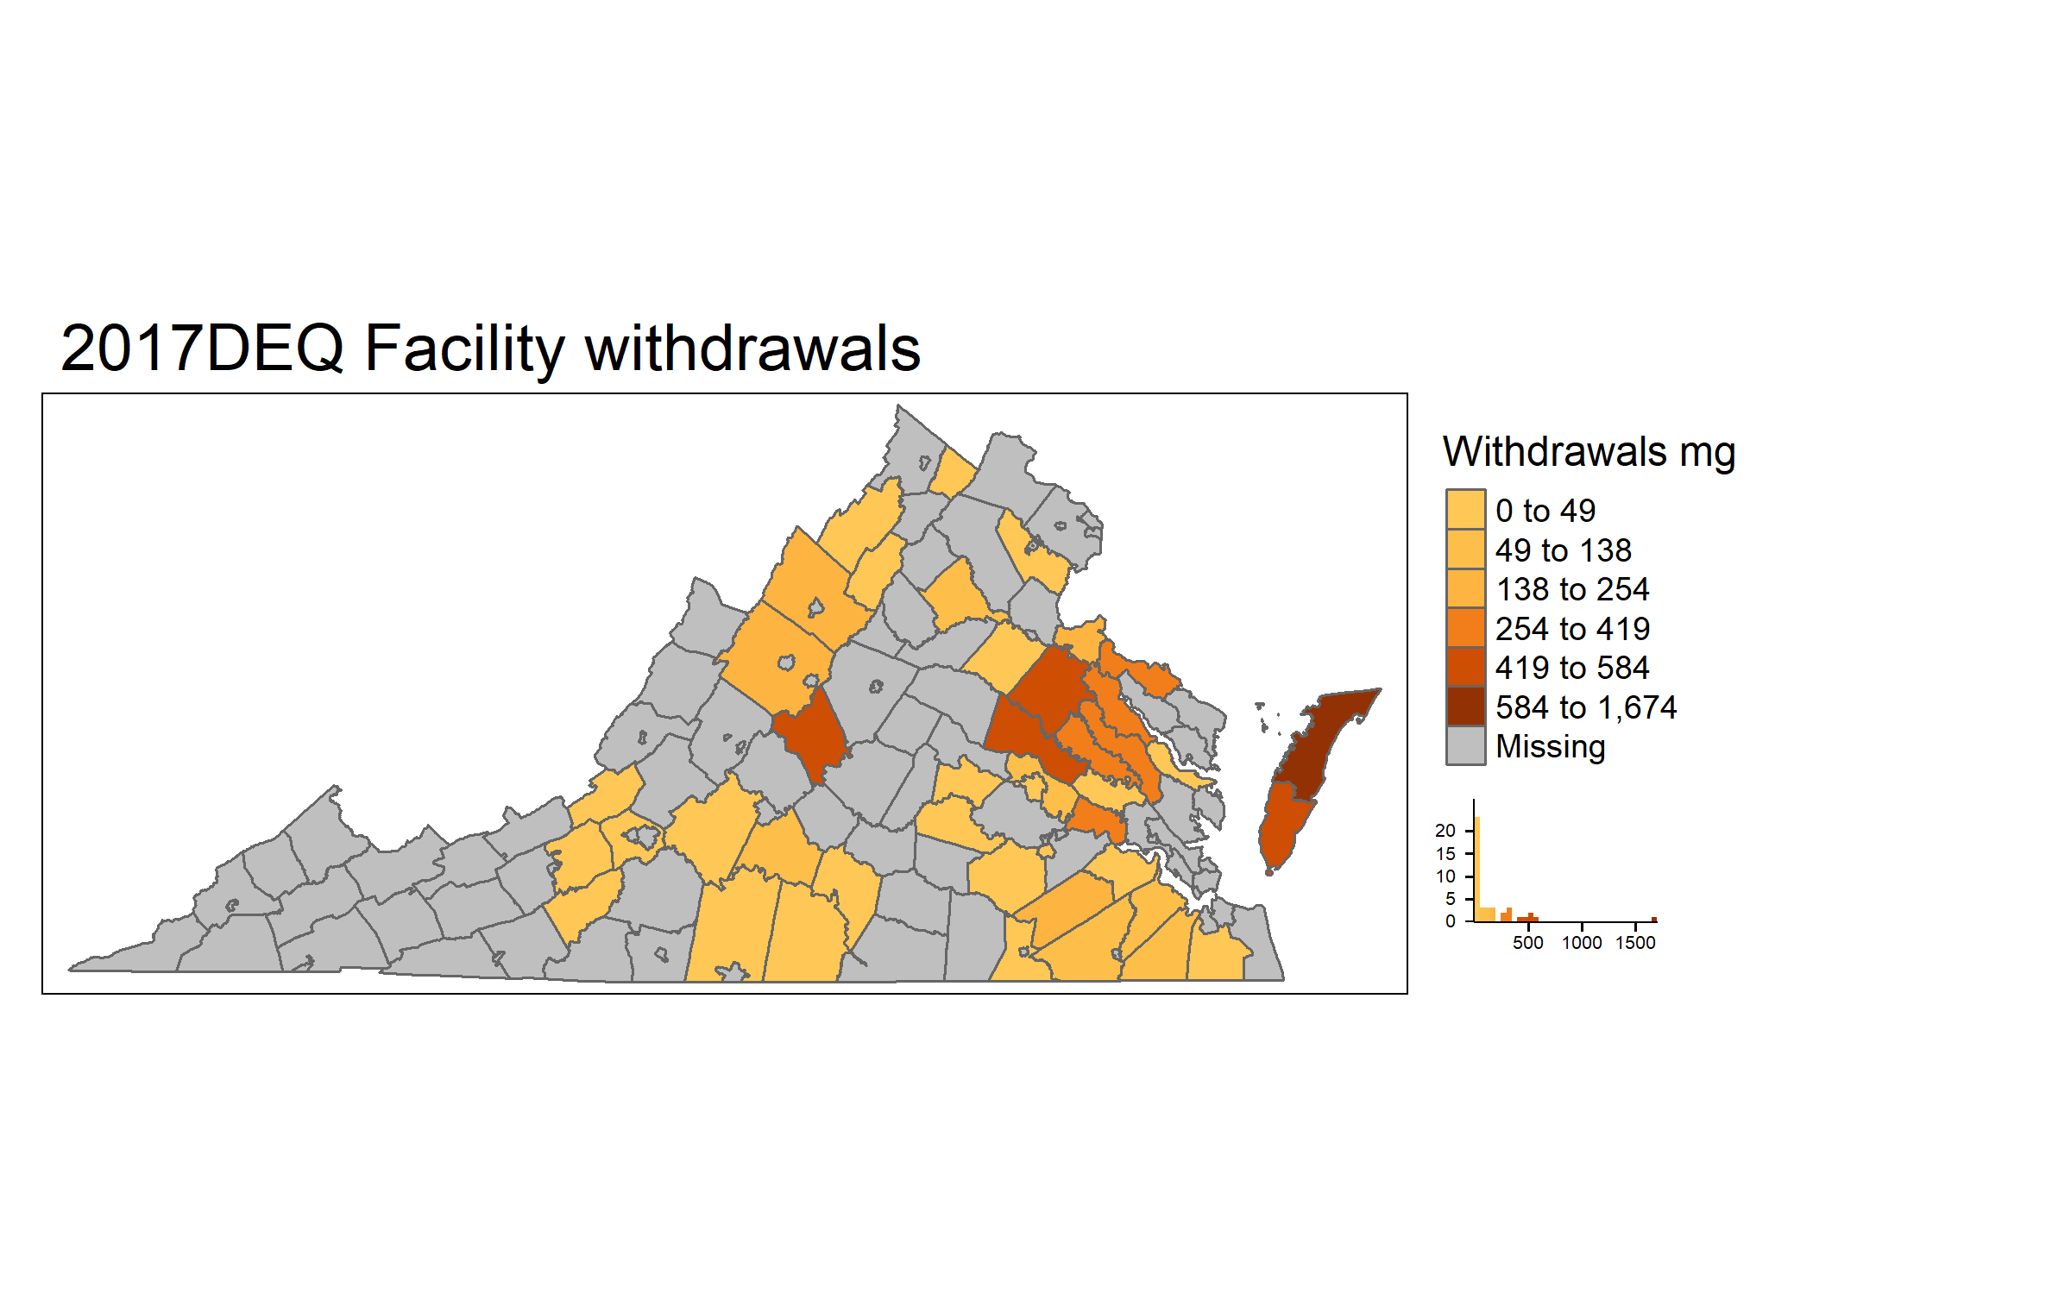
DEQ withdrawals
59 Counties: 8550 mg
58 Counties: 8994 mg
62 Counties: 10382 mg
43 Counties: 7322 mg
Notes:
2002: Accomack County 3480.674 Caroline County 960.526 )6th spot in census) Northampton County 742.087 Augusta County 461.554 Westmoreland County 311.381 (low in census)
2007: Accomack County 1819.128 Northampton County 882.5956 Westmoreland County 863.926 King William County 702.694 Augusta County 592.1592
2012: Accomack County 3465.538 Northampton County 881.5341 Caroline County 792.39 Rockingham County 578.196 Hanover County 560.29
2017:Accomack County 1673.848 Hanover County 583.8264 Caroline County 543.92 Northampton County 509.6057 Nelson County 474.32

Slide 10
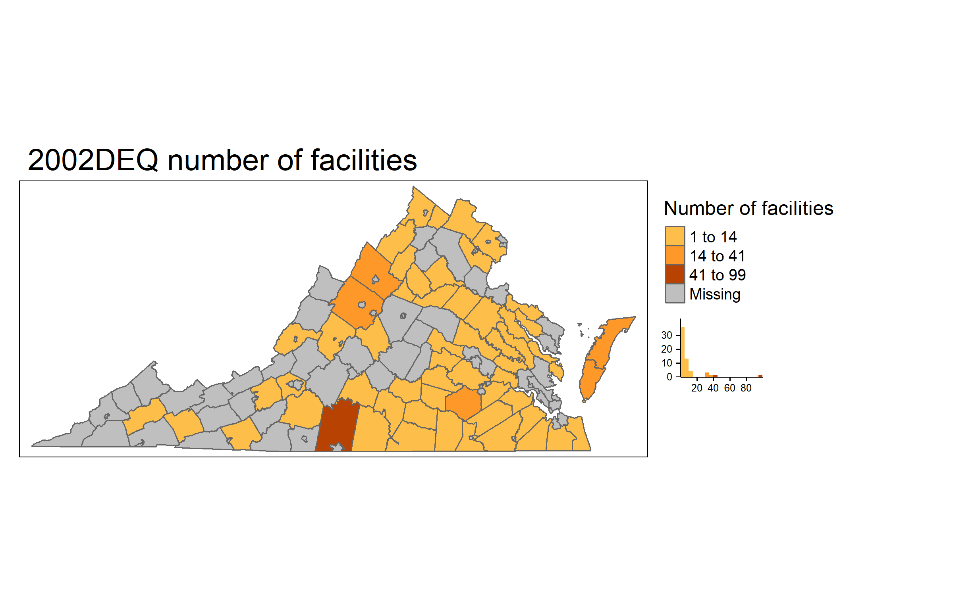
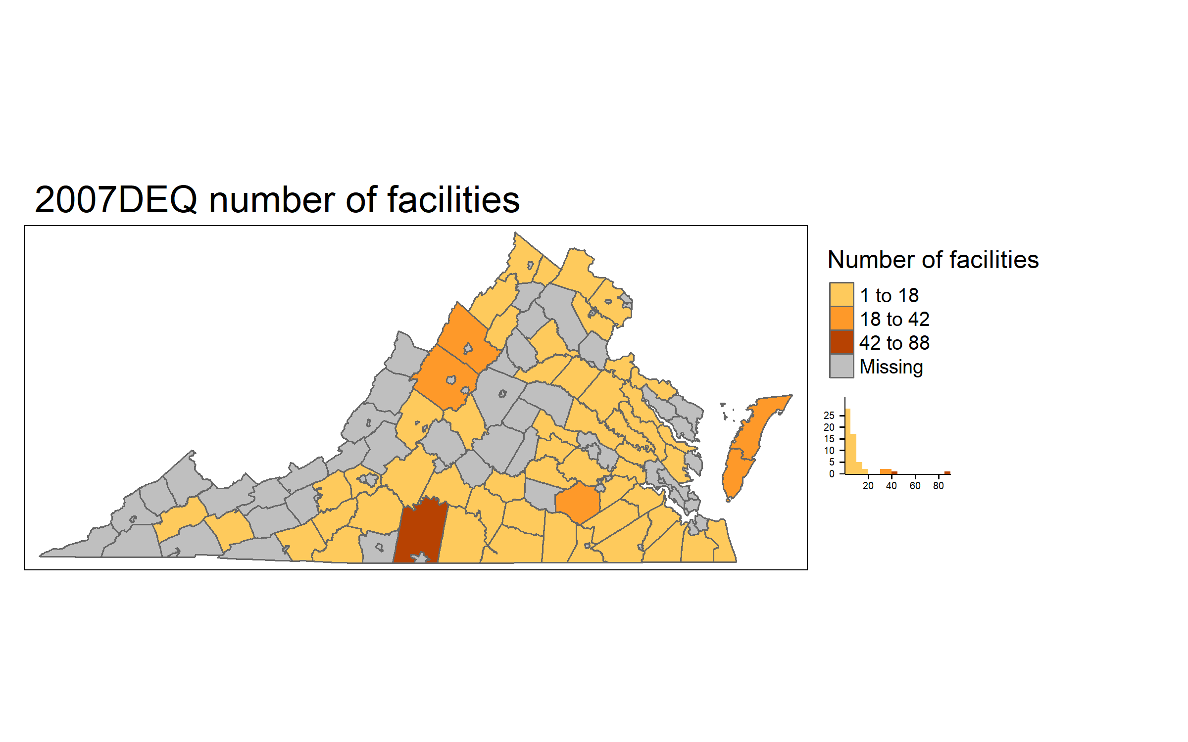
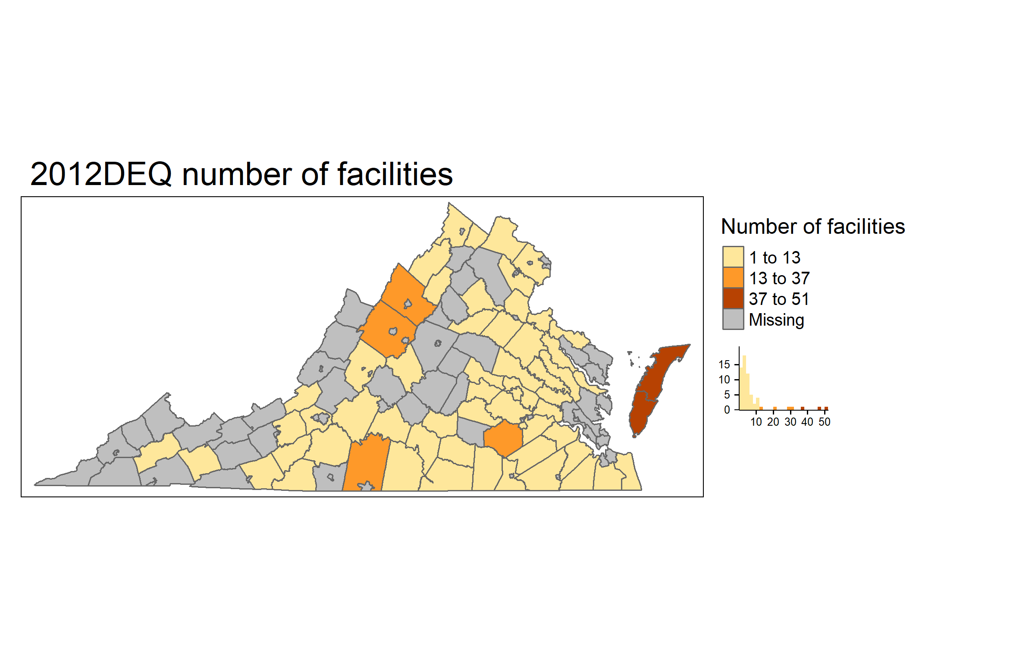

DEQ number of Facilities
59 Counties: 528 facilities
59 Counties: 493 facilities
62 Counties: 423 facilities
43 Counties: 117 facilities

Slide 11
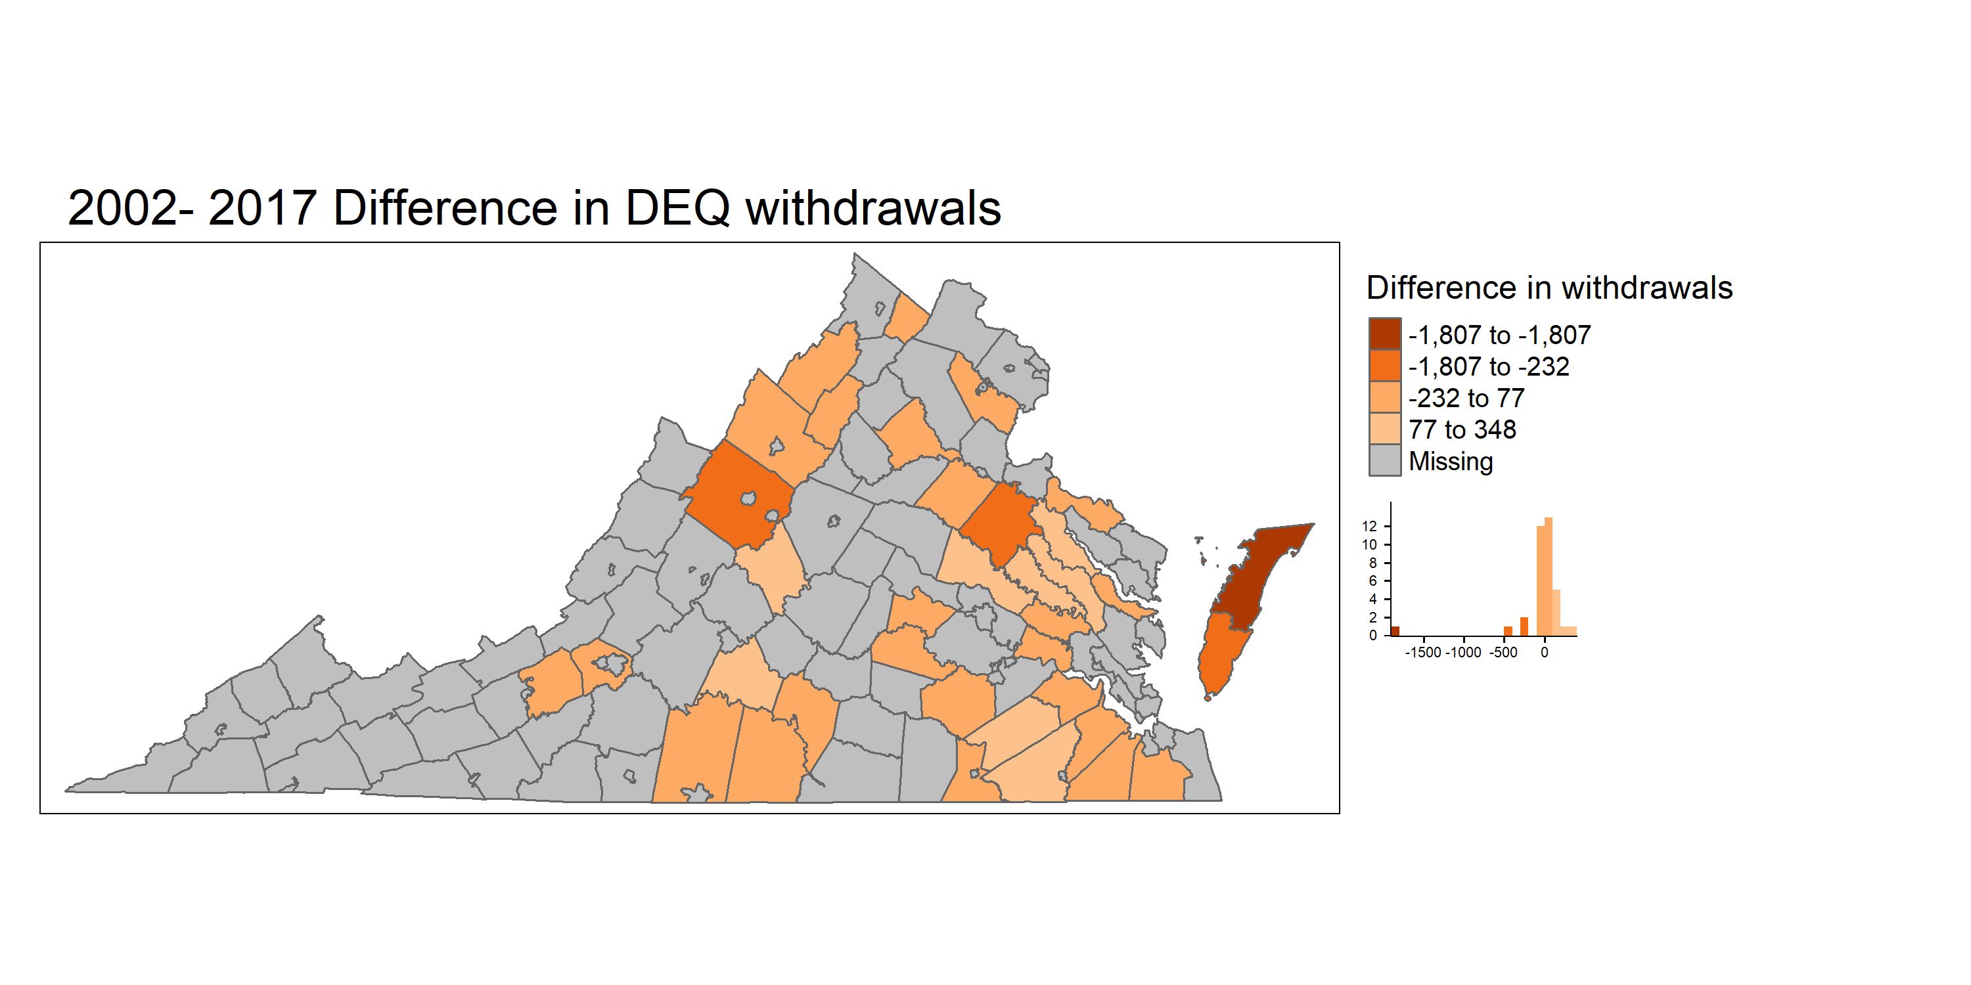
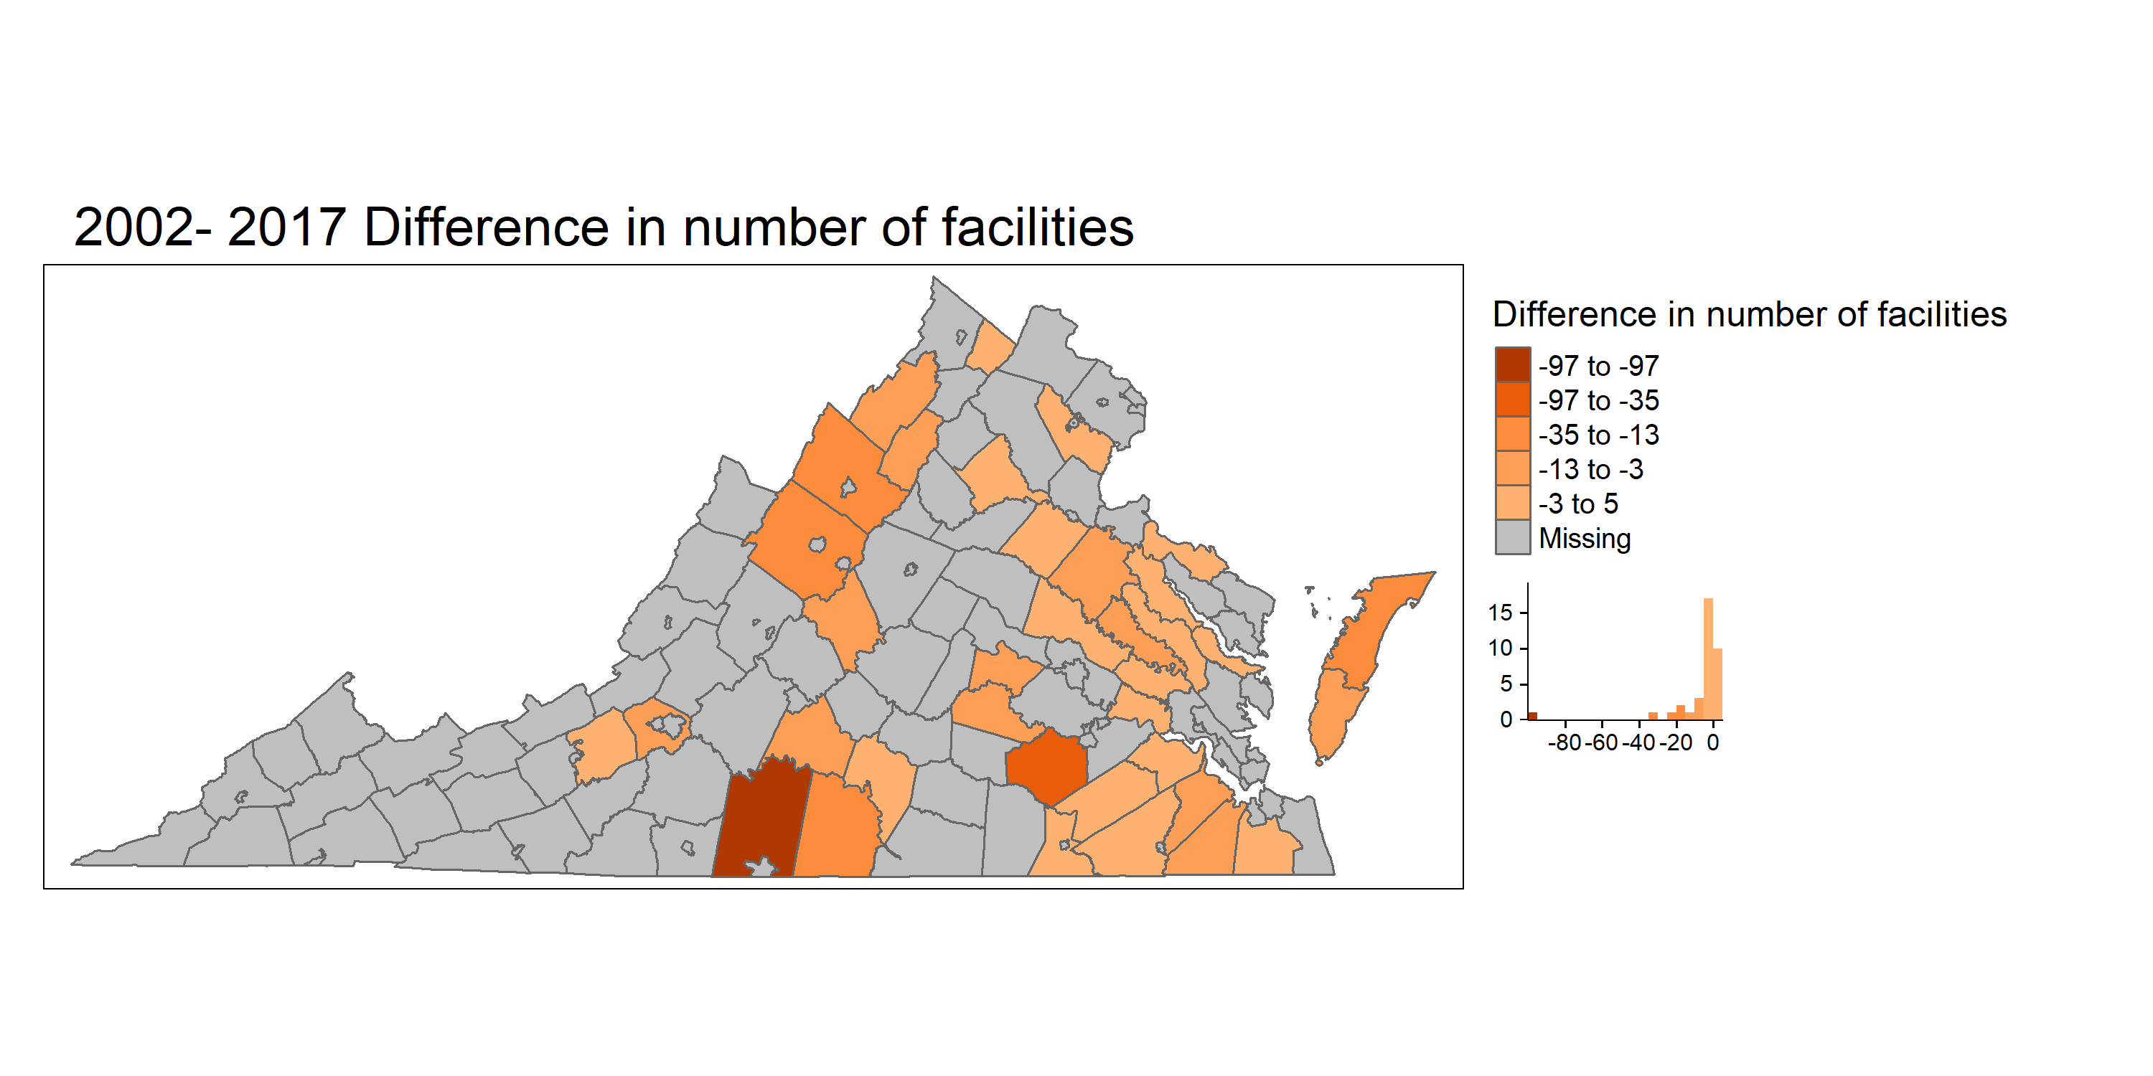
Difference between 2002 and 2017 - DEQ
Notes:
Withdrawal dec : Accomack County -1806.83 Caroline County -416.606 Augusta County -285.894 Northampton County -232.481 Suffolk city -96.69
Withrawal inc: Hanover County 347.7807 Nelson County 282.19 Essex County 200 King and Queen County 161.7788 Sussex County 156.764 King William County 141.881
Facilities Pittsylvania County -97 Dinwiddie County -35 Augusta County -23 Rockingham County -17 Accomack County -16
Hanover County 5 Southampton County 3 Charles City County 2 Prince William County 2 Sussex County 1

Slide 12
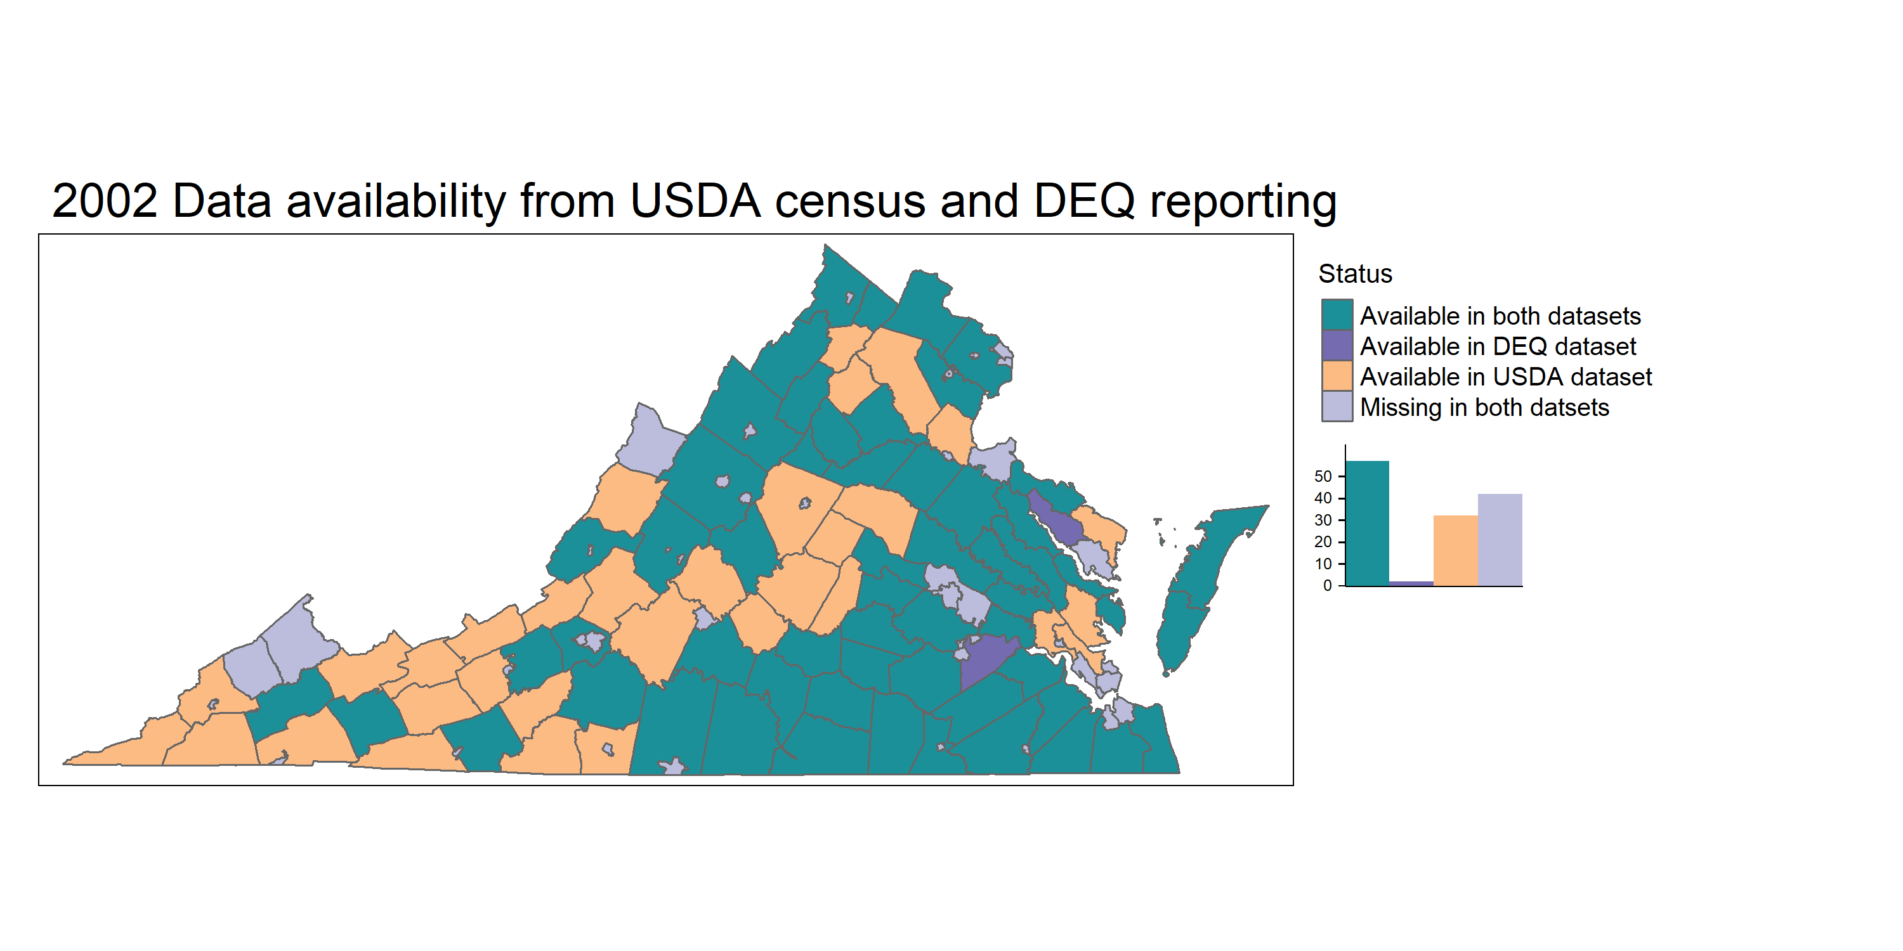
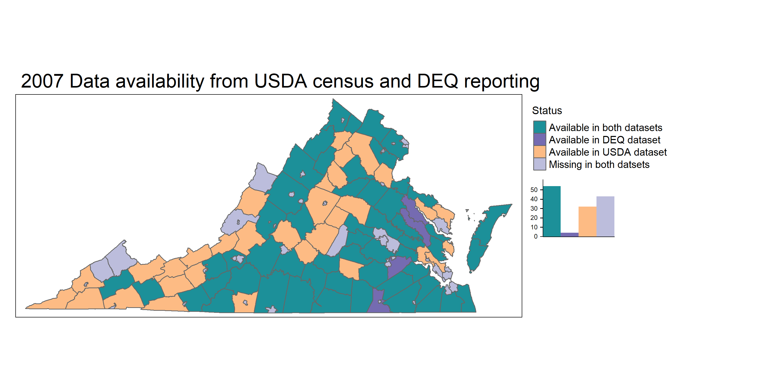
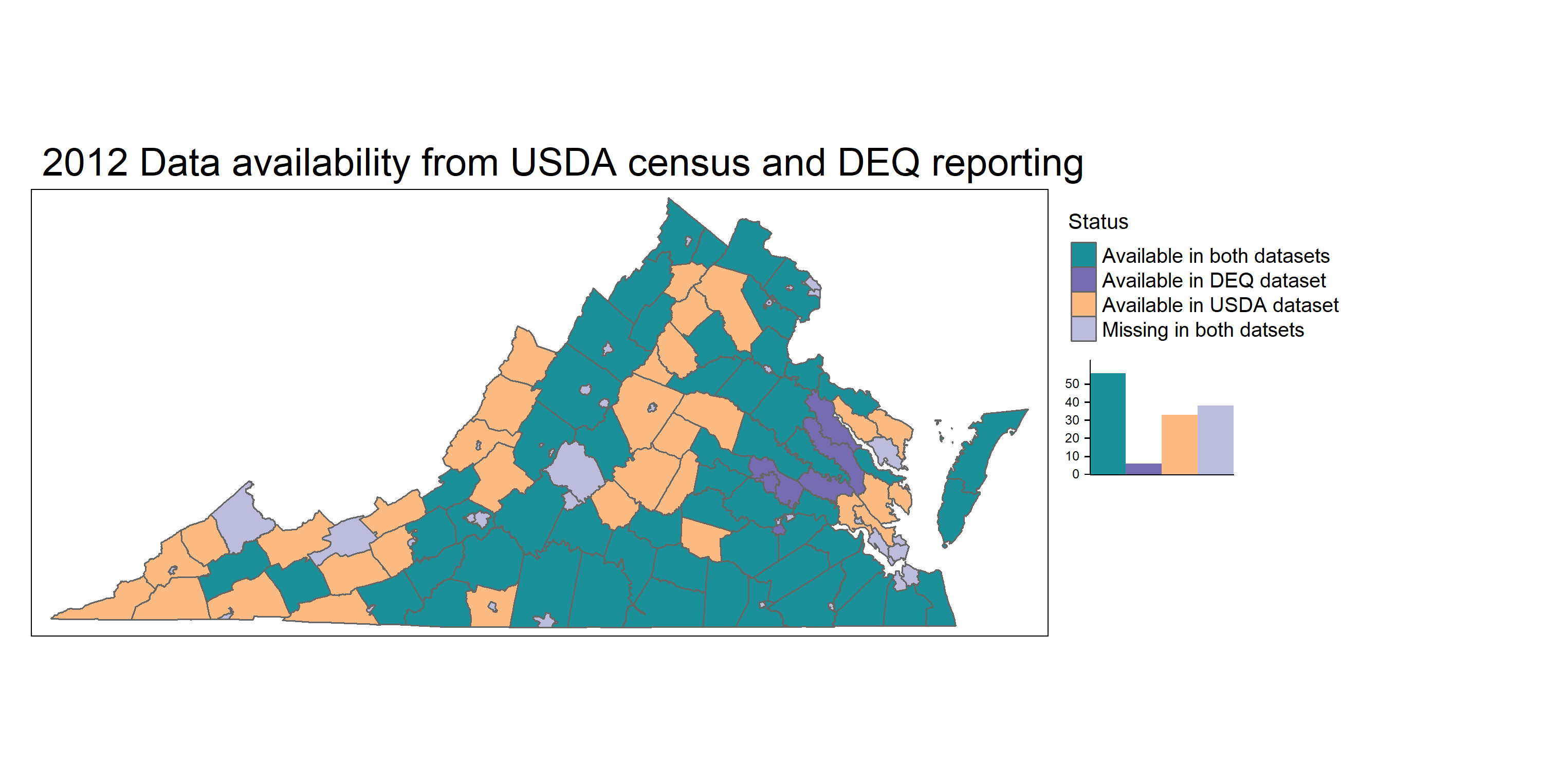
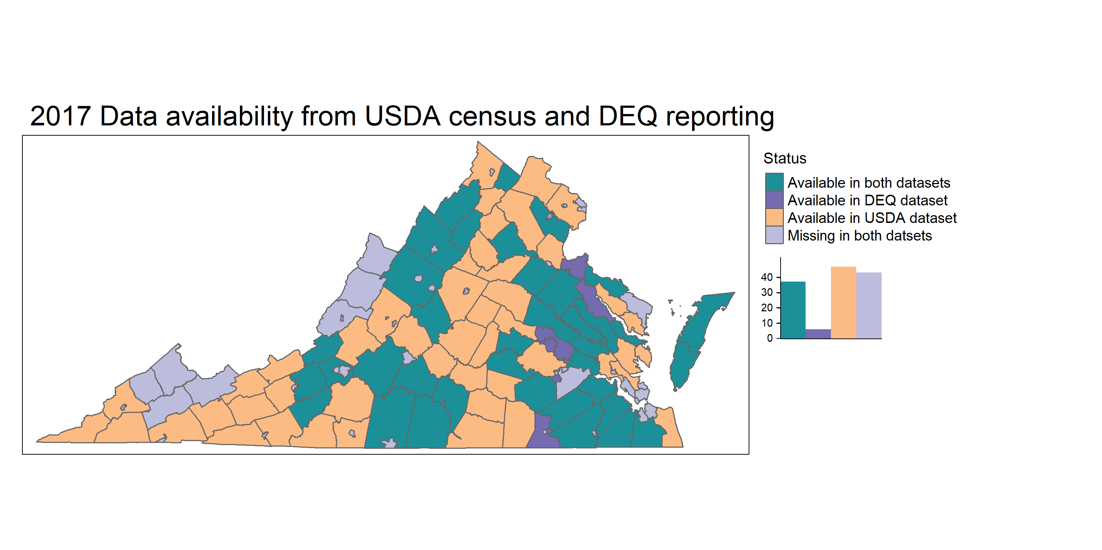
Data availability in both datasets from 2002 to 2017
57 Counties
54 Counties
56 counties
37 counties

Slide 13
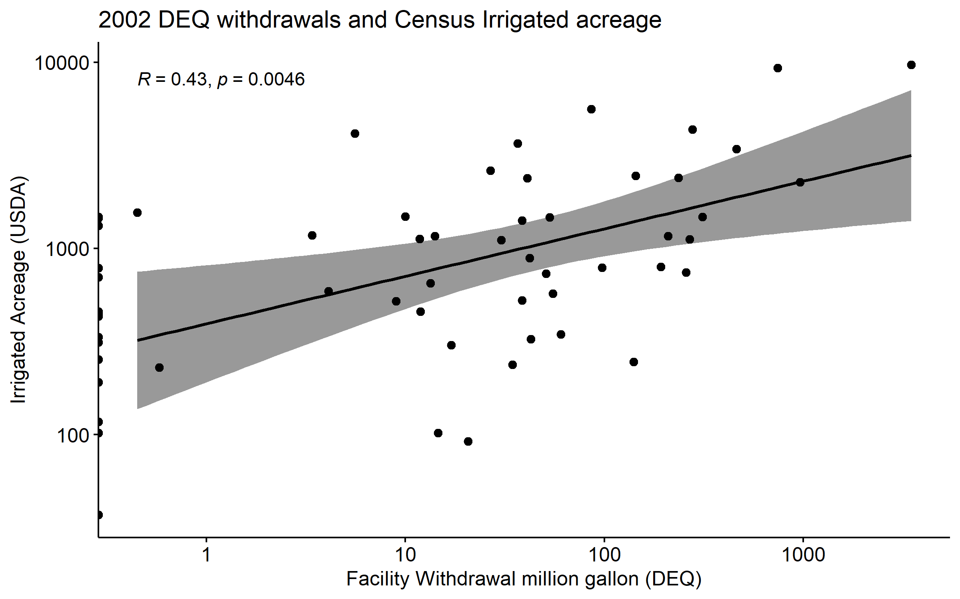
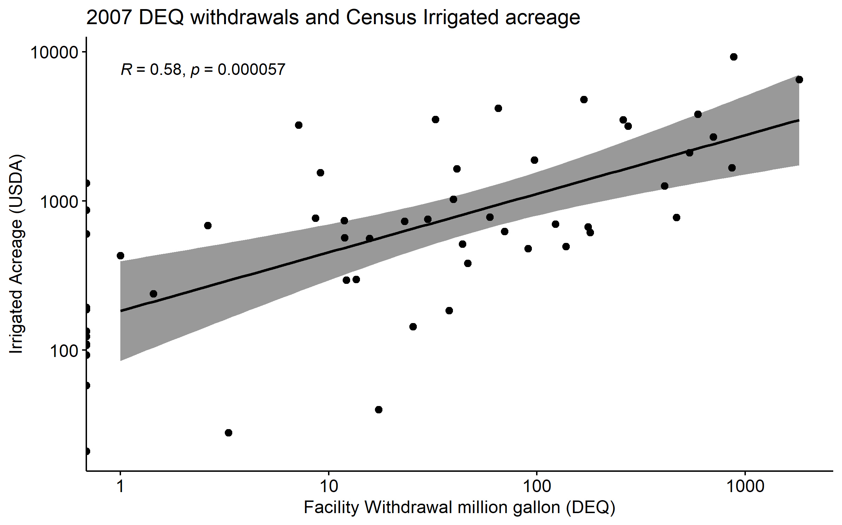
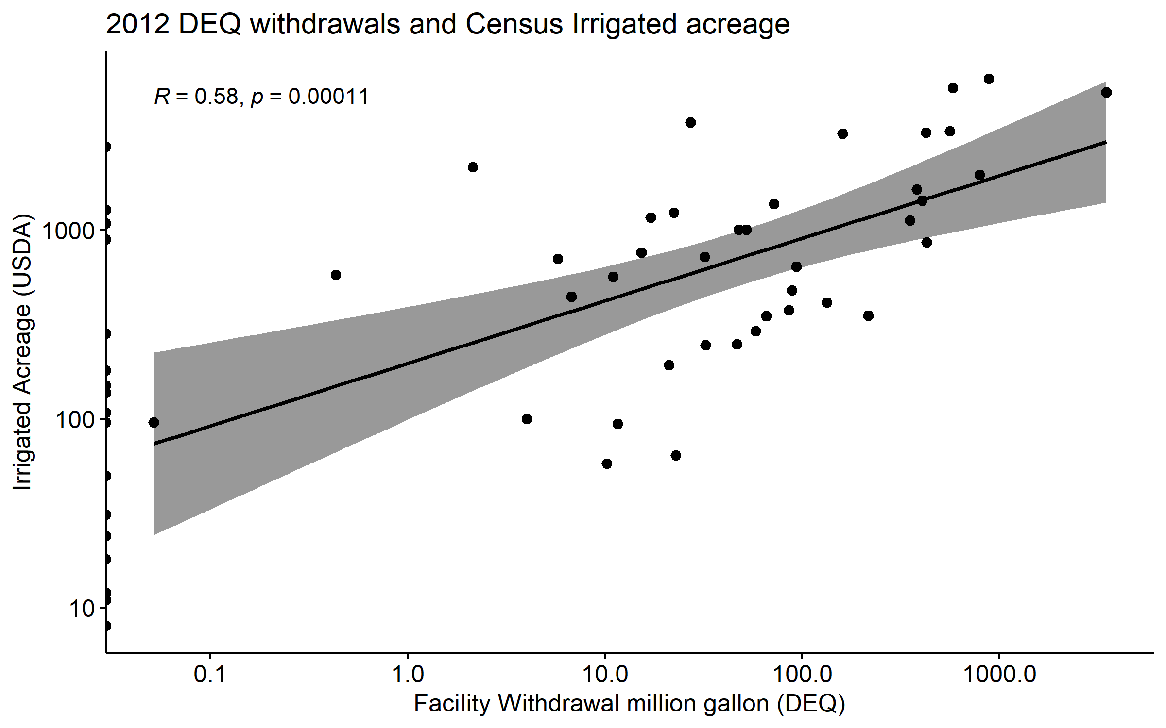
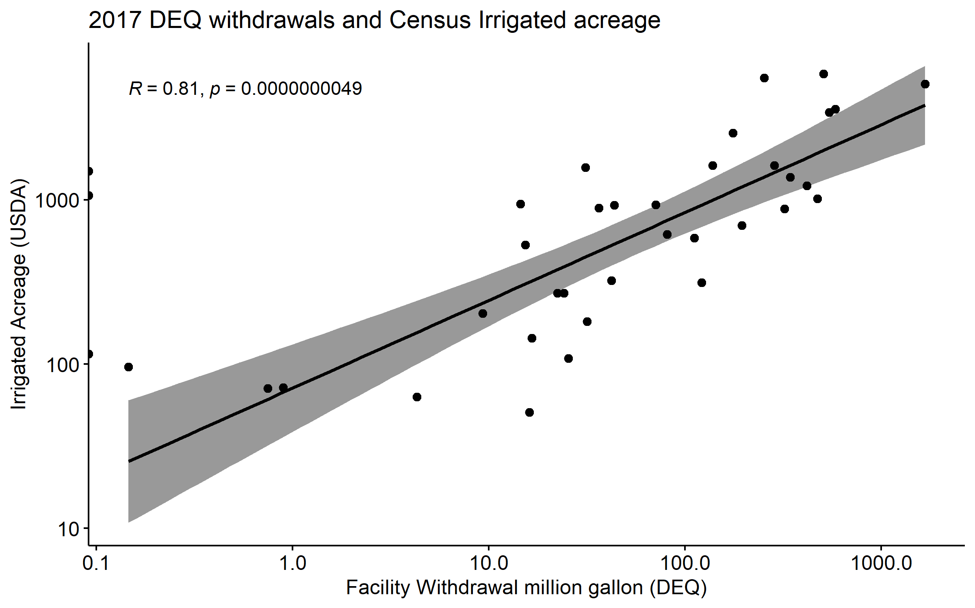

Slide 14
