Slide 1
WUDR Update
19th April

Slide 2







Outline
Get census and DEQ 2002-2017
Data availability summary (Correlation and rank difference)
In census data substitute and rescale D values
Calculation of area under threshold
Review of Census and DEQ data for all census years

Slide 3
Census Data
ACCOMACK | Irrigated Acreage | No of operations
AREA OPERATED: (1.0 TO 9.9 ACRES) | 29 | 9
AREA OPERATED: (10.0 TO 49.9 ACRES) | 25 | 7
AREA OPERATED: (50.0 TO 69.9 ACRES) | 82 | 4
AREA OPERATED: (70.0 TO 99.9 ACRES) | (D) | 1
AREA OPERATED: (100 TO 139 ACRES) | NA | NA
AREA OPERATED: (140 TO 179 ACRES) | NA | NA
AREA OPERATED: (180 TO 219 ACRES) | NA | NA
AREA OPERATED: (220 TO 259 ACRES) | (D) | 1
AREA OPERATED: (260 TO 499 ACRES) | 668 | 5
AREA OPERATED: (500 TO 999 ACRES) | (D) | 1
AREA OPERATED: (1,000 TO 1,999 ACRES) | (D) | 1
AREA OPERATED: (2,000 OR MORE ACRES) | 4,129 | 7
Census data on irrigated acreage and number of farms
Breakdown by farm size
Total in county

Slide 4
Census Data
County Summary
Irrigated Operations (Sum of No. of operations)
Irrigated Acreage (reported at county level)
COUNTY_NAME | Irrigated Operations | Irrigated Acreage | Size Bins | Operation Bins
ACCOMACK | 36 | 5078 | 5 | 9
ALBEMARLE | 67 | 783 | 6 | 12
AMELIA | 14 | 204 | 1 | 6
AMHERST | 12 | 175 | 1 | 7

Slide 5
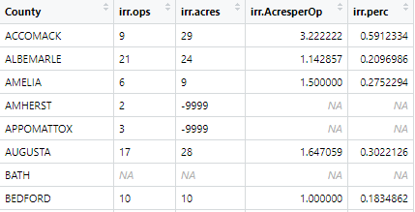
Fill “D” values
1.0 TO 9.9 Acre Size bin
Binned summary table
For each size bin calculate Irrigated Acres per operation and Irrigated percentage in all counties
Notes:
Binned data and county summary for a particular year.
Irrigated Acres per operation = Irr.acres / irrigated ops
Irri. Percetage =Irrigated Acres per operation /mean area of the size bin

Slide 6
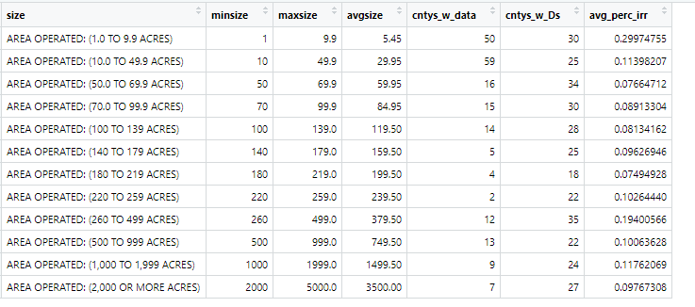
Fill “D” values
Binned summary table
All counties summary
All Counties
For each size bin calculate number of counties with and without D values and average Irrigated percentage in all counties
Notes:
average Irrigated percentage avreage of last column from previous table

Slide 7
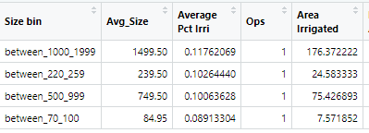
Fill “D” values
ACCOMACK | Irrigated Acreage | No of operations
AREA OPERATED: (1.0 TO 9.9 ACRES) | 29 | 9
AREA OPERATED: (10.0 TO 49.9 ACRES) | 25 | 7
AREA OPERATED: (50.0 TO 69.9 ACRES) | 82 | 4
AREA OPERATED: (70.0 TO 99.9 ACRES) | (D) | 1
AREA OPERATED: (100 TO 139 ACRES) | NA | NA
AREA OPERATED: (140 TO 179 ACRES) | NA | NA
AREA OPERATED: (180 TO 219 ACRES) | NA | NA
AREA OPERATED: (220 TO 259 ACRES) | (D) | 1
AREA OPERATED: (260 TO 499 ACRES) | 668 | 5
AREA OPERATED: (500 TO 999 ACRES) | (D) | 1
AREA OPERATED: (1,000 TO 1,999 ACRES) | (D) | 1
AREA OPERATED: (2,000 OR MORE ACRES) | 4,129 | 7
ACCOMACK
The
Notes:
We know avregae irirgigaed are ain the size bin from other counties with data available

Slide 8
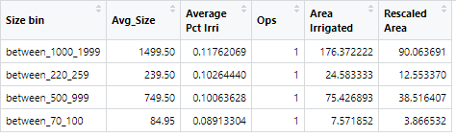
Fill “D” values
ACCOMACK | Irrigated Acreage | No of operations
AREA OPERATED: (1.0 TO 9.9 ACRES) | 29 | 9
AREA OPERATED: (10.0 TO 49.9 ACRES) | 25 | 7
AREA OPERATED: (50.0 TO 69.9 ACRES) | 82 | 4
AREA OPERATED: (70.0 TO 99.9 ACRES) | (D) | 1
AREA OPERATED: (100 TO 139 ACRES) | NA | NA
AREA OPERATED: (140 TO 179 ACRES) | NA | NA
AREA OPERATED: (180 TO 219 ACRES) | NA | NA
AREA OPERATED: (220 TO 259 ACRES) | (D) | 1
AREA OPERATED: (260 TO 499 ACRES) | 668 | 5
AREA OPERATED: (500 TO 999 ACRES) | (D) | 1
AREA OPERATED: (1,000 TO 1,999 ACRES) | (D) | 1
AREA OPERATED: (2,000 OR MORE ACRES) | 4,129 | 7
County Summary
COUNTY_NAME | Irrigated Operations | Irrigated Acreage | Size Bins | Operation Bins
ACCOMACK | 36 | 5078 | 5 | 9
4 “D” values have sum of 145 acres
SUM = 4933
Notes:
This process was repeated for all the counties

Slide 9
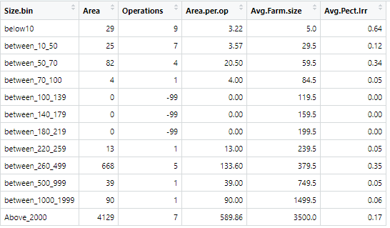
Calculation of area under threshold
Get the D filled binned dataset for all counties
Assign a threshold (10 acres)
Area.per.operation is under threshold
Make necessary calculations
D filled binned dataset (Accomack)
Irrigated area under TH : 58 acres
Irrigated area above TH: Remaining
Percentage under TH of Total Area
Percentage under TH of Area above TH
Notes:
Threshold Is the assumed area below which irrigation is under reported

Slide 10
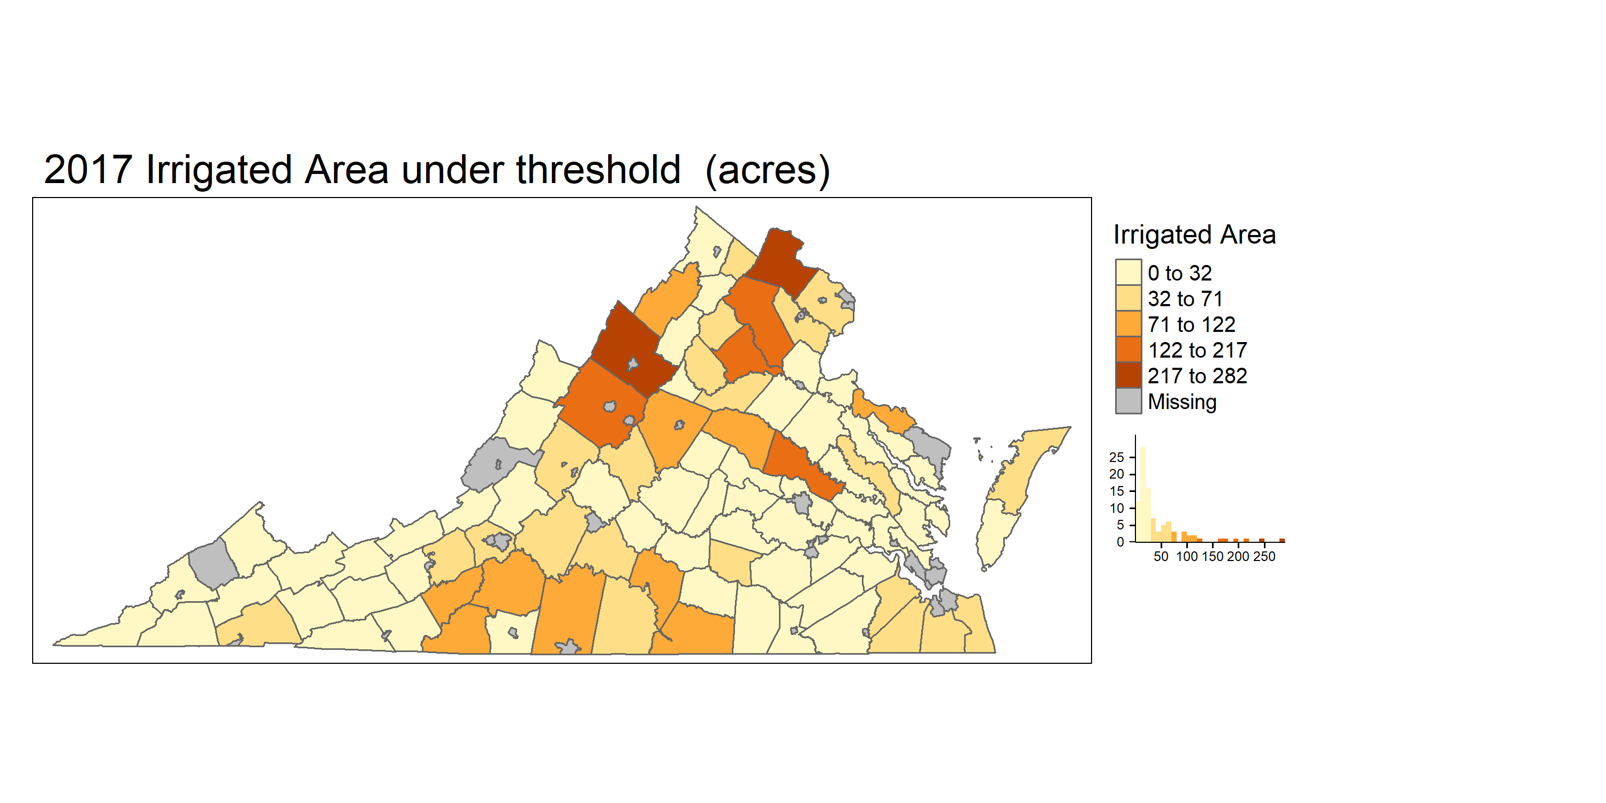


Irrigated area under threshold

Slide 11
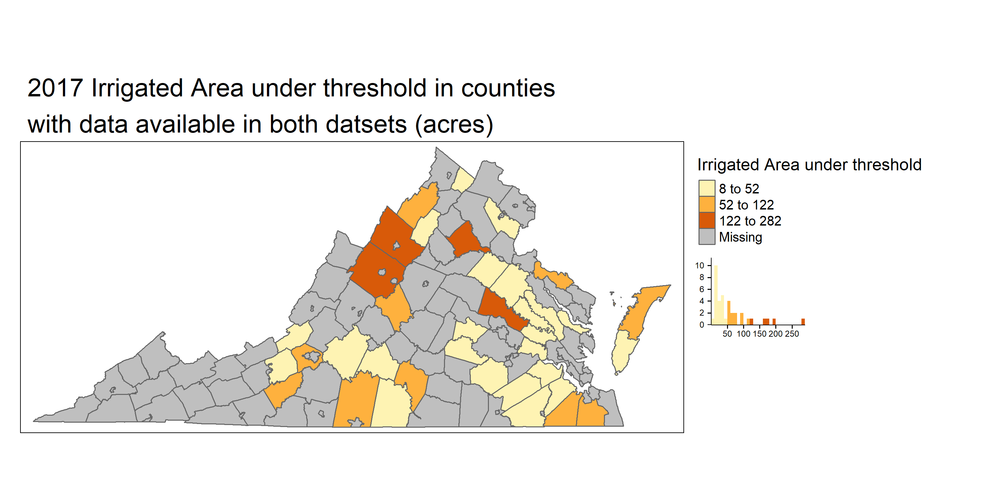
Irrigated area under threshold

Slide 12
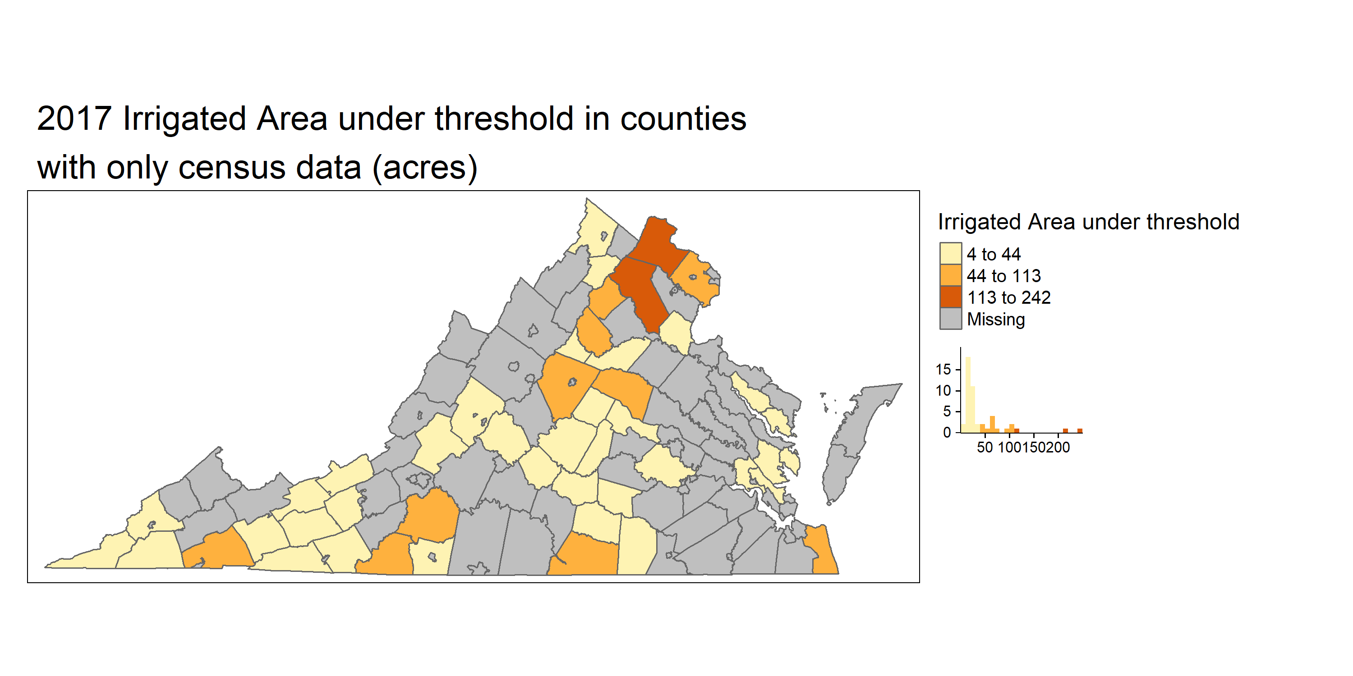
Irrigated area under threshold

Slide 13
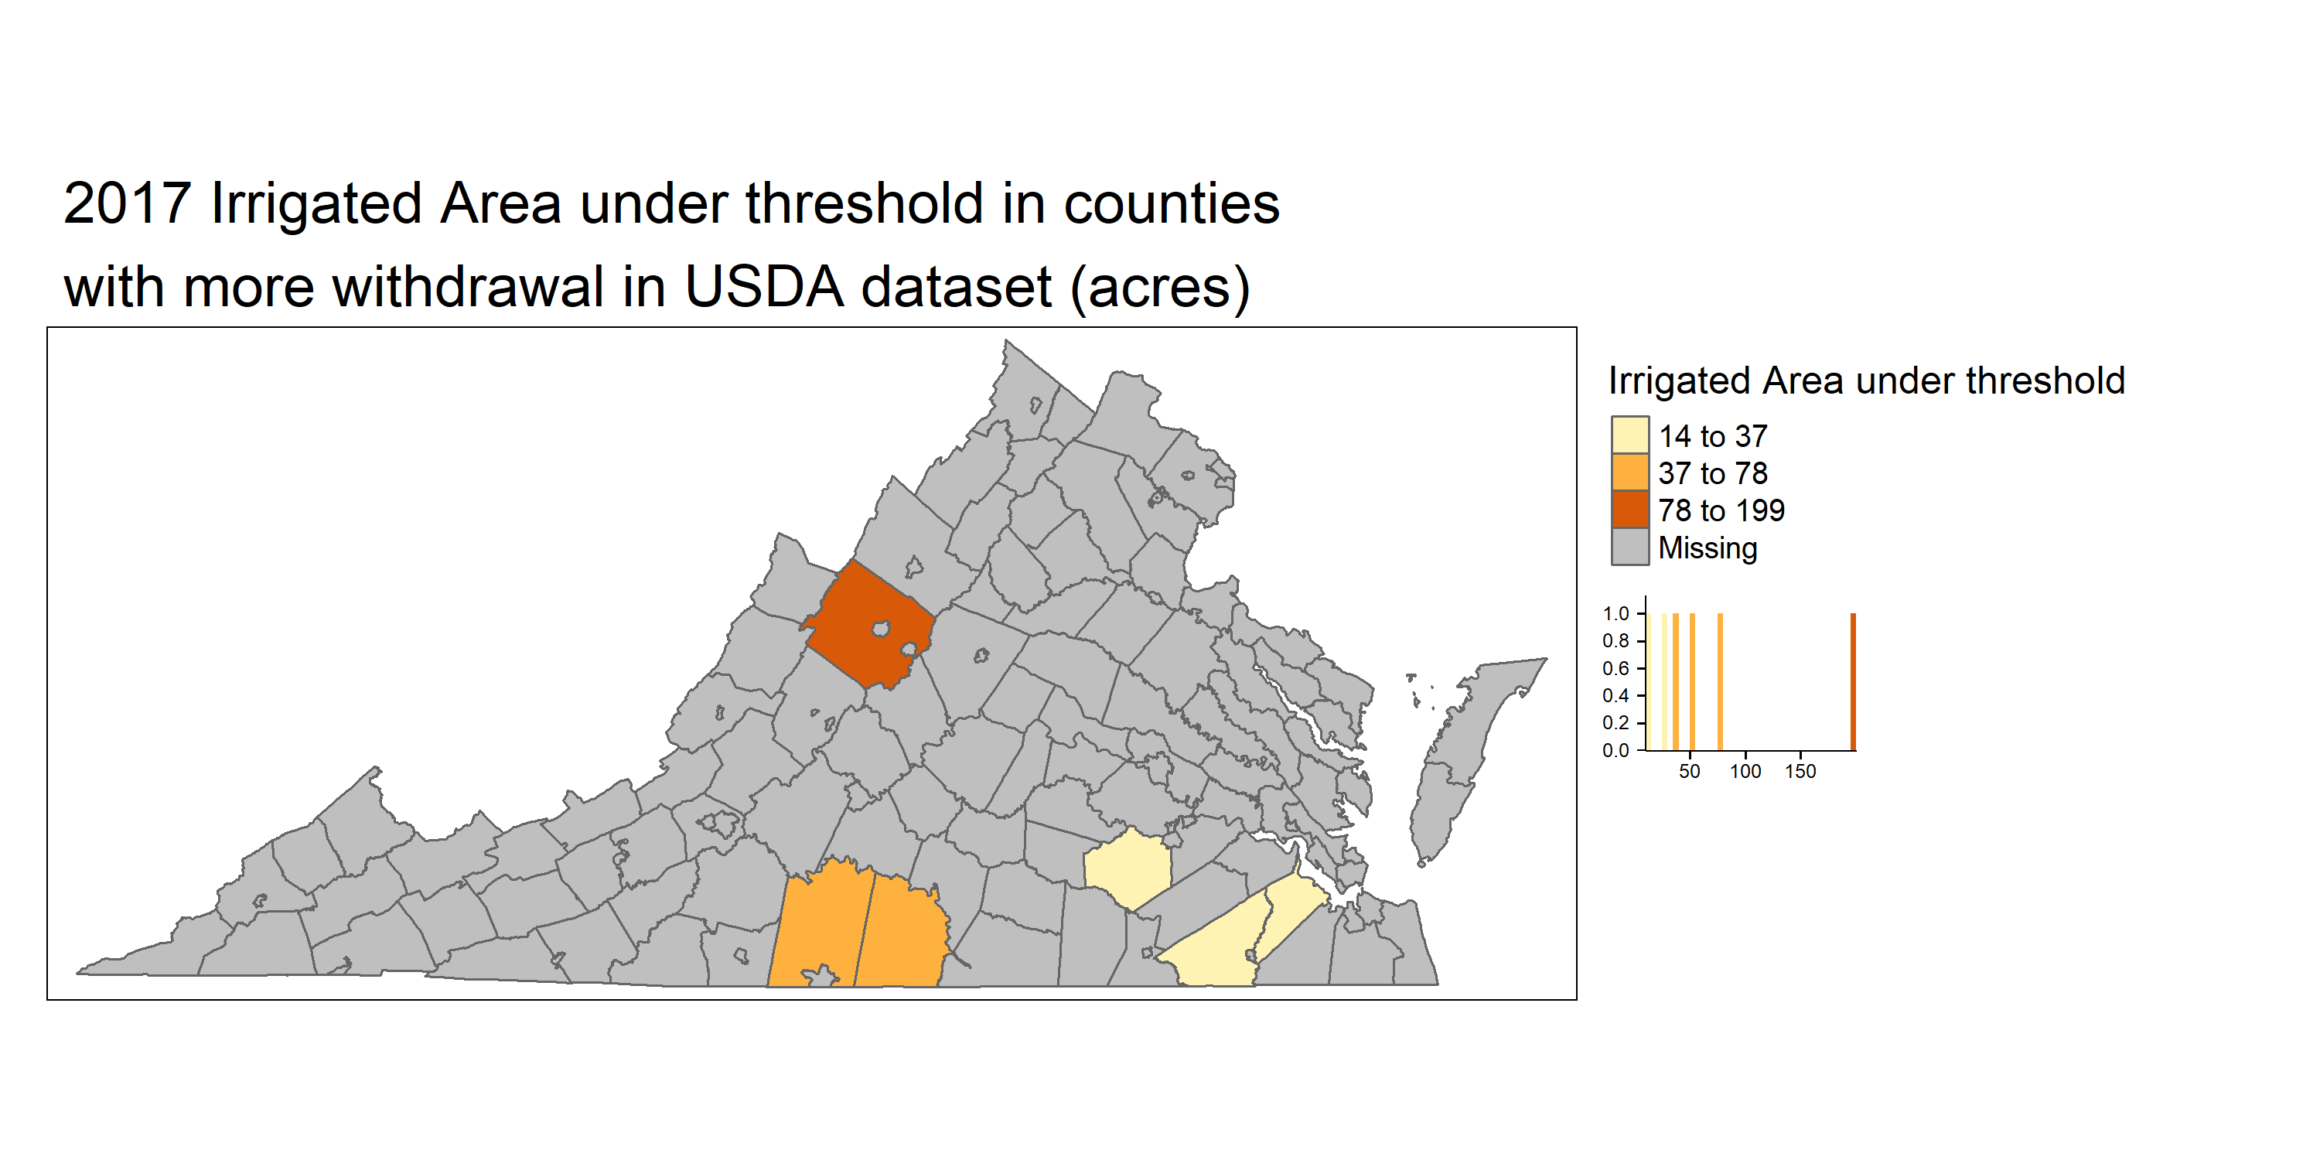
Irrigated area under threshold
Notes:
Counties which resulted in 80% of withdrawals in census data but were not as high in DEQ data

Slide 14
Data Availability in other years

Slide 15
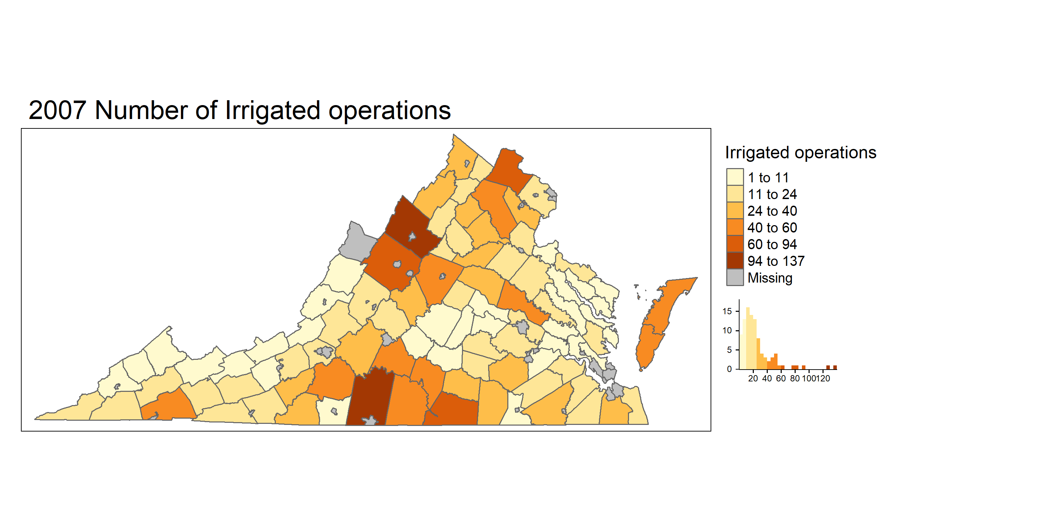
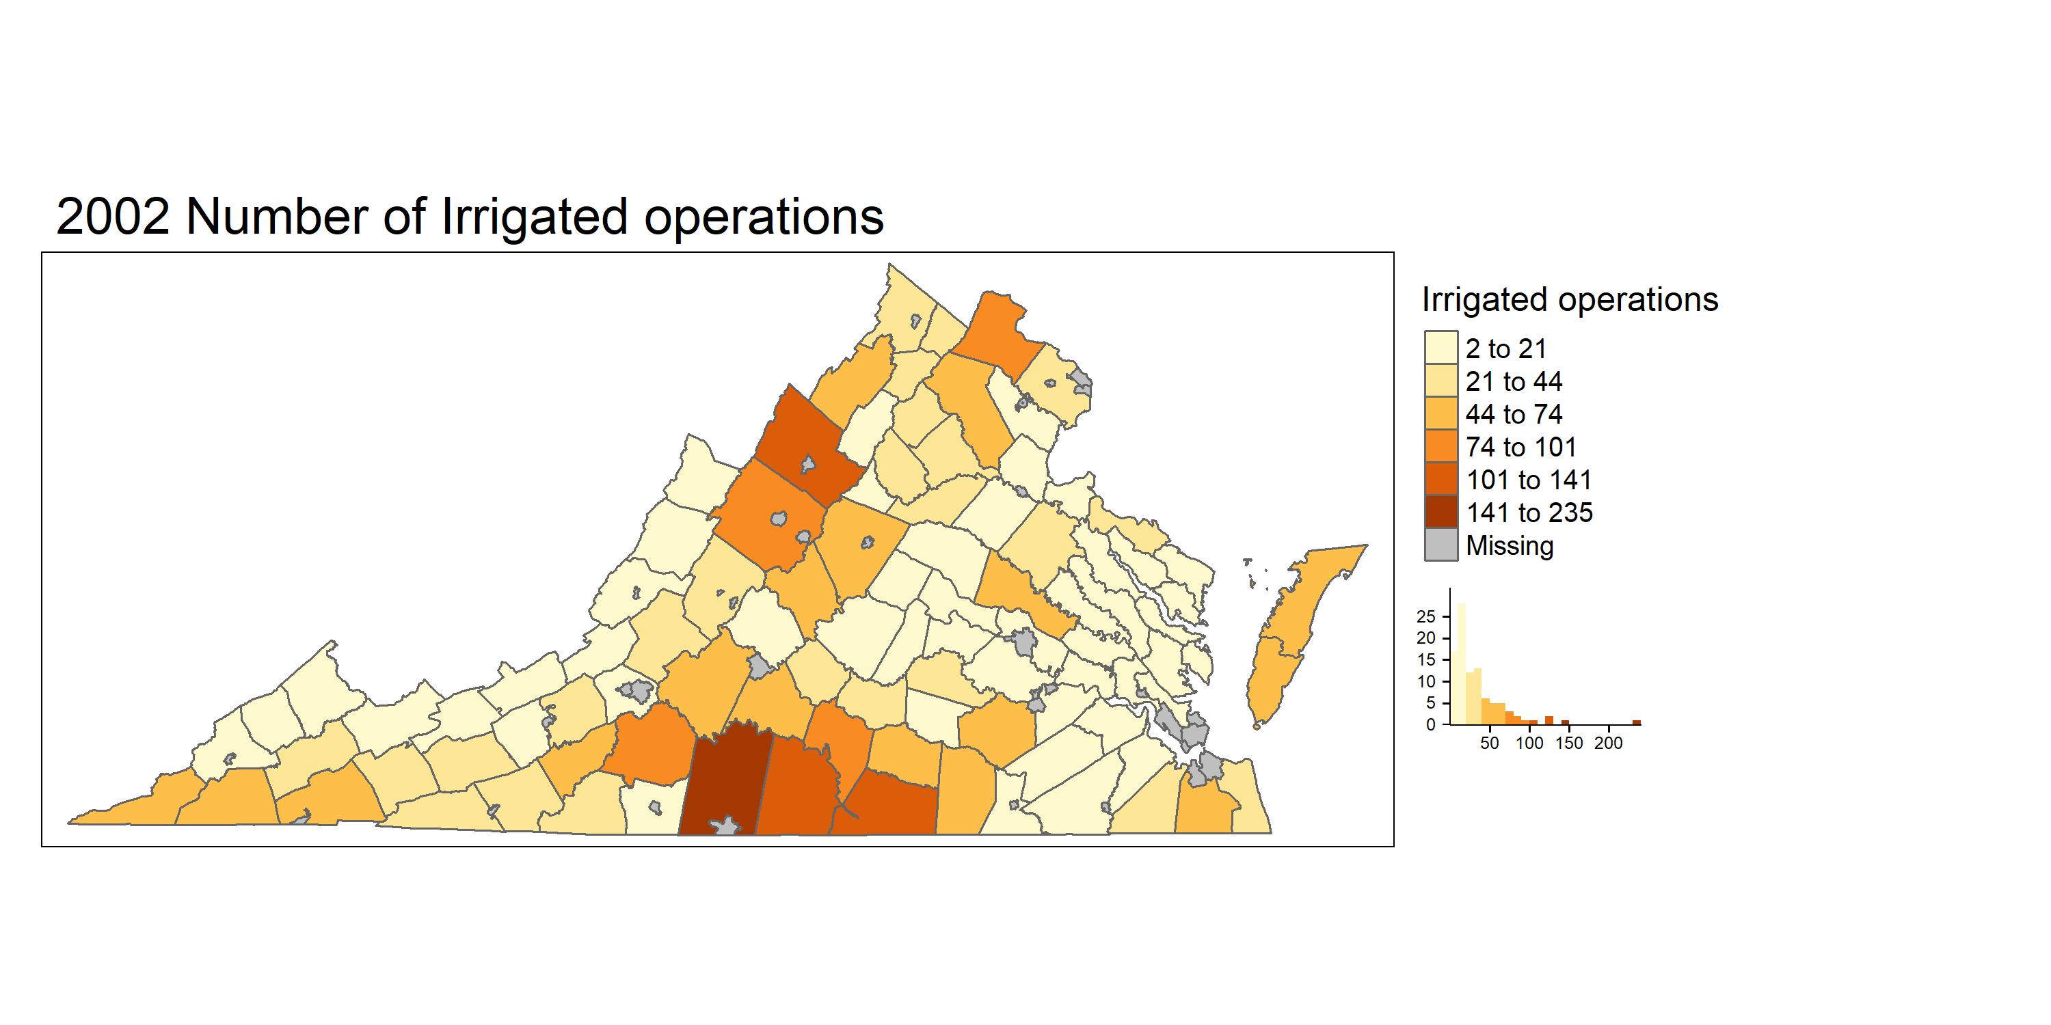
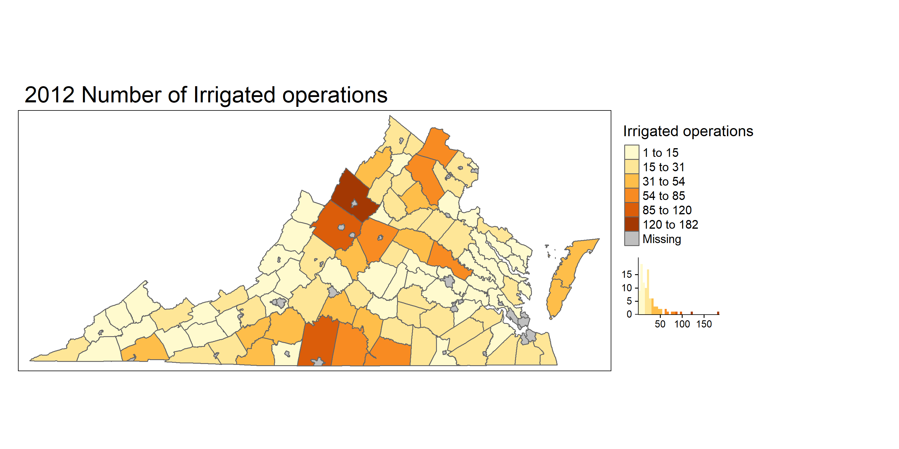
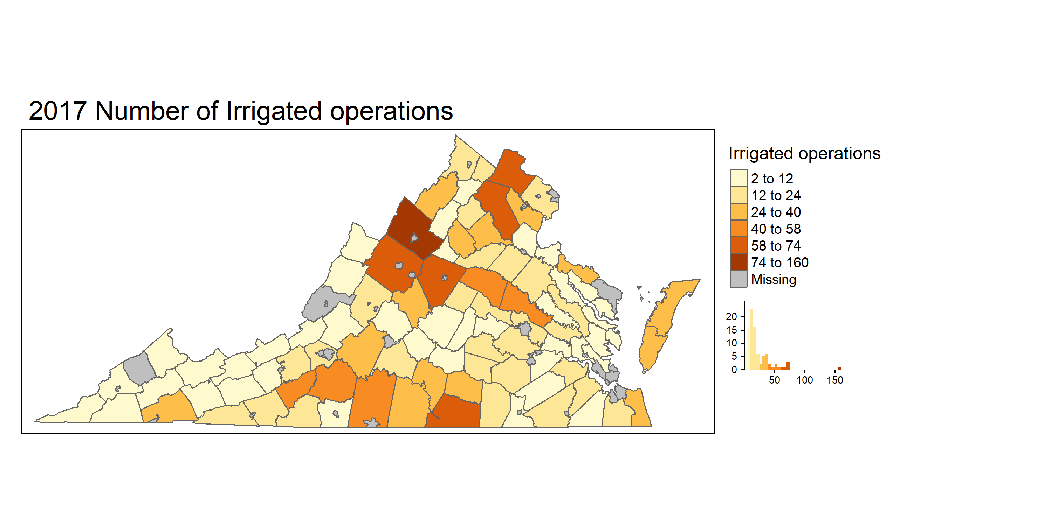
Irrigated Operations for different years
90 Counties : 3285 operations
87 Counties : 2296 operations
90 Counties : 2408 operations
85 Counties : 2003 operations
Notes:
Irrigated operations were higher in 2002 . May be due to previous drought years ?
2002 PITTSYLVANIA 235 , ROCKINGHAM 141, HALIFAX 126, MECKLENBURG 123, AUGUSTA 101
2007 : ROCKINGHAM 137 , PITTSYLVANIA 127, AUGUSTA 94, MECKLENBURG 81, LOUDOUN 76
2012: ROCKINGHAM 182 PITTSYLVANIA 120 AUGUSTA 95 HALIFAX 85 HANOVER 81
2017: ROCKINGHAM 160 MECKLENBURG 74 LOUDOUN 74 FAUQUIER 71 ALBEMARLE 67
PITTSYLVANIA had most reduction in number of operations

Slide 16
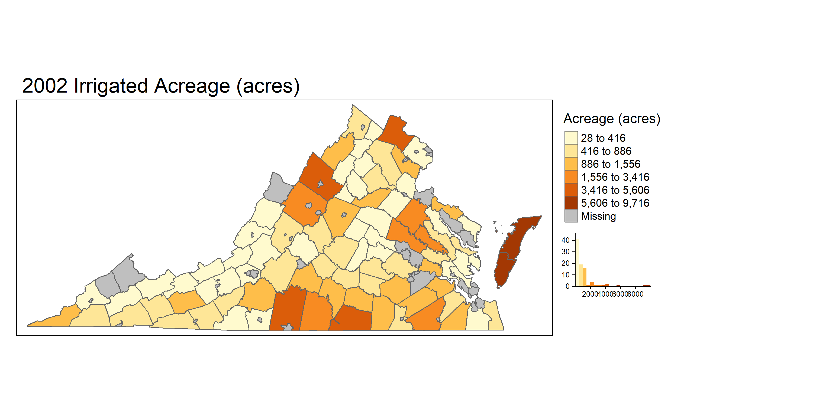
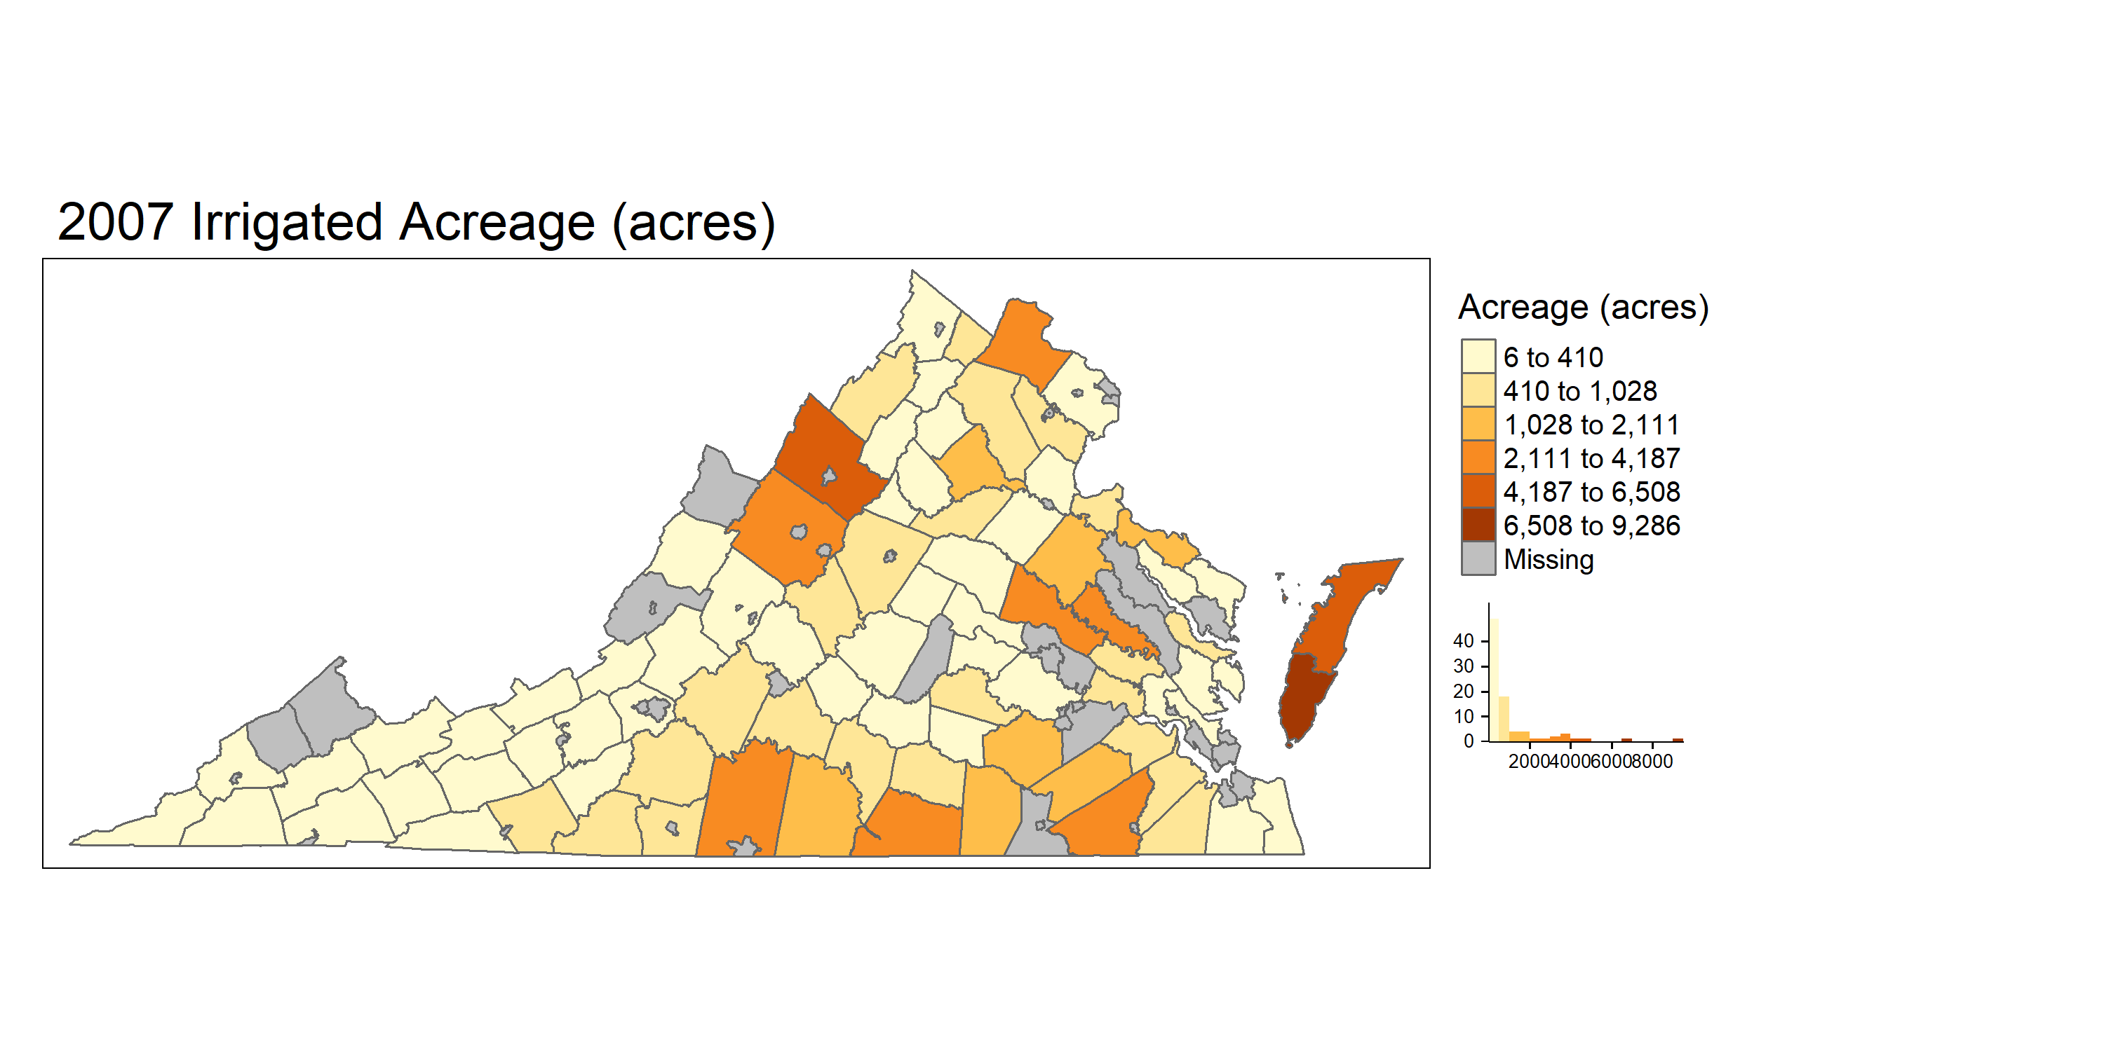
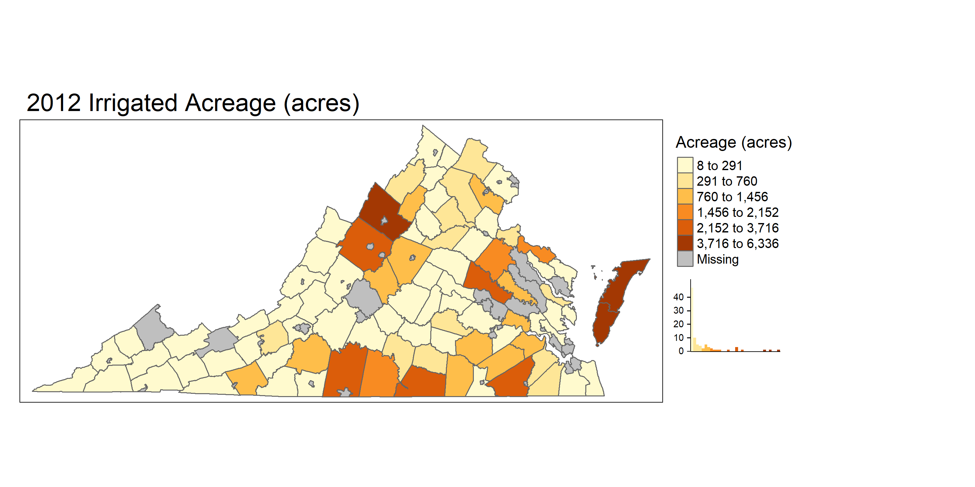
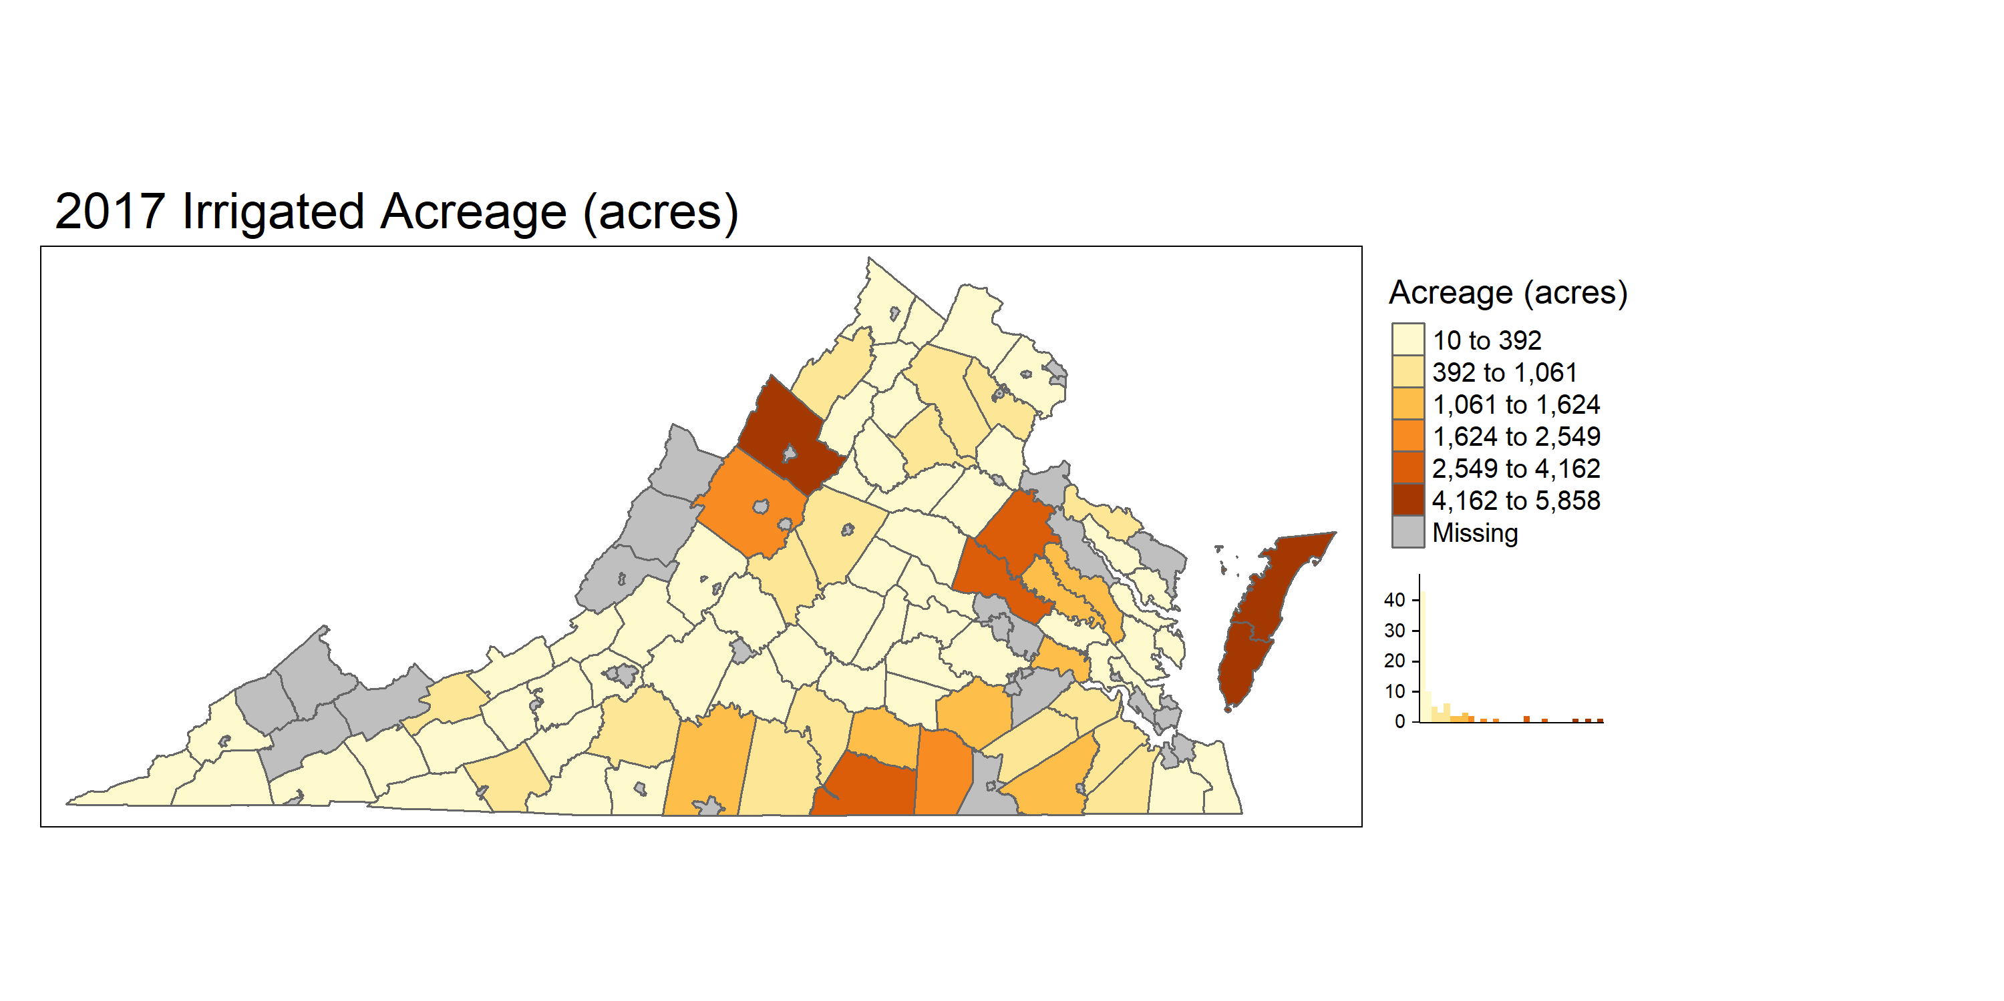
Irrigated Acreage for different years
90 Counties: 97309 acreage
87 Counties : 78925 acreage
90 Counties : 64577 acreage
85 Counties : 60125 acreage
Notes:
Similar to operations Irrigated acreage ad same trend
2002: ACCOMACK 9716 NORTHAMPTON 9338 PITTSYLVANIA 5606 ROCKINGHAM 4355 MECKLENBURG 4158 LOUDOUN 3666
2007: NORTHAMPTON 9286 ACCOMACK 6508 ROCKINGHAM 4808 PITTSYLVANIA 4187 AUGUSTA 3813
2012: NORTHAMPTON 6336 ROCKINGHAM 5645 ACCOMACK 5370 PITTSYLVANIA 3716 HANOVER 3338
2017: NORTHAMPTON 5858 ROCKINGHAM 5526 ACCOMACK 5078 MECKLENBURG 4162 HANOVER 3570 (Most reduction Acomack, northampton Pitts and loudon 1492 and 392 in 2017)

Slide 17
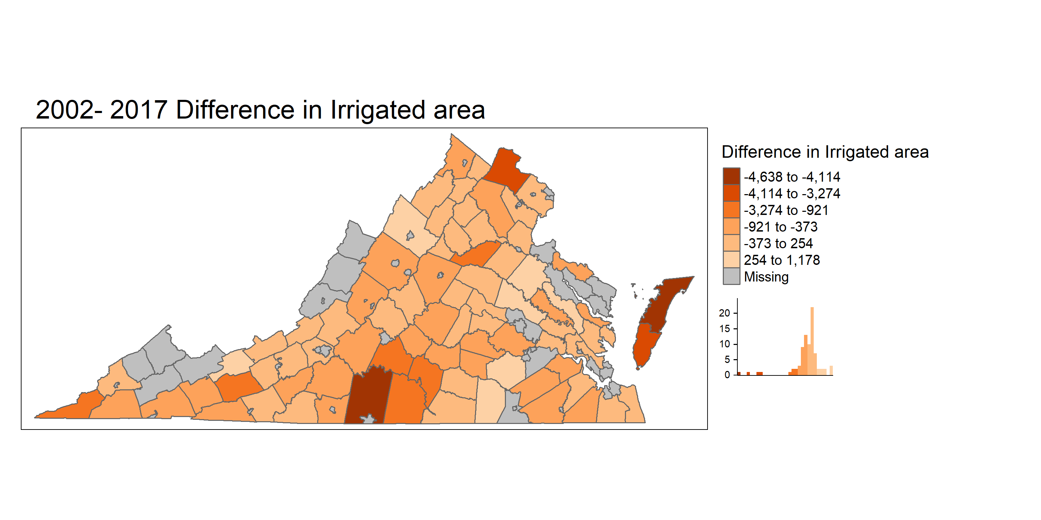
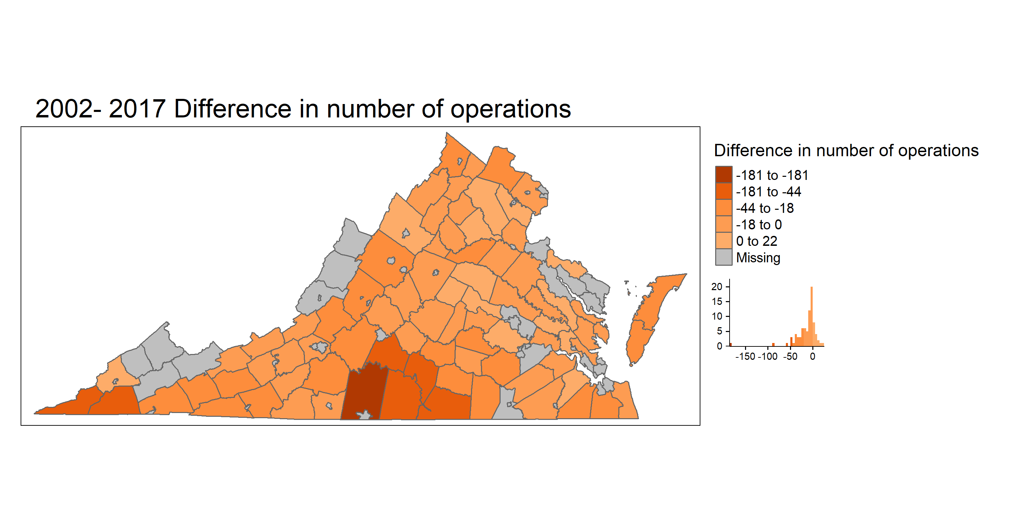










Difference between 2002 and 2017
Notes:
Acreage decrease: ACCOMACK -4638 PITTSYLVANIA -4114 NORTHAMPTON -3480 LOUDOUN -3274 HALIFAX -1556
Acreage Increase : HANOVER 1178 ROCKINGHAM 1171 CAROLINE 1139 BLAND 666 BRUNSWICK 640
Operation increase: LOUISA 22 ROCKINGHAM 19 PRINCE WILLIAM 11 ISLE OF WIGHT 10 FAUQUIER 8
Operation decrease: PITTSYLVANIA -181 HALIFAX -86 SCOTT -60 LEE -50 MECKLENBURG -49

Slide 18
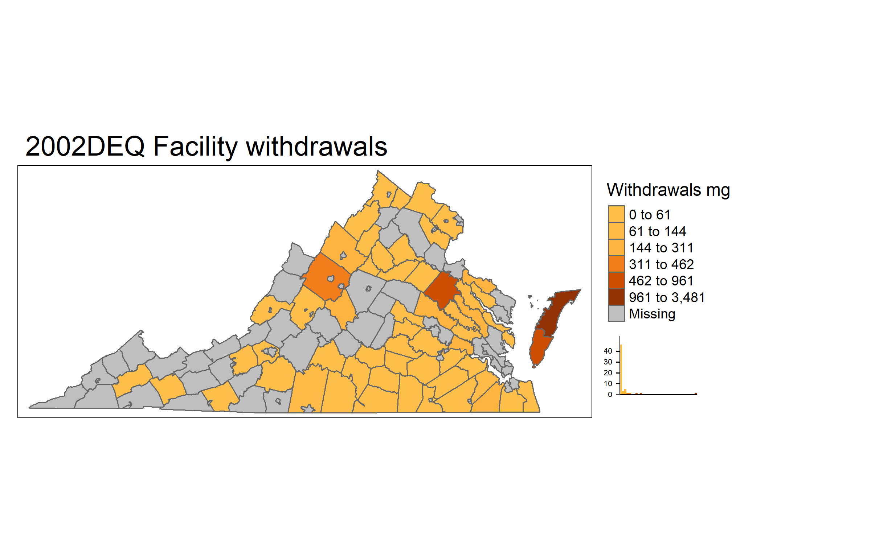
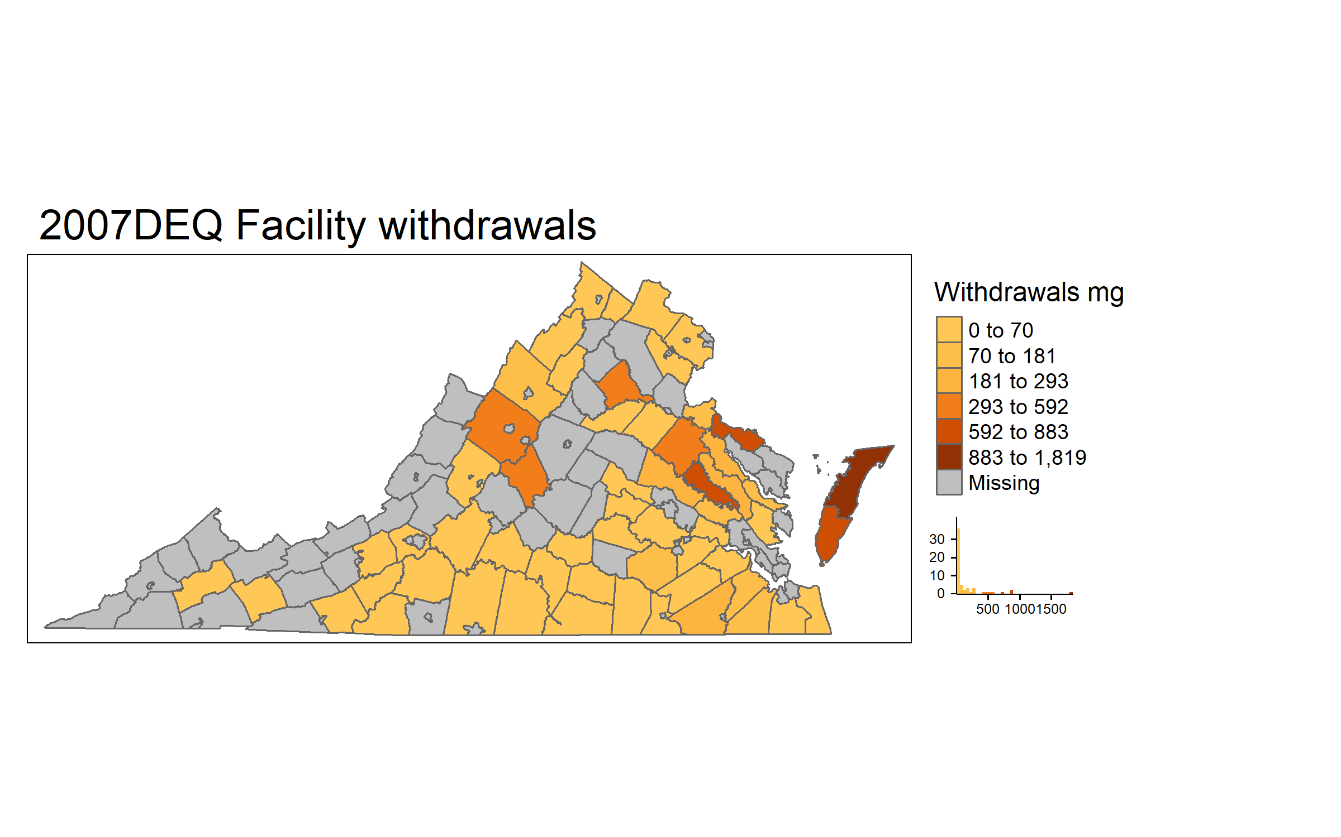
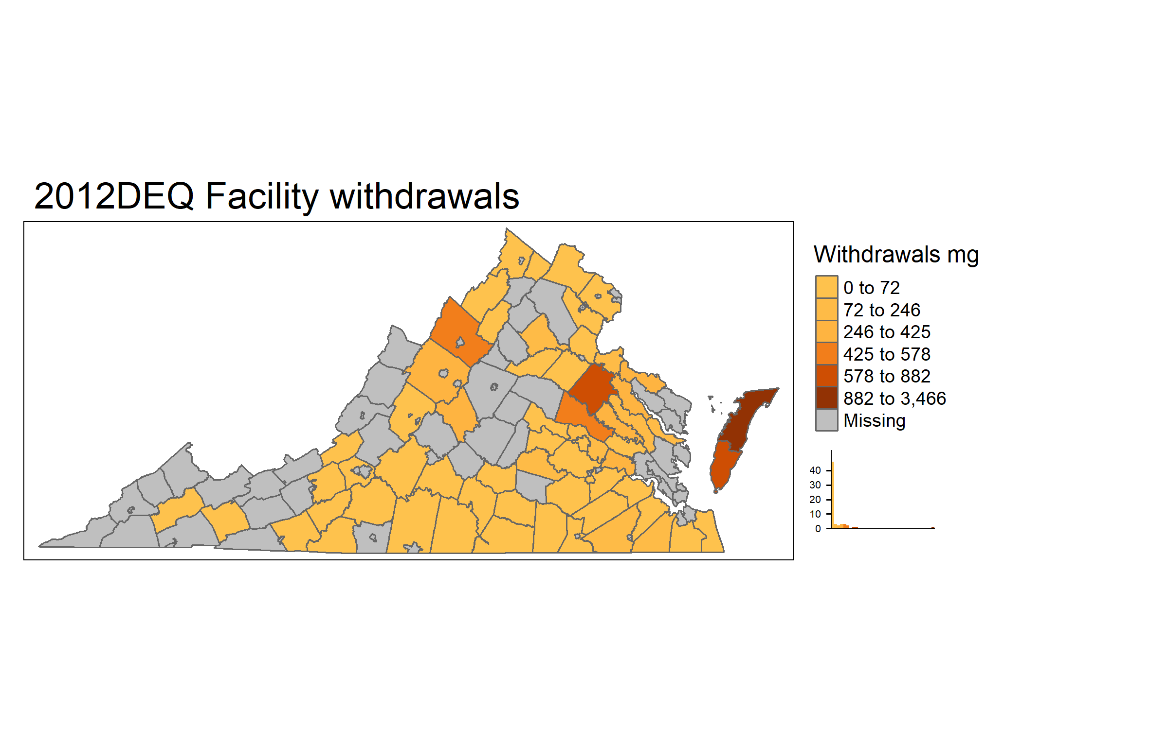
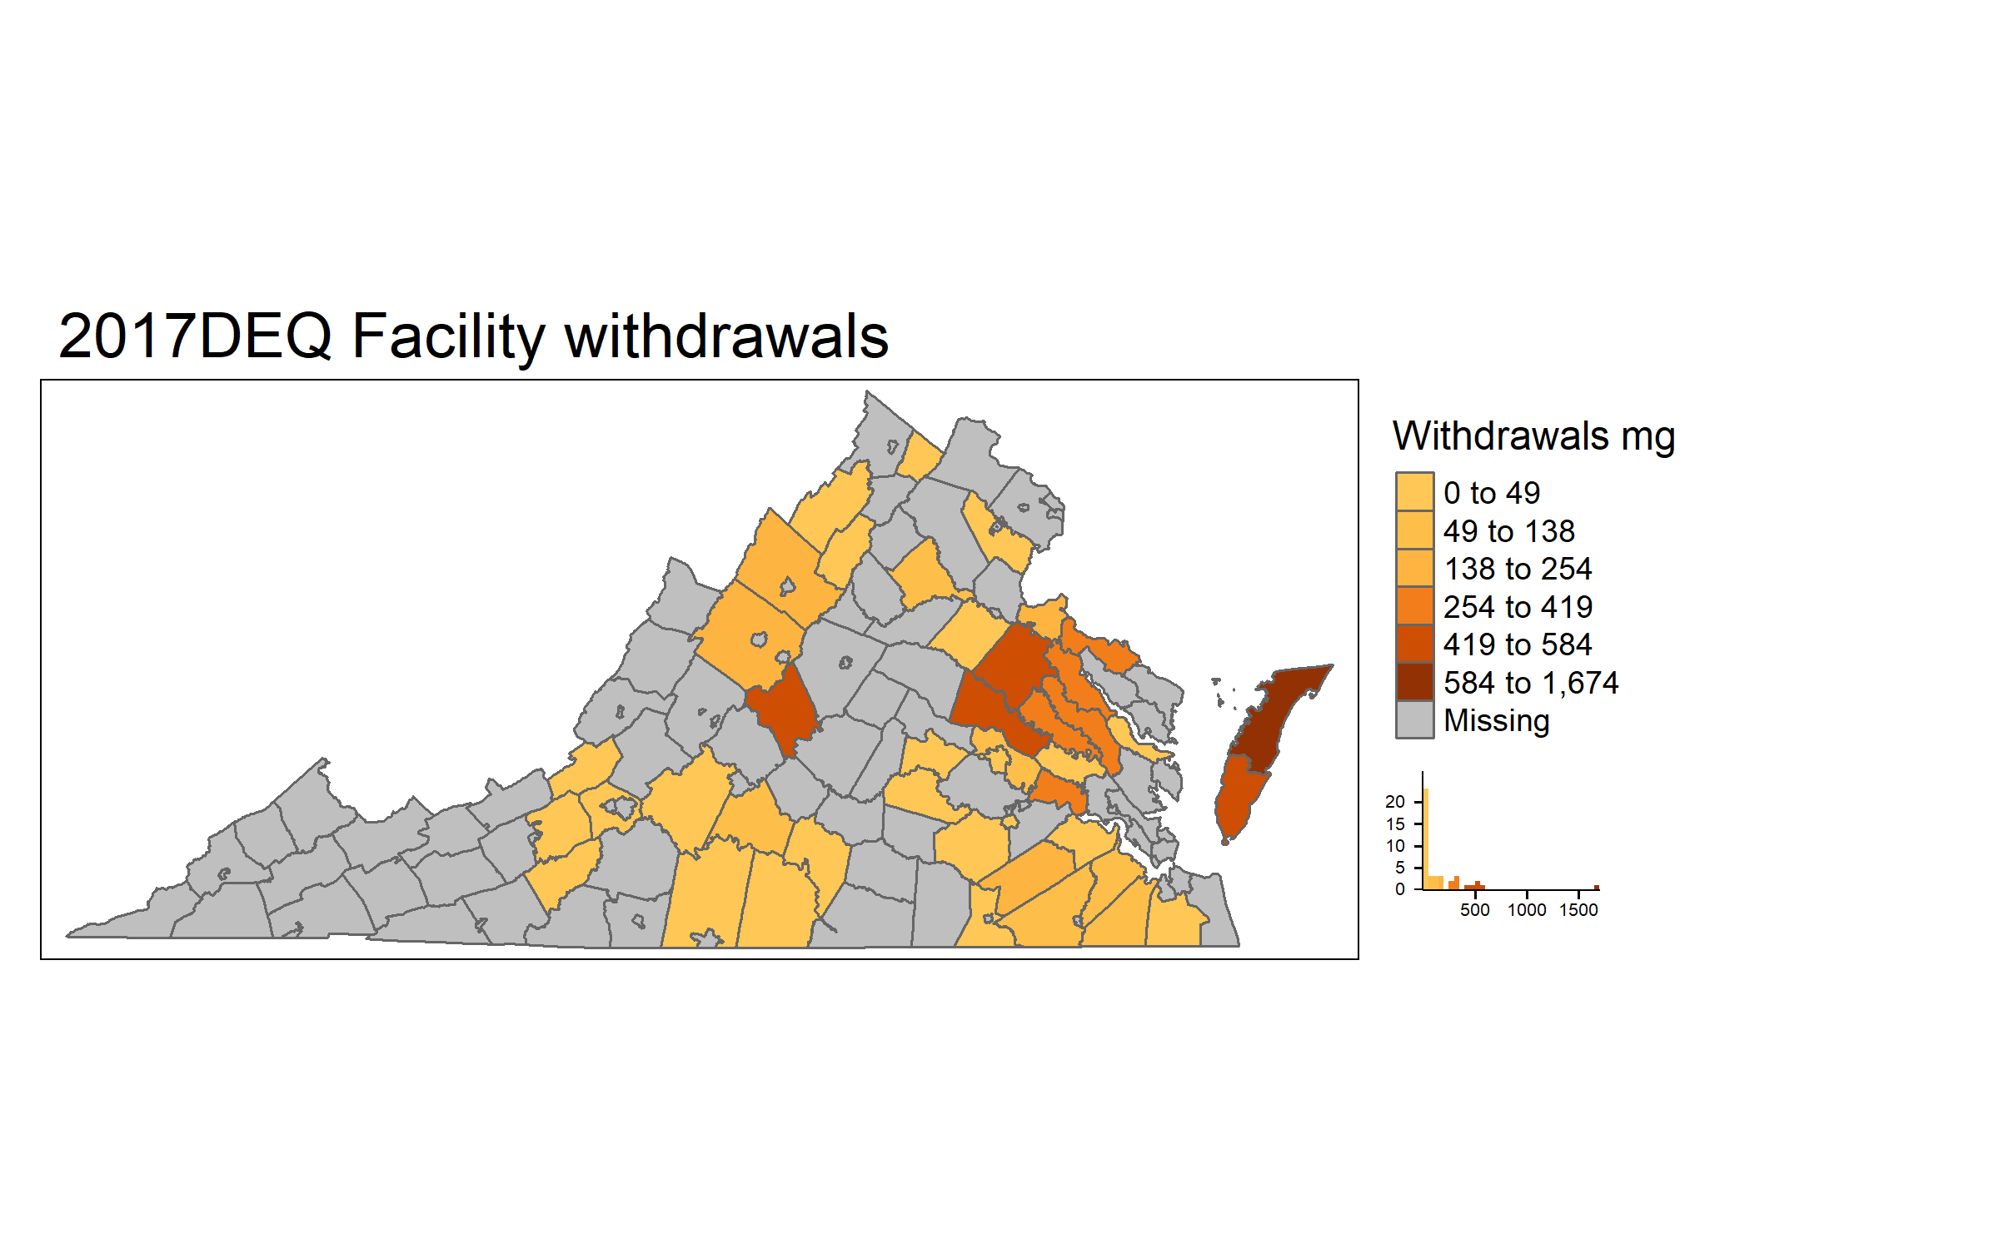
DEQ withdrawals
59 Counties: 8550 mg
58 Counties: 8994 mg
62 Counties: 10382 mg
43 Counties: 7322 mg
Notes:
2002: Accomack County 3480.674 Caroline County 960.526 )6th spot in census) Northampton County 742.087 Augusta County 461.554 Westmoreland County 311.381 (low in census)
2007: Accomack County 1819.128 Northampton County 882.5956 Westmoreland County 863.926 King William County 702.694 Augusta County 592.1592
2012: Accomack County 3465.538 Northampton County 881.5341 Caroline County 792.39 Rockingham County 578.196 Hanover County 560.29
2017:Accomack County 1673.848 Hanover County 583.8264 Caroline County 543.92 Northampton County 509.6057 Nelson County 474.32

Slide 19
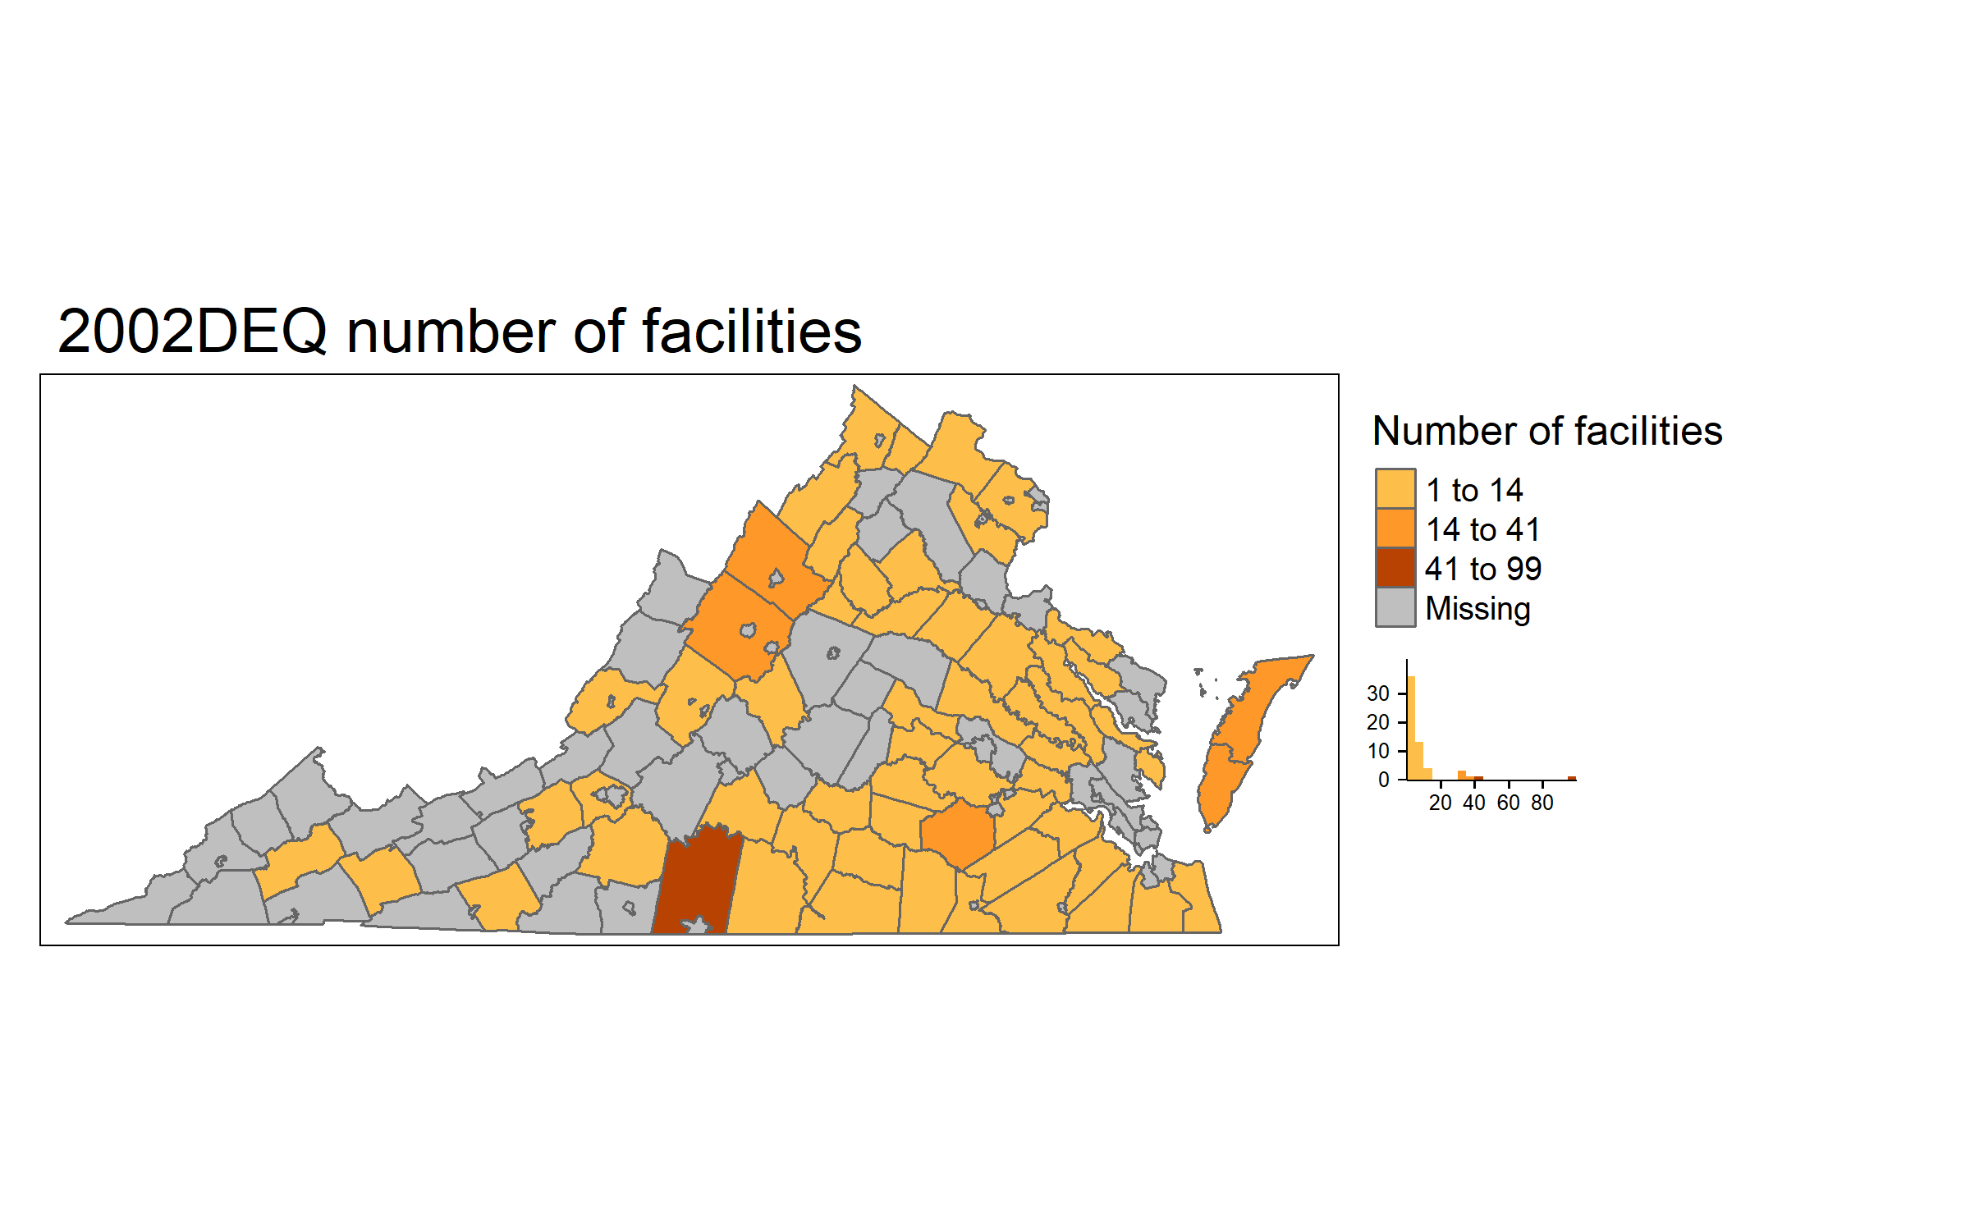
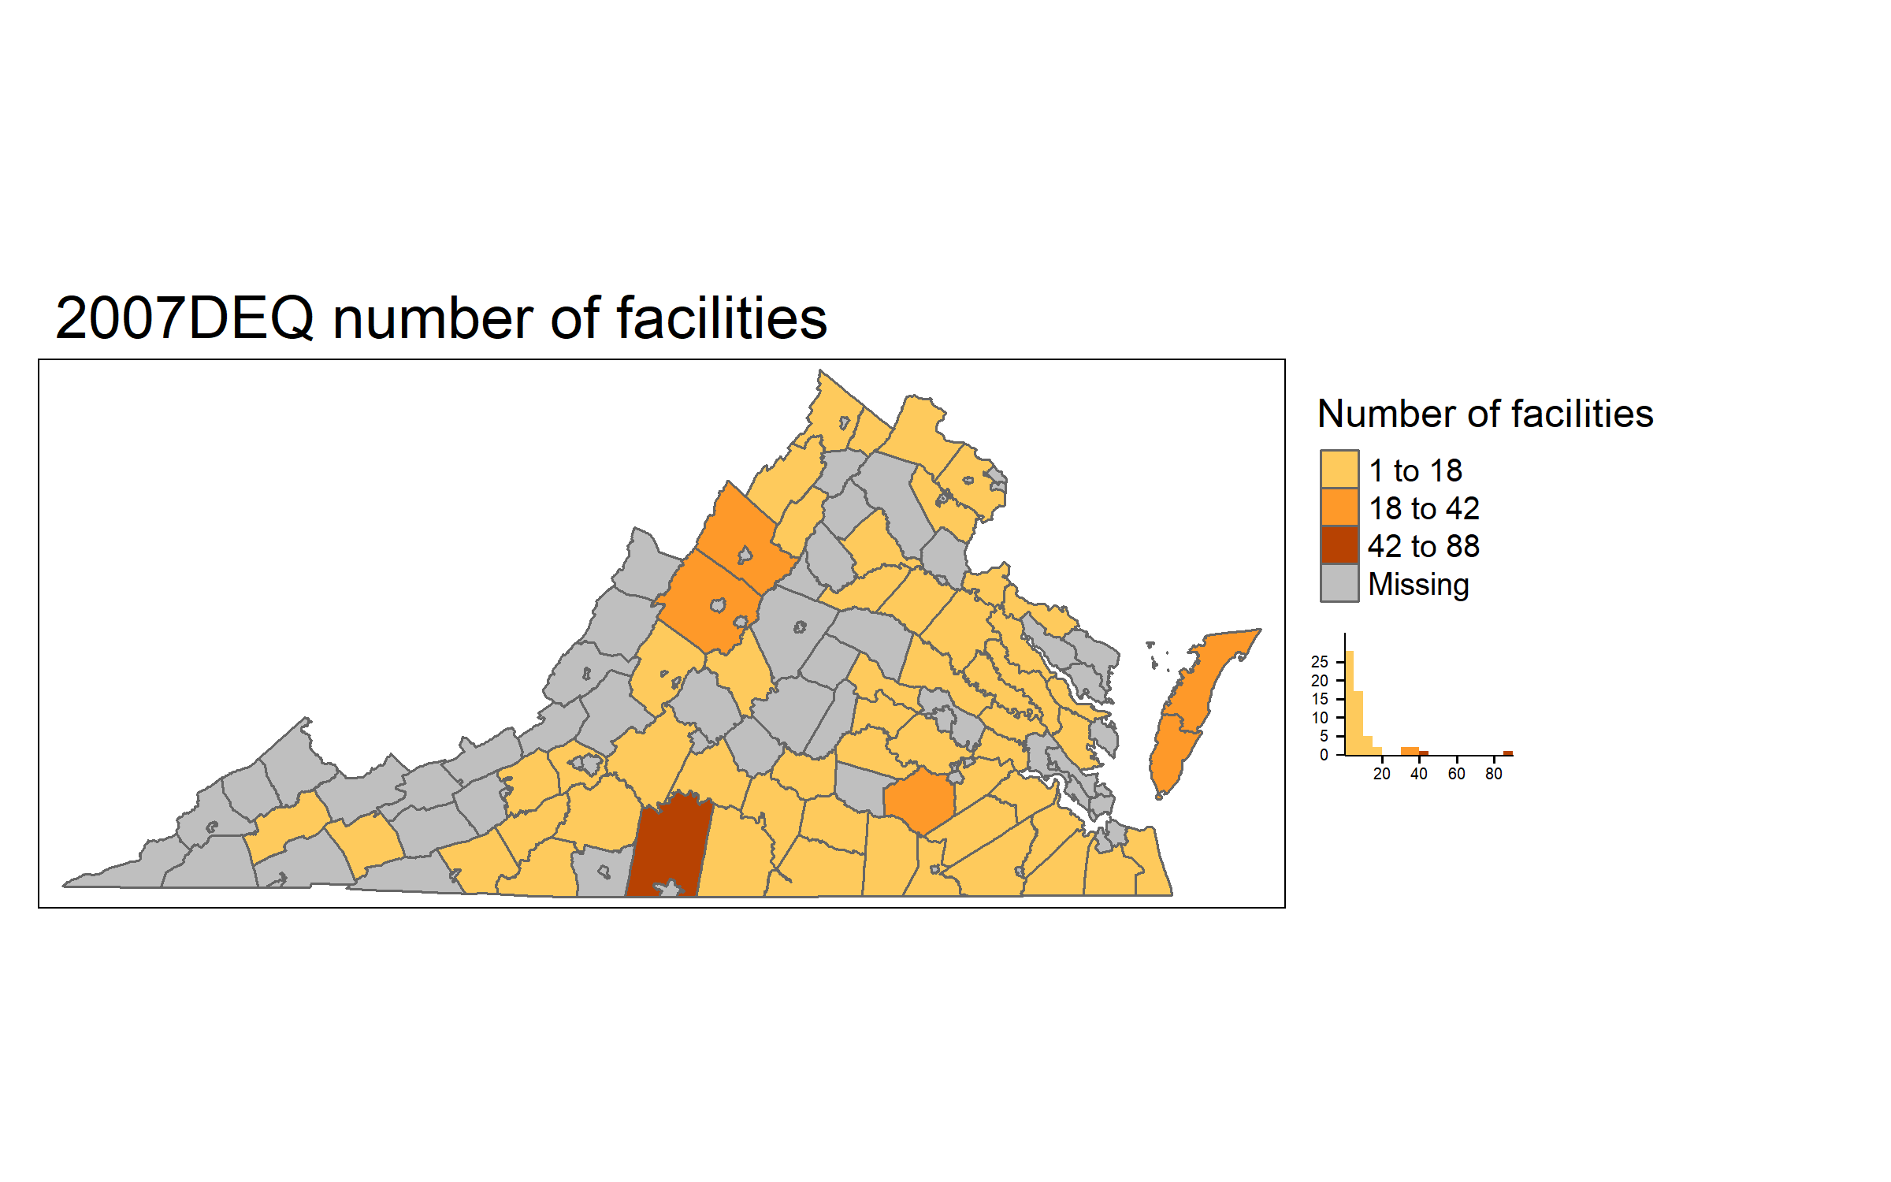
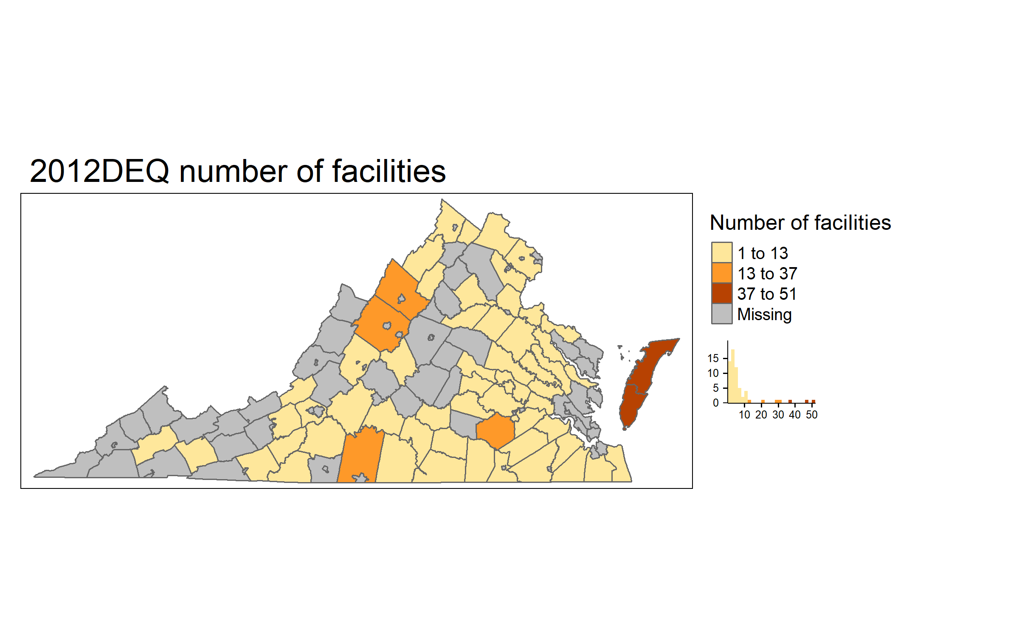












DEQ number of Facilities
59 Counties: 528 facilities
59 Counties: 493 facilities
62 Counties: 423 facilities
43 Counties: 117 facilities

Slide 20
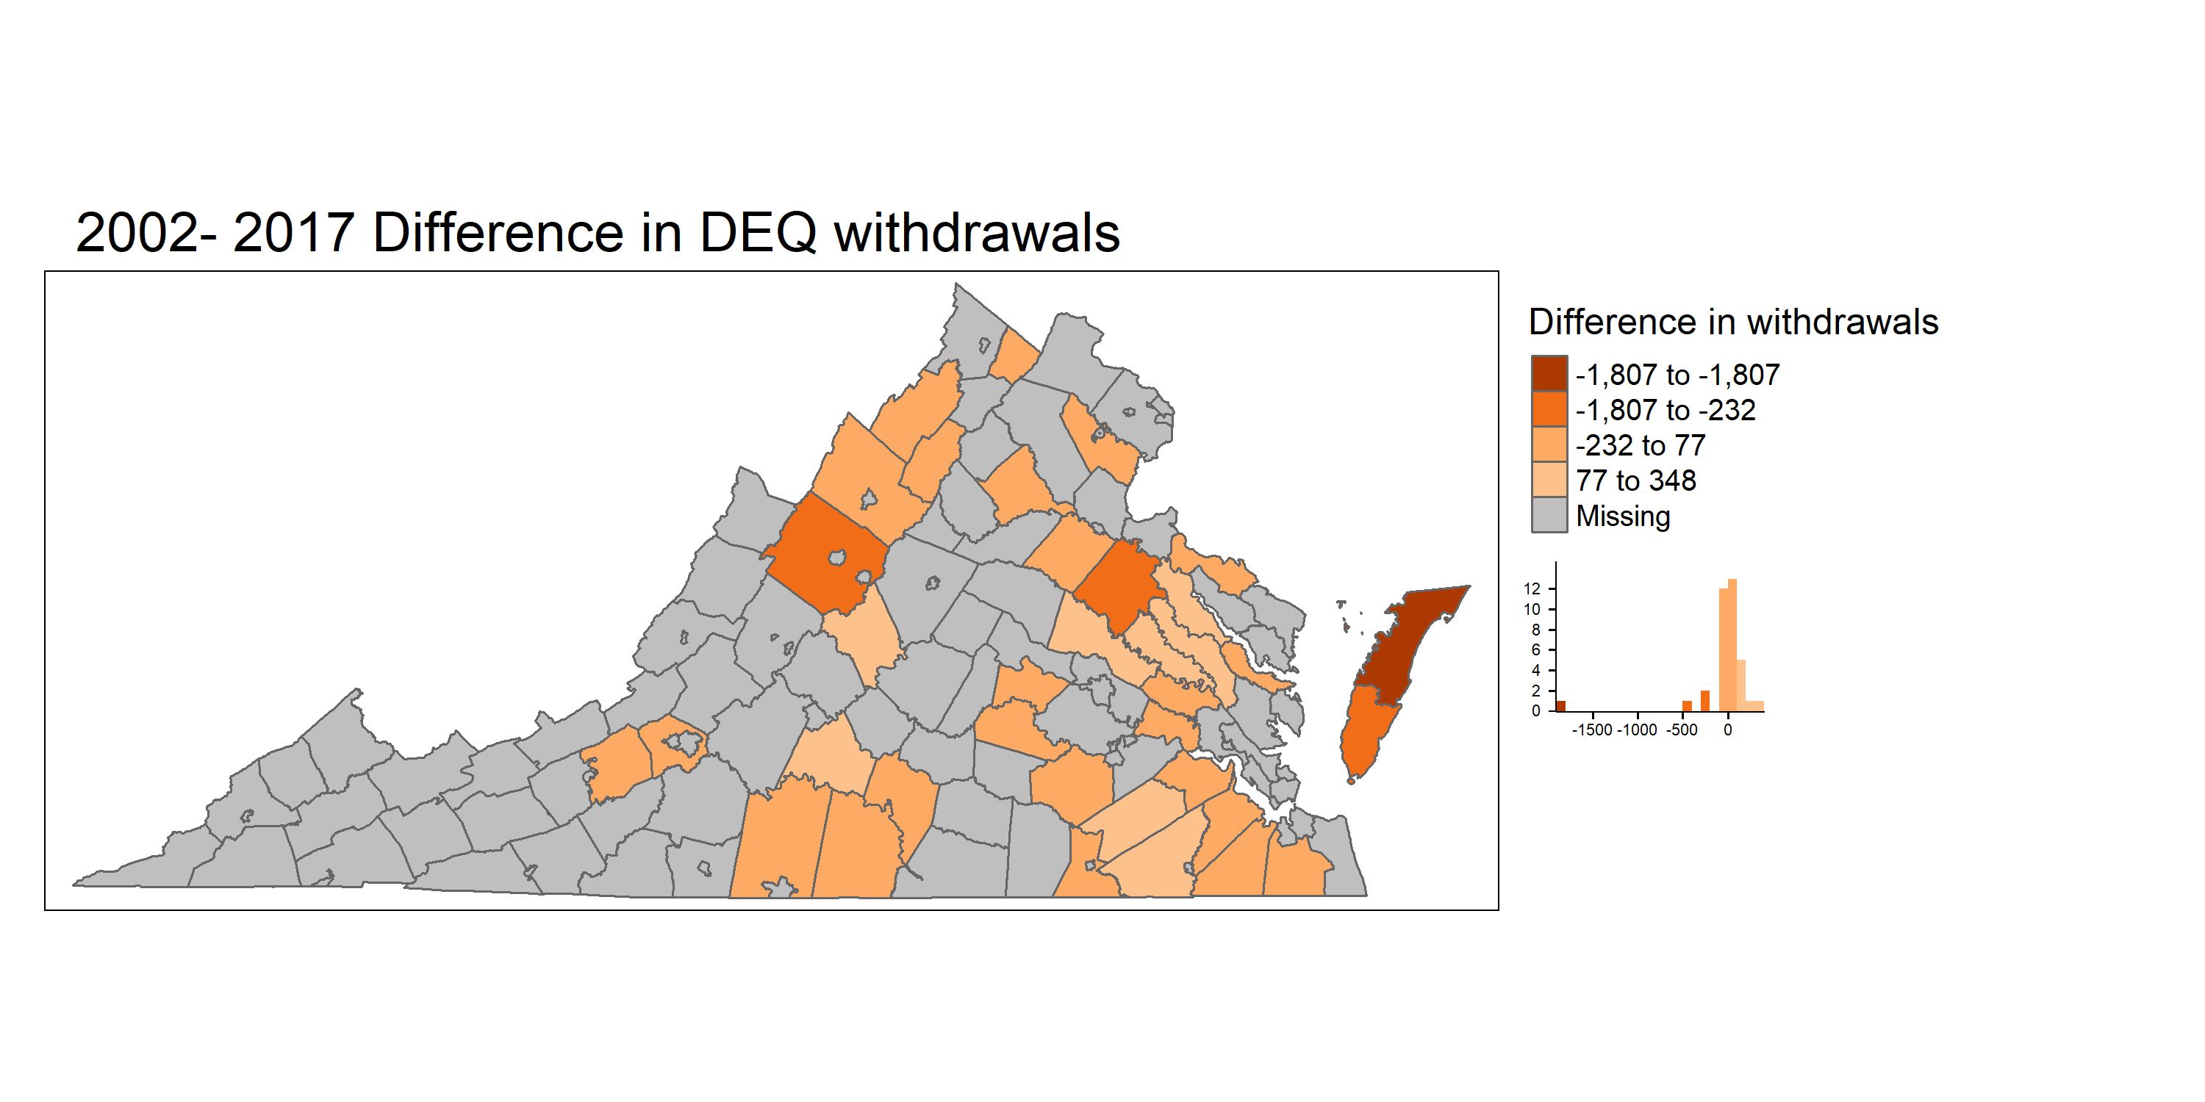
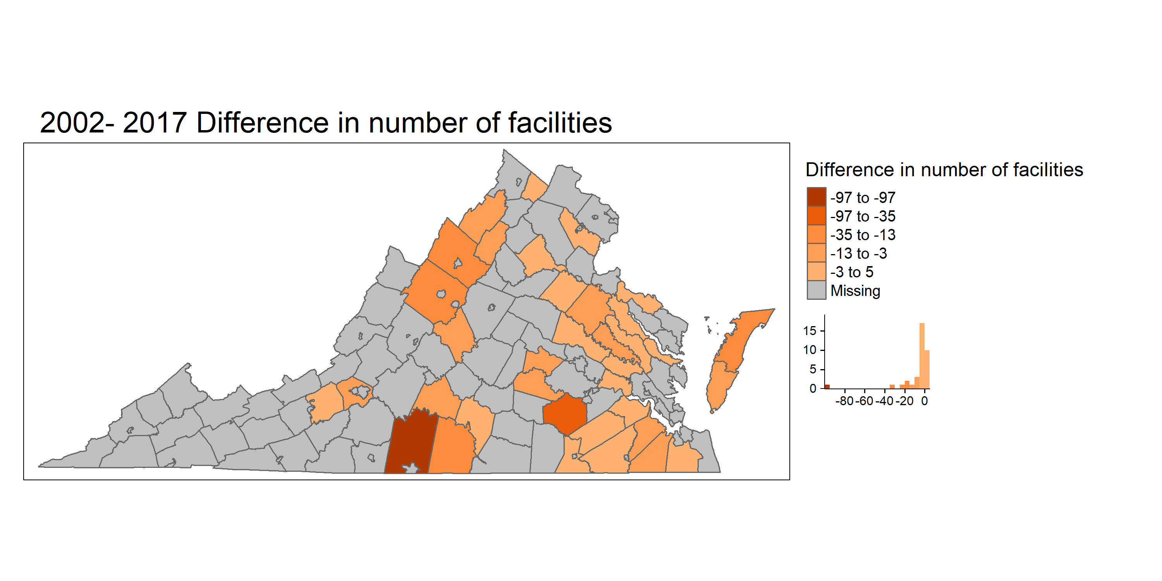
Difference between 2002 and 2017 - DEQ
Notes:
Withdrawal dec : Accomack County -1806.83 Caroline County -416.606 Augusta County -285.894 Northampton County -232.481 Suffolk city -96.69
Withrawal inc: Hanover County 347.7807 Nelson County 282.19 Essex County 200 King and Queen County 161.7788 Sussex County 156.764 King William County 141.881
Facilities Pittsylvania County -97 Dinwiddie County -35 Augusta County -23 Rockingham County -17 Accomack County -16
Hanover County 5 Southampton County 3 Charles City County 2 Prince William County 2 Sussex County 1

Slide 21
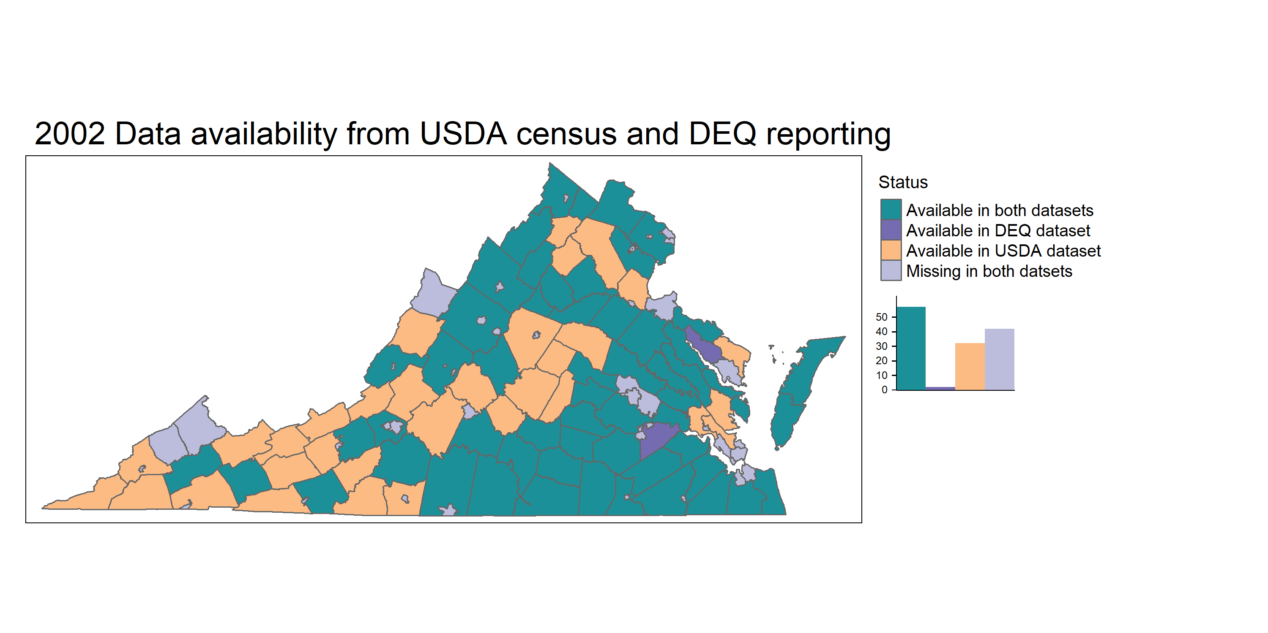
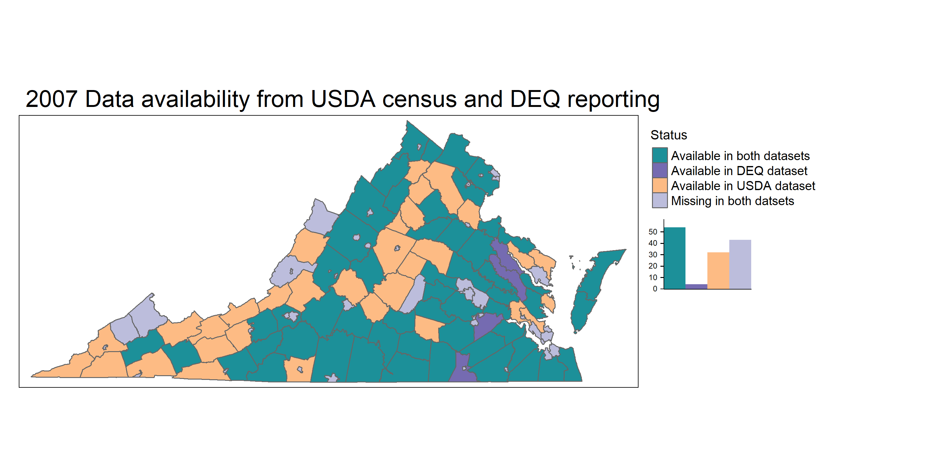
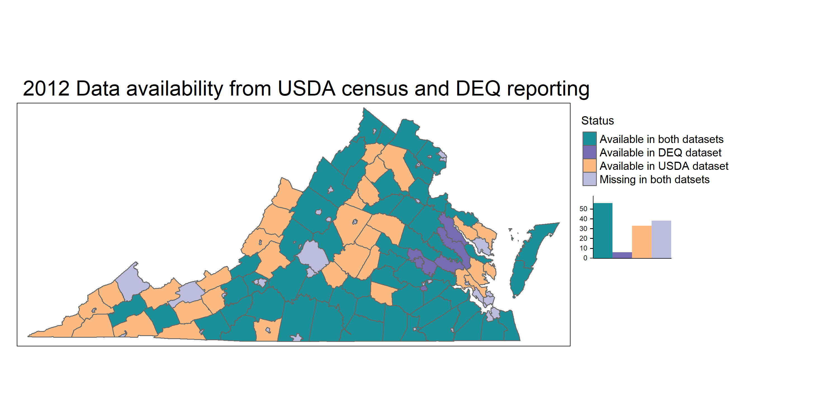
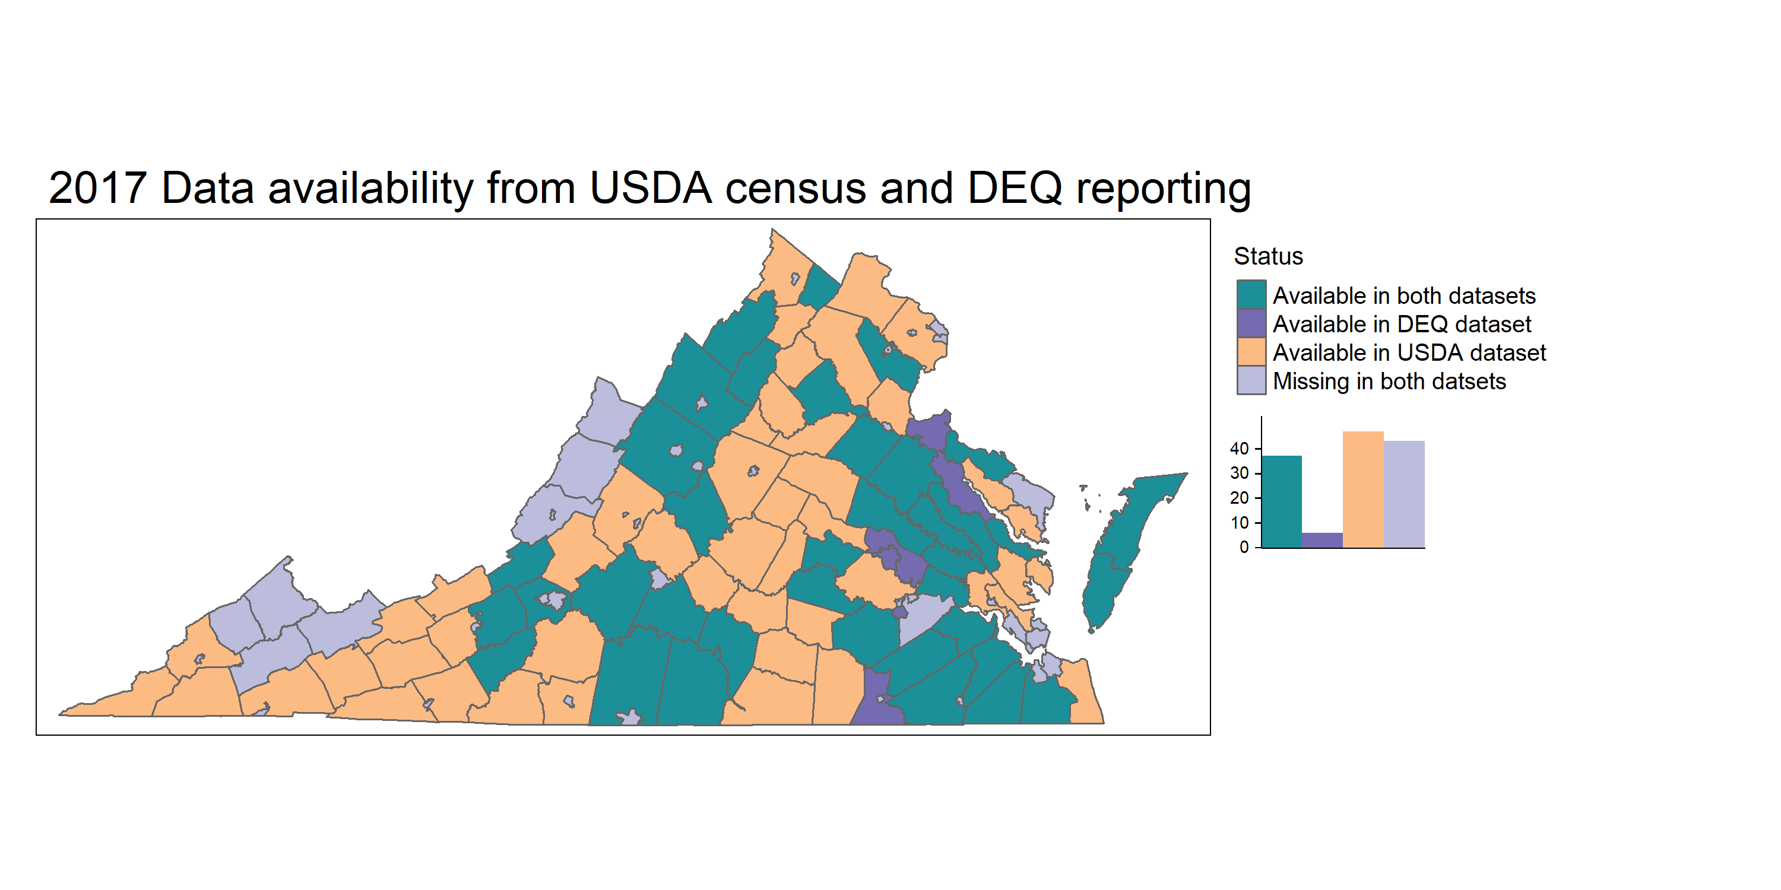

Data availability in both datasets from 2002 to 2017
57 Counties
54 Counties
56 counties
37 counties

Slide 22
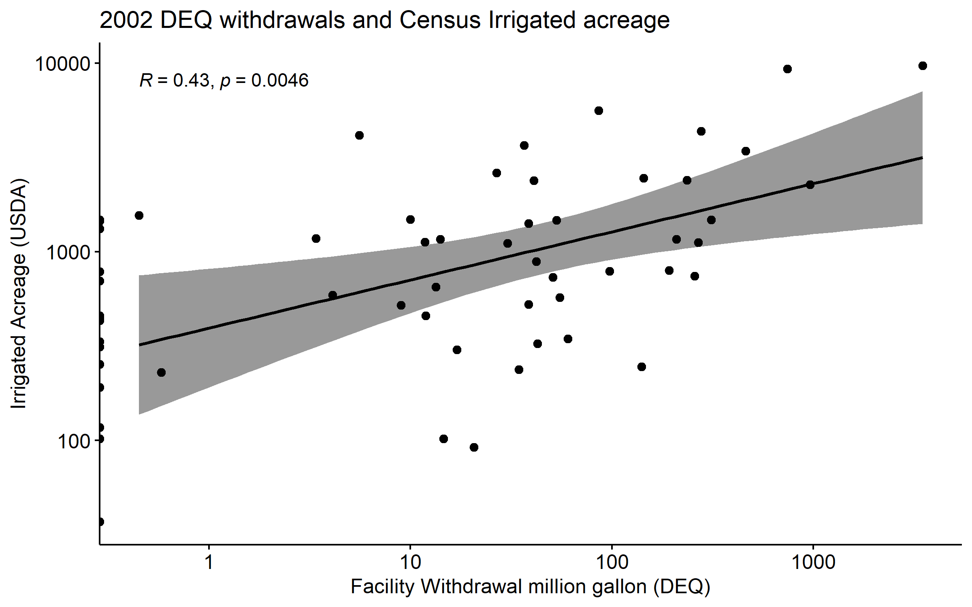
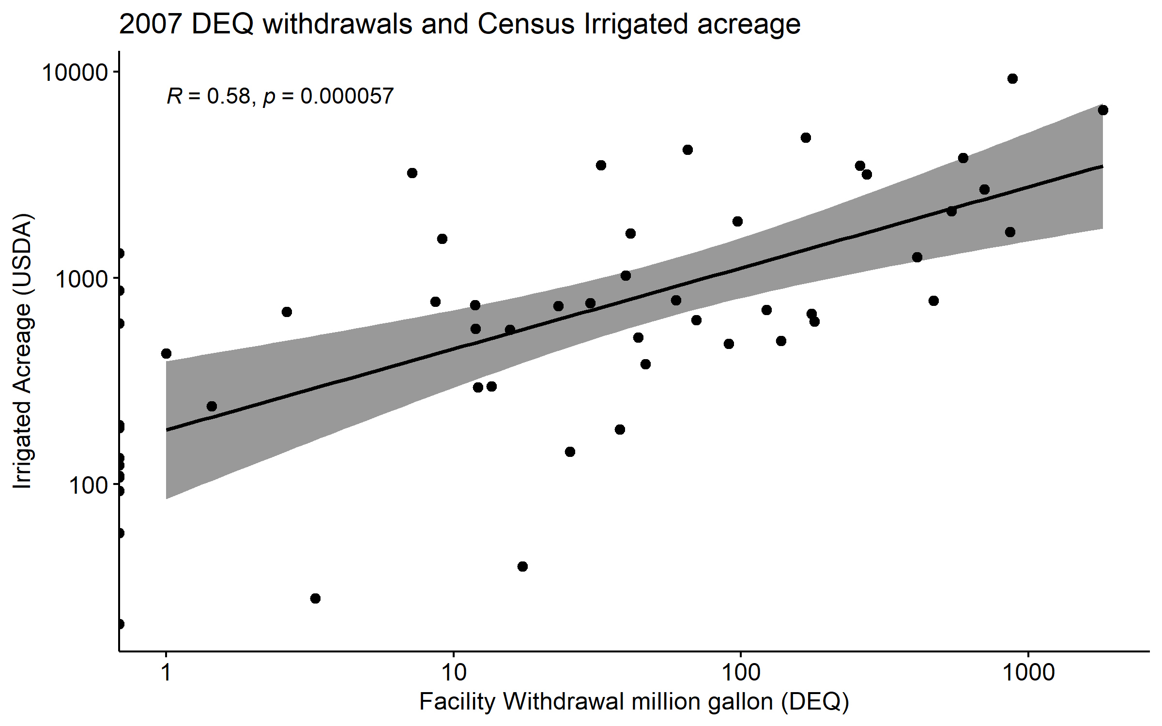
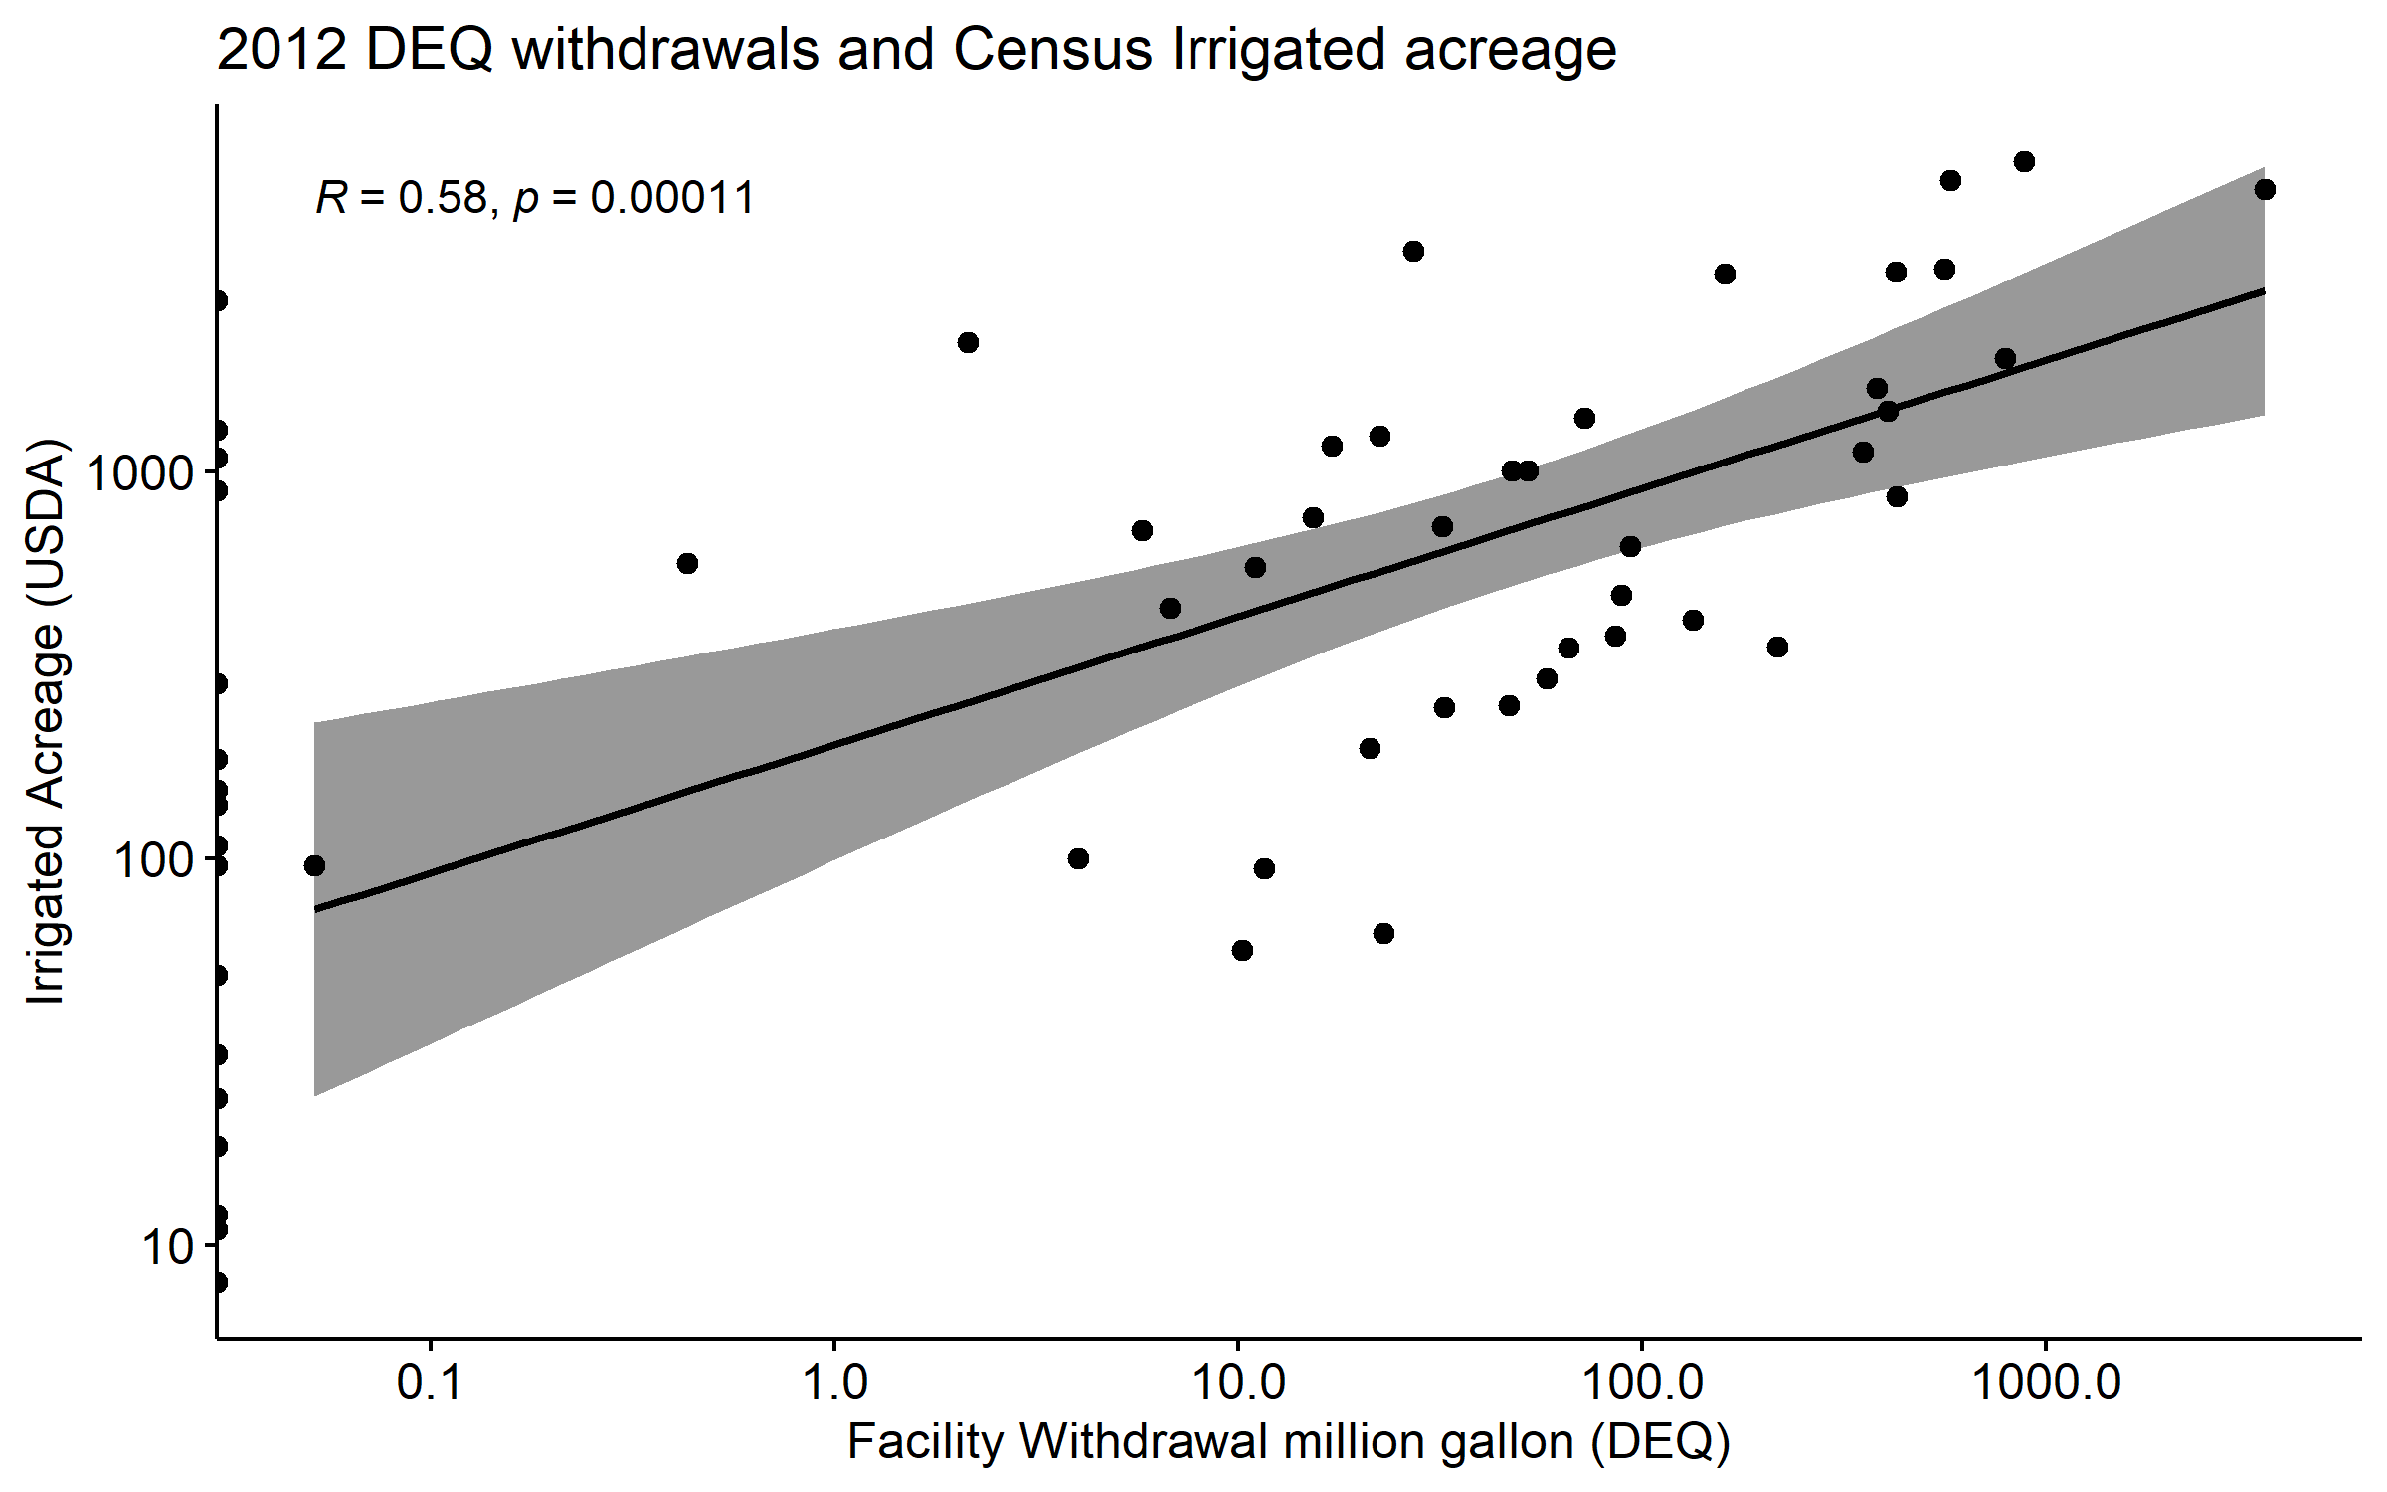
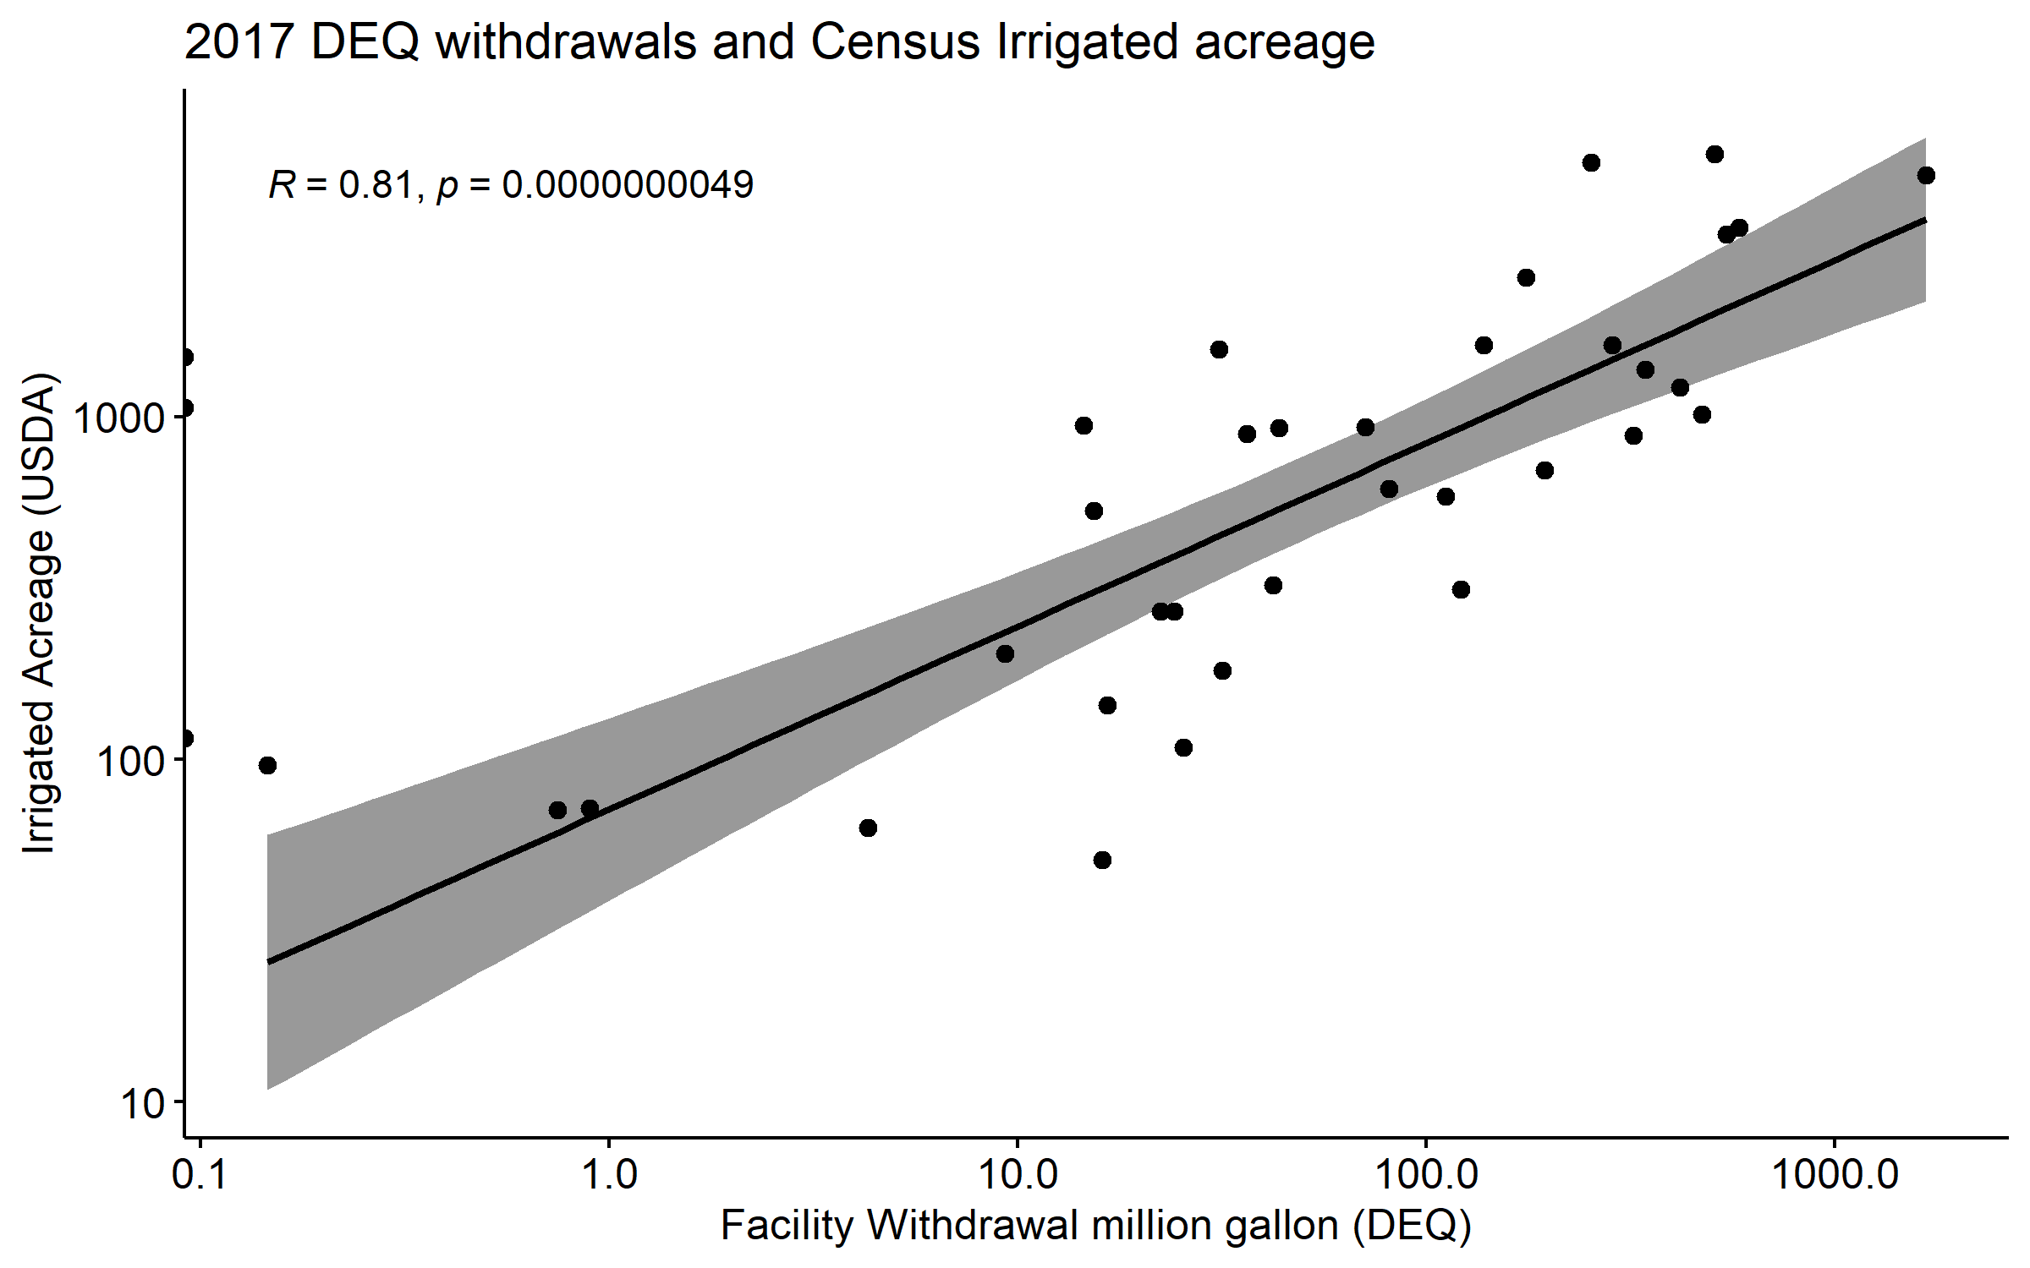

Slide 23
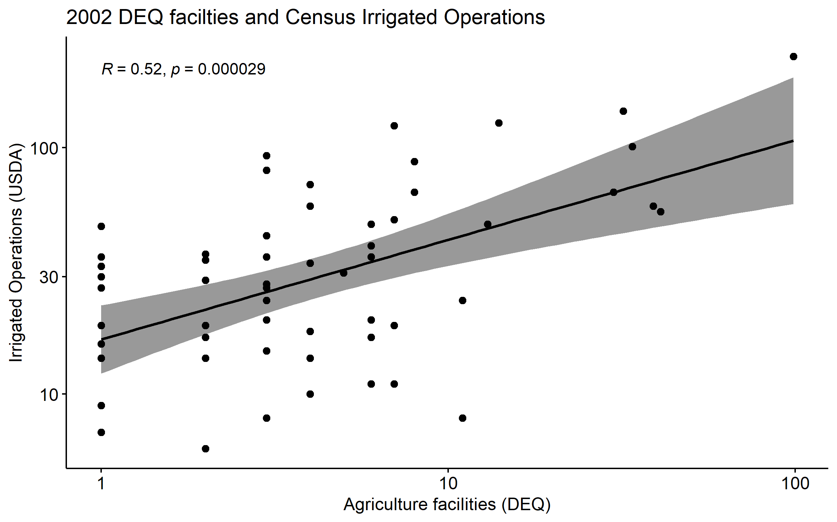
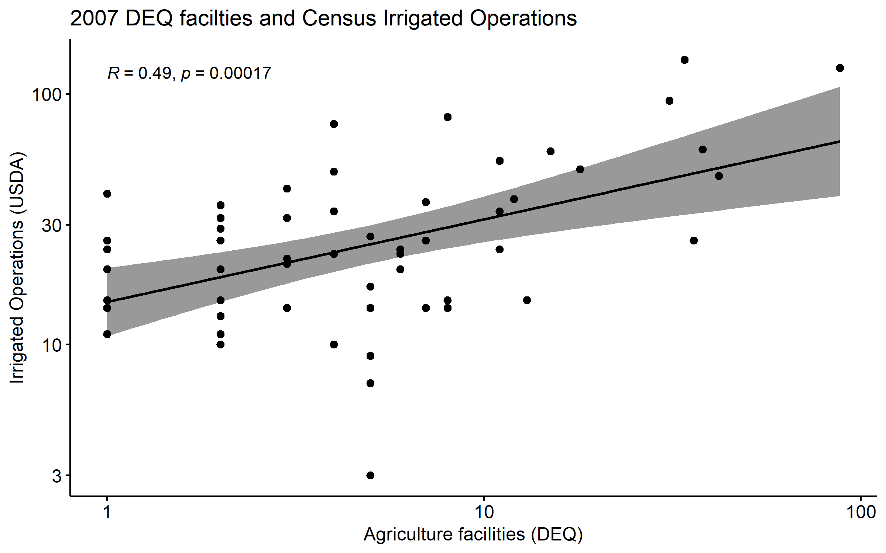
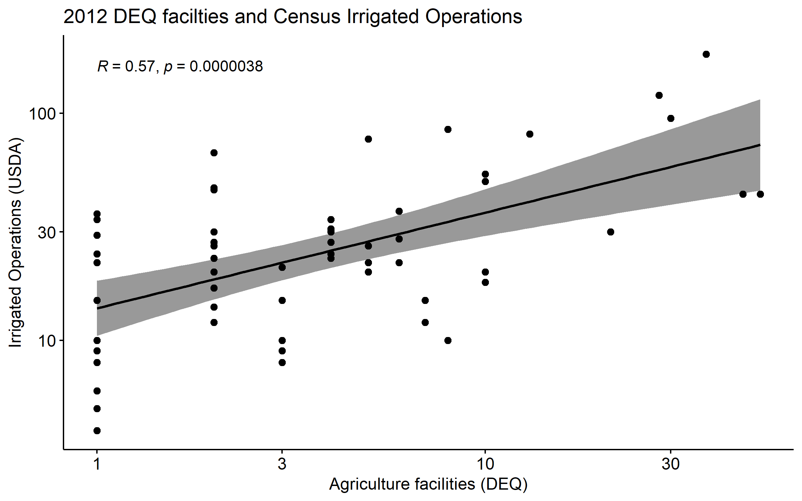
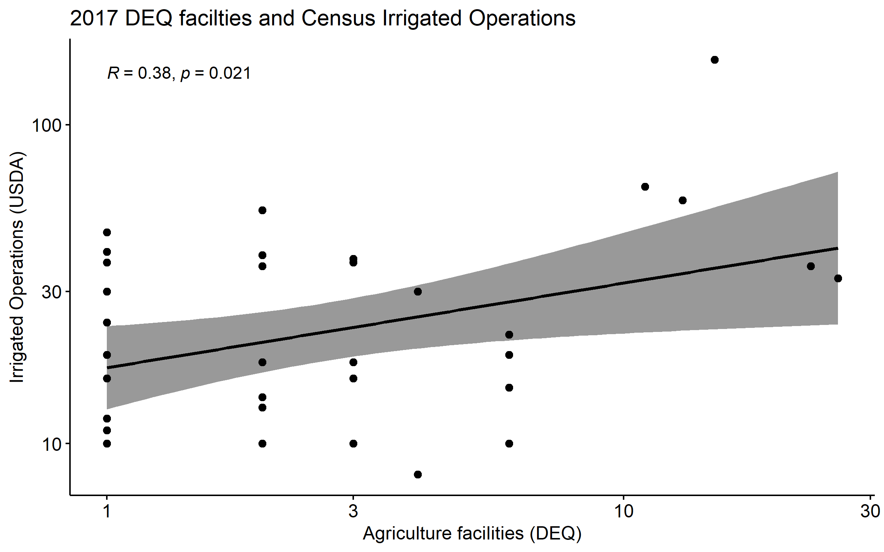


Slide 24
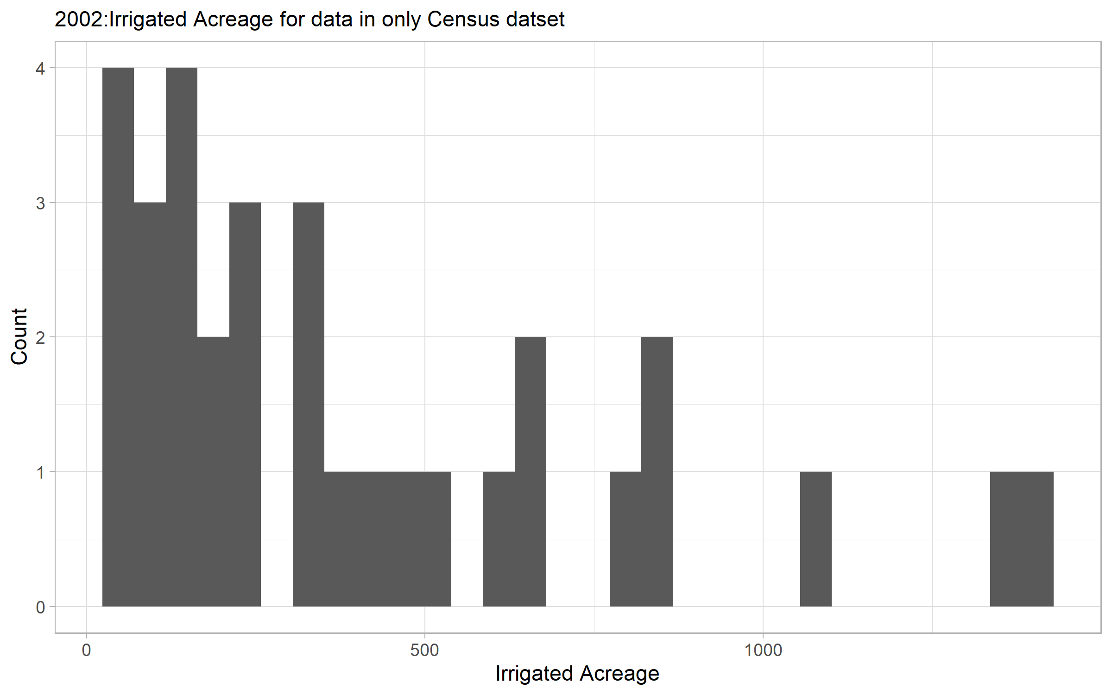
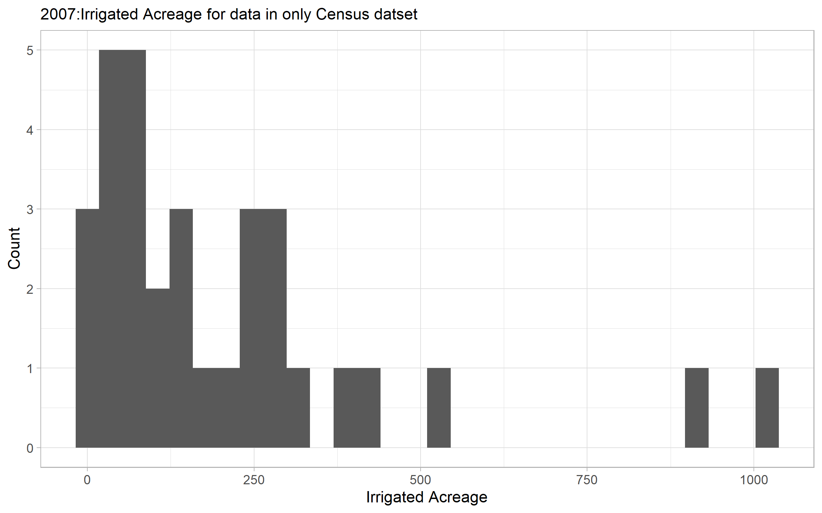
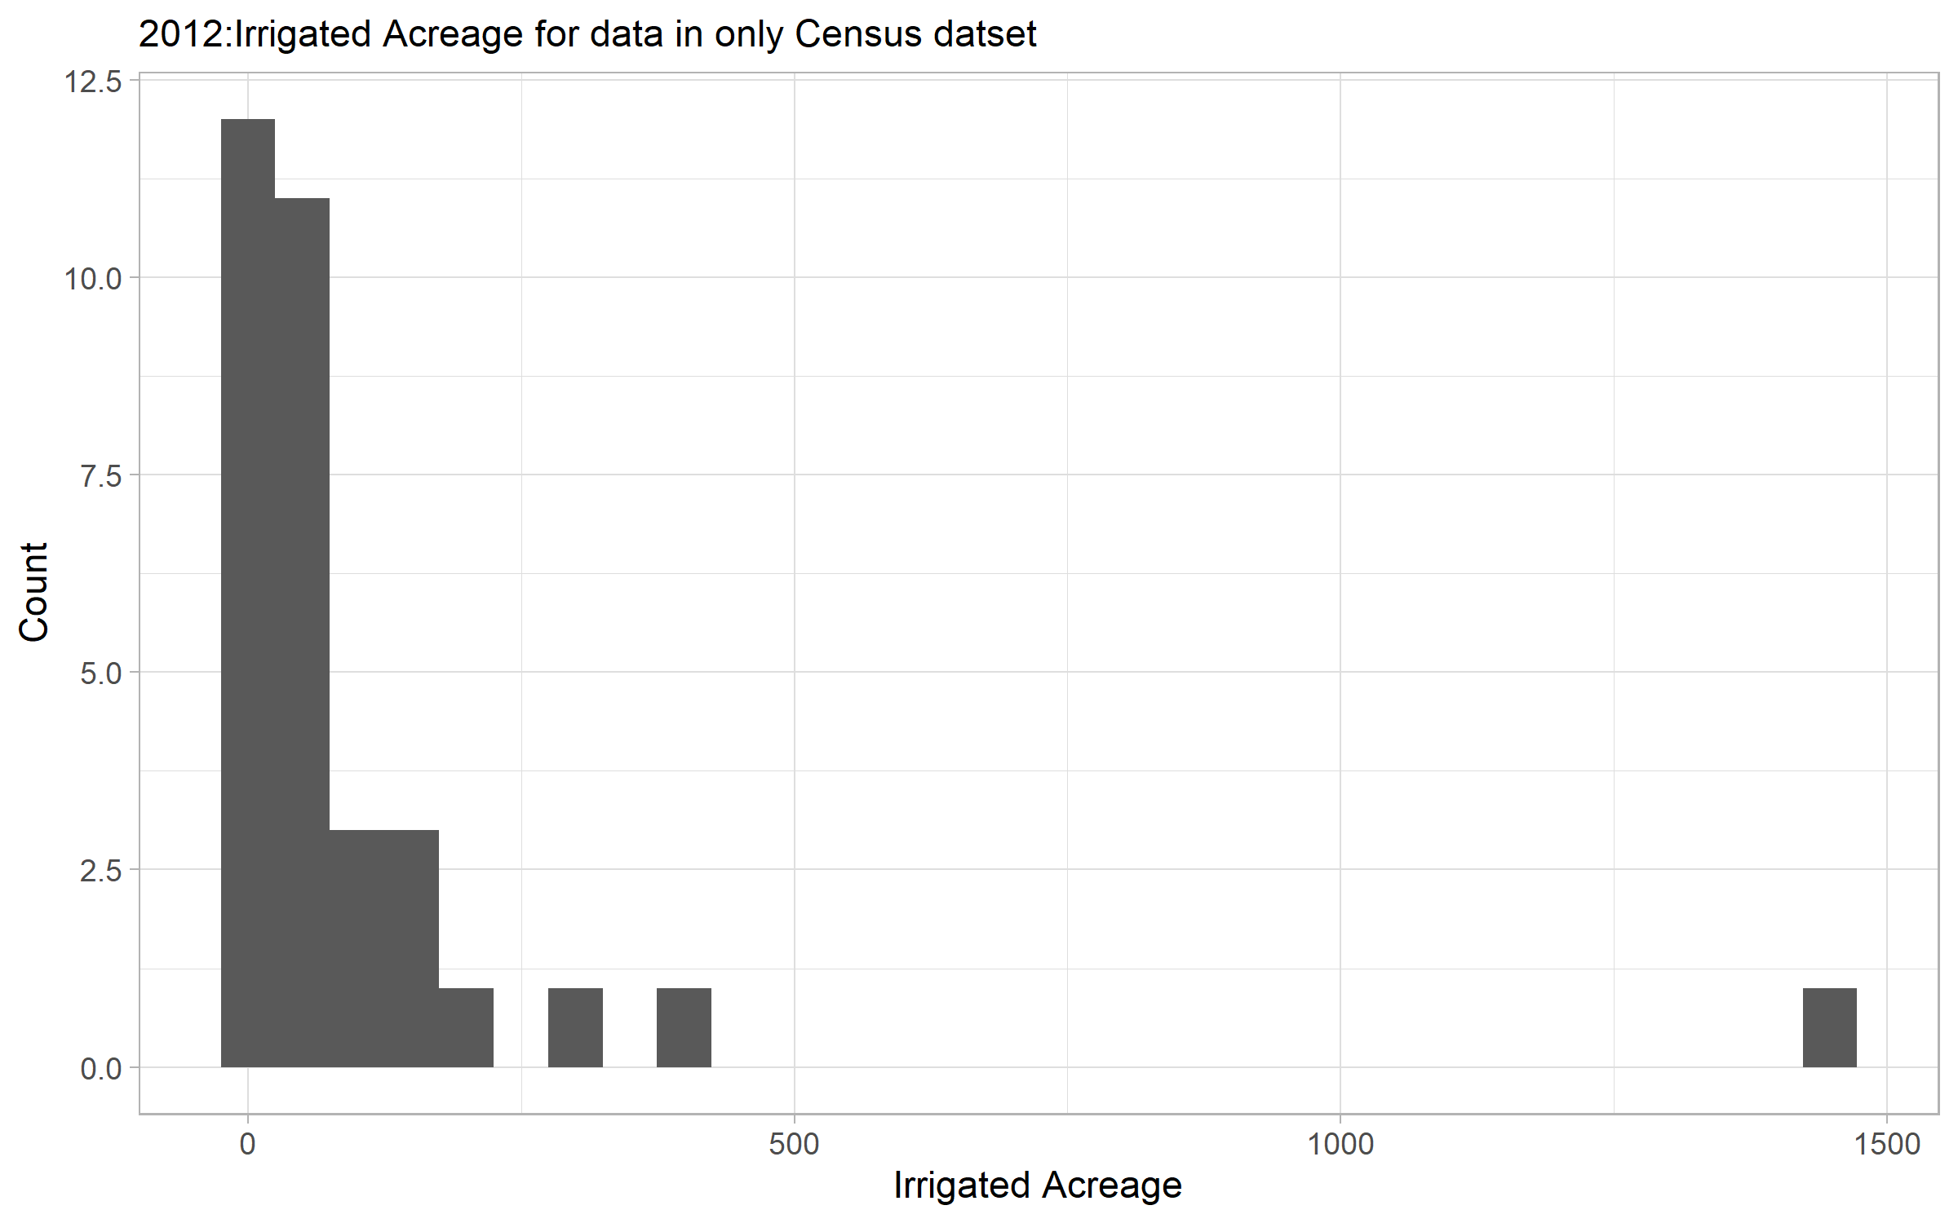
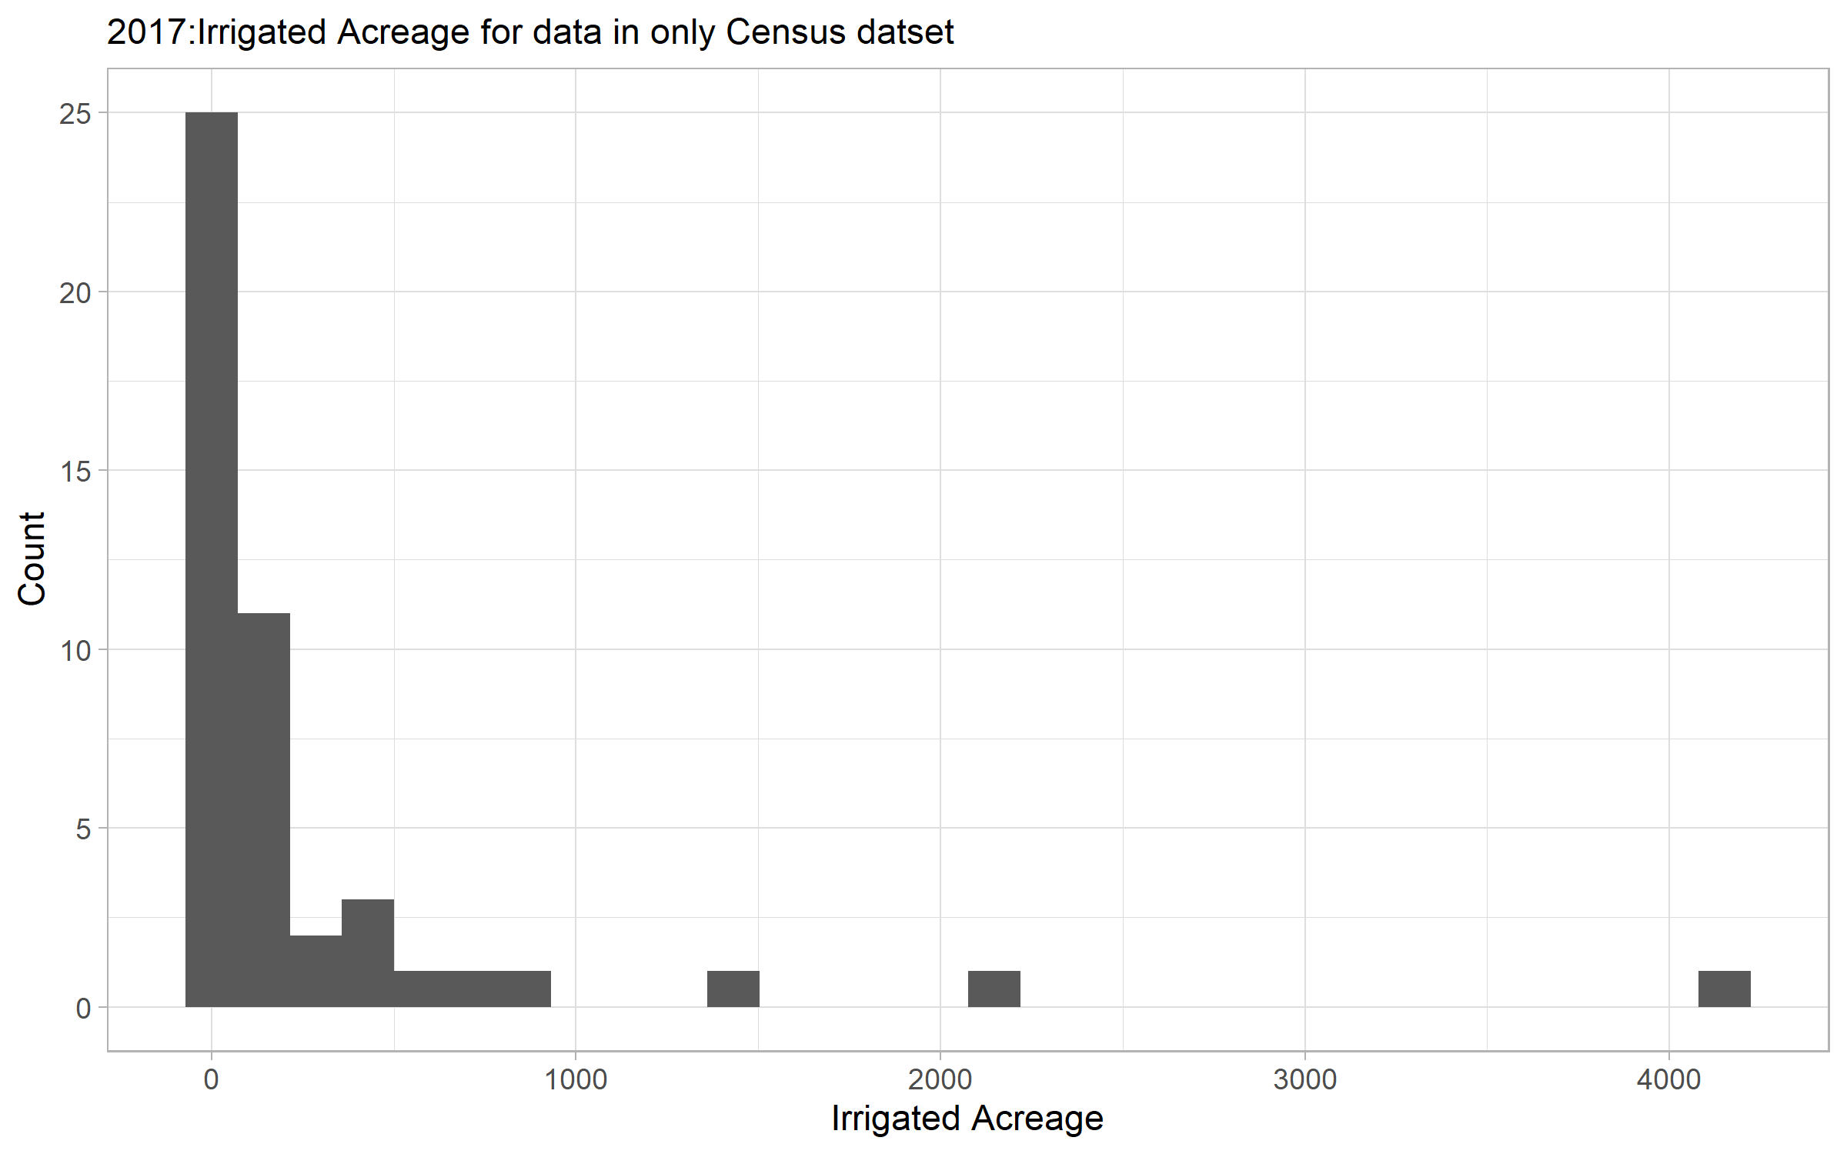





Notes:
Overview of counties missing in DEQ datset

Slide 25
EXTRA Slides

Slide 26
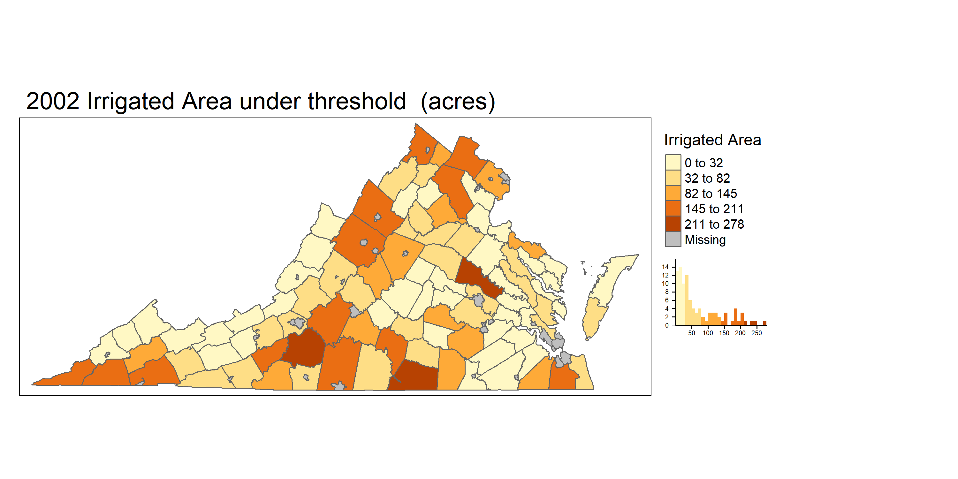
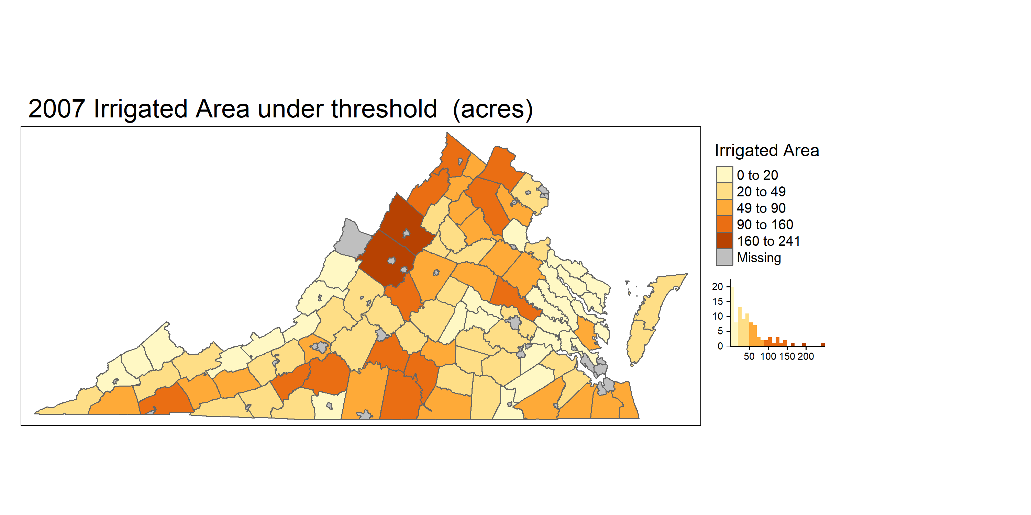
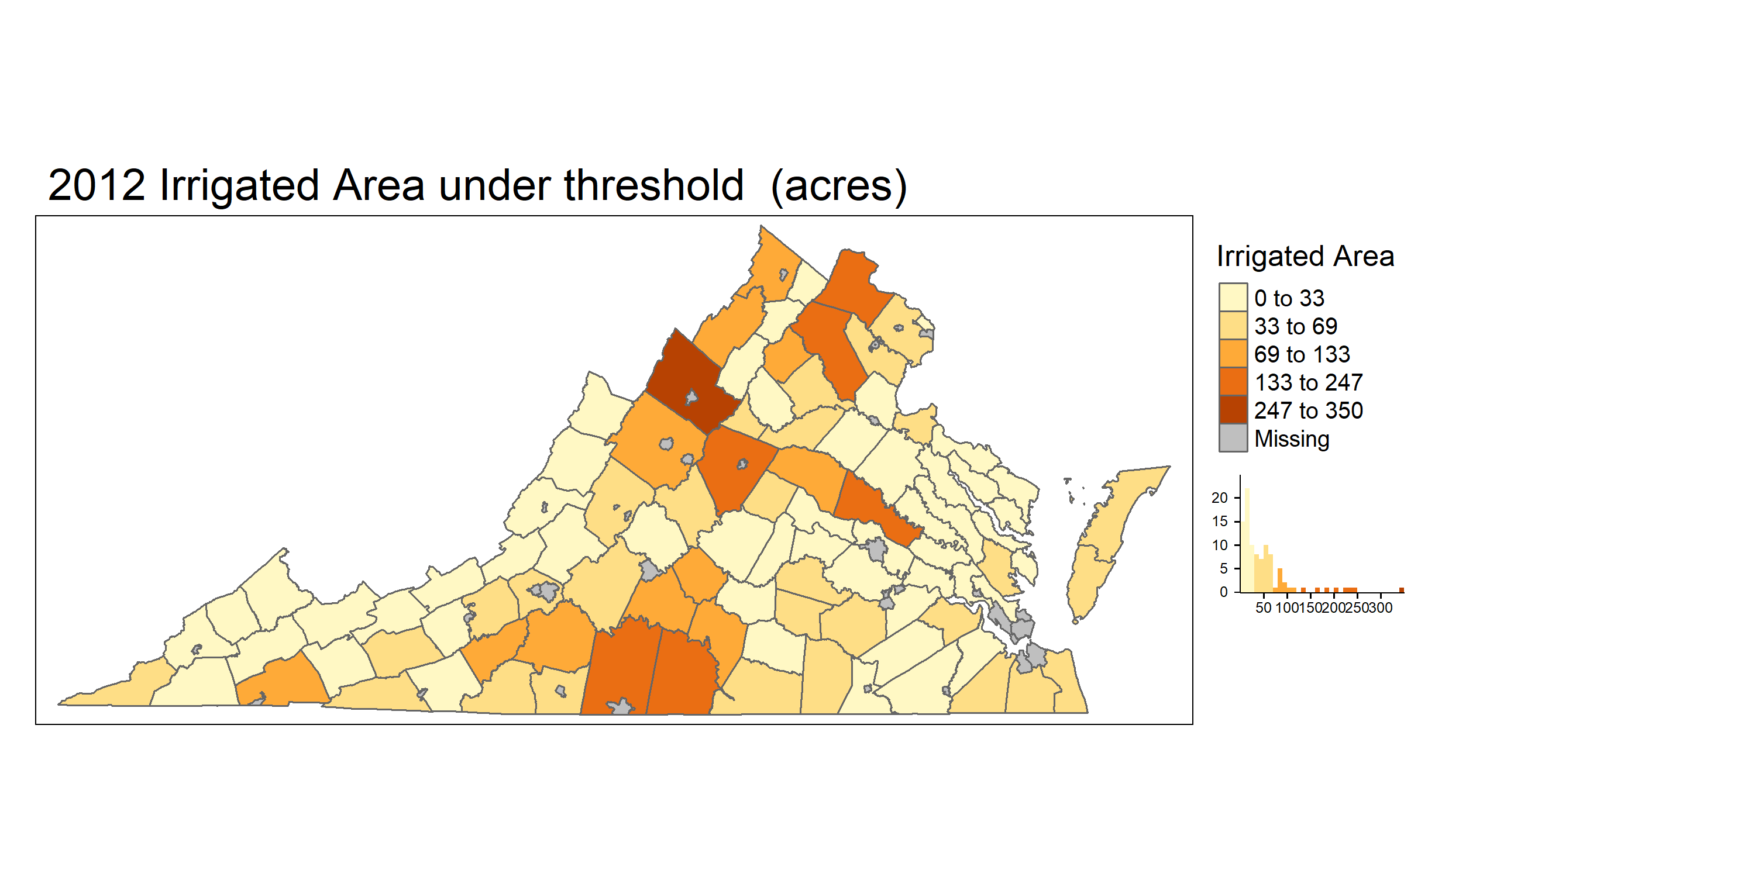











Irrigated area under threshold

Slide 27
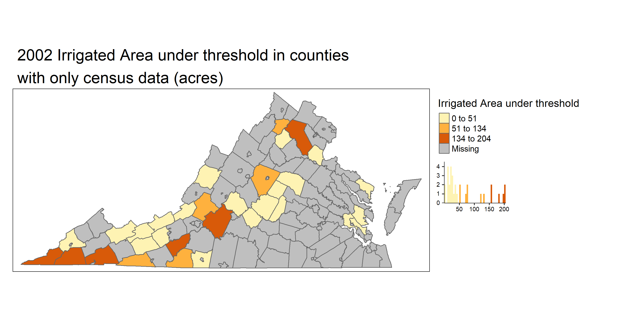
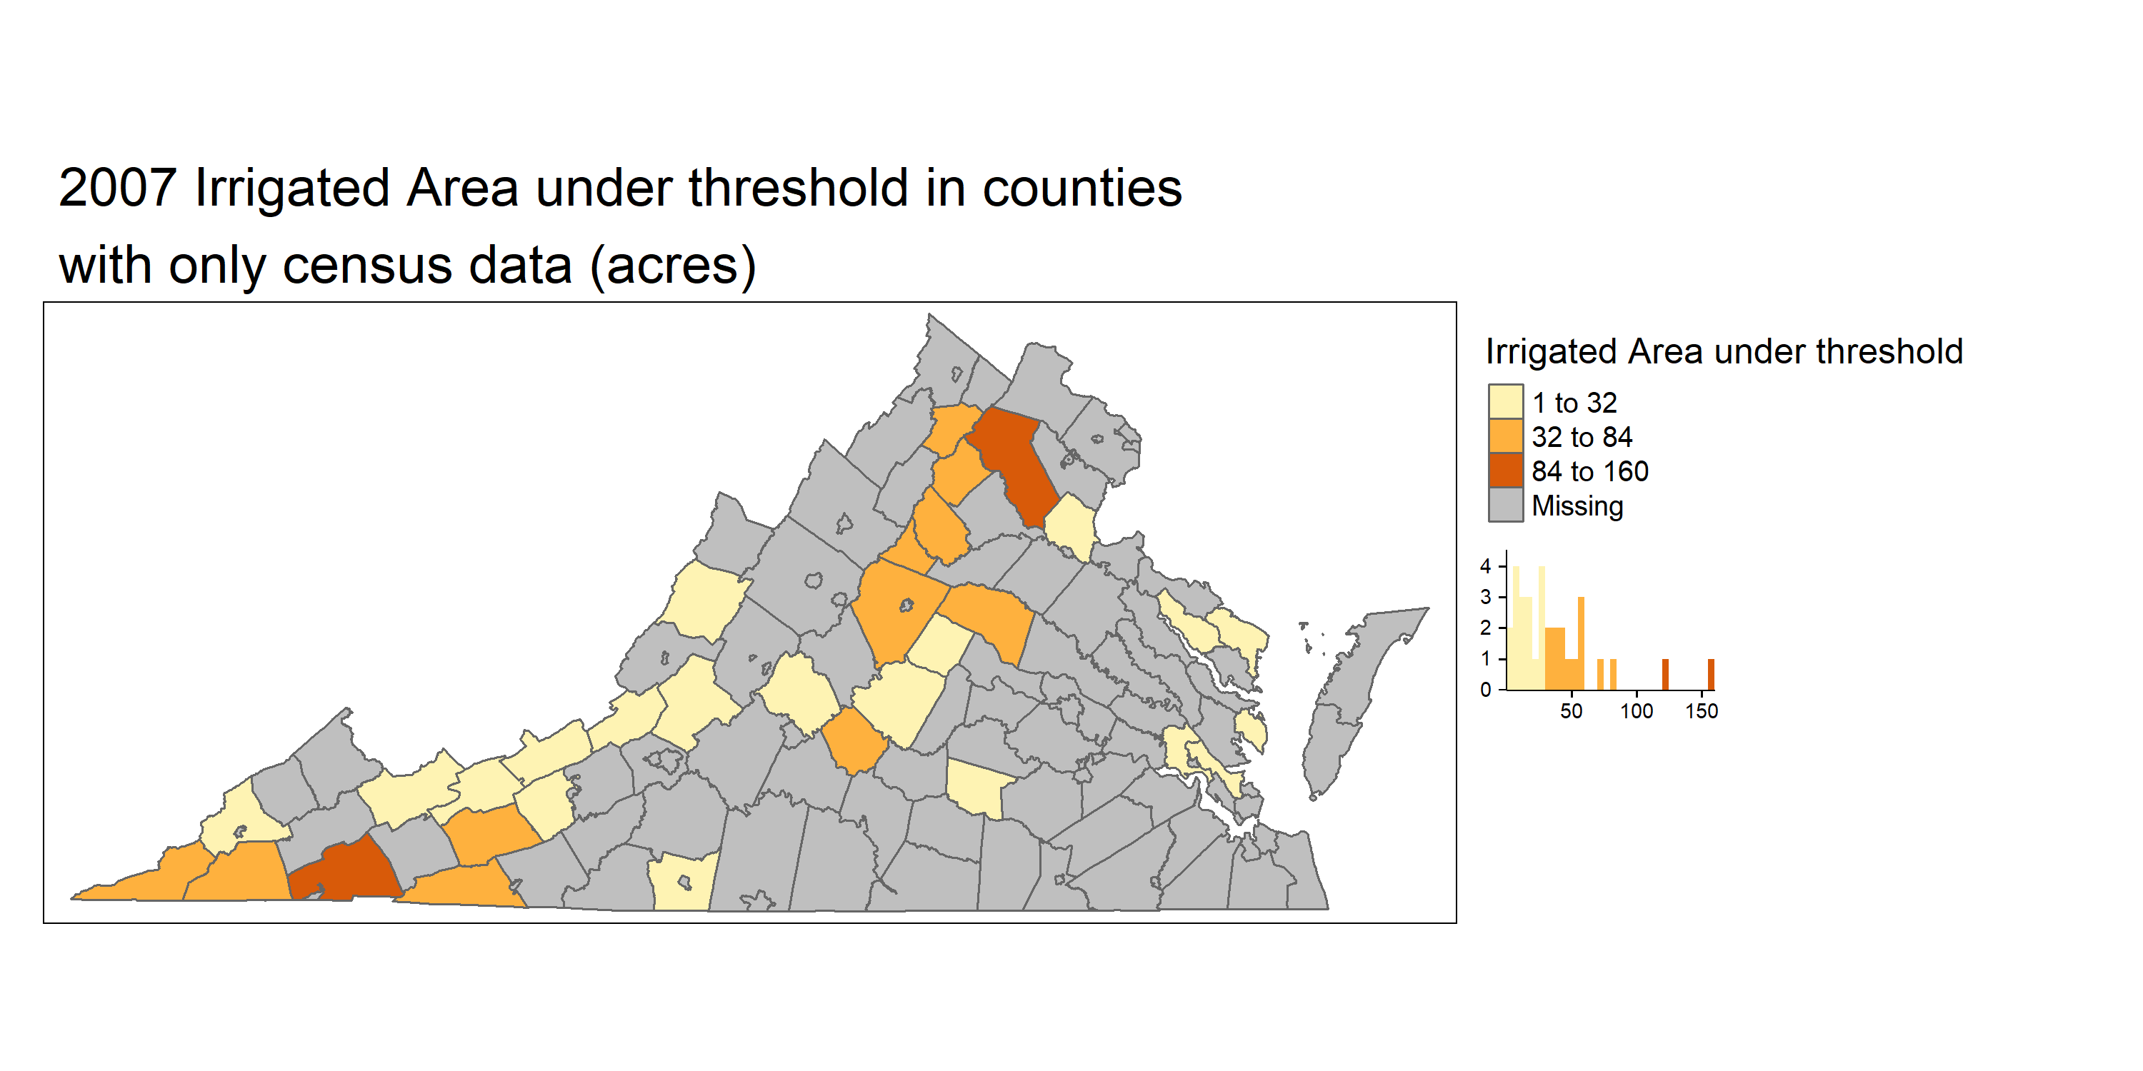
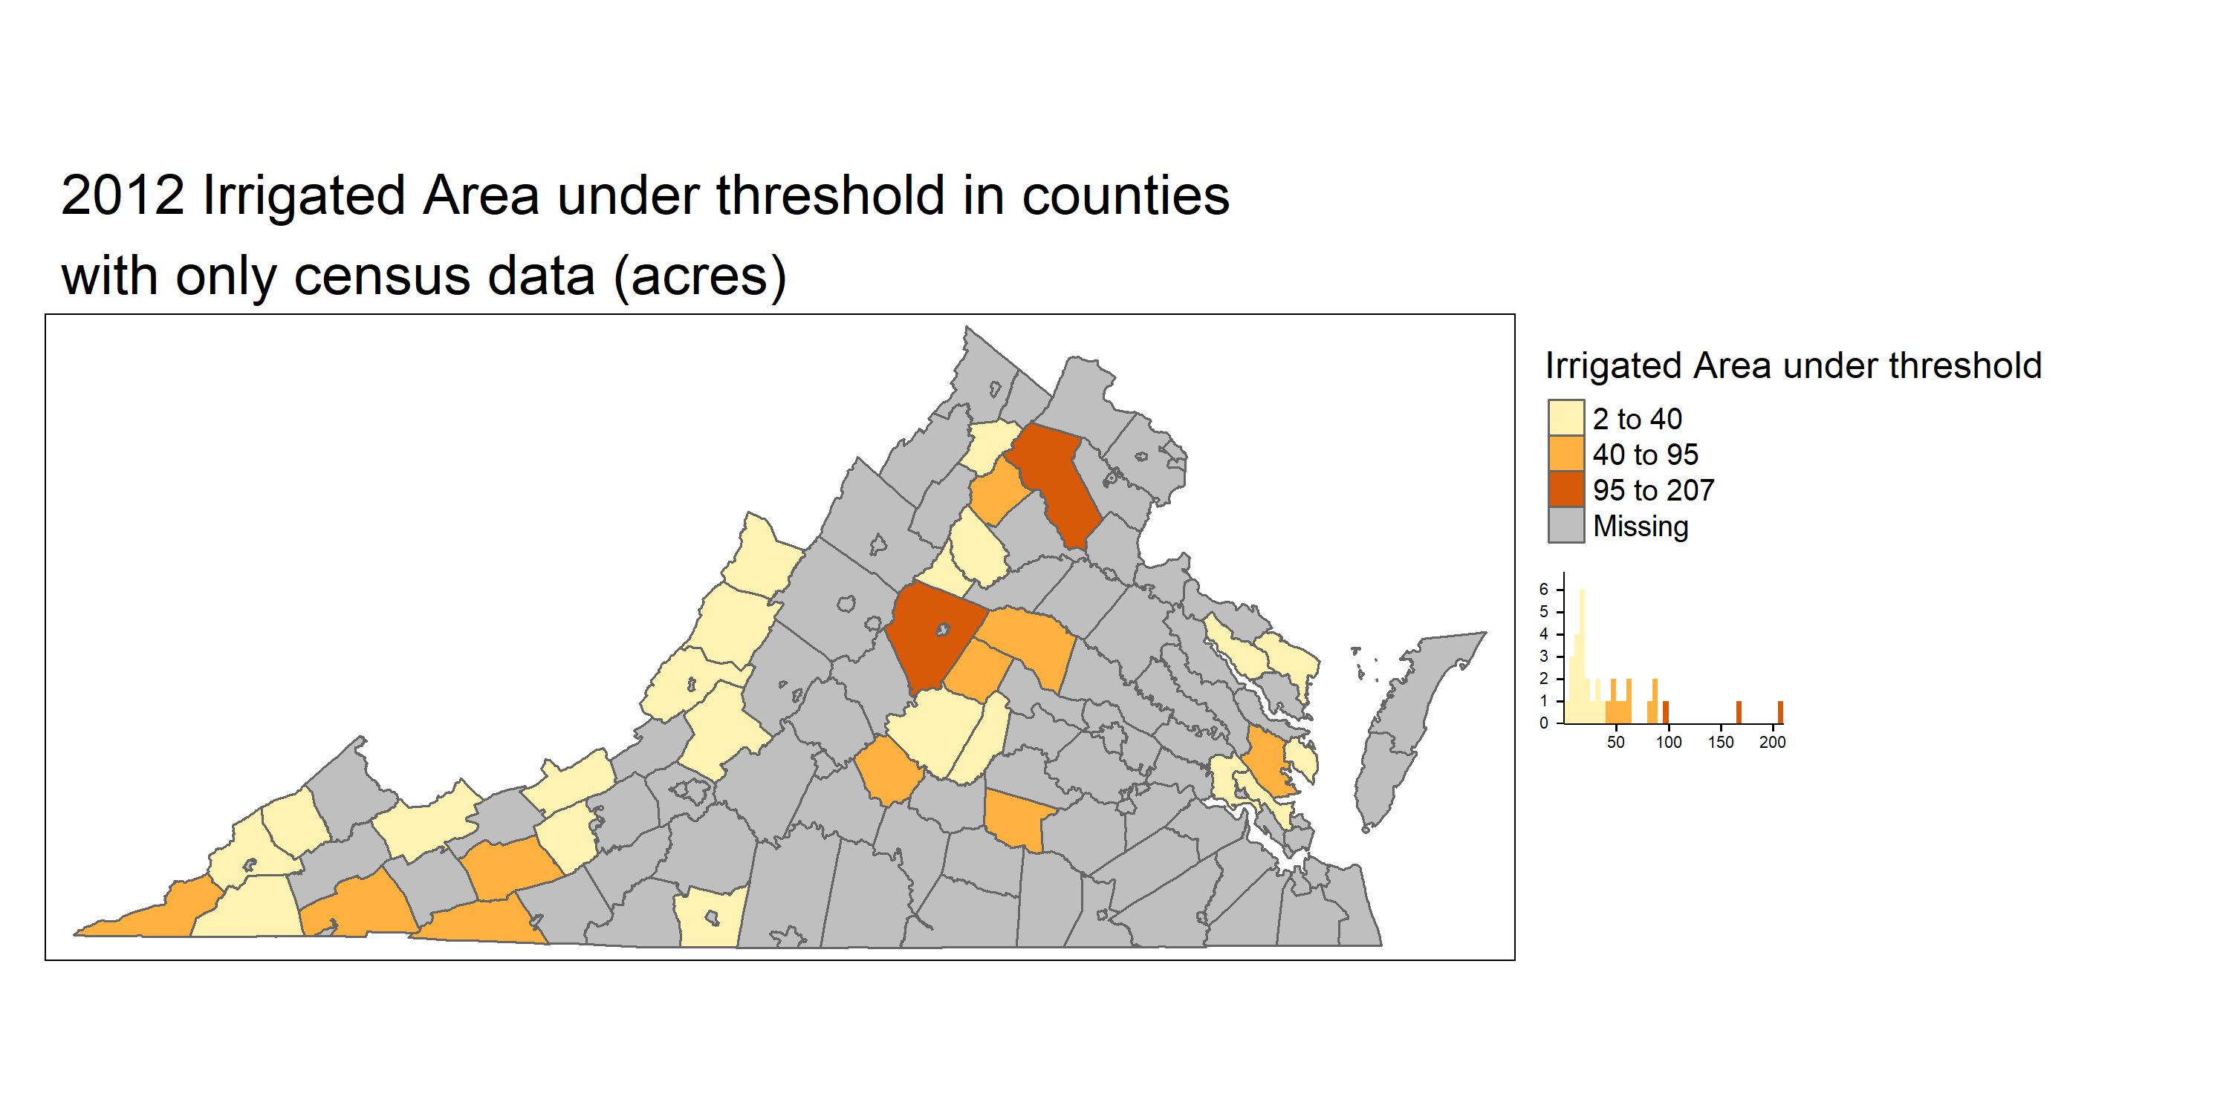

Irrigated Area under threshold for counties missing in DEQ dataset

