Slide 1


Sediment and Nutrient
Land Calibration
Jing Wu
Modeling Subcommittee Quarterly Review
May 19, 2011

Slide 2
What’s Changed…
Land use – more classes, increase in urban acreage
New segmentation - Federal lands
New hydrological calibration method – incorporating ICPRB low flow simulation
New application rates (?)

Slide 3
What’s remained the Same…
Sediment/Nutrient Targets
Same targets for sediment
Median TN/TP targets from literature review for each land use
Calibration Methodology
Methodology has been stable since 2006

Slide 4
Land Sediment Simulation
Detached Sediment
Wash off
KSER
Rainfall
Detachment
Generation
KRER
Attachment
AFFIX
NVSI
Soil Matrix
(unlimited)
4 parameters, 1 target

Slide 5
Land Use Categories for Sediment
Agriculture
Pasture
Bad pasture
Hay
Nursery
High till with manure
High till without manure
Low till with manure
Other –
Forest
Harvested forest
Extractive
Construction
Pervious developed
Impervious developed

Slide 6
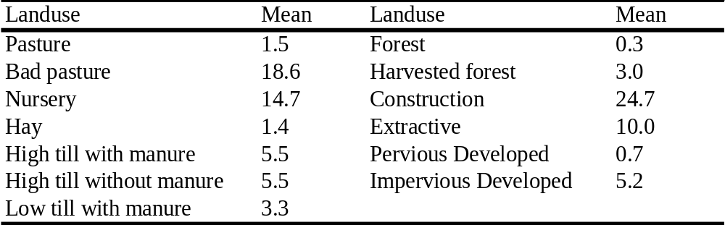
EOF Targets for Sediment
Agricultural land uses - NRI gave estimates of Pasture and Cropland for each county, based on RULE
Other land uses - Sediment load targets come from literature review

Slide 7
Sediment Calibration Strategy
Calibrate Edge of Field to targets for each county/each land use
Reduce the parameter set through a series of decision rules
Develop automatic calibration routine

Slide 8
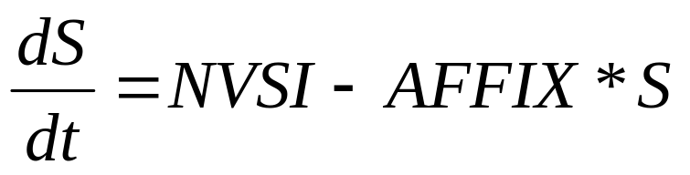
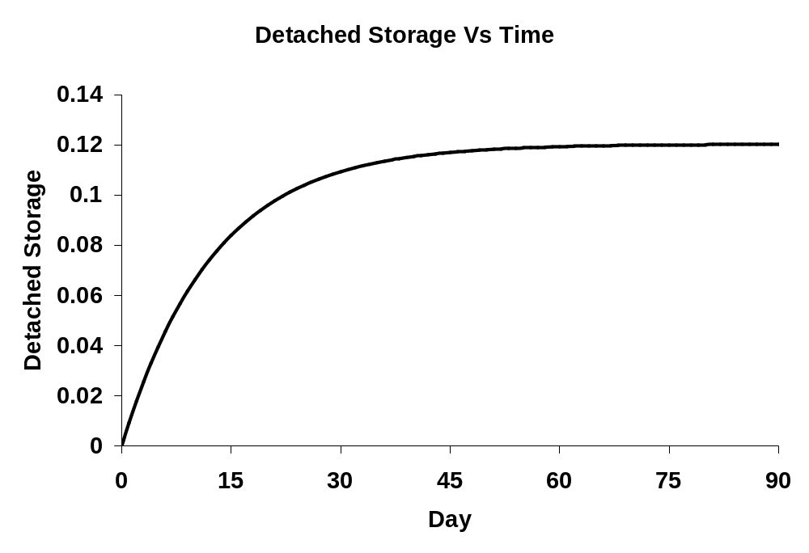
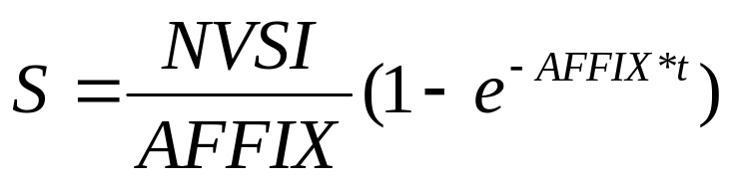
Decision Rules for Four Key land Parameters:
Rule1 – Detached Sediment Storage Reaches
90% of its Max in 30 Days
AFFIX = 0.07673

Slide 9
Rule2 – Generation makes up significant portion of
Detached Sediment
Detached Sediment
Rainfall
Detachment
Generation
KRER
NVSI
Soil Matrix
(unlimited)
NVSI = [significant fraction] * target load

Slide 10
Rule 3 - Zero Detached Sed after Large Storms
1. Assume ratio of KSER : KRER
2. Adjust KSER to ensure:
- No build-up after most big storms
- meet targets
Detached Sediment
Wash off
KSER
Rainfall
Detachment
Generation
KRER
Attachment
AFFIX
NVSI
Soil Matrix
(unlimited)

Slide 11
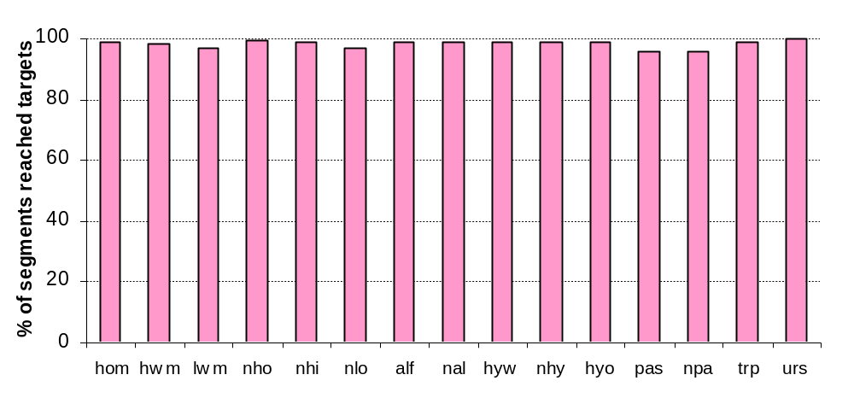
Sediment Calibration Results

Slide 12
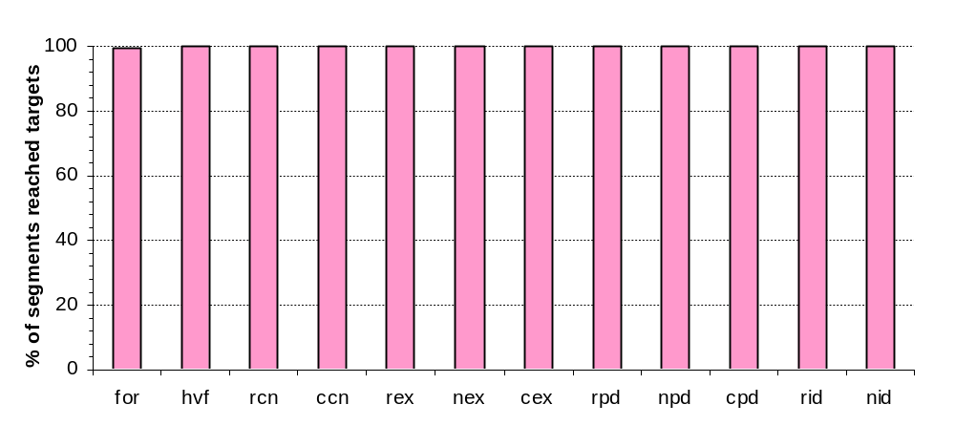
Sediment Calibration Results

Slide 13
Land Nutrient Calibration
Calibrate Edge of Field (EOF) loading to specific targets for each land use
Same calibration methodology - stable since June 2006
Same Median TN/TP targets estimated from literature review, but slightly different spatial varied targets due to changes in application rates
Different modules used for different land uses, depending on the applicability of a mess-balance approach and availability of field uptake data

Slide 14
Land Use Group for Nutrient
Hay with manure
Alfalfa
High till with manure
High till without manure
Low till with manure
Forest
Pervious developed
Hay without manure
Pasture
Bad pasture
Nursery
Extractive
Construction
AGCHEM for N and P
AGCHEM for N and PQUAL for P
PQUAL for N and P

Slide 15
Calibration Targets - 8 for each land use
}
NH₃
NO₃
Labile ORGN
Refractory ORGN
SURFACE
INTERFLOW
(“slow” surface flow)
lower soil layer
NH₃
NO₃
Labile ORGN
Refractory ORGN
Groundwater

Slide 16
Nitrogen Cycle in Watershed Model
(After HSPF documentation)
Trees
Denitrification
denitrification
Roots
Leaves
Nitrate
Atmospheric Deposition
Export
nitrification
Nitrate/ammonium
immobilization rate
Solution
Particulate
Particulate
Ammonia
Labile
Refractory
Volatilization
organic N mineralization
Organic N
Organic N
partitioning coefficient
for labile organic N
partitioning coefficient
for refractory organic N
Export
Export
Export
Solution
Solution
Adsorbed
Export
Export
Refractory
Export
Labile
Ammonia
Organic N
Organic N

Slide 17
Automatic Calibration Method
Assess the sensitivity of model parameters to particular model outputs in attempting to match ‘target loadings’
Make calibration feasible (more than 60,000 targets to meet)
Ensures even treatment across jurisdictions
Repeatable. Can easily rerun with updated
data / rules / segmentation

Slide 18
Decision Rules - Nitrogen
Optimize parameters to reach EoS targets and crop uptake
- Adjust organic N mineralization rate to reach balance between Organic
N and Inorganic N
- Adjust nitrification rate and denitrification rate (below surface ONLY)
to reach NH4 and NO3 targets
- Adjust particulate/soluble partitioning coefficient to reach Organic N
targets
- Adjust NH4/NO3 immobilization rate and Wilting Points to reach
uptake targets
Optimize initial storages of organic N to stabilize storage over time

Slide 19
Decision Rules - Phosphorus
Parameters subject to calibration
Decision rules
- Adjust phosphate immobilization rate to control transformation inorganic P
- Adjust Organic P mineralization rate to reach uptake targets
- Adjust coefficient in the single-value Freundlich method to reach PO4
targets
Plant
-
P
P
lant
Uptake
Adsorption
Mineralization
Adsorbed Phosphate
(PO4-A)
Phosphate in Solution
(PO4-S)
Organic Phosphorus
(ORG-P)
Desorption
Immobilization

Slide 20
Measurements of Nutrient Calibration
TN, TP loads within 25% of targets
Each species fairly close to its own targets
Crop uptake within reasonable range of observed data
Stable N storage over time
Reasonable response to nutrient management actions
Parameters in a fairly constrained distribution

Slide 21
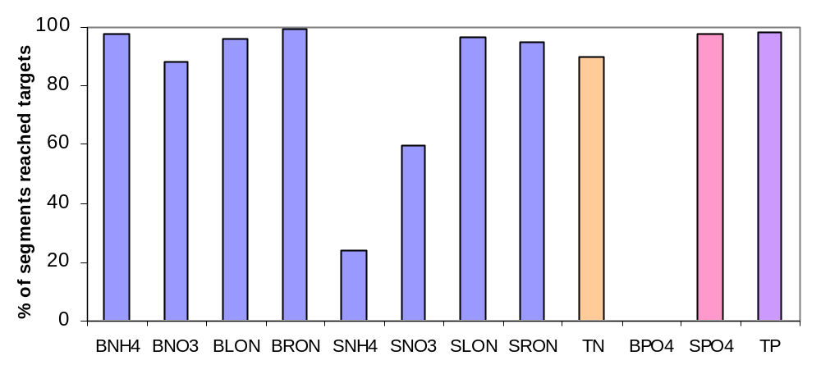
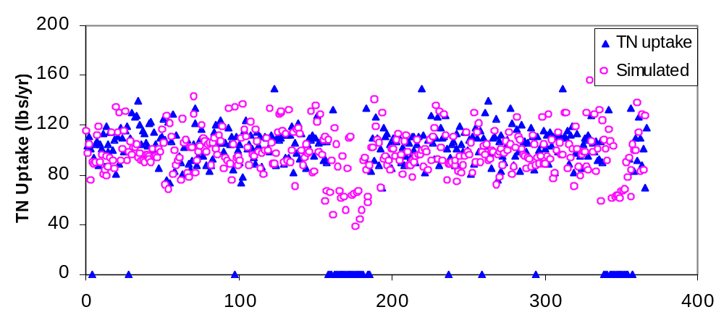
High tillage with manure

Slide 22
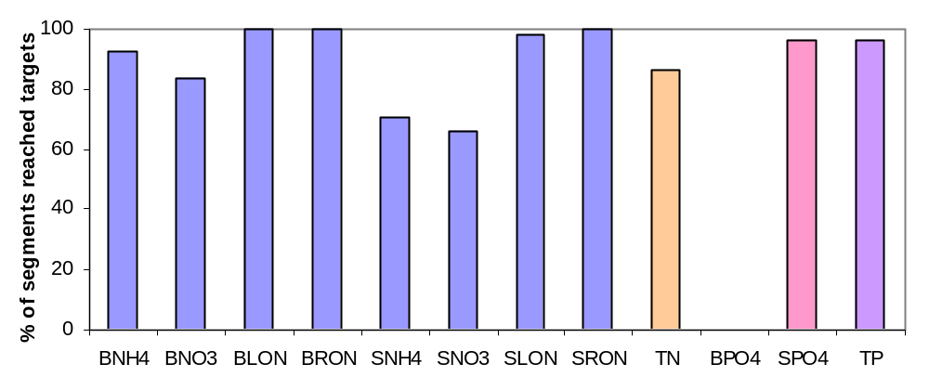
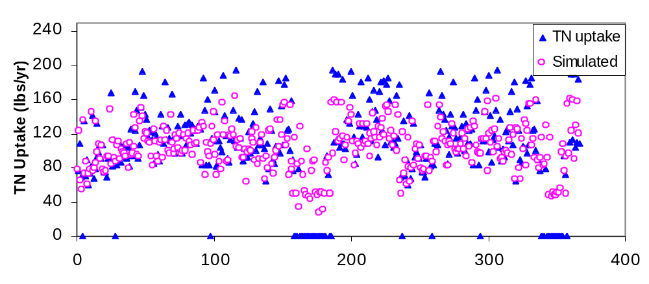
High tillage with/o manure

Slide 23
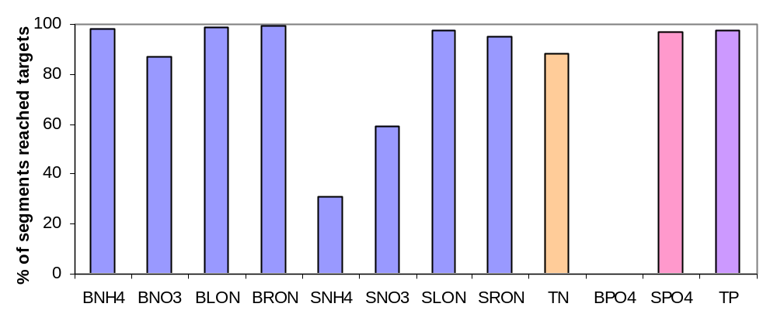
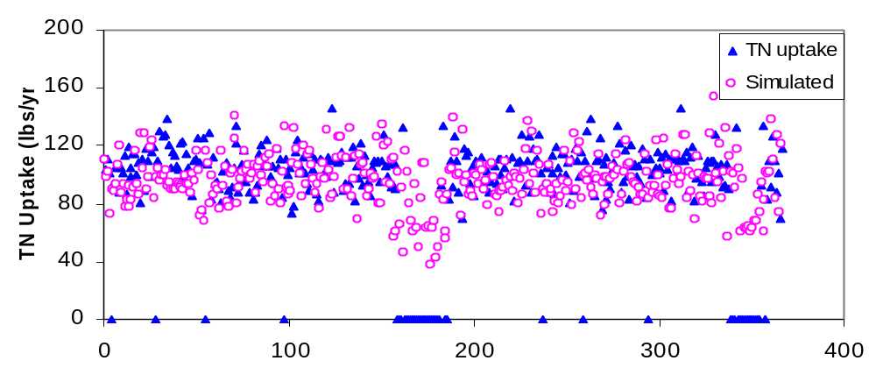
Low tillage with manure

Slide 24
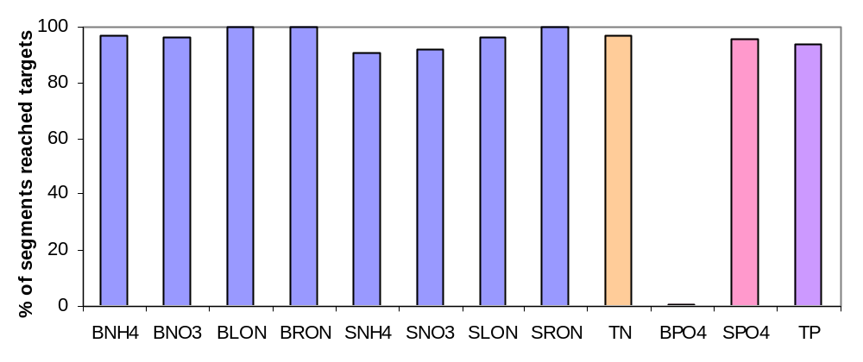
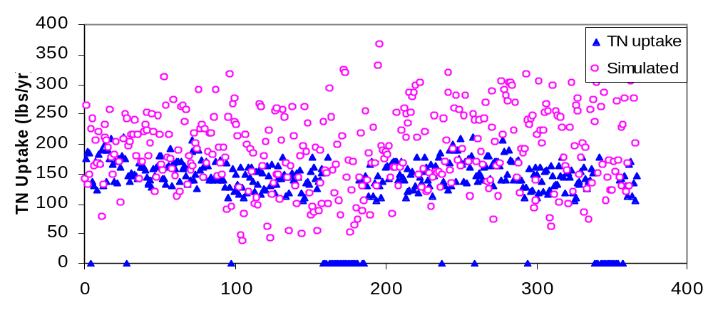
Alfalfa

Slide 25
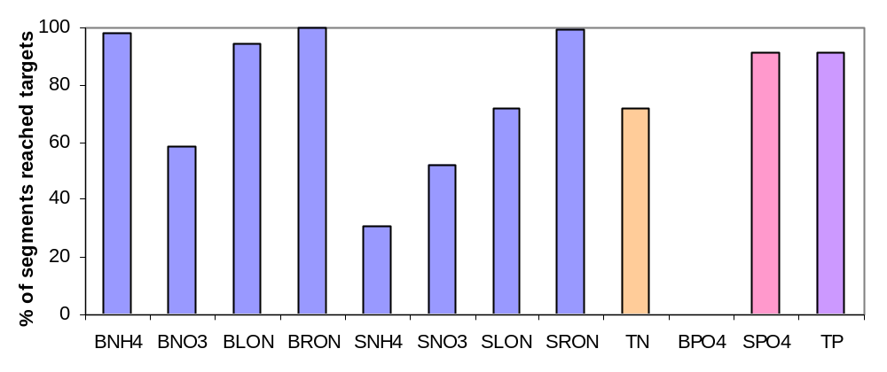
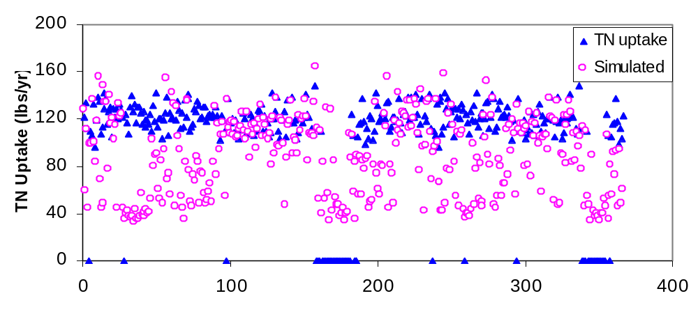
Hay with manure

Slide 26
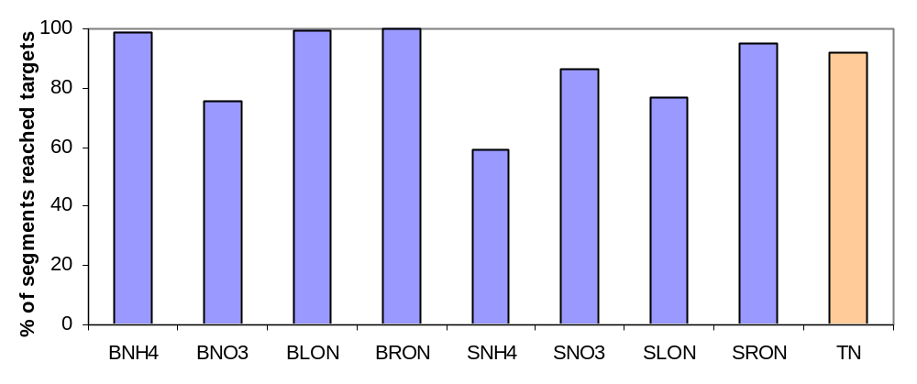
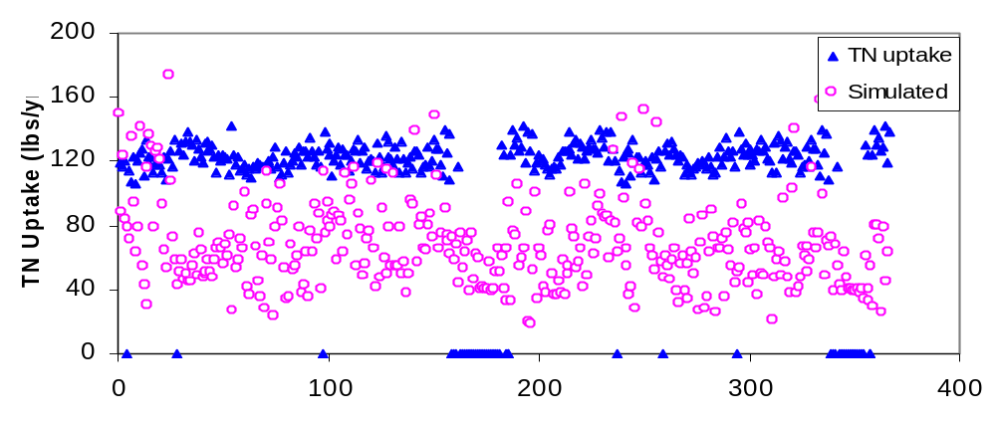
Pasture

Slide 27
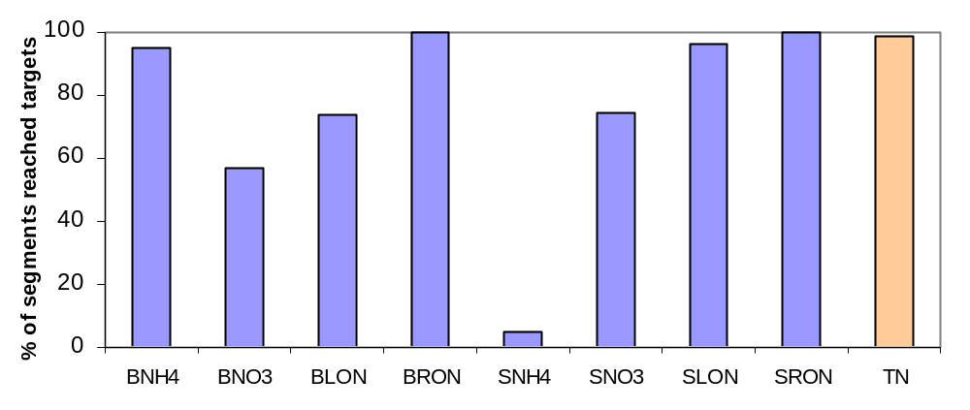
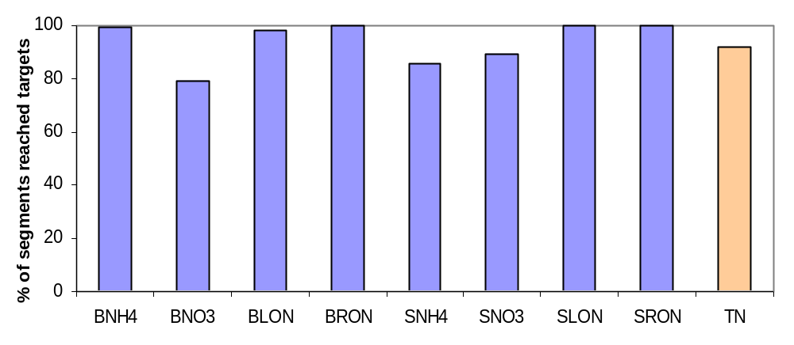
Forest
Hay with/o manure

Slide 28
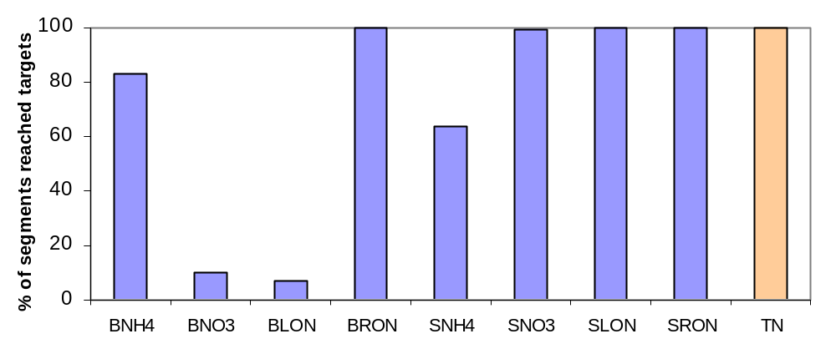
Pervious Developed

Slide 29
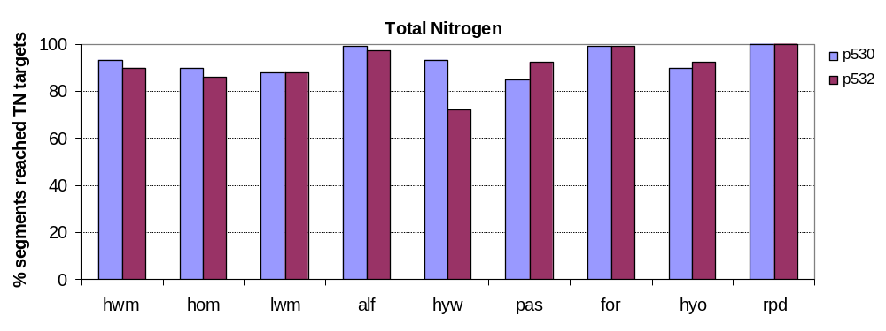
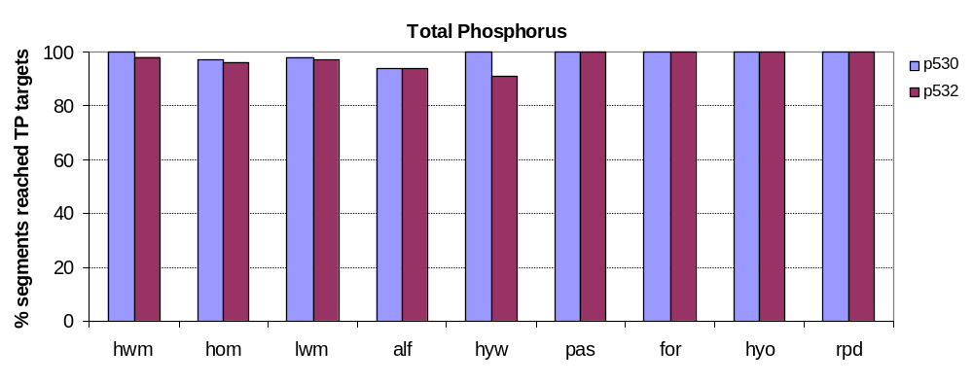
Comparison with P53 Calibration

Slide 30
Summary
Simulated sediments load match targets very well for each land use, as always
Simulated nitrogen and phosphorus loads within range of targets, particularly for TN, TP.
P532 calibration results are very similar to p530

