Slide 1
Phase 5 land segmentation is
primarily county-based
Some counties were divided to accommodate different rainfall patterns.
Reasons why counties are a practical choice for segmentation:
  Most counties are completely within a hydrogeomorphic region
  BMP and Crop data are not known on a finer scale in most cases
  Near the limit of computing capacity

Slide 2
Phase 5 river segmentation
Consistent criteria over entire model domain
  Greater than 100 cfs
    or
  Has a flow gage
Near the limit of meaningful data

Slide 3

With different and non-nesting land and river segmentation schemes, how do you run the model?
The river segment (shown in black outline) must take inputs from four different land segments (shown in red outline)
The intersection of land segment and river segment should have a particular land use acreage based on satellite imagery, not just proportional to the land segment as a whole.

Slide 5
Logistics problem
308 land segments and 25 land use types = 7500 independent land simulations requiring 7500 input files that must be modified during calibration and scenarios
930 rivers requiring input files
50,000 land use / river connections

Slide 7
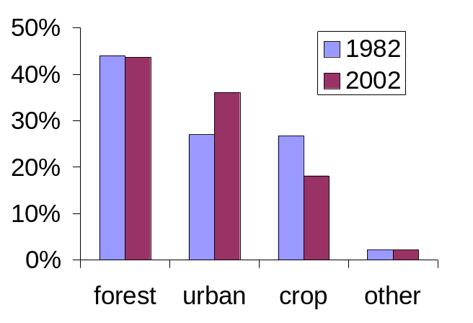
Since this software is outside of HSPF, we can incorporate other features, for example, land use change or BMP change over the course of the calibration 1984-1999
External
Transfer
Module
Land use change in the Patuxent Basin 1982-2002

Slide 8
{
Nutrient
Application
Database
Module
Specification
Database
Process
Parameter
Database
Control file
Land Input File Generator
Each land use type simulation within each land segment requires a unique input file. Software was developed to automatically generate these.

Slide 9
{
Module
Specification
Database
Process
Parameter
Database
Control file
River Input File Generator
Each river simulation also requires a unique input file. Software was developed to automatically generate these.

Slide 10
Model Software Structure
WDM = HSPF-specific binary file type
UCI = User Controlled Input (input file)
MET
WDM
ATDEP
WDM
PS
WDM
Land Input File Generator
River Input File Generator
1
4
External
Transfer
Module
2
3
5
Land variable
WDM
River variable
WDM
Final Text
Output
6
Land UCIs are generated
HPSF is run on the land UCIs and output is stored in individual WDMs
The ETM is run converting land output to river input, incorporating land use, BMPs, and land-to-water delivery factors. Output is stored in river-formatted WDMs
River UCIs are generated
HSPF is run on the river UCIs and output is written back to WDMs
Postprocessor reads river WDMs and writes ASCII output

Slide 11
ETM Functionality
Interposing non-HSPF software between the land and river simulation allows for opportunity to address issues of flexibility that are difficult to manage in traditional HSPF applications, including:
External
Transfer
Module
Time Varying Land Use
Time Varying BMPs
BMP efficiency reacting to hydrologic condition
Design life of BMPs
Sub-grid effects (differential land-to-river transport)
Overall Flexibility

Slide 12
Overall software system functionality
River Input File Generator
The software system devised for phase 5 has other advantages over a tradition HSPF application as well:
External
Transfer
Module
Land Input File Generator
Easily allows large-scale parameter adjustments during calibration
Parallel computing operations convenient
Easy to add new land use types
Easily integrated into outside databases for scenarios

