Slide 1
CHURN PREDICTION AND RETENTION SIMULATION
Who will leave the loyalty programme, and where should retention spend go?
FreshBasket Retail · 2,600 members · Jan 2023 – Jun 2024 ·
Notes:
Open with the business question: retention offers go to everyone today. This talk shows who is really at risk, why, and what targeting is worth.

Slide 2
Setup: predict churn using only data from before April 2024
2,368
49
2 tests
members with purchase history; 232 excluded because churn is undefined without one. 34.3% churned.
leakage-safe features in 5 groups, all built from months up to March 2024. Label-window fields in the source were dropped.
Cohort split: train on signups before Apr 2023 (1,657), validate on later signups (711). Plus an out-of-time backtest. No random split.
Notes:
Data quality fixes are on the next slide. The key leakage trap is the label-table fields computed over the label window.

Slide 3
Data quality: every issue was found, counted and fixed
71
56
2,086
duplicate rows dropped, plus 2 conflicting customer-months
bad spend values (23 negative, 20 zero, 13 outliers) rebuilt from basket × transactions
missing months across 1,644 members, kept as gaps, not invented
Also: 12 tier spellings became 3, 40 city spellings became 10, 260 missing profile values handled, and 3 label-table columns excluded as leakage.
Notes:
Zero-transaction months (2,330) are kept because inactivity is signal. Months after a member's last row are zeros, not missing.

Slide 4
Most churn is already visible. The active base is the real task.
97.8%
6.9%
of the 715 members with no purchase for 2+ months by March had churned
of the 1,653 members who bought in Feb or Mar churned (114 people). Early warning matters here.
Churn by months since last purchase: 0 → 3.5% · 1 → 38% · 2 → 81% · 3+ → 98–100%
Notes:
A one-line rule scores well overall but catches nobody in the active base, so every result is reported twice.

Slide 5
LightGBM wins overall and in the active base
Model (PR-AUC, held-out cohort) | All members | Active base
Rule: no purchase in 2 months | 0.865 | 0.278
Logistic regression | 0.850 | 0.351
Random forest | 0.923 | 0.473
LightGBM (tuned) | 0.944 | 0.599
Active-base prevalence is 7.6% (45 churners), so 0.599 is about 8x random; interval 0.43–0.73. Out-of-time backtest agrees (0.637). All-member F1 0.87, precision 0.91, recall 0.84.
Notes:
Paired bootstrap: LightGBM beats every rival in both populations. Class weighting changed ranking very little; threshold choice matters more.

Slide 6
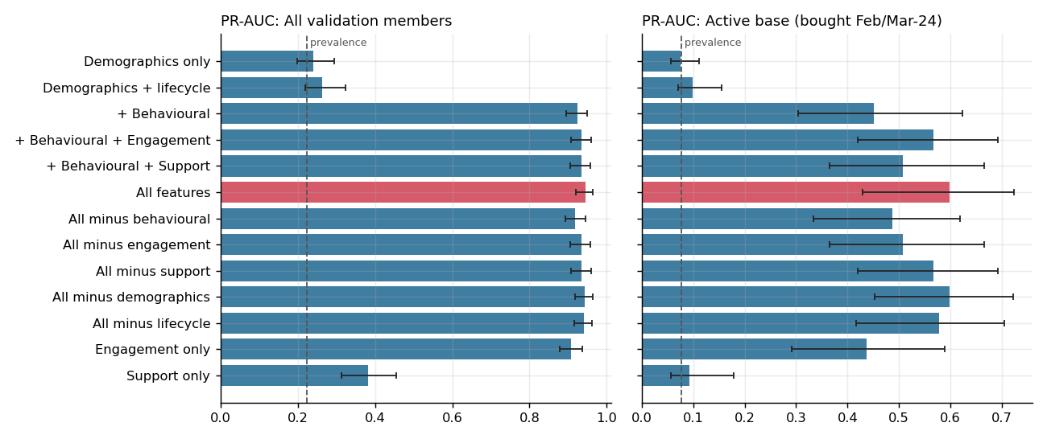
Ablation: behaviour and engagement add the lift; demographics add none
Notes:
Engagement alone reaches 0.908 overall. Support alone is weak (0.383) but adds a little on top of the rest.

Slide 7
Drivers: attribution and association agree
51% / 44%
2.4 → 18.4%
of SHAP attribution is behavioural / engagement. Support 4%, lifecycle 1%, demographic 1%. Demographics alone: PR-AUC 0.24 vs 0.22 prevalence.
active-base churn for 0 vs 2+ support tickets in six months. App use, lowest vs highest quartile: 31.7% vs 1.0%.
Associations, not causal effects. Tier p = 0.98, city p = 0.72 in the active base.
Notes:
Adjusted odds ratios in the active base: each ticket 2.8x, each app session 0.5x, each email opened 0.39x. Across all members tickets look protective only because lapsed members raise none.

Slide 8
Segments: tier and city do not separate risk
Segment | All members | Active base | p (active)
Tier: Silver / Gold / Platinum | 35 / 33 / 34% | 6.9 / 6.7 / 7.2% | 0.98
City range | 31–41% | 3.7–8.8% | 0.72
Signup cohort range | 3–43% | 3.2–8.7% | 0.26
Support tickets: 0 / 1 / 2+ | misleading | 2 / 8 / 18% | <0.001
Newer cohorts look better only because they had less time to lapse. Across all members tickets look protective because lapsed members raise none.
Notes:
Use the active-base columns for decisions. The all-member columns are confounded by members who had already left.

Slide 9
Targeted outreach beats a blanket offer
Policy (20% churn reduction) | Contacted | Churners reached | Net benefit | ROI
Blanket (all active) | 1,653 | 100% | $1,769 | 0.5
Top 10% by risk | 165 | 74% | $2,898 | 8.8
Top 20% by risk | 331 | 85% | $3,239 | 4.9
Top 30% by risk | 496 | 91% | $3,470 | 3.5
Assumptions: $2 per contact, 25% margin, 12-month value. At a 10% reduction the blanket offer loses $768; the top 10% still nets $1,284. A simulation, not a causal estimate.
Notes:
The model what-if for an engagement nudge shows a 74% risk drop, which is a sensitivity of the model, not a forecast. Measure real uplift with a randomised holdout.

Slide 10
Forward scores for Jul–Sep 2024: validated by replay
72%
6.3%
of High-band active members churned in the replay, against 22.5% Medium and 2.5% Low
predicted churn vs 6.9% observed for active members, so probabilities are calibrated
No feature drifted materially (PSI below 0.25). Of 1,594 active members, 77 are High and 87 Medium risk. Real accuracy is known only after Sep 2024.
Notes:
The replay repeats the forward procedure one period earlier using only information available then. It overlaps the earlier backtest, so it is a consistency check, not an independent test.

Slide 11
Recommendations
Move the 715 lapsed members to a separate low-cost win-back programme.
Score monthly and contact the top 10–30% of the active base, not everyone.
Send members with 2+ tickets in six months to service recovery before any offer.
Stop targeting by tier, city, age or gender; none separates risk.
Run a randomised holdout on the first campaign to measure true uplift.
Limits: one label window, 45 active-base churners in validation, associations not causes.
Notes:
Close on the decision: shift from blanket offers to a monthly scored list plus a controlled test.

