Slide 1

MCA Major Project Mid Term Evaluation
Employee Task Management Tool
Under the guidance of
Dr. Pradeep Kumar
Department of Computer Applications
Faculty of Science, Technology and Architecture
Manipal University Jaipur
By
Harsh Gupta
23FS20MCA00002
2023-25

Slide 2
Outline
Introduction
Motivation
Process Model
Software Requirement Specification (SRS)
Data Flow Diagram (DFD)
Output
Conclusion
Future Scope

Slide 3
1. Introduction
What is an Employee Task Management Tool?
A system that helps assign, track, and manage tasks efficiently.
Ensures better task visibility, accountability, and productivity.
Used in businesses, startups, and enterprises to streamline work.
Why is it Important?
Manual task tracking leads to inefficiencies.
Helps organizations manage deadlines and team performance.
Reduces miscommunication and increases work transparency.

Slide 4
2. Motivation
Why Was This System Developed?
Challenges in Traditional Task Management:
Lack of real-time tracking.
Poor task delegation leads to inefficiencies.
Communication gaps between employees and management.
Benefits of Task Management Automation
Better Organization: Tasks assigned systematically.
Transparency: Every team member knows their responsibilities.
Efficiency: Reduces delays and improves productivity.

Slide 5
3. Process Model
Process Model Used
Incremental Model
The system is built and delivered in small functional modules.
Each module is tested and improved before moving to the next.
Benefits:
Early deployment of core features.
Easier debugging and improvements.

Slide 6
3. Process Model
Task Management Workflow
Task Creation – Admin or Manager assigns tasks.
Task Assignment – Assigned to specific employees.
Task Execution – Employees work on the task.
Task Monitoring – Status updates in real time.
Task Completion & Review – Managers review & approve tasks.
Reporting & Feedback – Insights and performance evaluation.

Slide 7
4. Software Requirement Specification (SRS)
Functional Requirements
User Authentication (currently basic later JWT Authentication) & Role-based Access.
Task Creation, Assignment & Tracking.
Notifications & Reminders.
Reporting & Analytics Dashboard.
Non-Functional Requirements
Scalability: Handles growing number of users/tasks.
Security: Data encryption & user authentication.
Performance: Fast task retrieval & updates, which is being achieved effortlessly by the two JS frameworks.
Integration: Can connect with Slack, Google Calendar, etc.

Slide 8
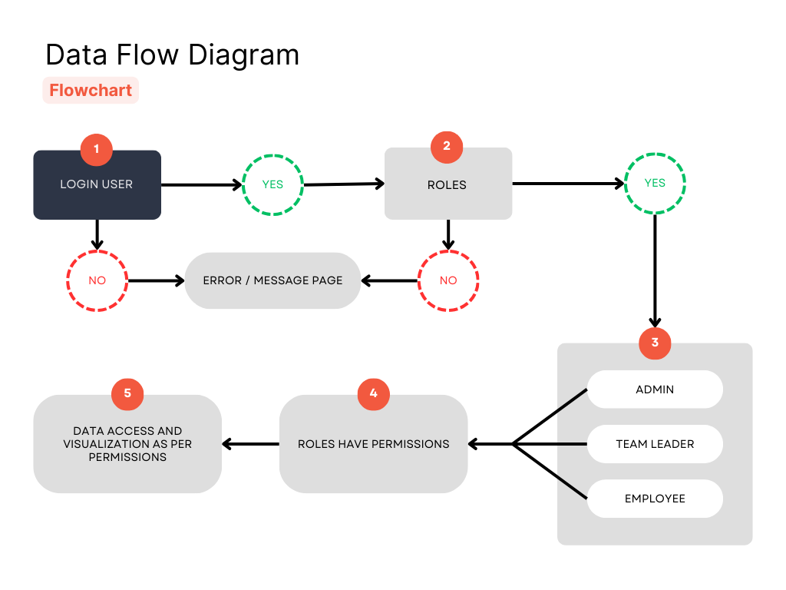
5. Data Flow Diagram (DFD)
User Login – Users enter credentials; valid users move forward, invalid users see an error.
Role Verification – The system checks assigned roles; unauthorized users are denied access.
Role Assignment – Users are classified as Admin, Team Leader, or Employee based on roles.
Permission Control – Each role gets specific access and functionalities.
Data Access – Users can view and manage data as per their permissions.

Slide 9
6. Output (Expected Screens & Results)
User Dashboard
Task List with status (Pending, In Progress, Completed).
Quick task filters & search functionality.
Task Assignment & Tracking
Employees receive assigned tasks with deadlines.
Managers track task progress.
Reports & Analytics
Employee performance tracking.
Task completion rate and bottleneck identification.

Slide 10
7. Conclusion
A well-structured task management tool improves productivity.
Helps organizations track employee performance effectively.
Reduces delays, miscommunication, and missed deadlines.
A proper track over the productivity of the organization and with proper team communications.

Slide 11
8. Future Scope
The goal is to scale the system globally and establish it as a widely adopted project management solution.
The system will be offered to other organizations, allowing them to manage their projects efficiently, just as we do.
Future enhancements will focus on seamless integration with industry-leading tools like Slack, Jira, and Trello moreover we will try to go with JWT Authentications to make it more secure.
Plans include cloud-based deployment for accessibility across different teams and organizations.
Advanced automation features will be introduced to optimize task tracking and reporting.
A mobile-friendly platform will be developed to enable on-the-go task management.

