Slide 1

VE-MAIL
Voice based mail System

Slide 2
Group Members
Harsh Vajpayee 190101125
Harshit Garg 190101126

Slide 3
Content
1. Objective
2. Literature Survey
3. System Analysis And Requirement
4. System Design

Slide 4
Objective
This project aims at developing an email system that will help even a naïve, visually impaired
person to use the services for communication without previous training. The system does not
require the use of keyboard. Instead, it will work only on mouse operations and speech conversion to
text. This system can also be used by any normal person.

Slide 5
OVERVIEW
The complete system is based on voice prompts . When using this system the computer will be prompting the user to perform specific operations to avail respective services and if the user needs to access the respective services then he/she needs to perform that operation. One of the major advantages of this system is that, in most of the part user won’t require to use the keyboard. All operations will be based on mouse click events. . Now the question that arises is that how will the blind users find location of the mouse pointer. As particular location cannot be tracked by the blind user, therefore the user has to traverse the mouse throughout the screen from top to bottom and then left to right. This system will be perfectly accessible to all types of users as it is just based on simple mouse clicks and there is no need to remember keyboard shortcuts. Also because of this facility those who cannot read need not worry as they can listen to the prompting done by the system and perform respective actions

Slide 6
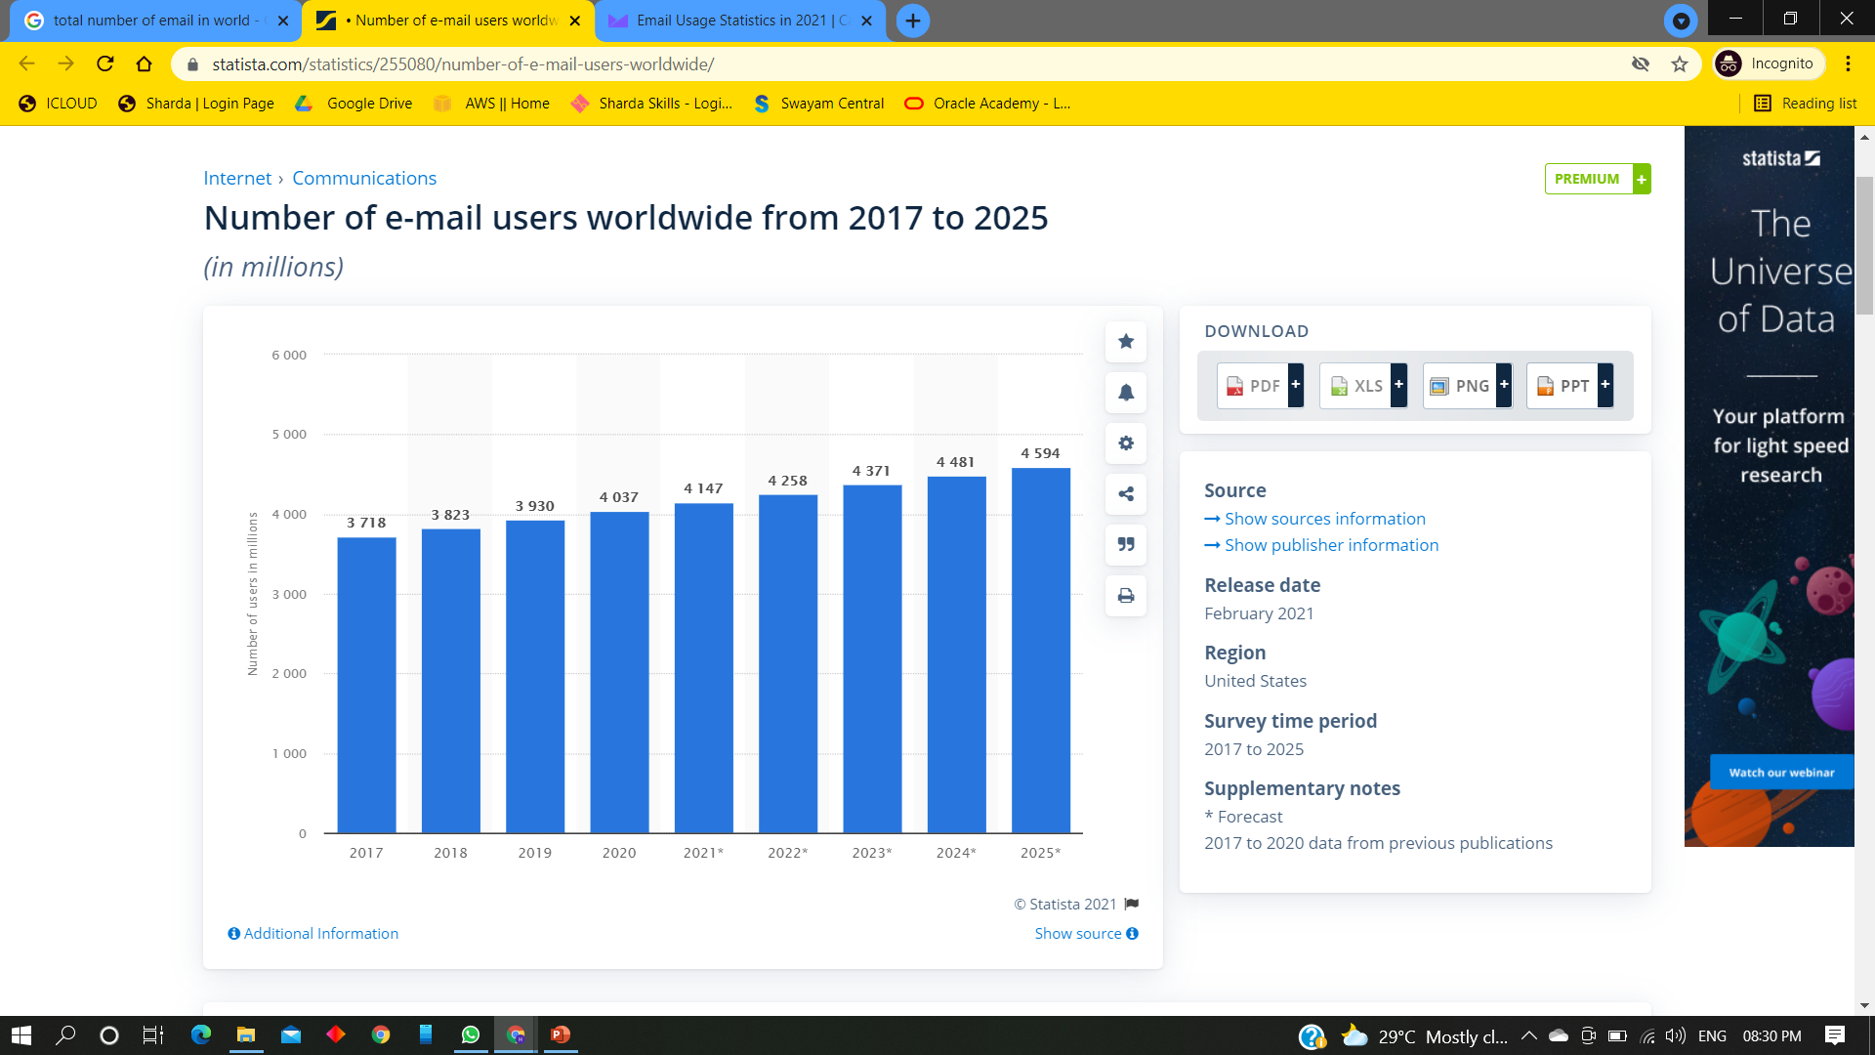

Slide 7
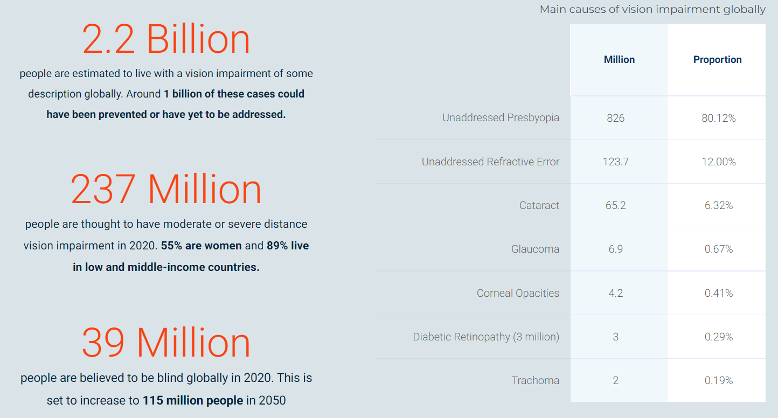

Slide 8
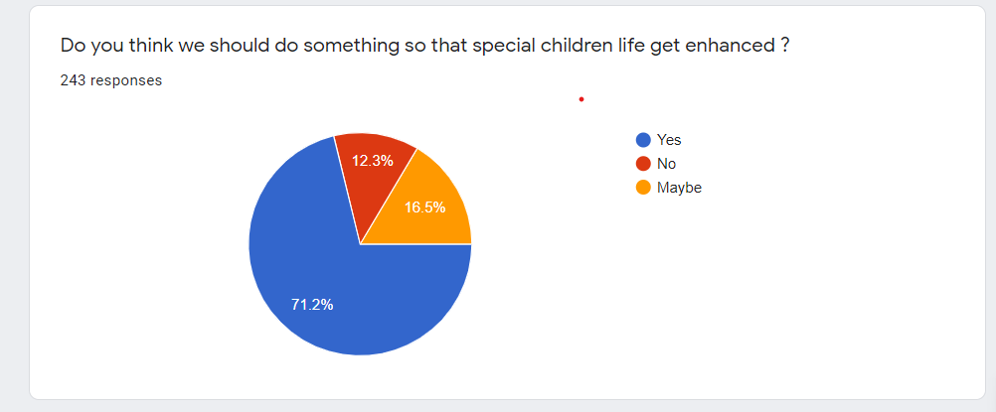
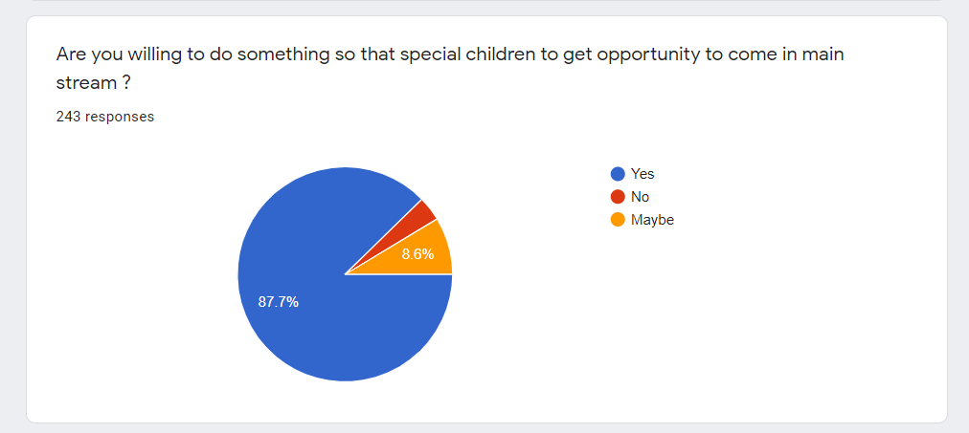
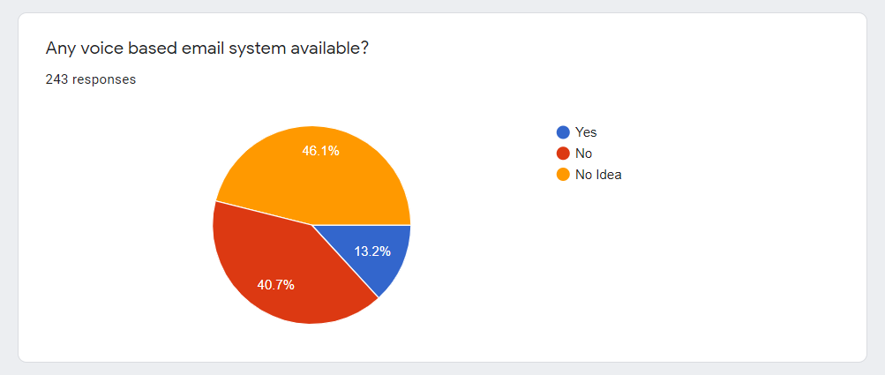

Slide 9
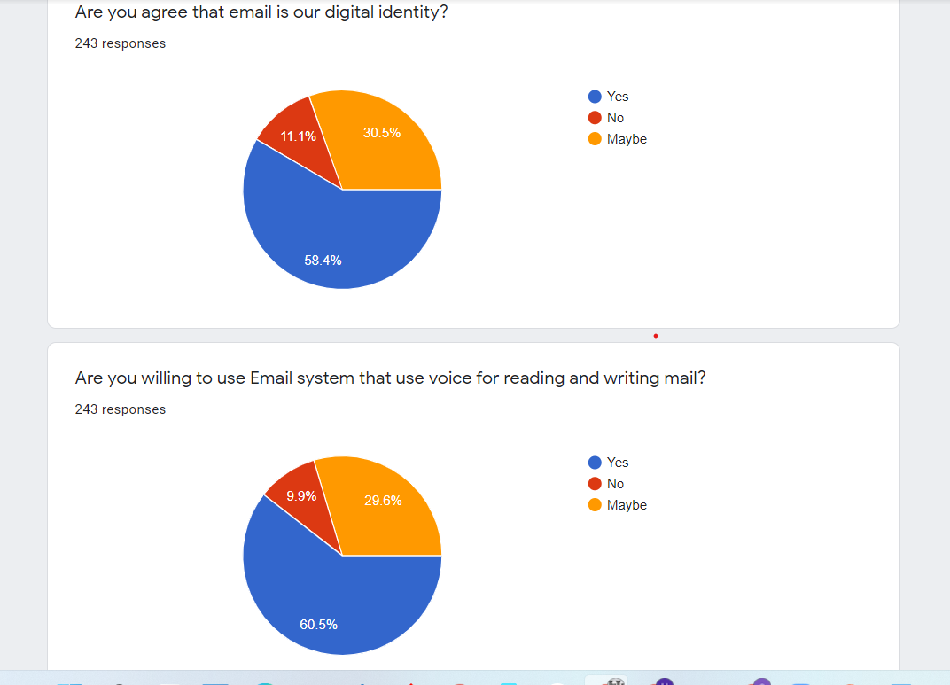
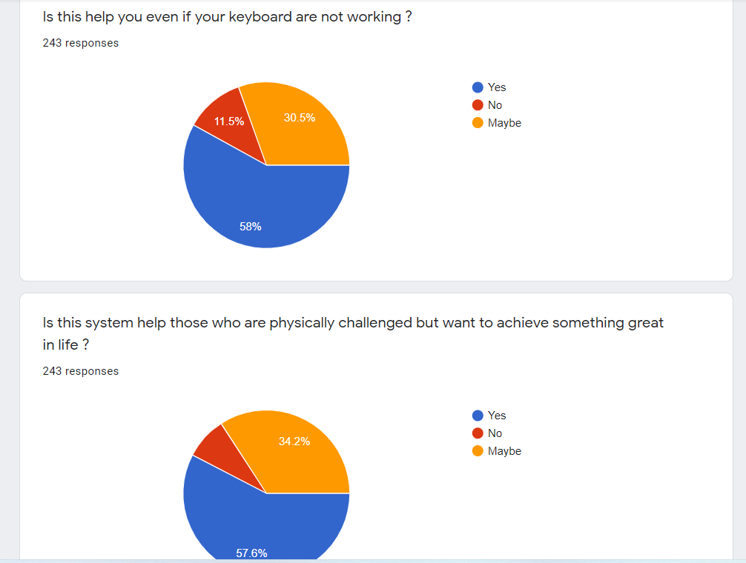

Slide 10
LITERATURE SURVEY

Slide 11
EXISTING SYSTEM
There are 4 million email accounts created until 2020 and there will be estimated 4.6 million accounts by end of 2025. This makes emails the most common form of communication. The most common mail services that we use in our day-to-day life cannot be used by visually challenged people because they do not provide any facility so that the person in front can hear out the content of the screen, As they cannot visualize what is already present on screen they cannot make out where to click in order to perform the required operations.
For a visually challenged person using a computer for the first time is not that convenient as it is for a normal user even though it is user friendly. Although there are screen readers available still these people face minor difficulties. Screen readers read out whatever content is there on the screen and to perform those actions the person will have to use keyboard shortcuts as mouse location cannot be traced by the screen readers. A user is new to computer can therefore not use this service as they are not aware of the key locations.

Slide 12
PROPOSED SYSTEM
The proposed system is based on a completely novel idea and is nowhere like the existing mail systems. The most important aspect that has been kept in mind while developing the proposed system is accessibility. A system is said to be perfectly accessible only if it can be used efficiently by all types of people whether able or disable. The current systems do not provide this accessibility. Thus, the system we are developing is completely different from the current system. Unlike current system which emphasizes more on user friendliness of normal users, our system focuses more on user friendliness of all types of people including normal people visually impaired people as well as illiterate people. The complete system is based on voice prompt and clicks events. When using this system, the computer will be prompting the user to perform specific operations to avail respective services and if the user needs to access the respective services then he/she needs to perform that operation.

Slide 13
SYSTEM ANALYSIS & REQUIREMENTS

Slide 14
Software Requirement
Software Requirements are:
Python:
1. Version: 3.7
2. Requirements: Windows (All Versions), Linux

Slide 15
Hardware Requirement
Hardware Requirements are:
Mouse
Headphone with microphone jack

Slide 16
SYSTEM DESIGN

Slide 17
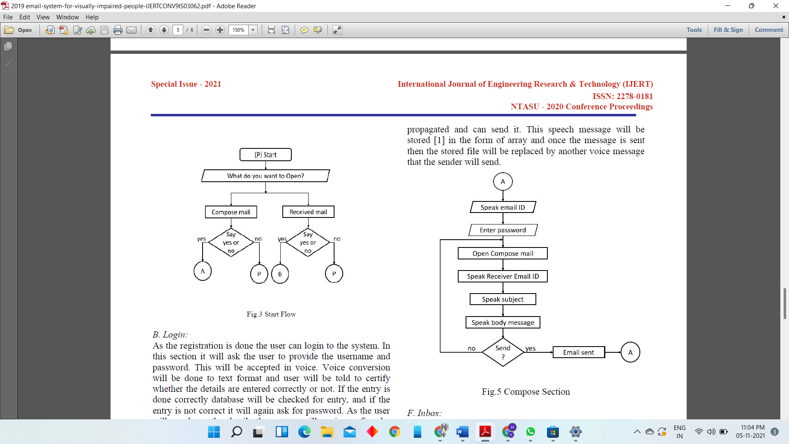
GENERAL DESIGN ARCHITECTURE

Slide 18
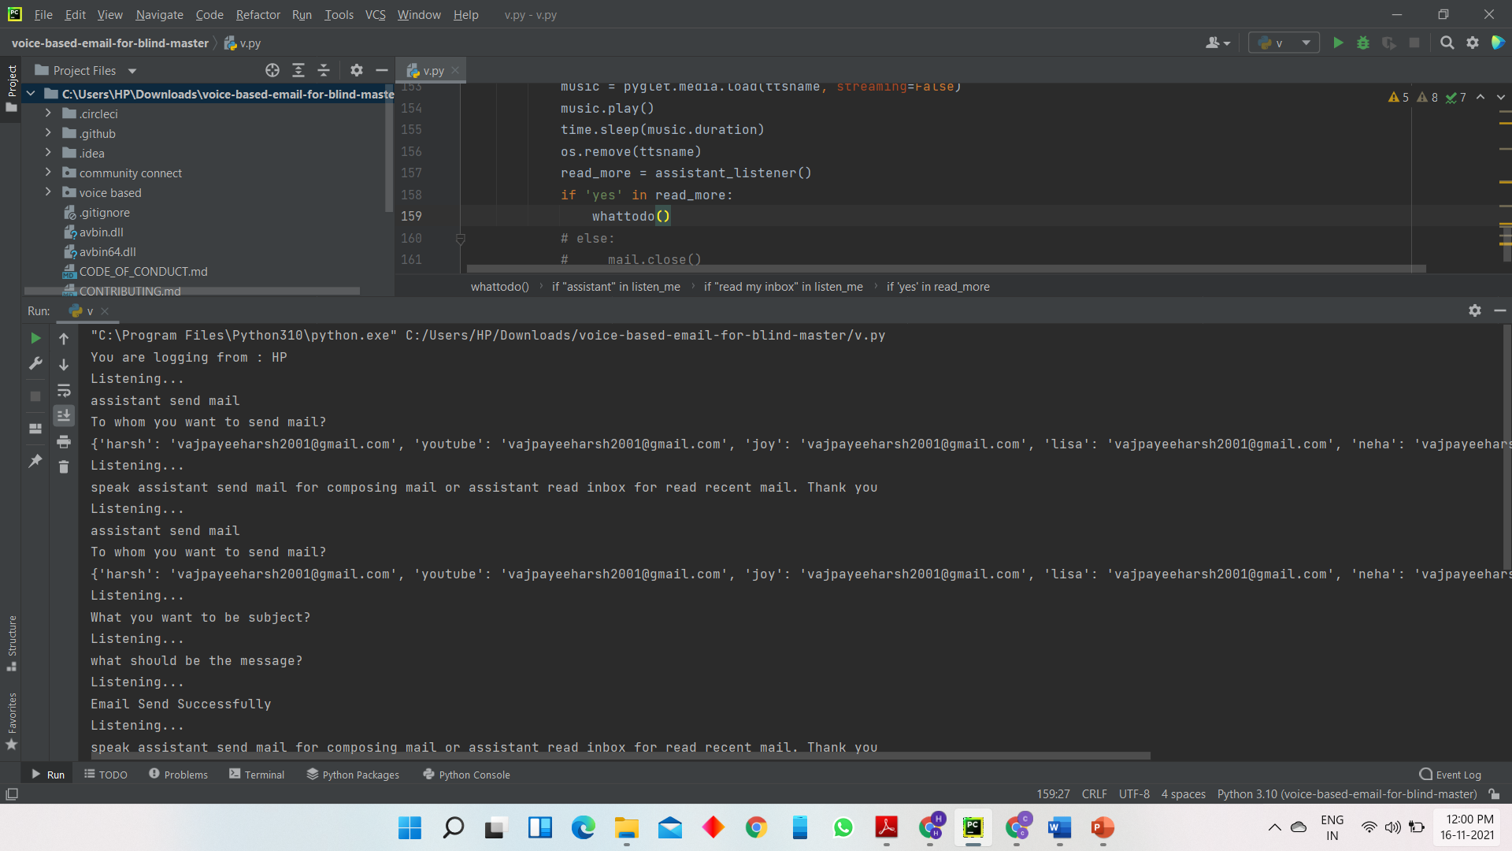
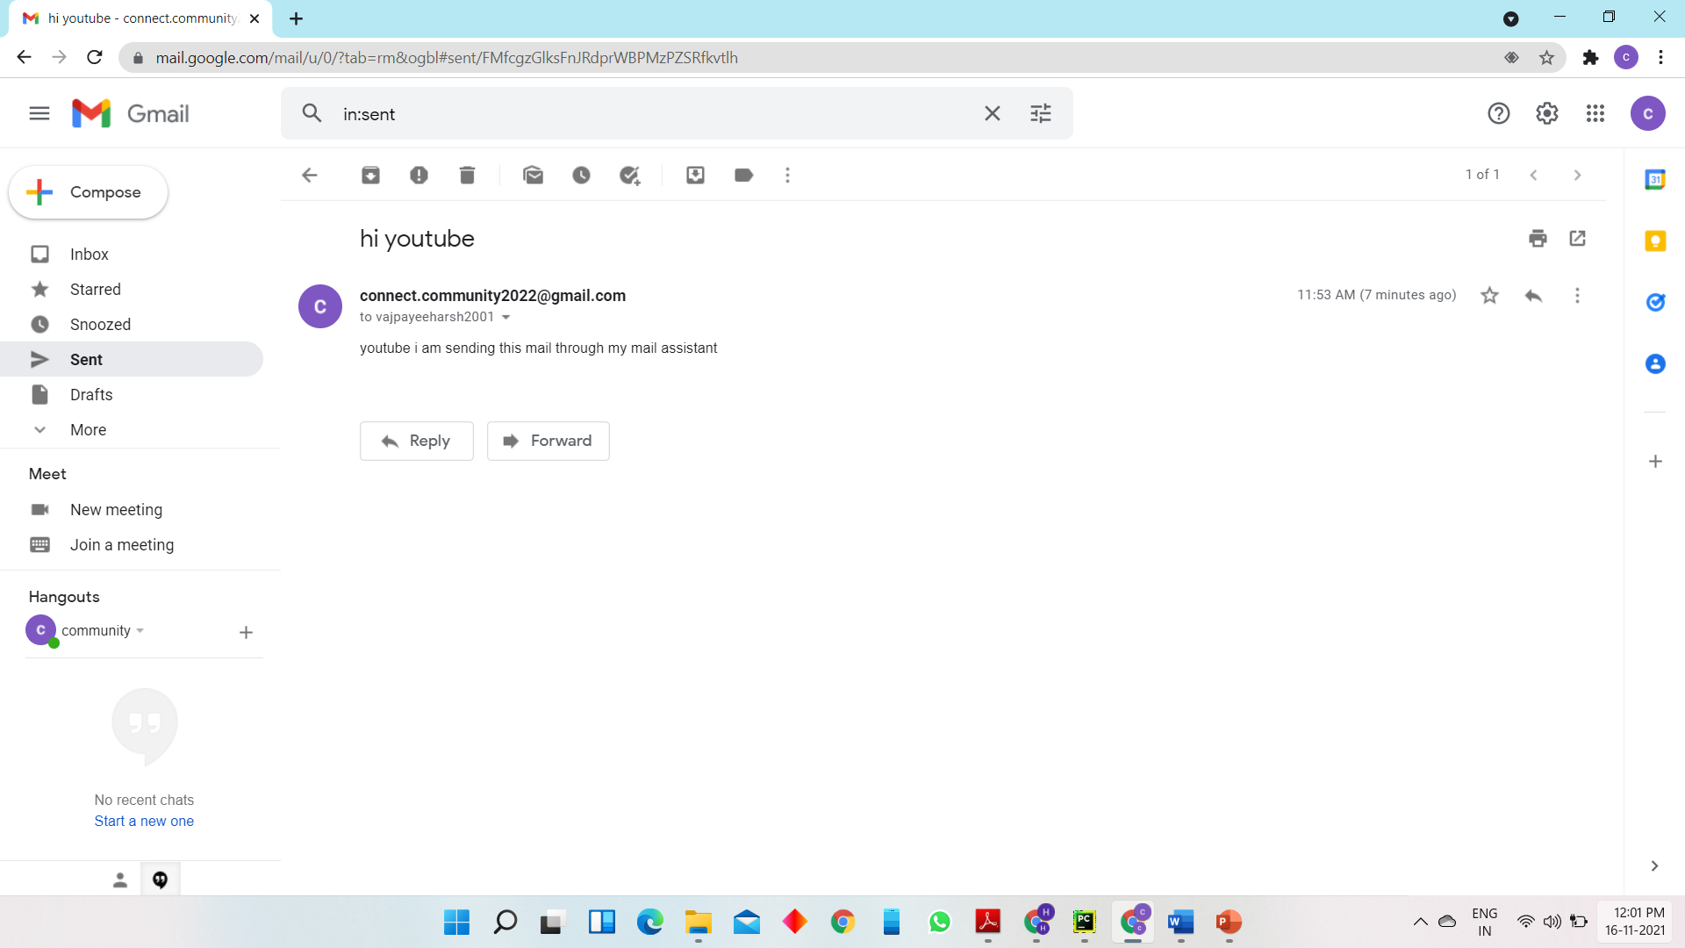
Output (Write Mail)

Slide 19
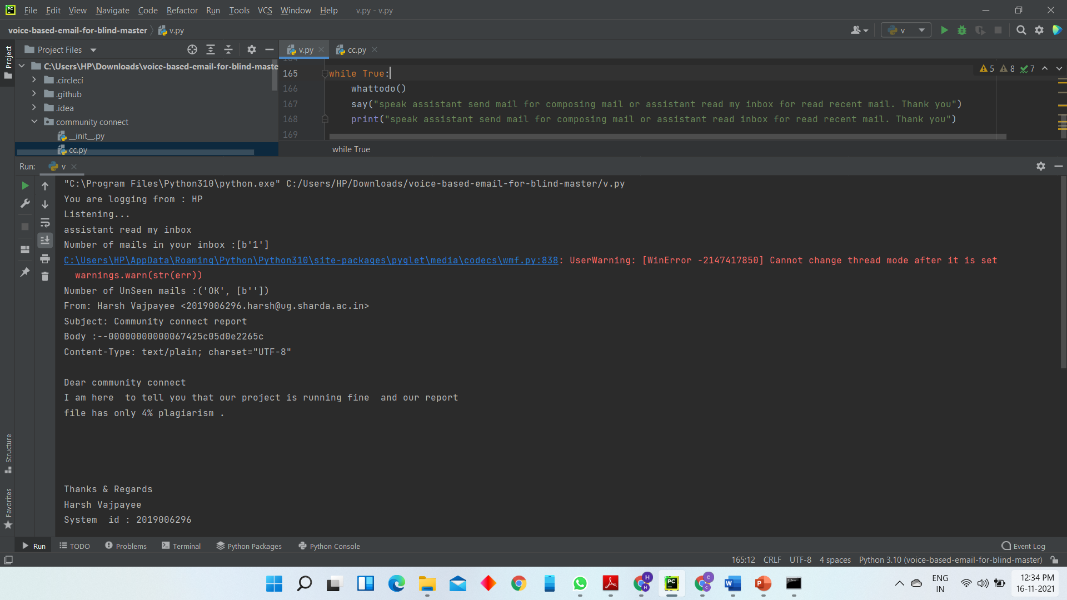
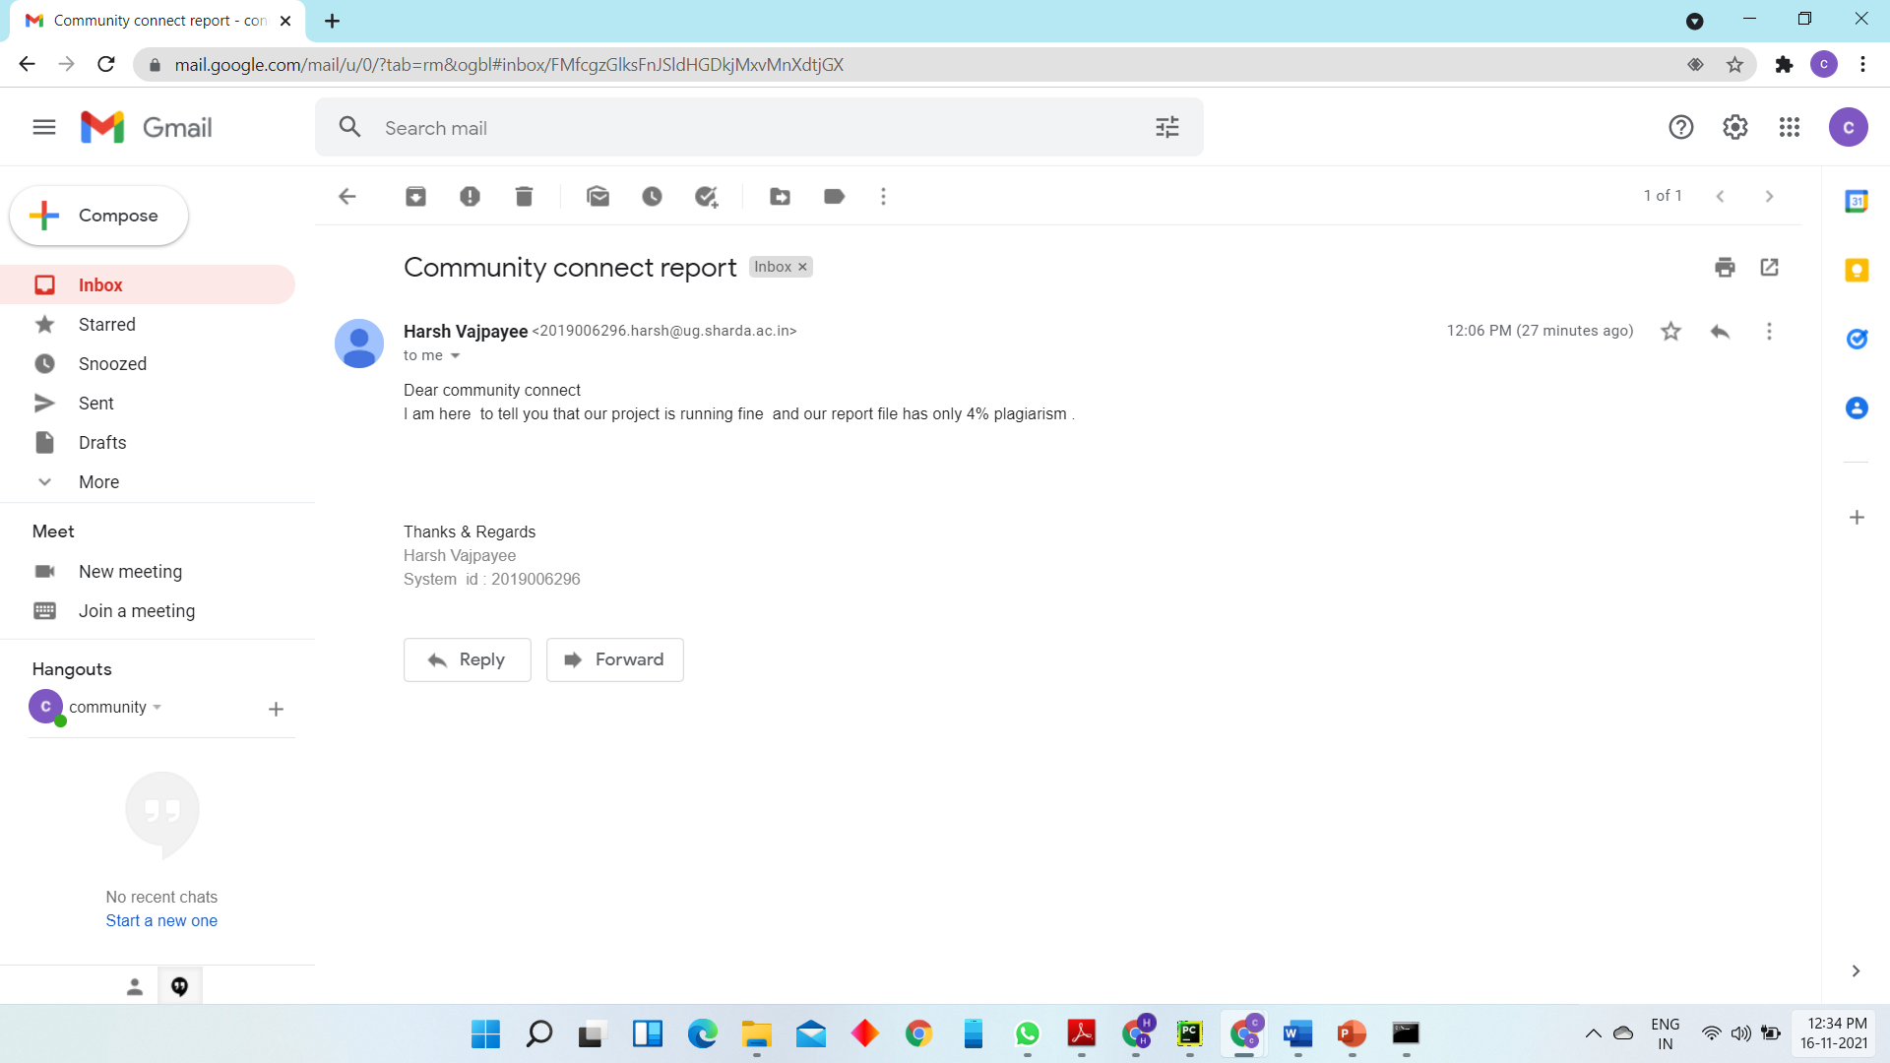
Output( Read mail)

