Slide 1
ADA: Advanced Dynamic Assistant
A new leap beyond traditional AI assistants.
20/04/2025
ADA

Slide 2

Meet the Team
Sire Saini
2301730335
B.Tech CSE (AI/ML) - E
Harsh Raj
2301730286
B.Tech CSE (AI/ML) - E
Speech Interaction
Object Detection
Interface Design
System Integration
Movement Control
Backend
20/04/2025
ADA

Slide 3
The Problem
Why ADA?
Current AI assistants:
Voice-only, limited interaction
Lack of emotional intelligence & visual understanding
Applications:
Elderly Care
Education
Customer Service
20/04/2025
ADA

Slide 4
ADA’s Core Objectives
Our Mission:
Natural Language Processing (NLP)
Real-time Object & Person Recognition
Context-aware Interaction
Basic Movement Capabilities
Seamless Integration for Real-World Use
20/04/2025
ADA

Slide 5
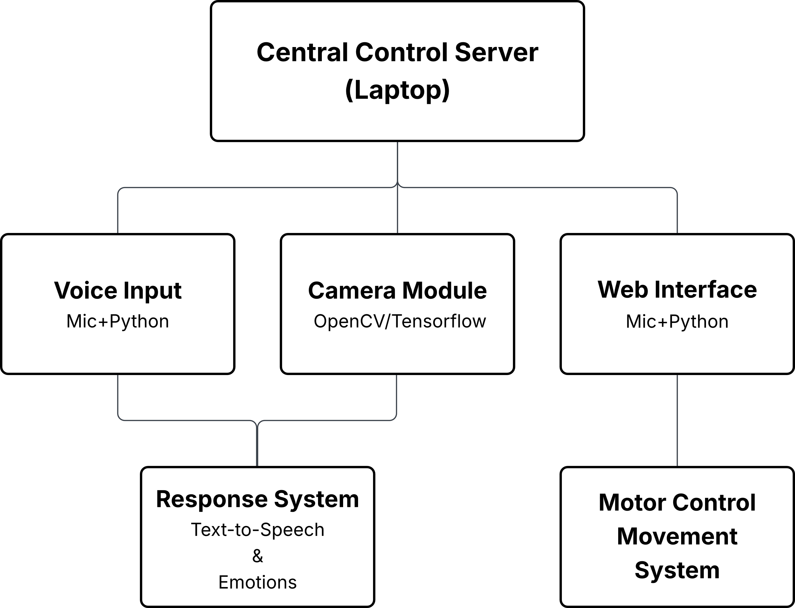
System Architecture
20/04/2025
ADA

Slide 6





Frontend + UI Design
User Experience
HTML
CSS
JavaScript
Live webcam feed & sensor data
Control panel for:
Voice commands
Movement
Remote responses
Wireframed using Figma
20/04/2025
ADA

Slide 7


Backend & Server Integration
Behind the Scenes
Python Flask Server
Arduino + Serial Communication
OpenCV for video processing
Libraries:
SpeechRecognition
gTTS
pyttsx3
TensorFlow Lite
20/04/2025
ADA

Slide 8
AI Features
Brains of ADA
Speech:
SpeechRecognition + pyttsx3 for real-time talk
Transformers & logic for responses
Vision:
YOLO + TensorFlow Lite for object detection
dlib + OpenCV for face recognition
Adaptive responses based on input
20/04/2025
ADA

Slide 9
Live Demonstration
20/04/2025
ADA

Slide 10
What We Learned
Project Takeaways
Hardware + Software Integration
Real-time AI System Design
UX and Backend Development
Task Management & Debugging
Performance Optimization
20/04/2025
ADA

Slide 11
Future Plans
What’s Next for ADA?
Gesture Recognition
OLED Facial Expressions
GPT-based Cloud NLP
Voice Cloning
Compact Mobile Version
20/04/2025
ADA

Slide 12
Final Words
The Vision for ADA
More than a project — it’s the future of assistants
Emotionally intelligent, physically present AI
20/04/2025
ADA

