Slide 1
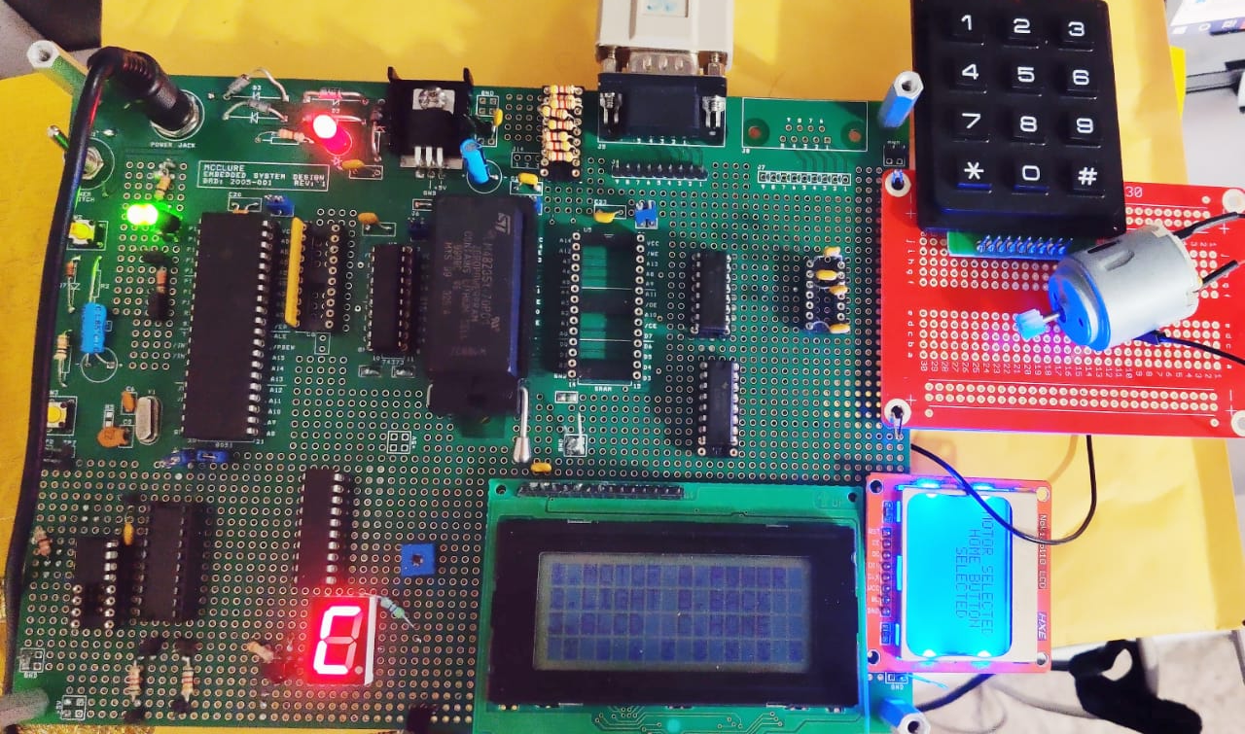
INFRARED REMOTE CONTROL

Slide 2


COMPONENTS USED
IR RECEIVER TSOP 38238
L293DNE MOTOR DRIVER
IR REMOTE
4*3 KEYPAD
GLCD
7 SEGMENT DISPLAY
DC MOTOR
LCD DISPLAY
8051 MICROCONTROLLER

Slide 3
AIM OF THE PROJECT
THE REMOTE USES NEC PROTOCOL FOR INFRARED COMMUNICATION AND IS SET TO CONTROL OUTPUT DEVICES CONNECTED TO THE MICROCONTROLLER FOR THE GIVEN INPUTS
USES A REPROGRAMMABLE REMOTE MECHANISM WHERE THE REMOTE KEY CAN BE MAPPED TO PERFORM OPERATIONS BASED ON USERS CHOICE.

Slide 4
BLOCK DIAGRAM
TSOP 38238 IR RECEIVER
GLCD
REMOTE
REPROGRAMMABLE REMOTE
AT89C51
MICROCONTROLLER
L293DNE MOTOR DRIVER
DC MOTOR
LCD DISPLAY
7 SEGMENT DISPLAY
LED
4*3 KEYPAD

Slide 5
WORKING OF THE PROJECT
THE TSOP RECEIVER DETECTS THE IR TRANSMISSION AND CAPTURES THE SET OF IR PULSES.
DEPENDING ON THE PROTOCOLS PULSES AND TIMING SCHEME OF ADDRESS AND COMMAND BITS, THE MICROCONTROLLER DECODES THE TRANSMISSION IN BINARY FORM
WE MAKE USE OF THREE INTERRUPTS OF THE MICROCONTROLLER
EXTERNAL INTERRUPT INT0 IS USED FOR DETECTING THE PULSES AND TIMER 0 INTERRUPT IS USED FOR MEASURING THE PULSE WIDTH.
TIMER 2 INTERRUPT IS USED FOR RUNNING THE DC MOTOR AND VARYING ITS SPEED USING PULSE WIDTH MODULATION TECHNIQUE
USER HAS CONTROL OVER THE DC MOTORS SPEED AND DIRECTION WHICH IS CONNECTED TO MICROCONTROLLER THROUGH THE L293DNE MOTOR DRIVER
USER IS ALLOWED TO MAP THREE KEYS TO PERFORM THREE DIFFERENT SETS OF OPERATIONS.
THUS THE KEY PERFORMS THAT SPECIFIC OPERATION UNTIL IT IS LATER CHANGED BY THE USER TO PERFORM A DIFFERENT OPERATION.
KEYPAD AND 7 SEGMENT DIPLAY ARE USED AS OTHER SETS OF INPUTS AND OUTPUTS
LCD DISPLAY WHICH PRINTS THE STATUS OF THE KEY SELECTED BY USER

Slide 6
HARDWARE AND SOFTWARE ELEMENTS
HARDWARE:
OBSERVING THE IR PULSES ON THE OSCILLOSCOPE TO CHECK FOR THE PULSE WIDTH AND OBSERVING THE START AND END OF THE FRAME, THE ADDRESS FOR THE RECEIVING DEVICE AND FINALLY THE DATA BITS.
CONNECTING PULL UP RESISTORS AND MONITORING THE OUTPUT WORKING SIMULATANEOUSLY BECAUSE OF OVERLAP OF PIN CONNECTIONS THE DEVICES ARE CONNECTED TO.
SOFTWARE:
EXAMINING THE PULSES AND DECODING IT ON THE MICROCONTROLLER. WRITE A PROGRAM TO ACTIVATE THE EXTERNAL INTERRUPT FOR DETECTING THE PULSES AND TIMER TO MEASURE WIDTH OF PULSES.
ALSO, INTERFACING LCD BY ENABLING THE DIFFERENT REGISTERS ALONGWITH SENDING COMMAND INSTUCTION AND DISPLAY DATA TO THE GRAPHICAL LCD WHICH USES SPI PROTOCOL
USING PWM TECHNIQUE TO ALTER DC MOTOR’S SPEED

